Slide 1
In the Packet Trenches – Searching is not learning...
October 18th, 2016
Hansang Bae
CTO, Riverbed

Slide 2
Misc
http://www.youtube.com/hansangb
http://bit.ly/HSBBook
https://app.box.com/v/Sharkfest2016
(trace files and my Wireshark profiles are in the Sharkfest2016 link above)
This only works if you practice.

Slide 3
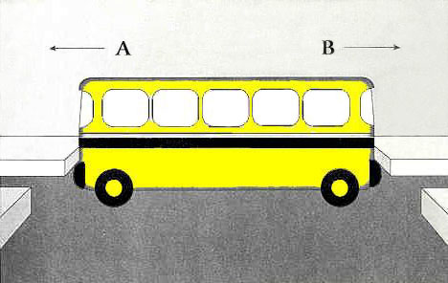
Searching is not learning

Slide 4
Searching is not learning
SUNDAY
MONDAY
TUESDAY
WEDNESDAY
THURSDAY
FRIDAY
SATURDAY

Slide 5
Searching is not learning
SUNDAY
MONDAY
TUESDAY
WEDNESDAY
THURSDAY
FRIDAY
SATURDAY

Slide 6
Searching is not learning
Slow Start
Direction matters
Application not working – IPSec is involved
What do you look for?

Slide 7
Queries by email
Slow Start
Direction matters
Application not working – IPSec is involved
What do you look for?
ip icmp rate-limit unreachable [df] [ms]
ip icmp rate-limit unreachable df 50

Slide 8
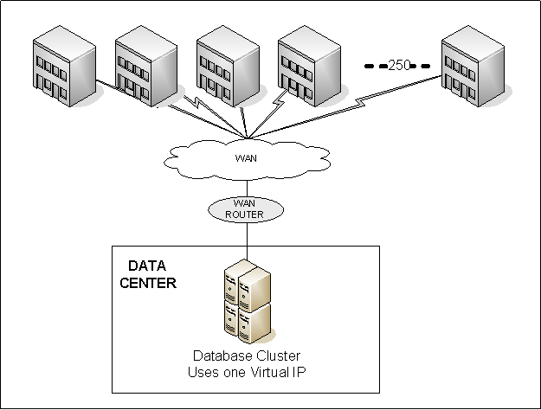
Queries by email
Slow Start
Direction matters
Application not working – IPSec is involved
What do you look for?
ip icmp rate-limit unreachable [df] [ms]
ip icmp rate-limit unreachable df 50

Slide 9
ESX NFS Host to NAS is Slow
Not all packet losses are the same
Fast and RTO Retransmissions
BOLO: direction matters when you‘re looking at retransmissions

Slide 10
ESX NFS Host to NAS is Slow
http://www.intel.com/content/www/us/en/embedded/products/networking/gbe-controllers-interrupt-moderation-appl-note.html

Slide 11
THANK YOU!
Don’t forget to do the feedback
Ask Questions

