Slide 1
Snort Alerts in Wireshark
19th October 2016
Martin Mathieson
Core Developer

Slide 2
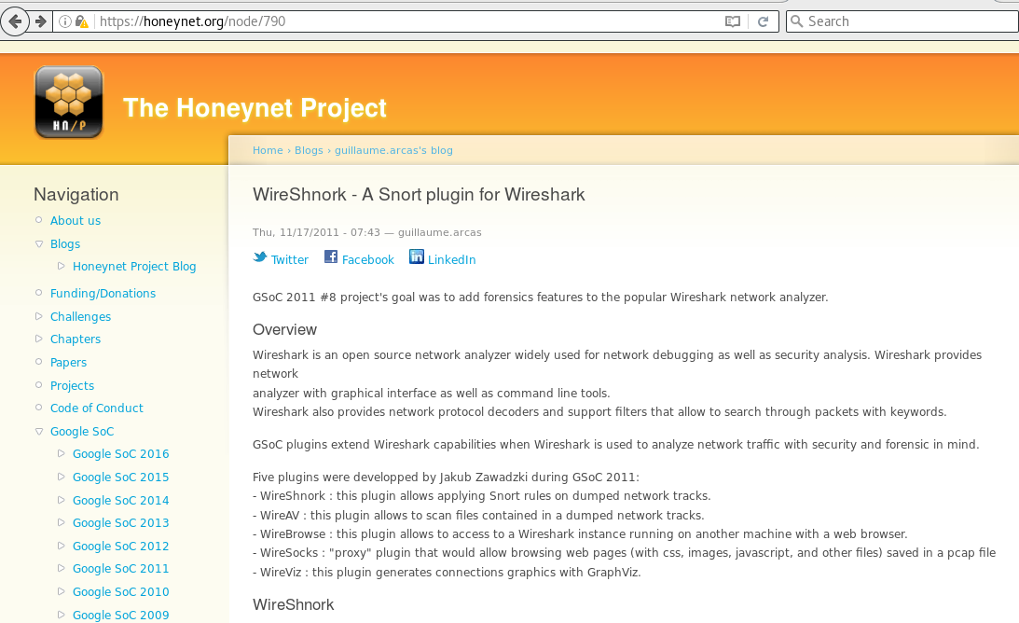
Jakub’s Wireshnork
Some Topic

Slide 3
Agenda
Introduction to Snort
Demo 1: Trying out simple rules
Snort dissector uses / futures?
Demo 2: Using it for real
Lessons learned and status

Slide 4
Introduction to Snort

Slide 5
Snort
Network Intrusion Detection System (NIDS)
Open Source software and rules
  Runs on same platforms as Wireshark
Snort 2.9 is mature/stable
Snort 3 / Snort++ is emerging

Slide 6
Snort (continued)
Detailed configuration of network
  Protected home network
  Expected servers / ports
Custom decoders for popular protocols, e.g.
  HTTP, SSL, SSL, FTP, ...

Slide 7
Snort Rules
Free Rule Sets
  Talos (GPL)
  Emerging-threats (BSD)
  Your own site-specific rules!

Slide 8
Rule Breakdown
alert tcp $HOME_NET any -> $EXTERNAL_NET any
(msg:"Example rule"; flow:to_client,established;
content:"Content-Type"; offset:20;
content:"|65 2d 43|";
content:"content-type:"; nocase;
content:!"martin";
pcre:”/success(ful|fully|es)/i”;
Uricontent:”google.com”;
reference:nessus,11157; classtype:misc-activity;
sid:2000001; rev:1;)

Slide 9
Content position constraints
Packet Start
Packet End
offset
distance
Content
Content
depth
within

Slide 10
WorkFlow
[0] Convert to pcap format
Capture(s)
1 Run pcaps through snort
PCAP(s)
2 Identify interesting alerts
3 Load capture into Wireshark
Alerts
4 Find alert packets
5 Find rule + references
Rule + references

Slide 11
Snort Alerts
Fast Alert Output Format
10/13/09-20:18:28.268377 [**] [1:2101411:12] GPL SNMP public access udp [**] [Classification: Attempted Information Leak] [Priority: 2] {UDP} 10.0.16.30:1252 -> 10.0.16.12:161

Slide 12
Running Snort (Wireshnork)
Snort dissector
Snort
Packets
Packets (PCAP)
Alerts
Lookup
Update
Packet | Alert(s)
21 | SID=20001, Rule=...
104 | SID=31888, Rule=...
511 | SID=30011, Rule=...

Slide 13
Dissector inputs and outputs
Packet Bytes
Protocol Tree + filters
Snort alerts
Snort dissector
Expert Info
Snort config + rules
Web links
Wireshark dissection

Slide 14
Demo 1: Example rules

Slide 15
Uses / Features / Futures?

Slide 16
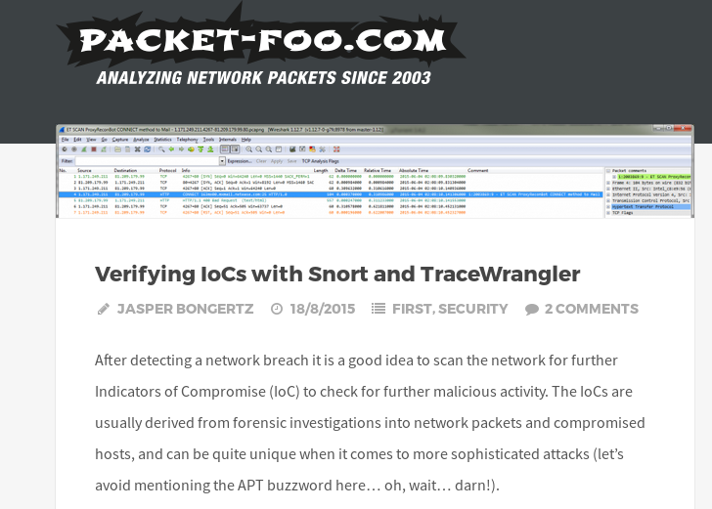
Use Case – Examining Alerts

Slide 17
Use Case – Examining Alerts (continued)
Need to run Snort and prepare only relevant PCAPs/streams
    e.g. workflow as in Jasper’s blog post
Try to gather/present relevant information in one place
See lessons learned later...

Slide 18
Use Case – Debugging Snort Config
If Wireshark sees an HTTP server response inside $HOME_NET…
  Is the address covered by $HTTP_SERVERS?
  Is the port covered by $HTTP_PORTS?
  Flag mismatch in Expert Info

Slide 19
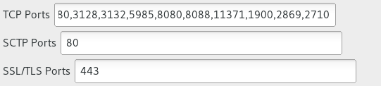
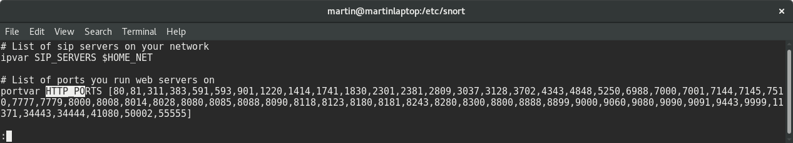
Use Case – Debugging Wireshark config
If Snort detects an HTTP alert, but Wireshark does not dissect as HTTP…

Slide 20
Uses Cases – Rule Debugging
Ask Wireshark why no alert for rule?
  Addresses/ports/direction doesn’t match?
  Content missing?
  Content found but in wrong position?
  Content almost found – find/present closest match?

Slide 21
Feature – Write alerts into file?
Would make dissector faster/simpler
Store in per-packet comment?
    What info to include?
  New option to pcapng enhanced packet block?
    Store rule + other relevant info from snort config

Slide 22
Demo 2: Looking at ‘real’ alerts

Slide 23
Choose Some Rules
Using recent Talos + Emerging-threats sets gave > 20,000 rules
Some editing required
  Includes rules files that don’t exist
  Some rules have !any, which can never match

Slide 24
Choose Some Packets
Captured on home network
  Sadly(?), no alerts…
  Probably needed to set up a honeypot and forward ports
Laura’s book resources
  http://wiresharkbook.com/wireshark101.html
  Some alerts…
wiki.wireshark.org/SampleCaptures
Found 20,455 alerts in 465 captures

Slide 25
Lessons Learned and status

Slide 26
Lessons Learned
Run under Snort first – save results
Follow Jasper’s advice for preparing PCAP
    My script took > 24 hours to run
Disable checksum checks in Snort!
Duplication between rule sets

Slide 27
Lessons Learned (continued)
Re-assembly makes things tricky
Running > 20k rules is very slow
Set $HOME_NET and $EXTERNAL_NET
Linked references vary in quality
Lots of old captures files on wiki.wireshark.org

Slide 28
Code status
Not yet reviewed/merged
Will test on Windows soon
tshark may not work at the moment
Feedback still very welcome!

Slide 29
Thank you

