Slide 1
TLS and DLP
Behind the green lock

Slide 2
www.pluralsight.com

Slide 3
Goals
Encrypting Data
Diffie Hellman Elliptical Curve Key Exchange
Validation and Encryption with Certificates
Data Loss Prevention
Wireshark Demo

Slide 4
Web Browser Encryption
Negotiate Encryption Session
TLS 1.2 and 1.3
Encryption Protocols

Slide 5
Web Browser Encryption
Negotiate Encryption Session
Secure Socket Layer (SSL)
Transport Layer Security (TLS)
Encryption Protocols
RSA
Diffie Hellman
ECDHE
3DES
AES
ChaCha20

Slide 6
Web Browser Encryption
Negotiate Encryption Session
Secure Socket Layer (SSL)
Transport Layer Security (TLS)
Encryption Protocols
RSA
Diffie Hellman
ECDHE
3DES
AES
ChaCha20

Slide 7
Web Browser Encryption
Negotiate Encryption Session
Secure Socket Layer (SSL)
Transport Layer Security (TLS)
Encryption Protocols
RSA
Diffie Hellman
ECDHE
3DES
AES
ChaCha20

Slide 8
SSL/TLS Versions
TLS v1.2
TLS v1.3

Slide 9
Data Encryption Basics

Slide 10
Encrypting Communication
HTTPs Client
HTTPs Server

Slide 11
Encrypting Communication
HTTPs Client
HTTPs Server
+

Slide 12
Encrypting Communication
HTTPs Client
HTTPs Server
+

Slide 13
Encrypting Communication
HTTPs Client
HTTPs Server
+

Slide 14
Encrypting Communication
HTTPs Client
HTTPs Server

Slide 15
Encrypting Communication
HTTPs Client
HTTPs Server

Slide 16
Encrypting Communication
HTTPs Client
HTTPs Server
+

Slide 17
Encrypting Communication
HTTPs Client
HTTPs Server
+

Slide 18
Encrypting Communication
HTTPs Client
HTTPs Server
+

Slide 19
Encrypting Communication
HTTPs Client
HTTPs Server

Slide 20
Encrypting Communication
HTTPs Client
HTTPs Server

Slide 21
TLS Encryption
Data
Encryption
AES (128 or 256 bits)
Chacha20
Key
Exchange
Handshake
Integrity

Slide 22
TLS Encryption
Data
Encryption
AES (128 or 256 bits)
Chacha20
Key
Exchange

Slide 23
TLS Encryption
Key
Exchange
Data
Encryption

Slide 24
TLS Encryption
TLS v1.2
TLS v1.3
Key
Exchange
Data Encryption
Handshake Integrity
RSA
Diffie Hellman
Elliptical Curve
Diffie Hellman
RSA
Diffie Hellman
Elliptical Curve
Diffie Hellman

Slide 25
TLS Encryption
TLS v1.2
TLS v1.3
Key
Exchange
Data Encryption
Handshake Integrity
RSA
Diffie Hellman
Elliptical Curve
Diffie Hellman
Elliptical Curve
Diffie Hellman

Slide 26
TLS Encryption
TLS v1.2
TLS v1.3
Key
Exchange
Data Encryption
Handshake Integrity
RSA
Diffie Hellman
Elliptical Curve
Diffie Hellman
Elliptical Curve
Diffie Hellman

Slide 27
TLS Encryption
TLS v1.2
TLS v1.3
Key
Exchange
Data Encryption
Handshake Integrity
RSA
Diffie Hellman
Elliptical Curve
Diffie Hellman
Elliptical Curve
Diffie Hellman

Slide 28
Elliptical Curve Diffie-Hellman Ephemeral

Slide 29
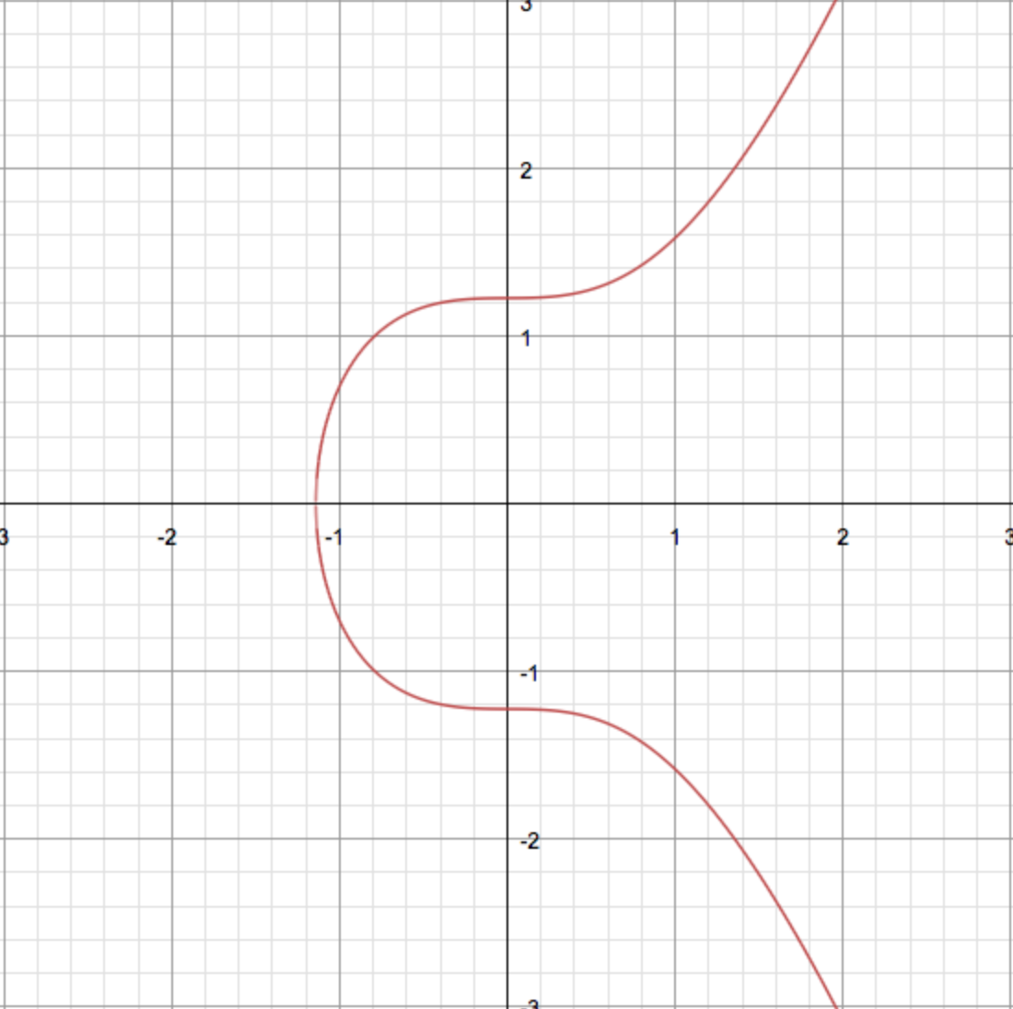
Elliptical Curve
Curve Types
x25519
secp256r1
secp284r1
fecp521r1
ffdhe2048
ffdhe3073

Slide 30
Elliptical Curve
Curve Types
x25519
secp256r1
secp284r1
fecp521r1
ffdhe2048
ffdhe3073

Slide 31
Elliptical Curve

Slide 32
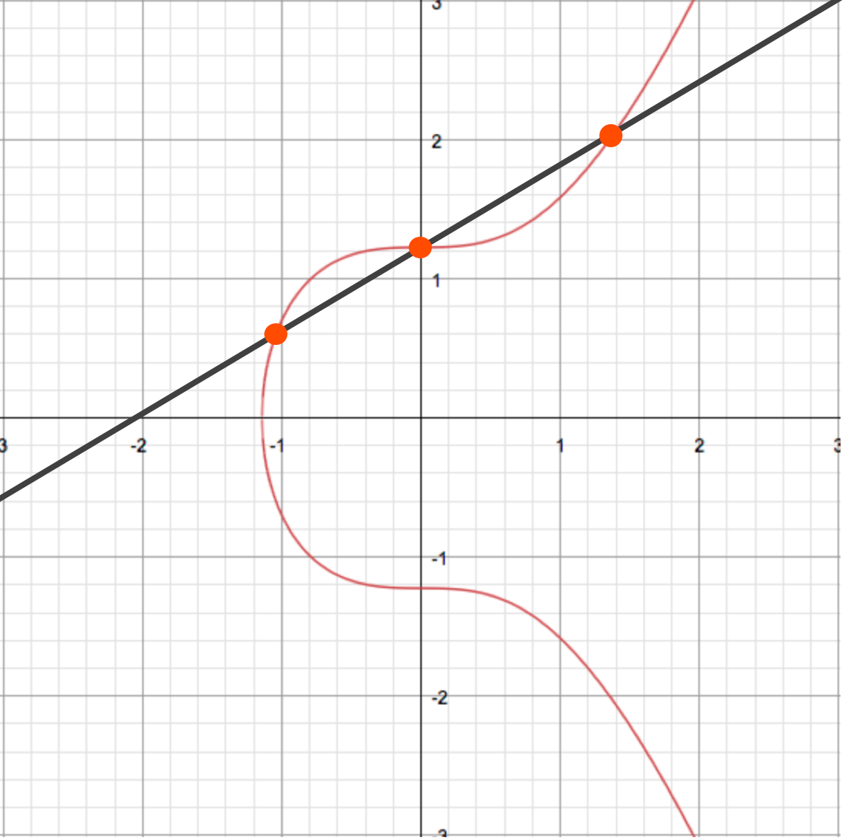
TLS 1.2 DHECE Key Exchange
Private
Key
Private
Key
047d1bb98aa0d6b4a5a5cc4dba83df2c35ac2b7a63e973edae0f14d680d196b942494490803fe36426baffe67fa6048b2e989c48461f50449a83e563a0d84bdbfd
HTTPs Client
HTTPs Server
Public Key

Slide 33
TLS 1.2 DHECE Key Exchange
Private
Key
Private
Key
HTTPs Client
HTTPs Server
Public Key

Slide 34
TLS 1.2 DHECE Key Exchange
Private
Key
Private
Key
047d1bb98aa0d6b4a5a5cc4dba83df2c35ac2b7a63e973edae0f14d680d196b942494490803fe36426baffe67fa6048b2e989c48461f50449a83e563a0d84bdbfd
+
HTTPs Client
HTTPs Server
Public Key

Slide 35
TLS 1.2 DHECE Key Exchange
Private
Key
Private
Key
+
HTTPs Client
HTTPs Server
047d1bb98aa0d6b4a5a5cc4dba83df2c35ac2b7a63e973edae0f14d680d196b942494490803fe36426baffe67fa6048b2e989c48461f50449a83e563a0d84bdbfd
Public Key

Slide 36
TLS 1.2 DHECE Key Exchange
Private
Key
Private
Key
+
HTTPs Client
HTTPs Server
047d1bb98aa0d6b4a5a5cc4dba83df2c35ac2b7a63e973edae0f14d680d196b942494490803fe36426baffe67fa6048b2e989c48461f50449a83e563a0d84bdbfd
Public Key

Slide 37
TLS 1.2 DHECE Key Exchange
Private
Key
Private
Key
HTTPs Client
HTTPs Server
047d1bb98aa0d6b4a5a5cc4dba83df2c35ac2b7a63e973edae0f14d680d196b942494490803fe36426baffe67fa6048b2e989c48461f50449a83e563a0d84bdbfd
Public Key

Slide 38
TLS 1.2 DHECE Key Exchange
Private
Key
Private
Key
047d1bb98aa0d6b4a5a5cc4dba83df2c35ac2b7a63e973edae0f14d680d196b942494490803fe36426baffe67fa6048b2e989c48461f50449a83e563a0d84bdbfd
HTTPs Client
HTTPs Server
047d1bb98aa0d6b4a5a5cc4dba83df2c35ac2b7a63e973edae0f14d680d196b942494490803fe36426baffe67fa6048b2e989c48461f50449a83e563a0d84bdbfd
Public Key

Slide 39
TLS 1.2 DHECE Key Exchange
Private
Key
Private
Key
047d1bb98aa0d6b4a5a5cc4dba83df2c35ac2b7a63e973edae0f14d680d196b942494490803fe36426baffe67fa6048b2e989c48461f50449a83e563a0d84bdbfd
HTTPs Client
HTTPs Server
047d1bb98aa0d6b4a5a5cc4dba83df2c35ac2b7a63e973edae0f14d680d196b942494490803fe36426baffe67fa6048b2e989c48461f50449a83e563a0d84bdbfd
Public Key

Slide 40
TLS 1.2 DHECE Key Exchange
Private
Key
Private
Key
+
047d1bb98aa0d6b4a5a5cc4dba83df2c35ac2b7a63e973edae0f14d680d196b942494490803fe36426baffe67fa6048b2e989c48461f50449a83e563a0d84bdbfd
HTTPs Client
HTTPs Server
047d1bb98aa0d6b4a5a5cc4dba83df2c35ac2b7a63e973edae0f14d680d196b942494490803fe36426baffe67fa6048b2e989c48461f50449a83e563a0d84bdbfd
Public Key

Slide 41
TLS 1.2 DHECE Key Exchange
Private
Key
Private
Key
+
HTTPs Client
HTTPs Server
047d1bb98aa0d6b4a5a5cc4dba83df2c35ac2b7a63e973edae0f14d680d196b942494490803fe36426baffe67fa6048b2e989c48461f50449a83e563a0d84bdbfd
047d1bb98aa0d6b4a5a5cc4dba83df2c35ac2b7a63e973edae0f14d680d196b942494490803fe36426baffe67fa6048b2e989c48461f50449a83e563a0d84bdbfd
Public Key

Slide 42
TLS 1.2 DHECE Key Exchange
Private
Key
Private
Key
047d1bb98aa0d6b4a5a5cc4dba83df2c35ac2b7a63e973edae0f14d680d196b942494490803fe36426baffe67fa6048b2e989c48461f50449a83e563a0d84bdbfd
HTTPs Client
HTTPs Server
047d1bb98aa0d6b4a5a5cc4dba83df2c35ac2b7a63e973edae0f14d680d196b942494490803fe36426baffe67fa6048b2e989c48461f50449a83e563a0d84bdbfd

Slide 43
TLS 1.2 DHECE Key Exchange
Private
Key
Private
Key
047d1bb98aa0d6b4a5a5cc4dba83df2c35ac2b7a63e973edae0f14d680d196b942494490803fe36426baffe67fa6048b2e989c48461f50449a83e563a0d84bdbfd
HTTPs Client
HTTPs Server
047d1bb98aa0d6b4a5a5cc4dba83df2c35ac2b7a63e973edae0f14d680d196b942494490803fe36426baffe67fa6048b2e989c48461f50449a83e563a0d84bdbfd

Slide 44
TLS 1.2 DHECE Key Exchange
Private
Key
Private
Key
+
+
047d1bb98aa0d6b4a5a5cc4dba83df2c35ac2b7a63e973edae0f14d680d196b942494490803fe36426baffe67fa6048b2e989c48461f50449a83e563a0d84bdbfd
047d1bb98aa0d6b4a5a5cc4dba83df2c35ac2b7a63e973edae0f14d680d196b942494490803fe36426baffe67fa6048b2e989c48461f50449a83e563a0d84bdbfd
HTTPs Client
HTTPs Server

Slide 45
TLS 1.2 DHECE Key Exchange
Private
Key
Private
Key
+
+
047d1bb98aa0d6b4a5a5cc4dba83df2c35ac2b7a63e973edae0f14d680d196b942494490803fe36426baffe67fa6048b2e989c48461f50449a83e563a0d84bdbfd
047d1bb98aa0d6b4a5a5cc4dba83df2c35ac2b7a63e973edae0f14d680d196b942494490803fe36426baffe67fa6048b2e989c48461f50449a83e563a0d84bdbfd
HTTPs Client
HTTPs Server

Slide 46
TLS Encryption
TLS v1.2
TLS v1.3
Key
Exchange
Data
Encryption
Handshake
Integrity
RSA
Diffie Hellman
Elliptical Curve
Diffie Hellman
RSA
Diffie Hellman
Elliptical Curve
Diffie Hellman

Slide 47
TLS Encryption
Key
Exchange
Data
Encryption
Handshake
Integrity

Slide 48
TLS Encryption
Key
Exchange
Data
Encryption
Handshake
Integrity

Slide 49
TLS Encryption
Key
Exchange
Data
Encryption
Handshake
Integrity

Slide 50
TLS Encryption
Key
Exchange
Data
Encryption
Handshake
Integrity
Server Authenticity

Slide 51
Certificates

Slide 52
Certificates
Certificate Authority
Server
Intermediate
Root

Slide 53
Certificates
Certificate Authority
Server
Intermediate
Root

Slide 54
Certificates
Certificate Authority
Server
Intermediate
Root

Slide 55
Certificates
Certificate Authority
Root
Server
Intermediate

Slide 56
Certificates
Certificate Authority
Root
Intermediate
Server

Slide 57
Certificates
Certificate Authority
Root
Intermediate
Server
Validation

Slide 58
Certificates
Certificate Authority
Server
Intermediate

Slide 59
Certificates
Server
Intermediate

Slide 60
Certificates
Server
Intermediate

Slide 61
Certificates
Server
Intermediate

Slide 62
Certificates
But aren’t certificates used to encrypt?
Key Exchange Only
RSA
Diffie Hellman
(p and g values)

Slide 63
Certificates
But aren’t certificates used to encrypt?
Key Exchange Only
RSA
Diffie Hellman
(p and g values)

Slide 64
Certificates
Used for Server Authenticity
Independent from
Certificate

Slide 65
Data Loss Prevention
aka MITM or SSL intercept

Slide 66
Data Loss Prevention
Client
Server

Slide 67
Data Loss Prevention
DLP Appliance
Client
Server

Slide 68
Data Loss Prevention
DLP Appliance
TLS Session
TLS Session
Client
Server

Slide 69
Data Loss Prevention
DLP Appliance
TLS Session
TLS Session
Client
Client Observes End to End
Server

Slide 70
Data Loss Prevention
DLP Appliance
TLS Session
TLS Session
Client
Server
Unencrypted Client/Server Data

Slide 71
Data Loss Prevention
DLP Appliance
TLS Session
TLS Session
Client
Trusted
Certificate
Server

Slide 72
Data Loss Prevention
DLP Appliance
TLS Session
TLS Session
Client
?
Server
Trusted
Certificate

Slide 73
Data Loss Prevention
DLP Appliance
TLS Session
TLS Session
Client
?
Server
Trusted
Certificate

Slide 74
Data Loss Prevention
DLP Appliance
TLS Session
TLS Session
Client
Server
Root
Intermediate
Server

Slide 75
Data Loss Prevention
Intermediate
DLP Appliance
TLS Session
TLS Session
Client
Server
Server

Slide 76
Data Loss Prevention
Intermediate
DLP Appliance
TLS Session
TLS Session
Client
Server
Server

Slide 77
Data Loss Prevention
Intermediate
DLP Appliance
TLS Session
TLS Session
Client
Client Observes End to End Encryption
Server
Server

Slide 78
Data Loss Prevention
DLP Appliance
TLS Session
TLS Session
Client
Server
Unencrypted Client/Server Data

Slide 79
Certificates

Slide 80
More Information
https://sharkfestasia.wireshark.org/sf18asia
SSL/TLS Decryption: Uncovering the Secrets
Peter Wu
https://www.pluralsight.com/
Wireshark Troubleshooting:
Analyzing and Decrypting TLS Traffic
Ross Bagurdes

Slide 81
Summary
Encrypting Data
Diffie Hellman Elliptical Curve Key Exchange
Validation and Encryption with Certificates
Data Loss Prevention
Wireshark Demo

