Slide 1
Developer Lightening Talks

Slide 2
What is this?
Talking about things we like
This is an open-discussion course
Ask us!

Slide 3
Agenda 1/2
Extcap – Just a short overview
Sniffing the Thingy
Capture using a netlink interface

Slide 4
Agenda 2/2
SSL Tips / Tricks
Future of Wireshark

Slide 5
Extcap – Just a short overview

Slide 6
If the packets won’t come to Wireshark
Wireshark will go to the packets

Slide 7
Usage Scenarios
Data residing on a different network environment
Data not being „networky“ at all
System events and logs
RF environments

Slide 8
Pipes to the rescue
dumpcap understands pipes
Easy right?

Slide 9
What can go wrong
Restart / Start / Stop
Broken pipe / Broken rights
Windows
Configuration means restart

Slide 10
extcap
external capture interface
First presented at SharkFest US‘13 by Mike Kershaw and Mike Ryan
https://sharkfestus.wireshark.org/sharkfest.13/presentations/NAP-11_Expanding-Wireshark-Beyond-Ethernet-and-Network-Interfaces_Kershaw-Ryan.pdf
Part of Wireshark since 2.0
Mission statement: Utilize the pipe interface and make a nice gui for it

Slide 11
extcap features
Start / Stop / Restart capture from interface
Handle interface configuration
Handle runtime control

Slide 12
Capture
Provide a list of interfaces
Provide a list of Configs
Macbook:extcap rknall$ ./extcap_example.py --extcap-interfaces
extcap {version=1.0}{help=http://www.wireshark.org}{display=Example extcap interface}
interface {value=example1}{display=Example interface 1 for extcap}
interface {value=example2}{display=Example interface 2 for extcap}
Macbook:extcap rknall$ ./extcap_example.py --extcap-interface example1 --extcap-config
arg {number=0}{call=--delay}{display=Time delay}{tooltip=Time delay between packages}{type=integer}{range=1,15}{default=5}
arg {number=1}{call=--message}{display=Message}{tooltip=Package message content}{type=string}{required=true}{placeholder=Please enter a message here ...}
...

Slide 13
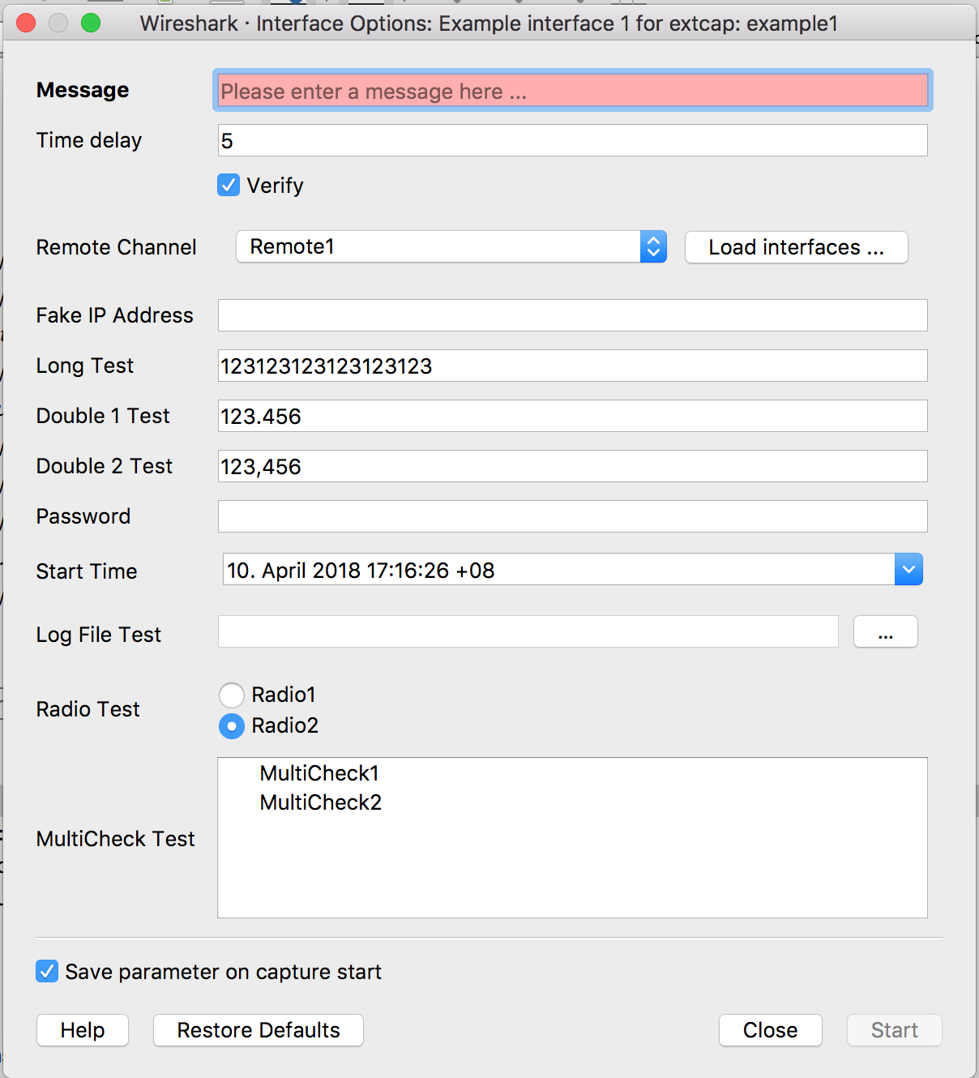
Interface Configuration
Various options
Text, Integer, Bool, IP Addresses, Passwords (hashed), Date/Time, Files, Radio, Dropdown, Multicheck (parent dependency)
Check for Ranges or with RegExp
Mandatory fields

Slide 14
Interface Configuration (2)
Parameter get‘s stored
Restore to defaults possible
Help provided via website or local link

Slide 15
Interface configuration (3)
Reload functionality (WS 3.0)
Reload calls extcap with all filled out parameters

Slide 16
Control while running
Create a toolbar for your interface
Live control your capture and change settings
Button, Text, Selector, Boolean, Help and Log

Slide 17
Where to go next?

Slide 18
extcap_example.py
Python 2.7/3.x driven example
Implements all configuration options
Implements all control options

Slide 19
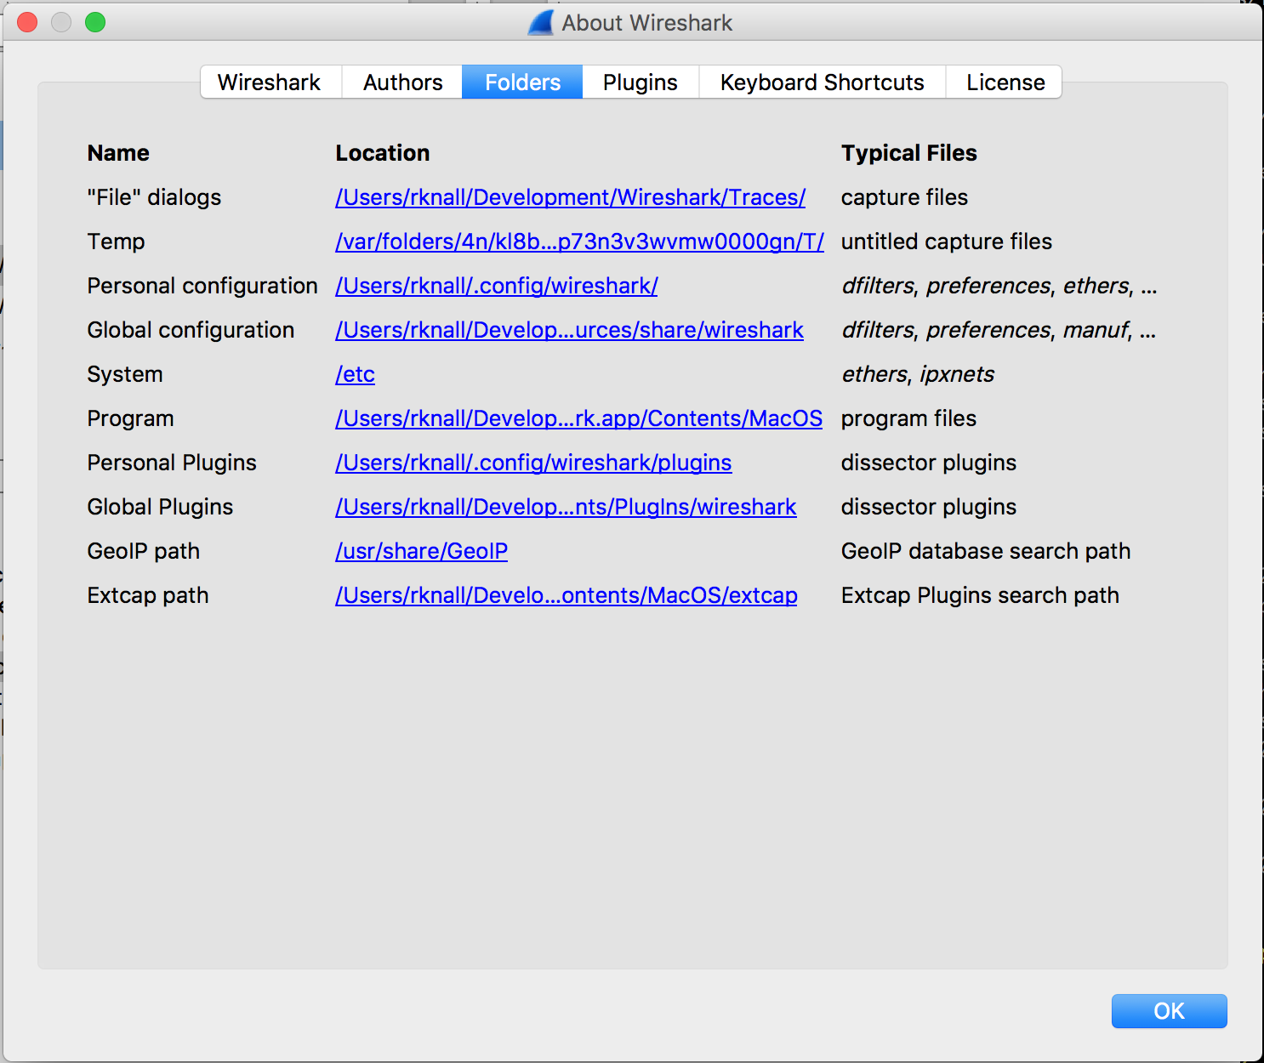
Locate the extcap Folder in Wireshark/Help
Only global folders available
Copy extcap_example.py there

Slide 20
Windows Users
Create batch script for execution
Command Execution does not evaluate shell scripts
Example in the header of extcap_example.py

Slide 21
Adapt the example
Let‘s take a look at
def extcap_capture(...)
Creates a pcap header
Encapsulates data in pcap block

Slide 22
C-Based extcap
Alternative: c-based extcap utility
extap/extcap-base.h
Handles all extcap managment stuff for you
Ensures correct and working extcap arguments
extcap/ssh-base.h
Handles ssh connections

Slide 23
Sniffing a thingy

Slide 24
Capture using a netlink interface

Slide 25
Wireshark and Capture
Wireshark is like the microscope.
Allows you to zoom in to the bit level of a frame.
Making a capture is like taking a tissue sample.
You don’t use a microscope for that!

Slide 26
Linux capture (network)
Capture is a privileged operation.
There need to be privileges assigned to the process.
In Linux this can be handled through Capabilities.
Capabilities are added to files in the filesystem.
Processes launched from the file get these Capabilities.
/sbin/setcap cap_net_raw,cap_net_admin=eip dumpcap

Slide 27
Linux capture (USB)
Capture needs an interface.
Load kernel module usbmon.
/sbin/modprobe usbmon
Grant the user read access rights to the device.
setfacl -m u:$USER:r /dev/usbmon*

Slide 28
Linux capture (netlink)
Capture needs an interface.
Load kernel module nlmon.
/sbin/modprobe nlmon
Create a network interface for it.
ip link add type nlmon
ip link set nlmon0 up

Slide 29
SSL Tips / Tricks

Slide 30
Future of Wireshark

