Slide 1
Reliable Packet Captures
Christian Reusch
CRnetPACKETS.com

Slide 2
Some real world dialogs about network capturing
We want to capture all the data, for our BIG DATA solution!
And here is our really innovative solution…
  But you will miss packets of interest, if you capture with your plan!
Missed packets are not important for us!
----------------------------------------------------------------
I can see lost frames in the capture, seems that your server has not send the data!
  Can we trust the capture?
Ugh… normally for sure, it is a normal Wireshark trace…
--------------------------------------------------------------
I see 20kByte large frames in the trace, please activate Jumbo Frames support on the switches to fix the problem!

Slide 3
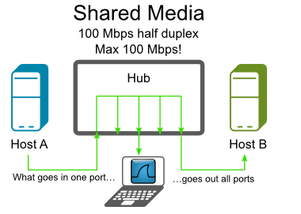
Hub
First modern Ethernet and no COAX anymore
Still a shared medium
  Means: Every Packet of a Layer2 network can be seen on every Port of the Layer2 network
Mostly 10 Mbit/s HDX
  Some Variants with 100 Mbit/s HDX
(1)

Slide 4
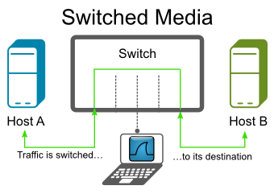
Switch
Switched network
  A switch brings „intelligence“ and performance into the network
  But makes it much harder to capture
(1)
(1)

Slide 5
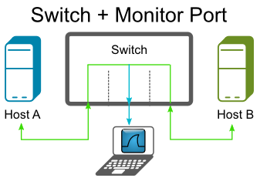
Switch
Monitor Ports (SPAN)
  Remote SPAN (RSPAN) [VLAN]
  Encapsulated Remote SPAN (ERSPAN) [GRE RSPAN]
  CRC errors will not be detected
  SPAN Port will only have TX
  direction, so it can be
  oversubscribed
(1)

Slide 6
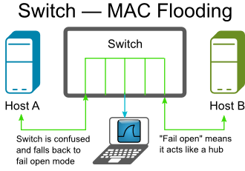
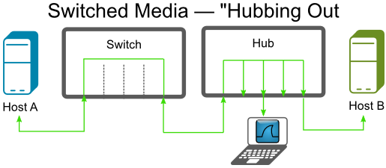
Switch
Other; but no recommended solutions
  ARP Poisoning
  CAM-Table flooding
  HUB
(1)
(1)

Slide 7
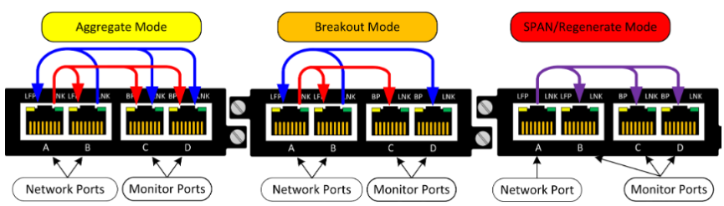
TAP
A TAP provides a fully nonreactive Capture Point
  Fully passive at 100 Mbit/s on networkside
  At 1000 Mbit/s needs to be active on networkside
  Best capture mode for reliable captures is „Break Out“
(2)

Slide 8
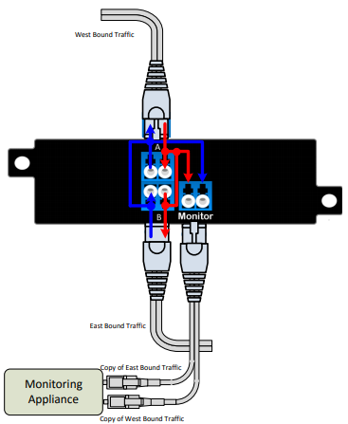
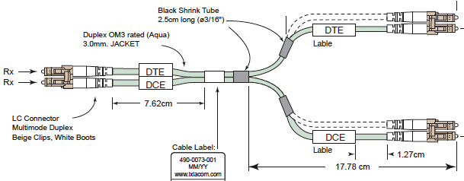
FiberSplitter
Fully passive
Cost effective
Same device can be used
from 1 to 100 Gbit/s
(1)
(3)
(2)

Slide 9
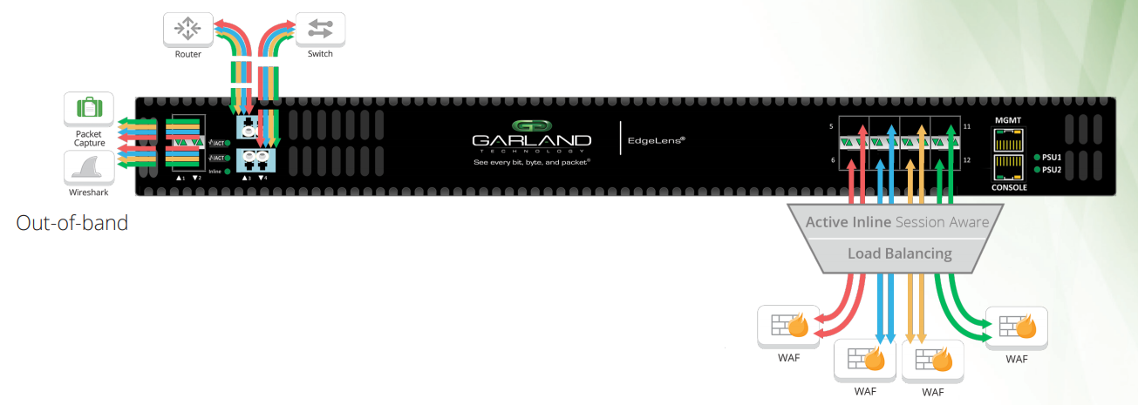
Packet Brocker
Managed TAP
  Can filter traffic
  Can redirect traffic
  Remote admistration
  But cannot always be used inline
(2)

Slide 10
Localhost capturing
Easy to use
  Linux
    Libpcap (tcpdump)
  Windows
    WinPCAP on Windows (needs Install)
    RAWCAP from NETRESEC
    no installation needed
Nowadays it isn´t anymore usefull,
due to Segmentation Offloading
  (TSO_TRACE)

Slide 11
Where: VM Capturing
Outside as close as possible to the VM
Internal captures for internal Traffic
Do not use GuestOS captures
From my point of view it is getting more and more important

Slide 12
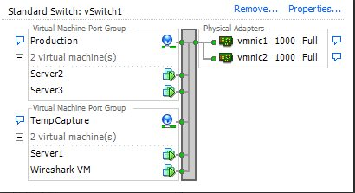
How: VM capturing
Tip for normal vSwitch (by Jasper Bongartz (4))
  Using Portgroups to isolate the „Promiscous“ function of the vSwitch
  Using a dedicated capture VM
  -> does not affect the services
  on the other productive VMs
    Special appliances can be used
      Endace
      Riverbed
      Savvius
      Wireshark
(4)

Slide 13
How: VM capturing 2
Other solutions:
  Virtual Taps
    Somekind of ERSPAN
  Enterprise Plus Licence
    Mirror Port
    Direct at the Hypervisor level
    Usage of different Switches, like a Cisco NEXUS

Slide 14
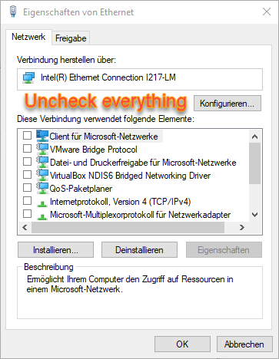
How: Wireshark Capture
Very easy to use
Live analysis possible
Only reliable up to around
300 Mbit/s
Interface should be prepared
Trace can easily get lost
by accident
Timestamping not reliable
Only counts if packets get lost while
writing to disk
  Trace example

Slide 15
How: Profesional Capture Software
Optimized for:
  Capturefile Storing and Indexing
  Data Retention
Captures stored mostly in somekind of Database
You will normally never loose a capture file by accident
Retention can be done by Graphs or Searchmasks
Mostly Very Expensive

Slide 16
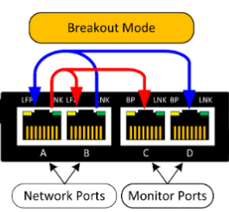
How: Profesional Capture cards
HW Timestamping
  Breakout Capturing
  Latency, Microburst Analysis (6)
      Trace
Produce Reliable Capture,
as capture errors will be logged
at NIC level
CRC Errors will be captured
External: Profishark
Internal: Napatech, Endace

Slide 17
Tip: Capturing 10/100 Mbit/s
Using a Hub for 10MBit/s HDX
Using a Span Port or a TAP in Aggregation Mode,
if the Monitor Port Speed supports 1GBit/s
Using Wireshark can be sufficient, but without reliable timestamping
  Better to use special capture HW

Slide 18
Tip: Capturing 1 Gbit/s
Using a TAP in Breakout Mode
  But a TAP at 1 Gbit/s is not fully passive and not that cheap
Better idea using a Fiber Splitter fully passive and cheaper
Using special HW capture cards e.g.
  Profishark
  Nappatech
  Endace
  ...

Slide 19
Tip: Capturing 10 Gbit/s and beyond
Native reliable capturing of 10 Gbit/s and more is
very expensive >50k €
Workaround:
  Using a Fibersplitter same price as 1 Gbit/s and using Packetbrockers to prefilter the traffic to a 1 Gbit/s breakout monitor link
  Using special HW capture cards to capture at 1 Gbit/s e.g.
    Profishark
    Nappatech
    Endace
    ...

Slide 20
Tip: Reliable Capturing Remote Solutions
Deploy TAPs or Fibersplitter
permanently in the network
Connect them to a Packet Broker
Connect a Capture device to one port
of the Packet Broker
Use the Packet Broker to select which
traffic you want to capture

Slide 21
Capture Strategys
Strategies:
  “One Try” strategy (BEST, massive HW, special HW
  -> Consultants, Carrier, Big Problem, Netwok Forensic)
  “More try” strategy (Network Admin, Not enough equipment)

Slide 22
Client-Server

Slide 23
Client-Server

Slide 24
Client-FW-Server

Slide 25
Client-FW-Server

Slide 26
Client-WAN-FW-Server

Slide 27
Client-WAN-FW-Server

Slide 28
Client-WAN-FW-LB-Server

Slide 29
Client-WAN-FW-LB-Server

Slide 30
Client-FW-WAN-FW-LB-Server

Slide 31
Client-FW-WAN-FW-LB-Server

Slide 32
Client-FW-WAN-FW-LB-VM(Server-Server)

Slide 33
Client-FW-WAN-FW-LB-VM(Server-Server)

Slide 34
Takeaway Capture Strategy
One try strategy
  Every Layer4 device, bottleneck and demarcation point is a useful capturepoint
  Capture as close as possible to a device but not on it
  You should use Taps/Fibersplitters and professional capture equipment
    So you can trust your captures
More try strategy
  You are in a lucky position
  You can use fast access capture points (local captures) to plan the next steps
  You can use a divide and conquer strategy
    2 parallel capture points are useful

Slide 35
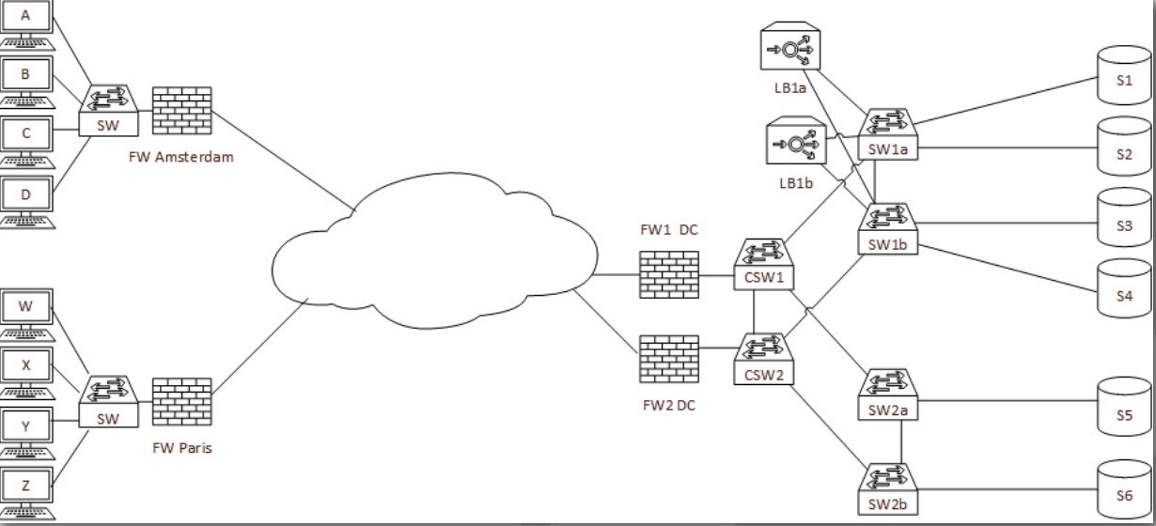
Where would you capture if...(5)
User “A” complains that something is not working in application on “s6”

Slide 36
Where would you capture if... (5)
All users complain about the performance of an application on server S6?

Slide 37
Where would you capture if... (5)
Some users in Paris complain about the performance of the loadbalanced application on server S1, S2, S3, S4?

Slide 38
Where would you capture if... (5)
All users in Amsterdam complain about slow performance on every application?

Slide 39
Takeaway
Tips: How to capture
How develop a capture strategy
Problem orientated capturing
Questions?

Slide 40
References
(1) https://wiki.wireshark.org/CaptureSetup/Ethernet
(2) https://www.garlandtechnology.com/
(3) https://blog.packet-foo.com/2013/04/capturing-packets-of-vmware-machines/comment-page-2/
(4) https://www.ixiacom.com/company/blog/fiber-taps-y-cables-matter
(5) Zen and the art of packet Capturing... By Sake Blok: https://sharkfestus.wireshark.org/assets/presentations15/31.pdf
(6) The little thing called MicroBurst: https://sharkfesteurope.wireshark.org/assets/presentations16eu/09.pptx

Slide 41
Thank You!
Thank you!
I am happy about FEEDBACK
at Sharkfest Europe Guidebook

Slide 42
About me?
Christian Reusch
  Analyzing Networks since 1999
  Twitter: @crnetpackets
  Web: crnetpackets.com
  If you like you can send my Traces and I will answer
    creusch@crnetworks.com

