Slide 1
Compare the accuracy of trace files captured with a tap and Cisco ACI
Markus Liechti
Eddi Blenkers

Slide 2
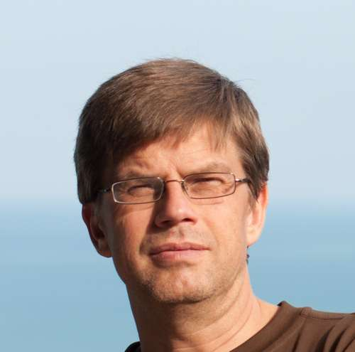
Let me introduce us
Markus Liechti
Network Analyst, BIT - OFIT – FOITT
Markus Liechti is a veteran network analyst working for the Swiss Federal Office of Information Technology and Communication
Among other tools, he uses WireShark to investigate network problems small, big, and exceptionally big
Eddi Blenkers
Security Analyst, BLS
Eddi Blenkers is a security practitioner with over 20 years of experience. He currently works for the Swiss rail company BLS as a Security Analyst

Slide 3
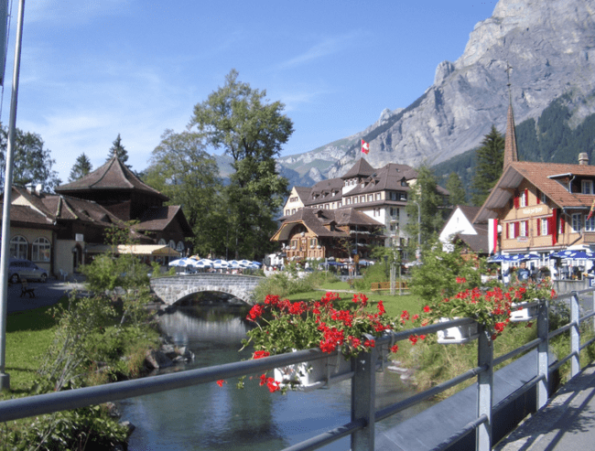
We work in Switzerland
Kandersteg
Geneva
Lugano
Davos Klosters
City of Bern

Slide 4
Ice Cream in Lugano?
We love Lugano because it has great ice cream

Slide 5
Our contact addresses
if you want to go for an ice cream with us you can find us at:
eduard.blenkers@bls.ch
markus.liechti@bit.admin.ch

Slide 6
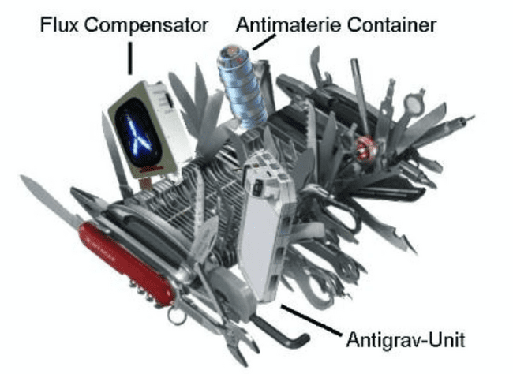
we want to start
In this experiment, we transfer a file and record the event with a tap and the Cisco ACI Engine. Intuitively, we could configure a SPAN port because it is cheap and fast. This experiment will investigate the situation when the infrastructure or virtual capture points are overloaded.

Slide 7
Overview Test and Measurement
File Transfer
System B
System A
10Gbit/s)
Packet Capture Engine
Riverbed Netshark 2100 (10Gbit/s)
Fiber-Tap
Fiber-Tap
Packet Capture Engine
Allegro 1000 (10Gbit/s)
ACI-Leaf
ACI-Leaf
Measurement Point 1
Measurement Point 2
ACI-Spine
ACI-Spine
Measurement Point 3 (ACI)
ERSPAN
Target measurement with end-to-end throughput via ACI and glass taps for verification
Packet Capture Engine
ARP XPert 6000 (20Gbit/s)

Slide 8
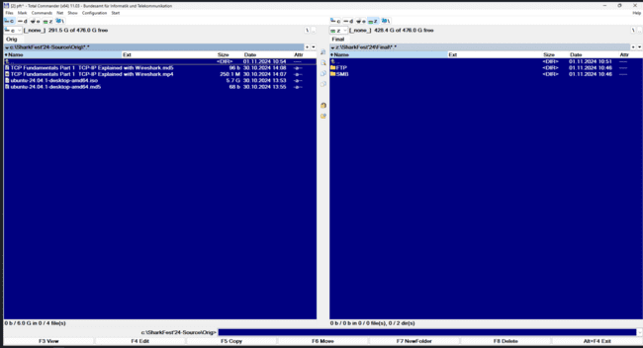
How does the measurement work?
Create md5 checksum of your file
Copy the file from A to B with FTP to the destination

Slide 9
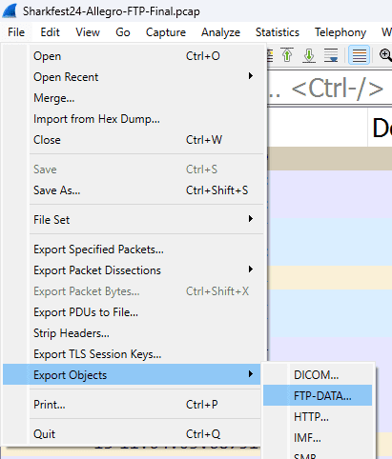
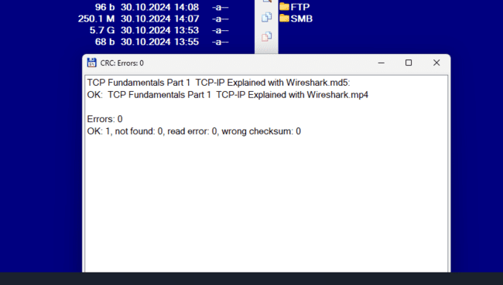
How does the measurement work?
The video can be exported from the Pcap file
Now you can check with the md5 file if it works and the file is without CRC errors

Slide 10
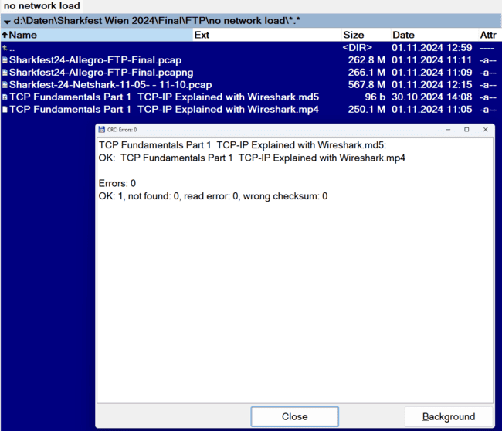
Test and Measurement with low traffic
File Transfer
System B
System A
10Gbit/s)
Packet Capture Engine
Riverbed Netshark 2100 (10Gbit/s)
The measurement has finished
Which measuring points had no errors?
Packet Capture Engine
Allegro 1000 (10Gbit/s)
Measurement Point 1
Measurement Point 2
Measurement Point 3 (ACI)
Packet Capture Engine
ARP XPert 6000 (20Gbit/s)

Slide 11
Summary
Summary measurement with low network traffic
All measuring points worked correctly

Slide 12
Test and Measurement with high volume traffic
System A
File Transfer
System B
iPerf / JPerf Troughput Test
Packet Capture Engine
Fiber-Tap
Fiber-Tap
Packet Capture Engine
ACI-Leaf
ACI-Leaf
ACI-Spine
ACI-Spine
iPerf / JPerf Troughput Test with 3 Streams
Copy the file from A to B with FTP or SMB to the destination
ERSPAN
Packet Capture Engine

Slide 13
Test and Measurement with high volume traffic
File Transfer
System B
System A
10Gbit/s)
Packet Capture Engine
Riverbed Netshark 2100 (10Gbit/s)
The measurement has finished
Which measuring points had no errors?
Packet Capture Engine
Allegro 1000 (10Gbit/s)
Measurement Point 1
Measurement Point 2
Measurement Point 3 (ACI)
Packet Capture Engine
ARP XPert 6000 (20Gbit/s)

Slide 14
Test and Measurement with high volume traffic
File Transfer
System B
System A
10Gbit/s)
Packet Capture Engine
Riverbed Netshark 2100 (10Gbit/s)
Packet Capture Engine
Allegro 1000 (10Gbit/s)
No data found to restore, therefore no CRC to calculate
Measurement Point 1
Measurement Point 2
Measurement Point 3 (ACI)
Packet Capture Engine
ARP XPert 6000 (20Gbit/s)

Slide 15
Summary
Summary measurement with big network traffic
No measuring point worked correctly
Wireshark did not contain the file with FTP
Network Miner was empty
We don't know why it didn't work. But we will find out and present the solution at the next WiresharkFest. Before we close, here are some tips for you.

Slide 16
Tips and tricks
Create a baseline with your measurement setup
Create a MD5 test file first and then transfer the video (mp4) to see if all systems are working correctly
Try to generate a lot of load (Iperf/jperf) to see if the results are still correct
Come to the next SharkFest to see the follow-up post on how we solve the problem

Slide 17
Feedback
Q&A Mail:
eduard.blenkers@bls.ch
Web: blog.packet-foo.com
markus.liechti@bit.admin.ch
Web: www.bit.admin.ch/de/arbeiten-beim-bit

