Slide 1
Cloud doesn’t have Packets!
Stephen Donnelly
Endace

Slide 2
Apocrypha
“Cloud doesn’t have packets”

Slide 3
Surely…
All communications to and from Cloud uses Packets
  Public Internet, Private Connections
Applications, OSes, Containers in Cloud all use Packets
Cloud does have Packets!
Notes:
No surprise, obviously Cloud does have Packets. So why would someone say that?

Slide 4
Theory 1: Abstraction
Cloud is described/advertised very abstractly
  Adoption often driven from the Board/Executives
  Lower Costs, TCO, CapEx vs OpEx
Cloud Transition Focuses on Applications
Networking and Security overlooked
Notes:
Were they serious?

Slide 5
Theory 2: Not My Problem
Cloud architecture designed around Applications
Outsourcing: Cloud Service Provider handles Network
  Including Configuration?
  Including Security?
  We’re behind a CDN/WAF right?
Network and Security teams not considered stakeholders in Cloud Transition
  Lessons learnt from physical networks are lost
Notes:
“We don’t have to worry about Packets in Cloud”
Even those who know that Cloud has packets may overestimate how much CSPs do for you

Slide 6
Why?
Notes:
Is this a problem? Does it matter? Why do we capture packets?

Slide 7
Why capture packets?
Networking | Security
Reachability: “Network is Down”, Hardware Faults, DHCP, Routing, DNS, Firewall tuning | Intrusion detection/prevention (IDS/IPS)
Performance: “Network is Slow”, TCP/Application tuning, WiFi issues | Network Behavioral Anomaly Detection (NBAD)
Application or Service Troubleshooting | Data Loss Prevention (DLP)
Application, Service, or Protocol Development | Incident Response (IR)
… | Detection Engineering and Threat Hunting (DEATH)
 | Passive Vulnerability Scanning (PVS)
 | Compliance (US M-21-31, EU MiFID II)
 | …
Notes:
Why do we capture packets on-prem? Incomplete list. Audience survey. Which of these things are still our responsibility in Cloud?

Slide 8
Who does what?
Layer | Cloud Provider
Layer 0 Premise, Power, Cooling | Everything
Layer 1 Cabling, Patching, Transceivers, Servers, NICs, Storage | Everything
Layer 2 Switches | Hardware, Faults, Patching, Secure Management
Layer 3 Routers | Hardware, Faults, Patching, Secure Management, Basic routes, Peering/Transit
Layer 4+ OS, Firewall, Application | Marketplace: VM Images, Services (CDNs, WAFs, NAT, Gateways…)
Notes:
In on-prem data centers, the owner is responsible for everything. What are Cloud Providers offloading? Shared Responsibility Model

Slide 9
Who does what?
Layer | Cloud Provider | Cloud Customer
Layer 0 Premise, Power, Cooling | Everything | -
Layer 1 Cabling, Patching, Transceivers, Servers, NICs, Storage | Everything | -
Layer 2 Switches | Hardware, Faults, Patching, Secure Management | Virtual Network configuration, Virtual NIC attachments
Layer 3 Routers | Hardware, Faults, Patching, Secure Management, Basic routes, Peering/Transit | Network and subnet configuration, IP allocation, ACLs, Security Groups, User Defined Routes
Layer 4+ OS, Firewall, Application | Marketplace: VM Images, Services (CDNs, WAFs, NAT, Gateways…) | VM, OS, Application installs, Configuration, patching, Security, Management, Firewall Rules, Users, Endpoint Protection, Intrusion Detection, DLP…
Notes:
In on-prem data centers, the owner is responsible for everything. What are Cloud Providers offloading? Shared Responsibility Model

Slide 10
Cloud Packet Capture
Networking | Security
Reachability: “Network is Down”, Hardware Faults, DHCP, Routing, DNS, Firewall tuning | Intrusion detection/prevention (IDS/IPS)
Performance: “Network is Slow”, TCP/Application tuning, WiFi issues | Network Behavioral Anomaly Detection (NBAD)
Application or Service Troubleshooting | Data Loss Prevention (DLP)
Application, Service, or Protocol Development | Incident Response (IR)
… | Detection Engineering and Threat Hunting (DEATH)
 | Passive Vulnerability Scanning (PVS)
 | Compliance (US M-21-31, EU MiFID II)
 | …
Notes:
Do we need to capture packets in Cloud? Yes.
Can we capture in Cloud?

Slide 11
How?

Slide 12
How to capture packets:
On premise
Capture software on Client/Server
Passive/Active Tap*
Port Mirror on Switch/Firewall/Router*
Network Packet Broker*
*Plus capture system

Slide 13
How to capture packets:
In Cloud
Capture software/Agent on Client/Server
Cloud Provider Traffic Mirror service*
Cloud Packet Broker*
Bump-in-the-wire*
*Plus capture system

Slide 14
1. Capture Software
Capture software installed into VM/Instance
  Capture traffic locally
  Uses VM/Instance CPU and storage
Same issues as on physical machines:
  Access/Permission to install software
  NIC Segmentation/Receive Offloads
  Unset checksums
  Poor timestamps
  Can affect Server/Client behavior or performance
  Ah hoc deployment - after the fact
Notes:
Just install Wireshark/tshark!
Security: installing packet capture software on compromised system tips off intruders

Slide 15
1. Capture Agents
Agent software installed into VM/Instance
  Capture traffic locally and send to remote collector
  On-demand, triggered, or continuous
  Same limitations as Software capture
  Adds network traffic
Cloud Packet Brokers support Virtual Tap Agents
  Introduces additional costs
  Decryption*

Slide 16
1. Agents: Azure Network Watcher – Packet Capture
Special Mention: Azure Network Watcher
  CSP Agent
Installed via Agent Extensions (Windows and Linux)
Captures to local file
  Optionally copies to Azure Blob storage
Captures on all VM interfaces
Supports filters
Defaults to 1GB or 5hrs (max)
  Not suitable for continuous capture
Notes:
Special mention, Cloud Provider capture agent

Slide 17
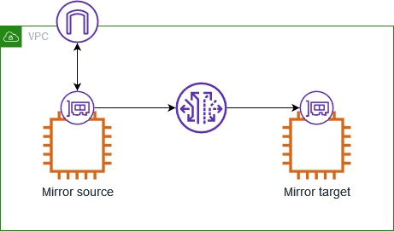
2. Cloud Traffic Mirror
Three components:
  Mirror Source
  Mirror Session
  Mirror Target
Mirrored traffic consumes instance bandwidth
Rate Limiting can cause Packet Drop
Notes:
Each packet can only be mirrored once, and sent to a single destination.

Slide 18
2. Cloud Traffic Mirror
 | AWS | Azure | Oracle | Google
Name | VPC Mirror | Virtual network TAP Preview (again!) | VTAP | Packet Mirroring
Sources | Instance-type Elastic Network Interfaces (ENI)* | - | Instance VNIC, Load Balancer, Database, Exadata VM Cluster, … | Compute Engine VM instances (subnets, network tags, or instance names)
Destinations | Instance ENI, Network Load Balancer, Gateway Load Balancer | - | Network Load Balancer | Internal Load Balancer
Mirror Priority | Lower | - | Lower (default) or Production | Production?
Encapsulation | VXLAN | - | VXLAN | None
Notes:
* AWS VPC Mirror not supported on all instance types

Slide 19
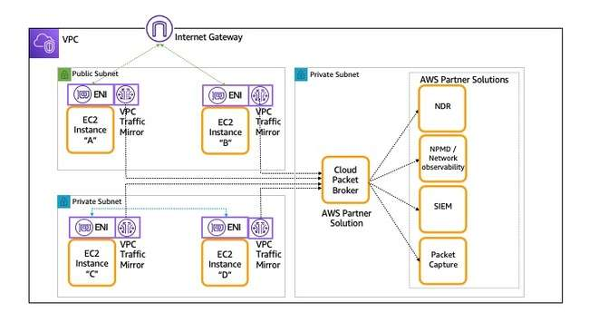
3. Cloud Packet Brokers
Aggregate traffic from Agents or Traffic Mirrors
Multiple vendors: Gigamon, Keysight, Niagara etc.
Additional costs
May provide:
  Load Balancing
  Replication
  Filtering
  Truncation
  De-duplication
  Decryption*

Slide 20







4. Bump-in-the-wire
Inline capture or mirroring by an existing or new network element:
  Router
  Firewall
Route traffic with User Defined Routes
Local capture or Mirror
Decryption*
AWS Cloud
Virtual private cloud (VPC)
Internet gateway
Application subnet
Firewall
subnet
Capture subnet
VXLAN
Webserver
ENI
ENI
Firewall
ENI
ENI
Capture

Slide 21
Scorecard
Capture Method | Pros | Cons
1. Software | “Simple” “Easy” “Free” Doesn’t steal Bandwidth | Permission to log in, install software NIC Offload issues Steals CPU, IO/storage Ad hoc rather than continuous capture
2. Agents | Remote control Most don’t steal IO/storage | Permission to install software NIC Offload issues Steals CPU, Bandwidth
3. Cloud Traffic Mirror | No software install Doesn’t steal CPU, IO/storage | Not available everywhere May drop packets Additional costs Steals Bandwidth
4. Bump-in-the-wire | No software install Doesn’t steal CPU, IO/storage, Bandwidth Available everywhere | Network architecture change Potential bottleneck or point of failure Mirroring not supported by all devices, services, appliances

Slide 22
Where?
Notes:
Where is the4 Cloud can/should we capture?

Slide 23
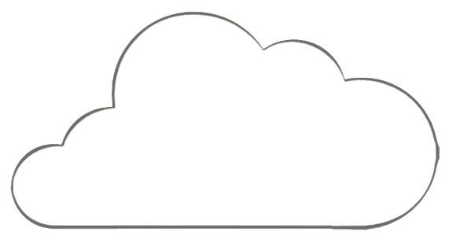






BC – Before Cloud
HQ or Private Datacenter
Cloud SaaS
DMZ
No Longer Trusted Zone
LAN
Core
Switch
Internal
Firewall
Private
Data
Center
Internet
Partner Zones
Untrusted WiFi
Branch Offices

Slide 24
CE – Cloud Era
DirectConnect /​
ExpressRoute
HQ or Private Datacenter
Public Cloud
No Longer Trusted Zone
Dedicated
Connection
LAN
Core
Switch
Internet
Untrusted WiFi
Branch Offices

Slide 25


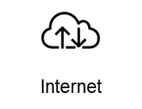
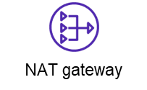
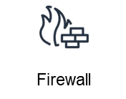

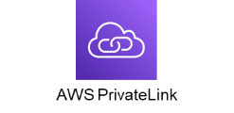

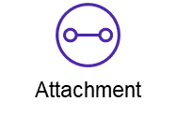

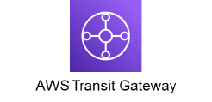
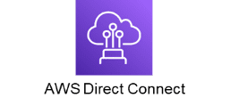
In Cloud - Centralized
AWS Cloud
Network VPC
Firewall subnet
Security Tools subnet
Traffic Mirror
Packet Capture
Shared Services subnet
Corporate
data center
Business Unit 1 VPC
Business Unit 2 VPC

Slide 26



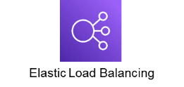
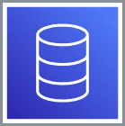

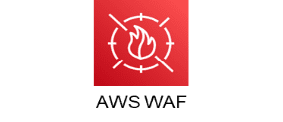
Cloud Native – Multi-Tier Web Application
AWS Cloud
Region
Virtual private cloud (VPC)
Availability Zone
Webserver
subnet
Application
subnet
Internet
Database
Availability Zone
Webserver
subnet
Application
subnet
Database

Slide 27

Cloud Native – Multi-Tier
AWS Cloud
Region
Virtual private cloud (VPC)
Availability Zone
Webserver
subnet
Application
subnet
Packet
Capture subnet
Internet
Database
Availability Zone
Webserver
subnet
Application
subnet
Packet
Capture subnet
Database

Slide 28
Conclusions

Slide 29
Conclusions
Cloud does have Packets after all!
We do (still) need to capture them
You can capture “Cloud Packets”
Packet Analysis is here to stay

Slide 30

Please complete Feedback!
Notes:
https://conference.wireshark.org/sharkfest-24-eu/talk/TPT9PT/feedback

