Slide 1
Introduction to Cloud Packet Capture
Stephen Donnelly

Slide 2
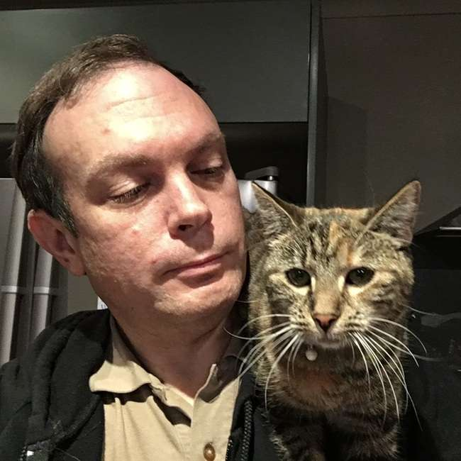

Let me introduce myself
Stephen Donnelly
Endace CTO
Sharkfest Sponsor
Wireshark Foundation Platinum Sponsor
endace.com

Slide 3
Why?
Notes:
Why? Do we need to capture packets in Cloud?
Why do we capture packets?

Slide 4
Why capture packets?
Networking | Security
Reachability: “Network is Down”, Hardware Faults, DHCP, Routing, DNS, Firewall tuning | Threat Hunting
Performance: “Network is Slow”, TCP/Application tuning, WiFi issues | Incident Response (IR)
Troubleshooting: Multi-Tier Applications or Services | Data Loss/Leakage Prevention (DLP)
Development: Application, Service, or Protocol | Compliance (US M-21-31, EU MiFID II)
Notes:
Why do we capture packet on-prem? Not a comprehensive list! Audience survey. Which of these things are still our responsibility in Cloud?

Slide 5
Who does what? Shared Responsibility Model
Layer | Cloud Provider | Cloud Customer
Layer 0 Premise, Power, Cooling | Everything | -
Layer 1 Cabling, Patching, Transceivers, Servers, NICs, Storage | Everything | -
Layer 2 Switches | Hardware, Faults, Patching, Secure Management | Virtual Network configuration, Virtual NIC attachments
Layer 3 Routers | Hardware, Faults, Patching, Secure Management, Basic routes, Peering/Transit | Network and subnet configuration, IP allocation, ACLs, Security Groups, User Defined Routes
Layer 4+ OS, Firewall, Application | Marketplace: VM Images, Services (CDNs, WAFs, NAT, Gateways…) | VM, OS, Application installation, Configuration, Patching, Security, Management, Firewall Rules, Users, Endpoint Protection, Intrusion Detection, DLP…
Notes:
In on-prem data centers, the owner is responsible for everything. What are Cloud Providers offloading? Shared Responsibility Model

Slide 6
How?
Notes:
How do we capture Packets? Compare on prem with Cloud
Are Cloud environments really that different?

Slide 7
Capture Software
Why not just install Wireshark?
Access/Permission to install software
NIC Segmentation/Receive Offloads
Packet counts/sizes differ
Unset checksums
Poor timestamps
Capture may affect host behavior or performance
Ad hoc deployment - after the fact
Tips off intruders!
Notes:
Just install Wireshark/tshark!
Security: installing packet capture software on compromised system tips off intruders

Slide 8
Segmentation Offload
Application
1MB
Kernel
64kB
NIC
1500B
MTU

Slide 9
Segmentation Offload
Application
Stratoshark
sysdig
1MB
scap
Kernel
Wireshark
dumpcap
64kB
pcap
NIC
1500B
MTU

Slide 10
How to capture packets: On premise
Capture software (on Client/Server)
Network Tap
Port Mirror
Network Packet Broker
Notes:
Physical Network Tap: Active and Passive
Port Mirror aka SPAN: Switch, Firewall, Router

Slide 11
How to capture packets: In Cloud
Capture software/Agent (on Client/Server)
Cloud Provider Traffic Mirror service*
Bump-in-the-wire
Cloud Packet Broker
* Where available
Notes:
Bump-in-the-wire: adding a router or firewall element specifically to tap traffic

Slide 12
Capture Agents
Agent: Capture software installed into VM/Instance
Capture traffic locally and send to remote collector
On-demand, triggered, or continuous
Same limitations as Software capture
Adds network traffic
Cloud Packet Brokers support Virtual Tap Agents
Introduces additional costs

Slide 13
Agents: Azure Network Watcher – Packet Capture
1st party: by MS Azure
Installed via Agent Extensions (Windows and Linux)
Captures on all VM interfaces
Supports filters
Defaults to 1GB or 5hrs (max)
Writes to a local file
Then optionally copies to Azure Blob storage
Not suitable for continuous capture
Notes:
Special mention, Cloud Provider capture agent

Slide 14
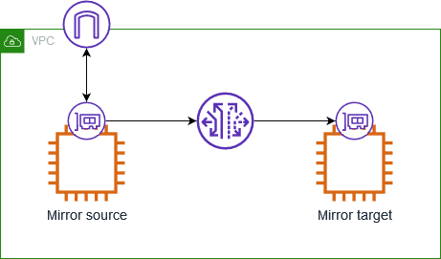
Cloud Traffic Mirror
Three components:
Source
Session
Target
Mirrored traffic consumes instance bandwidth
Notes:
Each packet can only be mirrored once and then sent to a single destination.

Slide 15
Cloud Traffic Mirror Comparison
 | AWS | Azure | Oracle | Google | Google NSI
Name | VPC Mirror | Virtual Network TAP (Public Preview) | VTAP | VPC Packet Mirroring | Network Security Integration Packet Mirroring - OOB
Sources | Instance-type Elastic Network Interfaces (ENI)* | VM Network Interfaces* | Instance VNIC, Load Balancer, Database, Exadata VM Cluster, … | Compute Engine VM instances (subnets, network tags, or instance names) | Firewall Policy/Security Profile
Destinations | Instance ENI, Network Load Balancer, Gateway Load Balancer | VM or Load balancer | Network Load Balancer | Internal Load Balancer | Internal Load Balancer
Mirror Priority | Lower | Free Double Bandwidth! | Lower (default) or Production | Production? | Production?
Encapsulation | VXLAN | VXLAN (VNI 27?) | VXLAN | None | GENEVE
Notes:
AWS VPC Mirror not supported on all instance types
Azure
All instance types, limited regions (7):
Asia East, US West Central, UK South, US East, India Central, Germany West Central, US Central
Coming soon: Australia East, Korean Central, Canada Central
Not IPv6
Not in VNets with encryption enabled
Network downtime up to 60s when added or removed as a source
https://learn.microsoft.com/en-us/azure/virtual-network/virtual-network-tap-overview
https://techcommunity.microsoft.com/blog/azurenetworkingblog/azure-virtual-network-terminal-access-point-tap-public-preview-announcement/4405540
NSI: 15 resources required

Slide 16
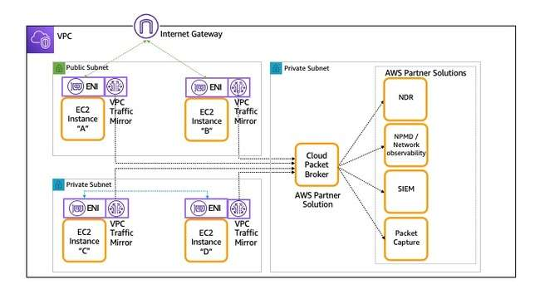
Cloud Packet Brokers
3rd party/commercial solutions, typically VMs
Aggregates traffic from Agents or Traffic Mirrors
May provide:
Load Balancing
De-duplication
Replication
Filtering
Truncation
Decryption*

Slide 17







Bump-in-the-wire
Inline capture or mirroring by an existing or new network element: Router or Firewall
Route traffic with User Defined Routes
Local capture or Mirror
Decryption*
AWS Cloud
Virtual private cloud (VPC)
Internet gateway
Application subnet
Firewall
subnet
Capture subnet
VXLAN
Webserver
ENI
ENI
Firewall
ENI
ENI
Capture

Slide 18
Scorecard
Capture Method | Pros | Cons
Software | “Simple” “Easy” “Free” Doesn’t steal Bandwidth | Permission to log in, install software NIC Offload issues Steals CPU, IO/storage Ad hoc rather than continuous capture
Agents | Remote control May not steal IO/storage May be used continuously | Permission to install software NIC Offload issues Steals CPU, Bandwidth
Cloud Traffic Mirror | No software install Not “local” capture Doesn’t steal CPU, IO/storage | Not available everywhere May drop packets Additional costs Steals Bandwidth
Bump-in-the-wire | No software install Doesn’t steal CPU, IO/storage, Bandwidth Available everywhere | Network architecture change Potential bottleneck or point of failure Not supported by all devices/services/appliances

Slide 19
Where?
Notes:
Where in Cloud should we capture? Is Cloud architecture different?

Slide 20







BC – Before Cloud
HQ or Private Datacenter
Cloud SaaS
DMZ
No Longer Trusted Zone
LAN
Core
Switch
Internal
Firewall
Private
Data Center
Internet
Partner Zones
Untrusted WiFi
Branch Offices
Notes:
Border: Net Performance, reachability. Security: Scans/probes, exploits, C2, Exfil
Internal: App performance, troubleshooting. Security: Threat hunting, IOCs, lateral movement

Slide 21
WC – With Cloud
DirectConnect /​
ExpressRoute
HQ
Public Cloud
No Longer Trusted Zone
Dedicated
Connection
LAN
Core
Switch
Internet
Untrusted WiFi
Branch Offices

Slide 22


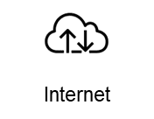
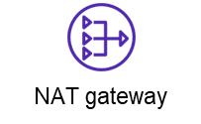
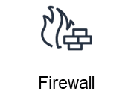

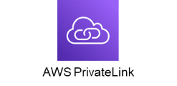

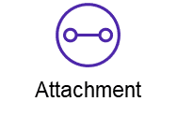
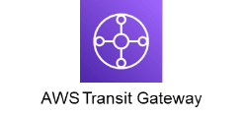

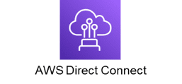
In Cloud - Centralized
AWS Cloud
Network VPC
Firewall subnet
Security subnet
Packet Capture
Shared Services subnet
Corporate
data center
Business Unit 1 VPC
Business Unit 2 VPC
Notes:
What’s inside the Cloud? What does it look like?
AWS diagram, other clouds similar with different names.

Slide 23




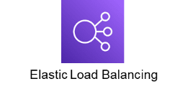

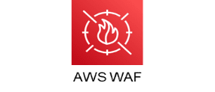
Cloud Native – Multi-Tier
AWS Cloud
Region
Virtual private cloud (VPC)
Availability Zone
Webserver subnet
Application subnet
Internet
Database
Availability Zone
Webserver subnet
Application subnet
Database

Slide 24

Cloud Native – Multi-Tier
AWS Cloud
Region
Virtual private cloud (VPC)
Availability Zone
Webserver subnet
Application subnet
Packet Capture subnet
Internet
Database
Availability Zone
Webserver subnet
Application subnet
Packet Capture subnet
Database

Slide 25
Conclusions

Slide 26
Conclusions
Packet Capture is needed in Cloud
Cloud environments are different
Capture is possible, solutions are available

Slide 27

Feedback
Notes:
Please leave feedback!

