Slide 1
Using wireshark in LTE, and 5G networks…
Mark Stout
T-Mobile

Slide 2
About me?
In wireless technology CDMA/LTE/5G since 1998
Work on various OEM’s
  Cisco
  Ericsson
  Nokia
  Nortel

Slide 3
eNodeB
MME
HSS
PCRF
S6a
S1-MME
Uu
S11
Gx
X2
S1-U
S5/S8
SGi
Internet
UE
Uu
S-GW
P-GW
eNodeB
E-UTRAN
Enhanced Packet Core (EPC)
We will concentrate on packets entering, exiting, and within the highlighted portion.
UE User Equipment, Users phone, or device
eNodeB Radio Access side of the network
MME Local Mobility Management Entity. Only handles signaling for call setup, and certain hand offs
S-GW Serving Gateway. Mobility anchor point. Handles signaling, and data plane
P-GW PDN-GW. Packet Data Network Gateway. Provides IP, and session connectivity(UE Anchor).
HSS Home Subscriber Server. Houses subscriber related information, and provides Authentication, and Authorization.
PCRF Policy and Charging Function.
**Certain nodes are not represented for simplicity

Slide 4
Protocols we’re covering
SCTP – Session Control Transmission Protocol
Diameter
GTP – GPRS Tunneling Protocol
S1ap – S1 Application Protocol
Then 5G
MME
SCTP
HSS
PCRF
Diameter
S6a
S1-MME
SCTP
S1ap
Diameter
GTP-C
S11
TCP
Gx
UDP
S1-U
S5/S8
SGi
Internet
UDP
UDP
GTP-U
GTP-U
S-GW
GTP-C
P-GW

Slide 5
SCTP
Stream Control Transmission Protocol RFC4960
Not datagrams, nor Segments, SCTP uses Chunks.
Chunk: Unit of information within an SCTP packet. Chunks contain either user data, or SCTP control data.
Multiple chunks can be bundled into one SCTP packet up to the MTU size, except for the INIT, INIT ACK, and SHUTDOWN COMPLETE chunks.
Endpoint: The logical sender/receiver of SCTP packets. In the context of a multi-homed host, an SCTP endpoint is represented to its peers as an association of multiple transport addresses, consisting of a set of eligible destination addresses for outbound SCTP packet transmission and a set of eligible source addresses for inbound reception
SCTP uses stream as the logical channel for transporting in-order application messages. A stream is defined as unidirectional

Slide 6
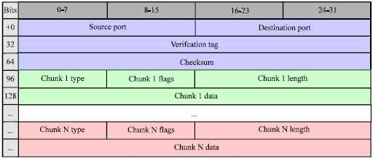
Standard header
Start of all SCTP headers
Different Chunk types are defined starting at the 13th Byte (96 bit)

Slide 7
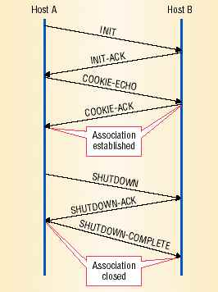

SCTP
Stream Control Transmission Protocol RFC4960
Association establishment and shutdown. SCTP uses a cookie mechanism in a four-way handshake to establish an association.
The shutdown process is a three-way handshake.

Slide 8
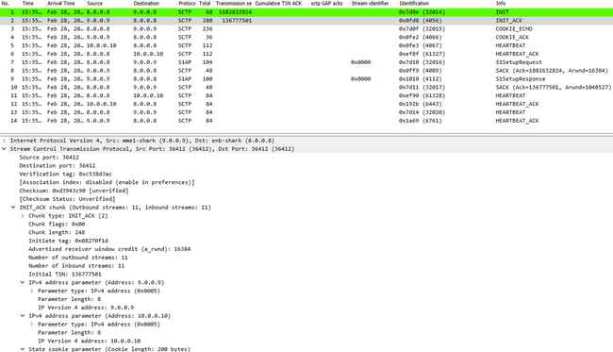
Redundancy built in
Multihoming can be established at time of init ack.
This is how we dynamically build redundant route from Cell Site, to MME.
Redundant route start heart beat.

Slide 9
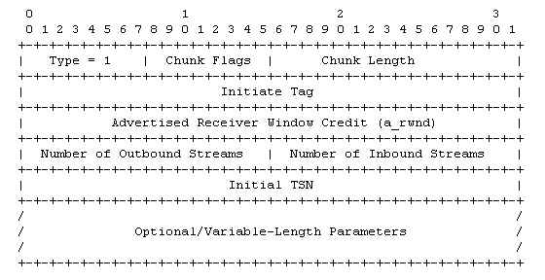
Initiation (INIT)
Initiate Tag
  This value MUST be placed into the Verification Tag field of every SCTP packet.

Slide 10
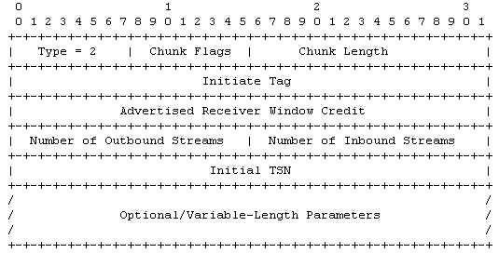
Initiation Acknowledgement (INITACK)
INIT ACK uses two extra variable parameters: The State Cookie and the Unrecognized Parameter:

Slide 11
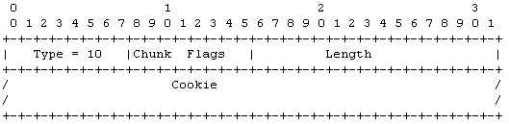

Cookie Echo (COOKIE ECHO)
Cookie is echo’d from cookie in INIT ACK
Cookie Acknowledgement (COOKIE ACK)

Slide 12
SCTP
Stream Control Transmission Protocol RFC4960
Selective Ack’s
  The acknowledgements carry all Transmission Sequence Number (TSN) numbers that have been received by one side with them.
  That is, there is a Cumulative TSN Ack value, that indicates all the data that has successfully been reassembled at the receivers side.
  there are Gap Blocks that indicate which segments of data chunks have arrived, with some data chunks missing in between.
Path Monitoring
  HEARTBEAT chunks are sent over all paths. Each HEARTBEAT chunk has to be acknowledged by a HEARTBEAT-ACK chunk.
  Each path is assigned a state: active or inactive.
  The number of events in which heartbeats were not acknowledged within a certain time or the number of retransmission events exceeds a certain configurable limit, the peer endpoint is considered unreachable and the association will be terminated via an ABORT chunk.

Slide 13
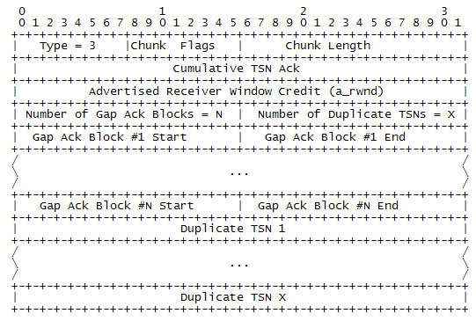
Selective Acknowledgement (SACK)

Slide 14
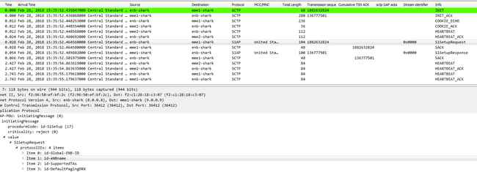
SCTP
Stream Control Transmission Protocol RFC4960
S1 peering setup

Slide 15
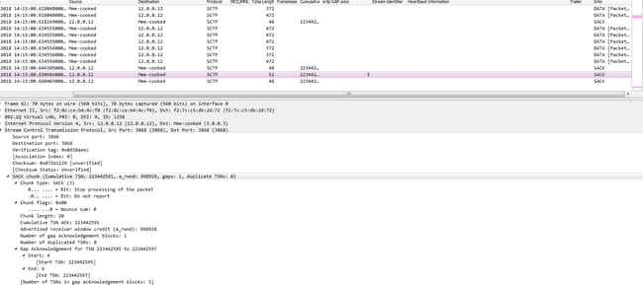

Selective Acknowledgement (SACK)

Slide 16
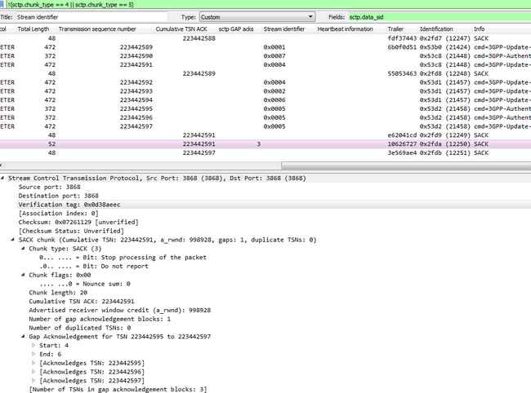
SCTP profile
Create a button to remove heartbeats/acks
Create columns to show the stream, gap count, and TSN
Create a color rule that shows you when gaps are present
Create a color rule that shows sctp layer fragments
I always create a color rule that shows the start of a peer, or session.

Slide 17
Diameter
Diameter is the protocol used within the EPC architecture for AAA (Authentication, Authorization, and Accounting), PCRF (Policy and Charging Rules Function), and HSS (Home Subscriber Server).
Diameter is specified in RFC 3588 and then by the RFC 6733.
The name is a pun on the name of the predecessor protocol, RADIUS(Remote Authentication Dial In User Service) - a diameter is twice the radius.

Slide 18
Diameter
All data delivered by diameter is in the form of AVPs (Attribute Value Pairs). Some of these AVP values are used by the Diameter protocol itself, while others deliver data associated with particular applications that employ Diameter.
Ability to exchange messages and deliver AVPs ( Attribute Value Pairs)
Capabilities negotiation
Error notification
Extensibility, required in [RFC2989], through addition of new applications, commands, and AVPs
Basic services necessary for applications, such as the handling of user sessions or accounting

Slide 19
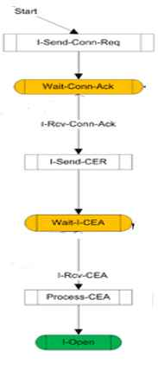

Diameter
Peering State Machine
I-Send-Conn-Req = SYN
Wait-Conn-Ack = SYN, ACK
I-Rcv-Conn-Ack = ACK
I-Send-CER = send Capabilities Exchange Request
I-Wait-I-CEA = ACK
I-Rcv-CEA = receive Capabilities Exchange Answer

Slide 20
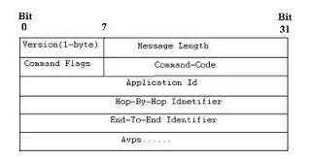
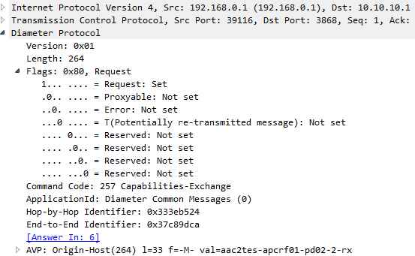
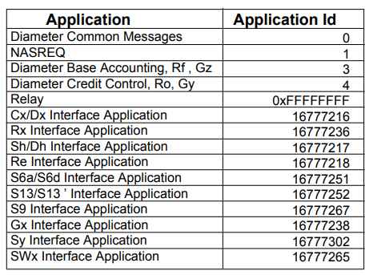
Diameter
Diameter Header information
All Diameter headers start with the same 20 bytes. After that AVP’s are added
Capabilities-Exchange-Request CER 257
Capabilities-Exchange-Answer CEA 257
Device-Watchdog-Request DWR 280
Device-Watchdog-Answer DWA 280
Disconnect-Peer-Request DPR 282
Disconnect-Peer-Answer DPA 282
Abort-Session-Request ASR 274
Abort-Session-Answer ASA 274
Re-Auth-Request RAR 258
Re-Auth-Answer RAA 258
Session-Termination-Request STR 275
Session-Termination-Answer STA 275
Accounting-Request ACR 271
Accounting-Answer ACA 271

Slide 21
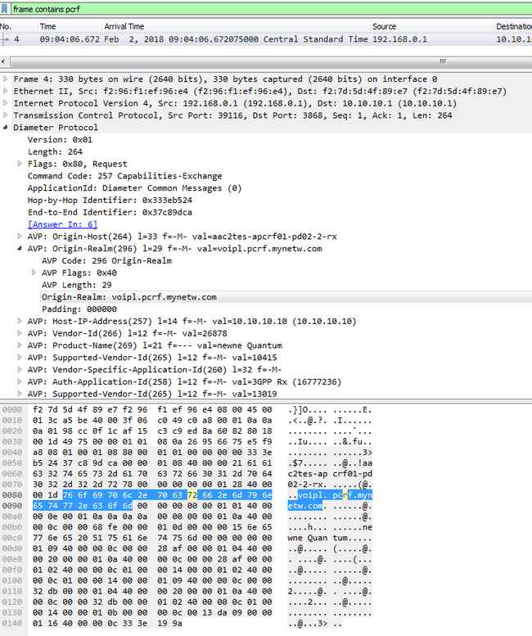
Diameter
Diameter AVP’s carry a lot of data is asci format. Use it to your advantage using the “frame contains xxx” as a filter
You can also just click on the ascii portion of the “Packet Bytes” pane, and the AVP will open directly in the “Packet Details” view.

Slide 22

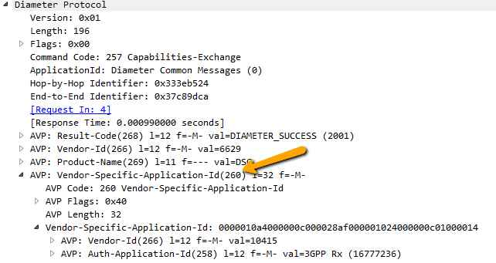



Diameter
The AVP’s are grouped in a parent, child relationship. This relationship is setup in readable xml files in the <wireshark home>/diameter directory.
This info is helpful when trying to find what AVP’s could be grouped under one parent, or to find documentation associated with that avp.

Slide 23
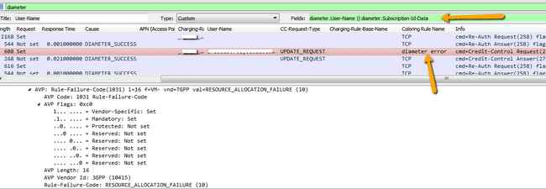
Diameter profile
Diameter has multiple request, and answer types. These can be in different AVP’s. Don’t build multiple columns for that. Use the custom column, and use || to define different AVP’s.
Create custom color rule for known bad issues, then show color rule in column.

Slide 24
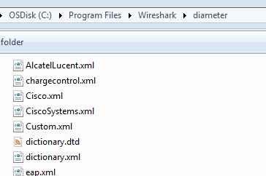
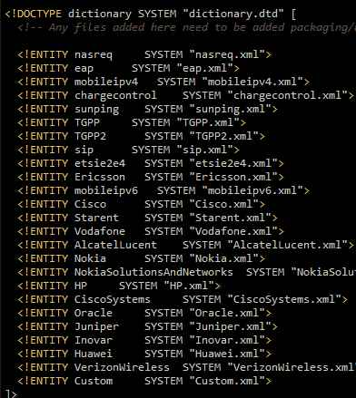
Diameter profile
Dictionary.xml is the main file, and is responsible for calling all the other specific files
<avp name="Vendor-Id" code="266" mandatory="must" may-encrypt="no" protected="may" vendor-bit="mustnot">
<type type-name="VendorId"/>
</avp>
<avp name="Firmware-Revision" code="267" mandatory="mustnot" protected="mustnot" may-encrypt="no" vendor-bit="mustnot">
<type type-name="Unsigned32"/>
</avp>
<avp name="Result-Code" code="268" mandatory="must" may-encrypt="no" protected="mustnot" vendor-bit="mustnot">
<type type-name="Enumerated"/>
<enum name="DIAMETER_MULTI_ROUND_AUTH" code="1001"/>
<enum name="DIAMETER_SUCCESS" code="2001"/>

Slide 25
Diameter profile
<avp name="Charging-Rule-Name" code="1005" mandatory="must" may-encrypt="yes" protected="may" vendor-bit="must" vendor-id="TGPP">
<type type-name="OctetString"/>
</avp>
<avp name="Event-Trigger" code="1006" mandatory="must" may-encrypt="yes" protected="may" vendor-bit="must" vendor-id="TGPP">
<type type-name="Enumerated"/>
<enum name="SGSN_CHANGE" code="0"/>
<enum name="QOS_CHANGE" code="1"/>
<enum name="RAT_CHANGE" code="2"/>
<enum name="TFT_CHANGE" code="3"/>
<enum name="PLMN_CHANGE" code="4"/>
<enum name="LOSS_OF_BEARER" code="5"/>
</avp>
In this example <avp starts the a new description
name= defines the name that will show in wireshark for the code= defined
type-name=“Enumerated = a number value that will later get a name assigned to the value
OctetString = A string of octets ie. 0a ff cd bb
UTF8String = text
if “Enumerated” is defined then <enum name=“what ever” code=“0”/> associates a string with whatever number value is seen.
Mandatory, May-encrypt, Protected, Vendor-bit = Not used in wireshark, but refers to the flags in the diameter message

Slide 26
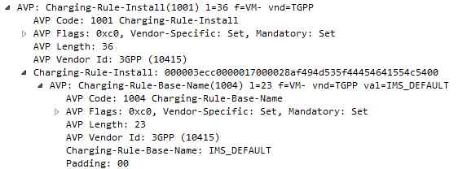
Diameter profile
<avp name="Charging-Rule-Install" code="1001" mandatory="must" may-encrypt="yes" protected="may" vendor-bit="must" vendor-id="TGPP">
<grouped>
<gavp name="Charging-Rule-Definition"/>
<gavp name="Charging-Rule-Name"/>
<gavp name="Charging-Rule-Base-Name"/>
<gavp name="Bearer-Identifier"/>
<gavp name="Rule-Activation-Time"/>
<gavp name="Rule-Deactivation-Time"/>
<gavp name="Resource-Allocation-Notification"/>
</grouped>
</avp>
<avp name="Charging-Rule-Base-Name" code="1004" mandatory="must" may-encrypt="yes" protected="may" vendor-bit="must" vendor-id="TGPP">
<type type-name="UTF8String"/>
</avp>

Slide 27
GTP
GPRS Tunneling protocol is a IP/UDP based protocol used in GSM, UMTS and LTE core networks. It is used to encapsulate user data when passing through core network and also signaling traffic between various core network entities.
In LTE, version 2 is used for GTP-C and version 1 is used for GTP-U
In our shown LTE network implementation, GTP-v2 is used on S5 and S11 interfaces and GTPv1 is used on S1-U, S5.
MME
HSS
PCRF
S6a
S1-MME
GTP-C
Gx
S11
S1-U
S5/S8
SGi
Internet
GTP-U
GTP-C
GTP-U
S-GW
P-GW

Slide 28
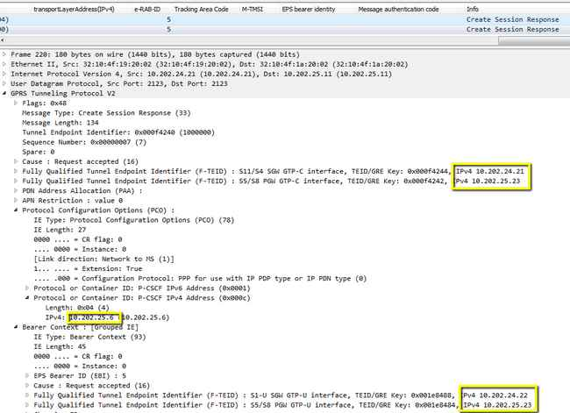
GTPv2
Different GTP-C messages are used to manage a Tunnel or to set up the tunnel for GTPv1.
GTP-C does not necessarily tunnel messages, as no payload is carried above GTP-C.
The GTP-C messages are Create Session, Create Bearer, Modify Bearer, Update Bearer, Delete Session, Delete Bearer.

Slide 29
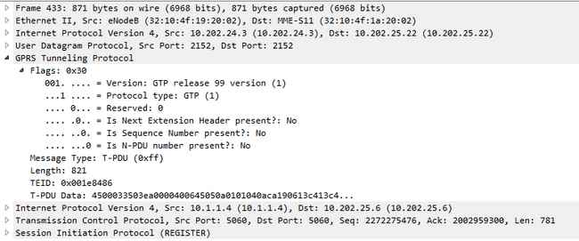

GTPv1
The transport bearer is identified by the GTP-U TEID and the IP address (source TEID, destination TEID, source IP address, destination IP address)
As Bearer is received over a TEID on S1-U at the SGW, the SGW then forwards on a different TEID towards the PGW.

Slide 30
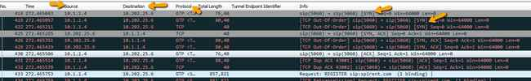
GTP
While GTP is stateless the upper level protocols may not be.
GTPv2 should be diagnosed from request to response (or lack there of).
Looking at TCP over GTPv1 holds the best advantages for me. But there are things to look out for!
When you take a capture at the SGW, and PGW. You will see that wireshark shows 3 packets per 1. Then Wireshark will do TCP analysis on 3 packets, and mark all packets (except the first) with some error (retran, ooo)
You’ll also notice that WS will only show the upper most layer IP in the source/Destination field

Slide 31
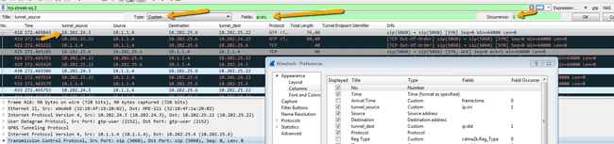
GTP Tunnel Viewing Version1
Using the previous example, the 1st thing I want to do is look at my GTP endpoints and not just the upper layer IP
Create a new column name “tunnel_source”
Choose type “custom”, and fields as ip.src
Make occurrences “1” (this is for single tunnel, you can do 2 when you have a tunnel in a tunnel
You now see the tunnel_source address, and the upper layer address. (only “Source” will resolve name)

Slide 32
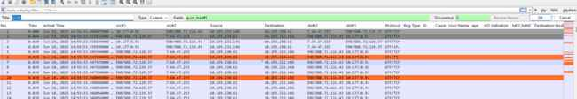
GTP Tunnel Viewing Version2
Using the previous example, the 1st thing I want to do is look at my GTP endpoints and not just the upper layer IP
Create a new column name “tunnel_source”
Choose type “custom”, and fields as ip.src_host#1
Change “Source” column to “Inner Source” and make the fields as ip.src_host#2
You now see the tunnel_source address, and the upper layer address.
      (both addresses will be resolved using the _host field)

Slide 33
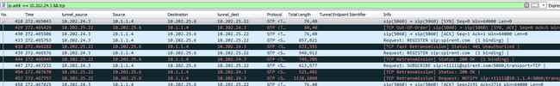
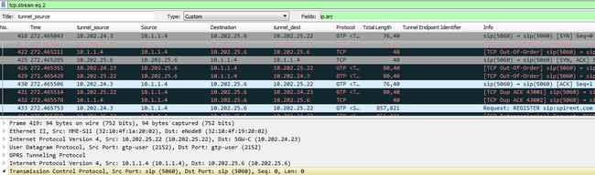

GTP
2nd, we need to de’dup the packets so that we can use the TCP analysis feature in wireshark (assuming we’re looking for things like packet loss).
Putting a display filter does not help in the cases where you capture S1-u, S5, and Sgi in the same capture. Wireshark analysis feature is based on all packets in the capture regardless of whether you are view them or not.
Find something unique in each of the interfaces. I usually use the MAC address or tunnel IP, since S1, S5, and Sgi will typically use different interfaces. Then create a display filter for that.
This will now show you just show just a single flow of the TCP packets (still showing error). So now “export specified packets”, and save “displayed”
Open the capture you just created.
BEFORE
Original File
AFTER

Slide 34
Let’s build a profile

Slide 35
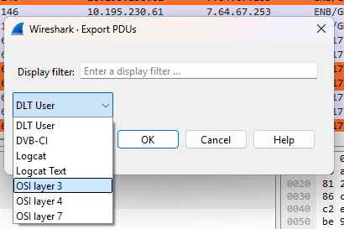
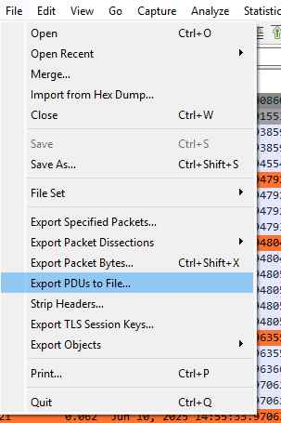
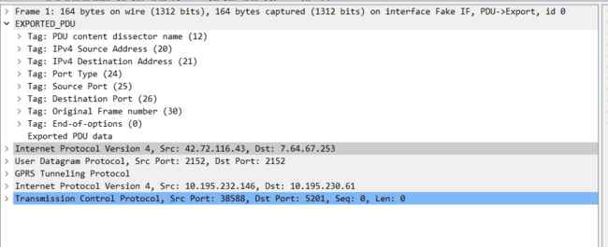
Sharing tunneled payload

Slide 36
Tools, Tools, Tools, they are there for you.
Editcap to remove true
.\editcap.exe -w –I .0001 C:\temp\roamingIssue.pcap C:\temp\roamDedup.pcap
153 packets seen, 12 packets skipped with duplicate time window equal to or less than 0.000100000 seconds.
duplicate packets. Most useful on S5 interface that leaves SGW, and arrives at PGW.
For large files use capinfos to determine size, and calculate the size of the chunks that the pcap can be broken up into.
Mergecap…..

Slide 37
Slicing packets in large traces file to reduce the file size
editcap -s 128 superbowl.pcap superbowl_128.pcapng
Take a larger trace and slice the packets after byte 128 and save to a new file. This means I won’t get the complete payload, but that is ok in the cases where your troubleshooting packet loss using TCP analysis. You can always go back to the original trace file if you need the payload. This will dramatically reduce the size of a trace.
Split a large file into many smaller ones.
editcap -c <number of packets per file> superbowl.pcap smallSuperbowl.pcap
Becomes smallSuperbowl_0000.pacp _0001.pcap,
smallSuperbowl_0000.pacp _0002.pcap,
etc.

Slide 38
Verify each packet has hit every tap
Recommend doing this before deduping packets.
tshark.exe -r 4perToBeDeduped.pcap -T fields -e tcp.seq_raw | sort | uniq -c
4 1000461189
4 1218696134
4 1218697032
4 1218698412
4 1218699792
4 1218701172
1 2689484057
1 2689485425
1 2689486793
1 2689488161
4 2710474120
4 2710476617
4 2746774803
-T <def> = defines output type (fields, text, ps). When using –e this MUST be <fields>
-e <field> = which field to print. Must be repeated print multiple fields

Slide 39
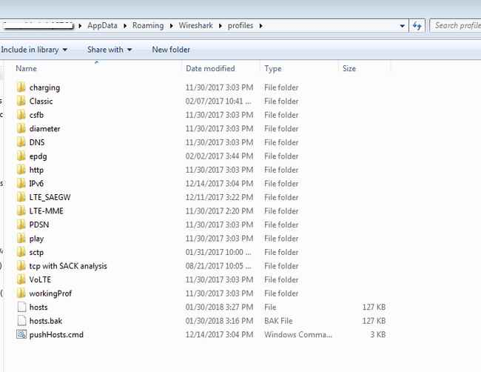
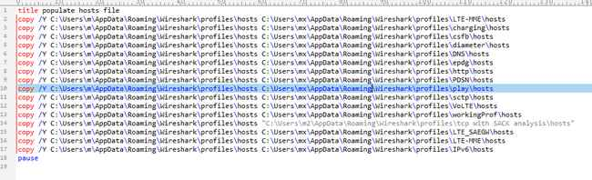
Use a common host file, and distribute to all my profiles using a batch file

Slide 40
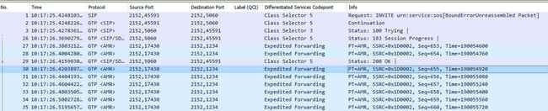
IMS / Volte
Volte is really nothing more that SIP/RTP (VoIP) over LTE with a guaranteed bearer and more favorable DSCP markers on the packet.
Most tools for SIP will work with trouble shooting Volte

Slide 41
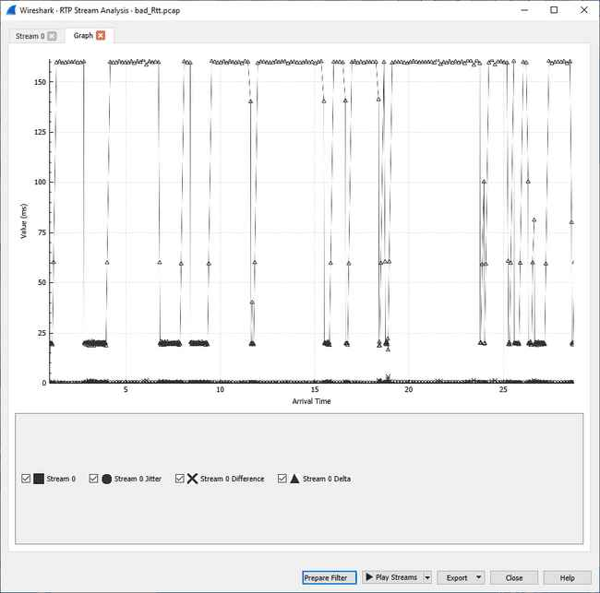
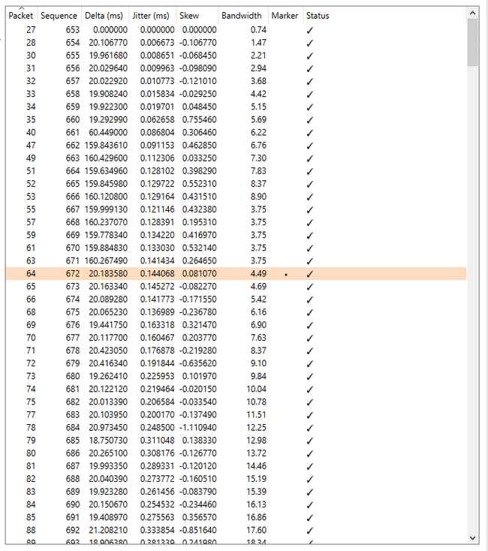
RTP Stream Analysis
A quick view into the nature, and timing of RTP packets.
Knowing your RTP timers help when using these tools.
Example; I know in this case active conversation packets are 20ms, and silent packets are 160ms

Slide 42
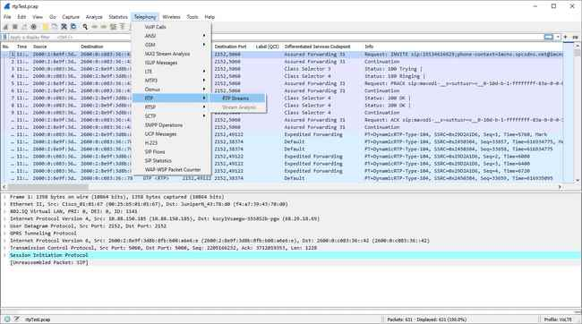

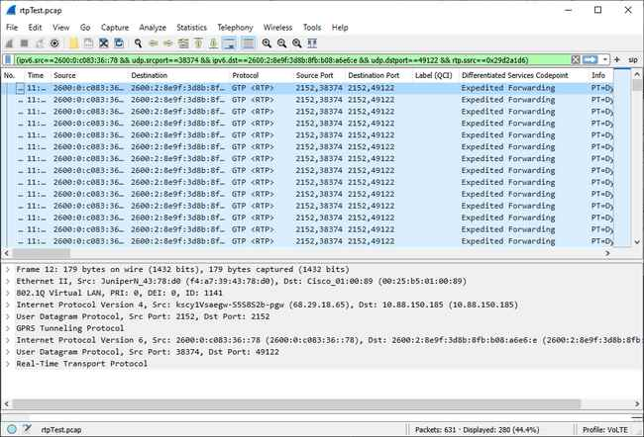
IO Graph for jitter/packet arrival
1
2
3
Find all RTP streams in the capture.
Pick one side of the stream you are looking for, then click “Find Reverse”.
Click “Prepare Filter”.
Go back to Wireshark main screen, and click the arrow in the display filter portion, to execute the filtering of the streams.
4

Slide 43
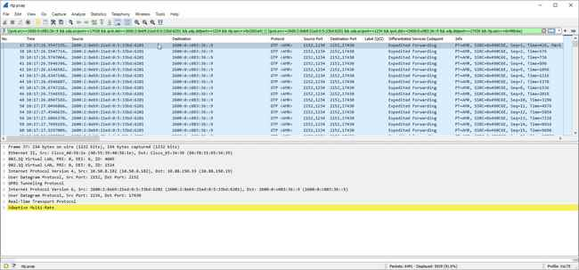
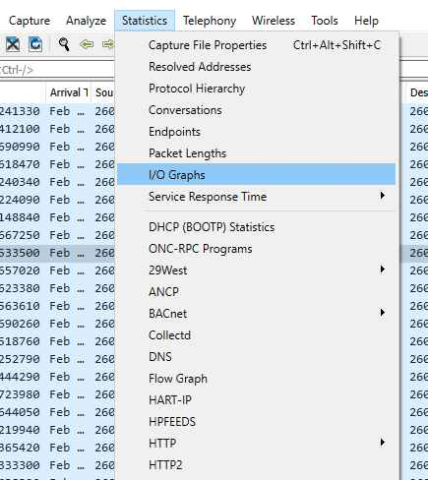
Note the left and right sides of the || operator

Slide 44
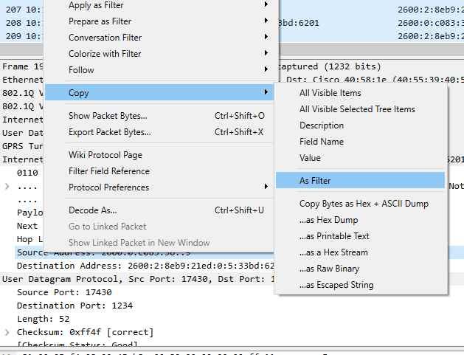
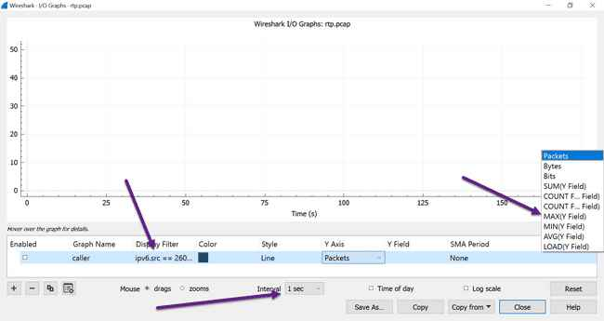
Open IO Graph
We know RTP active packet time is 20ms, so we’ll set interval to 1ms.
Our Y field will be udp.time_delta which will give us time of arrival delta between each packet that matches our display filter
To get display filter expression
CTRL-V or
Left side of conversation filter

Slide 45
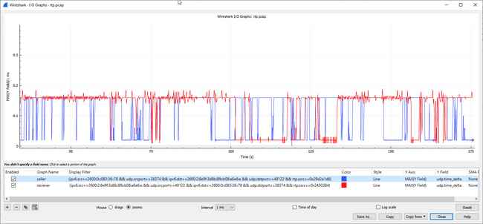
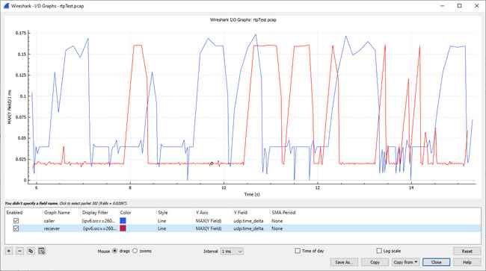
Left graph depicts what we expect to see. That is 20ms time on active packets, and 160ms on silent packets. Using this graph you can tell who was speaking during this conversation.
Right graph is showing the Caller with an active call time at 40ms instead of 20ms, with spikes down to 0ms. Hmm.

Slide 46
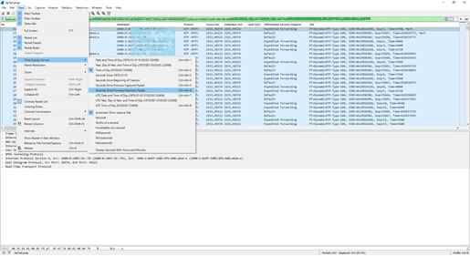
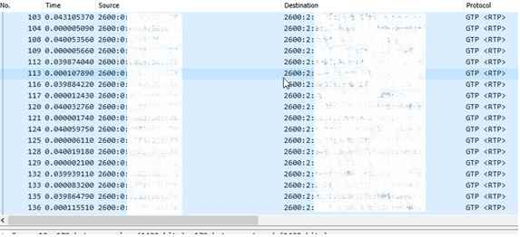
Set time format to “seconds since previous displayed packet”
Adjust display filter to just show caller.
We can now see that the caller sends 2 packets every 40ms. That is one at the 40ms mark, then another one within the same sub-millisecond.
??
This was found to be uplink packet time scheduling on the eNodeB. Packets could only be requested on the 40ms timeslot. So UE would send 2 at a time.

Slide 47
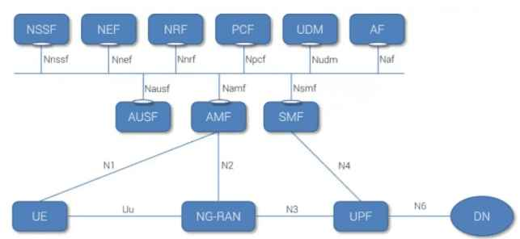
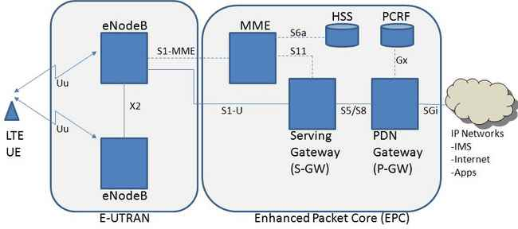
4G to 5G
What was combined functions on 4G have now been separated, and segregated into their own network functions
Functions are now treated like services, and can be called upon with API like queries.

Slide 48
NETWORK FUNCTIONS
Access and Mobility Management function (AMF) supports: Termination of NAS signaling, NAS ciphering & integrity protection, registration management, connection management, mobility management, access authentication and authorization, security context management. (AMF has part of the MME functionality from EPC world)
Session Management function (SMF) supports: session management (session establishment, modification, release), UE IP address allocation & management, DHCP functions, termination of NAS signaling related to session management, DL data notification, traffic steering configuration for UPF for proper traffic routing. (SMF has part of the MME and PGW functionality from EPC world)
User plane function (UPF) supports: packet routing & forwarding, packet inspection, QoS handling, acts as external PDU session point of interconnect to Data Network (DN), and is an anchor point for intra- & inter-RAT mobility. (UPF has part of the SGW & PGW functionality from EPC world)
Policy Control Function (PCF) supports: unified policy framework, providing policy rules to CP functions, access subscription information for policy decisions in UDR. (PCF has part of the PCRF functionality from EPC world)
Authentication Server Function (AUSF) acts as an authentication server. (part of HSS from EPC world)
Unified Data Management (UDM) supports: generation of Authentication and Key Agreement (AKA) credentials, user identification handling, access authorization, subscription management. (part of HSS functionality from EPC world)
Application Function (AF) supports: application influence on traffic routing, accessing NEF, interaction with policy framework for policy control. (same as AF in EPC world)
Network Exposure function (NEF) supports: exposure of capabilities and events, secure provision of information from external application to 3GPP network, translation of internal/external information. (not present in EPC world)
NF Repository function (NRF) supports: service discovery function, maintains NF profile and available NF instances. (not present in EPC world)
Network Slice Selection Function (NSSF) supports: selecting of the Network Slice instances to serve the UE, determining the allowed NSSAI, determining the AMF set to be used to serve the UE. (not present in EPC world)

Slide 49
User plane protocols unchanged
The highlighted part still uses GTP, like the previous 4G slides

Slide 50
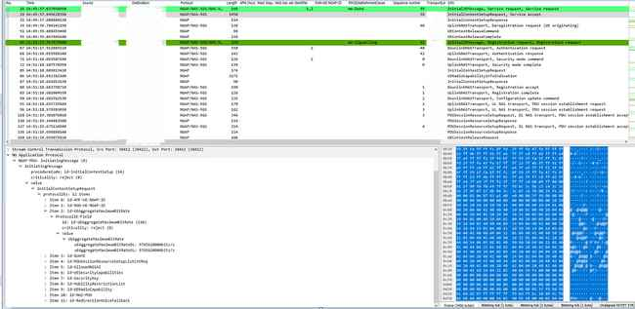
RAN Signaling
S1AP has changed to NGAP, but is the same type of informational elements, just more
Also is still on top of SCTP

Slide 51
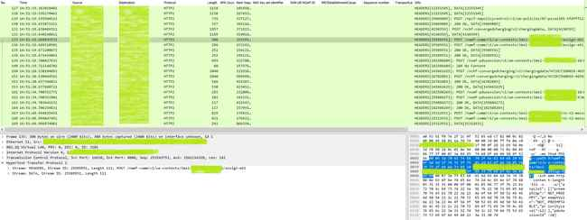
Core signaling over http2
4G diameter interfaces have now become JSON over HTTP2 (API like queries)

Slide 52
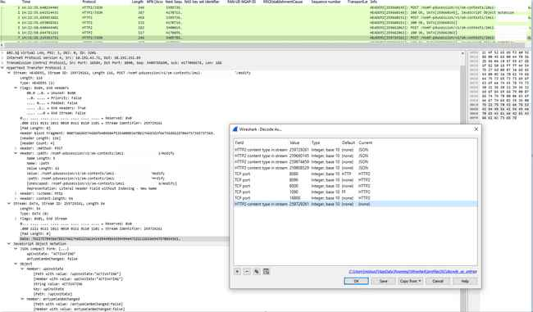
HTTP2 information
Must have wireshark 3.4 or greater
Decode As: HTTP2 content type in stream, enter value, and set as JSON
Currently must be done
  for each stream ID

Slide 53

JSON over HTTP2
Current WS versions require you to filter like this
This is not great, because it doesn’t match a key value pair.
So any key with a value of “ACTIVATING” could be
matched, as long as the key upCnxState exist.
Development version allows for absolute filters
While this allows for more exact filtering, there is still work to be done.

Slide 54
LUA dissector pt1
Provided to you:
  tvb: Protocol data access
  pinfo: Packet meta-info
  tree: detail tree
You provide:
  Header info

Slide 55


LUA dissector pt2
-- Append "NAT64" address to the Info column with a post-dissector, and create it's own tree.
-- create a new protocol so we can register a post-dissector
local myproto = Proto("nat64","NAT 64 encapsulated IPv4")
-- create a new field so we can assign that to the Proto
myproto_source = ProtoField.string("nat64.ipv4", "IPv4 Address")
-- Assign field to the proto object.
myproto.fields = { myproto_source }
-- register our new dummy protocol for post-dissection
register_postdissector(myproto)
--local nat64_field = Field
-- the dissector function callback
function myproto.dissector(tvb,pinfo,tree)
--
end

Slide 56


LUA dissector pt3
function myproto.dissector(tvb,pinfo,tree)
local dest = tostring(pinfo.dst)
local source = tostring(pinfo.src)
if string.find(dest, "7700") then
first, second = string.match(dest, "%d+:%d+:%d+:%d+:%d+:%d+:(.*):(.*)$")
firstOct, secondOct = string.match(first, "(..)(.+)")
thirdOct, fourthOct = string.match(second, "(..)(.+)")
ipv4Address = tonumber(firstOct, 16) .. "." .. tonumber(secondOct,16) .. "." .. tonumber(thirdOct,16) .. "." .. tonumber(fourthOct,16)
pinfo.cols.info:append( " NAT64 " .. tonumber(firstOct, 16) .. "." .. tonumber(secondOct,16) .. "." .. tonumber(thirdOct,16) .. "." .. tonumber(fourthOct,16))
local subtree = tree:add(myproto,tvb(), "NAT64 v4")
subtree:add(myproto_source, ipv4Address)
--repeat for source
else
end

Slide 57
-- Append "NAT64" address to the Info column with a post-dissector, and create it's own tree.
-- create a new protocol so we can register a post-dissector
local myproto = Proto("nat64Test","NAT1 64 encapsulated IPv4")
myproto_source = ProtoField.string("nat64.ipv4", "IPv4 Address")
myproto.fields = { myproto_source }
-- the dissector function callback
function myproto.dissector(tvb,pinfo,tree)
local dest = tostring(pinfo.dst)
local source = tostring(pinfo.src)
if string.find(dest, "7700") then
first, second = string.match(dest, "%d+:%d+:%d+:%d+:%d+:%d+:(.*):(.*)$")
firstOct, secondOct = string.match(first, "(..)(.+)")
thirdOct, fourthOct = string.match(second, "(..)(.+)")
ipv4Address = tonumber(firstOct, 16) .. "." .. tonumber(secondOct,16) .. "." .. tonumber(thirdOct,16) .. "." .. tonumber(fourthOct,16)
pinfo.cols.info:append( " NAT64 " .. tonumber(firstOct, 16) .. "." .. tonumber(secondOct,16) .. "." .. tonumber(thirdOct,16) .. "." .. tonumber(fourthOct,16))
local subtree = tree:add(myproto,tvb(), "NAT64 v4")
subtree:add(myproto_source, ipv4Address)
elseif string.find(source, "7700") then
first, second = string.match(source, "%d+:%d+:%d+:%d+:%d+:%d+:(.*):(.*)$")
firstOct, secondOct = string.match(first, "(..)(.+)")
thirdOct, fourthOct = string.match(second, "(..)(.+)")
ipv4Address = tonumber(firstOct, 16) .. "." .. tonumber(secondOct,16) .. "." .. tonumber(thirdOct,16) .. "." .. tonumber(fourthOct,16)
pinfo.cols.info:append( " NAT64 " .. tonumber(firstOct, 16) .. "." .. tonumber(secondOct,16) .. "." .. tonumber(thirdOct,16) .. "." .. tonumber(fourthOct,16))
local subtree = tree:add(myproto,tvb(), "NAT64 v4")
subtree:add(myproto_source, ipv4Address)
else
end
end
-- register our new dummy protocol for post-dissection
register_postdissector(myproto)

Slide 58


Slide 59

Contact: Mark.stout@markstout.com
Scan for feedback

