Slide 1

www.tinyurl.com/kwvs4n
Network Forensics:
Wireshark as Evidence Collector
Laura Chappell
Founder, Wireshark University
http://www.wiresharktraining.com | laura@wiresharktraining.com
Presenter, Wireshark Jumpstart Series
http://www.chappellseminars.com | laura@chappellseminars.com
SHARKFEST '09
Stanford University
June 15th, 2009 10:45-12:15
Wireshark is divine!

Slide 2
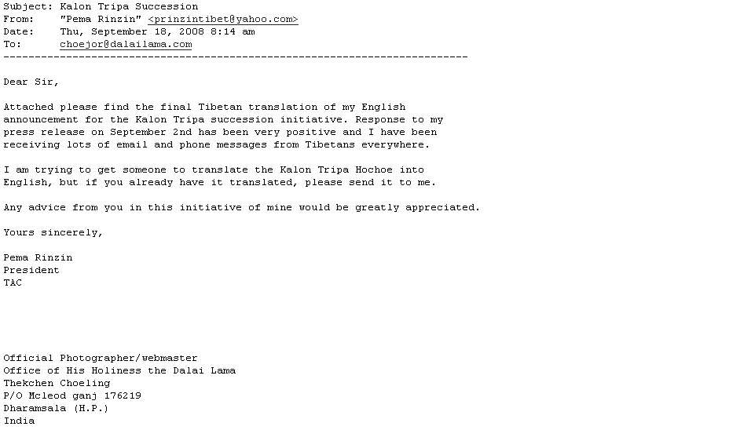
The OHHDL Case
Planting the Seed of Social Malware

Slide 3

Another Case of Interest
Here’s your sense of false security… Enjoy your stay.
Thank goodness they have WEP on this WLAN!

Slide 4
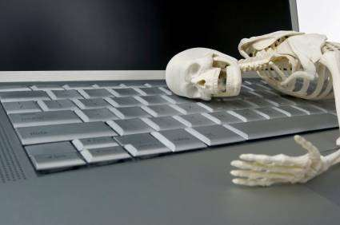
In this Session
Network Forensics 101
Evidence of Reconnaissance
Evidence of Breaches
LIVE ANALYSIS

Slide 5


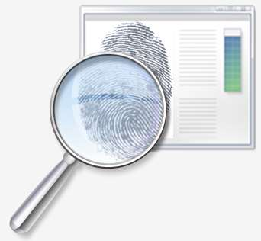



Evidence of Reconnaissance
TCP scans (excessive RSTs)
UDP scans (excessive ICMP Type 3/Code 3)
IP scans (excessive ICMP Type 3/Code 2)
OS
fingerprinting
(ICMP type 13, 15 and 17)
Address scans (‘dark IP’ or ‘dark MAC’ hits)
Application scans (unusual responses)

Slide 6
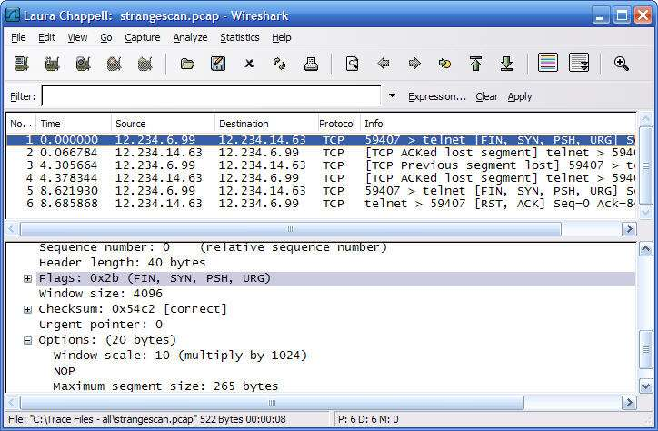

Evidence of Breaches
Unusual communication pairs
Unusual protocols and ports
Excessive failed connections
Unusual inbound connections
Check out…
Statistics > Protocol Hierarchies
Statistics > Conversations
Filter on DNS
Filter on ICMP
Unusual outbound connections
Peer-to-peer traffic paths

Slide 7
Now…
Enough of this slide stuff…

Slide 8
Links
High Technology Crime Investigation Association
  http://www.htcia.org
Snooping Dragon Report
  http://www.cl.cam.ac.uk/techreports/UCAM-CL-TR-746.pdf
Hacked Hosts: Network Forensics
  http://www.chappellseminars.com/s-hackedhosts.html
Yes – I tweet – “laurachappell”
Yes – I blog - feeds2.feedburner.com/InsideLaurasLab
Yes – I Facebook – “laurachappell”

Slide 9
Thank You!
Check out Laura’s live seminars at chappellseminars.com.
Help us spread the word!
Thanks!

