Slide 1
http://tinyurl.com/kwvs4n
Tips and Tricks:
Case Studies
Laura Chappell
Founder, Wireshark University
http://www.wiresharktraining.com | laura@wiresharktraining.com
Presenter, Wireshark Jumpstart Series
http://www.chappellseminars.com | laura@chappellseminars.com
SHARKFEST '09
Stanford University
June 15th, 2009 10:45-12:15

Slide 2

In this Session
Attacking Enterprise Problems
The Case of the Lousy Latency

Slide 3
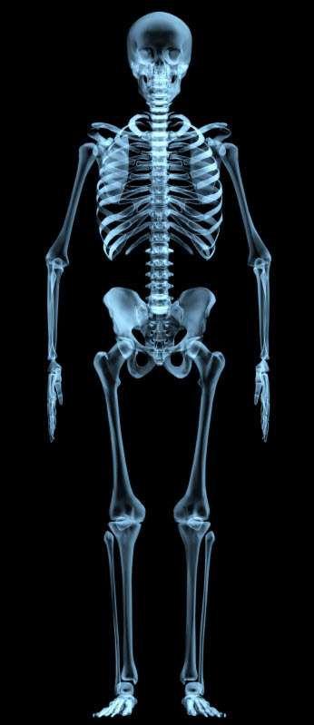
Where’s the Problem?

Slide 4

Packet Pigs

Slide 5
The Case of the Lousy Latency
Video-based application requires consistent availability of 20 Mbps throughput to run properly.
The latency is measured at 100ms.
It looks terrible now.

Slide 6
Tcp1323Opts
HKEY_LOCAL_MACHINE\SYSTEM\CurrentControlSet\Services\Tcpip\
Parameters
Add a new Registry DWORD for Tcp1323Opts
Tcp1323Opts
Key: Tcpip\Parameters
Value Type: REG_DWORD—number (flags)
Valid Range: 0, 1, 2, 3
0 (disable RFC 1323 options)
1 (window scaling enabled only)
2 (timestamps enabled only)
3 (both options enabled)
Default: No value.

Slide 7
TcpWindowSize
Key: Tcpip\Parameters
Value Type: REG_DWORD—Number of bytes
Valid Range: 0–0x3FFFFFFF (1073741823 decimal; however, values greater than 64 KB can only be achieved when connecting to other systems that support RFC 1323 window scaling)
Default: This parameter does not exist by default.

Slide 8
Calculating
Bandwidth*Delay Product
Bandwidth*delay product:
    measures amount of data that will fill the pipe
    defines the buffer space at sender and receiver to gain maximum throughput on the TCP connection over the path
    defines the amount of unacknowledged data TCP must handle to keep pipe full
100 (Mbps)
x 0.1 (RTT)
10 Mb
Convert to bytes:
10,000,000/8 = 1,250,000
~The optimal send/receive buffer sizes are 1.5*BDP (or 1,875,000 bytes)

Slide 9


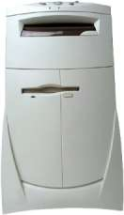
The iPerf Lab Test
The Effects of Latency, TCP Receive Window Size and Window Scaling
Network 10.0.0.x/24
Network 10.10.0.0/16
10.0.0.6
10.10.0.99
Router
iperf –c 10.10.0.99
iperf –s

Slide 10
Lab Test Results:
Throughput/Scaling Relationship
Lab Test | Delay | A: 1323 On B: rWin-1,875,000 | iperf –s rWin at 1,875,000 | iperf –c rWin at 1,875,000 | Results
#1: Local iPerf |  |  |  |  | 94.5, 90, 92, 94, 94

Slide 11
Lab Test Results:
Throughput/Scaling Relationship
Lab Test | Delay | A: 1323 On B: rWin-1,875,000 | iperf –s rWin at 1,875,000 | iperf –c rWin at 1,875,000 | Results
#1: Local iPerf |  |  |  |  | 94.5, 90, 92, 94, 94
#2: iPerf at 100ms delay | 100 ms |  |  |  | 4.6, 4.8, 4.58, 4.61, 4.62

Slide 12
Lab Test Results:
Throughput/Scaling Relationship
Lab Test | Delay | A: 1323 On B: rWin-1,875,000 | iperf –s rWin at 1,875,000 | iperf –c rWin at 1,875,000 | Results
#1: Local iPerf |  |  |  |  | 94.5, 90, 92, 94, 94
#2: iPerf at 100ms delay | 100 ms |  |  |  | 4.6, 4.8, 4.58, 4.61, 4.62
#3: iPerf w/delay + reg change | 100 ms | Reg sets (x32) 1323 on 1,875,000 rWin |  |  | 5.6, 4.6, 4.7, 4.7, 4.7
Enabled Window Scaling and increased
rWin Setting at operating system (XP)

Slide 13
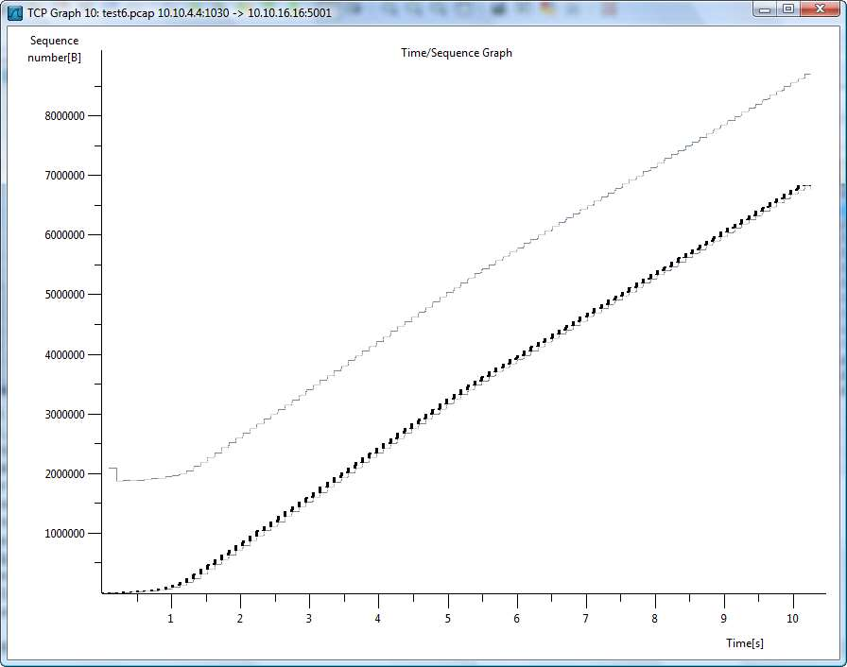
Application not taking
advantage of maximum
rWin value

Slide 14
Lab Test Results:
Throughput/Scaling Relationship
Lab Test | Delay | A: 1323 On B: rWin-1,875,000 | iperf –s rWin at 1,875,000 | iperf –c rWin at 1,875,000 | Results
#6: iPerf to 10.10.16.16 w/delay + rWin at receiver set | 100 ms | “ | Receive window (-w) set at 1,875,000 |  | 5.0

Slide 15
Lab Test Results:
Throughput/Scaling Relationship
Lab Test Results:
Throughput/Scaling Relationship
Lab Test | Delay | A: 1323 On B: rWin-1,875,000 | iperf –s rWin at 1,875,000 | iperf –c rWin at 1,875,000 | Results
#6: iPerf to 10.10.16.16 w/delay + rWin at receiver set | 100 ms | “ | Receive window (-w) set at 1,875,000 |  | 5.0
#7: iPerf to 10:10:16:16 w/delay + rWin at receiver set | 100 ms | “ | “ | Sender window (-w) set at 1,875,000 | 77.6

Slide 16
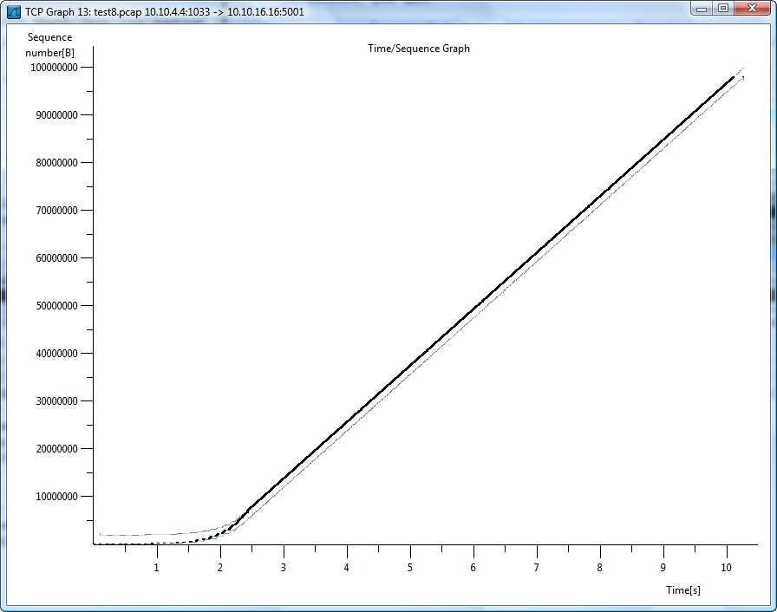
Application optimized
for maximum rWin values

Slide 17
Lab Test Results:
Throughput/Scaling Relationship
Lab Test Results:
Throughput/Scaling Relationship
Lab Test | Delay | A: 1323 On B: rWin-1,875,000 | iperf –s rWin at 1,875,000 | iperf –c rWin at 1,875,000 | Results
#6: iPerf to 10.10.16.16 w/delay + rWin at receiver set | 100 ms | “ | Receive window (-w) set at 1,875,000 |  | 5.0
#7: iPerf to 10:10:16:16 w/delay + rWin at receiver set | 100 ms | “ | “ | Sender window (-w) set at 1,875,000 | 77.6
#8: iPerf to 10:10:16:16 w/delay – satellite link speed simulation | 800 ms | “ | “ | “ | 1.2

Slide 18
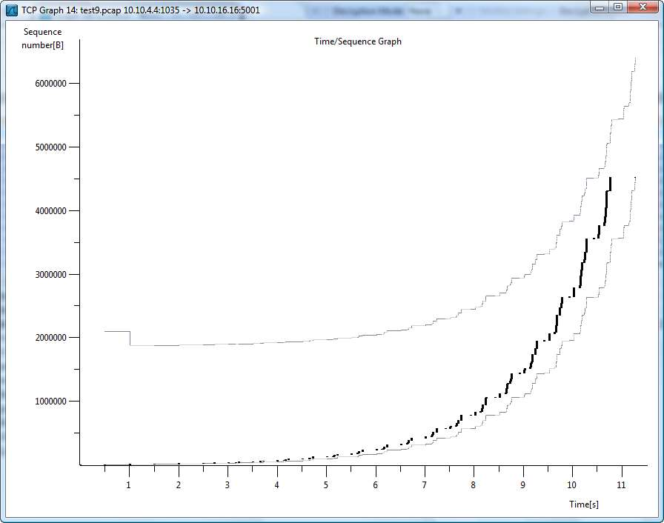
Satellite Simulation

Slide 19

The Case of the Sputtering Stream
Network Forensics 101
Evidence of Reconnaissance
Evidence of Breaches
LIVE ANALYSIS

Slide 20
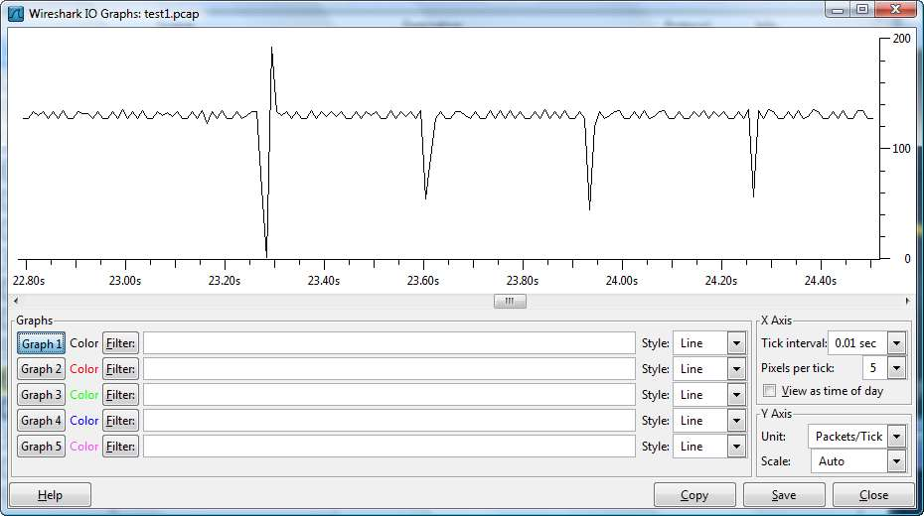
Path Issues - Who’s “Special?”
Sent through Queue
Held
in Queue
Dropped by Queue

Slide 21
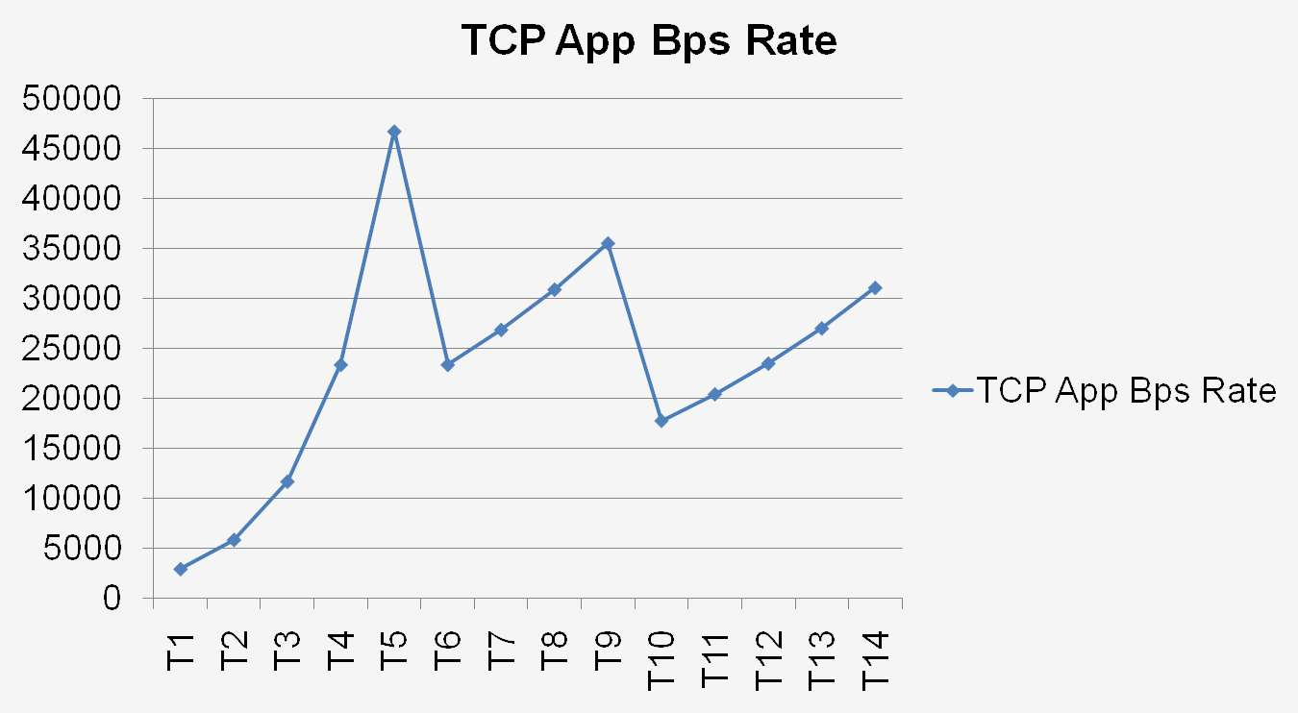
TCP Packet Loss
Notes:
Suspicions
Whether confirmed or unconfirmed, it is these suspicions that launch the exam and investigation process – the trigger per se.
Forensic Exam
DON’T bury the body. If you walked in to a crime scene where a dead body lay on the floor with a knife sticking out of its body, you wouldn’t put the knife in the dishwasher, bury the body and hose down the blood spatter from the walls. Common knowledge of forensic evidence collection indicates this would be a bad process. Well… in the digital world, we must collect evidence in order to learn what is happening/what happened. Don’t reimage a drive until you image it for a forensic exam. Don’t overwrite log files. Don’t ignore the network traffic.
Investigation
Ahh… now we’re getting into the meaty part. Now we’re ready to take the evidence collected and begin the investigation process. But first… who is the investigator?

Slide 22
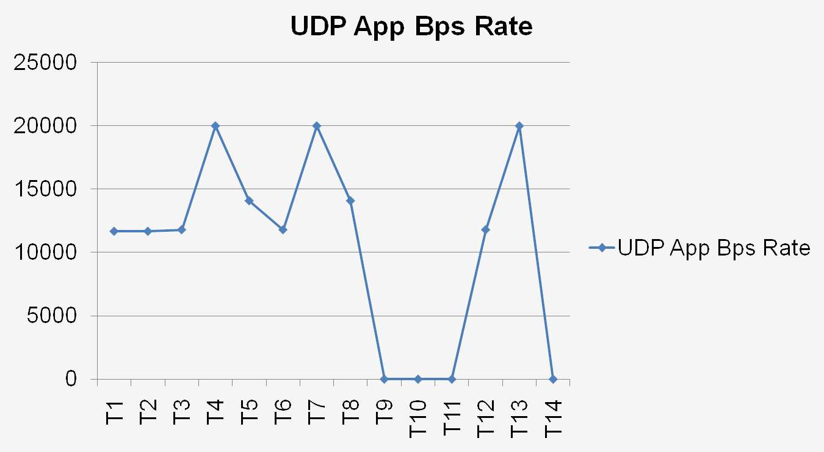
UDP: In the Hands of the Developers
Notes:
Suspicions
Whether confirmed or unconfirmed, it is these suspicions that launch the exam and investigation process – the trigger per se.
Forensic Exam
DON’T bury the body. If you walked in to a crime scene where a dead body lay on the floor with a knife sticking out of its body, you wouldn’t put the knife in the dishwasher, bury the body and hose down the blood spatter from the walls. Common knowledge of forensic evidence collection indicates this would be a bad process. Well… in the digital world, we must collect evidence in order to learn what is happening/what happened. Don’t reimage a drive until you image it for a forensic exam. Don’t overwrite log files. Don’t ignore the network traffic.
Investigation
Ahh… now we’re getting into the meaty part. Now we’re ready to take the evidence collected and begin the investigation process. But first… who is the investigator?

Slide 23

HOT in the Enterprise
Bad cops
are
everywhere!

Slide 24
Now…
Enough of this slide stuff…

Slide 25
Links
Wireshark Weekly Tips
  http://www.wiresharktraining.com/tips.html
Bandwidth*Delay Product Calculator
  http://www.speedguide.net/bdp.php
Yes – I tweet – “laurachappell”
Yes – I blog - feeds2.feedburner.com/InsideLaurasLab
Yes – I Facebook – “laurachappell”

Slide 26
Thank You!
Check out Laura’s live seminars at chappellseminars.com.
Help us spread the word!
Thanks!

