Slide 1
The Reality of 10G Analysis
Presented by: Network Critical
Wednesday, June 17th, 2009
1:30 pm – 3:00 pm

Slide 2
Overview
What are the challenges of managing 10 Gig links?
How can we overcome these challenges?
How can I use WireShark at 10 Gig?
SmartNA 10G Filtering Aggregating TAP
Notes:
Ask questions
Who is 10G?
Who is at 1G?
Do you know how much traffic is on you links?
How do get that information?
(likely answer will be router or switch….cumulative averages…not granular enough?)

Slide 3
10 Gbps is a LOT of Data
10,000,000,000 bps
Ten billion bits per second
~2.4 Million packets per second of 1,024 byte packets
1,197,000+ per direction
~29 Million packets per second of 64 byte packets
14,880,000+ packets per second per direction
Notes:
These numbers are one way…a duplex link doubles these numbers. At 64 byte packets almost 30 Million packets per second…. So if you are having issues at 1G…how do you think it will work at 10g….

Slide 4
Challenges and Limitations
Capture devices do not keep up with 10G traffic
Limited capture bandwidth
Custom NICs are EXPENSIVE and still dropping packets under load
No real-time information
10G monitoring tools are very expensive
e.g. ranging from $50K to $150K and beyond
Notes:
This translates to critical information being lost – dropped packets on the capture side… simply can not capture at 10G… Very expensive…You need 1.25 Gigabytes of memory for each second of buffer…so you can not get all the packets in the capture file…then you can not open the file correctly. Bottom line is that these tools can not scale to 10G per second.. Better to capture the needle rather than capture the hay stack and then look for the needle.
The point here is that you want to make your 10G tools work more efficiently…or be able to take advantage of less expensive monitoring options such as Wireshark.

Slide 5
WireShark on a Laptop? … Good, But
WireShark on a laptop is invaluable ☺
But performance of receive, capture and analysis is limited
10Gbps link would exhaust the memory in a second … ☹
Not strong enough to sustain capturing and analysis at high rate
Notes:
Laptops are limited to packet processing…can not handle 10G speeds…large packet capture files 200Mbps will take minutes to open..files can be gig in size. Laptops can not even manage 1Gigps of data…like trying to plug a fiber into a laptop…it is simply not designed for massive amounts of data.
Summary…Current tools can not manage 1G and 10G duplex data links. So now what?

Slide 6
Simple and Effective Solution
Limit your WireSharking to relevant traffic subset only
Selectively filter according to header fields AND payload content as needed
On-the-fly second by second visibility to network behavior and Key Performance Indicators
Intuitive graphs and visualization

Slide 7
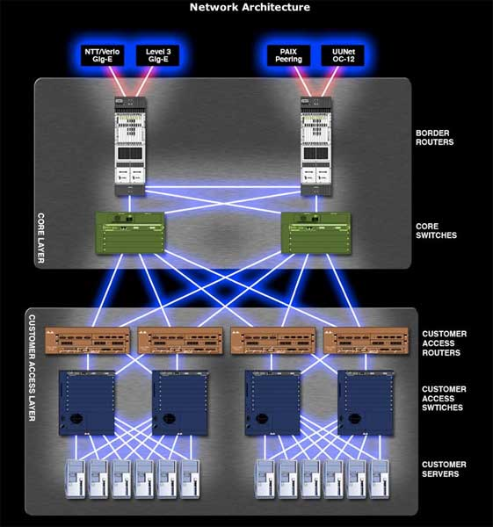
How Well Do You Know Your Network?
Are your 10G links fully utilized?
What types of traffic are dominant?
How about spikes and micro-bursts?
Can you analyze every bit or event today?
How do you access data remotely?
WireShark can’t handle 10 Gbps of data
"If you can not measure it, you can not improve it“ - Lord Kelvin
Notes:
“How will you…” variety – i.e. “How will you know when your 10G links are fully utilized?” , “How can you drill down on only the traffic of interest from a 10G link?” etc…
Wireshark on a PC max capacity…100M using Tshark application (command line).

Slide 8
How to Get the Relevant Traffic?
Built-in access to network traffic is essential
How do you pull out network traffic
TAP (traffic access point)
SPAN/mirror port
But you need only the relevant network traffic …
Feed WireShark only filtered traffic
Notes:
Goes to the point that all the data is not good…can’t handle it….too little data is not good…missing important information…need access to all the relevant data… all the time.

Slide 9
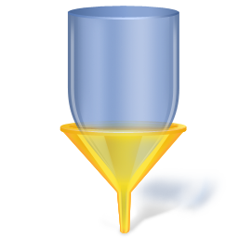
Flexible Filtering at 10 Gigabits
Filter by:
MAC addresses
VLAN ranges
IP address ranges
Protocol types
QoS level
Port ranges
Advanced pattern matching (Layer 2-7)
Notes:
You need to have access to all the data…then filter to relevant data…full packet inspection

Slide 10
Easy-to-use, Exact, Guaranteed
True parsing of the protocol header stack
Automatic header skipping
Flexible Complete Packet Inspection filters
Non-anchored/anchored patterns
Case sensitive/insensitive searches
Easy incremental provisioning
Simple browser form and a command line
Notes:
Easy, precise, guaranteed
Anchored example… flexibility…non-anchored…info can be anywhere in the packet and be found. If you only look at first 128 bytes,,, you will not find the info you want.
Dynamic…starts at the click right now…incremental you can add parameters to search as you go along
true parsing of protocol header stack…supports arbitrary subnets and port ranges…correct parsing of chained VLAN tags, IP option, TCP option
We can search anywhere in the payload…anchored, non-anchored
Rather than filter on first 128 bytes, we can look at the entire packet including payload.
Pattern Search with wild cards inside the packet down to the last byte
Simple web browser interface…no disruption to currently active profiles during update

Slide 11
Flexible Filtering, Mirroring, Bandwidth Reduction
MONITORING
OUTPUT
MANAGEMENT
CONTROL
PAD
POWER
LINK/ACTIVITY
STATUS
DISPLAY
Two 10Gbps full-duplex Data Interfaces (A and B)
Two Transmit-only 10 Gbps Duplicate Interfaces (1 and 2)
Two Transmit-only 1Gbps Duplicate Interfaces (3 and 4)
Aggregation, reduction, time stamping (μS), and forwarding over UDP
One management/configuration interface for provisioning and reports
Notes:
LC duplex cable for TAP ports is standard.
Aggregate monitor port is receive only to tool.

Slide 12
Key Features
Smart TAP: Two 10 GigE data + two 10G dup + two 1G dup
Integrated fiber bypass - zero risk passive deployment in line
Duplicating and filtering traffic to 10G and 1G “smart ports”
Bandwidth reduction and remote forwarding of specific traffic
Selective filtering according to headers and payload patterns
True packet header parsing and pattern search anywhere in payload
Microsecond accurate time stamp for delay & jitter analysis
Notes:
Remote forwarding…tool does not need to be co-located with tap…we provide a utility you can load on your laptop that will accept the information and load it into Wireshark.
Packet parsing is intelligent inspection knowing protocols and locations of information in the packet header

Slide 13
Key Features
Visualization, aggregation, and correlation of performance info
Second by second network behavioral information
Performance metrics – not just raw packets
Burst capture
Sample packets and retrieve as pcap from any web browser
Narrow down on specific packet types as necessary
Detailed and 100% accurate counters of packets and bytes
Accurate performance break-down at one second resolution

Slide 14
SmartNA TAP Deployment
Notes:
This graphic shows how the 10G filtering tap is connected to the network.

Slide 15
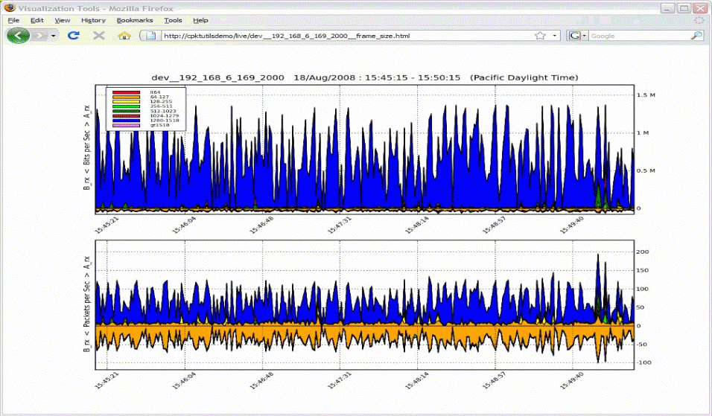
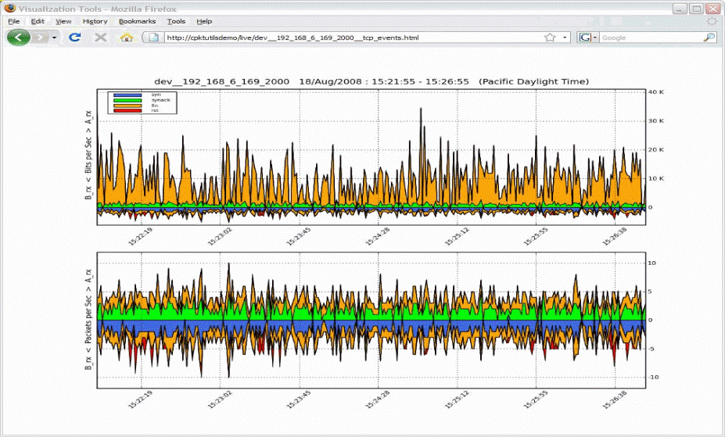
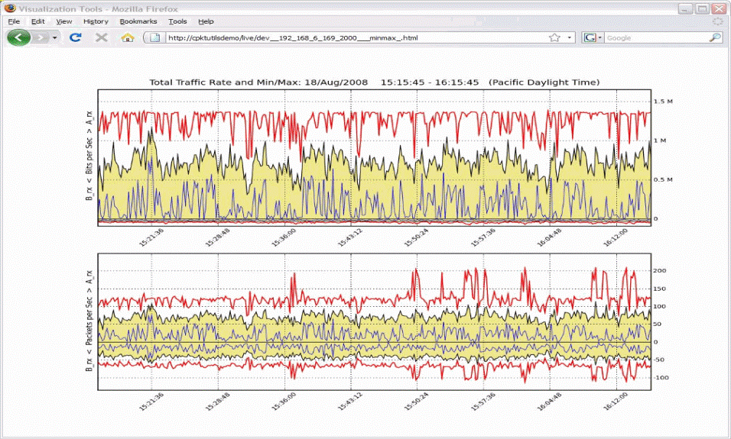
Performance Visualization and Behavioral Analysis
Performance monitoring on-the-fly
Aggregation, correlation, visualization
Built-in and user-defined graphs
Export data in CSV to Excel, SQL, …
View remotely over web browser

Slide 16
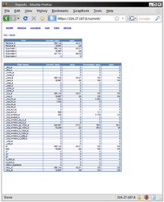
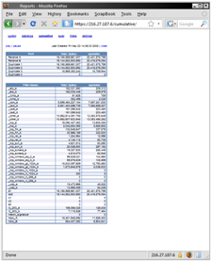
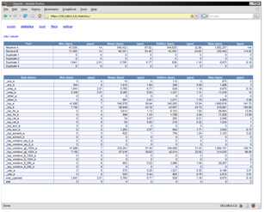
SmartNA 10G TAP
Web-based reporting with detailed counters and statistics
Current, statistical (min, max, mean, std dev), cumulative
All counters accurate to the bit
30 Built-in profiles and 16 user-defined profiles
Break down to major protocol groups, TCP events, TCP window sizes

Slide 17
Example: Filtering & Duplicating Specific Traffic
Example: filter incoming web traffic (from port 80) to subnet 192.168.10.0/24 and duplicate from Live Port A to Duplicate Port 1
Open simple form by pointing Web browser to cTap management IP address
Define subnet filter is IPv4 destination by using CIDR mask (192.168.10.0/24)
Select TCP protocol from pull down and set sport to 80
Activate filter and monitor rate of packets and bytes matching the profile

Slide 18
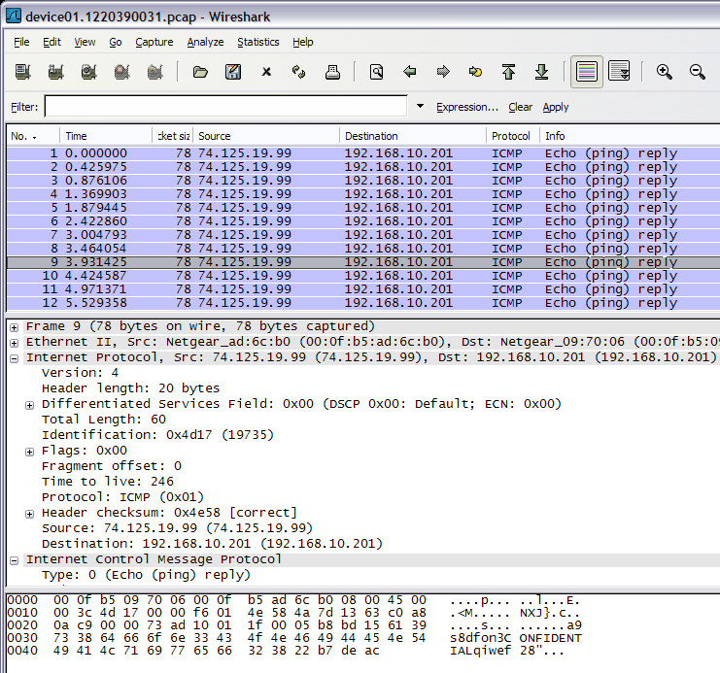
Example: On-the-Fly Pattern Search at 10G Line Rate
Simple web browser configuration
Select string match template
Set payload field to “confidential”
Select IGNORECASE (case insensitive)
Activate the filter
Monitor rate of packets and bytes matching the profile

Slide 19
Example: need to filter all packets with “Confidential” in payload based on pattern search

