Slide 1
Advanced Threat Intelligence and Session Analysis
Tim Belcher, CTO

Slide 2
Agenda
NetWitness Company Overview
A brief overview of the current cyber threat environment and what’s missing today in computer network defense
NetWitness: Better situational awareness, operational, automated network forensics, and knowing what’s really happening on your network
Technology illustrations and specific use cases
Final thoughts and open discussion

Slide 3
NetWitness Company Overview
Founded in 2006, HQ in Herndon VA
NetWitness provides an enterprise-class, distributed, full-packet capture infrastructure performing the most advanced, real-time network forensics and analytics available today
NetWitness gives security experts situational awareness and definitive answers to the most complex network security questions
NetWitness has the agility to adapt to the changing threat landscape and rapidly integrates with existing third party, network centric security management technologies
NetWitness is trusted by over 30,000 security experts in 5,000 organizations in 128 countries
95 employees; Small business status
Cleared Personnel, All developers are U.S. Citizens
All code developed in the U.S.
Privately held, 7 straight quarters of profitability
Two U.S. patents, with others pending
Executive Leadership Team with strong security DNA and start-up experience
Amit Yoran-CEO
Tim Belcher-CTO
Eddie Schwartz-CSO
Notes:
Elevator Pitch- 30 seconds
In two sentences describe at its core what your technology does and why its better/different. This slide is your chance to capture the attention of the audience or not. Our attendees are sophisticated and have been slide show’d to death. If you can start by clearly, concisely and compellingly capturing the core competency and value proposition of your project, the engagement with the audience will improve dramatically.
What not to do:
Use hyperbole to self proclaim your product/service as the greatest thing since sliced bread
Fail to include the value to the customers/users
Fill the screen with words. The shorter the better

Slide 4
The Threat Landscape
Time to Change the Way We Do Things

Slide 5
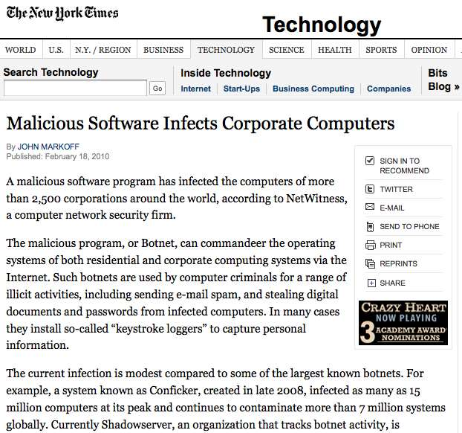
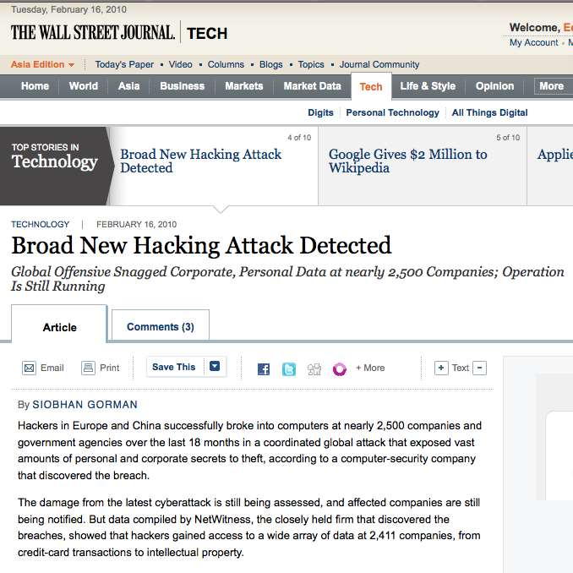
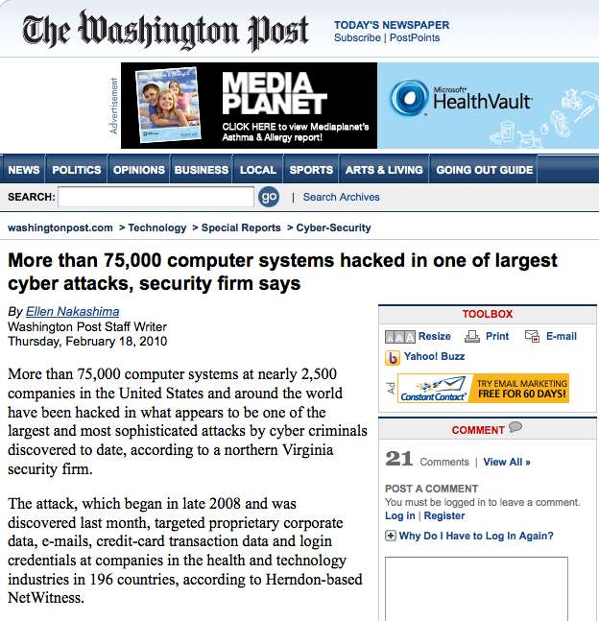
Which Security Teams Do Not Have Problems?

Slide 6
The Top Threats Are Not Preventable
Spear phishing attacks
Poisoned websites and DNS – “Drive-by” attacks
Pervasive botnet infection (e.g., ZeuS / Gumblar / Storm 2.0)
Malware….
Social Networking / Mobility / Web 2.0
Cloud Computing
Undetected data exfiltration
Product Vulnerabilities (e.g. Adobe, Microsoft, Oracle )
The Bottom Line
Threats are already on the inside
Exploits that matter have already happened

Slide 7
The Global Threat Landscape
Electronic Criminal Groups: Established Underground Industry (continued examples of successful large scale operations)
Organization: Low to High
Capability: Medium to High
Intent: High for financial gain, but intent is complex
“Kneber” ZeuS BotNet – information sold to anybody
Nation-Sponsored Activities: From Intelligence Gathering to Network-Centric Warfare
Organization: High
Capability: High
Intent: Connected to national policy
Aurora, Titan Rain, etc.
Non-State Actors
Increasing interest from radical / extremist groups in cyberterror
“Hacking as a service”

Slide 8
What Do Our Clients and Prospects See?
Nation-sponsored attacks on anything (critical infrastructure, defense industry base, etc.)
Designer malware directed at end users through spear phishing attacks
Covert network channels and obfuscated network traffic
Low and slow data exfiltration
Rogue encryption
Organized criminal group attacks
Insertion of rogue code into retail POS, wire transfer, and ATM systems
Infiltration of transaction processing systems in critical infrastructure sectors
Theft of data at the application, database, and middleware layers with deep “personal information” and other “key” attributes

Slide 9
The New Underground IT Organization
Drop Sites
Payment
Gateways
eCommerce
Site
eCurrency
Gambling
Phishing
Keyloggers
Validation
Service
(Card Checkers)
ICQ
Banks
Wire
Transfer
Botnet
Owners
Botnet
Services
Spammers
Card
Forums
Retailers
Drop
Service
Malware
Distribution
Service
Data
Acquisition
Service
Data
Mining &
Enrichment
Data
Sales
Cashing
$$$
Malware
Writers
Identity
Collectors
Credit
Card Users
Master
Criminals

Slide 10
Advanced Persistent Threats (APT)
Advanced - the adversary can operate in the full spectrum of computer intrusion
Persistent - the adversary is driven to accomplish a mission
Threat - the adversary is:
Organized
Funded
Motivated
There ARE specific targets…

Slide 11
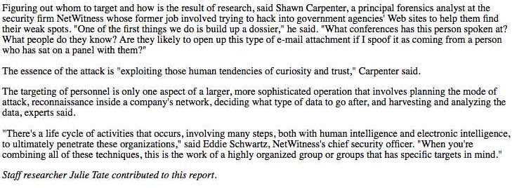
Why Are Security Teams Failing?
People
Underestimate the complexity and capability of the threat actors
In many cases, security teams lack appropriate knowledge and experience
In others, expertise does not equate to ANSWERS
Process
Organizations have misplaced IT measurements and program focus
Technology
Current infrastructure is not well suited to fight threat environment
Holes in situational awareness

Slide 12
The Gaps in Status Quo Security
Intent – Prevent or limit unauthorized connections into and out of your network
Reality – Adversaries are designing malware to use “allowed paths” (DNS, HTTP, SMTP, etc) to provide reliable and hard to detect C&C and data exfiltration channels from inside your internal network.
Even worse, they are using encrypted tunnels to provide “reverse-connect” for full remote control capabilities.
Firewalls

Slide 13
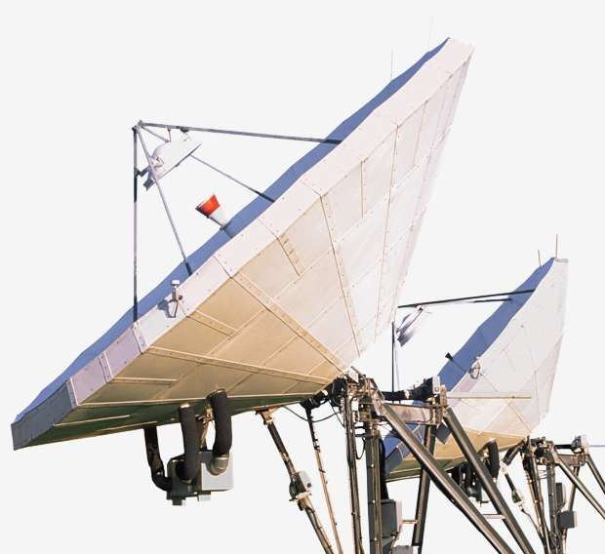
The Gaps in Status Quo Security
Intent – Alert on or prevent known malicious network traffic
Reality – Adversaries are designing malware to use “allowed paths” (DNS, HTTP, SMTP, etc) to provide reliable and hard to detect C&C and data exfiltration channels from inside your internal network.
Even worse, they are using encrypted tunnels to provide “reverse-connect” for full remote control capabilities.
Intrusion Detection/ Prevention Systems

Slide 14
The Gaps in Status Quo Security
Intent – Prevent malicious code from running on an endpoint, or from traversing your network
Reality – Most current anti-malware technologies are signature-based, requiring constant signature updates to remain effective. Due to the current level of malware production, these signatures lag behind from days to weeks Even worse…adversaries create custom malware for high value targets. If they don’t use widespread distribution, you are even less likely to have timely signatures.
Anti-Malware Technologies
From an AV Vendor Forum

Slide 15
Strengthening Cyber Defense in 2010 and Beyond – What is Required?
Know everything happening across the network from layer 2 to layer 7
Get definitive answers to any imaginable security question – no matter how complex
Achieve 24 X 7 real-time situational awareness
Obtain the accuracy and detail only available from AUTOMATED network forensics
Integrate the intelligence of open and classified threat sources
Deploy an agile solution that can address emerging threat trends

Slide 16
NetWitness Lessens the Guesswork and Uncertainty
Why do we have network traffic today with a foreign IP address and an unknown protocol?
Could this binary be associated with some sort of Trojan or other malware?
Who is using policy evasion technologies such as TOR, anonymizers, or PGP encryption?
How can I be sure this IDS or SIEM event is a false positive?
What is the organizational magnitude of this malware incident?
What is this subject of interest doing on the network?
What is the potential source of an attack or breach?
How is data leaving our organization?
Who is using Skype and other technologies to transfer files out of our network?
Notes:
16

Slide 17
NetWitness: Technology Architecture and Overview
Notes:
NextGen Demo (minimum requirements):
Port Agnostic examples
GeoIP Drilling
UDP Streaming (e.g., VoIP)
Constructs, including TDS SQL Constructs
Attachments
Content searching
SIEMLink
Live
InSight Demo (minimum requirements):
Data discovery demonstration (impact of data loss)
Avenues of exploitation (likelihood of exploitation factor)
SCAP
Remediation options
Trending
(Scheduling)
(Reporting)

Slide 18
What is NetWitness NextGen?
NetWitness is a network security solution providing real-time situational awareness and network forensics
NextGen uses full packet capture, live network sessions, and a patented, rules-based analytical process that is unlike any other solution on the market today
Unlike legacy security tools, NextGen is not limited by signatures, log files, and statistics
NetWitness provides network visibility that organizations simply do not have into advanced threats
NextGen provides an “obsolete-proof” and agile infrastructure for rules-based and interactive session analysis across the entire protocol stack – from the network to the application layer
NextGen dramatically improves the process for problem detection, investigation and resolution, shortens the risk exposure gap, and lowers overall business impact
Notes:
18

Slide 19
Who Is the NetWitness Buyer?
Aware of Advanced Threat Landscape
Daily Attacks, Many With Serious Compromises
Prevention Is FAILING
Recognition of Advanced Attacks Beyond Signature Based, Perimeter Defense Capabilities
Concerned About the Loss of Highly Sensitive Data (Classified Data, R&D, IP, etc.)
Need to Exceed Requirements in Highly Regulated Industries (e.g., USG, Banking, Energy, others)
Main Reason Why Our Customers Have Bought NetWitness:
They Have Tested NetWitness and Seen It In Action
NetWitness Produces Tangible RESULTS…
Two types of enterprises today:
Those that KNOW they face advanced threats
Those that face them WITHOUT knowing it.
19
Notes:
19

Slide 20
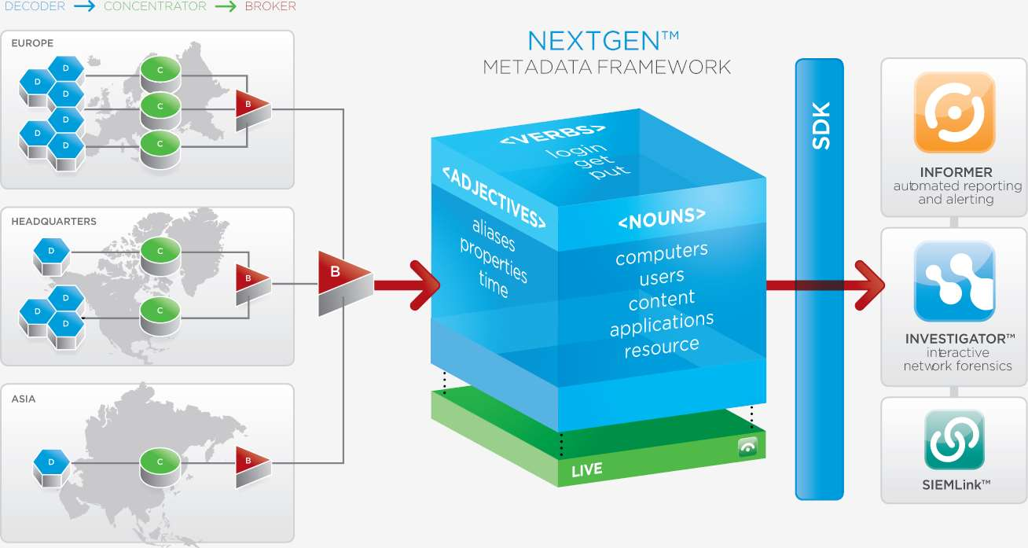
Understanding the NetWitness Architecture
Deploy NextGen at gateways and critical connection points
Use Investigator and Informer to provide situational awareness and network forensics
Spot new exploits at zero-day
Analyze and model their behavior
Conduct broad analysis across the infrastructure and set alerts for future detection
Conduct complete investigations on anything that does get through
Robust Enterprise reporting
Fuse corporate network traffic with multi-source threat feeds to identify any and all sessions to known malicious locations
Use SIEMLink to integrate with other enterprise security solutions - strengthening their power and closing the gaps

Slide 21
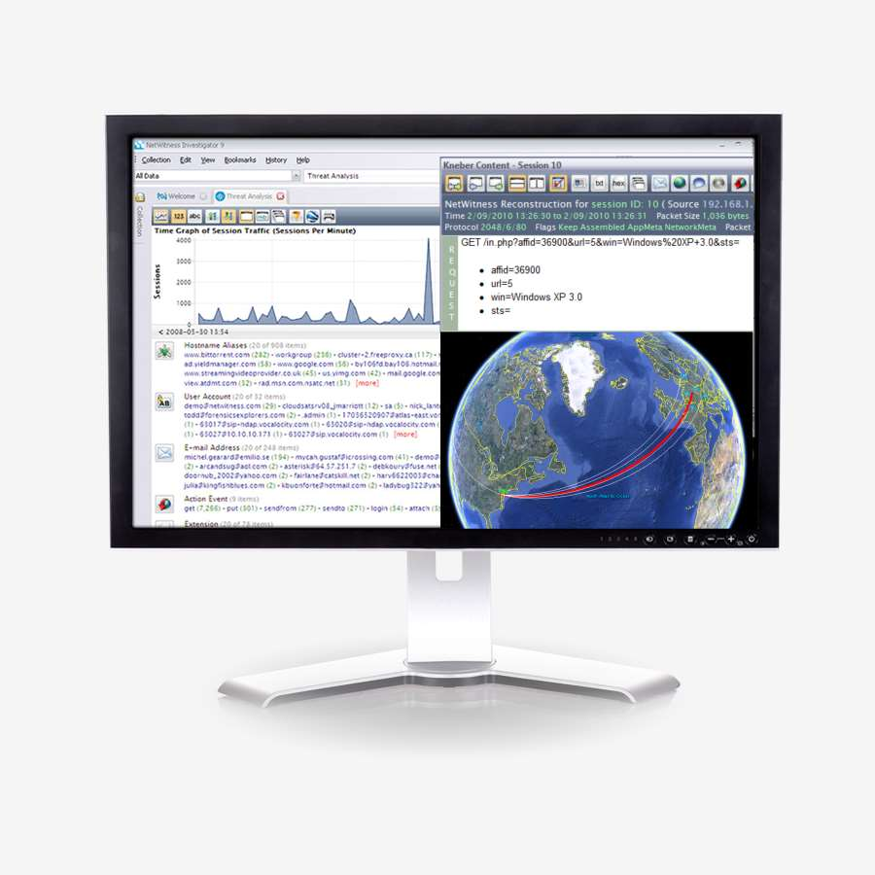
NetWitness Investigator 9.0
Layer 2-7 Analytics
Patented port agnostic session analysis
Infinite freeform analysis paths and content /context starting points
Specialized metadata paths, such as Threat Feeds, GeoIP, PII, IPv6, Crypto
Supports WLAN 802.11
Full Context
Pure session data stored as it occurred
Data presented as the user experienced (Web, Voice, Files, Emails, Chats, etc.)
Integration with NetWitness Live
Supports massive data-sets
Instantly navigate terabytes of data
Fast analytics
Analysis that once took days, now takes minutes
Freeware Version
Notes:
21

Slide 22
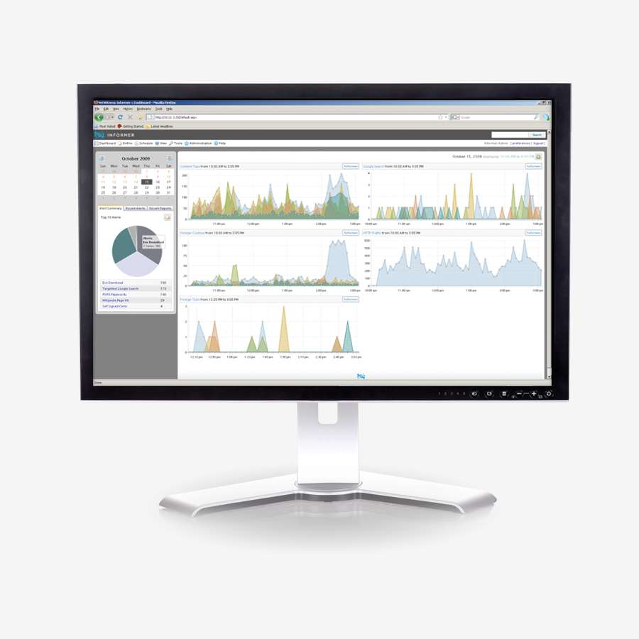
NetWitness Informer Appliance / Software
Product Features:
Flexible, WYSIWYG live charting, drag-and-drop report builder & scheduling engine
Fully customizable, XML-based rules and report library for infinite report and alert combinations
RBAC
HTML and PDF report formats included
Supports SNMP, syslog, SMTP data push
Pre-loaded with hundreds of report rules
Supports 3rd party data sources (e.g., botnet, reputation services) to enrich report context
Offered as Windows® software –or– integrated 1U/2TB appliance for total flexibility

Slide 23
Informer vs. Investigator: The Differences
Informer is an automated analyst with additional display capabilities
Same data, different presentation types
Investigator
Informer
Notes:
Peaks don’t line up exactly – investigator has minute intervals, informer has 5 minute intervals

Slide 24
NetWitness Live – Fusing the Intelligence of the World
24x7 Intelligence Service for NetWitness Products
Know when your network is/has communicated with clear and present threats to your data?
Access to timely intelligence to expose zero day and pre-zero day threats (botnets, malware, etc.)
Improve the efficiency and accuracy of incident detection and response processes.
Situational Awareness
Multisource, globally distributed threat feed sources
Real-time, full content navigation of threat intelligence
Integration of Microsoft Active Directory

Slide 25
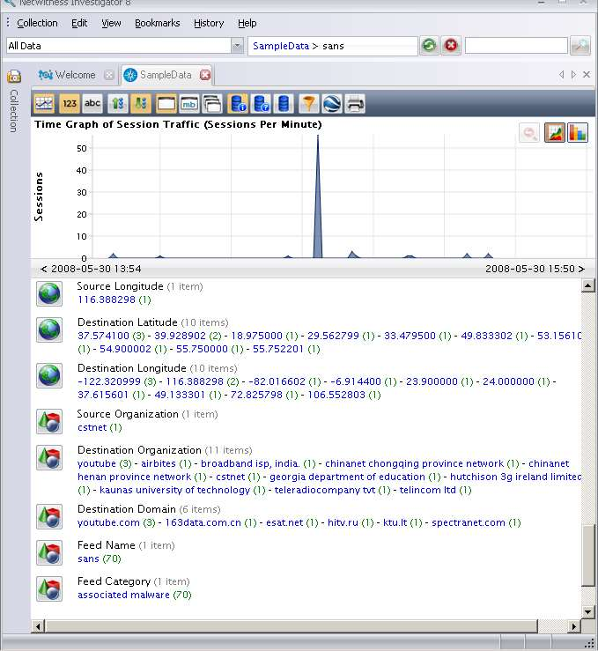
NetWitness Live – Benefits
Real-time, reliable and credible multi-source threat intelligence
Definitively classify computers associated with illegal third party exploits, open proxies, worms/viruses, spam engines, botnets and other current and zero-day exploits
Proactively optimize and automate insight into advanced threats
Provides real-time, full content navigation of network threat intelligence
Synchronize with NetWitness content derived from best of breed data feeds or with your own content
Copyright 2007 NetWitness Corporation
Notes:
25

Slide 26
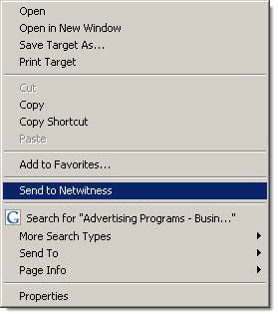
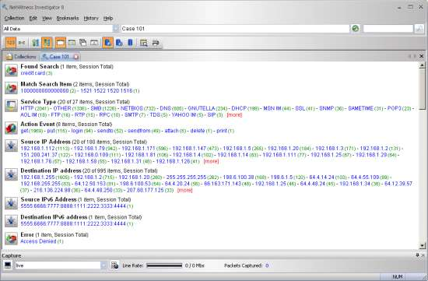
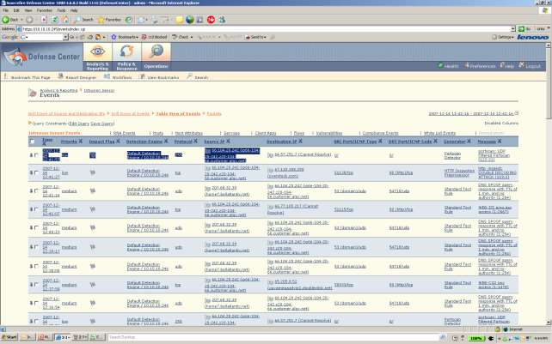
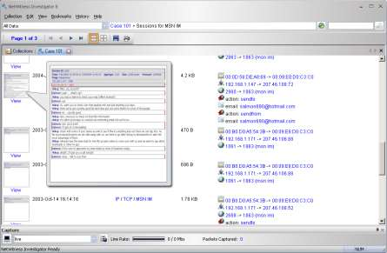
NetWitness SIEMLink™
NetWitness SIEMLink™ - Light-weight windows utility that generically enables network event interrogation by NetWitness from ANY existing system
Compatible with any existing SIEM, intrusion or log console or enterprise network management system
Highlight-right-click functionality from any browser-based console
Augment and empower interactive contextual analysis around every event your enterprise creates
Event Console
Get Instant Context via NetWitness Investigator and the NextGen Infrastructure
Event: Buffer Overflow
IP: 212.2.3.2 @ 11:32PM
Tray Utility

Slide 27
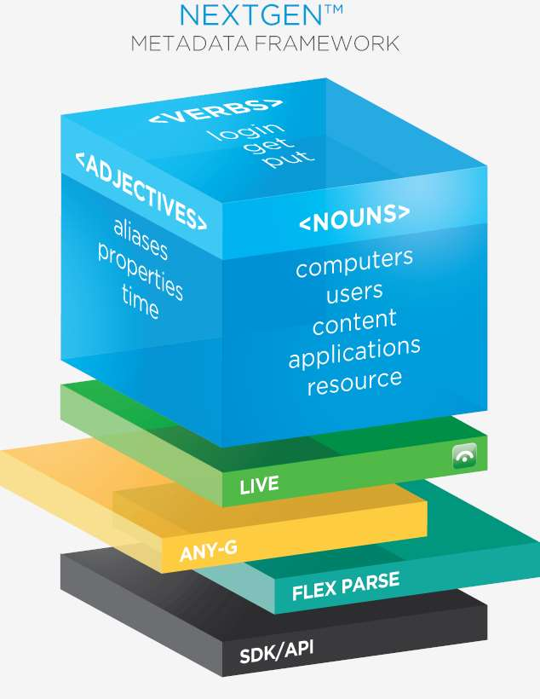
NetWitness = Agility

Slide 28
Examining Advanced Threats

Slide 29
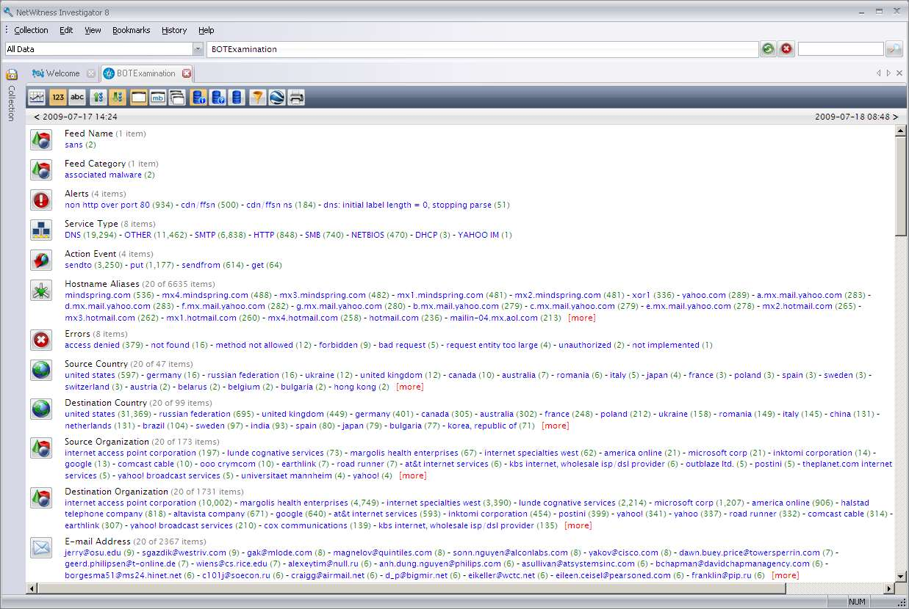
Initial Glance
High DNS count
High SMTP count
Mostly MX Servers
Notes:
On first screen we see high dns, smtp and mail server activity from a single computer.

Slide 30
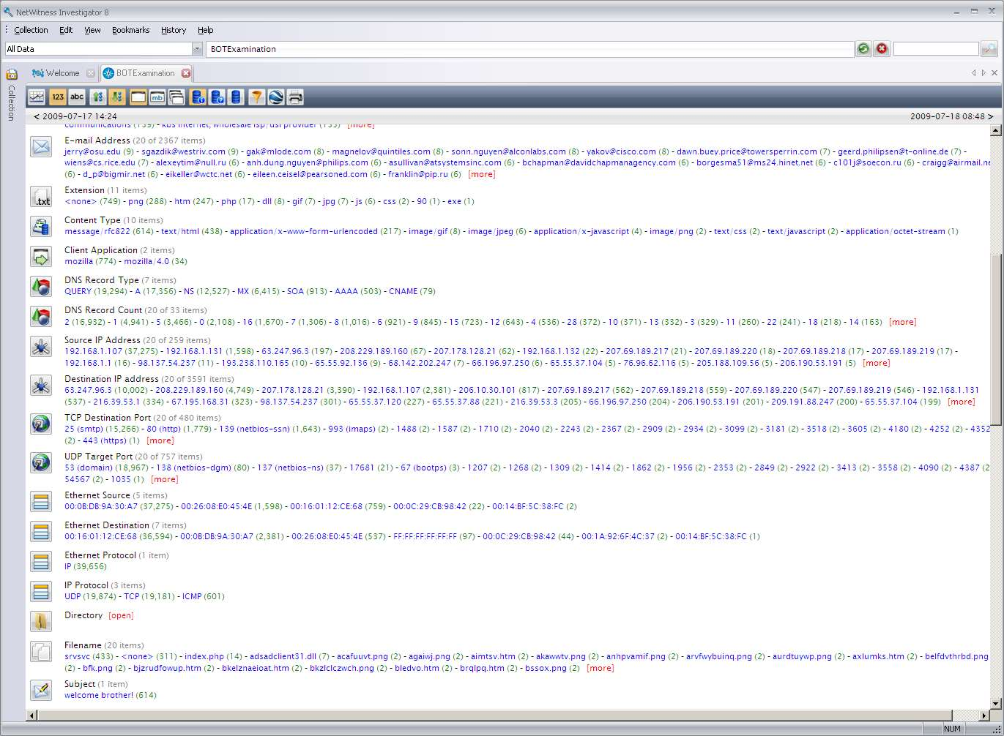
Initial Glance
2300+ email addresses
Single email subject
Randomly generated filenames
Notes:
Further we see 2300 email with a single subject line from a single computer.

Slide 31
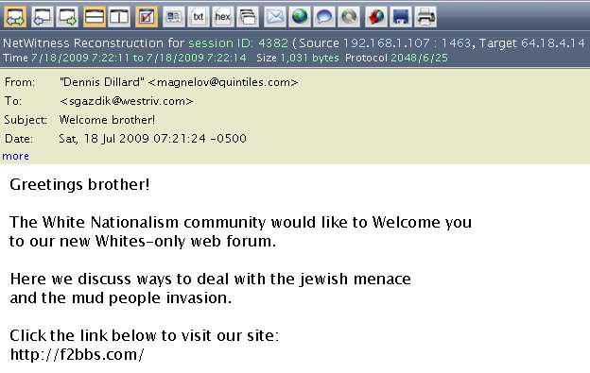
Email Content Review
Indicators show malware is spamming: White Supremacy Forum
But what about the random filenames?

Slide 32
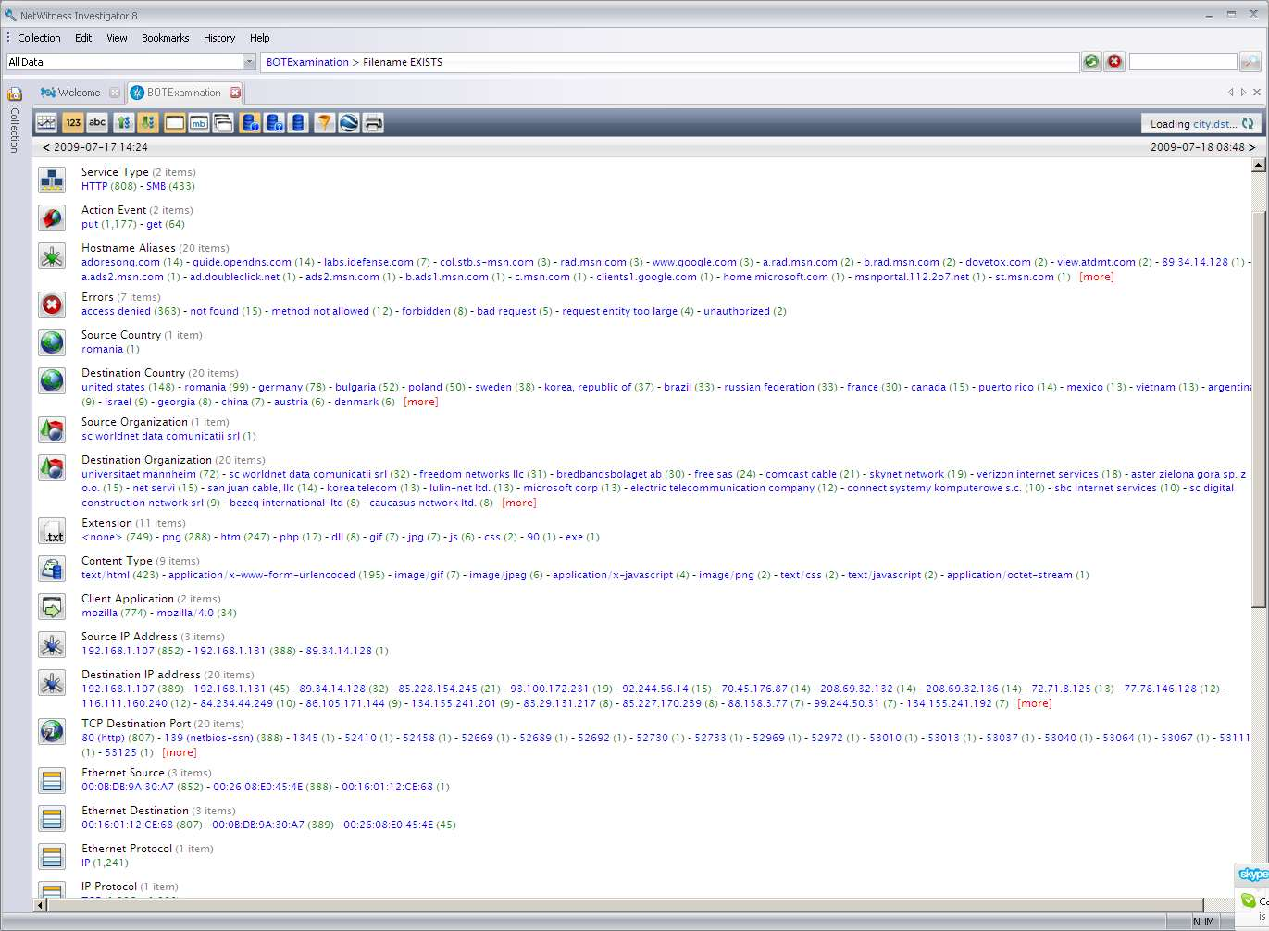
Random Filename Analysis
Breadcrumb
Consider this combination

Slide 33
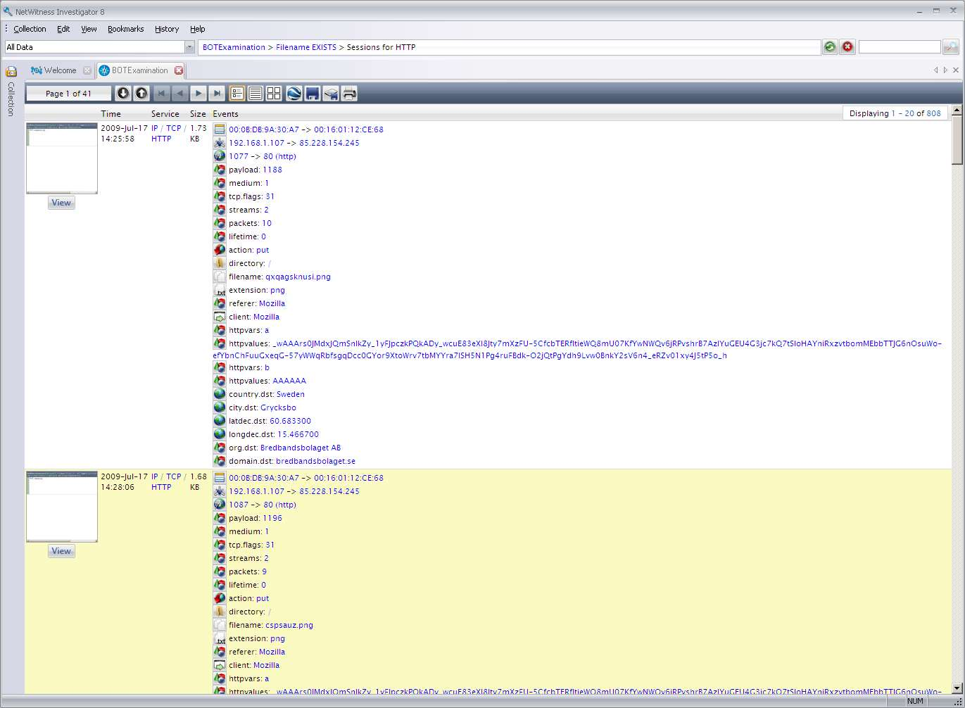
Session detail for HTTP
Breadcrumb
HTTP-PUT random named PNGs?
Suspicious query string
International destination
… 807 more of these HTTP Sessions….

Slide 34
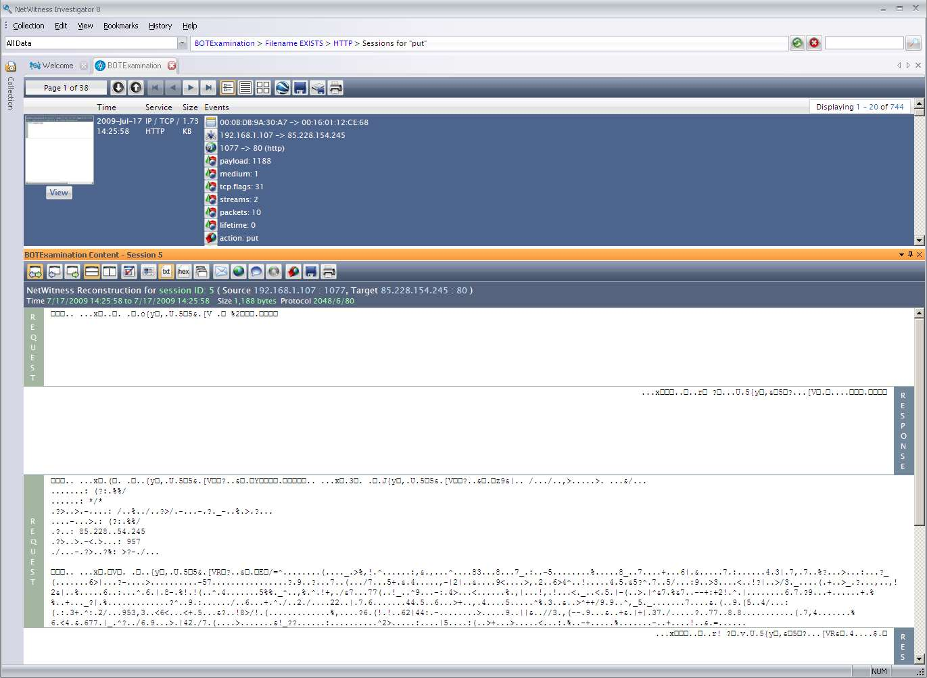
Content Analysis
Breadcrumb
HTTP Put
Encoded/Encrypted content

Slide 35
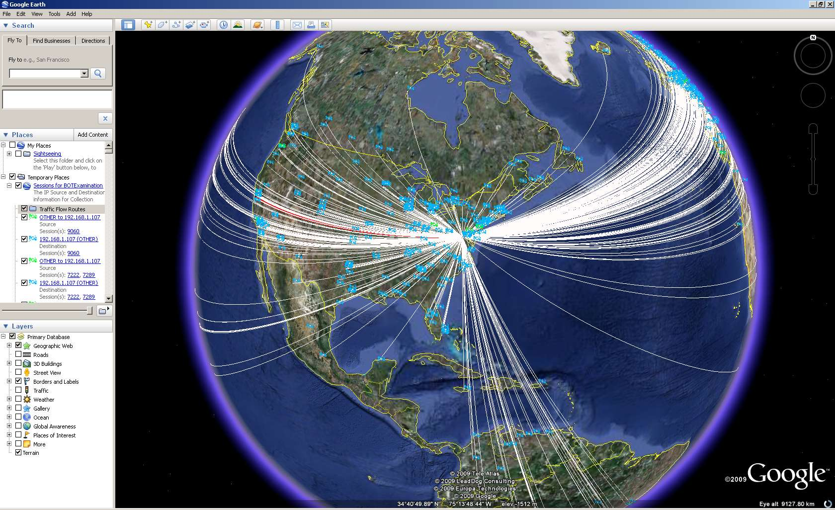
Geographic Activity Map

Slide 36
BOT Examination Summary
Clearly using host to SPAM
Using HTTP for Command and Control
.png PUT
Global BOT
Top domain name in HTTP C&C traffic is “adoresong.com”.
Adoresong.com was one of the domains that was used during the social engineering spam that Waledac used
Spam is a cover for other data exfiltration activity
Notes:
36
Add caveat that some of the details are classified; what I am going to talk about has already been reported in the press, or is available in Congressional testimony transcripts
Extensive network supports 40,000 employees and contractors at over 100 domestic and 260 international locations
Sequence of events:
Attackers sent spear phishing emails to several Department of State employees
The senders were spoofed, and appeared to originate from persons that the targeted employees knew
The subjects and content of the emails were relevant to the targeted individuals’ work, and the topics of the emails were something the sender would have interest in also
One targeted individual read the email and then opened an attached Microsoft Word document that contained information relevant to that individual’s area of expertise
A small binary file was dropped on the victim’s machine and executed when the doc file was opened – no antivirus alerts or any other error messages were generated
On a regular basis, the victim’s machine attempted to connect to an outside dynamic DNS domain
The attacker established a reverse shell and obtained command-line access to the victim’s machine
Almost immediately, the attacker disabled AV, pulled down other exploitation tools (keystroke logger, scanners, etc.) and began laterally exploiting other machines in the domain
Keystroke loggers and other malicious software was installed on machines the attacker compromised
Attacker(s) obtain legitimate domain administrative privileges and begin to pull down other malicious binaries that beaconed to different dynamic DNS domains that were pre-registered about a month before the attack
When information was observed being exfiltrated via a non-HTTPS channel established over TCP 443, HTTPS access was shut down.
Analysts and enterprise AV vendors worked closely together to deploy updated AV signatures generated from analyses of malicious binaries
Analysts worked with outside entities to develop a temporary patch to mitigate a zero-day vulnerability (MS06-040) that attackers were using to laterally compromise vulnerable systems
The entire incident took almost two weeks to fully resolve
After action reporting, forensics, patching and other mitigation and cleanup efforts continued for over two months after the resolution

Slide 37
Case Study
Understanding a Custom ZeuS-based APT Spear Phishing Attack

Slide 38
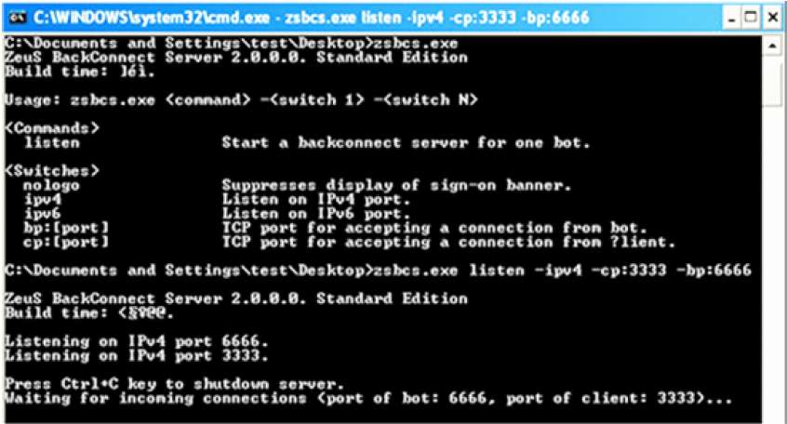
Advanced Threats Are More Prevalent Than You Think
There are many commercial and non-commercial variants of Trojans such as ZeuS that have been developed by eCrime groups for specific targets of interest:
Banks, DIB, specific government agencies in U.S. and Europe
Numerous signs of collaboration among malware writers, including “best practices” for improving techniques for detection avoidance and resilience (e.g. ZeuS and Waledac collaboration noted in NetWitness “Kneber” report)
Source: iSightpartners
New features, such as the inclusion of robust Backconnect reverse proxy capabilities
Many of these non-commercial variants are invisible to typical security tools

Slide 39
Continued Targeted Attacks Against USG Assets
During the last year+ there has been an ongoing campaign associated with forged emails containing targeted ZeuS infections
Typical scenario is email from some “reliable” email address containing spear phishing text of interest and link to custom ZeuS site
Parallels: this approach directly imitates non-USG mass eCrime ZeuS approaches
Subject: DEFINING AND DETERRING CYBER WAR
From: ctd@nsa.gov
U.S. Army War College, Carlisle Barracks, PA 17013‐5050
December 2009
DEFINING AND DETERRING CYBER WAR
Since the advent of the Internet in the 1990s, not all users have acted in cyberspace for peaceful purposes. In fact, the threat and impact of attack in and through cyberspace has continuously grown to the extent that cyberspace has emerged as a setting for war on par with land, sea, air, and space, with increasing potential to damage the national security of states, as illustrated by attacks on Estonia and Georgia. Roughly a decade after the advent of the Internet, the international community still has no codified, sanctioned body of norms to govern state action in cyberspace. Such a body of norms, or regime, must be established to deter aggression in cyberspace. This project explores the potential for cyber attack to cause exceptionally grave damage to a state’s national security, and examines cyber attack as an act of war. The paper examines
efforts to apply existing international norms to cyberspace and also assesses how traditional concepts of deterrence apply in cyberspace. The project concludes that cyber attack, under certain conditions, must be treated as an act of war, that deterrence works to dissuade cyber aggression, and provides recommendations to protect American national interests.
Source: iSightpartners

Slide 40
“DPRK has carried out nuclear missile attack on Japan”
Email with bogus message about a missile attack on Japan by the DPRK received by member of the intelligence community
The sender’s email from this example is forged – nic@dni.gov
Other forged senders used in same phish – e.g., ODNI@dia.mil, SSC@dia.mil
The email contained “tear lines” and fake classification markings (i.e. “U//FOUO”) in an attempt to look legitimate
The sophistication level is fairly low; there is one obvious grammatical error, the far-fetched claims in the email can be quickly disproved, and the phish requires user action (open linked file) to successfully install the malware
Despite the low sophistication level of the spear phish, it reeled in numerous victims before the command & control server was deactivated – it was good enough

Slide 41
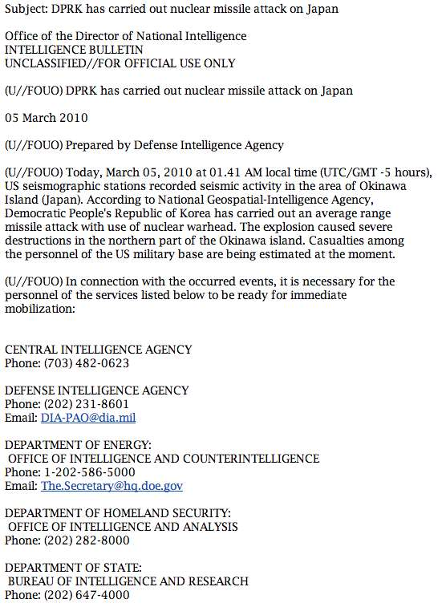
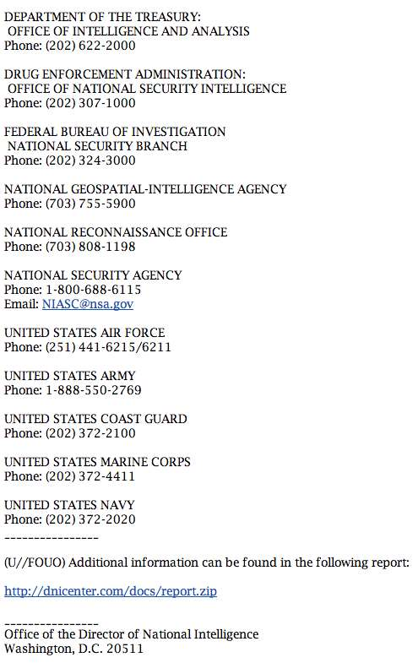

Slide 42
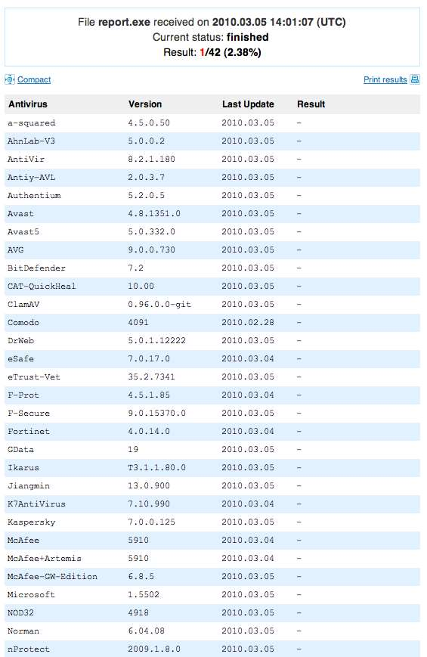
“DPRK has carried out nuclear missile attack on Japan”
Only 1 of 42 AV vendors indentified the file as malicious on 03.05.2010

Slide 43
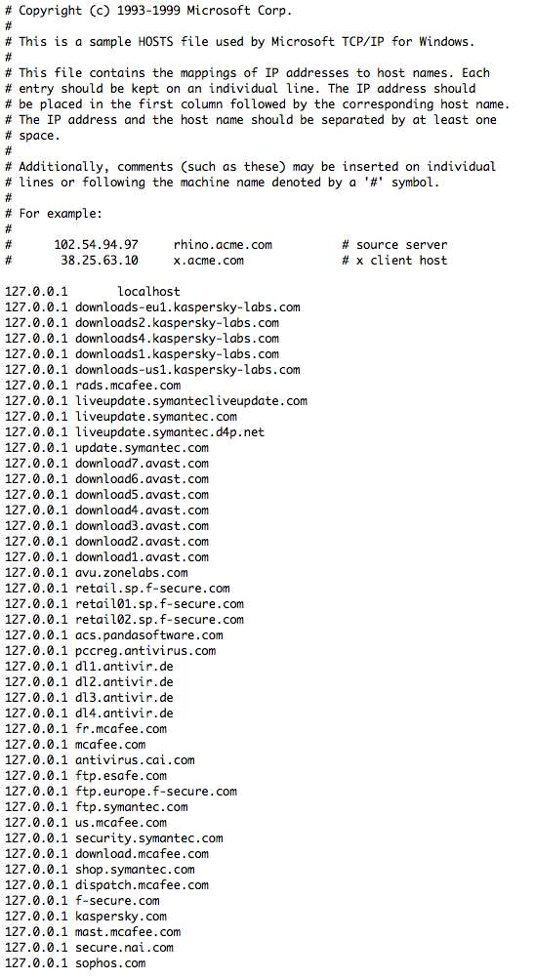
“DPRK has carried out nuclear missile attack on Japan”
AV effectively “neutered” by overwriting the OS hosts file
Attempts to retrieve updates from vendor update server hosts routed to 127.0.0.1
Result: if AV didn’t pick up the malware initially, it never will now

Slide 44
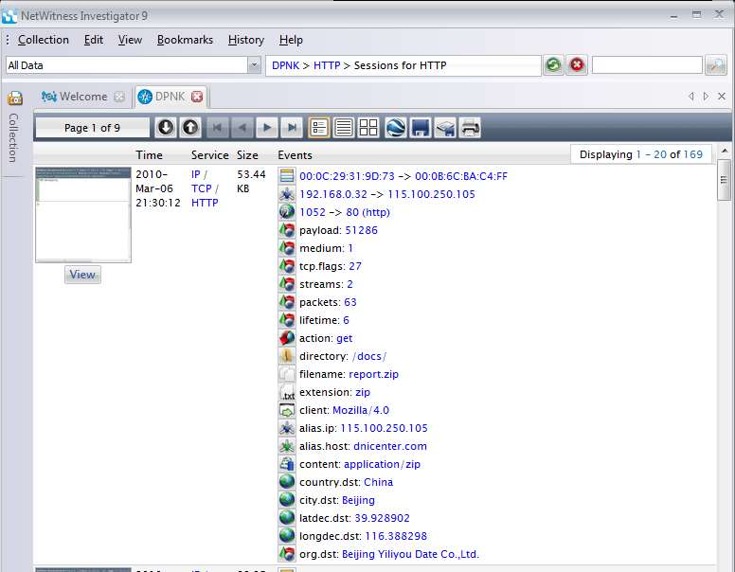
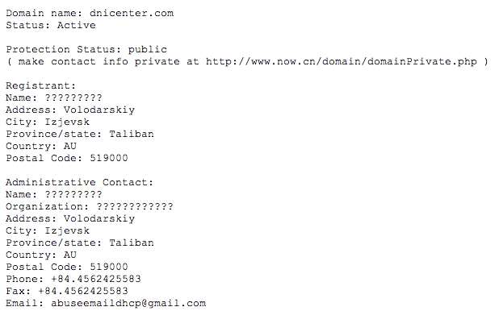
Infection Progression – Nothing Unusual
After a user clicks on the link, the file “report.zip” is downloaded from dnicenter.com
If user opens the file, the malware is installed
Malware is actually a Zeus variant; author used techniques to hamper reverse-engineering / analysis of the binary

Slide 45
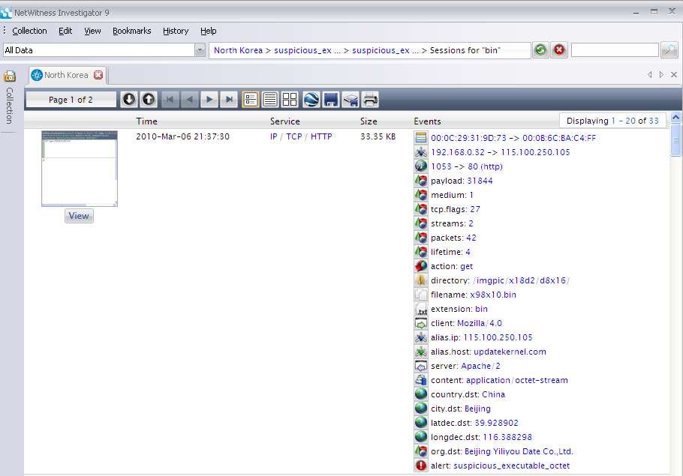
Further Network Forensics Evidence…
ZeuS configuration file download
This type of problem recognition can be automated

Slide 46
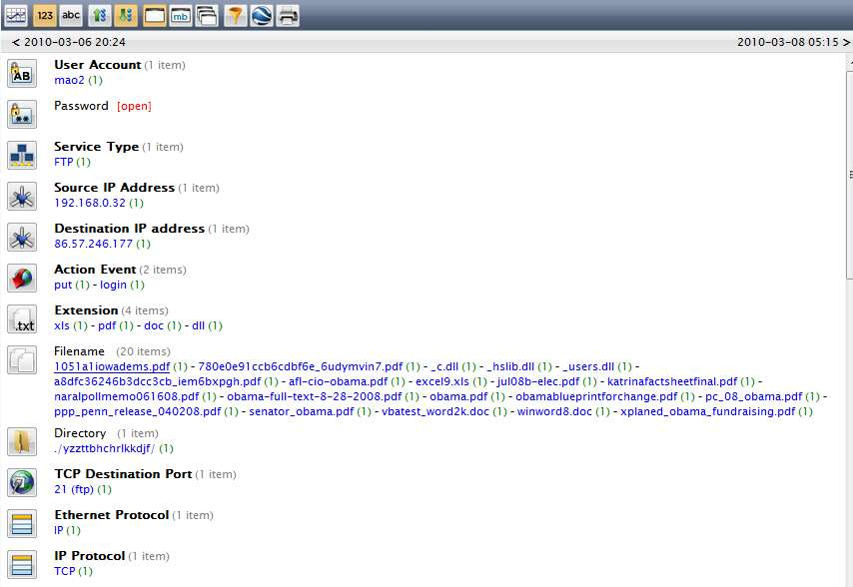
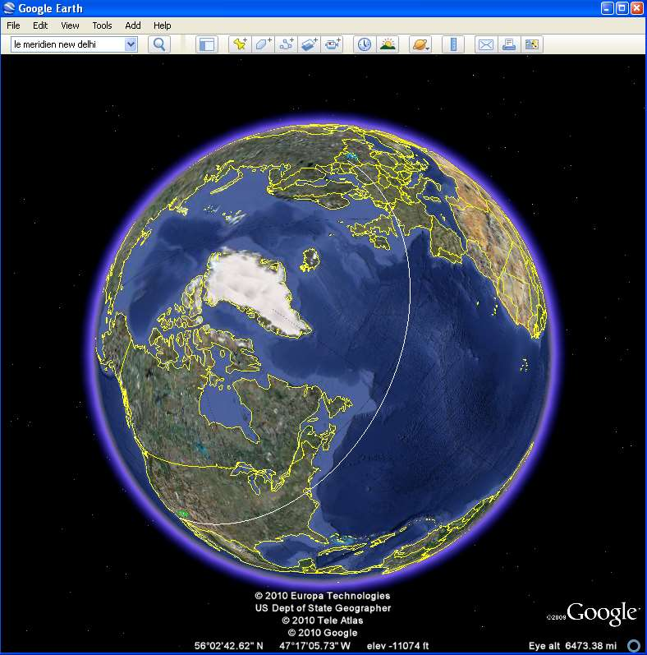
Malware stealing files of interest to the drop server in Minsk
FTP drop server still is resolving to same address
Early on March 8, 2010, server cleaned out and account disabled
username: mao2 password: [captured]

Slide 47
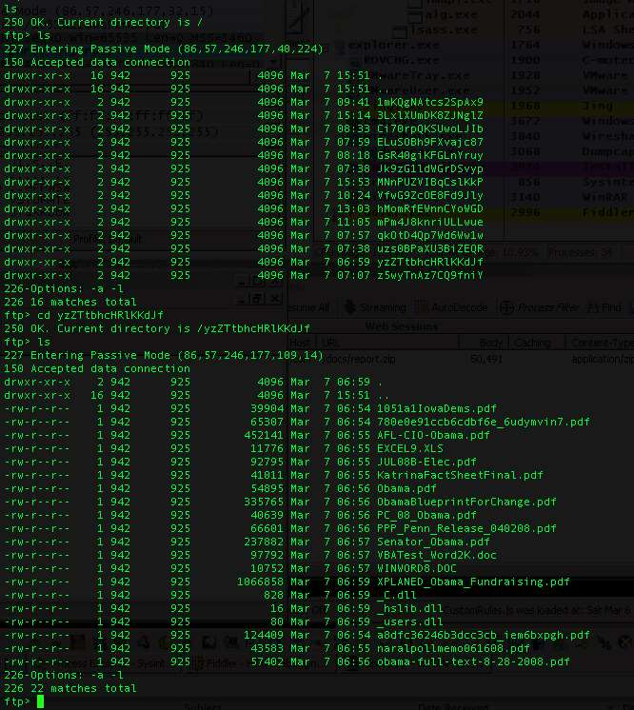
Files harvested from victim machines in drop server (located in Minsk, Belarus)
FTP drop hosted in Minsk, with directory listing of 14 compromised hosts containing exfiltrated data
Notes:
This particular directory contains files harvested by the attackers from my bait PC that I set up and infected; each directory (top listing in graphic for “/”) is associated with one victim.

Slide 48
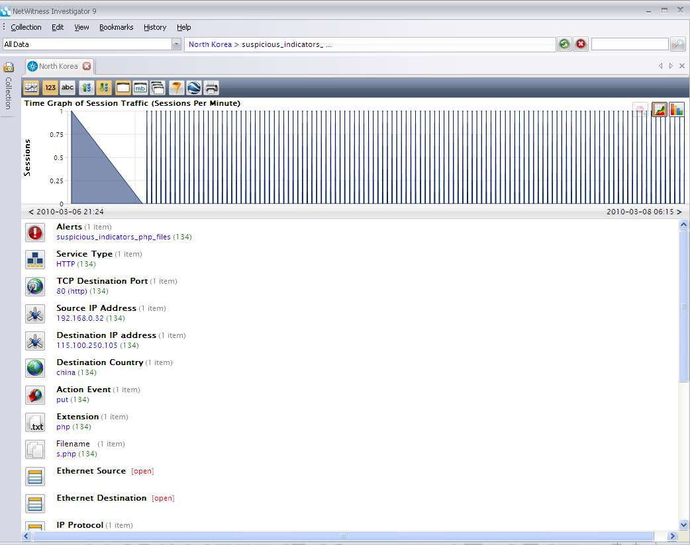
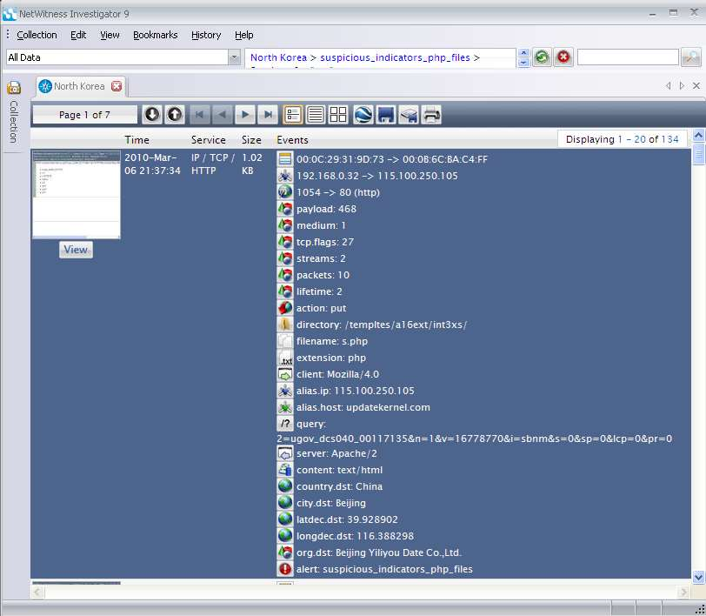
Time graph of beaconing activity and metadata showing comms to C&C server – all via “allowed pathways”

Slide 49
Case Study
The “Kneber” BotNet

Slide 50
Kneber ZeuS Botnet Statistics
75,000 systems compromised with ZeuS Trojan
Over half of the compromised systems also infected with Waledac
68,000 stolen credentials
2,000 stolen SSL certificate files
Data cache includes complete credentials and dossier-level data sets including dumps of entire IE protected storage of individual machines
Victim organizations include 2,500 public (federal, state, local) and commercial sector entities (400 U.S.-based)
Commercial sectors represented: Telecommunications, Financial Services, Online and Conventional Retail, Technology, Healthcare, Energy, Oil and Gas, Aerospace, Entertainment, Education
196 countries
Only one month of captured data (roughly 80Gb of data analyzed)

Slide 51
Many Amateur (?) Criminal Opportunities

Slide 52
Compromised Credentials – Top 5

Slide 53
Significance of Kneber
NetWitness found evidence that the Kneber crew has multiple data gathering goals and has been operating across the globe in a coordinated manner for over a year
The focus in this data cache on user credentials suggests the ultimate consumer of data could be groups other than organized crime, e.g.: nation-sponsored or terrorist groups
Both the malicious Trojans resident on the infected systems themselves and the data harvested by Kneber could be used to conduct information operations against a target with material impact:
Using Facebook identities and other information to steal government secrets or contractor designs for weapons
Using email social networking or email accounts as a vehicle for spear phishing attacks for advanced persistent threats (APT)
The coexistence of ZeuS and Waledac suggests the goals of resilience and survivability and potential deeper cross-crew collaboration in the criminal underground

Slide 54
Conclusions / Wrap-Up

Slide 55
Putting NetWitness in the Right Context
Data Source
Description
Firewalls, Gateways, etc.
Overwhelming amounts of data with little context, but can be valuable when used within a SEIM and in conjunction with network forensics.
IDS Software
For many organizations, the only indicator of a problem, only for known exploits. Can produce false positives and limited by signature libraries.
Highest Value Lowest Value
NetFlow Monitoring
Network performance management and network behavioral anomaly detection (NBAD) tools. Indicators of changes in traffic flows within a given period, for example, DDOS. Limited by lack of context and content.
SEIM Software
Correlates IDS and other network and security event data and improves signal to noise ratio. Is valuable to the extent that data sources have useful information and are properly integrated, but lacks event context that can be provides by network forensics.
Real-time Network Forensics (NetWitness)
Collects the richest network data. Provides a deeper level of advanced threat identification and situational awareness. Provides context and content to all other data sources and acts as a force multiplier.

Slide 56
Open Discussion
Freeware Download:
http://www.netwitness.com
Contacts:
tim@netwitness.com

