Slide 1
Operating a Flexible Network Monitoring Infrastructure
June 17, 2010
Dr Stephen Donnelly
Core Software Manager | Endace Technology Ltd
SHARKFEST ‘10
Stanford University
June 14-17, 2010

Slide 2
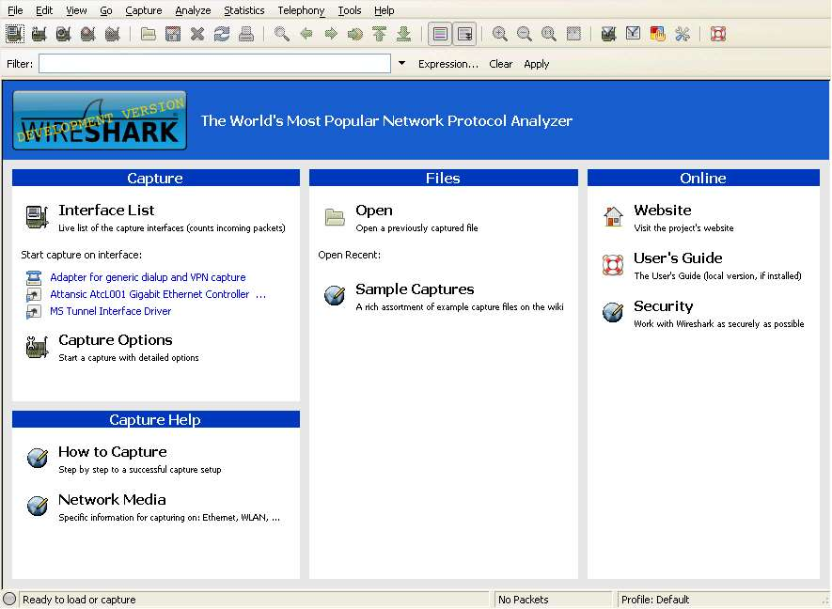
Wireshark

Slide 3
Wireshark
Hundreds of protocols
Live capture via libpcap/WinPcap
Offline analysis
Broad format support
Comprehensive filtering
Many analysis tools
Sessions
Service latency
VOIP

Slide 4
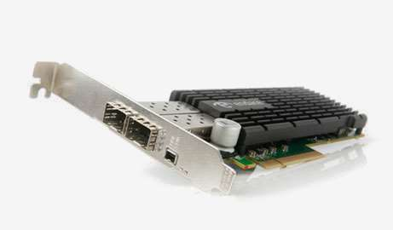
Endace
Wide range of Network Monitoring Interfaces
TDM/PDH T1/E1-DS3/E3
10/100/1000/10G Ethernet
SONET/SDH OC-3 to OC-768c
InfiniBand x4 SDR and DDR
Low Overhead/Zero Loss capture
Hardware time stamps
Global Clock Synchronization
In-band Metadata

Slide 5
Wireshark + Endace
Endace Record Format file support since 2003
ERF dissector since 2007
High resolution hardware time stamps
Multiple interfaces
In-band loss/error reporting
Expert Info
Live capture via libpcap/WinPcap
DLT_ERF means no loss of metadata

Slide 6
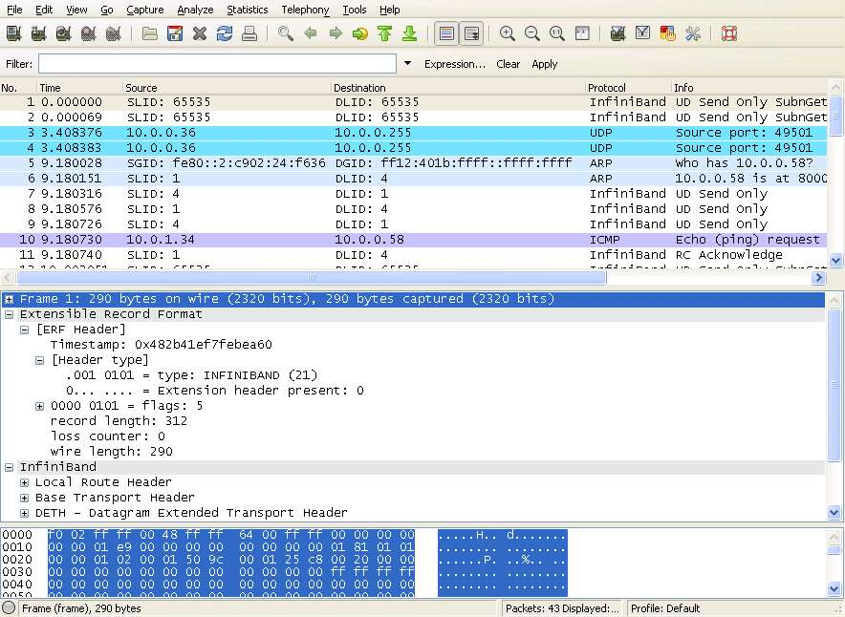
Endace Record Format

Slide 7
Use Cases
Wireshark works well on small scales
Network debugging
Protocol development
Need permanent / remote installations
Security
Forensics
Latency
Lawful Intercept

Slide 8
Issues
Scalability/Management
Capture rates
Storage volumes/backhaul
Reliability/Redundancy
Remote management
Purchasing
Warranty/Support/Spares
Deployment logistics

Slide 9
Planning
Many more people involved
Senior management
NOC
SOC
System Admins/Operators
Data Center techs
Lawyers
Corporate policy
Some groups are also customers

Slide 10
Outsource
Appliance
Single Vendor
Hardened systems
Pre-integrated
Optimized
Support multiple users
Tick Boxes
The fewer the better!
Appliance Sprawl

Slide 11
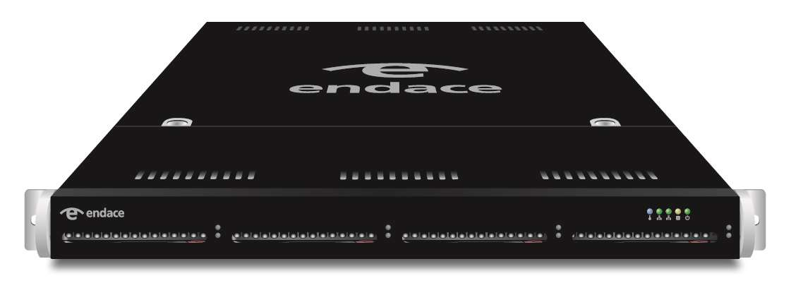
Endace Probe

Slide 12
Endace Probe
Monitored Links
LAN
Event Routing
Configuration and Management
SOAP/XML
Capture Files
Applications
CLI
Pilot
IDS
LI
Replay
GUI
SNMP
DAG
Filtering
DAG
NIC
DAG
ERF Stream Engine

Slide 13
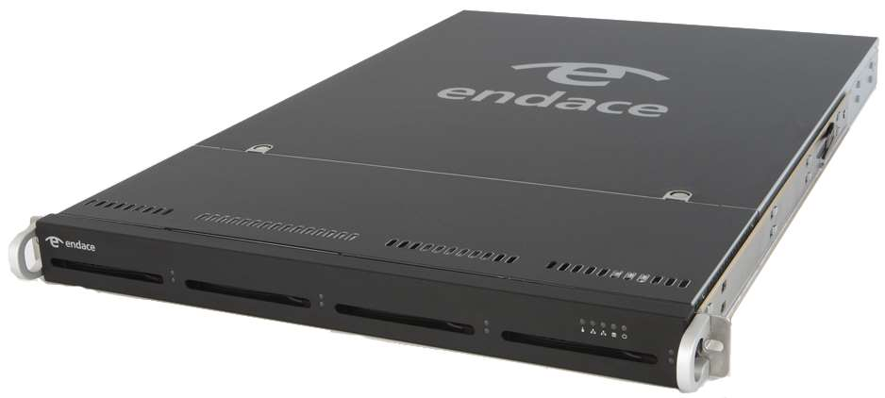
Endace Probe
Capture once platform
Scalable
Storage options
Load balancing
Multiple applications
Analytics, Forensics, Latency, LI, Security
Central management
Configuration, health, reporting and logging
Remote access

Slide 14
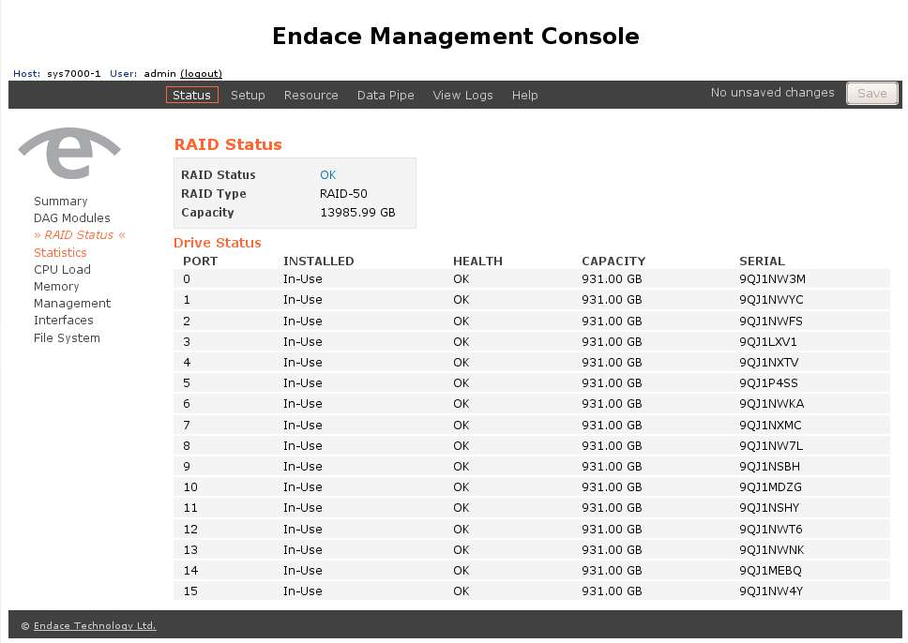
Management
CLI
Powerful, familiar interface
Web GUI
Quick start, easy configuration
SNMP
Remote monitoring
NMS/back-end integration
CMS/CMC
Remote KVM/Power/Health

Slide 15
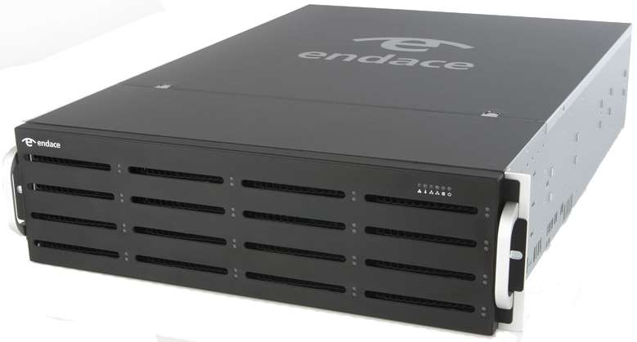
Network Forensics
Central high speed capture for packet data
LI
Forensics
Replay
Continuous capture
Data Mining
Time Indexed
Search filters
Up to 32TBytes in a 3U system

Slide 16
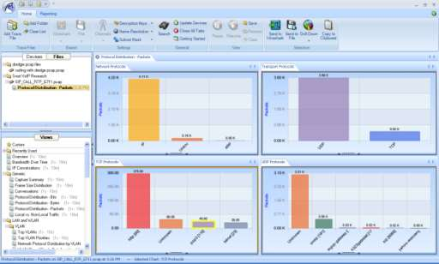
Analytics
CACE Technologies Pilot
Client/Server since 2008
Pilot Server on Probe
Connects to a Data Pipe
Windows Pilot Client
can connect to multiple Probes
Visualize live data
Mine trace file sets
Correlate events

Slide 17
NetFlow
NetFlow v5 generation
Avoid loading core router CPUs
Large ecosystem
Accounting
Analytics
Trending
Capacity planning
Unsampled – 100% packet/flow coverage
File or Port outputs

Slide 18
Security
Snort
Proven Open Source IDS engine
Large user community
Suricata
Open InfoSec Foundation (OISF)
http://openinfosecfoundation.org
Endace Security Manager
Central management
Alert console

Slide 19
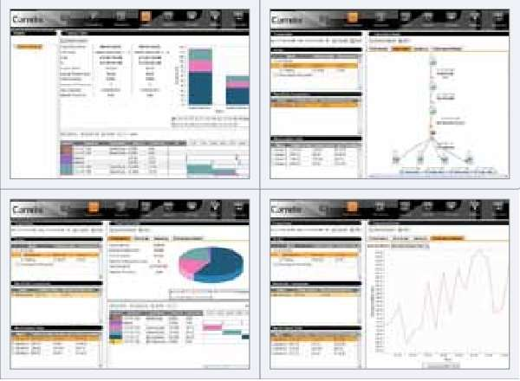
Latency
Correlated multi-point passive measurement
Monitor latency in real-time
Pinpoint bottlenecks
Track trends
Process flow views
Order flow
Volume sensitivity
System processing time

Slide 20
Open APIs

Slide 21
Endace Stream Manager API
User control over Data Pipes
Export live or pre-captured data
SOAP API
List Sources/Sinks
Create/Destroy Filters
Create/Destroy Data Pipes
Authenticated/Encrypted
Examples provided

Slide 22
Data Pipe
Application
DAG
ERF Stream
DAG
Raw packets
NIC
ERF-Stream
Rotation File
VM
Filtering
NetFlow
Truncation
Format Conversion
DAG Interface
ERF-Stream
NIC
(net address)
ERF-Stream
Rotation File
Stats and counters
Stats and counters
Packet Count
Bytes/Bits
Drop Count
Filter matches
…

Slide 23
Data Pipes
Sources
DAG Cards
File sets
Sinks
DAG Cards
File sets
Remote ports
IPv4/6, TCP/UDP, Rate-limit
VMs
Transformations
Filtering
Tcpdump style
Time range
NetFlow
Packet sampling
Flow sampling
Truncation
Format
ERF or PCAP

Slide 24
Data Pipes
Data Statistics
Total packets/Bytes
Filtered Packets/Bytes
Output packets/Bytes
NetFlow Statistics
Total Flows
Sampled Flows
Current Flows in memory

Slide 25
Eventing API
Communication between applications
Intelligent Reactive Behavior
Apps generate and consume events
Intra and Inter-Probe messaging
Probe Event Manager
Log
SNMP Trap
Email
Route

Slide 26
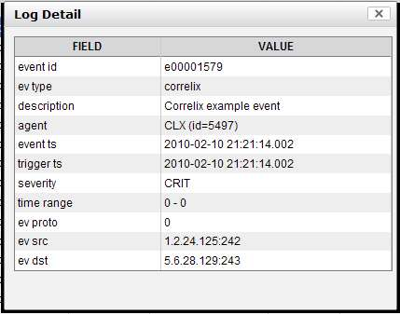
Event
Fixed fields
Session Id
Sequence No.
Length
Type
Extendable Body
Filtering/Routing on fields
Global Addressing
Events routed up to CMC

Slide 27
Endace Probe
Network Monitor
Latency Monitoring App
Event Routing
Lookup Table
Event Type A: Route to X
Event Type B: Route to Pilot
NIC
Pilot Client
Applications
App X
App Y
Pilot Server

Slide 28
Endace Probe
Network Monitor
Latency Monitoring App
Event Routing
Lookup Table
Event Type A: Route to X
Event Type B: Route to Pilot
Event Type: B
Time of Event
NIC
Pilot Client
Applications
App X
App Y
Pilot Server

Slide 29
Endace Probe
Network Monitor
Latency Monitoring App
Event Routing
Lookup Table
Event Type A: Route to X
Event Type B: Route to Pilot
Event Type B: Route to Pilot
NIC
Event Type: B
Time of Event
Pilot Client
Applications
App X
App Y
Pilot Server

Slide 30
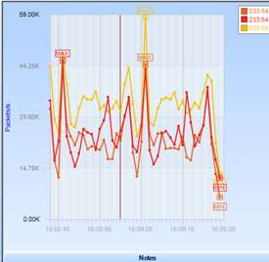
Endace Probe
Network Monitor
Latency Monitoring App
Event Routing
Lookup Table
Event Type A: Route to X
Event Type B: Route to Pilot
NIC
Updated View
Pilot Client
Applications
App X
App Y
Pilot Server

Slide 31
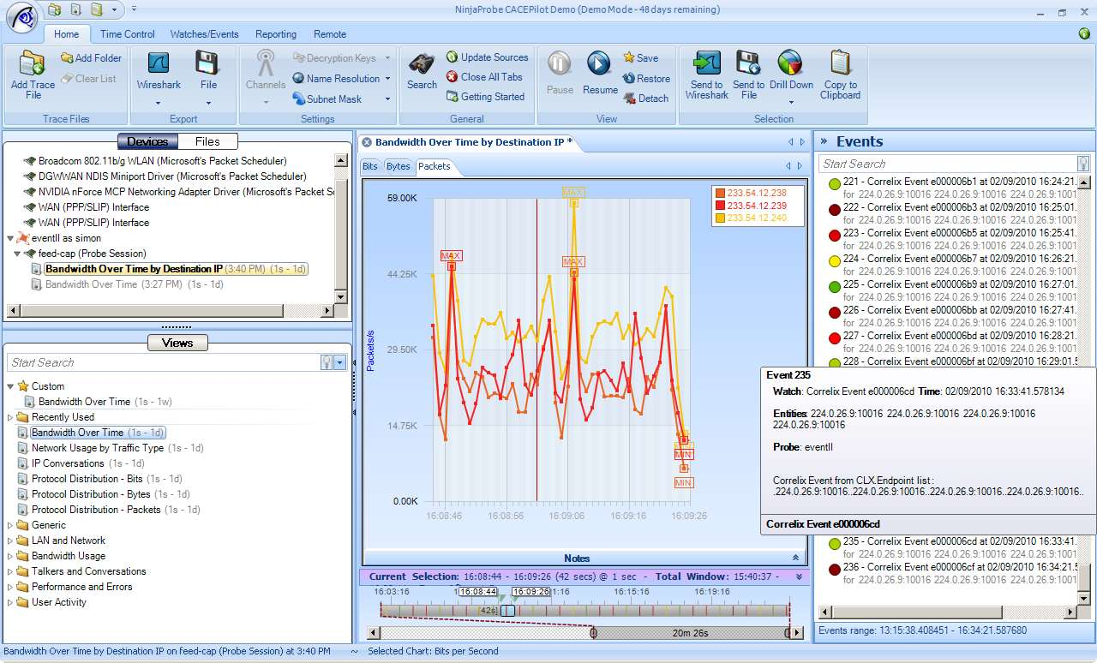
External events appear in real-time within the Pilot Events window
Roll the mouse over an event to see additional event information.
There need not be any views running
Events are searchable, as usual

Slide 32
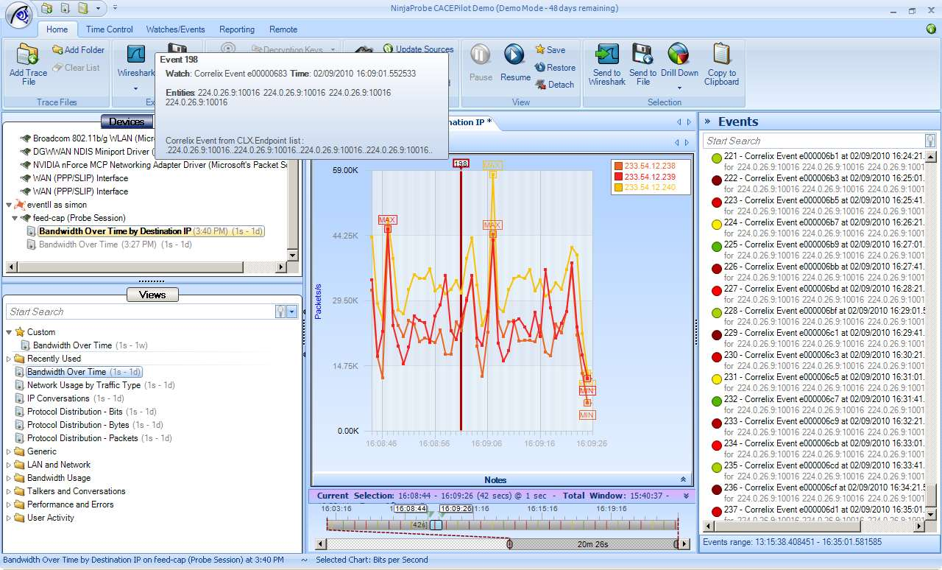
Events can be overlaid on any strip chart applied to any live capture session or stored file
They can also be seen in the time-control window (bottom-center)
Enables immediate correlation of event with select / targeted network activity
Events are not tied to any specific view
Views can be closed without deleting events

Slide 33
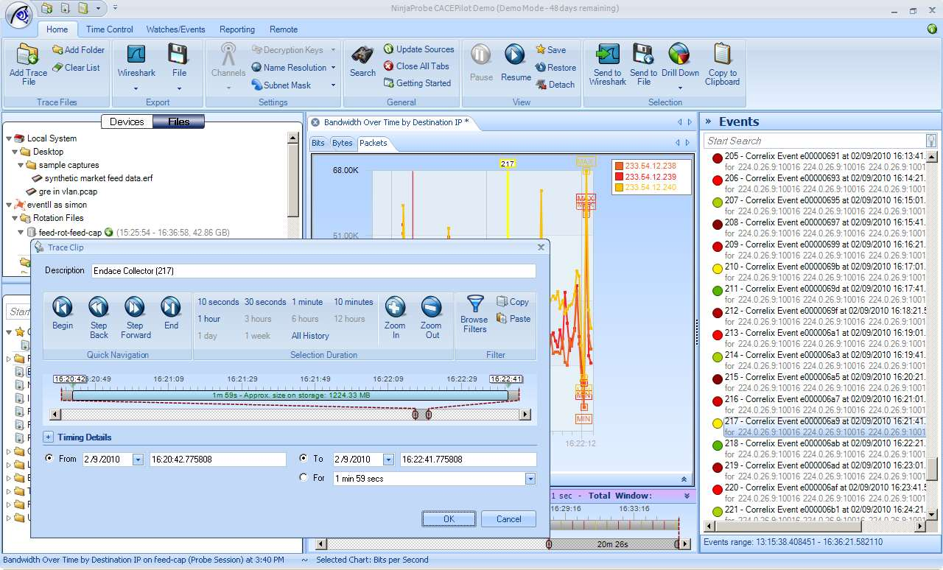
To analyze data around the event, drag/drop it onto the Probe’s rotation file
The trace clip editor defaults with the event number and a time window of 1-min either side of the event

Slide 34
Once the 2-minute time period has been clipped from the rotation file, it can be worked with in the same way as a stored file
Views can be applied and layered
Ultimately, packets can be isolated for decode in Wireshark

Slide 35
Virtualization
Monitored Links
LAN
Event Routing
Configuration and Management
SOAP/XML
Capture Files
Applications
CLI
Pilot
IDS
LI
Replay
GUI
SNMP
DAG
Filtering
DAG
NIC
DAG
ERF Stream Engine

Slide 36
Virtualization
Monitored Links
LAN
Event Routing
Configuration and Management
SOAP/XML
Capture Files
Applications
CLI
Pilot
VM1
IDS
VM2
User VM3
User VM#
GUI
SNMP
DAG
Filtering
DAG
NIC
DAG
ERF Stream Engine

Slide 37
Virtualization
More flexible appliance
User control of VM environments on Probe
Consolidation
Move User Apps onto Probe
Save space/power
Apps closer to data
Staged upgrades
Run new and old versions in parallel
Add capacity as required

Slide 38
Virtualization
Performance isolation
Resource reservation
Security isolation
Separate environments for users
High Performance Capture Interfaces
Connect to Data Pipes on Probe
DAG native or libpcap APIs
Multi-gigabit performance
Stream Manager and Eventing API access

