Slide 1

Large-Scale Passive Network
Monitoring using Ordinary Switches
Justin Scott
Senior Network OPS engineer
Juscott@microsoft.com
Rich Groves
Rgroves@a10networks.com

Slide 2
Preface
We are network Engineers
This isn’t a Microsoft Product
We are here to share methods and Knowledge.
Hopefully we can all continue to help foster evolution in the industry

Slide 3
About Justin Scott
Started career at MSFT in 2007.
Network Operations engineer, specialized in high profile, high stress outages
Turned to packet analysis to get through ambiguous problem statements
Frustrated by our inability to exonerate our network quickly.
Lack of ability to data mine telemetry data at the network layer

Slide 4
What’s this about?
A different way of aggregate data from a TAP/SPAN
Our struggle with other approaches
An Architecture based on OpenFlow and use of commodity merchant silicon
A whole new world of use-cases
Learnings we’ve taken away

Slide 5
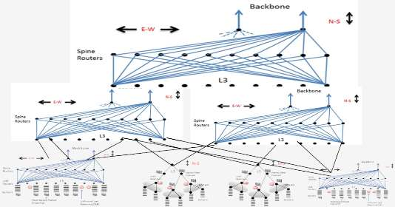
The Scale of the cloud
Thousands of 10g links per Data Center
8,16 and 32x10g uplinks from TORs
Cost makes it a non-starter with commercial solutions

Slide 6
Prior iterations
Capture-Net
  Consisted of off the shelf aggregation gear, which was far too expensive at scale
  high cost made tool purchases a difficult pitch, no point without tools
  Resulted in lots of gear gathering dust
  Operations not mature enough to back such a solution
PMA/PUMA –”Passive Measurement Architecture”
Lower cost than Capture-net
Designed for a specific environment and not intended to scale
Extremely feature rich
“Nemesys” AKA Rich’s crazy ideas
Big hub - Switched network with MAC learning turned off
Left with shuffling sniffers around the DC as troubleshoots popped up.

Slide 7
Questions?
NOT
THE END
Just took a step back

Slide 8
What features make up a packet broker?
80%
terminates taps
Can match on a 5-tuple
duplication
Packets unaltered
low latency
Stats
Layer 7 packet inspection
Time stamps
Frame Slicing
Microburst detection
20%

Slide 9
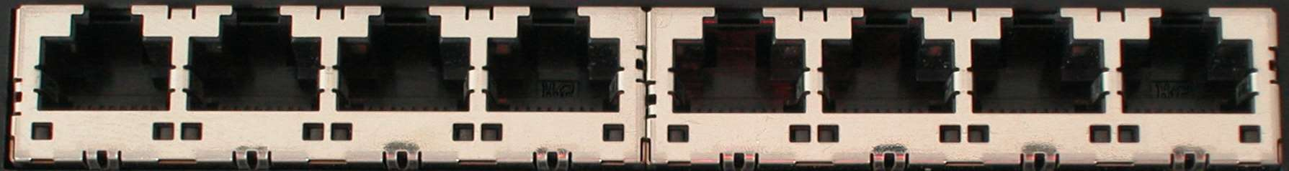
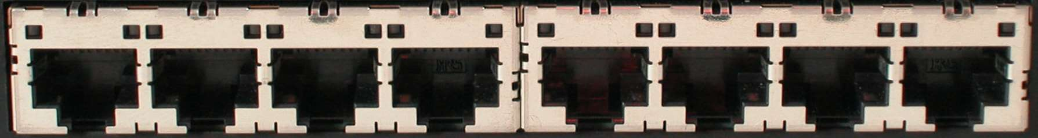
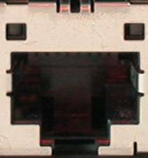
Reversing the Packet Broker
Filter Ports
backplane
MUX
Filter Ports
(pre-filter, de-duplication of data)
Service
Timestamps,DPI,etc
Service
Service
Delivery Ports
(data duplication and delivery)
Delivery

Slide 10
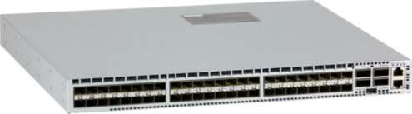
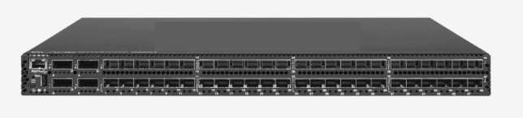
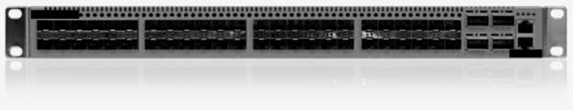
Can You Spot the Off the Shelf Packet Broker?
Which is 20x more expensive?
Is it called a Packet Broker cause it makes you broker?
-Raewyn Groves (Rich’s Daughter)
What do these have in common?
They are all the same switch!

Slide 11
Architecture

Slide 12
The glue – SDN Controller
Controller
Openflow 1.0
  runs as an agent on the switch
  Standards managed by the Open Networking Foundation
  developed at Stanford 2007-2010
  Can match on SRC and/or DST fields of either TCP/UDP, IP, MAC., ICMP code & types, Ethertype, Vlan id
Controller Discovers topology via LLDP
Can manage whole solution via remote API, CLI or web GUI

Slide 13


Multi-Tenant Distributed Ethernet Monitoring Appliance
Enabling Packet Capture and Analysis at Enterprise Scale
monitor ports
Appliance
filter
mux
filter
service
service
delivery
tooling
20X cheaper
than “off the shelf” solutions

Slide 14
Filter Layer
Monitor Ports
Filter
Filter
e
Terminates all monitor ports
Drops all traffic by default
De-duplication of data if needed
Aggressive sFlow exports

Slide 15
Mux Layer
Monitor Ports
MUX
Aggregates all filter switches in a data center
Directs traffic to either service nodes or delivery interfaces
Enables service chaining per policy

Slide 16
Services Nodes
monitor ports
r
Service
Service
Some Service:
Deeper (layer 7) filtering
  Time stamping
  Microburst detection
  Traffic Ratio’s (SYN/SYNC ACK)
  Frame slicing - (64, 128 byte)
  Payload removal for compliance
  Rate limiting
Aggregated by mux layer.
Majority of cost is here
Flows DON’T need to be sent through the service by default.
Service chaining
Notes:
Service chaining example
All SSL hello packets in a DC
All TCP sack packets in a DC

Slide 17
Delivery Layer
monitor ports
r
Delivery
tooling
1:N and N:1 delivery to duplication of data
Delivery to local or tunneling to remote tools

Slide 18
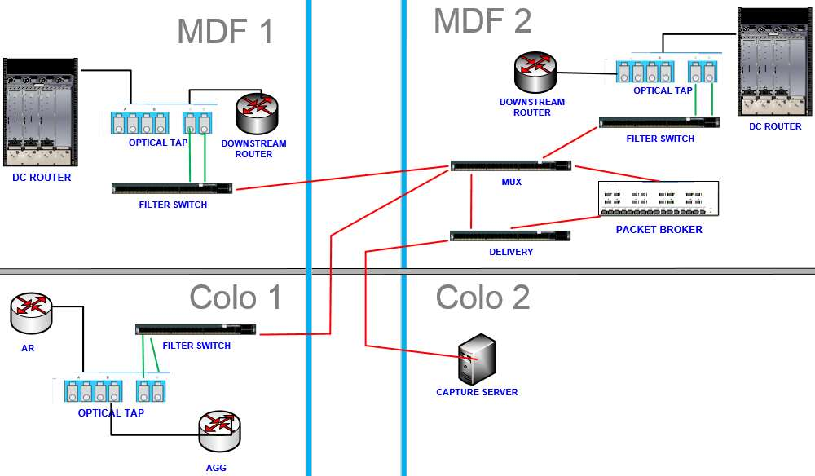

Controller
Router
Router
Filter_Switch2
Filter_Switch1
policy demo
description ‘Ticket 12345689’
1 match tcp dst-port 1.1.1.1
2 match tcp src-port 1.1.1.1
filter-interface Filter_Switch1_Port1
filter-interface Filter_Switch1_Port2
filter-interface Filter_Switch2_Port1
filter-interface Filter_Switch2_Port2
filter-interface Filter_Switch3_Port1
filter-interface Filter_Switch3_Port2
delivery-interface Capture_server_NIC1
Filter_Switch3

Slide 19
Extras
controller
Intelligence of the solution
Overlapping flow support
Vlan rewrite
ARP glean
Marker packet
Stats
Multi-User support
Tap Port grouping
Self terminating policy
… bring your own innovation

Slide 20
Use Cases and Examples

Slide 21
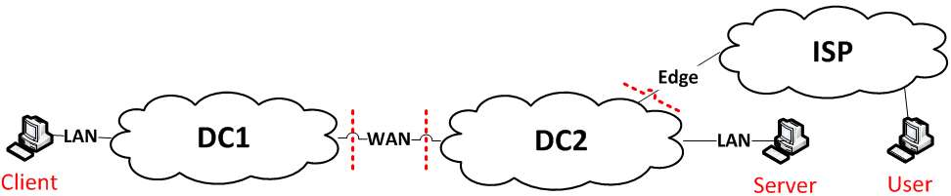
Reactive Ops Use-cases
Split the network into investigation domains.
Quickly exonerate or implicate the network
Time gained not physical moving sniffers from room to room
Verify TCP intelligent network appliance are operating as expected

Slide 22
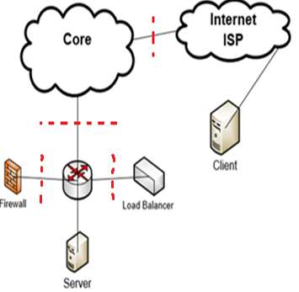
IPV6
Problem Statement:
Users on a large ISP in Seattle are intermittently unable to connect to exchange via IPV6.
Repro facts:
3-way TCP connection setup’s up.
9-way SSL handshake fails
Ack for Client hello doesn’t make it back to Loadbalancer
Solution:
Implicates or exonerates advanced L7 devices that are commonly
finger pointed
Root cause:
Race condition - If the client hello was received on the LoadBalancer,
before the backend connection was made it would trigger the bug
Notes:
Challenges:
In spite of collaborating with impacted users & exchange team, it was difficult to gather data troubleshoot, isolate this intermittent issue.
Bad data:

Slide 23
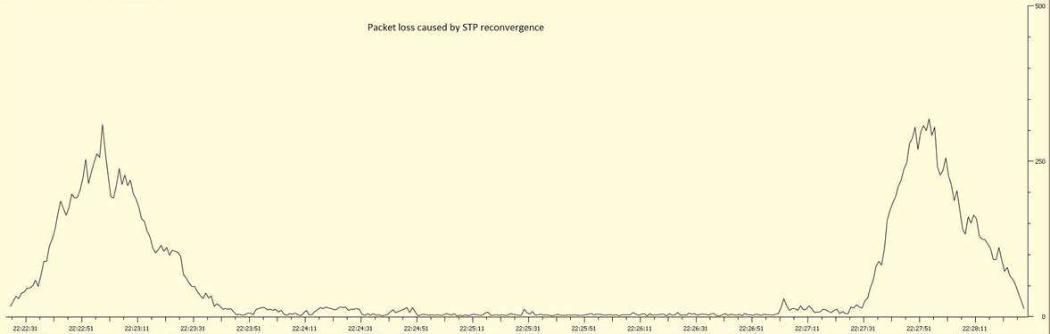
Proactive monitoring Use-case
Relying sole on SNMP polling and syslogs gives you false confidence
Exposure to the underlying TCP telemetry data is true network performance data
Detect retransmissions (TCP-SACK)
Notes:
The more TCP intelligent devices that are in the forwarding path the more things that can go

Slide 24
Controller
Router
Router
Filter_Switch2
Filter_Switch1
policy demo
description “Ticket 12345689 – short desc”
1 match tcp dst-port 443
2 match tcp src-port 443
filter-interface Filter_Switch1_Port1
filter-interface Filter_Switch1_Port2
filter-interface Filter_Switch2_Port1
filter-interface Filter_Switch2_Port2
delivery-interface Capture_server_NIC1
use-service remove_payload chain 1
use-service Layer_7_service_TCP_sack_match chain 2
Notes:
One filter switch can terminate 44 SPANs or L2 links or 22 TAP’d linked
Talk about MM VS SM. Placement of TAP/Filter switch matters.

Slide 25
Port-channels and delivery
Load-balance to multiple tools - Symmetric hashing
Duplicate data to multiple delivery interfaces
Binding portchannels to Openflow
Services expanding multiple interfaces

Slide 26
Increase Visibility on Large L2 networks
Connecting a filter-interface to a L2 network as a trunked link
Unicast flooding: NLB is a loadbalancing technology that doesn’t use traditional hardware based LB’s.
Stolen gateway: Human fat fingers an IP address as the default-gateway.
Broadcasts: All fun in games until the rate of broadcasts increase over some duration and starve out legitimate traffic… AKA broadcast storm.
STP TCN: A single packet that indicates the whole L2 network CAM table is going to be flushed and relearnt. A single occurrence isn’t the end of the world, but if it’s frequent occurrence bad things are happening.

Slide 27
Adding sFlow Analysis
monitor ports
filter1
filter
sFlow samples sourced from all interfaces
sFlow
Behavioral analysis
mux
Controller
delivery
More meaningful captures are taken
sFlow collector logic
Notes:
sFlow exports to collector
Problem subnets are observed through behavioral analysis.
sFlow collector executes Demon policy via the API to send all traffic from these subnets to a capture device
tracer packets are fired toward the capture device describing the reason and ticket number of the event

Slide 28
Remote delivery
monitor ports
filter1
filter
Controller
mux
Production network
delivery
Encap and send to remote tool in other DC
Decap on arrival

Slide 29
Basic Openflow Pinger Functionality
packet is transmitted through the openflow control channel
Spine
Spine
Spine
Spine
Packet flows through the production network
Packet is destined toward example dest 10.1.1.1
Leaf 1
Leaf 2
Controller
Demon 1588 Switch
Openflow encap is removed inner packet is transmitted through specified output port
Packets are counted and timestamps are read for timing analysis
Packet is crafted based on a template
Packets destined for controller encapsulated through Openflow control channel

Slide 30
Cost & Caveats

Slide 31
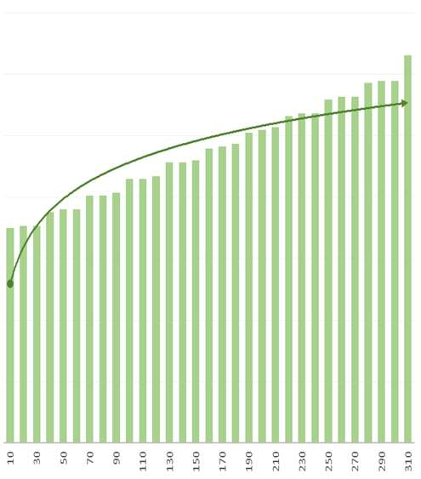
Solution breakdown
Cost to build out a TAP infrastructure to support 200 10gig links.
Cost
Number of links
Notes:
To understand how cost effective this solution really is…
Can save money if you don’t need advanced L7 features
AND/OR if you build your own SDN controller… Floodlight.

Slide 32
Learnings of raw openflow solution
Short term hurtles
TCAM limits
IPv6 support
Lacking multivendor support in the same ecosystem
Can’t match on TCP/IP if packets encapsulated (MPLS,IP-IP)
Most services are static and have a 10Gig cap.
Openflow Ecosystem
switch vendors implement Openflow a little differently
Commercial controller support is splintering.
Whitebox switches/bare metal
Total access/control of the underlying hardware
Notes:
40 port switch with 5 ip addresses (src/dst) =10

Slide 33
Questions ?

Slide 34
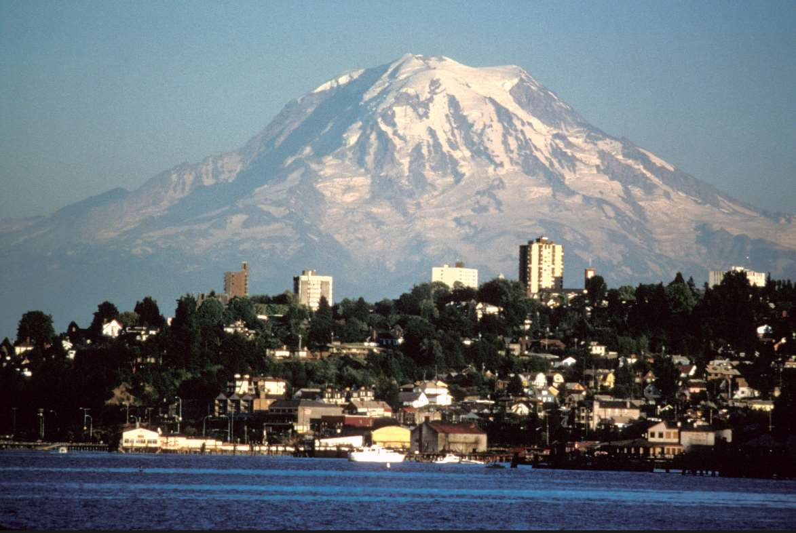
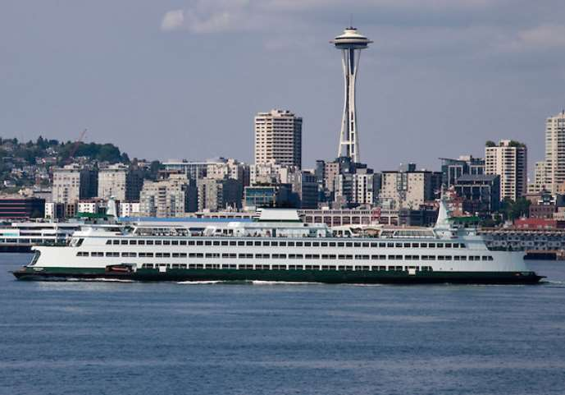
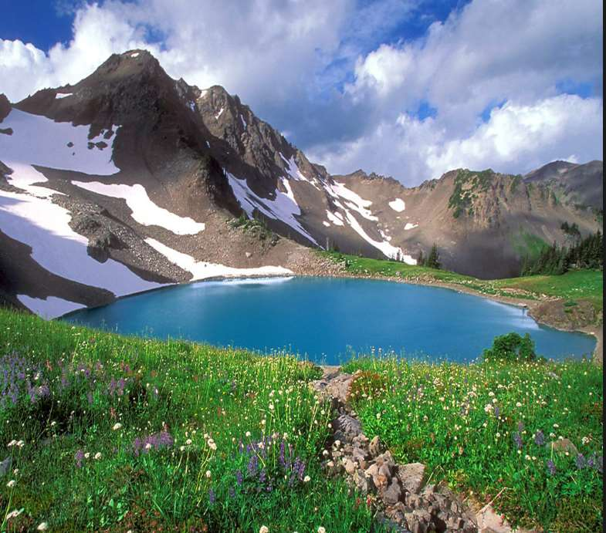

Microsoft is a great place to work!
We need experts like you.
We have larger than life problems to solve… and are well supported
Networking is critical to Microsoft's online success and well funded.
Washington is beautiful!
It doesn’t rain… that much. We just say that to keep people from cali from moving in

