Slide 1
Dive Even Deeper
sysdig – Wireshark for your system

Slide 4
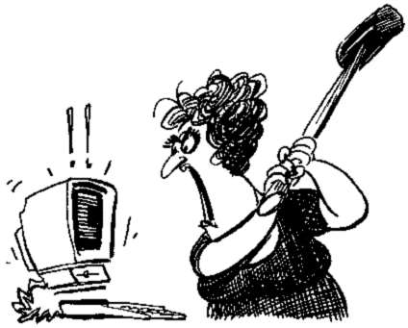

Slide 5
Agenda
Overview
Visualization
Fishing for Hackers

Slide 6
Wireshark Is Awesome

Slide 7
Why Is Wireshark Awesome?

Slide 8
The Workflow!
Capture
Don’t need to sit in front of the machine waiting for the issue
Share trace files
Capture in multiple locations and then correlate
Filter
Find the needle in the haystack
Don’t need to know what you’re looking for
Learn while exploring
Analyze
Put intelligence on top of low level information
Packets can tell us a lot
And never lie

Slide 9
Question: If Wireshark’s Workflow Is So Great, Can We Apply It To System Monitoring?

Slide 10
Sysdig
Capture system events
System calls
Context switches
More
Packetize them
Store them into pcap-ng traces
Wireshark-like display fields
Filtering
rendering

Slide 11
res = open(const char *pathname, int flags)
Type = open
Nargs = 2
“myfile.txt”
1
Store
Analyze
Filter

Slide 12
sysdig
Command line parsing
Capture management
Event parsing
State engine
Filtering
Output Formatting
Chisel execution
sinsp
scap
Capture Control
Dump files R/W
OS state collection
User
kernel
Event Buffer
Sysdig-probe
Non-blocking event collection
Type-based event packing
Memory mapped buffer handling

Slide 13
Chisels
Lua scripts to carve up the data you unearthed
First class citizens from day one
Callback API
Process events
Create summaries
Main API
Control sysdig
Extract fields
https://github.com/draios/sysdig/wiki/Sysdig%20Chisel%20API%20Reference%20Manual

Slide 14
Demo

Slide 15
Get Engaged
http://www.sysdig.org/
https://github.com/draios/sysdig
https://github.com/draios/sysdig/wiki
http://www.sysdig.org/install/

