Slide 1

B5 – TCP Analysis - First Steps
Jasper Bongertz, Senior Consultant
Airbus Defence and Space

Slide 2
About this presentation file
Since this presentation contains lot of animated slides I decided against converting it to a static PDF and offer that for the Sharkfest retrospective page. Instead, you get the PPT, so you can watch stuff happen in presentation mode.
Use the slides in your own trainings if you like. If you do, don‘t forget to mention where you got them from – it was a lot of work creating these ☺
Cheers,
Jasper

Slide 3
Agenda
Basics of managing Data Transfers
The Sliding Window
Packet Loss - „when Things go wrong“

Slide 4
Basics of managing Data Transfers

Slide 5
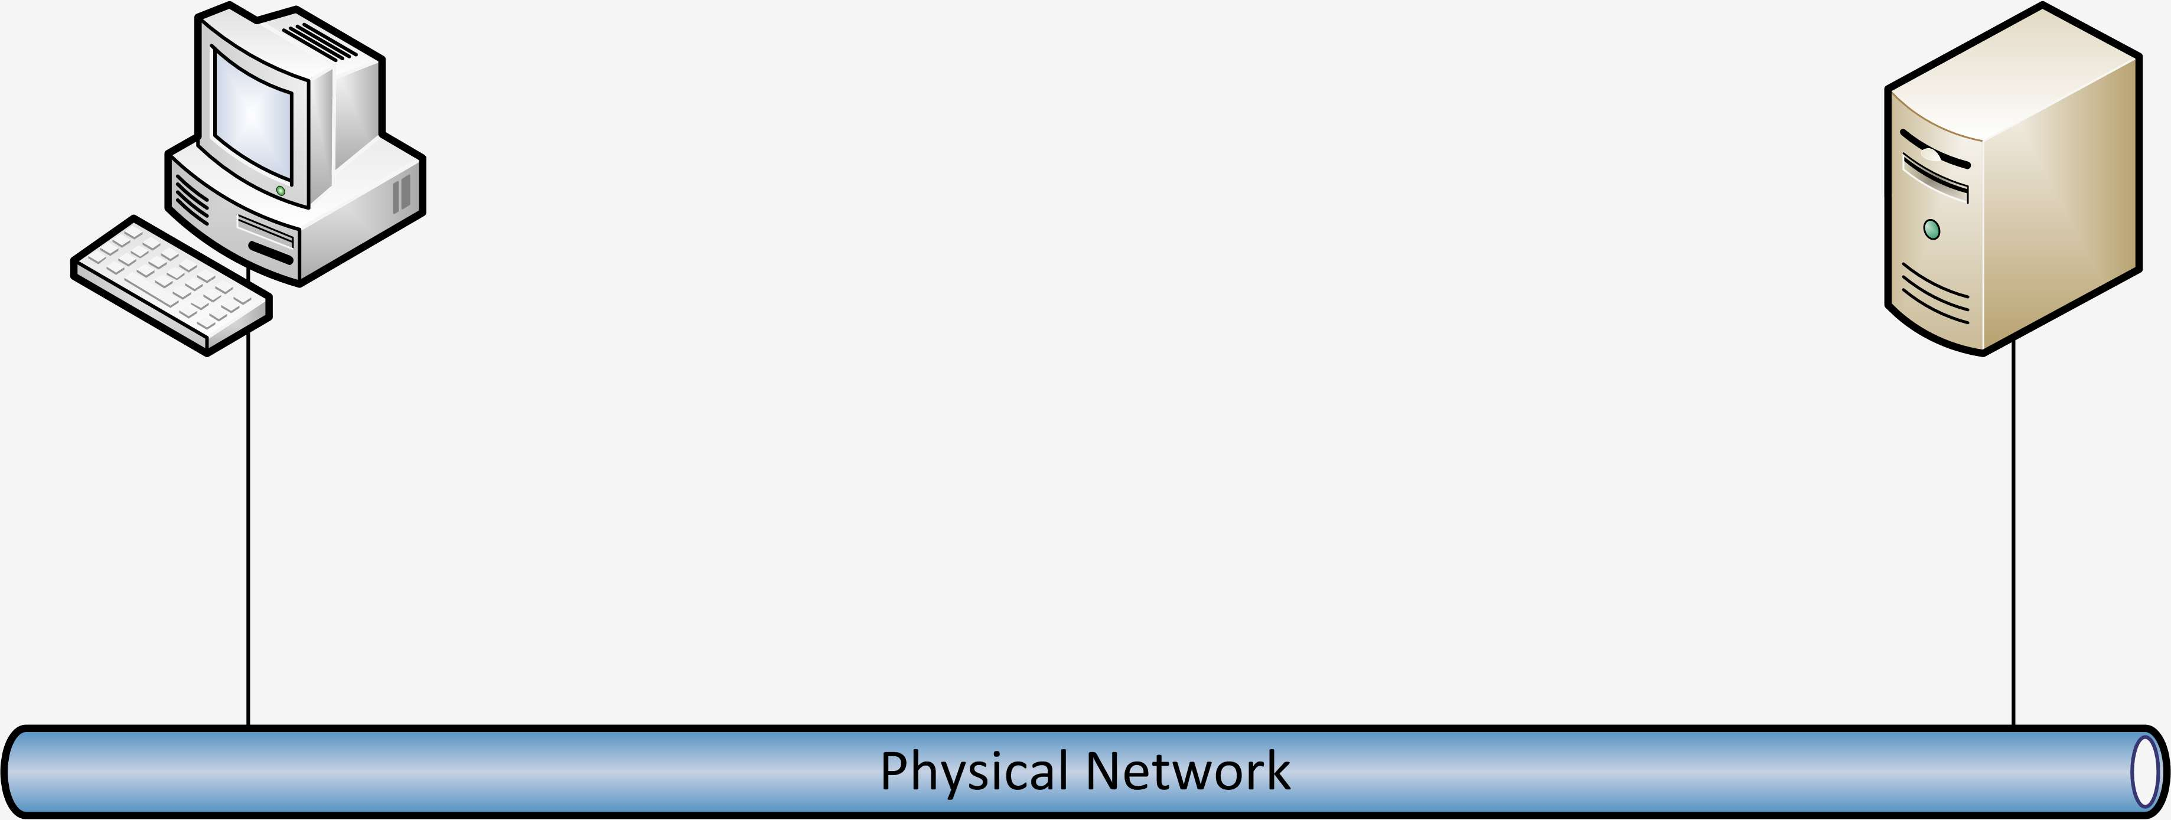
Basics of managing data transfers
Application data is segmented in small chunks before transfer
Data

Slide 6
Basics of managing data transfers
Sucessful Transfer of segmented data is not guaranteed by the physical network...

Slide 7
Basics of managing data transfers
...so let‘s number those segments and confirm which ones are received...
1
2
3
4
5
3
3
2
1

Slide 8
Basics of managing data transfers
Question: is numbering the packets good enough to ensure everything is fine?
Answer: unfortunately not...
  ...because we only know a certain segment was received, but not if it was complete

Slide 9

Basics of managing data transfers
How about this?
Can we improve that further?
#1
Len 100
Got #1
Len 100

Slide 10
Basics of managing data transfers
So let‘s see how TCP does it:
The confirmation is the number of continuous bytes received (meaning: no gaps)
Start at 0
Len 100
Start at 100
Len 100
Got 100
Got 200

Slide 11
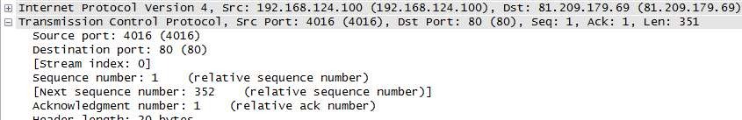
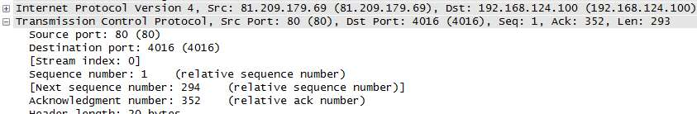
TCP Sequence and Acknowledge
The „Start at“ number is called „Sequence Number“
The „Got it“ number is called „Acknowledgement“
This is how it looks like in Wireshark:
So what‘s the correct ACK number?

Slide 12

TCP Session Start
Before exchanging data, TCP needs to establish the session
  „Three Way Handshake“: SYN -> SYN/ACK -> ACK
  ** Special rule: SYN flags count as 1 byte! **

Slide 13
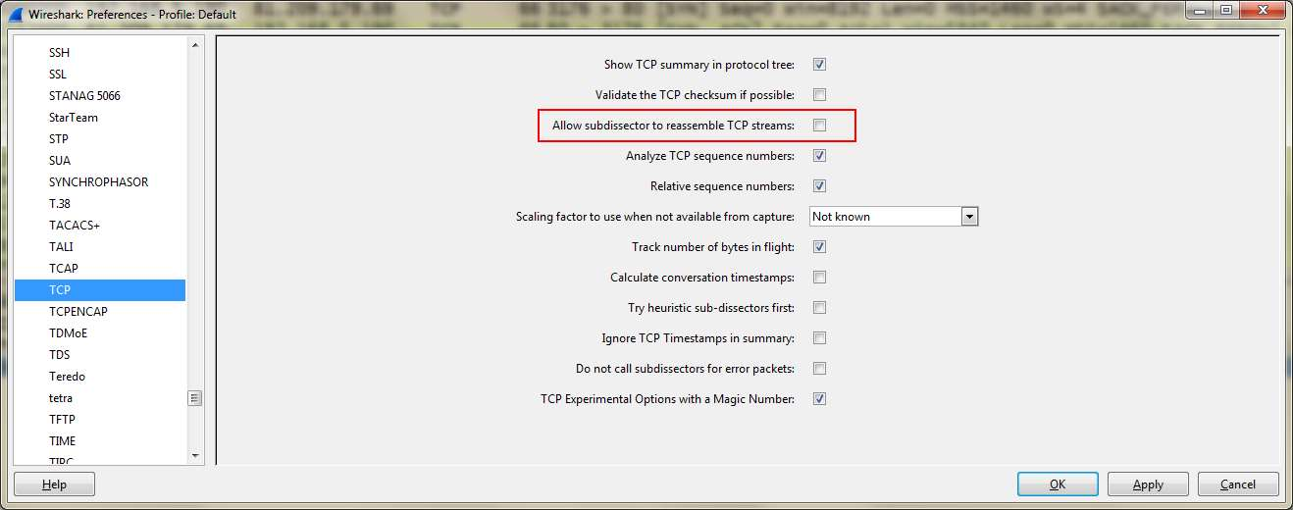
It‘s Wireshark time
First, let‘s turn of TCP reassembly:

Slide 14
Demo

Slide 15
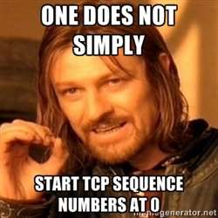
Initial Sequence Numbers
Wireshark displays „Relative Sequence Numbers“ by default
In reality, the initial sequence number is random
It can be anything between 0 and 2^{32:}
  0 - 4294967296

Slide 16
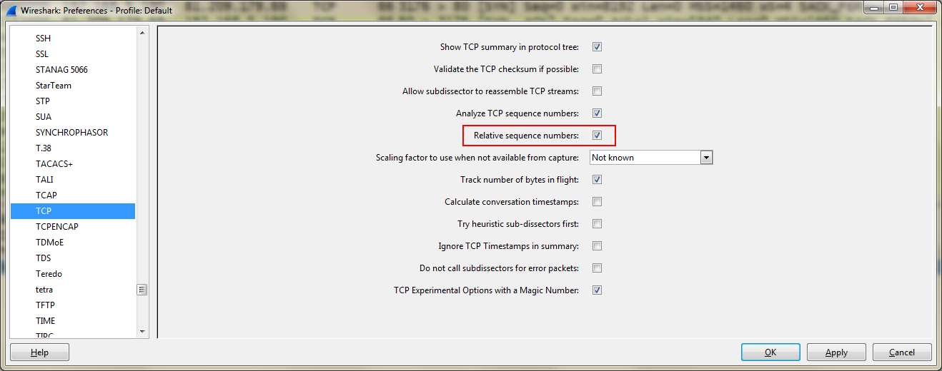
Relative Sequence Numbers
You can turn them on and off in the TCP preferences:

Slide 17
Sequence Numbers – The Rules
Each TCP sequence starts with random number
It is increased by 1 for each byte transmitted
SYN and FIN flags count as 1 Byte („Phantom Byte“)

Slide 18

Okay, let‘s see...
SYN, SeqNo = 100,000
SYN, SeqNo = 500,000
ACK, AckNo = 100,001
ACK, SeqNo = 100,001
AckNo = 500,001
80 Byte Data
SeqNo = 100,001
ACK, SeqNo = 500,001
AckNo = 100,081

Slide 19
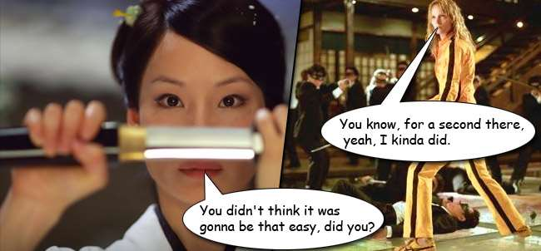
Additional things to consider
Every direction tracks its own sequence number
Relative sequence numbers can fool you because they may look similar for both directions

Slide 20
The Sliding Window

Slide 21
Positive Ack with Retransmission
It is not very efficient to send single packets back and forth:
1
2
3
4
5
3
3
2
1

Slide 22
Instead, send more...
Start at 0
Len 100
Start at 100
Len 100
Got 200
Send me a maximum of 200 bytes at once!

Slide 23
Instead, send more...
Start at 200
Len 100
Start at 300
Len 100
Got 400
Send me a maximum of 200 bytes at once!

Slide 24
Demo

Slide 25
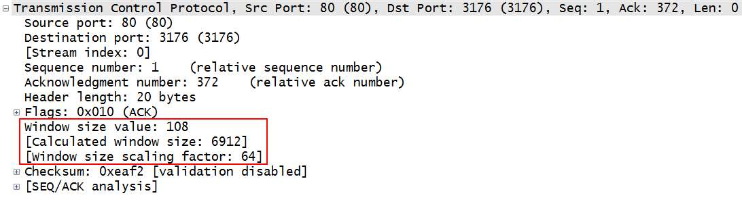
TCP Window Size
The TCP window size is very important as a speed and congestion factor
Look for „Calculated Window Size“ to read the current value

Slide 26
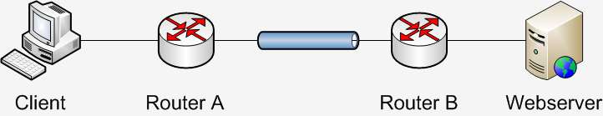

Insufficient TCP window size
A small window can slow down the transmission:
HTTP GET
Winsize=4k
Waiting
for the ACK
ACK

Slide 27
Performance Problems
The TCP Window is a great help for locating congested servers and clients
If a computer sends very low window sizes, or window sizes of zero, it may be in trouble
  Hardware apparently not fast enough to cope with incoming packets
Exceptions:
  Reset Packets -> always has window size of zero
  Busy servers that do not receive much, e.g. Newstickers often have low window sizes

Slide 28
Packet Loss – When things go wrong

Slide 29
First, everything looks good
Start at 0
Len 100
Start at 100
Len 100
Got 200
Send me a maximum of 200 bytes at once!

Slide 30
Then something goes wrong...
Start at 200
Len 100
Start at 300
Len 100
Got 200

Slide 31
Retransmission
Start at 200
Len 100
Got 400

Slide 32
Demo

Slide 33
TCP Retransmissions
Retransmissions happen in every network
Different ways to trigger a retransmission:
  By time out
  By Triple Duplicate ACK
  By Selective Acknowledgement (SACK)
Most important aspect:
  How much time do they cost?

Slide 34
Thanks! Questions?
eMail: jasper@packet-foo.com
Blog: blog.packet-foo.com
Twitter: @packetjay

