Slide 1

I3: Maximizing Packet Capture Performance
Andrew Brown

Slide 2

Agenda
Why do captures drop packets, how can you tell?
Software considerations
Hardware considerations
Potential hardware improvements
Test configurations/parameters
Performance results

Slide 3
What is a drop?
Failure to capture a packet that is part of the traffic in which you’re interested
Dropped packets tend to be the most important
Capture filter will not necessarily help

Slide 4
Why do drops occur?
Applications don’t know that their data is being captured
Result: Only one chance to capture a packet
What can go wrong?
Let’s look at the life of a packet

Slide 5
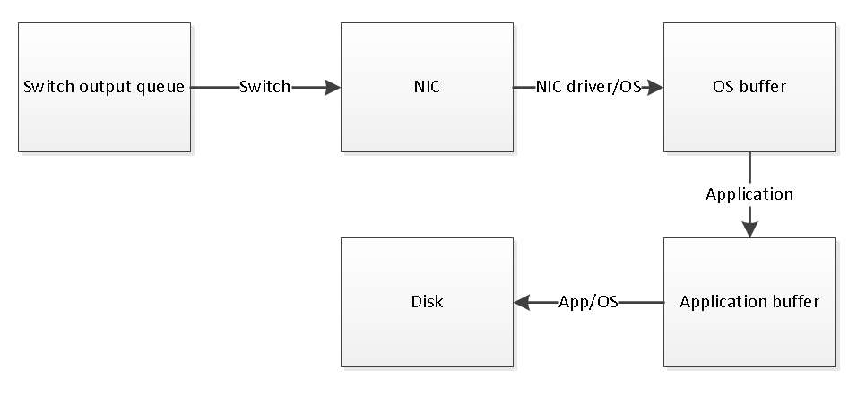
Internal packet flow
Path of a packet from NIC to application (Linux)
Switch output queue drops
Interface drops
Kernel drops

Slide 6
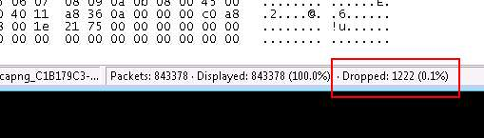
Identifying drops
Software reports drops
L4 indicators (TCP ACKed lost segment)
L7 indicators (app-level sequence numbers revealed by dissector)

Slide 7
When is (and isn’t) it necessary to take steps to maximize capture performance?
Not typically necessary when capturing traffic of
<= 1G end device
More commonly necessary when capturing uplink traffic from a TAP or SPAN port
Some sort of action is almost always necessary at 10G
Methods described aren’t always necessary
Methods focus on free solutions

Slide 8
Software considerations - Windows
Quit unnecessary programs
Avoid Wireshark for capturing
  Saves to TEMP
  Additional processing for packet statistics
    Uses CPU
    Uses memory over time, can lead to out of memory errors

Slide 9
Software considerations – Windows (continued)
Alternative? Dumpcap
  Command-line utility
  Called by Wireshark/Tshark for capture
  Provides greater control
  Dumpcapui for CLIphobic
  “At the limits” example
    Dumpcap captured 100% of packets sent
    Wireshark captured 68% of packets sent

Slide 10
Software considerations – Windows (continued)
Windows dumpcap buffer tuning
  Large buffers are generally good, but…
  Increased bandwidth has a tipping point
    Write to disk slows significantly
    Larger buffers make it worse
    Made buffer selection for testing difficult
    Best option seemed to be 50MB

Slide 11
Software considerations – Windows (continued)
Dumpcap “slow count” example
  Sending 844,600 packets @ .4Gb
  Packets take 1.48 seconds to send
  20MB buffer takes ~2.5 seconds to write
  512MB buffer takes ~46 seconds to write
  Neither setting captured all packets
  Not cosmetic (break out and file is truncated)
  Issue disappears at lower bandwidth

Slide 12

Software considerations – Windows (continued)
Video of normal count

Slide 13
Software considerations – Windows (continued)
Video of “slow count”

Slide 14
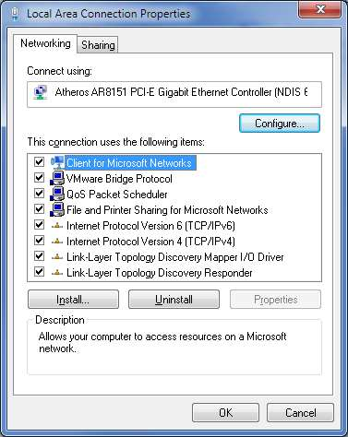
Software considerations – Windows (continued)
Disable protocols on interface (TAP/SPAN)
  Pure TAP/SPAN capture
  Only for TAP/SPAN
  Prevents OS from attempting to interpret packets
  Tested performance with destination MAC set to
  broadcast address
  Result: Captured 100% with protocols disabled,
  only 40% when enabled
  Eliminate performance impact immediately after link up
Uncheck everything below

Slide 15
Software considerations – Linux
Quit unnecessary programs
Use tcpdump with 512MB buffer
Ensure libpcap >= 1.0.0 (tcpdump -h)
Watch value of -s flag
No option to disable protocols like Windows
Static (or no) IP for dedicated capture interface
Use XFS with RAID and coordinate stripe sizes

Slide 16
Software considerations – Linux (continued)
Access to development resources? Look at PF_RING
  Module/NIC driver combination
  Improves capture performance
  Included tcpdump wasn’t better than stock
  We use the API and it works
  Different performance tiers some are free

Slide 17
Software considerations – Linux (continued)
PF_RING
  Kernel module/NIC driver combination
  Improves capture performance via various methods
  Included tcpdump wasn’t better than stock
  We use the API and it works
  Different performance tiers some are free

Slide 18
Hardware considerations - Storage
1Gb line rate traffic generates 123-133MB in one second
WD Black 7.2K RPM: 171MB/s
WD Raptor 10K RPM: 200MB/s
If 10Gb is 10X 1Gb… (do the math)
SSD: ~500MB/s
RAM disk is another option

Slide 19
Hardware considerations - CPU
Three considerations
  Number of cores
  Clock speed
  Performance per clock
Clock speed * PPC = Per-core performance
Multicore is good ...
… but per-core performance is better than many cores

Slide 20
Hardware considerations - NIC
Intel (regular NIC)
  Drivers more actively maintained
  Best PF_RING support
  10G NIC doesn’t help with 1G capture (1G and 10G NICs had the same max bandwidth at or below 1G)
Avoid USB NICs
  USB 2.0 is too slow (480Mb/s)
  USB 3.0 didn’t perform well

Slide 21
Benchmark methodology
Tested limits of capture configurations at 1G and 10G
  For each configuration, increase bandwidth until it fails
  Failure is defined as not capturing all packets
  Highest performing solutions formed basis for recommendations

Slide 22
Obvious question: Traffic profile?
If not testing for a specific use case, what is the appropriate traffic with which to test?
  What mix of TCP/UDP?
  What duration, frequency, severity of bursts?
  What mix of small/large packets?

Slide 23
(My) Answer: Many copies of a single packet with tests at various packet sizes
Takes Receive Side Scaling out of the picture
Removes buffering from the equation
Tends to be pessimistic

Slide 24
Test configuration
Unicast UDP packet used for (almost) all tests
Packet sizes of 64, 128, 256, 512, 1024, 1500 bytes
  Additional CPU overhead for every packet
  One second at 1Gb is ~82K 1500 byte packets
  One second at 1Gb is ~1.49M 64 byte packets
Number of packets tailored to generate a ~1.5GB capture file
Careful to eliminate disk as a bottleneck

Slide 25
Improving performance
The ideal
Ideal capture laptop
  Fast CPU
  Fast storage (SSD RAID)
  Dedicated Intel NIC
  10G capability
Perfect except for one issue
…it doesn’t exist

Slide 26
Improving performance Thunderbolt
PCIe via a cable (developed by Intel)
Allows use of desktop cards on a laptop
Expensive
Not very widespread (mostly Apple computers)
Other laptop limitations are still a problem

Slide 27
Improving performance
Laptop alternative
What level of performance is possible from (relatively) portable commodity hardware?
Packet toaster
  Used for all capture testing
  Intel i5 4570 desktop CPU (3.6GHz quad-core)
  Up to 16GB RAM for RAM disk
  Up to 4 SSD in RAID 0
  Cost ~$800 with 8GB RAM, 2 SSDs
Concept: Run without monitor, manage via laptop

Slide 28
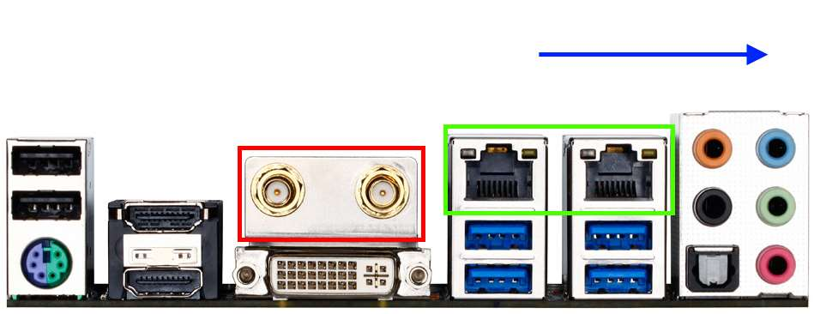
Packet Toaster port layout
Intel 1G NIC
Additional 1G NIC for management (SSH/RDP)
802.11n for capture (Linux) or management
PCIe slot for 10G

Slide 29
Solarflare
Low-latency NIC with stack bypass
Why include it?
  Price competitive with other commodity 10G NICs
  Works as a regular NIC under Linux, Windows, Mac etc.
  Works at 1G also
  SolarCapture app for high-performance Linux capture
Hardware/software capture solution
Tested with Packet Toaster and MacBook Pro
(via Thunderbolt)

Slide 30
The difference a week makes
At the time of testing, SolarCapture was a free download
Less than a week ago, Solarflare changed licensing tiers; free SolarCapture is no longer available
Pricing is reasonable (in my opinion) but…
  …reasonable is relative
  …this breaks my original concept of free software
Debated removing results but couldn’t (impacted other results and no time to re-test)

Slide 31
Performance Results Configurations
Wireshark under Windows 7 (SSD)
Dumpcap under Windows 7 (SSD)
Dumpcap under Linux (SSD)
TCPDump under Linux (SSD)
SolarCapture under Linux on MacBook Pro
via Thunderbolt (RAM)
SolarCapture under Linux (SSD)
SolarCapture under Linux (RAM)

Slide 32
Performance Results
Wireshark vs. Dumpcap (Win 7)

Slide 33
Performance Results
Dumpcap (Win7) - Dumpcap (Linux) – TCPDump (Linux)

Slide 34
Performance Results
Dumpcap (Win7) - Dumpcap (Linux) – TCPDump (Linux)

Slide 35
Performance Results
TCPDump (Linux) – SolarCapture (SSD) – SolarCapture (RAM)

Slide 36
Performance Results
Dumpcap (Win7) - Dumpcap (Linux) – TCPDump (Linux)

Slide 37
Performance Results
By Packet Size

Slide 38
Performance Results
By Configuration

Slide 39
Acknowledgements
BATS Global Markets
Guy Harris
  Core developer: libpcap, tcpdump and Wireshark

Slide 40
Appendix - Links
Links
  http://www.intel.com (Intel NICs)
  http://www.ntop.org (PF_RING)
  http://www.solarflare.com (SolarCapture)
  http://www.tcpdump.org (TCPdump/Libpcap)
  http://www.wireshark.org (Wireshark/Dumpcap)
  http://www.macsales.com (Thunderbolt enclosure)

Slide 41
Appendix – Packet Toaster Specs
CPU: Intel i5 4570 (3.6GHz quad-core)
Motherboard: Gigabye Z87N-WIFI
RAM: 8GB DDR3
Storage
  Samsung 840 Evo (Operating System)
  2 x Sandisk Extreme in RAID 0 (Capture destination)

Slide 42
Questions

