Slide 1

Top Causes for Poor Application Performance
Case Studies
Mike Canney

Slide 2

Contact Info…
Mike Canney, SE
mike.canney@riverbed.com

Slide 3
Bad Packets = Bad Analysis = Engineer that is wrong!
Where do you capture?
  Dedicated appliance vs. move when you need it
What Tools do you use?
How much money do you have?
How can I do this on the cheap?
Do I TAP the network or do I SPAN?

Slide 4
Design your own capture Strategy
What does your network look like?
What are your goals with capturing the packets?
  Troubleshooting?
  Statistical information? (Who, what, when and why.)
  Long term solution vs. turning it on and off when needed?
  Do multiple engineers need to view this capture data?

Slide 5
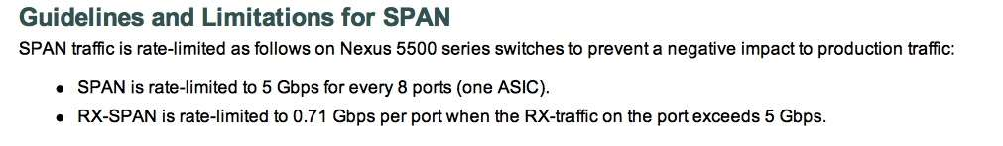
Rethink the use SPANs…

Slide 6
Creating your own Capture to Disk Appliance (CDA)
What is needed?
  Wireshark full download (dumpcap)
  Decommissioned PC or standalone “server” with multiple NICs.
  Simple batch file to launch the captures.
  Pilot!

Slide 7
The Batch File
cd \program files (x86)\wireshark
dumpcap -i 1 -b files:1000 -b filesize:2000000 –w c:\traces\internet\capture1.pcap
This batch file creates 1,000, 2 Gigabyte trace files in a ring buffer. When it reaches file 1,000 it starts rewriting the trace files.

Slide 8
So why 2 GB files?
Pilot!
I have analyzed traces in excess of 2 TB with Pilot in a matter of minutes.

Slide 9
Trace File sizes are out of control
10 Mbps 1.25 MBps
100Mbps 12.5 MBps
1 Gbps 120.5 MBps
10 Gbps 1.25 GBps
100 Gbps 12.5 GBps

Slide 10
The case of the SLOW Internet…
Case Study 1

Slide 11
The best way to create a CDA and still be cost effective
vShark
Up to 2 TB of rolling capture disk
Can install it on a stand alone ESXi server and use the physical NICs for capture.
Allows multiple people to access the Shark.
Can set up alerts (watches)

Slide 12
TCP and my Love/Hate relationship…

Slide 13
TCP Windowing
The TCP Window Size defines the host’s receive buffer.
Large Window Sizes can sometimes help overcome the impact of latency.
Depending on how the application was written, advertised TCP Window Size may not have an impact at all (more on this later).

Slide 14
Flow Control…
Slow’s the sender down if the receiver cannot handle the load
Uses a “window update”
  Typically along with an ACK
Sender is allowed to inject X amount of data onto the network before receiving an ACK
Set by the receiver

Slide 15
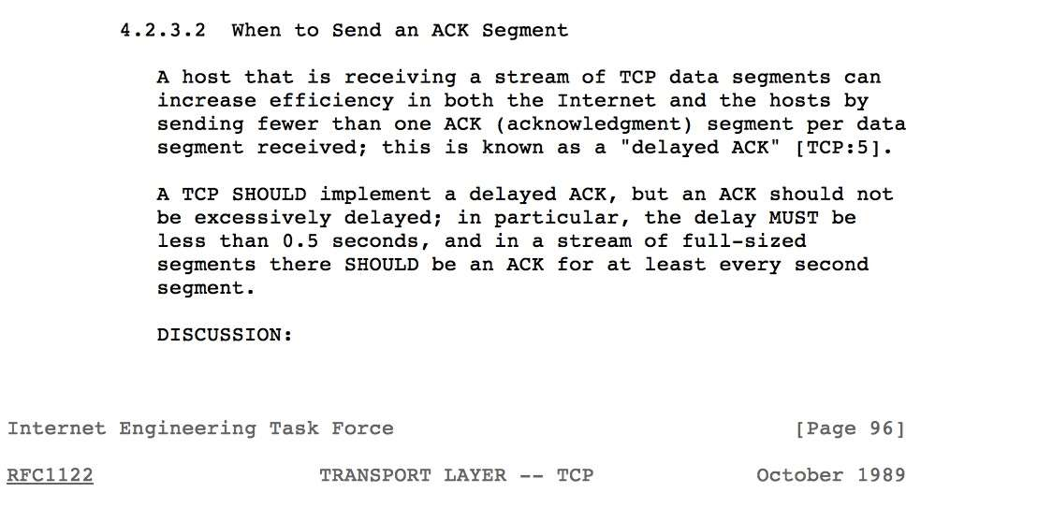
When are TCP ACKs sent?
RFC 1122

Slide 16
Server
Client
5,840 Byte Block
5,840 Bytes ACKed
5,840 Byte Block

Slide 17
Mystical Slow File Transfer…
Case Study 2

Slide 18
Server
Client
2,944 Byte Block
2,944 Bytes ACKed
With ~200ms delayed
ACK
2,944 Byte Block

Slide 19
Application Turns and Application Block Size

Slide 20
Application Turns
An Application Turn is a request/response pair
For each “turn” the application must wait the full round trip delay.
The greater the number of turns, the worse the application will perform over a WAN (Classic “Chatty” application).

Slide 21
App Turn Example

Slide 22
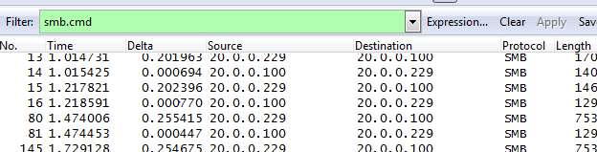
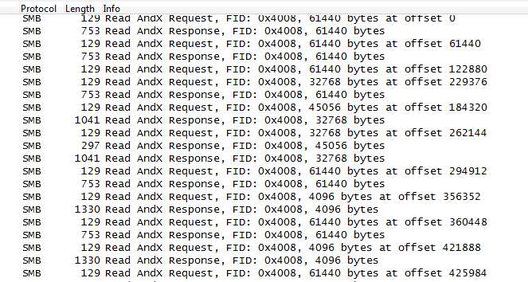

Slide 23
How does this impact response time?
It is easy to determine Application Turns impact on end user response time
  Multiply the number of App Turns by the round trip delay:
    100,000 turns * .040 ms delay = 4,0000 seconds due to latency

Slide 24
How do we make the most of our Bandwidth?
Bandwidth Delay Product (BDP)
  Bandwidth * Round Trip Latency/8 = offered load needed to fill the pipe
  (44,000,000 * .04)/8 = 220,000 bits per second to fill a DS3

Slide 25
Pop Quiz!!
We have an application that uses a 61,440 byte block size
This application has been deployed to Hawaii over a DS3 with 200 ms of round trip latency.
What kind of throughput should I expect?

Slide 26
How fast can we go?
Throughput = Offered Load (Block Size)/Round Trip Latency
Throughput for this deployment:
  (61,440/.200)*8 = 2,457,600 bits per second!!

Slide 27
Microsoft file transfer
Using SMBv1 in a WAN environment, is it faster to copy a file to the server or copy a file from the server?

Slide 28
The File Copy is Killing us!
Case Study 3

Slide 29
Multiple Capture points fill in the picture!
Case Study 4

Slide 30
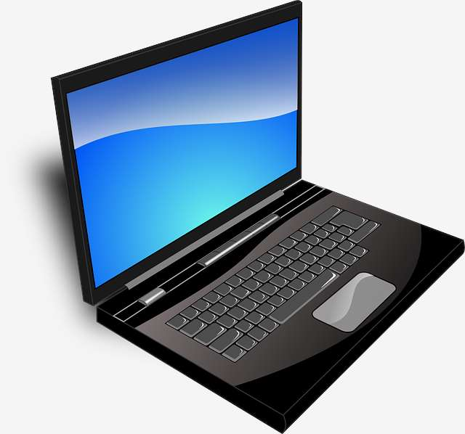
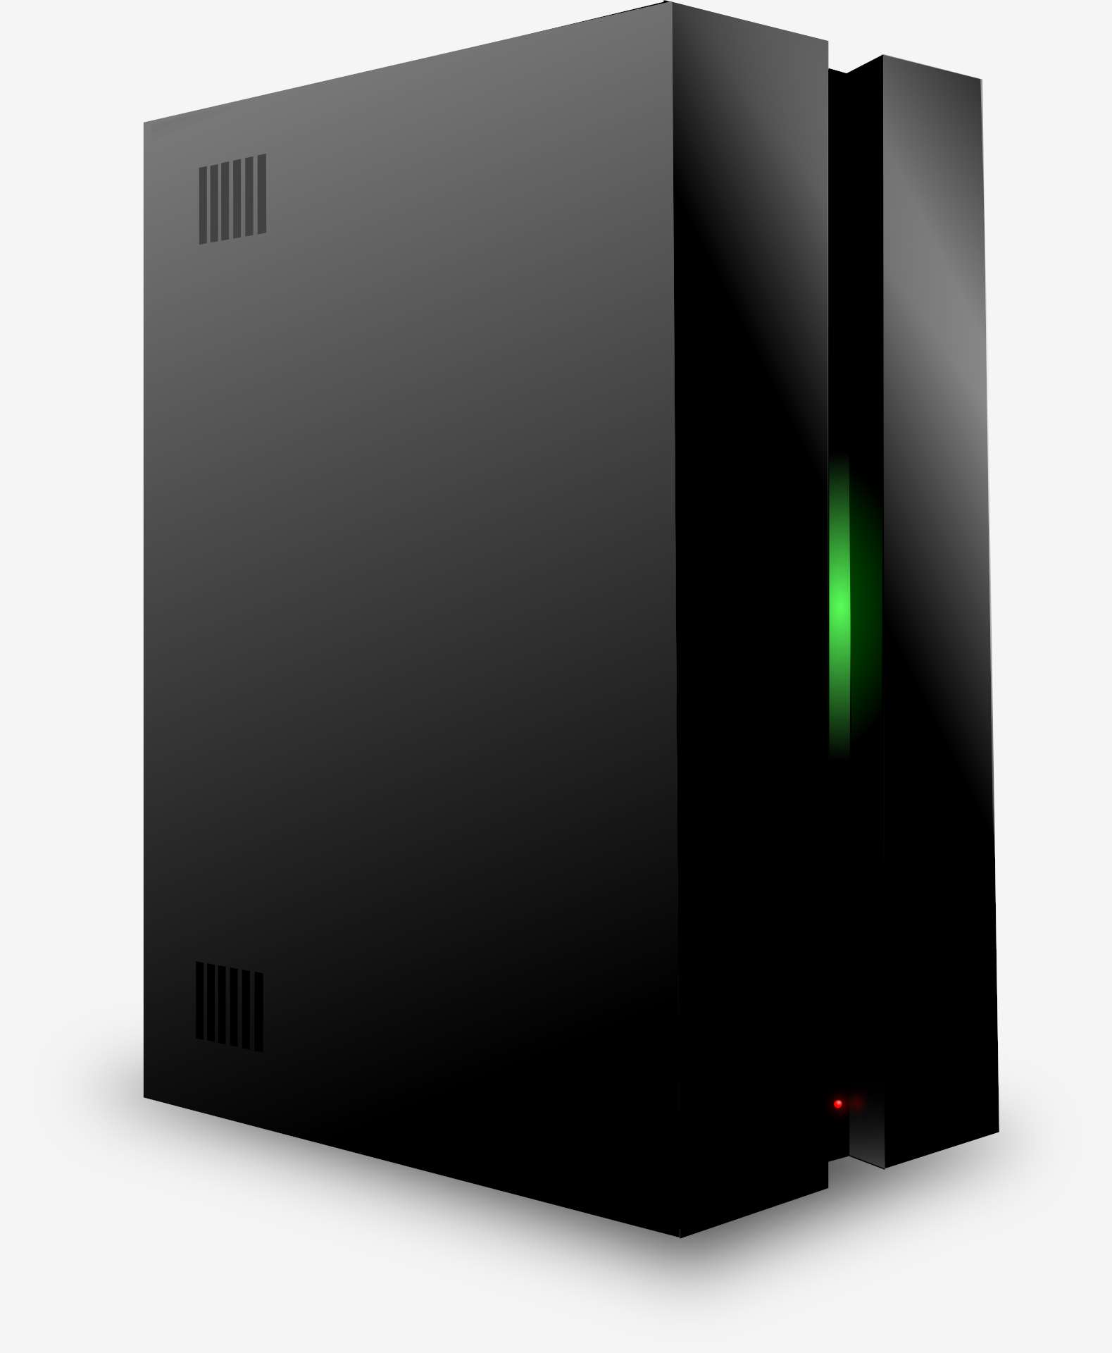

Lay of the Land…
End User
WEB Gateway
Internet
Users complaining that the Internet is slow!

Slide 31
Domain Users Login Nightmare!
Case Study 5

Slide 32
Thank You!
Mike Canney

