Slide 1
Monitoring Mobile Network Traffic (3G/LTE)
Luca Deri <deri@ntop.org>

Slide 2
Overview
Introduction to mobile traffic monitoring
Analysing mobile traffic with Wireshark
Monitoring mobile traffic using ntop nProbe, an open-source traffic monitoring probe.
Advanced mobile monitoring topics.

Slide 3
Why Mobile Traffic is Interesting?
Plain (wired or wireless) traffic monitoring is a topic that has been covered since very long time and there are many solid monitoring tools available.
Traffic generated by mobile devices is constantly increasing and it cannot be monitored using tools not designed for this task.
Mobile traffic monitoring does not mean that this is a just topic for mobile operators: there are plenty of opportunities for companies already active in the network monitoring world.

Slide 4
Opportunities in Mobile Monitoring [1/2]
Mobile network monitoring tools are usually derived from the telecommunication world.
Often these tools produce aggregated metrics (i.e. number of bytes per cell) or radio-related statistics.
Traffic monitoring tools are often not able to monitor mobile traffic in detail and usually rely on costly data capture cards or custom designed FPGA-based board.

Slide 5
Opportunities in Mobile Monitoring [2/2]
Monitoring tools are (usually) proprietary, and tight to the hardware platform used to capture data.
Monitored data is stored in proprietary format and usually not available to third party apps (no open-data).
Open source mobile traffic monitoring tools are rare, often just research tools (e.g. thesis outcome) and not production ready.

Slide 6
Motivation
Bring benefits of open-source and open-data to mobile traffic monitoring.
Exploit wireshark for mobile-traffic troubleshooting.
Create comprehensive mobile traffic monitoring tools leveraging on code and lessons learnt on Internet traffic monitoring.
In essence “open” the world of mobile traffic monitoring as happened with Internet monitoring.

Slide 7
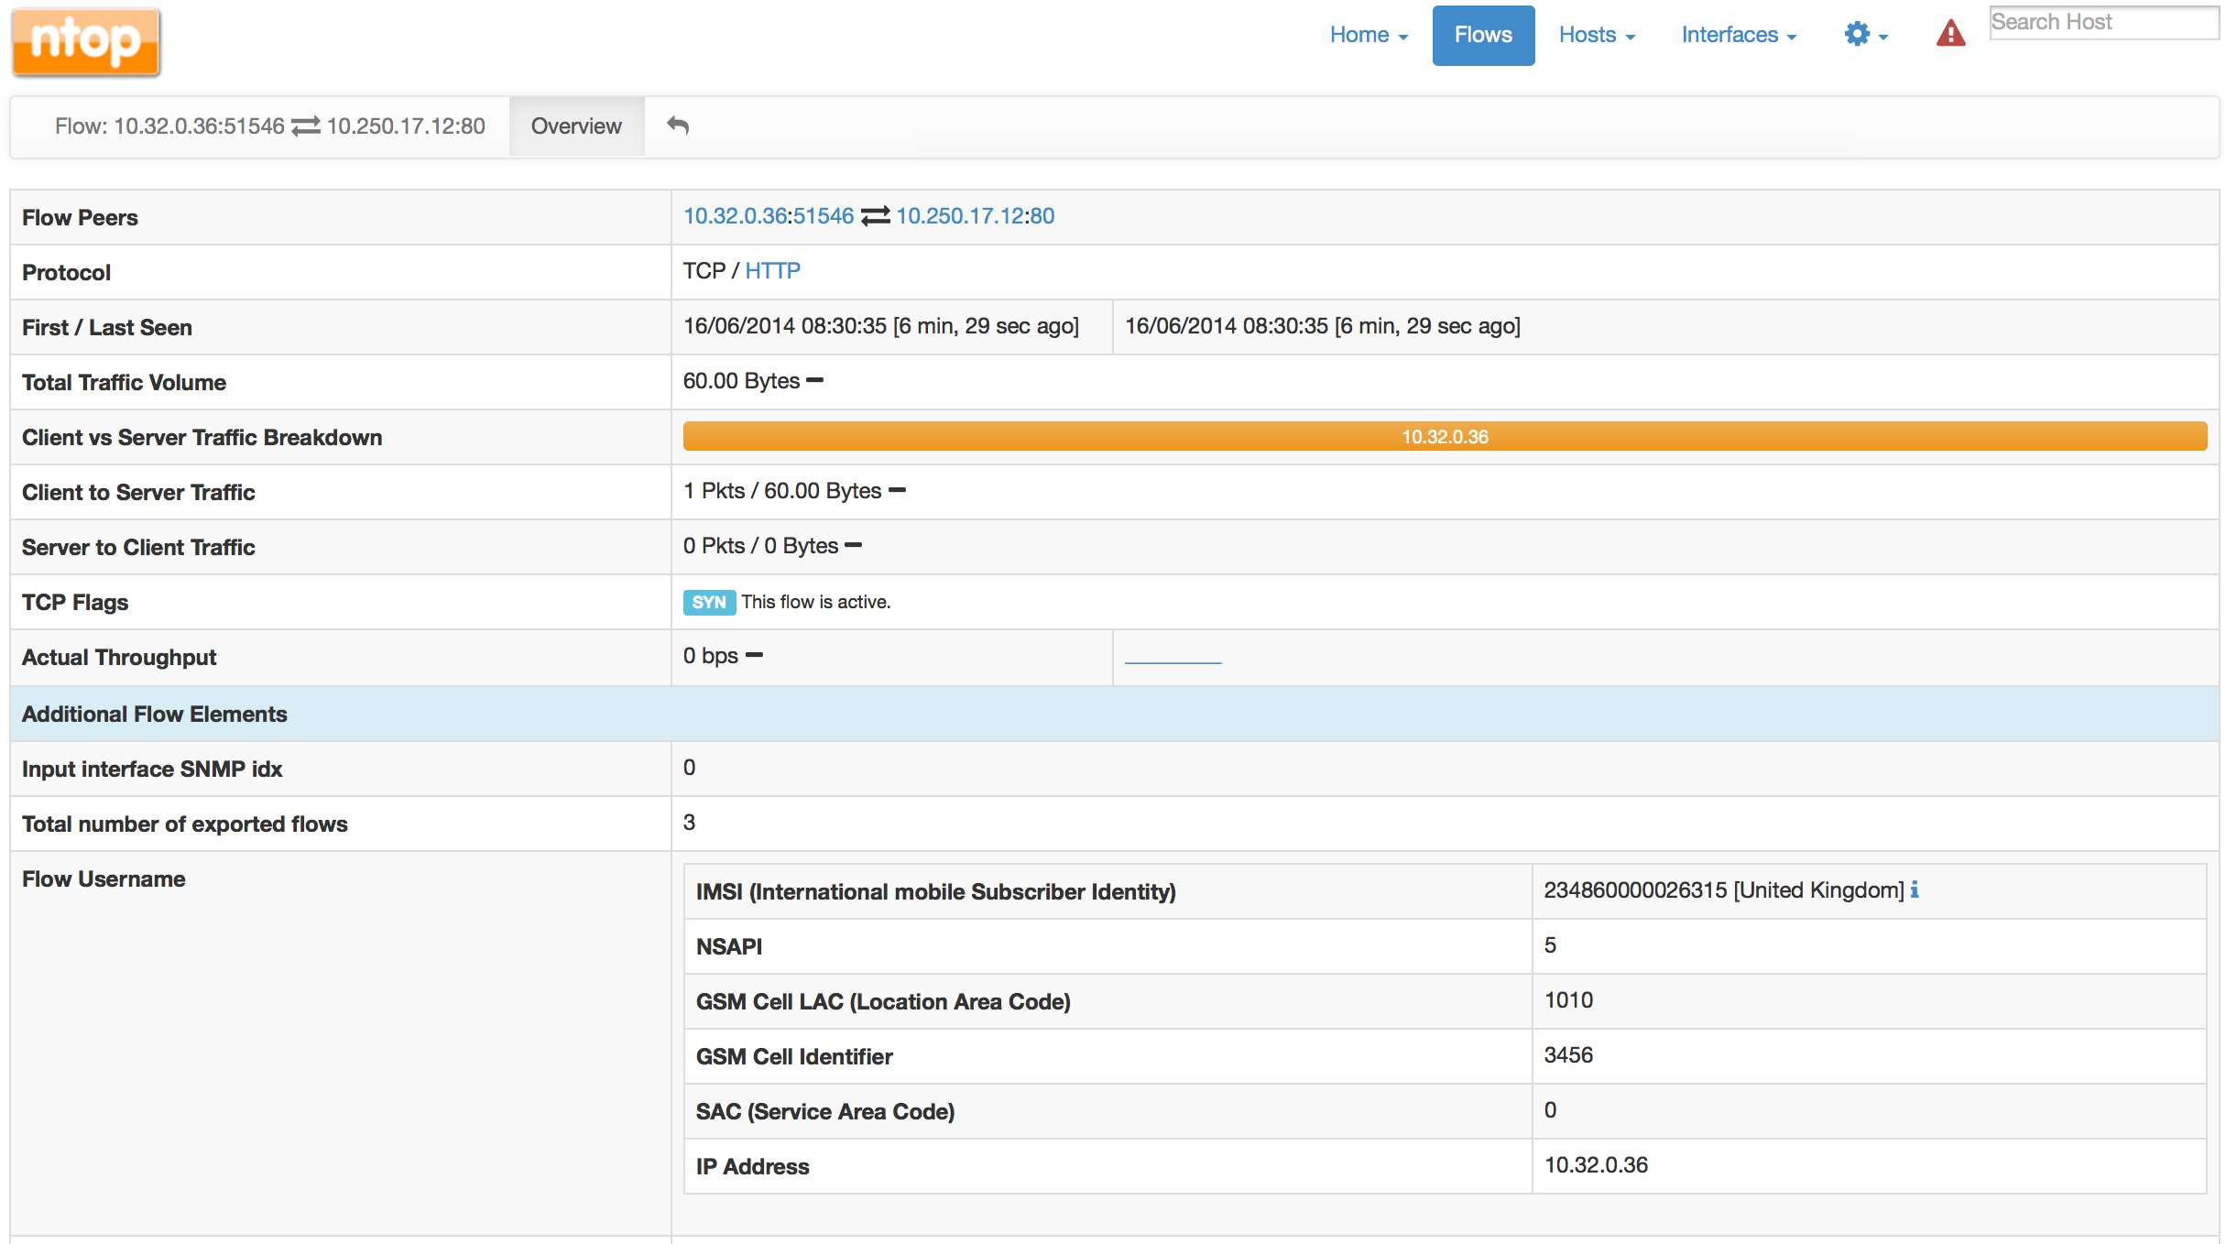
Let’s Start From The End…
What
Who
Where
Important: All realtime, using open source software, at 10 Gbit.

Slide 8
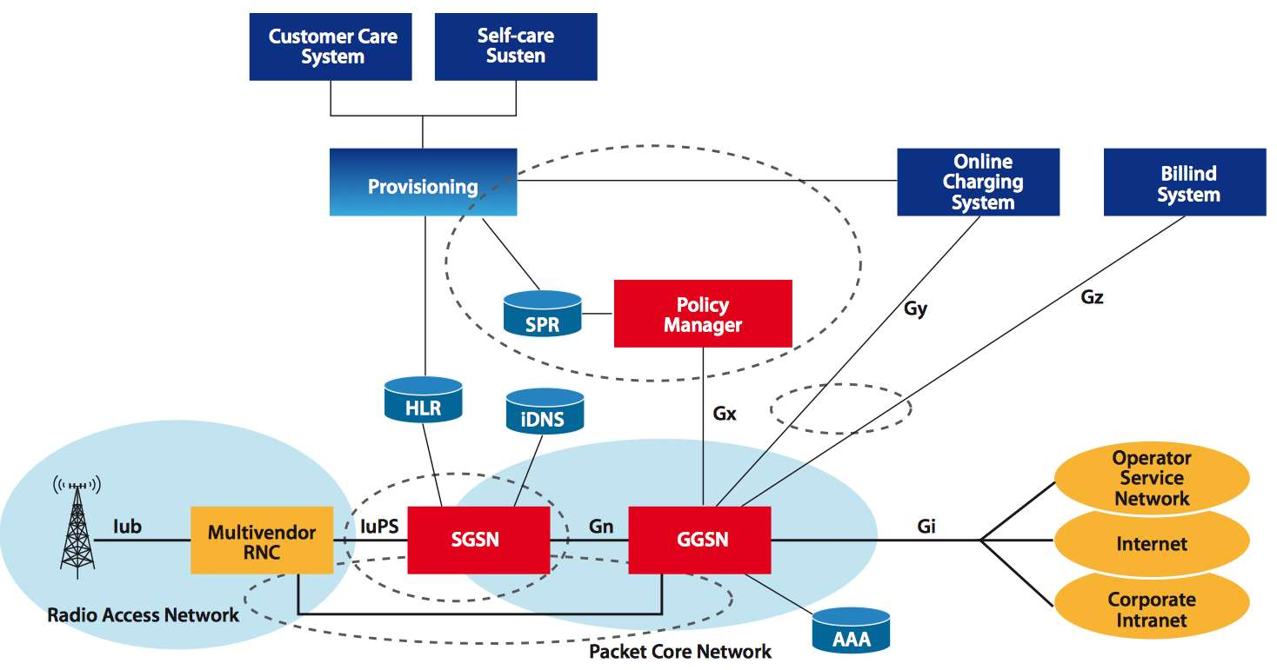
Mobile Network Architecture
Body Level One
Body Level Two
Body Level Three
Body Level Four
Body Level Five
Monitoring
Interfaces
Core Gateways

Slide 9
GPRS Core Network Nodes [1/2]
SGSN (Serving GPRS [General Packet Radio System] Support Node) is a node responsible for:
User authentication
Data session management including QoS (based on subscription type).
Gateway towards the radio access.
Traffic routing towards GGSN.
Management of roaming users.

Slide 10
GPRS Core Network Nodes [2/2]
GGSN (Gateway GPRS Support Node) is a node responsible for:
Inter-networking between the GPRS network and external network such as the Internet.
Gateway towards external networks (e.g. the Internet) identified by an APN (Access Point Name).
IP assignment to mobile terminals.
Billing and support for lawful interception.

Slide 11
Additional Network Nodes
iDNS (internal Domain Name Server) DNS server used to resolve APN an GGSN addresses to mobile terminals.
HLR (Home Location Register) Database containing the subscriber profiles.
Policy Manager Control platform able to interact with network devices in order to implement access control, per-user QoS, user charging and billing.

Slide 12
Core Network Interfaces
SGSN-to-GGSN (Gn) Interface IP-based network interface between the SGSN and the GGSN. In 4G networks this interface is called S11.
GGSN-to-PDN (Gi) Interface IP-based network interface between the GGSN and a public data network (PDN) such as the Internet. In 4G networks this interface is called S5.

Slide 13
Traffic Routing in GPRS Networks [1/2]
From the Internet, the GGSN is a router to an IP subnetwork: when incoming (from the Internet) traffic is received, it checks if the mobile address is active, and if so, it forwards the traffic to the SGSN gateway serving the mobile terminal.
When egress traffic (to the Internet) is received from the GPRS code, it routes it to the correct external network.

Slide 14
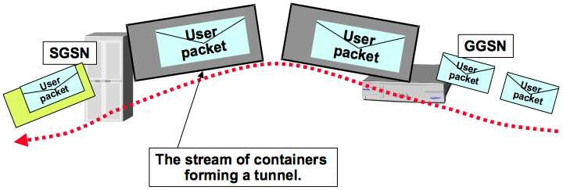
Traffic Routing in GPRS Networks [2/2]
On the GPRS network, user traffic is sent in tunnels that traverse the network backbone.
For mobile terminal, it looks as if they are connected via a router (the GGSN) to the Internet.
Properly handling tunnels, allows mobile users to move inside the mobile network while connected to the Internet with a permanent IP address (i.e. it does not change overtime).

Slide 15
GPRS Tunnelling Protocol [1/2]
GTP is the IP-based protocol used inside the core GPRS network.
In essence it is a tunnelling protocol that allows mobile terminals to move within a GSM/WCDMA network while connected to the Internet.
There are two GTP protocol versions (v0 is obsolete):
v1: used in 2G/3G/4G networks.
v2: used (for signalling) in 4G networks.

Slide 16
GPRS Tunnelling Protocol [2/2]
GTP can be decomposed into:
GTP-C used as signalling protocol between the GGSN and SGSN (Gn interface) as it allows to activate/deactivate an user session (PDP Context activation), modify session QoS, update an existing session.
GTP-U used to carry user data (e.g. email, Facebook, Whatsapp messages) between the radio access network and the GPRS core network, and within the GPRS core network.

Slide 17
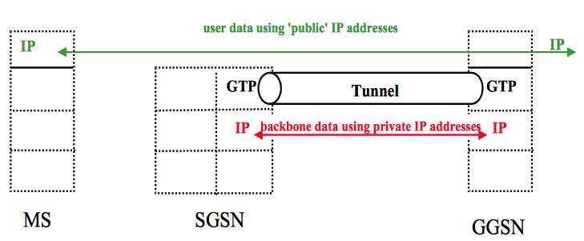
GTP Tunnelling [1/3]
Every user packet is encapsulated in GTP tunnels (Gn Interface).
Through the use of GTP tunnels, the mobile subscriber (MS) traffic traverses the GPRS backbone up to the Internet.

Slide 18
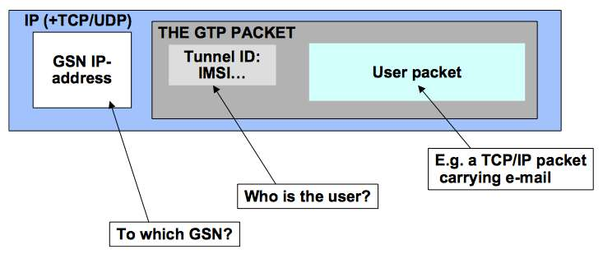
GTP Tunnelling [2/3]
GTP packets contain several encapsulation layers.
The external IP are those of the GGSN and SGSN.
The GTP packet contains the tunnel-Id that identifies the user IMSI (International Mobile Subscriber Identity) stored in the phone SIM.

Slide 19
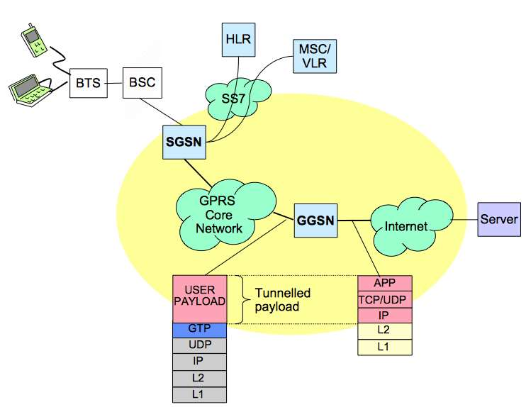
GTP Tunnelling [3/3]
User Traffic

Slide 20
GTP Tunnels [1/3]
A GTP tunnel is necessary for forwarding packets between an external network (e.g Internet) and a mobile station (MS).
As applications running on a mobile station can open multiple GTP tunnels, each tunnel has a NSAPI identifier associated (Network Service Access Point Identifier.
A tunnel Id (TEID - Tunnel Endpoint Identifier) identifies a GTP tunnel and is defined by two associated PDP (Packet Data Protocol) contexts (same principle as in TCP).

Slide 21
GTP Tunnels [2/3]
Tunnels are negotiated with GTP-C (UDP port 2123).
A tunnel is setup by a GTP Context Create PDU and deleted using a GTP Context Delete PDU.
During tunnel creation, all the mobile station information is exchanged and this is the only moment where it is possible to observe the association between a mobile station and an IP address.

Slide 22
GTP Tunnels [3/3]
GTP-C traffic is just about 10% of the overall traffic but it is mandatory not to drop any packet as otherwise the association between tunnel Ids and mobile users is lost for the duration of the tunnel.
Caveat: for “static devices” (e.g. a water meter with an embedded GSM modem for remote access) the GTP tunnel might be created when the device is installed, and stay active for the lifetime of the device (e.g. a few years).

Slide 23
GTP Support in Wireshark
Wireshark contains native dissectors for GTP (v0, v1, and v2).
It is able to follow GTP tunnels via “Follow UDP Stream”.
Wireshark can associate GTP requests with responses as well decode GTP fields.
Each GTP message has a fixed header message format (e.g. where the IMSI is stored), and a set of variable fields, each identified by a unique numeric identifier.

Slide 24
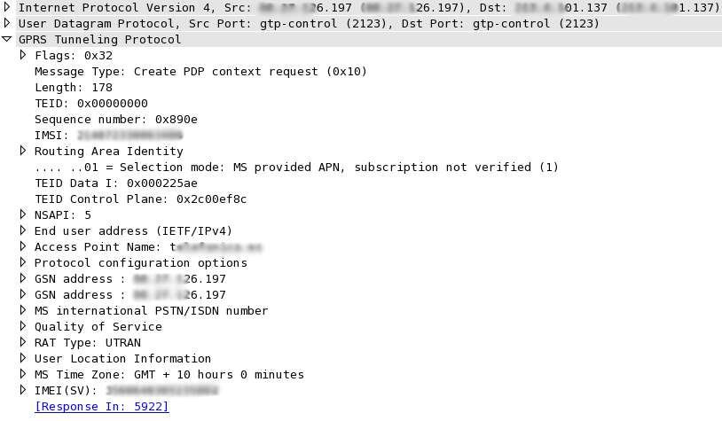
GTP-C Context Creation [1/2]
SGSN
GGSN
Associate Request
with Response
Unique User (SIM) Identifier
GTP-U Tunnel Id (SGSN -> GGSN)
GTP-C Tunnel Id (SGSN -> GGSN)
Session Identifier (0-15)
Requested Address Type (IPv4 or IPv6)
Mobile Terminal Phone Number
Bandwidth Assigned to the Mobile Terminal (Contract)
Radio Cell to which this Mobile Terminal is connected
International Mobile Equipment Identity (Unique Mobile Device Identifier)

Slide 25
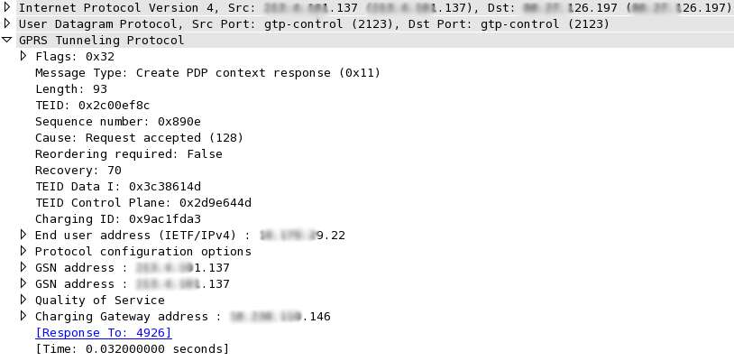
GTP-C Context Creation [2/2]
GGSN
SGSN
(IP Swap)
Same as Request
0
Positive/Negative Response
GTP-U Tunnel Id (GGSN -> SGSN)
GTP-C Tunnel Id (GGSN -> SGSN)
Assigned IP Address (DHCP-like)

Slide 26
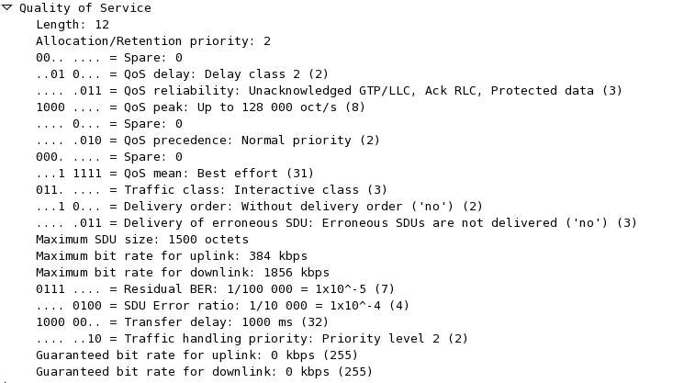
GTP-C QoS

Slide 27
GTP-C Mobile Terminal Location
During GTP-C context creation, the mobile terminal reports the cell to which it is currently connected.
Using the Cell LAC (Location Area Code) or Cell CI (Cell Identifier) it is possible to know approximately where the terminal is currently located (no GPS is needed).

Slide 28
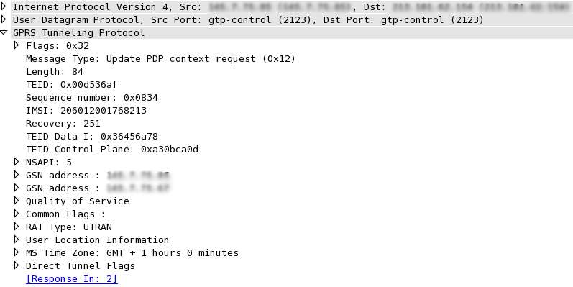
GTP-C Context Update [1/2]
When a mobile terminal changes SGSN (move inside the mobile network), the TEID can change.
GTP Direct Tunnel (see later).
Current TEID
New TEIDs
Current Location
Direct Tunnel Info

Slide 29
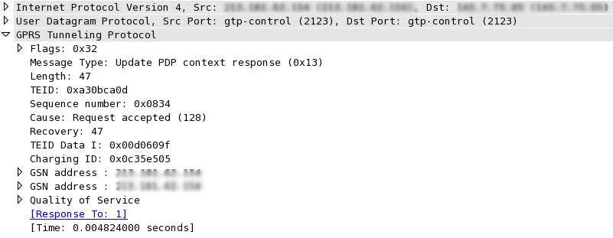
GTP-C Context Update [2/2]
In the response (if positive) there are the new tunnels for the reverse direction.
New TEID

Slide 30
3G Direct Tunnel (3GDT) [1/2]
The 3GDT allows direct data transfer from the Radio Access Network (RAN) to the GGSN, without passing through the SGSN (4G is always direct tunnel).
Without 3GDT
With 3GDT

Slide 31
3G Direct Tunnel (3GDT) [2/2]
With 3GDT the SGSN is offloaded by some tasks as GTP-U flows directly (but GTP-C still goes through the SGSN) decreasing latency and promoting network scalability.
During 3GDT activation/teardown, the GTP-C Context Update is used to update the TEIDs between the RAN and the GGSN (~40% more signalling on the GGSN due to GTP-C Updates).
3GDT is often activated from a mobile device wakes up, and deactivated when goes to sleep (no data transfer).

Slide 32
GTP-C Context Delete
GTP-C Delete Context is used to teardown tunnels (e.g. when a terminal is turned off).

Slide 33
GTP-U
GTP-U are GTP messages whose type is T-PDU.
GTP-U carries user traffic tunnelled in GTP data tunnels previously negotiated with GTP-C.
Due to GTP tunnelling, unless the interface MTU is enlarged, GTP-U might lead to strong traffic fragmentation.

Slide 34
GTP: Monitoring Challenges [1/2]
Due to the nature of GTP, monitoring tools need to face with many challenges:
For no reason GTP-C traffic can be dropped as this would lead to inability to map user/cells with user traffic.
Traffic Fragmentation. In general traffic can be fragmented, but with GTP this can happen much more often in networks where the MTU has not been enlarged. Fragmentation increases load on probes and slows down operations.

Slide 35
GTP: Monitoring Challenges [2/2]
Due to the distributed nature of mobile networks, it is unlikely that all the traffic can be observed from the same monitoring point.
The increasing network speed (also promoted by 4G networks) requires traffic to be balanced across multiple monitoring probes.
Traffic partition creates an additional issue if monitored data need to be consolidated into a single location.

Slide 36
Merging+Balancing GTP Traffic [1/3]
Interface merging is necessary whenever traffic is split across interfaces (e.g. network tap) or when multiple interfaces (e.g. master and fail-over interfaces) are monitored.
Once traffic is merged, it needs to be balanced across monitoring applications in order to share the load.
Due to the nature of GTP traffic, it is necessary to properly balance traffic in order to send both direction of the flow (src-to-dst and dst-to-src) to the same monitoring probe.

Slide 37
Merging+Balancing GTP Traffic [2/3]
Depending on GTP PDUs we need to balance on the inner or outer IP addresses.
GTP-U
GTP-C

Slide 38
Merging+Balancing GTP Traffic [3/3]
Balancing using the tunnelId as key is not a good idea as each direction of the tunnel as a different TEID. Thus tunnel coherency should be implemented by keeping the tunnel association of each direction via a stateful system.
Better (as it’s a stateless activity) to use IPs for balancing traffic across probes, and send each probe a portion of the traffic.
If necessary, in the market there are products (e.g. Gigamon) that allow to send GTP-C/U of selected IMSIs to a specific egress interface.

Slide 39
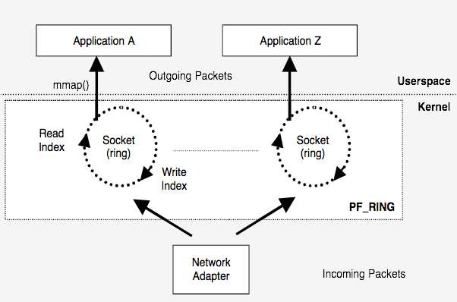
PF_RING [1/2]
PF_RING is a home-grown open source packet processing framework for Linux.
It is split in a kernel module and user-space libs.

Slide 40
PF_RING [2/2]
It comes in two flavours:
In-kernel packet capture: packets are received and processed inside the Linux kernel, then are dispatched using memory-map to user-space. This operating mode is good for1G interfaces.
Zero-copy: once the device is open, packets are ready directly by user-space applications without passing through the kernel. This is the preferred solution for aggregate traffic over 4/5 Gbit.

Slide 41
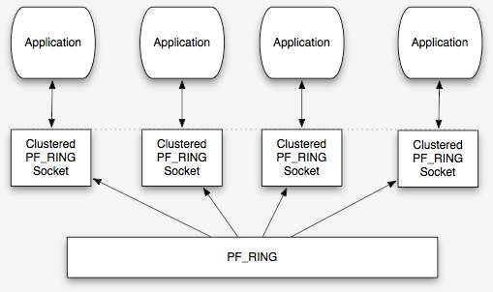
PF_RING and GTP [1/5]
The PF_RING kernel module comes with support for “ring clustering” that is the ability to federate applications each analysing a portion of the traffic.
User-space
Kernel

Slide 42
PF_RING and GTP [2/5]
Applications (e.g. GTP probes) opening PF_RING sockets can merge (via PF_RING), traffic from multiple interfaces.
Ingress traffic can be balanced in many ways (per-flow, round robin…) including 5 tuple (protocol, ip/port src/dst) that:
In case of GTP-U uses the user IP/ports
In case of GTP-C uses the GSNs IP/ports.

Slide 43
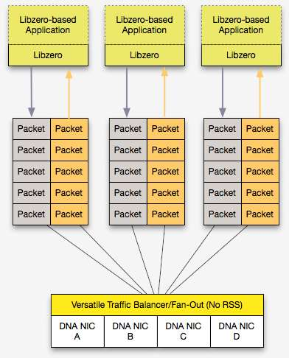
PF_RING and GTP [3/5]
For 10G interfaces, in-kernel packet capture is overkilling and thus it is necessary to bypass it.
On top of PF_RING ZC (Zero Copy) it is possible to efficiently read packets in zero-copy and distribute them to applications.

Slide 44
PF_RING and GTP [4/5]
Our software GTP balancer can aggregate and balance coherently GTP traffic from multiple 10G interfaces. It can support packet fan-out in zero-copy to multiple applications if necessary.
# DNALoadBalancer -h
Usage:
DNABalancer [-h][-d][-a][-q] -c <id> -i <device>
[-n <num app> | -o <devices>] [-f <path>]
[-l <path>] [-p <path>] [-t <level>]
[-g <core_id>]
-h | Help
-c <id> | Cluster id
-i <devices> | Capture device names (comma-separated list) [Default: dna0]
-n <num app> | Max number of slave applications (max 32) [Default: 1]
-o <devices> | Egress device names (comma-separated list) for balancing packets across interfaces
-m <dissector> | Dissector to enable:
| 0 - n-tuple [Default]
| 1 - GTP+RADIUS
| 2 - GRE
-q | Drop non GTP traffic (valid for GTP dissector only)
-r | Reserve first application for signaling only
-s <type> | n-Tuple type used by the hash algorithm:
| 0 - <Src IP, Dst IP> [Default]
| 1 - <Src IP, Dst IP, Src Port, Dst Port, Proto, VLAN>
| 2 - <Src IP, Dst IP, Src Port, Dst Port, Proto, VLAN> with TCP, <Src IP, Dst IP> otherwise
-u <mode> | Behaviour with tunnels:
| 0 - Hash on tunnel content [Default]
| 1 - Hash on tunnel ID
| 2 - Hash on outer headers
-d | Run as a daemon
-l <path> | Log file path
-p <path> | PID file path [Default: /tmp/dna_balancer.pid]
-t <level> | Trace level (0..6) [Default: 0]
-g <core_id> | Bind to a core
-a | Active packet wait
Example:
DNABalancer -i 'dna0,dna1' -c 5 -n 4

Slide 45
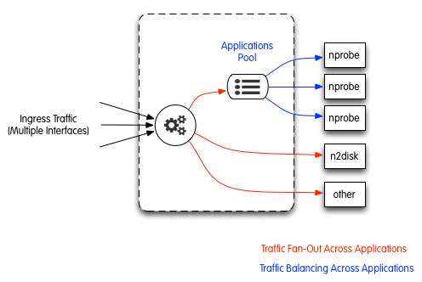
PF_RING and GTP [5/5]
• balancer -i “dna0,dna1,dna2″ -c 10 -n 3,1,1 -r 0
• nprobe -i dnacluster:10@0 -g 1
• nprobe -i dnacluster:10@1 -g 2
• nprobe -i dnacluster:10@2 -g 3
• n2disk -i dnacluster:10@3 ….
• wireshark -i dnacluster:10@4 …

Slide 46
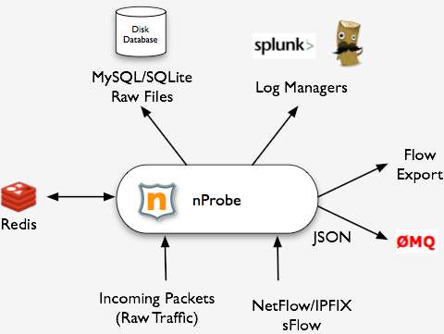
nProbe [1/3]
nProbe is a high-speed (multi 10G) open source traffic probe/collector developed by ntop.

Slide 47
nProbe [2/3]
Originally designed as a drop-in replacement of a physical NetFlow probe, currently it can:
Convert flow format (sFlow-to-NetFlow/IPFIX) or version (e.g. v5 to v9).
High-speed packet-to-flow processing.
Leverage on in-memory-databases to maintain flow state coherency.
Ability to pre-compute data for realtime traffic aggregation.

Slide 48
nProbe [3/3]
It has an open architecture extensible by means of plugins that include:
GTP (v0, v1, v2) plugins.
VoIP (SIP and RTP) plugins for analysing voice signalling (who’s calling who/when) and voice quality (Jitter and pseudo-MOS/R-Factor).
HTTP(S), Email (SMTP, IMAP, POP3), Radius, Database (Oracle and MySQL), FTP, DHCP, and BGP.

Slide 49
nProbe Flow Format [1/2]
nProbe supports flexible NetFlow, that allows data export format to be customised at runtime.
nProbe allow users to define a template on the command line.
In addition to the standard fields (IP, port…), nProbe can export many other fields such as packet stats (TTL and size distribution), network/application latency, geolocation, packets retransmitted/out-of-order, tunnel information, and DPI (Deep Packet Inspection).

Slide 50
nProbe Flow Format [2/2]
nProbe plugins also define datatypes that can be exported via NetFlow v9/IPFIX.
Example of GTPv1 Datatypes:
Plugin GTPv1 Signaling Protocol templates:
[NFv9 57692][IPFIX 35632.220] %GTPV1_REQ_MSG_TYPE GTPv1 Request Msg Type
[NFv9 57693][IPFIX 35632.221] %GTPV1_RSP_MSG_TYPE GTPv1 Response Msg Type
[NFv9 57694][IPFIX 35632.222] %GTPV1_C2S_TEID_DATA GTPv1 Client->Server TunnelId Data
[NFv9 57695][IPFIX 35632.223] %GTPV1_C2S_TEID_CTRL GTPv1 Client->Server TunnelId Control
[NFv9 57696][IPFIX 35632.224] %GTPV1_S2C_TEID_DATA GTPv1 Server->Client TunnelId Data
[NFv9 57697][IPFIX 35632.225] %GTPV1_S2C_TEID_CTRL GTPv1 Server->Client TunnelId Control
[NFv9 57698][IPFIX 35632.226] %GTPV1_END_USER_IP GTPv1 End User IP Address
[NFv9 57699][IPFIX 35632.227] %GTPV1_END_USER_IMSI GTPv1 End User IMSI
[NFv9 57700][IPFIX 35632.228] %GTPV1_END_USER_MSISDN GTPv1 End User MSISDN
[NFv9 57701][IPFIX 35632.229] %GTPV1_END_USER_IMEI GTPv1 End User IMEI
[NFv9 57702][IPFIX 35632.230] %GTPV1_APN_NAME GTPv1 APN Name
[NFv9 57703][IPFIX 35632.231] %GTPV1_RAI_MCC GTPv1 RAI Mobile Country Code
[NFv9 57704][IPFIX 35632.232] %GTPV1_RAI_MNC GTPv1 RAI Mobile Network Code
[NFv9 57814][IPFIX 35632.342] %GTPV1_RAI_LAC GTPv1 RAI Location Area Code
[NFv9 57815][IPFIX 35632.343] %GTPV1_RAI_RAC GTPv1 RAI Routing Area Code
[NFv9 57816][IPFIX 35632.344] %GTPV1_ULI_MCC GTPv1 ULI Mobile Country Code
[NFv9 57817][IPFIX 35632.345] %GTPV1_ULI_MNC GTPv1 ULI Mobile Network Code
[NFv9 57705][IPFIX 35632.233] %GTPV1_ULI_CELL_LAC GTPv1 ULI Cell Location Area Code
[NFv9 57706][IPFIX 35632.234] %GTPV1_ULI_CELL_CI GTPv1 ULI Cell CI
[NFv9 57707][IPFIX 35632.235] %GTPV1_ULI_SAC GTPv1 ULI SAC
[NFv9 57804][IPFIX 35632.332] %GTPV1_RESPONSE_CAUSE GTPv1 Cause of Operation

Slide 51
nDPI
nDPI is a ntop-maintained GPLv3 deep packet inspection library used in nProbe to dissect traffic and thus classify application protocols.
Supported protocols (~170) include:
P2P (Skype, BitTorrent)
Messaging (Viber, Whatsapp, MSN, The Facebook)
Multimedia (YouTube, Last.gm, iTunes)
Conferencing (Webex, CitrixOnLine)
Streaming (Zattoo, Icecast, Shoutcast, Netflix)
Business (VNC, RDP, Citrix, *SQL)

Slide 52
nProbe and GTP [1/5]
The nProbe core is able to natively handle and decode tunnelled (e.g. PPP, PPPoE, GRE, L2TP, Mobile IP) and tagged packets (e.g. 802.1Q, MPLS), and thus generate flows on GTP-U packets.
The GTP plugins are responsible for decoding GTP-C signalling packets, and save on in-memory-database (redis) signalling information such as TEID, Cell-Id, and IMSI.

Slide 53
nProbe and GTP [2/5]
User-to-traffic correlation is performed in realtime by the probe, and not (as often happens) by the collector often in post-processing (e.g. searching on a database) and thus not in realtime.
GTP-C traffic is spread across all probes (i.e. it can be processed in parallel with respect to sending it to one probe) as well as GTP-U.
GTP tunnel-to-user association is kept in redis and cached in individual probes for reducing the number of redis communications.

Slide 54
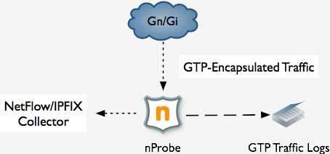
nProbe and GTP [3/5]

Slide 55
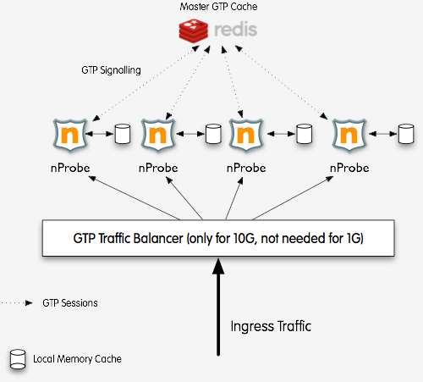
nProbe and GTP [4/5]

Slide 56
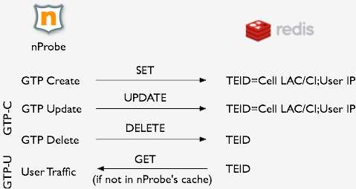
nProbe and GTP [5/5]
Example of GTP cache manipulation:

Slide 57
nProbe and Redis [1/4]
nProbe opens several connections to the redis cache.
Write to cache: these operations have lower priority and are queued and executed in batches.
Read from cache: high-priority synchronous (i.e. the probe cannot continue the operations until an answer is received) operation performed when the probe needs to export GTP-U data.

Slide 58
nProbe and Redis [2/4]
In average a single redis process can handle up to 50/70k requests/sec in total.
It is a good practice to run redis on the same host where the probes are working to avoid putting network latency into the equation and thus reduce the number of redis operations.
In order to add redundancy and increase resiliency it is possible to setup a redis cluster or use a proxy (e.g. https://github.com/twitter/twemproxy) to share keys across the various nodes.

Slide 59
nProbe and Redis [3/4]
Advantages of using redis:
The GTP state is kept on a central location regardless of the number of probes.
It can be used to aggregate the traffic monitored by each individual probe. For instance if it is necessary to compute the total amount of traffic per cellId, nProbe can increment the cell-bytes counter after a flow is expired.

Slide 60
nProbe and Redis [4/4]
Disadvantages of using redis:
It is a central point of failure thus it is important to use a cluster/proxy.
Read operations are synchronous and thus they are influenced by the network latency: keep redis and the nProbe instances on the same host and do not put them on a WAN.

Slide 61
GTP Traffic Reports [1/3]
The probe can produce two type of reports:
GTP-C reports that contain aggregate signalling information.
GTP-U traffic reports that contain standard flow fields (e.g. IPs/ports, bytes/packets) in addition to mobile terminal information (e.g. IMSI and cell Id).
In essence nProbe handles GTP signalling similar to what happens with Radius: it is use to map a user (IMSI) to a traffic (flow) along with metadata (e.g cell Id).

Slide 62
GTP Traffic Reports [2/3]
GTP-C report
#
# StartTime[epoch] Duration(ms)[float] GTP_version[uint] Peers[ascii:64] SeqId[hex:4] RspCause[ascii:64] c2s_s2c_msg_type[ascii:64] c2s_s2c_teid[hex:20] c2s_s2c_teid_data[hex:20] c2s_s2c_teid_ctrl[ascii:32] c2s_gsn_addr[ascii:32] APN[ascii:64] IMSI[ascii:32] MSISDN[ascii:32] IMEI[ascii:32] NSAPI[uint] rai_mcc[uint] rai_mnc[uint] rai_lac[uint] rai_rac[uint] uli_mcc[uint] uli_mnc[uint] uli_cell_lac[uint] uli_cell_ci[uint]uli_sac[uint] s2c_gsn_addr[ascii:32] s2c_end_user_ip[ascii:32] s2c_charging_gw[ascii:32] s2c_charging_id[uint] Req_QoS[ascii:255] Rsp_QoS[ascii:255]
#
1399325474 0.000 1 194.33.24.58,194.33.27.26 45 Request accepted(128) CreateContextRequest(16),CreateContextResponse(17) 00000000,0600170A 06001908,00000001 0600170A,00000044 194.33.24.58,194.33.24.52 orange 23486000002XXXX +44797335XXXX 5 0 0 0 0 0 0 0 0 0 194.33.26.17,194.33.26.17 10.32.0.36 0.0.0.0 12481267 delay=4,reliability=3,peak=6,precedence=2,mean=31,class=4,del_order=2,del_err_sdu=3,max_sdu=1500,max_ul=64,max_dl=384,res_ber=7,err_ratio=4,transfer_delay=2,traf_prio=3,guar_ul=16,guar_dl=64,src_stat_desc=0,sig_ind=0 delay=4,reliability=3,peak=6,precedence=2,mean=31,class=4,del_order=2,del_err_sdu=3,max_sdu=1500,max_ul=64,max_dl=384,res_ber=7,err_ratio=4,transfer_delay=2,traf_prio=3,guar_ul=16,guar_dl=64,src_stat_desc=0,sig_ind=0
1399325474 0.000 1 194.33.24.58,194.33.26.17 46 Request accepted(128) DeleteContextRequest(20),DeleteContextResponse(21) 00000044,0600170A 00000000,00000000 00000000,00000000 0.0.0.0,0.0.0.0 0.0.0.0,0.0.0.0 0.0.0.0 0.0.0.0 0 delay=0,reliability=0,peak=0,precedence=0,mean=0,class=0,del_order=0,del_err_sdu=0,max_sdu=0,max_ul=0,max_dl=0,res_ber=0,err_ratio=0,transfer_delay=0,traf_prio=0,guar_ul=0,guar_dl=0,src_stat_desc=0,sig_ind=0 delay=0,reliability=0,peak=0,precedence=0,mean=0,class=0,del_order=0,del_err_sdu=0,max_sdu=0,max_ul=0,max_dl=0,res_ber=0,err_ratio=0,transfer_delay=0,traf_prio=0,guar_ul=0,guar_dl=0,src_stat_desc=0,sig_ind=0

Slide 63
GTP Traffic Reports [3/3]
GTP-U Report (HTTP)
#
# Client[ascii:32] Server[ascii:32] Protocol[ascii:8] Method[ascii:8] URL[ascii:255] HTTPReturnCode[uint] Location[ascii:255] Referer[ascii:255] UserAgent[ascii:255] ContentType[ascii:96] Bytes[uint] BeginTime[epoch] EndTimeWithPayload[epoch] FlowHash[ascii:16] Cookie[ascii:255] Terminator[ascii:4] ApplLatency(ms)[uint] ClientLatency(ms)[uint] ServerLatency(ms)[uint] ApplicationID[uint] Application[ascii:32] BalancerHost[ascii:32] ServerIP[ascii:32] RehttpPkts[uint] Client2Server_TEID[ascii:8] Server2Client_TEID[ascii:8] FlowUserName (User or IMSI/LAC/CCI/CSAC)[ascii:32] AdditionalInfo[ascii:32] OOO_Cli2Srv[uint] OOO_Svr2Cli[uint] POSTParams[ascii:256]
#
10.68.78.155 web.icq.com http GET 302 www.icq.com/whitepages/online?icq=601004214&img=5 www.google.com Mozilla/5.0 (Linux; U; Android 4.1.2; ru-ru; GT-I9300 Build/JZO54K) AppleWebKit/534.30 (KHTML, like Gecko) Version/4.0 Mobile Safari/534.30 text/html 1170 1399325662 1399325664 838964263 0 U 40.173 23.091 20.200 7 HTTP 205.188.95.190 1 86048DB0 0001D69D "25001686073XXXX;592;54073;0;183493424" 0 0

Slide 64
Advanced GTP Monitoring [1/2]
The use of redis allows the simple creation of application that would have been much more difficult to create otherwise.
Suppose you want to have every 5 minutes the total amount of application protocol traffic per IMSI. Namely you want to know for all active network users, what are the protocols in use (e.g. HTTP, email, Whatspp, Skype) and the traffic volume for each of it.

Slide 65
Advanced GTP Monitoring [2/3]
Using a specified command line option (—imsi-aggregation) it is possible to tell nProbe that when a flow expires, it must increment in redis for the <5 mins epoch><IMSI> hash key, the number of bytes of the subkey <application protocol>.
Redis guarantees that increment operations are properly executed even if two simultaneous clients want to increment the same key.
Periodically a simple python script can access redis and read the aggregated values.

Slide 66
Advanced GTP Monitoring [3/3]
Companion script
Example of traffic reports
$ crontab -l|grep ggrega
*/5 * * * * /home/imsi/imsiAggregator.py --redis localhost --epoch -2 --outdir /export/working_dir/imsi
#
# Timestamp IMSI Granularity Protocol Packets Bytes Flows Duration #
1374938100 XXXXX2001106796 300 Unknown 3 298 2 2
1374938100 XXXXX1100485374 300 HTTP 393 283553 13 114
1374938100 XXXXX2001110729 300 SSL 49 14269 10 18
1374938100 XXXXX2001338233 300 Skype 15 1411 1 7
1374938100 XXXXX1101335045 300 DNS 2 385 1 1
1374938100 XXXXX2001931139 300 Viber 17 1487 4 35

Slide 67
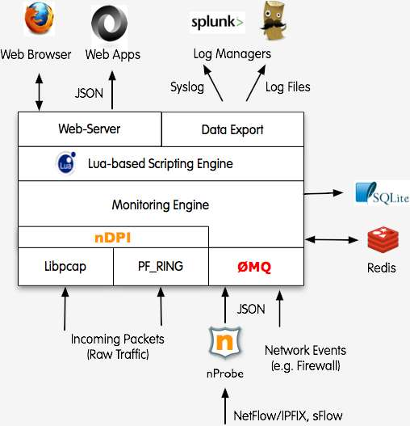
Using ntopng as Monitoring Console [1/2]

Slide 68
Using ntopng as Monitoring Console [2/2]

Slide 69
Final Remarks
In this talk we have learnt:
Introduction to mobile traffic monitoring.
How to use Wireshark to analyse mobile traffic.
Versatile software traffic merging/balancing using PF_RING.
Permanent GTP traffic monitoring using the open-source nProbe application. Thanks to Wireshark and the open source ntop tools presented, it is possible to effectively analyse mobile traffic without using costly proprietary tools.

