Slide 1

TCP – Tips and Case Studies

Slide 2


Presenter – Chris Greer
Packet Pioneer LLC
Network Analyst - WCNA
Training and Professional Services
Network and application performance analysis
www.lovemytool.com
www.brighttalk.com

Slide 3


Why TCP?
Important stuff uses it.
Some problems “hide” at this layer.
Key to isolating problem domain.
Few take responsibility
for it.

Slide 4

When a problem strikes
Network engineers check network interfaces, utilization levels, link errors and the wireless environment
They want to prove it’s not the network.
APPLICATION
PRESENTATION
SESSION
TRANSPORT
NETWORK
DATA LINK
PHYSICAL

Slide 5

When a problem strikes
Server and Application support people may check error logs and server resources to see if the issue is theirs.
APPLICATION
PRESENTATION
SESSION
TRANSPORT
NETWORK
DATA LINK
PHYSICAL

Slide 6
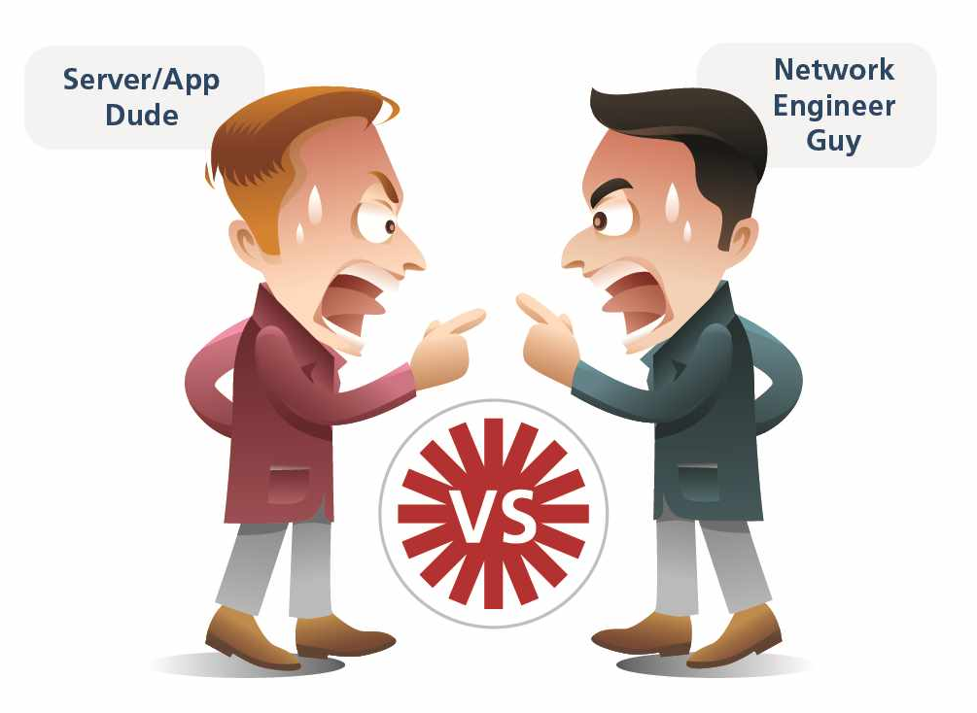
What if the problem is neither?
APPLICATION
PRESENTATION
SESSION
TRANSPORT
NETWORK
DATA LINK
PHYSICAL

Slide 7
A TCP Window Problem
Open TCP Window Problem.pcap

Slide 8
A Server Problem
Busy Server.pcap

Slide 9
TCP Keep Alives
These may look bad – but are they?
Open Slow Web Application.pcap

Slide 10


MSS Issues
WAAS

Slide 11
MSS Issues
Inbound TCP MSS Change
To 1432
WAAS

Slide 12
Thanks!
Enjoy the rest of Sharkfest 2015!

