Slide 1
The wireless side of Wireshark
Thomas d’Otreppe de Bouvette
Author of Aircrack-ng

Slide 2
whoami
Software developer @ MainNerve by day
WiFi researcher by night … well, the evening ;)
  Author of Aircrack-ng, OpenWIPS-ng
  Offensive-Security Wireless Attacks (aka WiFu)
Enjoy analyzing network traffic, especially WiFi

Slide 3
Agenda
WiFi basics
  IEEE 802.11
  Network architecture
  Communications
  Frames
Wireshark and Wireless
  Linux
  Windows
  OSX
Notes:
And a demo

Slide 4
IEEE 802.11
Institute of Electrical and Electronics Engineers
Leading authority
Split in committees and working groups
  802 committee: Network related norms
  .11 working group: Wireless LAN
Publications available for download
Notes:
.3 Ethernet, .15 is PAN

Slide 5
802.11
Lots of standards and amendments
Only 802.11 is a standard
  Others are amendments
  802.11F and 802.11T are recommended practices
Main amendments
  802.11a/b/g/n/ac/ad
  802.11e/i/w

Slide 6
802.11
Standard released in 1997
Rates: 1-2Mbit
Infrared/Radio (DSSS/FHSS)
CSMA/CA

Slide 7
802.11b
Amendment
CCK coding
New rates: 5.5 and 11Mbit
2.4GHz ISM band
14 overlapping channels
  Defined by their center frequency
  22MHz channels
  5 MHz apart
Notes:
11 for US, 13 for Europe, 14 for Japan

Slide 8
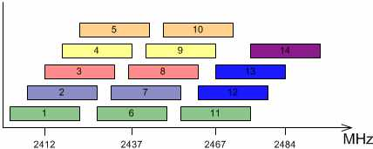
802.11b
Notes:
Also show with Chanalyzer
Yes, 14 is a bit off
Always talk about center frequencies when giving channel frequency

Slide 9
802.11a
5GHz band
  5180-5320Mhz (36-64)
  5500-5700Mhz (100-140)
  5745-5825Mhz (149-165)
Public safety: 4.9GHz
  4940 MHz to 4990 MHz (WLAN channels 20–26)
More expensive => less crowded
20MHz channels
OFDM
Max rate: 54Mbit
Notes:
Channels depends on country (much more complicated than b/g)
Other frequencies might be allowed in the 5Ghz: from 5150 to 5250 in the US.
OFDM uses a bunch of subcarries.

Slide 10
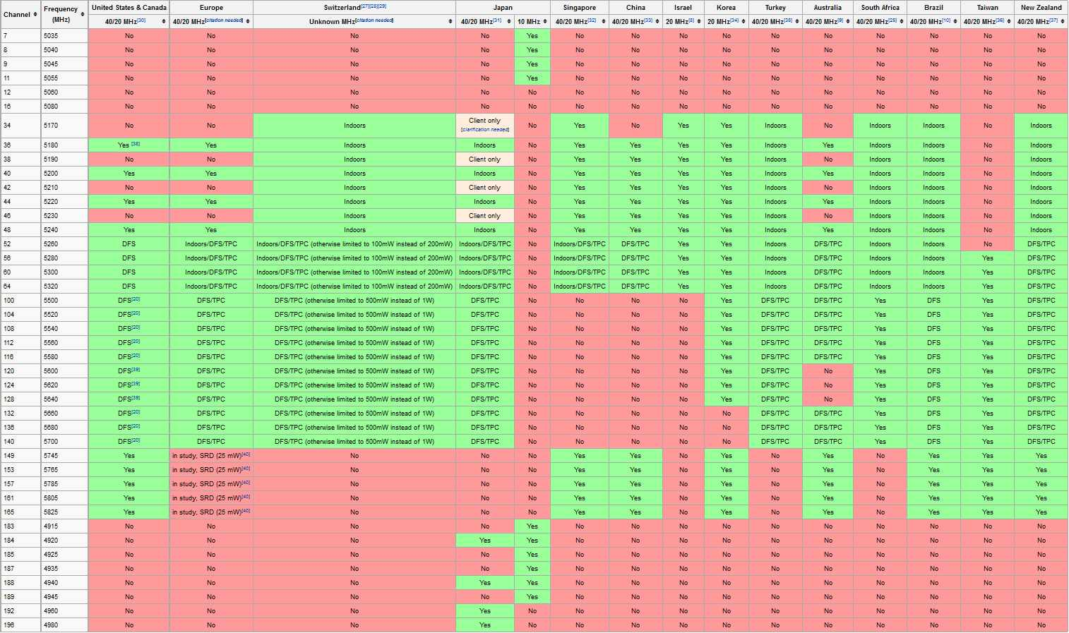
Notes:
Wikipedia

Slide 11
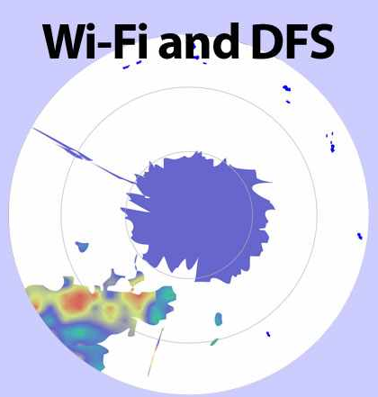
802.11h
Notes:
DFS: Dynamic Frequency Selection (part of 802.11h) → checks for radar stuff and change channel if necessary.
TPC: Transmit Power Control (part of 802.11h) → Allows devices to negotiate transmit power to use as little transmit power as possible
Required for most countries on at least a few freqs. It is meant to avoid interfering with doppler radars, up to 20 miles away. 1-2 miles is considered close proximity

Slide 12
802.11g
Similar to .11a but on 2.4GHz
Backward compatible with 802.11b

Slide 13
802.11n
Work started in 2004 – Final: September 2009
Single user MIMO
2.4GHz and 5GHz
40MHz channels
Up to 4 spatial streams – Commercial: up to 3
MCS rates - http://mcsindex.com
Greenfield mode
Notes:
Do not confuse with diversity which is completely different

Slide 14
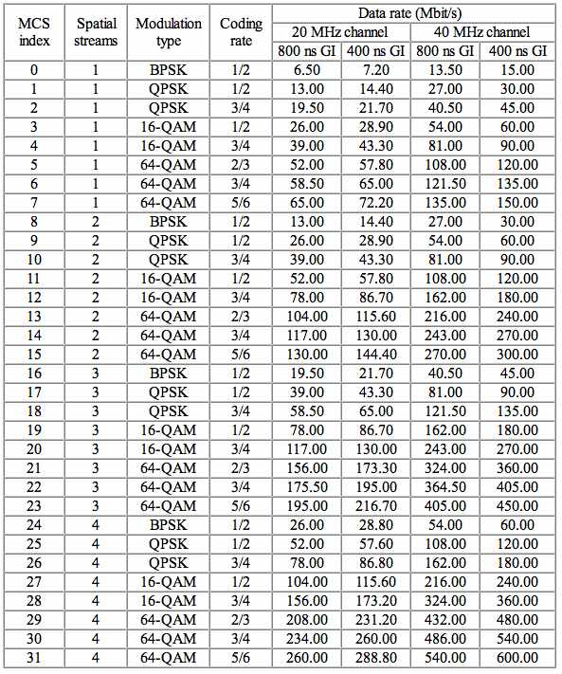
802.11n - MCS
Notes:
MCS: Modulation and coding scheme

Slide 15
802.11n – HT20/40+-
HT20: One 20MHz channel
HT40: Two 20MHz channels
  Primary channel is also used to communicate with clients incapable of 40MHz
  Secondary is 20MHz (4 channels) above (+) or below (-)
  Some combinations not available
  Information in beacons
Notes:
Explain what that does mean when selecting channel.
HT: Hight Throughput

Slide 16
802.11ac – Very High Throughput
Ran out of single letters, hence why 2 letters
5GHz only
Multi user MIMO
Up to 8 spatial stream
Different MCS rates
80/160MHz channels
  160Mhz can be split in two 80Mhz non-contiguous channels
Notes:
5 to 8 spatial streams

Slide 17
802.11ac - Waves
Wave 1
  Draft 2.0
  256-QAM (vs 64-QAM in 802.11n)
  80MHz channels
  Explicit TX beamforming
Wave 2
  Final version
  4 Spatial Streams
  160MHz channels
  MU-MIMO
  Up to 2.34Gbit/s
Notes:
What is 802.11ac Wave 1?
Wave 1 refers to the current generation of 802.11ac products that is currently in production and being certified by the Wi-Fi Alliance and supports data rates up to 1.3 Gbps with 3 spatial streams.
The following features beyond the prior 802.11n standard are implemented by leading vendors such as Aruba Networks:
256-QAM
This is a new quadrature amplitude modulation mode that was added as an optional, but widely implemented, component of 802.11ac and increases performance by roughly 30% when utilized.
80 MHz Channels
The channel width has been doubled to allow for up to 80 MHz channels with the ability to fall back to narrower channels when there are interfering devices. With this becoming a mandatory component of the certification program, this will double the throughput that a client can achieve.
Explicit Transmit Beamforming
While several 802.11n products implemented beamforming, it was not widely adopted due to the number of variables/options available in the 802.11n standard. 802.11ac has settled on a single standards-based explicit beamforming method to drive wider adoption. Products such as the AP-224/225 that implement Tx Beamforming and are certified for interoperability by the Wi-Fi Alliance will deliver maximized data rates at a given range.
Beamforming is a signal processing technique used to control the directionality of the transmission and reception of radio signals.
See also http://www.cisco.com/c/en/us/solutions/collateral/enterprise-networks/802-11ac-solution/q-and-a-c67-734152.html and http://chimera.labs.oreilly.com/books/1234000001739/ch05.html#catching_the_ac_technology_wave
Wave 2?
Wave 2 is a term used to describe the second generation of 802.11ac products. The current generation of products in production is based on 802.11ac Wave 1. The Wi-Fi Alliance standardization of Wave 1 products began in June 2013 with the Aruba Networks AP-225 being the first enterprise-class product to be certified and it is now a mature and proven product.
While there is no firm date on when chipset manufacturers will start releasing Wave 2 components, it is expected that this will occur by early 2015 (if there are no production delays) with enterprise-grade Access Points and client products containing these chipsets likely to begin shipping in mid-late 2015.
It is likely that the following features will be included in the Wave 2 certification requirements:
4 spatial streams (4SS)
This has the potential to increase performance by up to 33% beyond today’s products that incorporate 3 spatial streams by adding an additional fourth antenna to both the AP and clients. However just like with Wave 1 where most clients only implemented one or two spatial streams in order to save on power and space, the same is likely with Wave 2. Most devices will not be able to take advantage of the 4 spatial stream rates.
160 MHz channels
This feature enables the AP and client to double the channel width from Wave 1 and therefore increase throughput when the channel is clear. Where this will benefit users is the home environment where there is a single AP. Most enterprises are not likely to deploy 160 MHz channels because there are only two channels available when DFS-frequencies are included. With only two channels available it is highly likely that there will always be someone transmitting over the air and hence the APs will have to fall back to 80 MHz or 40 MHz operation due to the congestion such that clients will not be able to take advantage of the 160 MHz rates. Therefore it is quite likely that enterprise APs will not implement or certify for 160 MHz operation. It will probably take governments opening up additional frequencies in the future in the 5GHz band before one can truly leverage these wider channels.
Downlink Multi User MIMO (MU-MIMO)
This is the most interesting feature expected in Wave 2 as it will enable APs to simultaneously transmit to multiple clients by leveraging multiple instances of beamforming. For example, an AP could transmit 1SS to a smartphone while transmitting 2SS to a laptop. The one catch with MU-MIMO is that it will require new client hardware since both the AP and client need to be designed with the MU-MIMO capability. Therefore it will take until 2016, after the Wave 2 chipsets appear, for clients to become pervasive and be able to leverage the benefits of MU-MIMO.

Slide 18
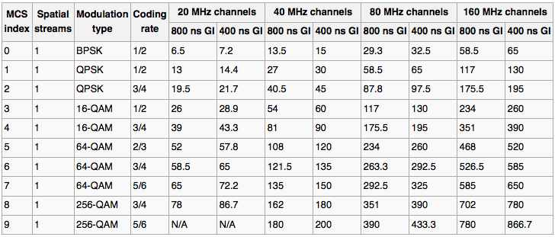
802.11ac – MCS Rates 1x1
Notes:
Different than 802.11 where it goes up to 77. Here, it goes only to 9 then repeats based on the amount of streams

Slide 19
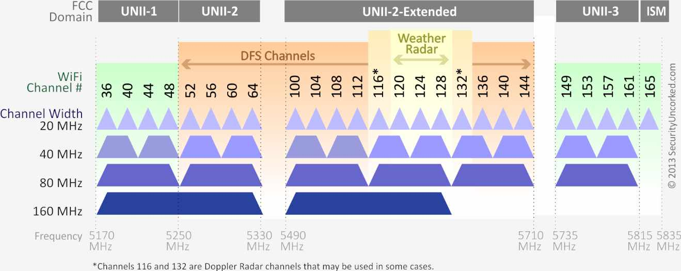
802.11ac – VHT channels
Notes:
40Mhz: 38, 46, 54, 62, 106, 122, etc
80Mhz: 42, 58, 106, 122, 138,
160Mhz: 50, 114
Availability:
This is for the US
Europe & Japan: UNII-1, 2 and extended
India: UNII-1 and UNII-3 + ISM → Limited to 80MHz channels
China: UNII-3 + ISM → limited to 80MHz channels

Slide 20
802.11ad
WiGig
  Wireless display
  Wireless networking
Uses 2.4, 5 and 60GHz (Unlicensed)
  USA/Canada/Korea: 57-64GHz
  Europe: 57-66GHz
  China: 59-64GHz and 45-50GHz
  Japan: 59-66GHz
Rates
  Between 385 and 6785 Mbits
  OFDM, Single Carrier and Low Power SC
Notes:
https://en.wikipedia.org/wiki/Wireless_Gigabit_Alliance

Slide 21
802.11ad channels
Channel | Center [GHz] | Low [GHz] | Up [GHz]
1 | 58.32 | 57.24 | 59.4
2 | 60.48 | 59.4 | 61.56
3 | 62.64 | 61.56 | 63.72
4 | 64.8 | 63.72 | 65.88
2.16GHz bandwidth for each channel

Slide 22
Other frequency bands
802.11ah: IoT, 900MHz
802.11y: licensed, 3.6GHz (3655–3695 MHz)
802.11p: Vehicules (WAVE), 5.9GHz

Slide 23
802.11 Networks
3 types of network
  Infrastructure
  Ad-Hoc
  WDS

Slide 24
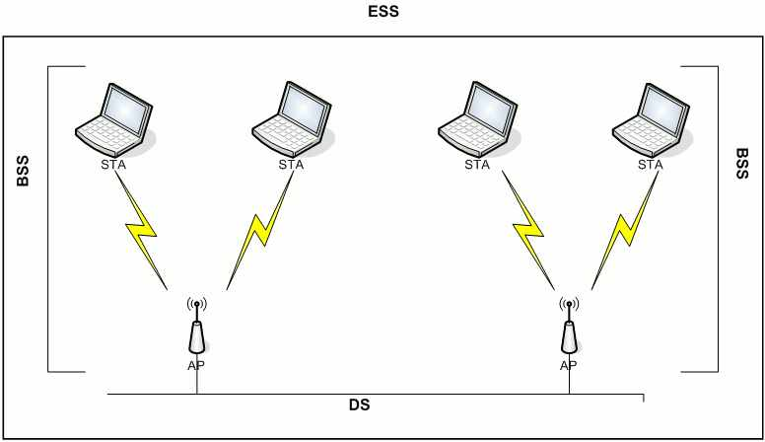
Infrastructure
Notes:
In infrastructure mode, there's at least one Access point (AP) and one Station (STA) that forms a BSS. This Access point is usually connected to a wired network which is called DS, Distribution System.
An ESS is a set of two or more wireless APs connected to the same wired network that defines a single logical network segment.
On Linux (and other OSes), acting as a STA is Managed mode. For AP, it is Master.

Slide 25
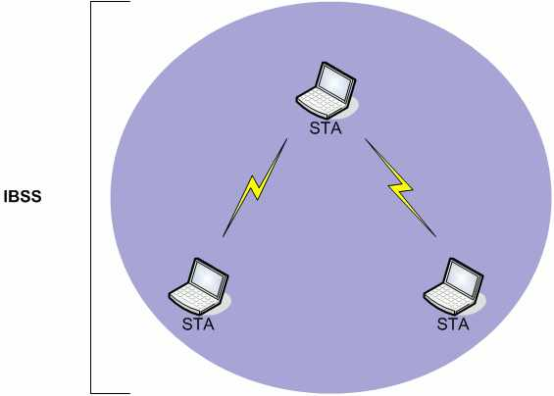
Ad-Hoc

Slide 26
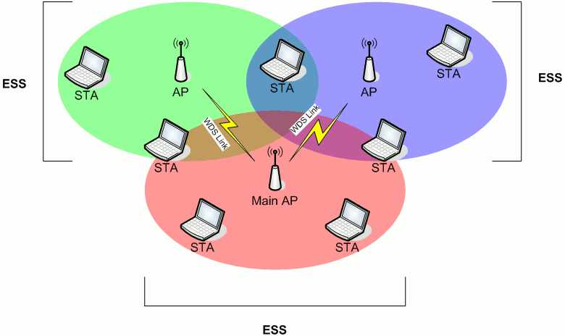
WDS
Notes:
WDS means Wireless Distribution System. This is similar to a standard DS but it's done via wireless and APs communicates together.
It has 2 connectivity modes:
- Wireless Bridging: Only allows WDS AP to communicate with each other.
- Wireless Repeating: Allows both stations and AP to communicate with each other.

Slide 27
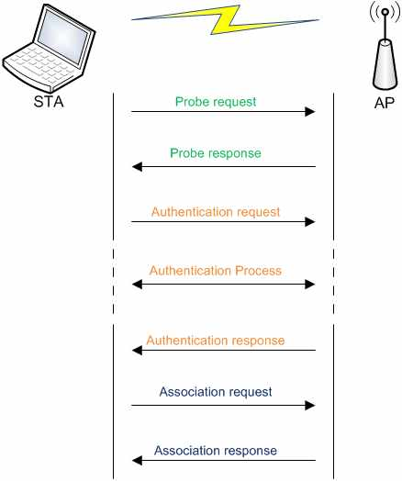
Network Interaction

Slide 28
WEP
Wired Equivalent Privacy
Part of the 802.11 standard
RC4
  24 bit Initialization Vector
  Key Scheduling Algorithm
  Pseudo Random Generation Algorithm
CRC32

Slide 29
WPA
IEEE created 802.11i working group when WEP flaws discovered
2 Link layer protocols
  TKIP -> WPA1
  CCMP -> WPA2
2 flavors
  Personal: PSK
  Enterprise: Radius server

Slide 30
WPA
WPA 1
  Based on 3rd draft of 802.11i
  Uses TKIP
  Backward compatible with old hardware
WPA 2
  Final 802.11i
  Uses CCMP (AES)
  Not compatible with old hardware

Slide 31
WPA – Encryption and data integrity
TKIP:
  MIC + ICV
CCMP
  MIC

Slide 32
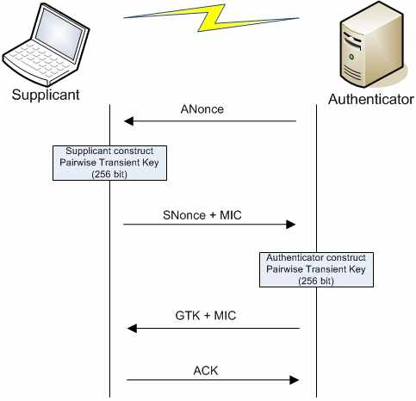
WPA Authentication

Slide 33
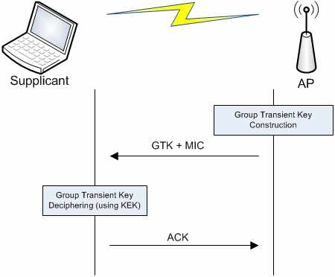
WPA – GTK Exchange

Slide 34
WPS
WiFi Protected Setup
  Allows easy and secure exchange of WPA PSK for secure network setup
Introduced in 2007 by WiFi Alliance
  Unify different vendor technologies
Methods:
  PIN
  Push Button
Notes:
Also NFC and USB flash drive but not covered by WPS certification

Slide 35
WPS – Technical Architecture
Types of devices
  Registrar
  Enrollee
  AP
Basic scenarios
  AP with internal registrar capabilities configures an Enrollee
  Registrar STA configures the AP as an enrollee
  Registrar STA configures enrollee STA
Notes:
https://en.wikipedia.org/wiki/Wi-Fi_Protected_Setup

Slide 36
WPS - Protocol
EAP Messages ~ WPA authentication
Advertised in beacons
Notes:
https://en.wikipedia.org/wiki/Wi-Fi_Protected_Setup

Slide 37
802.11 Frames
Generic frame structure
3 types of frames
  Management
  Control
  Data

Slide 38
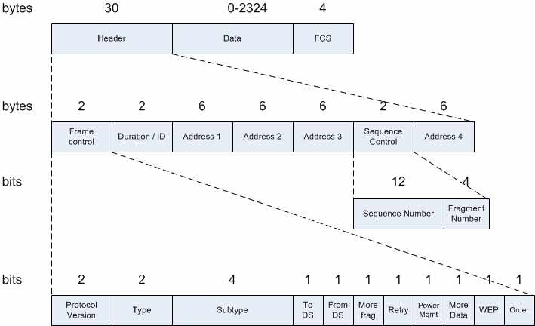
802.11 Frame structure

Slide 39
ToDS/FromDS Fields
ToDS | FromDS | Address 1 | Address 2 | Address 3 | Address 4
0 | 0 | DA | SA | BSSID
0 | 1 | DA | BSSID | SA
1 | 0 | BSSID | SA | DA
1 | 1 | RA | TA | DA | SA
DA: Destination Address
RA: Recipient Address
SA: Source Address
TA: Transmitter Address
BSSID: Basic Service Set Identifier – MAC of the Access Point

Slide 40
802.11 Frame types
Management
Control
Data

Slide 41
Management Frames
Type | Subtype | Meaning
0 | 0 | Association Request
0 | 1 | Association Response
0 | 2 | Reassociation Request
0 | 3 | Reassocation Response
0 | 4 | Probe Request
0 | 5 | Probe Response
0 | 6 | Measurement Pilot
0 | 7 | Reserved
Notes:
Maintenance of communication

Slide 42
Management Frames (2)
Type | Subtype | Meaning
0 | 8 | Beacon
0 | 9 | ATIM
0 | 10 | Disassociation
0 | 11 | Authentication
0 | 12 | Deauthentication
0 | 13 | Action
0 | 14 | Action No ACK
0 | 15 | Reserved

Slide 43
Control Frames
Type | Subtype | Meaning
1 | 0-6 | Reserved
1 | 7 | Control Wrapper
1 | 8 | Block ACK request
1 | 9 | Block ACK
1 | 10 | PS Poll
1 | 11 | RTS
1 | 12 | CTS
1 | 13 | ACK
1 | 14 | CF End
1 | 15 | CF End + CF ACK
Notes:
Facilitate in the exchange of data frames between stations

Slide 44
Data Frames
Type | Subtype | Meaning
2 | 0 | Data
2 | 1 | Data + CF ACK
2 | 2 | Data + CF Poll
2 | 3 | Data + CF ACK + CF Poll
2 | 4 | Null Function (no data)
2 | 5 | CF ACK (no data)
2 | 6 | CF Poll (no data)
2 | 7 | CF ACK + CF Poll (no data)

Slide 45
Data Frames (2)
Type | Subtype | Meaning
2 | 8 | QoS data
2 | 9 | QoS data + CF ACK
2 | 10 | QoS data + CF Poll
2 | 11 | QoS data + CF ACK + CF Poll
2 | 12 | QoS Null (no data)
2 | 13 | Reserved
2 | 14 | QoS CF Poll (no data)
2 | 15 | QoS CF ACK (no data)

Slide 46
Wireshark & WiFi
Options
  Columns
  Protocols
  Decrypt traffic
  Wireless toolbar
Capture headers
Filter
  Display
  BPF
OS Specific
  Windows
  Linux
  OSX
Notes:
Here, I’m talking about capturing wireless data. You can always analyze WiFi pcap on any OS.
All the examples here will be using the new version of Wireshark

Slide 47
Wireshark & WiFi
Stable version
Not yet in development version

Slide 48
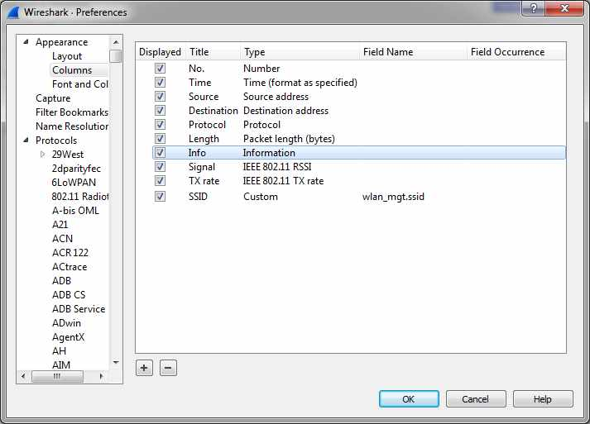
Custom columns

Slide 49
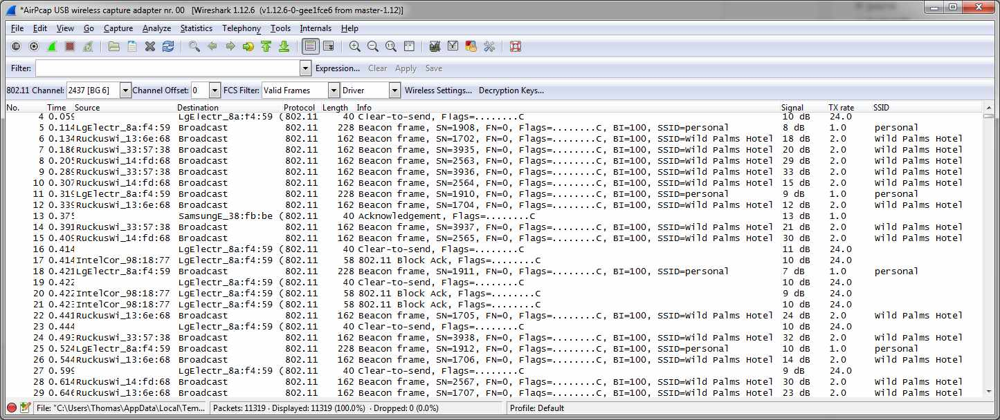
Custom columns

Slide 50
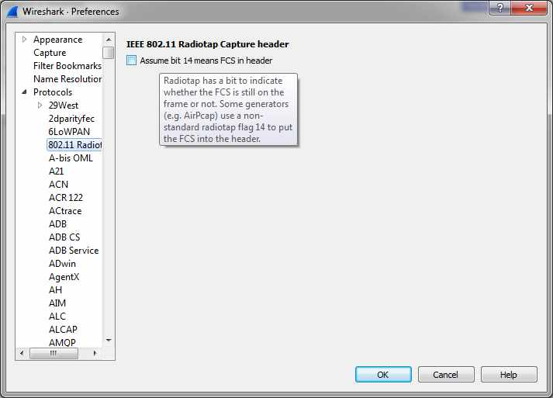
Protocols

Slide 51
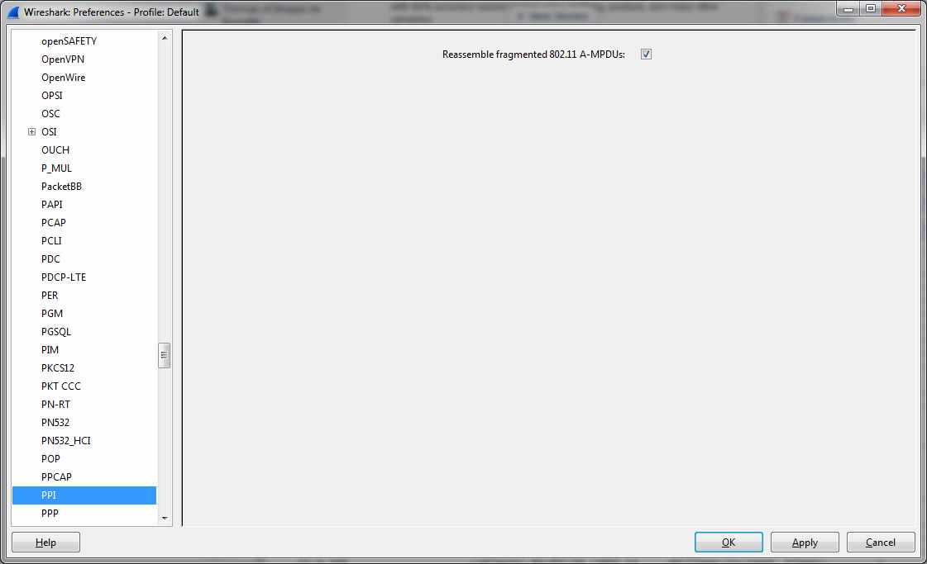
Protocols (2)
Notes:
Wireless frame aggregation

Slide 52
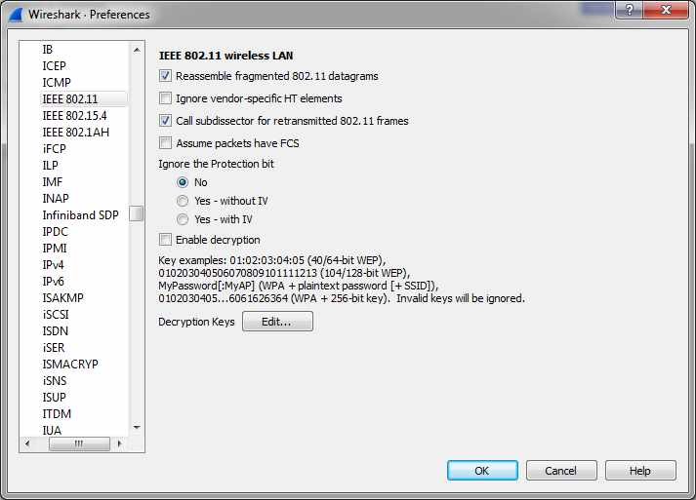
Protocols (3)
Notes:
Hover over options to see what they mean but here is the explanation for each of them.
Explain advantage or uses of each option

Slide 53
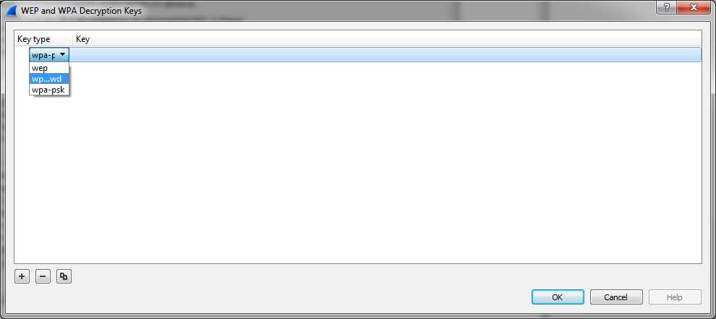
Traffic decryption

Slide 54
Traffic decryption
WEP
  Enter hex with or without colon to separate each byte
    aa:aa:aa:aa:aa
    aaaaaaaaaa
WPA
  PWD
    Passphrase:SSID or just Passphrase
    MyPassphrase:MySSID or just MyPassphrase
  PSK: Hash
Notes:
Hash/raw preshared key

Slide 55
Traffic decryption - limitations
WPA
  Can only decrypt PSK, not enterprise
  Require 4 way handshake for each client
  Wildcard SSID uses last SSID seen
    Does not work well on high traffic

Slide 56
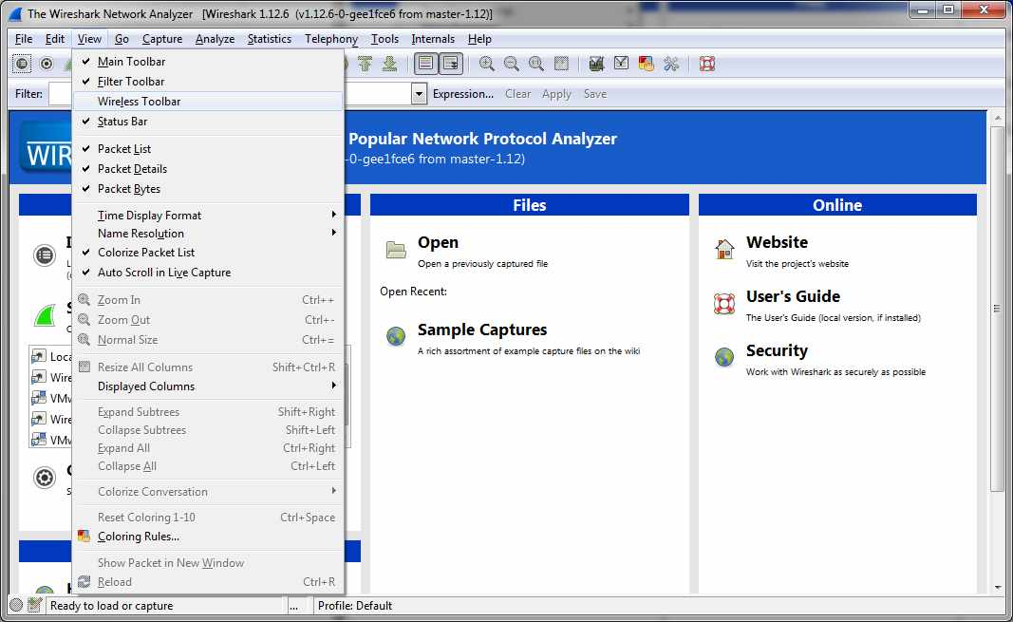
Wireless toolbar
Notes:
How to know what your card support – HT20/HT40 -> figure it out

Slide 57
Capture headers
Contain frame information (rate, signal, etc)
Ancient
  Prism2
  AVS
  Atheros descriptors
No header
  802.11
Current
  Radiotap
  PPI (Per packet information)

Slide 58
Display Filters
Header-related:
  ppi: PPI Packet Header
  ppi_antenna: PPI antenna decoder
  prism: Prism capture header
  radiotap: IEEE 802.11 Radiotap Capture header
  wlancap: AVS WLAN Capture header

Slide 59
Display Filters (2)
  eapol: 802.1X Authentication
  wifi_display: Wi-Fi Display
  wifi_p2p: Wi-Fi Peer-to-Peer
  wlan: IEEE 802.11 wireless LAN
  wlan_aggregate: IEEE 802.11 wireless LAN aggregate frame
  wlan_mgt: IEEE 802.11 wireless LAN management frame
  wlan_rsna_eapol: IEEE 802.11 RSNA EAPOL key
  wlancertextn: Wlan Certificate Extension
  wlccp: Cisco Wireless LAN Context Control Protocol
  wps: Wifi Protected Setup

Slide 60
Capture filters
Aka BPF
  wlan host XX:XX:XX:XX:XX:XX
  wlan[0] != 0x80

Slide 61
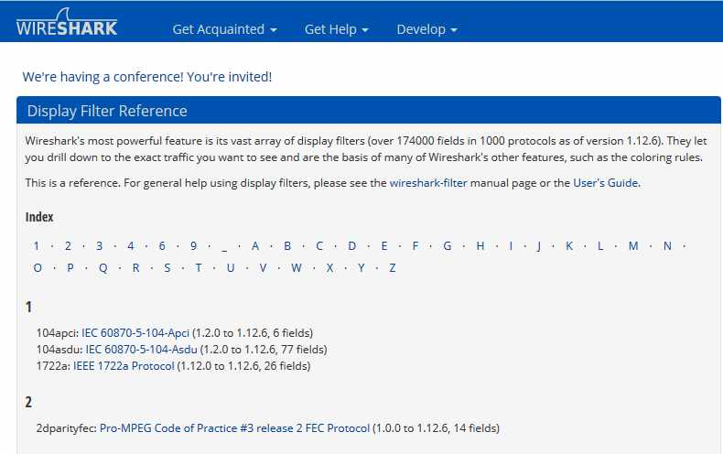
Reference
URL: https://www.wireshark.org/docs/dfref/

Slide 62
Wireshark - Windows
Require AirPcap
  Possible with some other cards but lots of limitations
  Other tools/drivers available but not compatible with Wireshark
Notes:
Limitations as inaccurate data, no injection, mode limitations.
Other tools:
NetMon
WildPackets

Slide 63
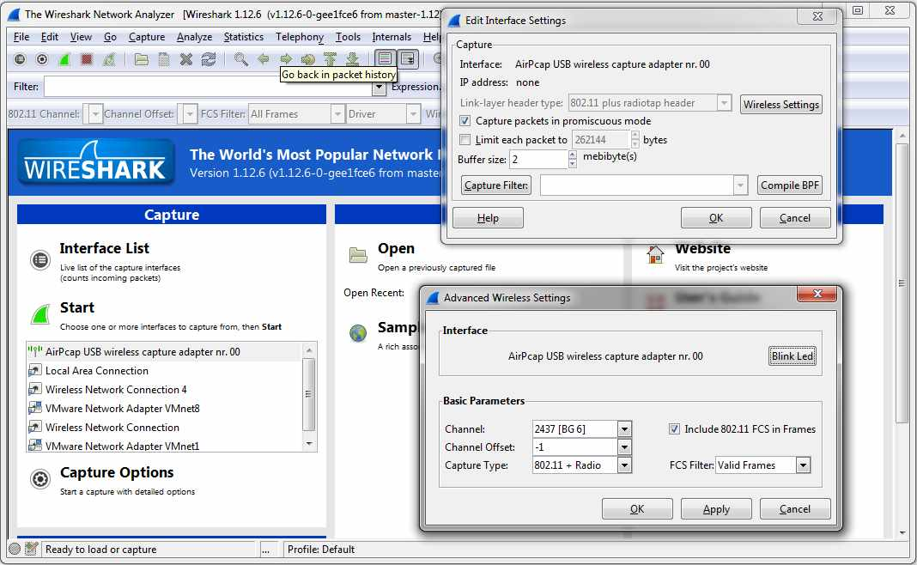
Windows - Setup

Slide 64
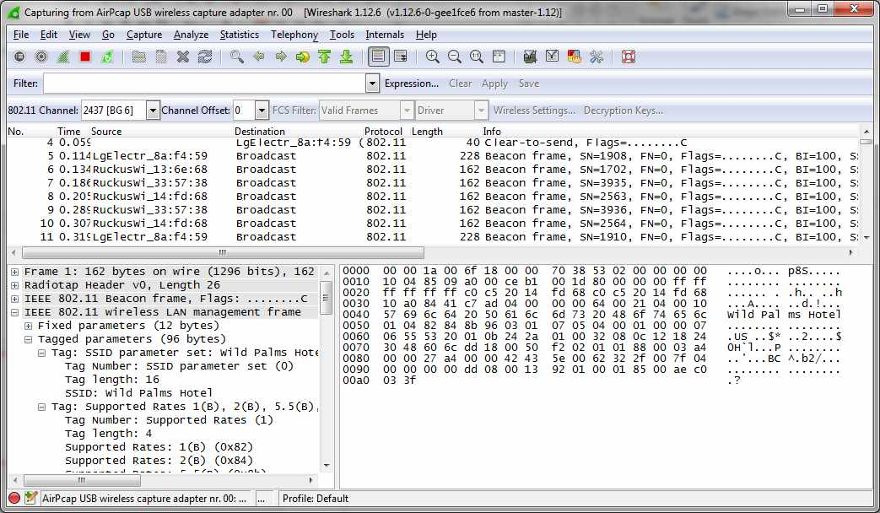
Windows - Capture

Slide 65
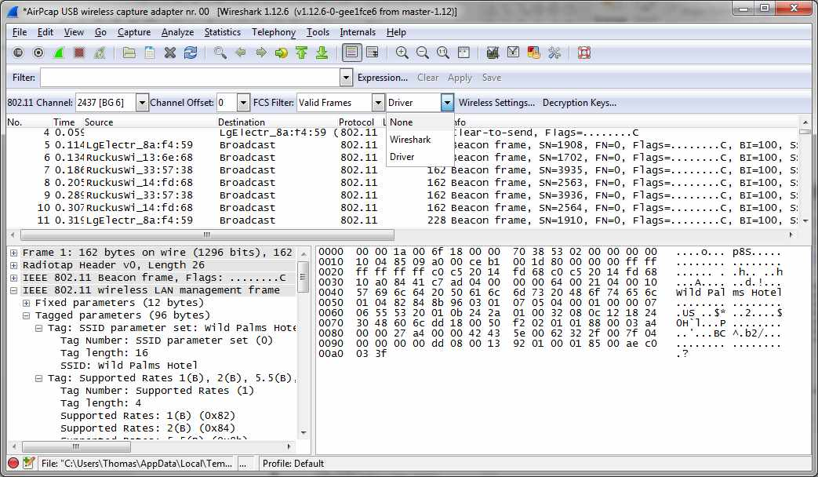
Windows – Change settings

Slide 66
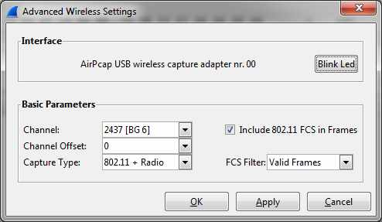
Windows – Wireless settings

Slide 67
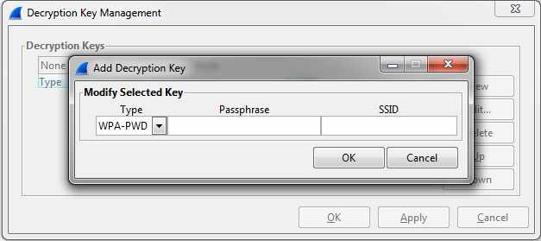
Windows – Decryption keys

Slide 68
Wireshark - Linux
Requires an open-source driver
  Staging or vendor driver don’t support monitor mode
If using in Virtualbox/VMware, USB WiFi card required
Limitations
  Most drivers capture all frame types
  No filtering for valid/invalid frames
  A 802.11n card might not support 802.11n capture
    Same applies for 802.11ac
Notes:
On Android, need a wireless card to capture data then open in Wireshark.

Slide 69
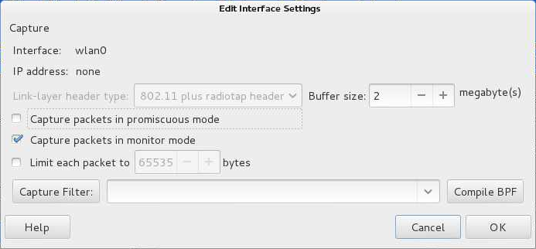
Linux – Interface settings
Notes:
Double click on the wireless interface – Check out the ‘special’ wireless icon’. Also valid for BSD and OSX if the interface support monitor mode
Select monitor and deselect promiscuous then click OK then on the start icon (green) above.

Slide 70
Linux – Change channel
Two possible tools on top of wireless toolbar
  iwconfig
  iw
Example command
  iwconfig wlan0 channel 6
  iw dev wlan0 set channel 6 [HT20/HT40+/HT40-]
    iw dev wlan0 set frequency 2412 [HT20/HT40+/HT40-]

Slide 71
Linux – Available channels
iw dev wlan0 info
Interface wlan0
ifindex 3
type managed
wiphy 0
iw phy phy0 info

Slide 72
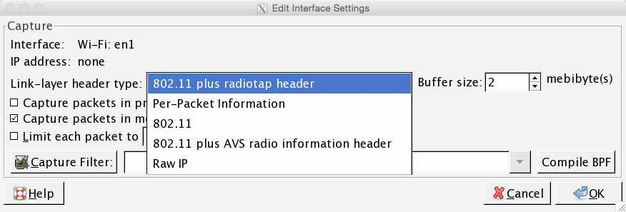
OSX – Interface settings
Notes:
https://wiki.wireshark.org/CaptureSetup/WLAN#Mac_OS_X

Slide 73
OSX - Limitations
Manual channel change
  Command line
No channel list
Receive both valid and invalid frames
Frames might or might not contain FCS
  Might have invalid frames that have FCS
  Might have invalid frames without FCS

Slide 74
OSX - Change channel
Use airport
  /System/Library/PrivateFrameworks/Apple80211.framework/Versions/Current/Resources/airport
Example
  sudo /System/Library/PrivateFrameworks/Apple80211.framework/
  Versions/Current/Resources/airport -c6
  Note: No space character between –c and channel number

Slide 75
OSX – Available channels
You have to know
Trial and error
  Use -cCHANNEL
  Then verify if set with just -c

Slide 76
Demo time

Slide 77
Other things
Windows:
  Netmon
  Wildpackets
  Acrylic WiFi
OSX
  airportd + tcpdump/tshark
Android
  Android PCAP Capture
Notes:
Android PCAP Capture by dragorn/Kismet
- Require rtl8187
https://supportforums.cisco.com/document/75221/wireless-sniffing-using-mac-os-x-106-and-above

Slide 78


Slide 79
Contact
Twitter: @aircrackng
Email
  tdotreppe@aircrack-ng.org
  thomas.dotreppe@mainnerve.com

