Slide 1

Network Troubleshooting Using ntopng
Luca Deri <deri@ntop.org>

Slide 2

Outlook
Part 1: Introduction to ntopng
  ntopng architecture and design.
  ntopng as a flow collector.
  Exploring system activities using ntopng.
Part 2: ntopng+Wireshark Monitoring Use Cases
  Using ntopng.
  ntopng and Wireshark.
  Advanced monitoring with ntopng.
  Future roadmap items.

Slide 3
About ntop.org
ntop develops open source network traffic monitoring applications.
ntop (circa 1998) is the first app we released and it is a web-based network monitoring application.
Today our products range from traffic monitoring, to high-speed packet processing, deep-packet inspection, and IDS/IPS acceleration (snort, Bro and suricata).

Slide 4
ntop’s Approach to Traffic Monitoring
Ability to capture, process and (optionally) transmit traffic at line rate, any packet size.
Leverage on modern multi-core/NUMA architectures in order to promote scalability.
Use commodity hardware for producing affordable, long-living (no vendor lock), scalable (use new hardware by the time it is becoming available) monitoring solutions.
Use open-source to spread the software, and let the community test it on unchartered places.

Slide 5
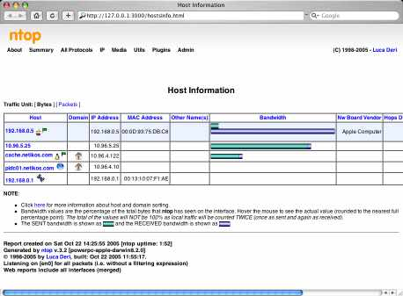
Some History
In 1998, the original
ntop has been created.
It was a C-based app
embedding a web server
able to capture traffic
and analyse it.
Contrary to many tools available at that time, ntop used a web GUI to report traffic activities.
It is available for Unix and Windows under GPL.

Slide 6
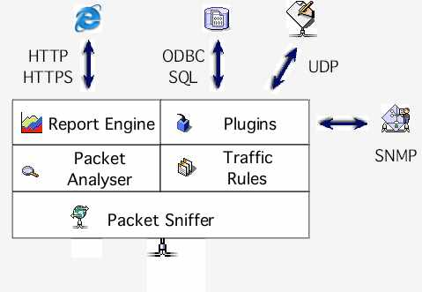
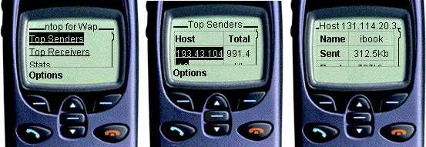
ntop Architecture
HTTP/HTTPS
RRD
Cisco NetFlow
InMon sFlow

Slide 7
Why was ntop obsolete?
Its original LAN-oriented design prevented ntop from handling more than a few hundred Mbit.
The GUI was an old (no fancy HTML 5) monolithic piece written in C so changing/extending a page required a programmer.
ntop could not be used as web-less monitoring engine to be integrated with other apps.
Many components were designed in 1998, and it was time to start over (spaghetti code).

Slide 8
ntopng Design Goals
Clean separation between the monitoring engine and the reporting facilities.
Robust, crash-free engine (ntop was not really so).
Platform scriptability for enabling extensions or changes at runtime without restart.
Realtime: most monitoring tools aggregate data (5 mins usually) and present it when it’s too late.
Many new features including HTML 5-based dynamic GUI, categorisation, DPI.

Slide 9
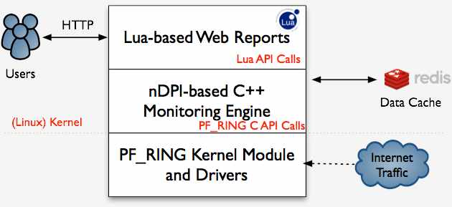
ntopng Architecture
Three different and self-contained components, communicating with clean API calls.

Slide 10
ntopng Monitoring Engine
Coded in C++ and based on the concept of flow (set of packets with the same 6-tuple).
Flows are inspected with a home-grown DPI-library named nDPI aiming to discover the “real” application protocol (no ports are used).
Information is clustered per:
    (Capture) Network Device
    Flow
    Host
    High-level Aggregations

Slide 11
Local vs Remote Hosts [1/2]
ntopng keeps information in memory at different level of accuracy in order to save resources for hosts that are not “too relevant”.
For this reason at startup hosts are divided in:
  Local hosts/System Host
  The local host where ntopng is running as well the hosts belonging to some “privileged” IPv4/v6 networks. These hosts are very relevant and thus ntopng keeps full statistics.
  Remote hosts
  Non-local hosts for which we keep a minimum level of detail.

Slide 12
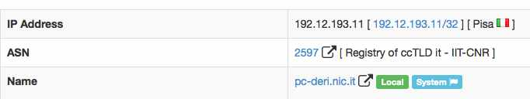
Local vs Remote Hosts [2/2]
For local hosts (unless disabled via preferences) are kept all L7 protocol statistics, as well as basic statistics (e.g. bytes/packets in/out).
No persistent statistics are saved on disk.
A system host is the host where ntopng is running and it is automatically considered local as well the networks of its ethernet interfaces.

Slide 13
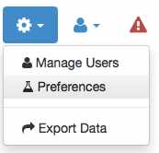
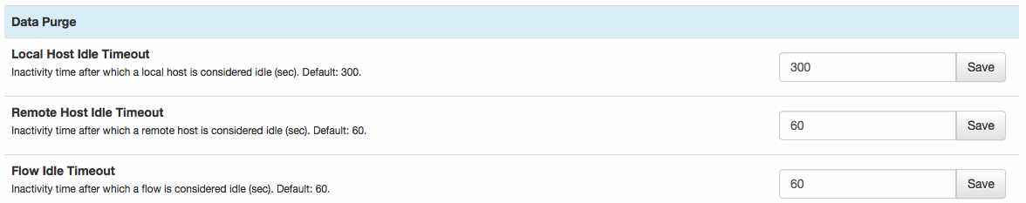
Information Lifecycle
ntopng keeps in memory live information such as flows and hosts statistics.
As the memory cannot be infinite, periodically non-recent information is harvested.
Users can specify preferences for data retention:

Slide 14
Packet Processing Journey
Packet capture: PF_RING, netfilter (Linux) or libpcap.
Packet decoding: no IP traffic is accounted.
IPv4/v6 Traffic only:
  Map the packet to a 6-tuple flow and increment stats.
  Identify source/destination hosts and increment stats.
  Use nDPI to identify the flow application protocol
    UDP flows are identified in no more than 2 packets.
    TCP Flows can be identified in up to 15 packets in total, otherwise the flow is marked as “Unknown”.
Move to the next packet.

Slide 15
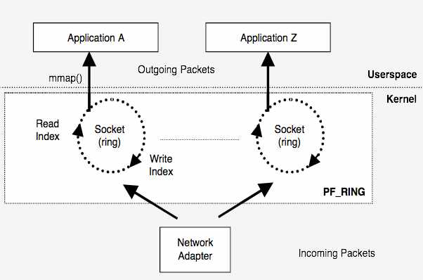
PF_RING
In 2004 we have realised the the Linux kernel was not efficient enough to fulfil our packet capture requirements and thus we have written a in-kernel circular buffer named PF_RING.

Slide 16
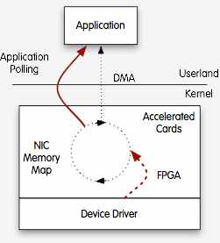
Moving towards 10 Gbit and above
The original PF_RING is a good solution up to 3/5 Gbit but not above as the cost of packet copy into the ring is overkilling.
PF_RING ZC (Zero Copy) is
an extension that allows
packets to received/transmitted
in zero copy similar to what
FPGA-accelerated cards (e.g.
Napatech and Accolade) do
in hardware.

Slide 17
PF_RING (ZC) and ntopng
Using PF_RING (ZC) with ntopng has several benefits:
  ntopng can scale to 10 Gbit and above by spawning several ntopng instances each bound to a (few) core(s).
  It is possible to send the same packet to multiple apps. For instance it is possible to send the same packet to ntopng (for accounting purposes) and n2disk (ntop’s application for dumping packet-to-disk at multi-10G) and/or and IDS (e.g. Suricata and snort).

Slide 18
The need for DPI in Monitoring [1/2]
Limit traffic analysis at packet header level it is no longer enough (nor cool).
Network administrators want to know the real protocol without relying on the port being used.
Selected protocols can be “precisely dissected” (e.g. HTTP) in order to extract information, but on the rest of the traffic it is necessary to tell network administrators what is the protocol flowing in their network.

Slide 19
The need for DPI in Monitoring [2/2]
DPI (Deep Packet Inspection) is a technique for inspecting the packet payload for the purpose of extracting metadata (e.g. protocol).
There are many DPI toolkits available but they are not what we looked for as:
  They are proprietary (you need to sign an NDA to use them), and costly for both purchase and maintenance.
  Adding a new protocol requires vendor support (i.e. it has a high cost and might need time until the vendor supports it) = you’re locked-in.
On a nutshell DPI is a requirement but the market does not offer an alternative for open-source.

Slide 20

Say hello to nDPI
ntop has decided to develop its own LGPLv3 DPI toolkit in order to build an open DPI layer for ntop and third party applications.
Supported protocols (> 180) include:
  P2P (Skype, BitTorrent)
  Messaging (Viber, Whatsapp, MSN, The Facebook)
  Multimedia (YouTube, Last.gm, iTunes)
  Conferencing (Webex, CitrixOnLine)
  Streaming (Zattoo, Icecast, Shoutcast, Netflix)
  Business (VNC, RDP, Citrix, *SQL)

Slide 21
nDPI Overview
Portable C library (Win and Unix, 32/64 bit).
Designed for user and kernel space
  Linux ndpi-netfilter implements L7 kernel filters
Used by many non-ntop projects (eg. xplico.org) and part of Linux distributions (e.g. Debian).
Able to operate on both plain ethernet traffic and encapsulated (e.g. GTP, GRE…).
Ability to specify at runtime custom protocols (port or hostname - dns, http, https -based).

Slide 22
nDPI on ntopng
In ntopng all flows are analysed through nDPI to associate an application protocol to them.
L7 statistics are available per flow, host, and interface (from which monitoring data is received).
For network interfaces and local hosts, nDPI statistics are saved persistently to disk (in RRD format).

Slide 23
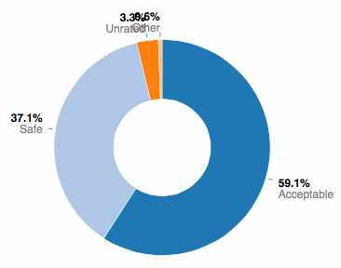
nDPI Protocol Clustering
nDPI can cluster protocols into categories:
Safe (e.g. SSH)
Acceptable (e.g. HTTP)
Fun (e.g. YouTube)
Unsafe (e.g. POP3)
Potentially dangerous (e.g. Tor)
Unrated (e.g. Unknown Protocol)

Slide 24
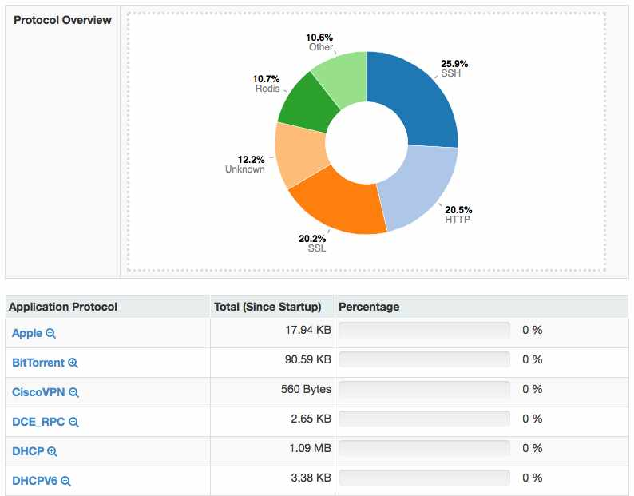
nDPI on ntopng: Interface Report [1/2]

Slide 25
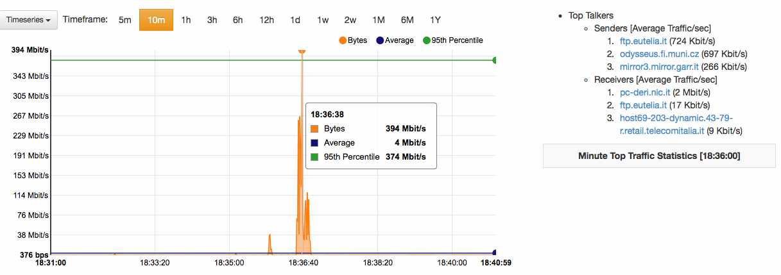
nDPI on ntopng: Interface Report [2/2]
Live data scrolling

Slide 26
ntopng and Redis
Redis is an open source key-value in-memory database.
ntop uses it to cache data such as:
  Configuration and user preferences information.
  DNS name resolution (numeric to symbolic).
  Volatile monitoring data (e.g. hosts JSON representation).
Some information is persistent (e.g. preferences) and some is volatile: ntopng can tell redis how long a given value must be kept in cache.

Slide 27
Lua-based ntopng Scriptability [1/3]
A design principle of ntopng has been the clean separation of the GUI from the engine (in ntop it was all mixed).
This means that ntopng can (also) be used (via HTTP) to feed data into third party apps such as Nagios or OpenNMS.
All data export from the engine happens via Lua similar to what happens in Wireshark.
Lua methods invoke the ntopng C++ API in order to interact with the monitoring engine.

Slide 28
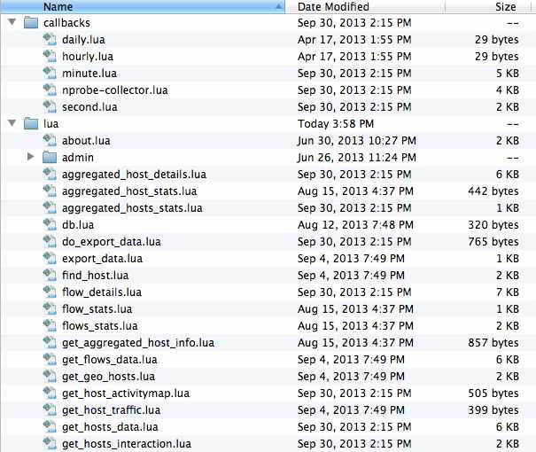
Lua-based ntopng Scriptability [2/3]
/scripts/callback/
scripts are executed
periodically to perform
specific actions.
/scripts/lua/ scripts
are executed only by
the web GUI.
Example:
http://ntopng:3000/lua/flow_stats.lua

Slide 29
Lua-based ntopng Scriptability [3/3]
ntopng defines (in C++) two Lua classes:
  interface
    Hook to objects that describe flows and hosts.
    Access to live monitoring data.
  ntop
    General functions used to interact with ntopng configuration.
Lua objects are usually in “read-only” mode
  C++ sets their data, Lua reads data (e.g. host.name).
  Some Lua methods (e.g. interface.restoreHost()) can however modify the information stored in the engine.

Slide 30
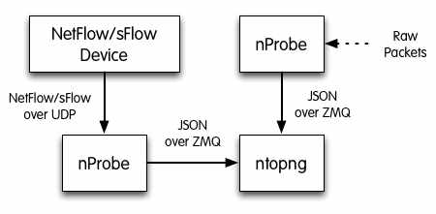
ntopng as a NetFlow/sFlow Collector [1/3]
The “old” ntop included a NetFlow/sFlow collector. Considered the effort required to support all the various NetFlow dialects (e.g. Cisco ASA flows are not “really” flows), in ntopng we have made a different design choice.

Slide 31
ntopng as a NetFlow/sFlow Collector [2/3]
nProbe (a home-grown NetFlow/sFlow collector/probe) is responsible for collecting/generating flows and convert them to JSON so that ntopng can understand it.
The communication ntopng <-> nProbe is over ØMQ a simple/fast messaging system that allows the two peers to be decoupled while:
  Avoiding “fat” communication protocols such as HTTP.
  Relying on a system that works per message (no per packet) and handles automatic reconnection if necessary.

Slide 32
ntopng as a NetFlow/sFlow Collector [3/3]
Flows are sent in the following format
{“8”:"192.12.193.11","12":"192.168.1.92","15":"0.0.0.0","10":0,"14":0,"2":5,"1":406,"22":1412183096,"21":1412183096,"7":3000,"11":55174,"6":27,"4":6,"5":0,"16":2597,"17":0,"9":0,"13":0,"42":4}
Where:
  “<Element ID>”: <value> (example 8 = IPV4_SRC_ADDR)
Contrary to what happens in NetFlow/sFlow ntopng (collector) connects to nProbe (probe) and fetches the emitted flows. Multiple collectors can connect to the same probe. No traffic is created when no collector is attached to the probe.

Slide 33
Flow Collection Setup: an Example
Flow collection/generation (nProbe)
Probe mode
nprobe --zmq "tcp://*:5556" -i eth1 -n none
sFlow/NetFlow collector mode
nprobe --zmq "tcp://*:5556" -i none -n none --collector-port 2055
Data Collector (ntopng)
ntopng -i tcp://127.0.0.1:5556

Slide 34
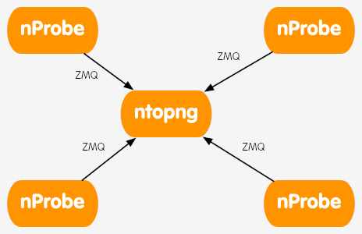
Creating ntopng Clusters [1/2]
ntopng is not only a flow collector, but it can export flows in the same JSON format used in the received flows.
This allows complex clusters to be created:

Slide 35
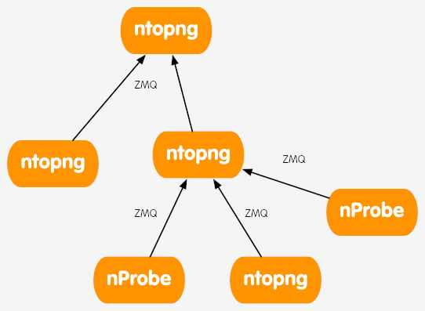
Creating ntopng Clusters [2/2]
In many companies, there are many satellite offices and a few central aggregation points.
Using ØMQ (both ntopng and nProbe flows are in the same format) it is possible to create a hierarchy of instances.
Each node aggregates the traffic
for the instances “below” it, so
that at each tree layer you have
a summarised view of the
network activities.

Slide 36
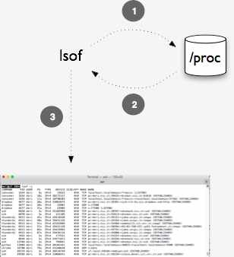
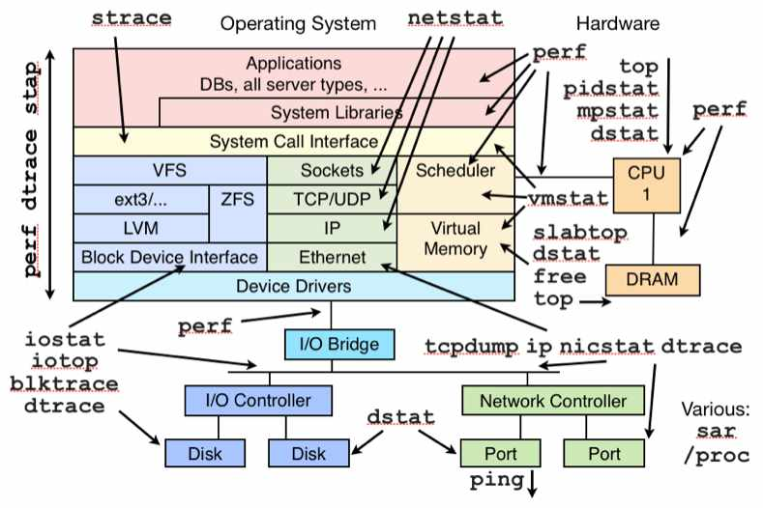
System+Network Monitoring [1/3]
This is how most system management tools work on Linux:

Slide 37
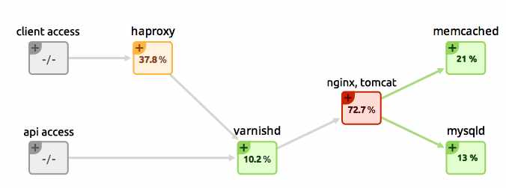
System+Network Monitoring [2/3]
?
?
?
?
?
?
?
Flow
Host
Using ntopng/nProbe you can see the flows that are are being exchanged across systems but it is not possible to know more than that.

Slide 38
System+Network Monitoring [3/3]
It would be desirable to know exactly what is the process originating the traffic observed and what resources the process is using while generating such traffic.
In essence we would like to see this picture:

Slide 39
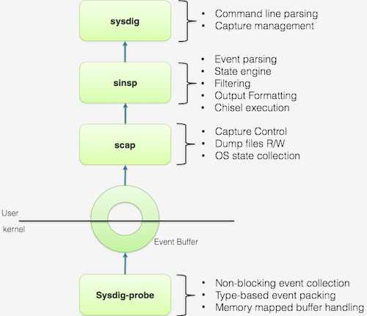
Welcome to Sysdig
Sysdig is a Linux
framework developed
by Sysdig Cloud for
capturing system calls.
The kernel module
intercepts the calls.
The user-space libs
receive and interpret
the received calls.

Slide 40
ntopng+nProbe+sysdig [1/2]
In order to activate system+network monitoring, it is necessary to load the sysdig kernel module and start nProbe (flow probe) as follows:
Then start ntopng (flow collector) as follows:
nprobe -T “%IPV4_SRC_ADDR %L4_SRC_PORT %IPV4_DST_ADDR %L4_DST_PORT %IN_PKTS %IN_BYTES %FIRST_SWITCHED %LAST_SWITCHED” %TCP_FLAGS %PROTOCOL @PROCESS@ %L7_PROTO --zmq “tcp://*:1234” -i any --dont-drop-privileges -t 5 -b 2
ntopng -i tcp://nprobe1.ntop.org:1234 -i tcp://nprobe2.ntop.org:1234 …

Slide 41
ntopng+nProbe+sysdig [2/2]
When ntopng receives flow enriched with system information, it interprets it, and depicts:
  The process-to-flow association.
  For flows whose peers are hosts monitored by nProbe instances, it “glues” the flows together.
  The process call father/process hierarchy is depicted.
  The overall system process view including the process relationships.

Slide 42
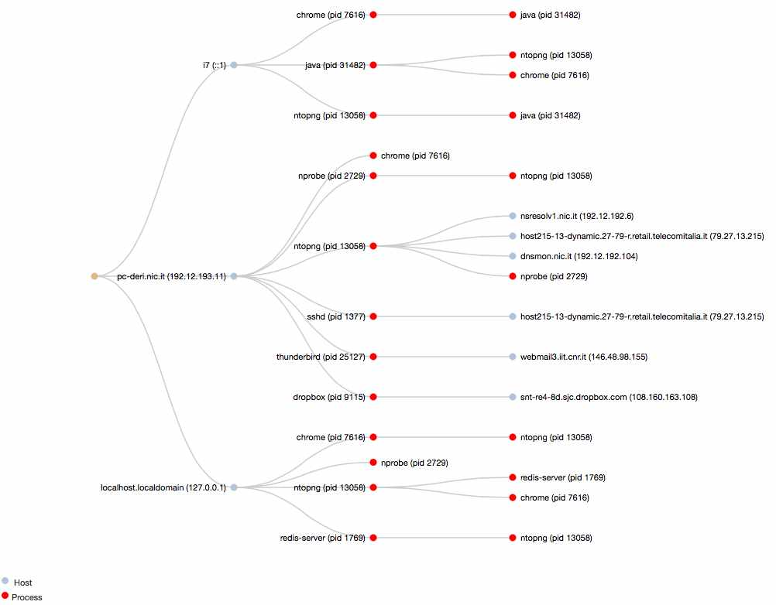
Process Network Communications

Slide 43
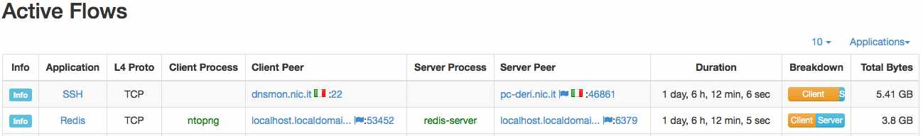
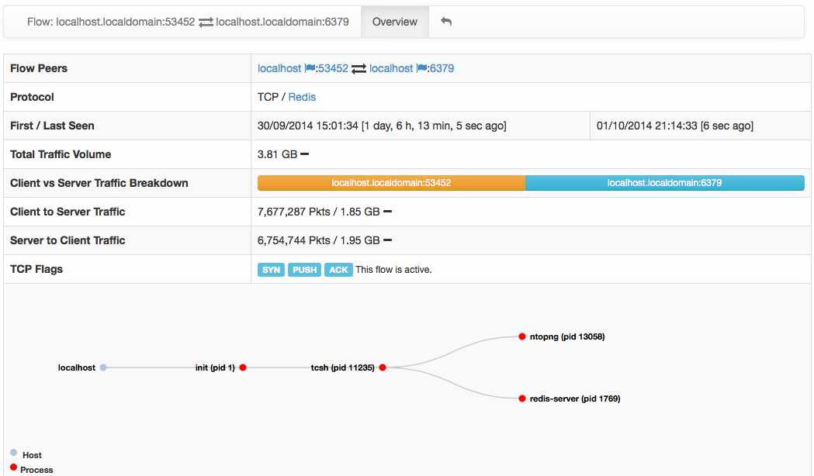
Flow/Process Drill-down [1/2]

Slide 44
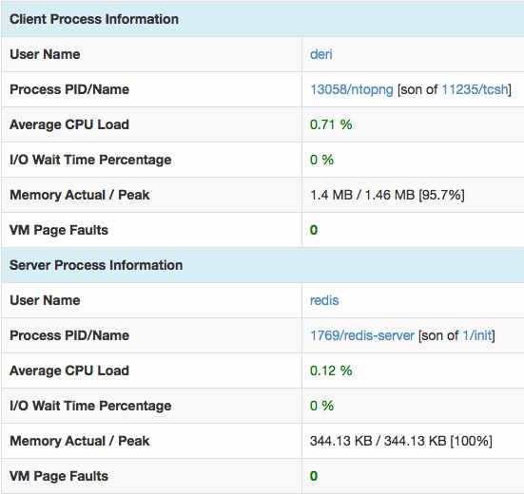
Flow/Process Drill-down [2/2]
Flow-to-Process binding
}
Dynamically Updated
Flow-to-Process binding
}
Dynamically Updated

Slide 45
ntopng and Big Data [1/2]
Using SQLite to save flows persistently is good when flows are not too many and the system that runs ntopng has storage.
For large deployments or disk-less systems (e.g. ARM-based PCs) it is desirable to upload flows on remote, cloud-based, systems able to scale with the number of flows.
In essence ntopng has been opened to what is currently defined as “big data” systems that can scale with data in volume and speed.

Slide 46
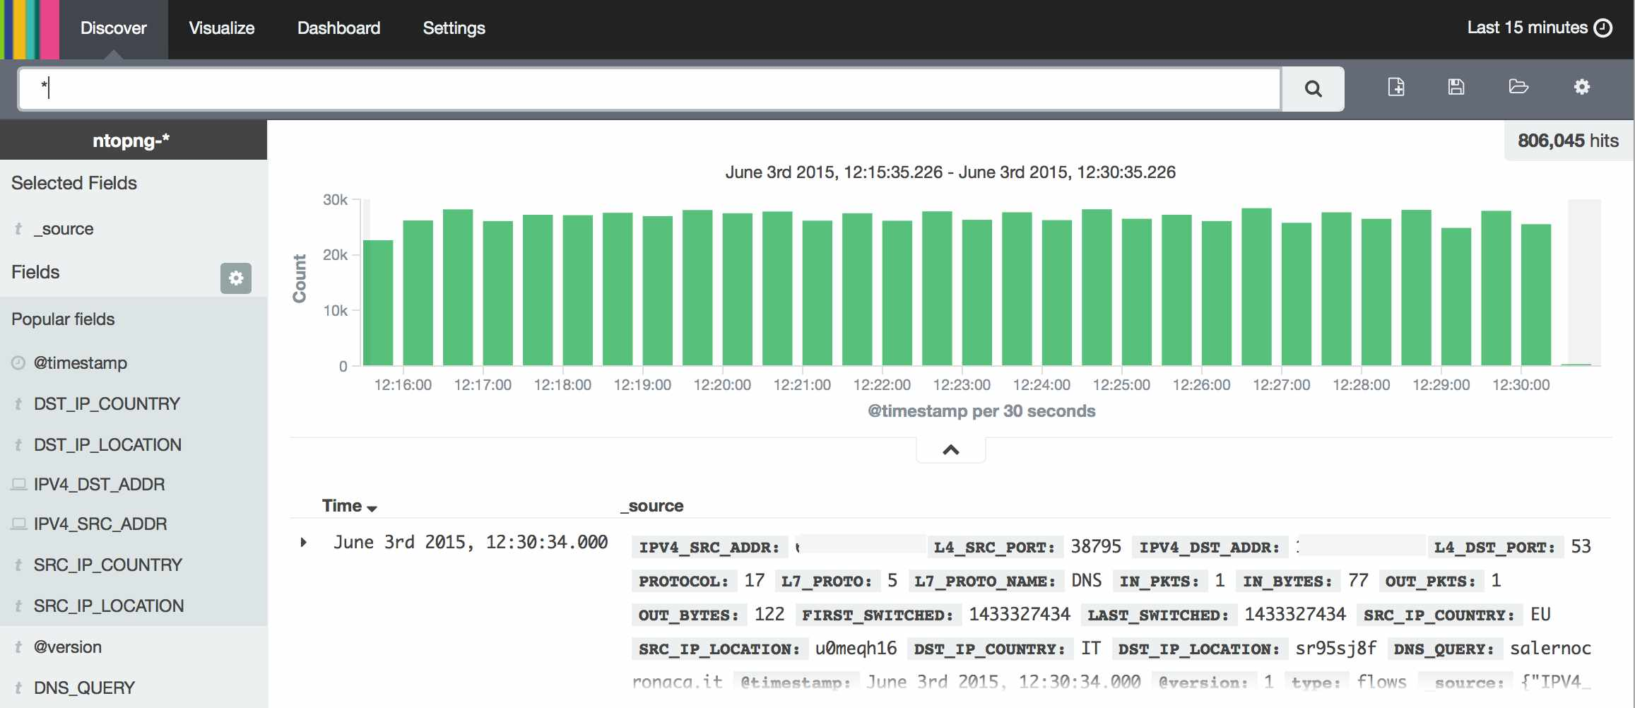
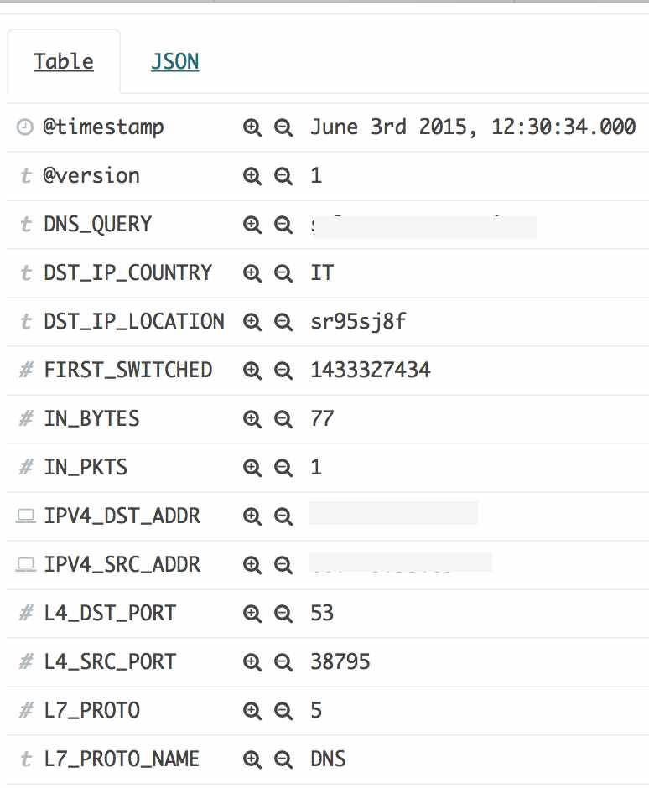
ntopng and Big Data [2/2]
You can configure ntopng to export flow data directly into ElasticSearch and display them with Kibana
ntopng -F “es;flows;ntopng-%Y.%m.%d;http://XYZ:9200/_bulk;” -i eth1

Slide 47
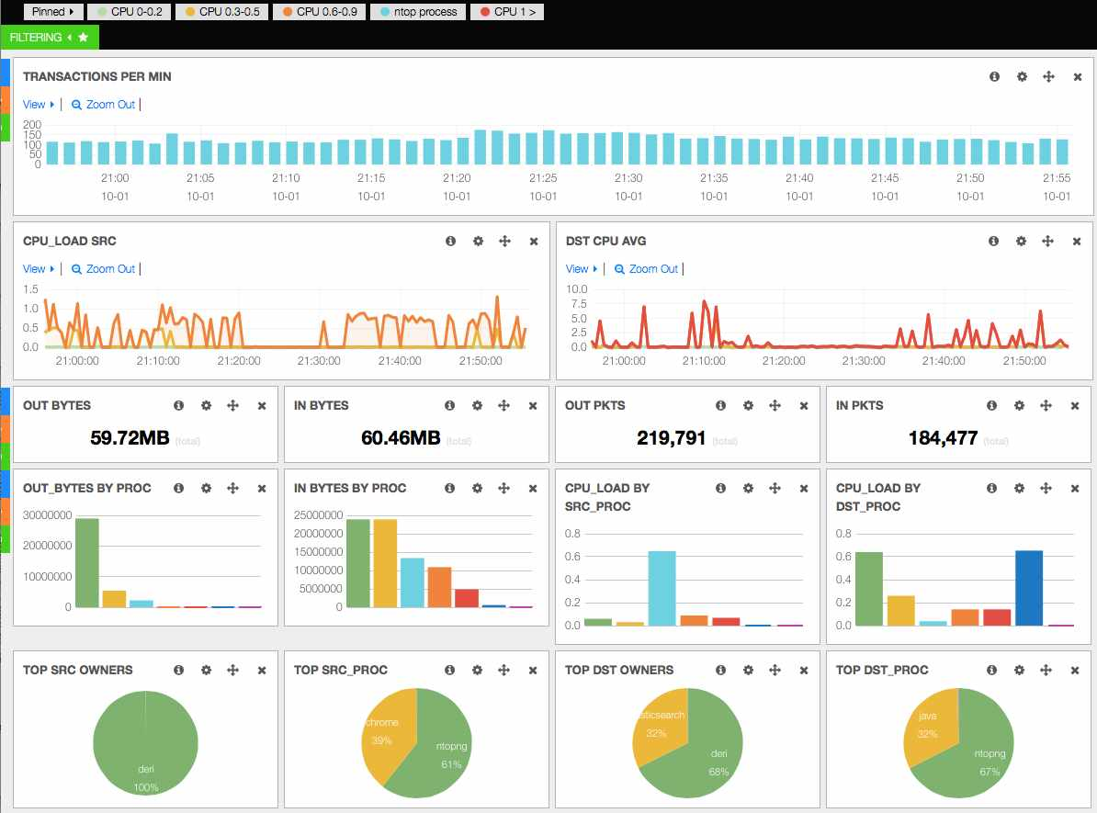
ntopng Kibana Dashboard [1/2]

Slide 48
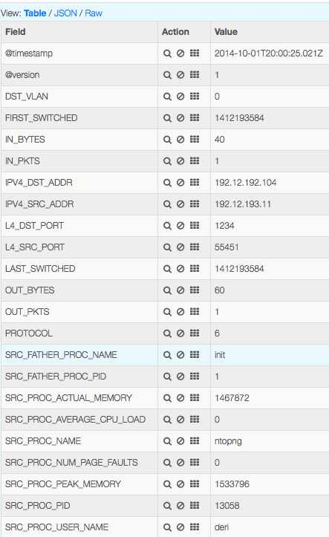
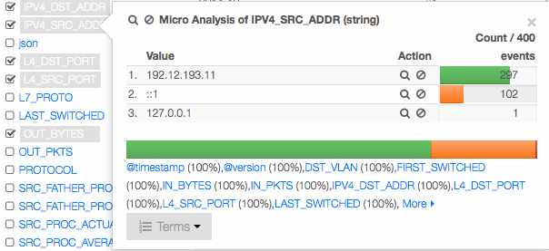
ntopng Kibana Dashboard [2/2]
The GUI refreshes automatically
as new data arrive and users
can drill down data or visualise
raw flows.

Slide 49


ntopng on Virtual Environments
ntopng has been packaged for major Linux distributions such as Debian/Ubuntu, CentOS/RedHat and also FreeBSD and OSX (brew): installation couldn’t be simpler.
However the current trend is going towards virtualised environments (not just VMs such as VMware) and IaaS (Infrastructure as a Service) and thus we need to support them.

Slide 50
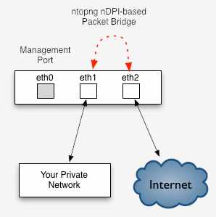



Using ntopng To Enforce Policies [1/2]
With ntopng 2.0 it is possible not just to monitor traffic but also to enforce network
policies.
In this case, ntopng works as an inline device operating as a network bridge.
ntopng
(Bump-In-The-Wire)

Slide 51
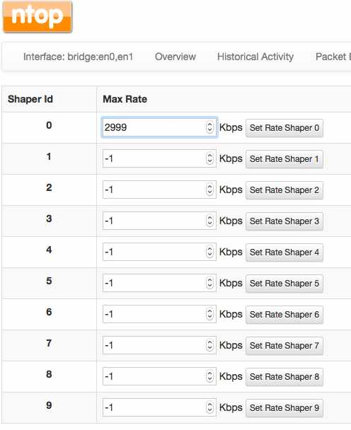
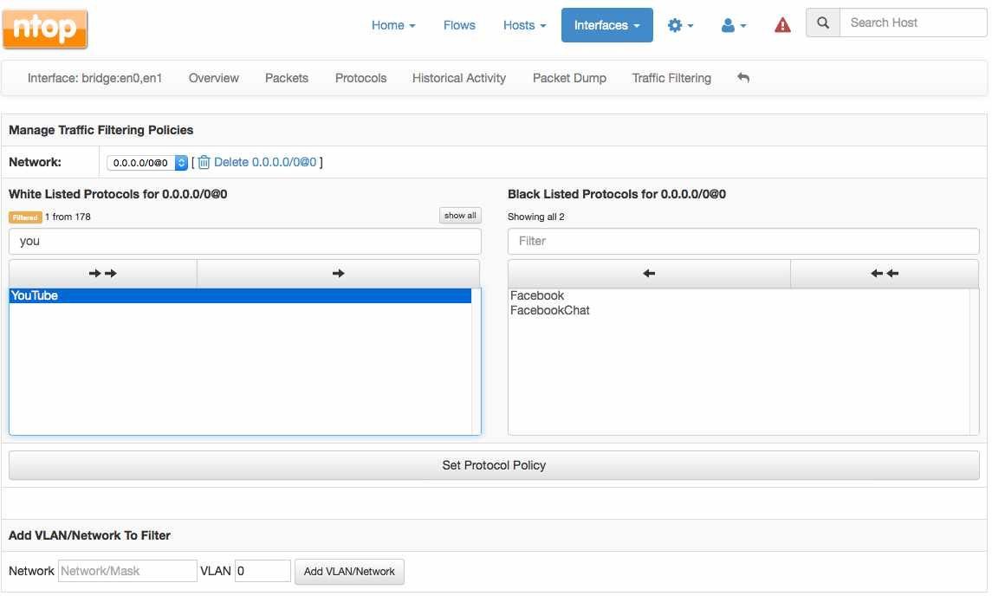
Using ntopng To Enforce Policies [2/2]
In inline mode ntopng can be configured to let specific traffic pass/not-pass (i.e. drop all Skype traffic) or shape.

Slide 52
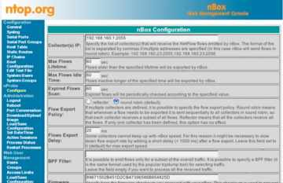

Embedding ntopng [1/3]
Historically we have started our first embed attempt in 2003 with the Cyclades TS100.
The nBox was used to analyse traffic then sent to ntop for representation.
After 10 years we have tried again with ntopng.

Slide 53
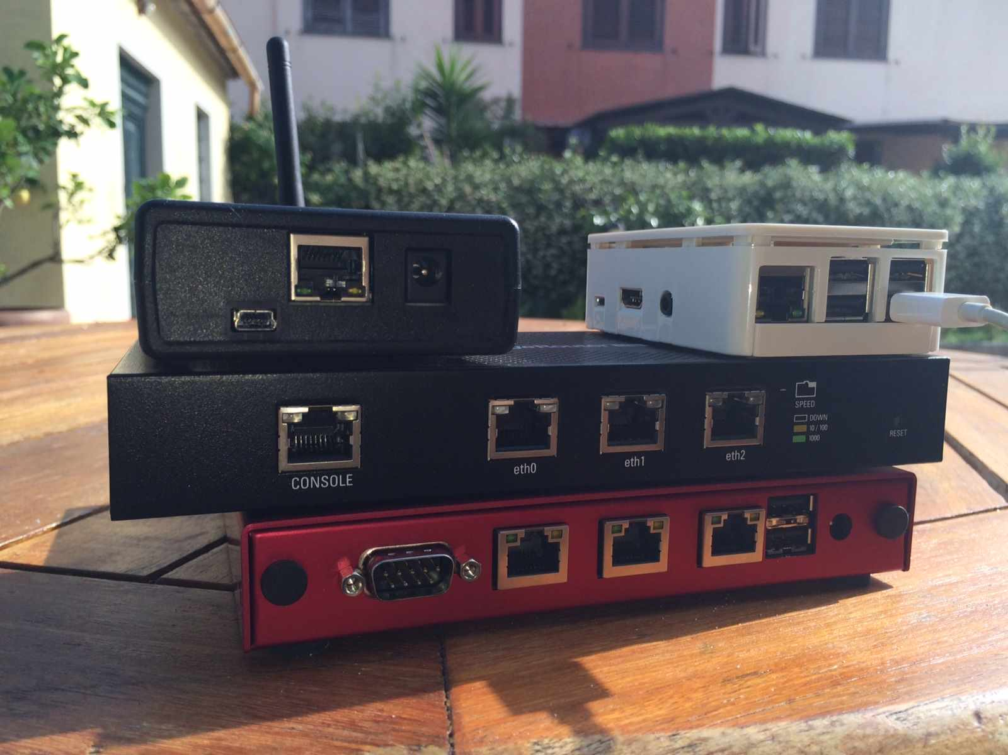



Embedding ntopng [2/3]
It is a while that we are working towards a cheap platform for everyone…
Raspberry PI2
BeagleBoard Black
Ubiquity
EdgeRouter Lite
PC Engines

Slide 54

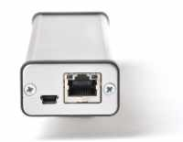

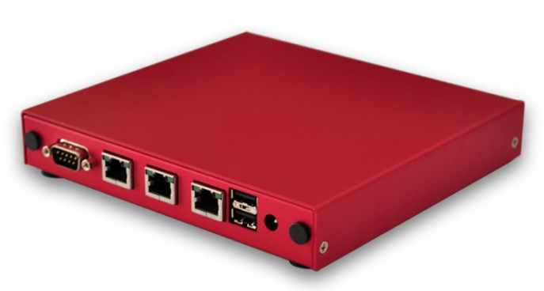
Embedding ntopng [3/3]
It is also possible to combine a
small ARM device with a copper
network tap using a CatchWire
device.
Or for those who need more horsepower, PCEngines can offer you a cheap x64 device to run ntopng on.

Slide 55
ntopng and Wireshark:
Real Life Monitoring Use Cases

Slide 56
Using ntopng with Wireshark
Wireshark has been traditionally used for in-depth packet analysis.
Usually Wireshark cannot be used as a long-term, permanent monitoring tool, but rather as tool used to analyse specific issues.
Combining ntopng with Wireshark can enable you to implement permanent monitoring while being able to analyse in detail specific packets. In essence: the best of both worlds.

Slide 57
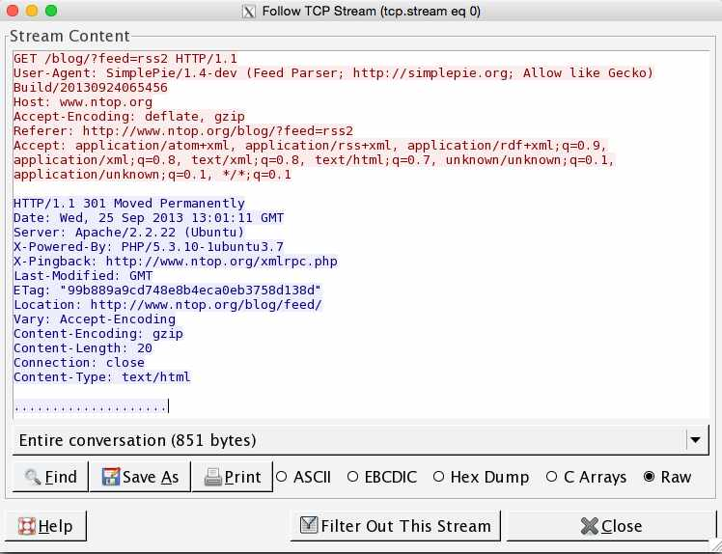
Analysing HTTP Traffic [1/4]
Wireshark allows you to follow TCP streams and analyse their content.

Slide 58
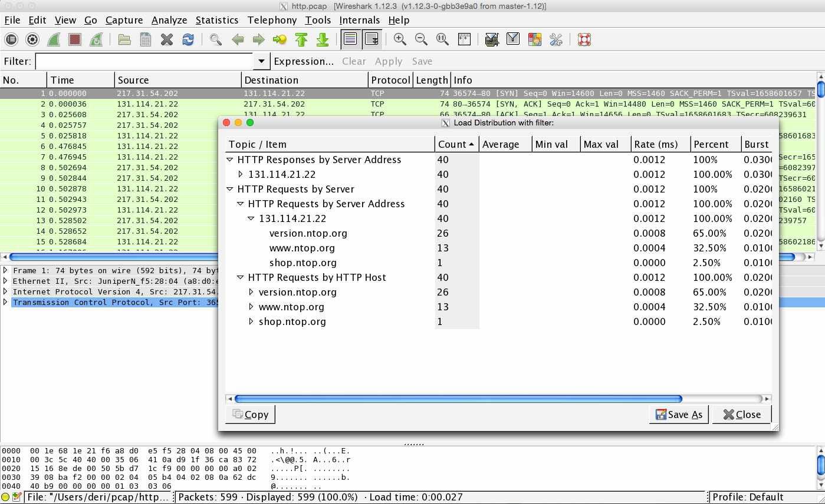
Analysing HTTP Traffic [2/4]
It is also possible to analyse sessions more in detail…

Slide 59
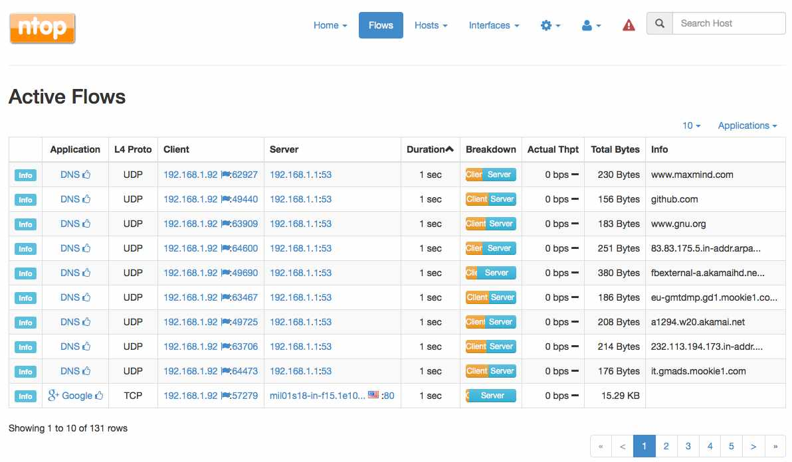




Analysing HTTP Traffic [3/4]
ntopng allows people to visualise flows in a realtime list
nDPI
Flow Details

Slide 60
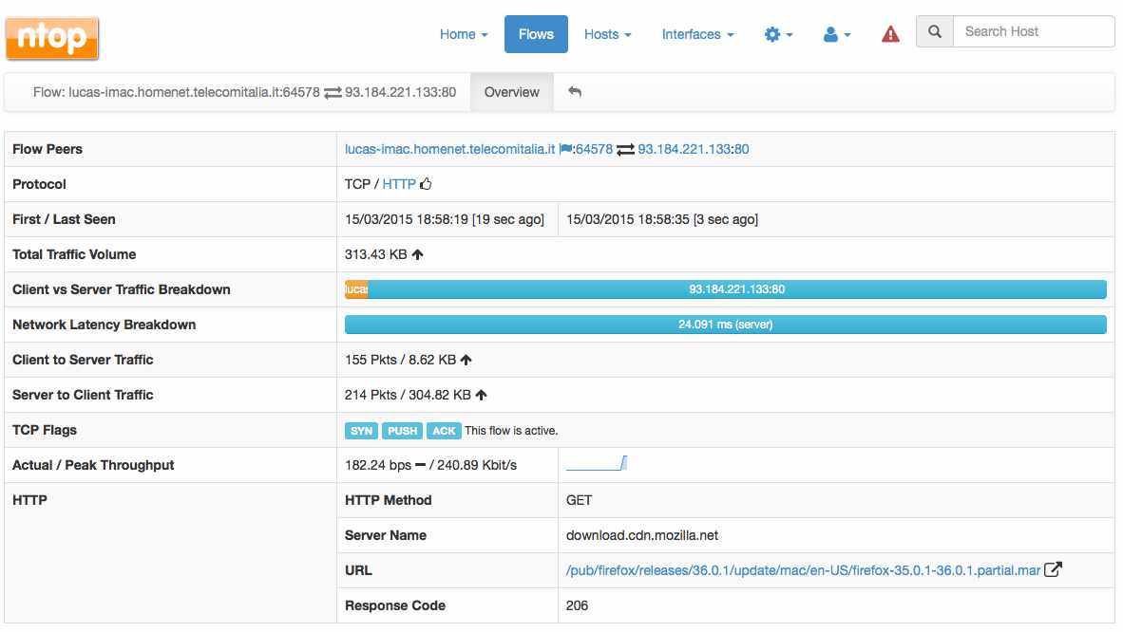

Analysing HTTP Traffic [4/4]

Slide 61
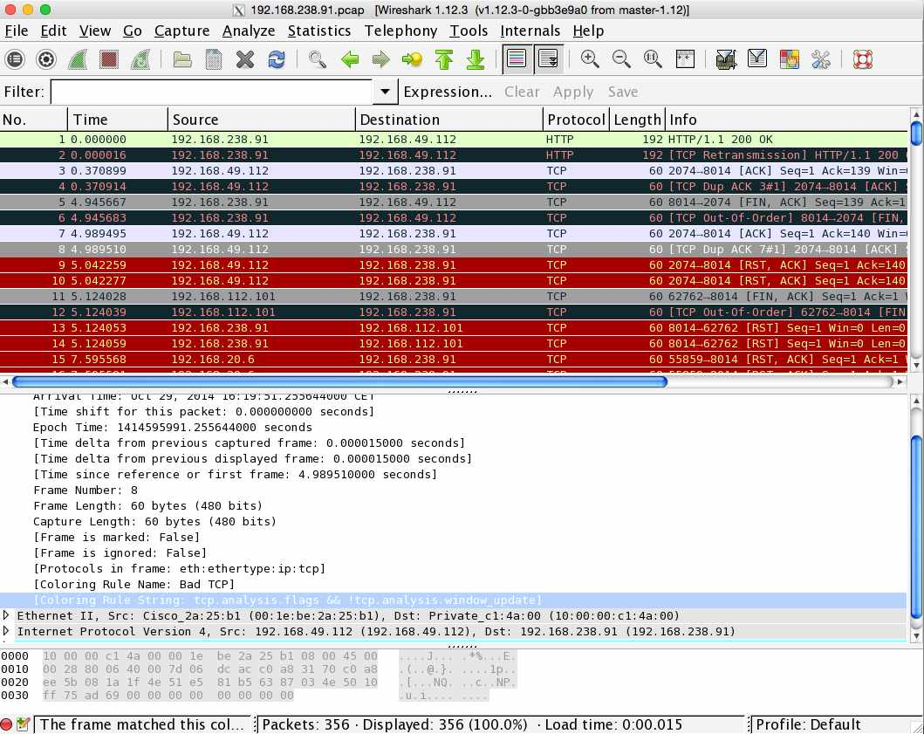
Network Health Analysis [1/3]
Wireshark allows you to analyse packet/connection issues,
including:
  Retransmissions
  Packets Out-Of-Order
  Packets Lost

Slide 62
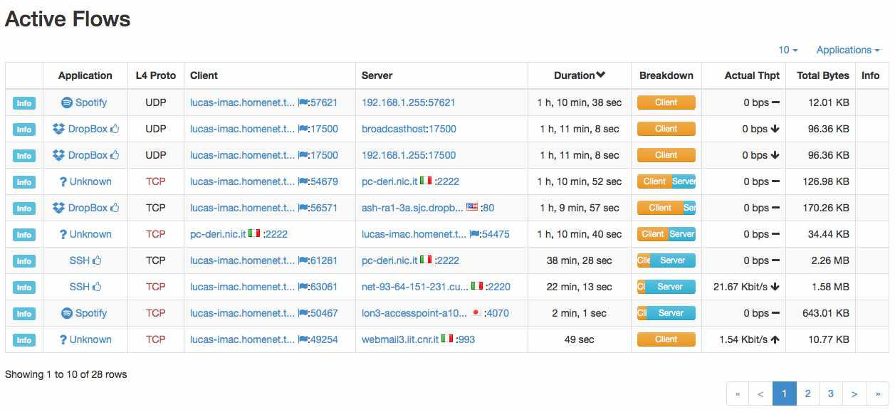





Network Health Analysis [2/3]
Flows to Pay Attention

Slide 63
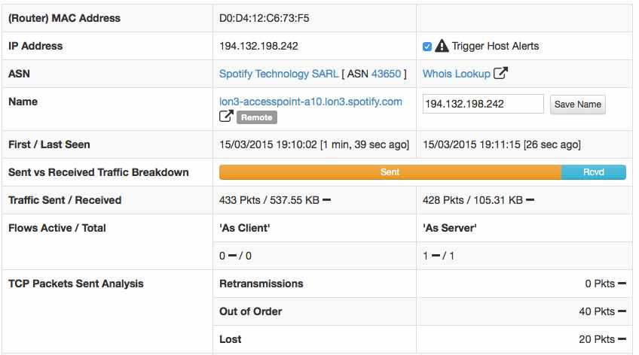

Network Health Analysis [3/3]

Slide 64
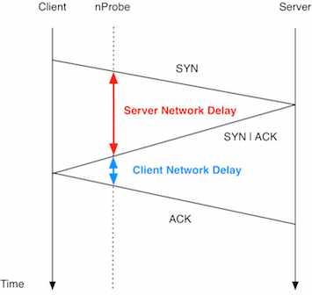


Network Performance Analysis [1/4]
With TCP, it is possible to measure the network latency by
analysing the 3-way
handshake
Observation Point

Slide 65
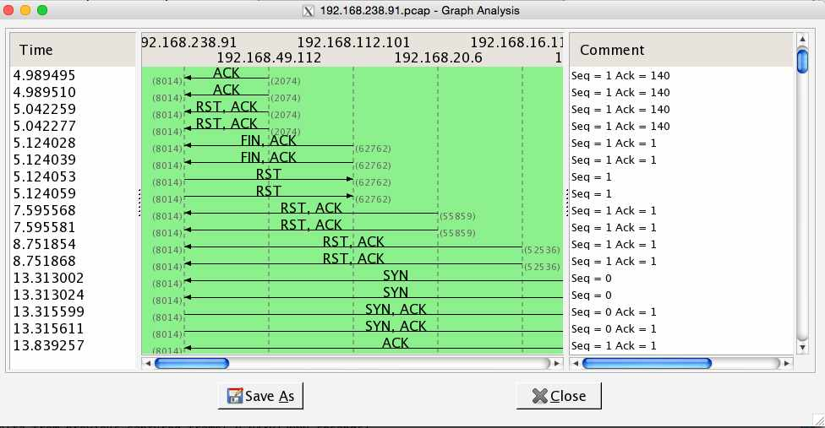
Network Performance Analysis [2/4]
Wireshark allows you to analyse packets delays. The idea is to make this simpler to read to everyone.

Slide 66
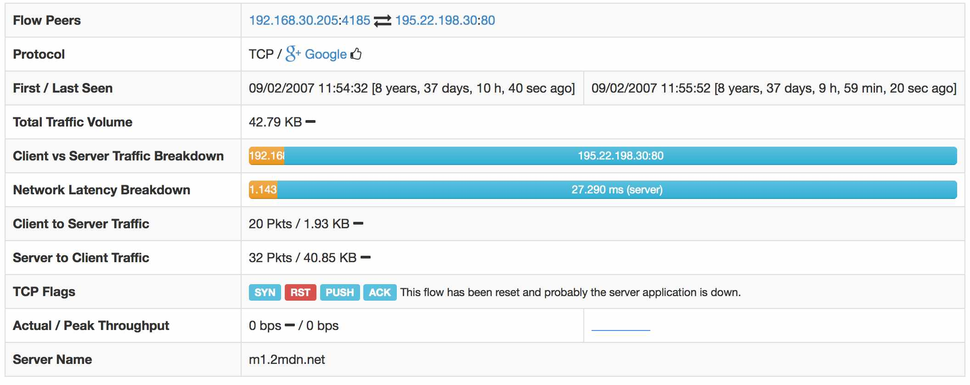

Network Performance Analysis [3/4]
Do you finally know where is the higher latency: client or server ?

Slide 67
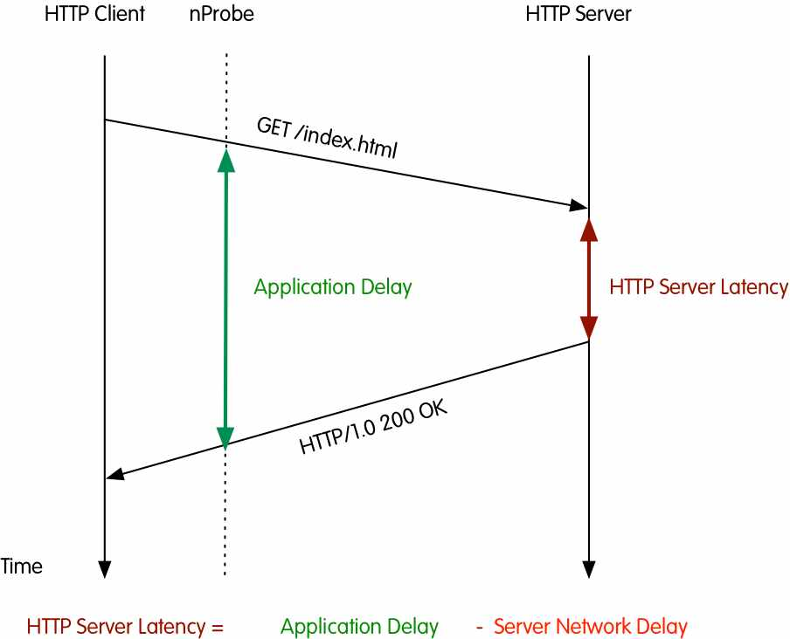
Network Performance Analysis [4/4]
Similar to network
latency, it is possible
to compute the
service response time.
It can be computed
for selected protocols
(e.g. HTTP) with
request/reply
behaviour.

Slide 68
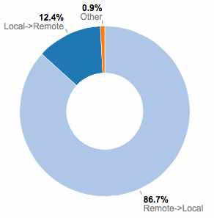





Download or Upload?
In Wireshark it is not possible to mark packet directions and thus to easily understand the relevant packet direction.
Current Network Load
Download or Upload ?

Slide 69
Packets Never Lie [1/3]
Suppose that for specific hosts (e.g. for which an IDS has reported security issues) you want to save raw packets.
Suppose that your host is under attack or is attacking somebody (e.g. portscan).
Suppose that you want to save packets of unknown (i.e. not detected by nDPI) communications for inspection (or for improving nDPI).
…then you need raw packets (pcap).

Slide 70
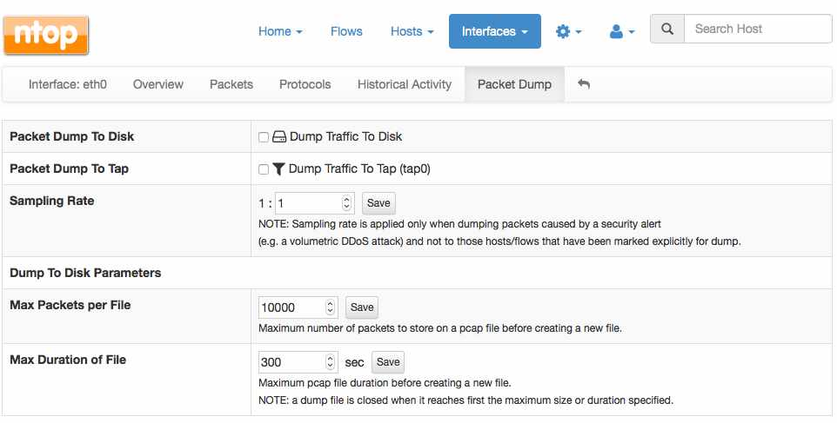





Packets Never Lie [2/3]
Only Under
Attack
Lightweight
Packet-to-Disk

Slide 71

Packets Never Lie [3/3]
Live Packet Export
ntopng
wireshark -i tap0
You can now see in realtime what is happening inside ntopng at packet level…
…and at the same time ntopng generates pcap files for you.

Slide 72
Triggering Alerts [1/3]
In Wireshark it is possible to identify issues and colour packets accordingly.
In ntopng it is possible to analyse traffic and trigger alerts when specific conditions happen. Example host X has made more than Y bytes of peer-to-peer traffic.
ntopng allows network administrators to set threshold for triggering alerts.

Slide 73
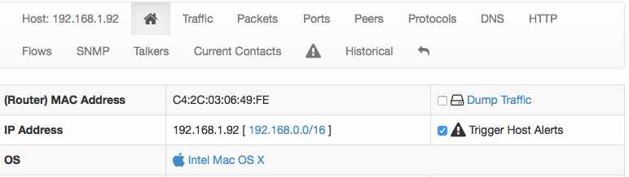








Triggering Alerts [2/3]
Per-host Alert Preferences
Observation Period
Condition
Thresholds

Slide 74



Triggering Alerts [3/3]
Flow Alert (No Threshold)

Slide 75
Using ntopng to Trigger Alerts [1/2]
Wireshark colouring rules cannot be used to trigger alerts and send them to a remote application.
Instead ntopng can be used as:
  Data source (e.g. give me the traffic of host X)
ntopng can use applications (e.g. nagios) for:
  Sending alerts and state changes.

Slide 76

Using ntopng to Trigger Alerts [2/2]
http://localhost:3000/lua/host_get_json.lua?ifname=eth0&host=192.168.1.1
nagios
(plugin)
ntopng
Active Mode
queueAlert()
ntopng
Passive Mode
nagios

Slide 77
Final Remarks
ntopng and Wireshark can enable you to implement permanent monitoring while dissecting traffic at packet level.
Commodity hardware, with adequate software, can now match the performance and flexibility that markets require. With the freedom of open source.
ntopng and nDPI are available under GNU (L)GPLv3 from https://github.com/ntop.

