Slide 1
Determining Topology from a Capture File
Wednesday 15th June 2016
Chris Bidwell
Network Engineer

Slide 2
L1-4 Reminder
4 | Transport | Proxies Load balancers Firewalls | TCP UDP
3 | Network | Router L3 Switch | IP ICMP IGMP
2 | Data-Link | Switch | (Ethernet) MAC address VLAN tags LACP
1 | Physical

Slide 3
L2 Analysis
Ethernet, MAC to MAC
Broadcast domains split on bridges and L3 boundaries
  We can see all broadcasts from our neighbours in the network, e.g. ARP, DHCP
  … and determine their type/vendor based on MAC OUI
  Spanning-tree
  Link-Layer Discovery Protocols
CoS markings for prioritised treatment in VLANs

Slide 4
L3 Analysis
IP to IP
TTL controls how far packets can go
  Monotonic decrement across L3 routers
  OS-specific defaults can be identified with a little guesswork
ICMP can inform of routing, access-control and link properties
  Redirects to optimise forwarding from hosts
  Unreachables: filtering, lack of route etc.
DSCP for QoS treatment

Slide 5
L4 Analysis
TCP, UDP etc. 5-tuple: sIP+dIP+proto+sprt+dprt
Port numbers frequently indicate application
  Some identify OS or device function
  Ephemeral range can further ID the OS
Load balancers
Proxies

Slide 6
Capture Scenarios
Content | Source | Size | Visibility
Single flow or fragment: One to one | Application-generated Firewall IPS/IDS event | KB-MB | L3, L4+
Multiple 5-tuples: One to many | Client Server Tap/SPAN | MB | L2+
Multiple 5-tuples: Many to many | Tap/SPAN | MB-GB | L2+

Slide 7
We Can Only See What’s There
Capture technique & location: App, Tap, SPAN
Capture hardware/resource limitation: NIC buffering, disk IO performance
Filtering: ACL, BPF, anonymisation
Segmentation: private VLAN, WLAN isolation
Connectivity: link or device failures

Slide 8
… And Sometimes Folks Lie And Hide
Not everything you see can be trusted…
  Deliberate misinformation from sysadmins
  Sanitisation efforts usually strip or replace identifying information
Can reduce the effectiveness of analysis
... Or highlight where some more work is required

Slide 9
So What Can We See?
“It depends”. With enough capture time and no filtering, you may see:
Some elements of physical interconnects
Manufacturer and OS information for visible nodes
VLAN assignment, QoS implementation clues
Local IP addressing scheme
Gateway quantity and functionality
Possible tunnelling, filtering, proxying or load-balancing
DNS, application or device discovery info

Slide 10
*.pcap

Slide 11
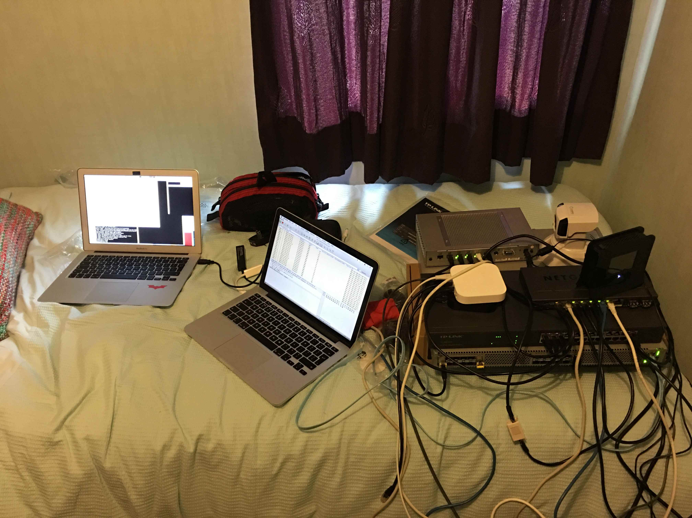
The Topology… sort of.

Slide 12
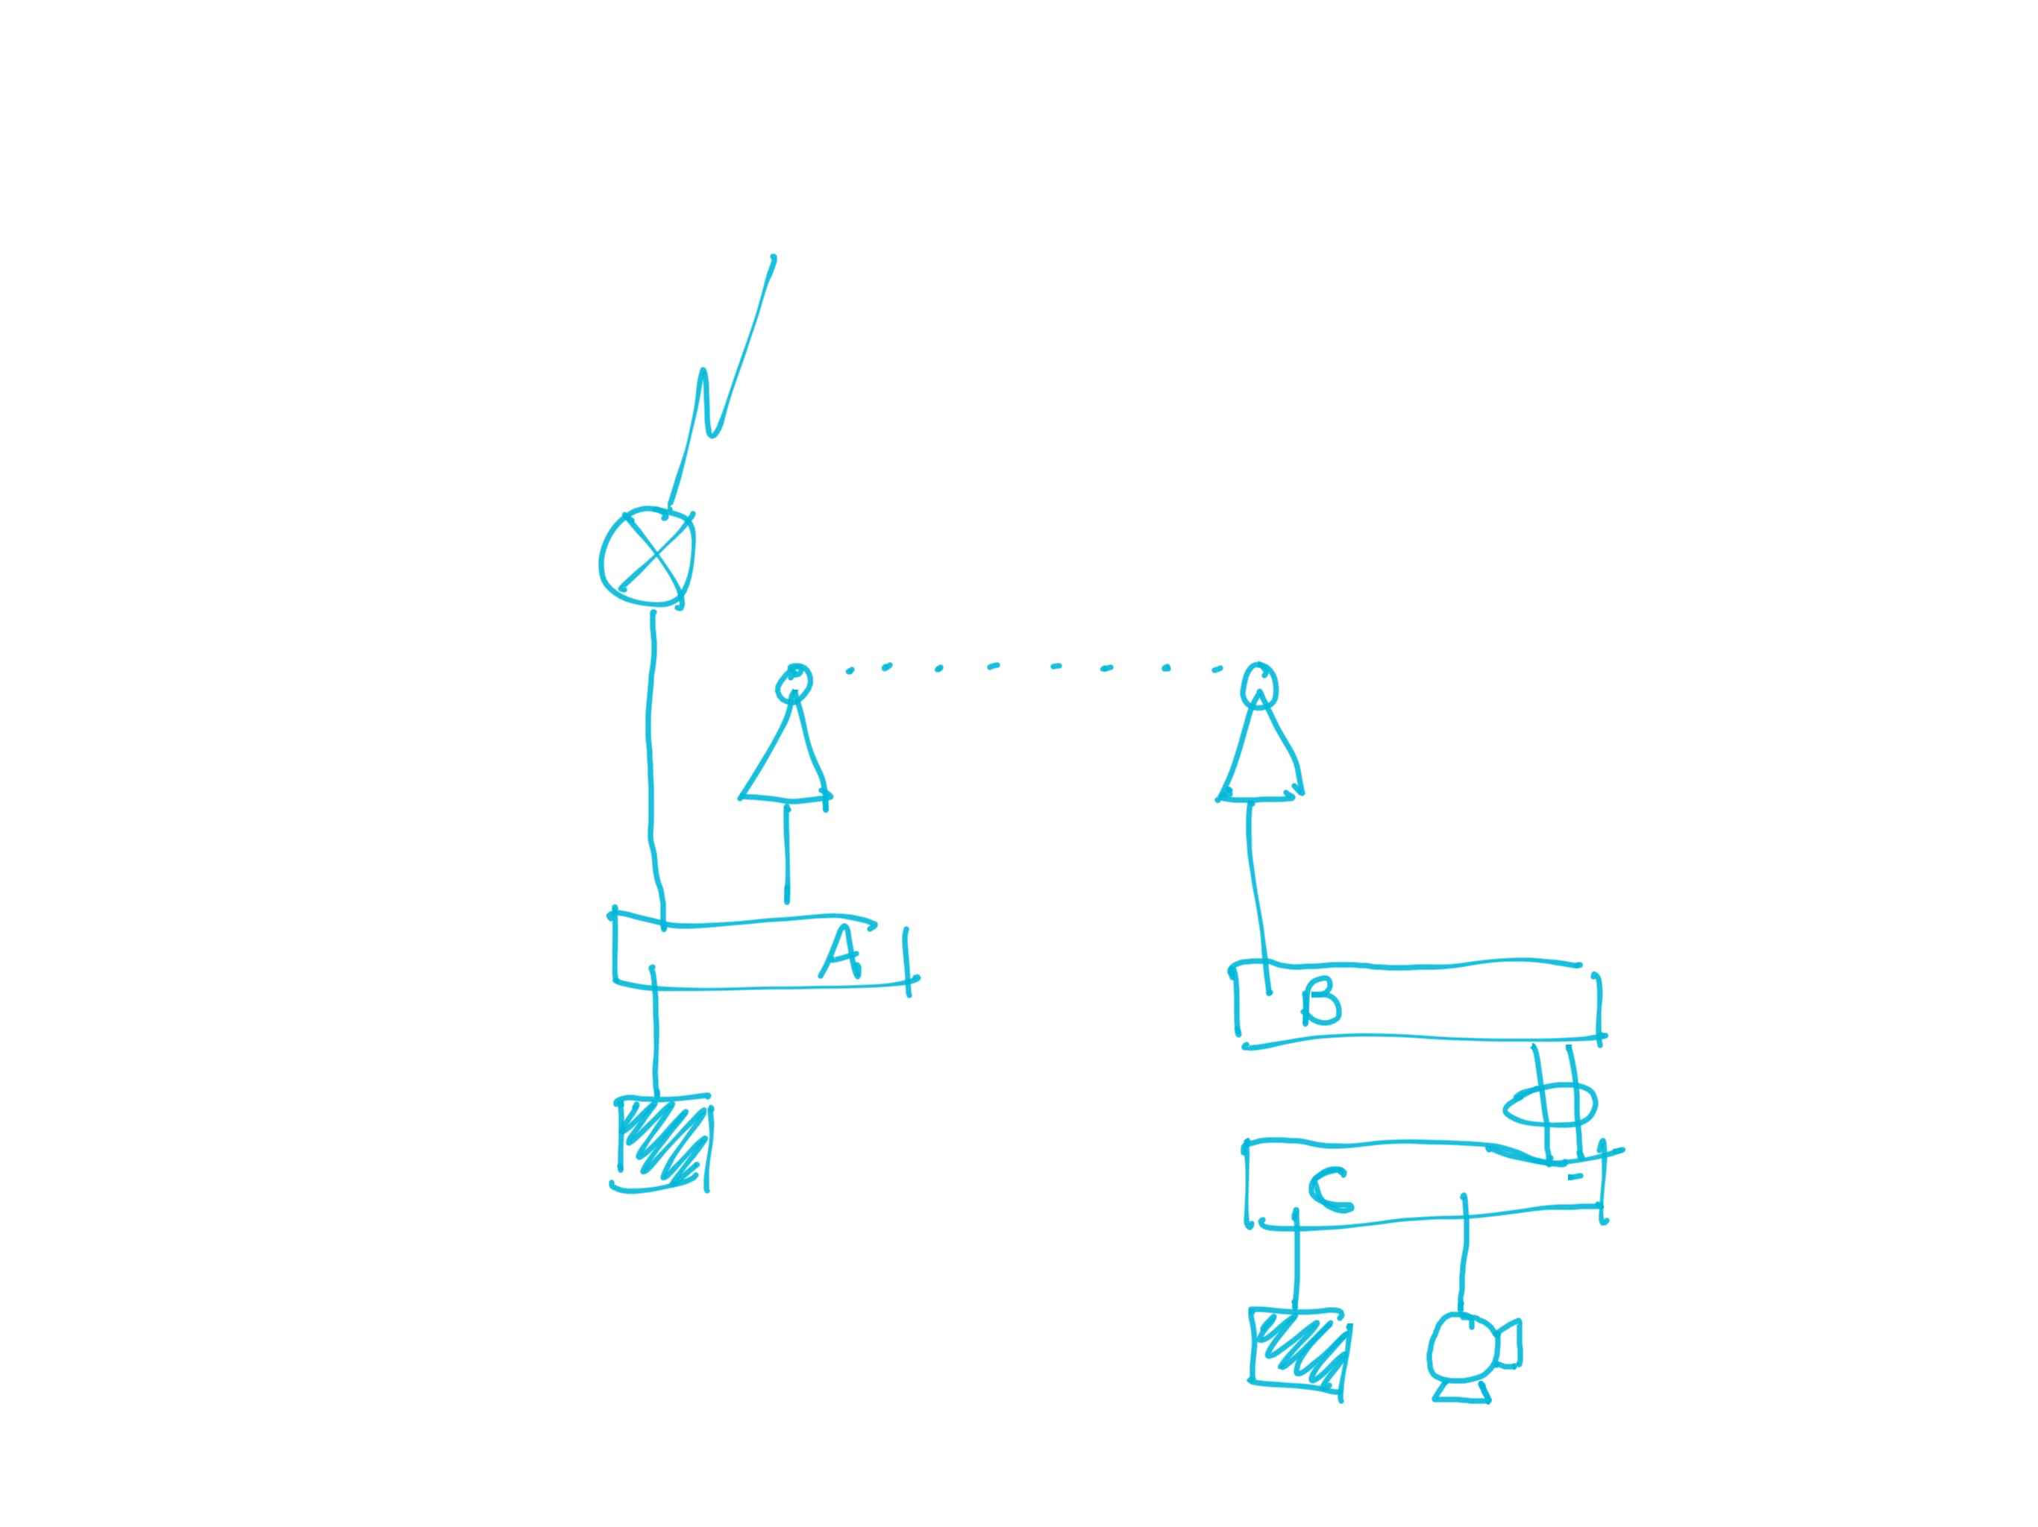
The Topology

Slide 13
FIN

