Slide 1
Augmenting Packet Capture with Contextual Metadata
The Why, What, and How
Stephen Donnelly
CTO | Endace
Notes:
Stephen Donnelly - Sharkfest Presentation Abstract
Full packet capture and archival is increasingly important, providing ‘ground truth’ evidence for investigating security incidents and performance issues. But captured packets by themselves lack context – such as information about where they were captured and the environment at the time of capture. This becomes especially problematic when packets are captured from multiple points, data resides in multiple places or multiple files, or when the data being analyzed is historical.
Augmenting packet data with metadata can help provide useful context about when, where and how packets were captured and the environment at the time of capture. It can also record a range of post-capture data such as comments or information from analytics applications.
This presentation will discuss what types of metadata can be useful, what it can be useful for, and how it can be encoded into packet capture data to ensure it provides permanent context to the packets that are captured.
Below is an outline of the information that we would look to cover in the presentation:
Metadata types
o Static capture context (host system, capture interfaces etc.)
o Dynamic capture context (timing and clock synchronization, link state/speed, optical power etc.)
o Post capture metadata (comments, events/alerts, Flow annotations, DPI, other expert information?)
Use cases
o Scalable capture (multi-point capture/multi-interface/multiple source files)
o Capture quality (packet loss auditing)
o Clock sync recording (Financial regulatory compliance – e.g. MiFID2)
o Big Data (feature extraction, ML)
Metadata in Wireshark history
o Pcap file header, linktype
File formats versus streaming
o Pcap-NG block types and per-packet options
o ERF extension headers and Provenance
Metadata display in Wireshark
o Wireshark GUI/CLI tools
o Packet display, file summary

Slide 2
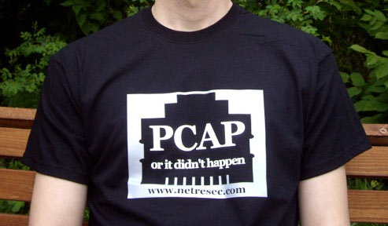
Packet Capture as Ground Truth

Slide 3
But is it really ground truth?
Packets Don’t Lie!!
Unless …
  You don’t know where they came from
  You don’t know if there was packet loss
  You don’t know if they’ve been filtered
  You don’t know if the time stamps are right
Metadata can provide that context
Notes:
Packet traces can be misleading without context

Slide 4
Agenda
Why?
  Why do we need metadata and-what would we use it for?
What?
  What do we mean by metadata
  What metadata might we want?
  What sorts of metadata are there?
How?
  A look at a couple of options for encoding metadata: PCAP-NG and ERF
  How do they differ and what is the impact of that difference?

Slide 5
WHY – data needs context
Metadata gives context - some use cases …
  Scalable capture
    Multi-point capture, multi-interface, multiple source files
  Data mining
    Search and retrieval using contextual indexes
  Capture quality
    Packet loss auditing
    Filtering
  Legal Evidence
    Attribution, Verification, Signing
  Clock sync recording
    Financial regulatory compliance – e.g. MiFID 2
    Event correlation
  Big Data
    Baselining, Trending/Forecasting
    Machine Learning / Cloud Services
  Security/Network event annotation
    Flagging suspect traffic for analysis
    Measuring SLA compliance

Slide 6
Agenda
Why?
  Why do we need metadata and-what would we use it for?
What?
  What do we mean by metadata
  What metadata might we want?
  What sorts of metadata are there?
How?
  A look at a couple of options for encoding metadata: PCAP-NG and ERF
  How do they differ and what is the impact of that difference?

Slide 7
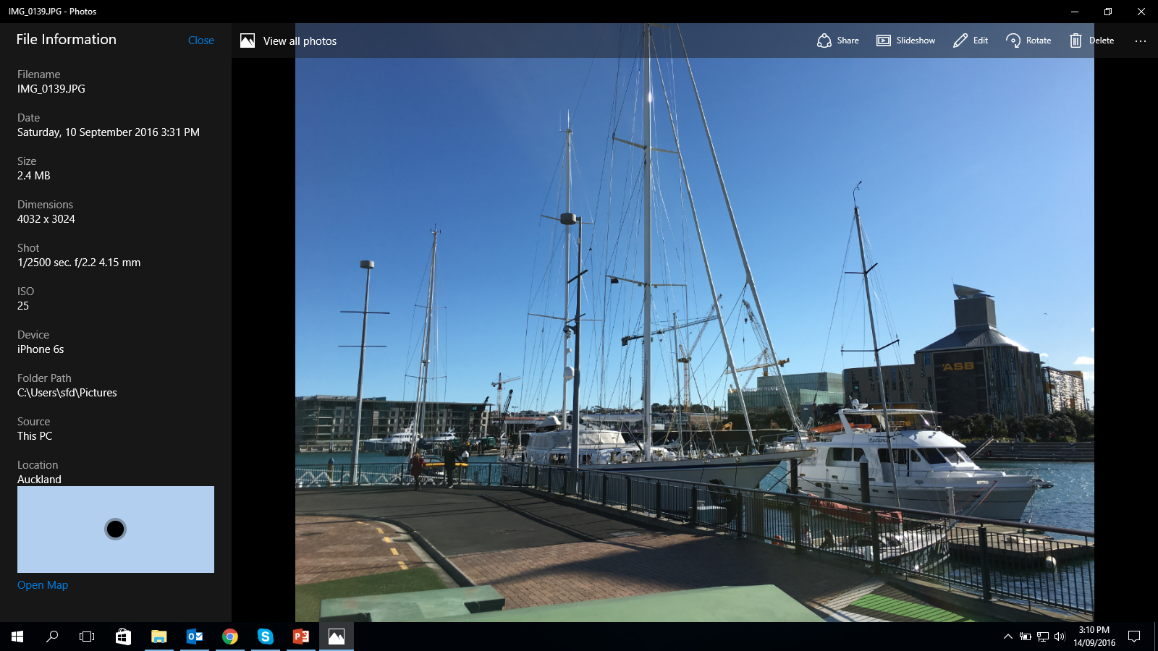
WHAT
Analogy to EXIF metadata
Notes:
Wireshark can also dissect JPEG EXIF Tags, but the display is not friendly

Slide 8
WHAT
Some examples of metadata we might be interested in
Who
What | When | Where | Why | Who | How
Packet contents | Time stamp | Interface ID | Ticket # | Authorization | Hardware model
Flags | Clock source | Card ID | IDS alert ID | User ID | OS
Flow Hash | Sync state | System ID | Application ID |  | Application
Capture filter | Clock error | Site | Comments |  | Link State
Search terms |  | Link name |  |  | Link Speed
 |  | NPB
 |  | Latitude /Longtitude

Slide 9
WHAT
Types of metadata
Static capture context
  Host system details
  Capture interfaces
  Software versions
Dynamic capture context
  Timing and clock synchronization
  Link state/speed
  Optical power
Post-Capture annotations
  User Comments
  Events/Alerts
  Flow records, DPI
  AI/ML

Slide 10
Agenda
Why?
  Why do we need metadata and-what would we use it for?
What?
  What do we mean by metadata
  What metadata might we want?
  What sorts of metadata are there?
How?
  A look at a couple of options for encoding metadata: PCAP-NG and ERF
  How do they differ and what is the impact of that difference?

Slide 11
HOW - PCAP file format
File Header
  Magic number (endianness, micro/nanosecond resolution)
  PCAP Version
  Time zone (GMT to local correction)
  Time stamp accuracy (?)
  Snap length
  Link type
Packet Header
  Time stamp
  Captured Length
  Length off wire
Packet/Frame content
Notes:
The time stamp accuracy field in the pcap file header is not read or written by libpcap, and appears unused.

Slide 12
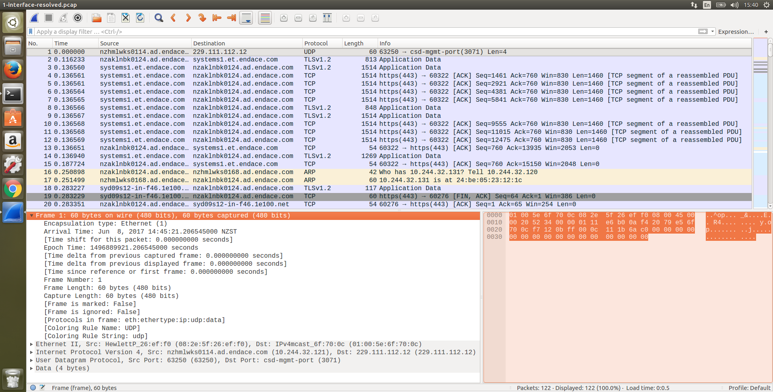
HOW – Pcap in Wireshark
Notes:
Pcap capture file in Wireshark, note there is no Interface information as Pcap only supports one interface.

Slide 13
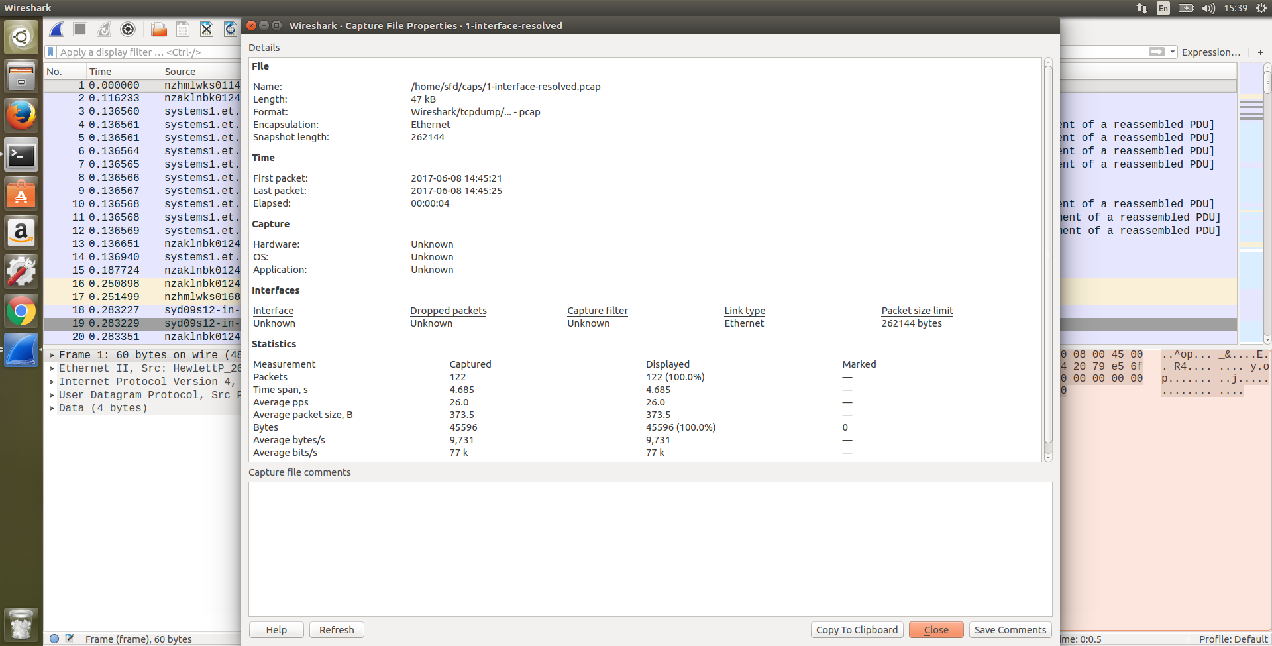
HOW – Pcap in Wireshark
Notes:
Single unnamed interface, no drop info, no filter info, no trace comment.

Slide 14
HOW - what does PCAP enable?
Metadata in PCAP files
What | When | Where | Why | Who | How
Packet contents | Clock source | Interface ID | Ticket # | Authorization | Hardware model
Flags | Sync state | Card ID | IDS alert ID | User ID | OS
Hash | Clock error | Probe ID | Application ID |  | Application
Capture filter | Time stamp | Site | Comments |  | Link State
Search terms | Time stamp resolution | Link name |  |  | Link Speed
 |  | NPB |  |  | Optical Power
 |  | Latitude /Longtitude |  |  | Capture hardware
Who
Notes:
Metadata coverage in pcap is not great.

Slide 15
HOW - PCAP-NG
Block based dump file format with TLV options
  Can store much richer metadata (30+ tags)
  Supports multiple interfaces
  Extendable
IETF Drafts
  2004, 2014
Supported since Wireshark 1.2.0 (2009)
Readable by Libpcap since 1.1.0 (2010)
Default format in Wireshark since 1.8 (2012)
  https://github.com/pcapng/pcapng

Slide 16
HOW - PCAP-NG Blocks
Section Header Block (SHB)
  Version
  Hardware, OS, Application
Interface Description Block (IDB)
  Linktype, Snaplen
  Name, Addresses, Speed, TS Resolution, Filter, FCS length
Enhanced Packet Block (EPB)
  Interface, Time stamp, Lengths, Packet
  Flags, Hash, Drops
Name Resolution Block (NRB)
  IPv4, IPv6
Notes:
In the standard, bold is required, italics are optional

Slide 17
HOW - PCAP-NG Blocks (cont)
Interface Statistics Block (ISB)
  Start, End, Received/Dropped/Filtered packets
TLV Options
  16-bit tag, 16-bit length, 32-bit padded value
  “Comment” string tags allowed in all blocks
Experimental Blocks (proposed)
  Compression
  Encryption
  Directory (index)
  Traffic Statistics and Monitoring
  Event/Security
  Vendor extensions

Slide 18

HOW - PCAP-NG File Format
EPBs
SHB
IDBs
ISBs
NRBs
Time
T=0
T=1
T=2
T=4
T=4
Notes:
Only one SHB supported by Wireshark
One IDB per Interface present
Wireshark User Manual says Resolved names not saved in capture file, but they are in PCAP-NG
Except, a bug in WS 2.2 means no names are saved!
As many NRBs are added as needed
One ISB per IDB, drop info from libpcap

Slide 19
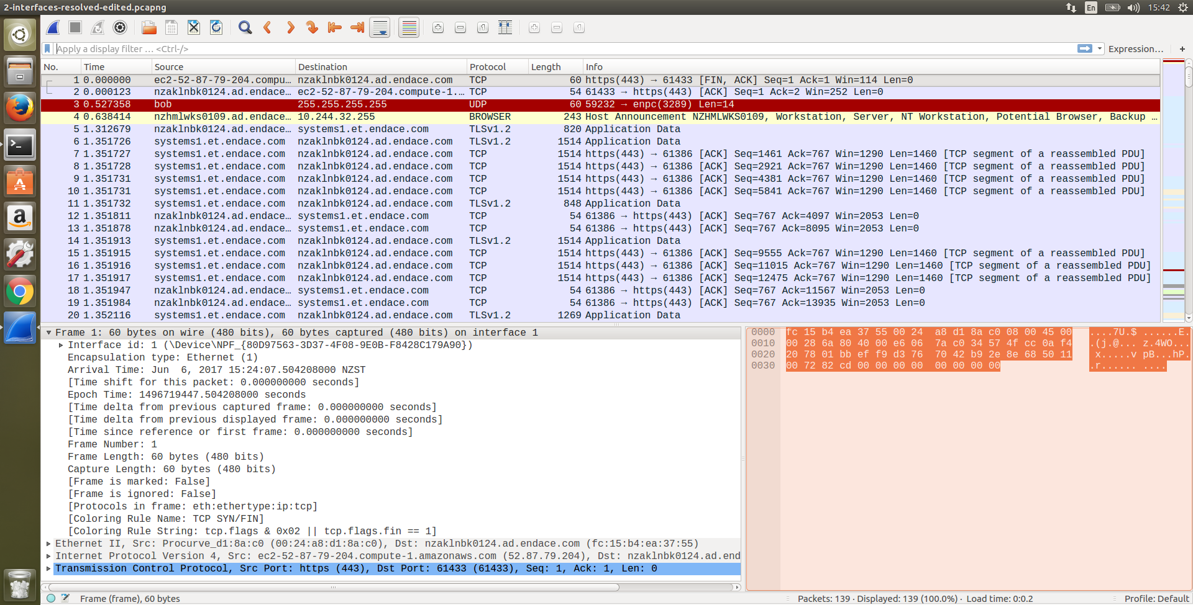
HOW – PCAP-NG in Wireshark
Notes:
Looks very similar to pcap
No SHB, IDBs etc in Packet List, the info is parsed but not displayed/dissected
Frame dissector now has Interface Id. Note Windows IF name is unhelpful, but Globally unique (GUID). Linux uses network device name (eth0), so not GUID.

Slide 20
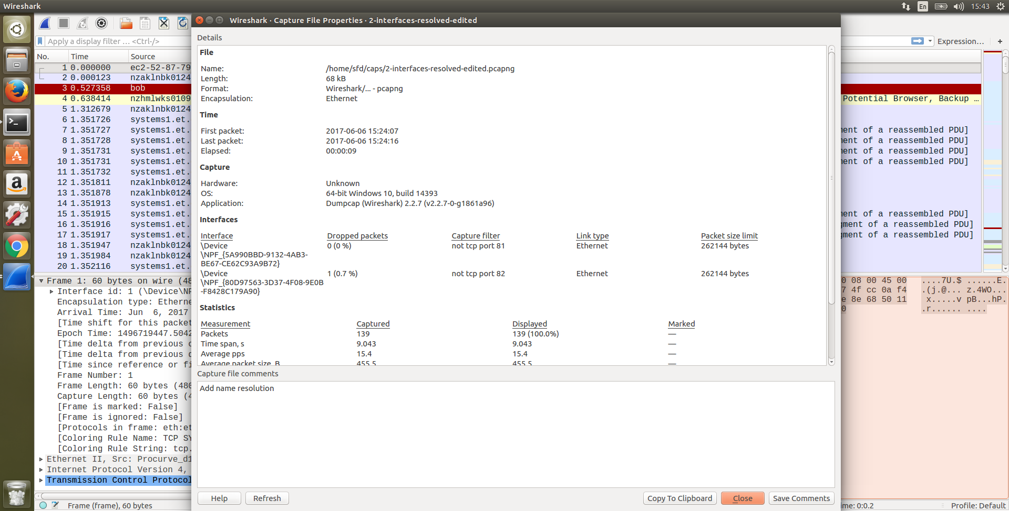
HOW – PCAP-NG in Wireshark
Notes:
Windows does not add Hardware option to SHB, whereas Linux puts a CPU model string in
Filled fields include Interface names, Dropped packets, capture filter, Link Type, Packet Size (snaplen)

Slide 21
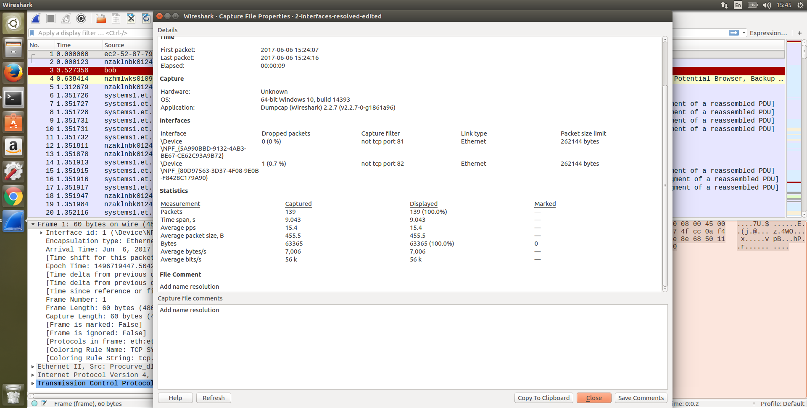
HOW – PCAP-NG in Wireshark
Notes:
Dropped Packet counts come from libpcap.
Packet Stats are global, and are computed by Wireshark, not read from PCAP-NG
File comment from SHB

Slide 22
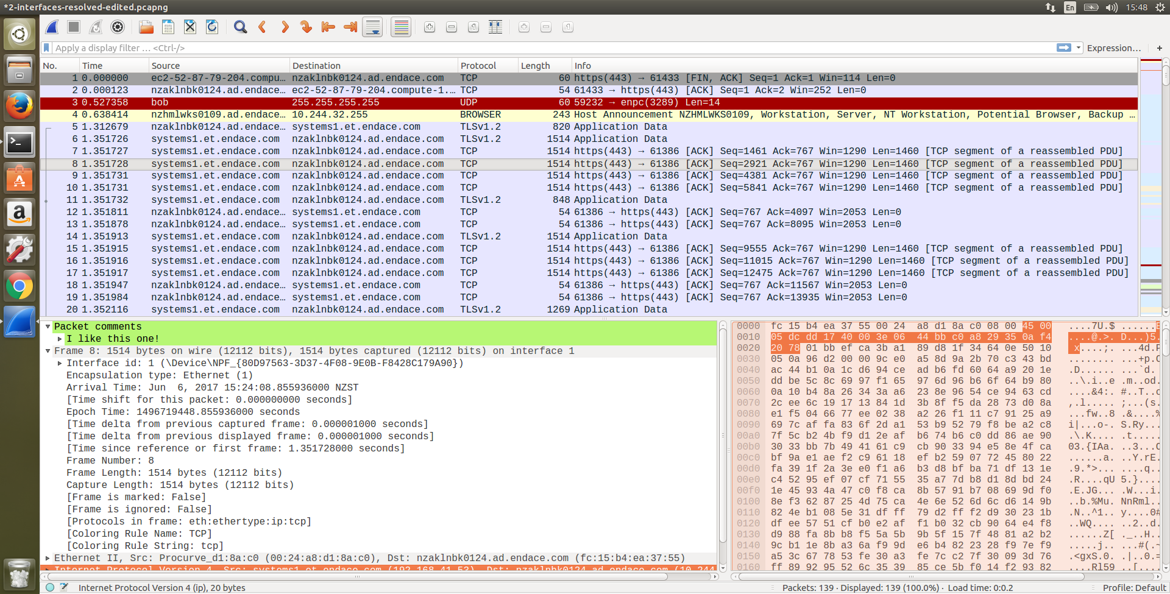
HOW – PCAP-NG in Wireshark
Notes:
Packet comments are options in EPBs
Comments are not saved until the whole file is rewritten

Slide 23
HOW - what does PCAP-NG enable?
Metadata in PCAP-NG files
What | When | Where | Why | Who | How
Packet contents | Clock source | Interface ID | Ticket # | Authorization | Hardware model
Flags | Sync state | Card ID | IDS alert ID | User ID | OS
Hash | Clock error | Probe ID | Application ID |  | Application
Capture filter | Time stamp | Site | Comments |  | Link State
Search terms | Time stamp resolution | Link name |  |  | Link Speed
 |  | NPB |  |  | Optical Power
 |  | Latitude /Longtitude |  |  | Capture Hardware
Who
Notes:
Hash is packet payload signature/checksum for dedupe etc, NOT a Flow Hash.
Capture filter is BPF/tcpdump grammar
Display Filters are not stored on export (Search terms)
Timestamp resolution not displayed by WS, can auto-set display resolution
Comments are a get out of jail card, but must be maintained manually!

Slide 24
HOW - Extensible Record Format (ERF)
Produced by Endace DAG cards and appliances
Stream of Records vs File format
  Multiple record types
  Fixed Headers and Extension Headers
ERF support since ethereal 0.9.15 (2003)
  Full support in modern Wireshark 2.x
  Actively developed, encourage feedback
  Live capture from Endace DAG cards via libpcap
  Complete ERF dissector, supports display filters, Expert Info etc
ERF Metadata support since Wireshark 2.2 (2016)
  Capture and per-packet comments in Wireshark 2.4 (2017)*
Notes:
Comments in 2.4 in pending PR 21873

Slide 25
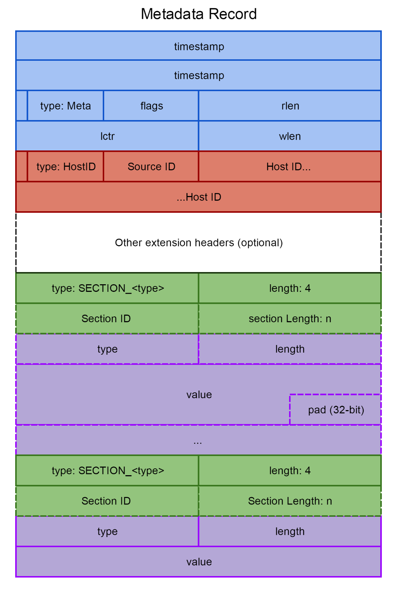
HOW - Extensible Record Format (ERF)
ProvenanceTM metadata record type (2016)
  Periodic and Event Metadata
  Per-Interface, Flow, and Packet annotations
    Including comments
  Hierarchical ID/addressing scheme
    Host
    Card
    Interface
  Metadata Generation Time recorded
  Multiple sections
  TLV options
  160+ Tags defined
  Up to 64kB per record
  Append on update policy
Notes:
Format support per-flow comments, Wireshark does not have a UI for it yet. Will come back to comments.
Wireshark Interface names include full name hierarchy information
All 160+ defined tags are dissected by WS, not all are currently used/filled during capture

Slide 26
HOW - ERF and ProvenanceTM
Provenance
Capture
Host
Module
X Interfaces
X Interfaces
Y Streams
Y Streams
Notes:
Provenance sections are hierarchical
Information is redundant, repeated each second
Allows for easy sub-setting on time ranges while maintaining metadata, and supports dynamic metadata changes

Slide 27
HOW - ERF and ProvenanceTM
Capture Section
  Name, Description
  Application, Version
  User
  Time zone
Host Section
  Hostname
  OS Version
  Model, Serial Number
  CPUs, RAM
  Organisation
  Location
Module Section
  Model, Serial Number
  Firmware version
  Hash mode
  Clock Sync State, PTP
Interface Sections
  SFP vendor/model
  Link speed, state
  RX/TX Optical power
  Addresses
Stream Sections
  Size, Drops, Snaplen
Notes:
Some brief examples, many more tags defined (160+)

Slide 28
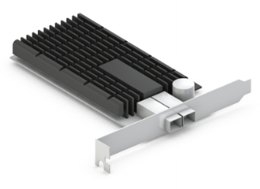
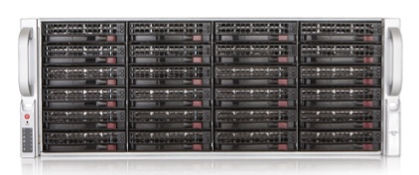
HOW - ERF Periodic Streaming Metadata
Packet Records
Provenance Records
Time
T=4
T=3
T=2
T=1
T=0
Notes:
Provenance records are inserted into the capture stream periodically, usually once per second.

Slide 29
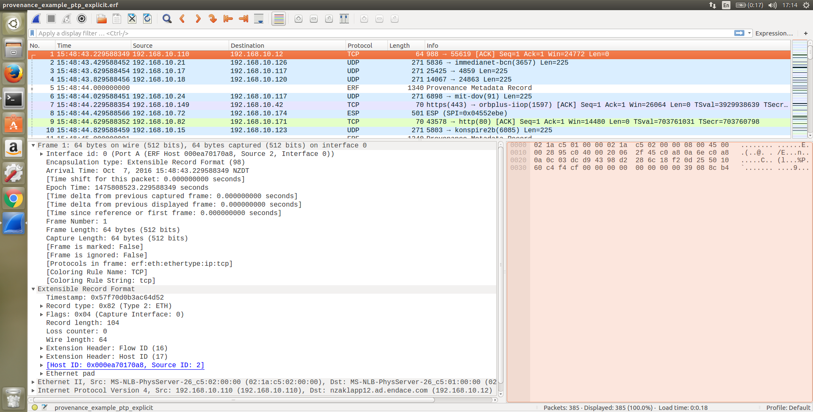
HOW – ERF in Wireshark
Notes:
Note Provenance metadata record in Packet List (frame 5)
Interface Id string has friendly name plus hierarchy, also see Extension Header
Provenance filters can be hidden in packet list if desired using a Display filter (could also get a coloring rule)

Slide 30
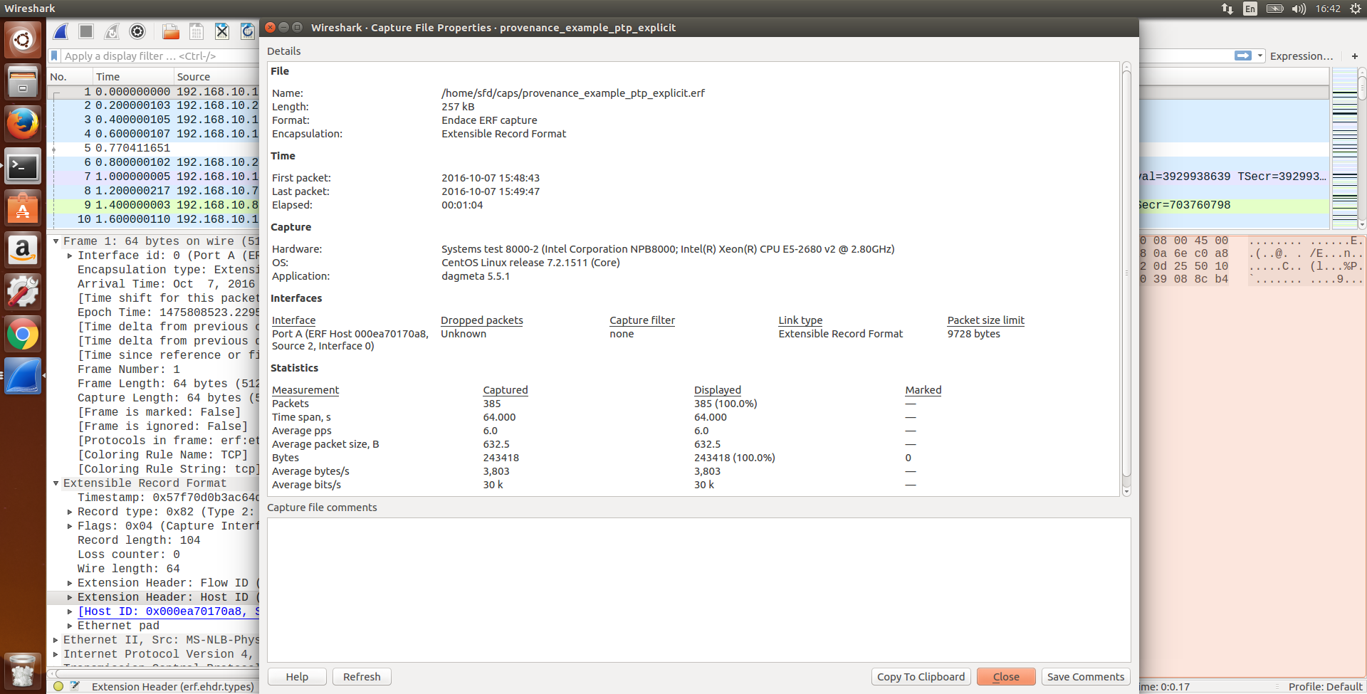
HOW – ERF in Wireshark
Notes:
Hardware from Host description, plus vendor, model, CPU info
Interface list has friendly name plus Hierarchy (Host, Module, Interface)
Dropped packets show as ‘Unknown’ because packet drops are accounted per stream not interface in DAG

Slide 31
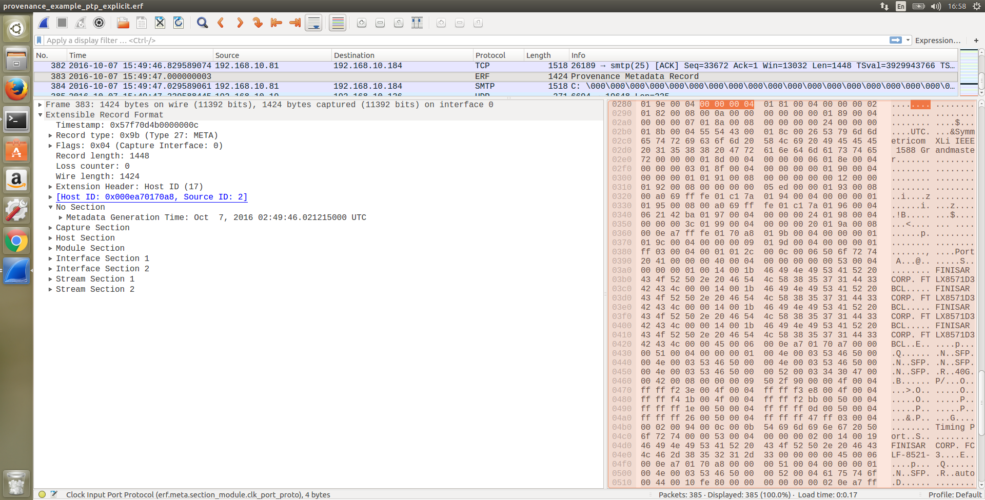
HOW – ERF in Wireshark
Notes:
Provenance records are fully dissected, visible in Packet List. Will be marked as ‘non-packet records’ internally.
Note highlighted dissected element at bottom left, erf.meta.section_module.clk_port_proto

Slide 32
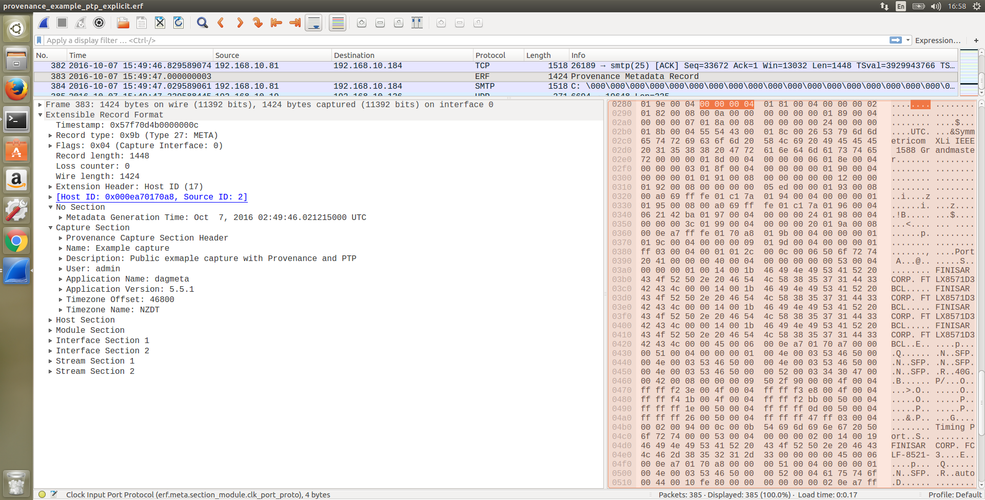
HOW – ERF in Wireshark
Notes:
Capture Section
Name/Description are manual fields

Slide 33
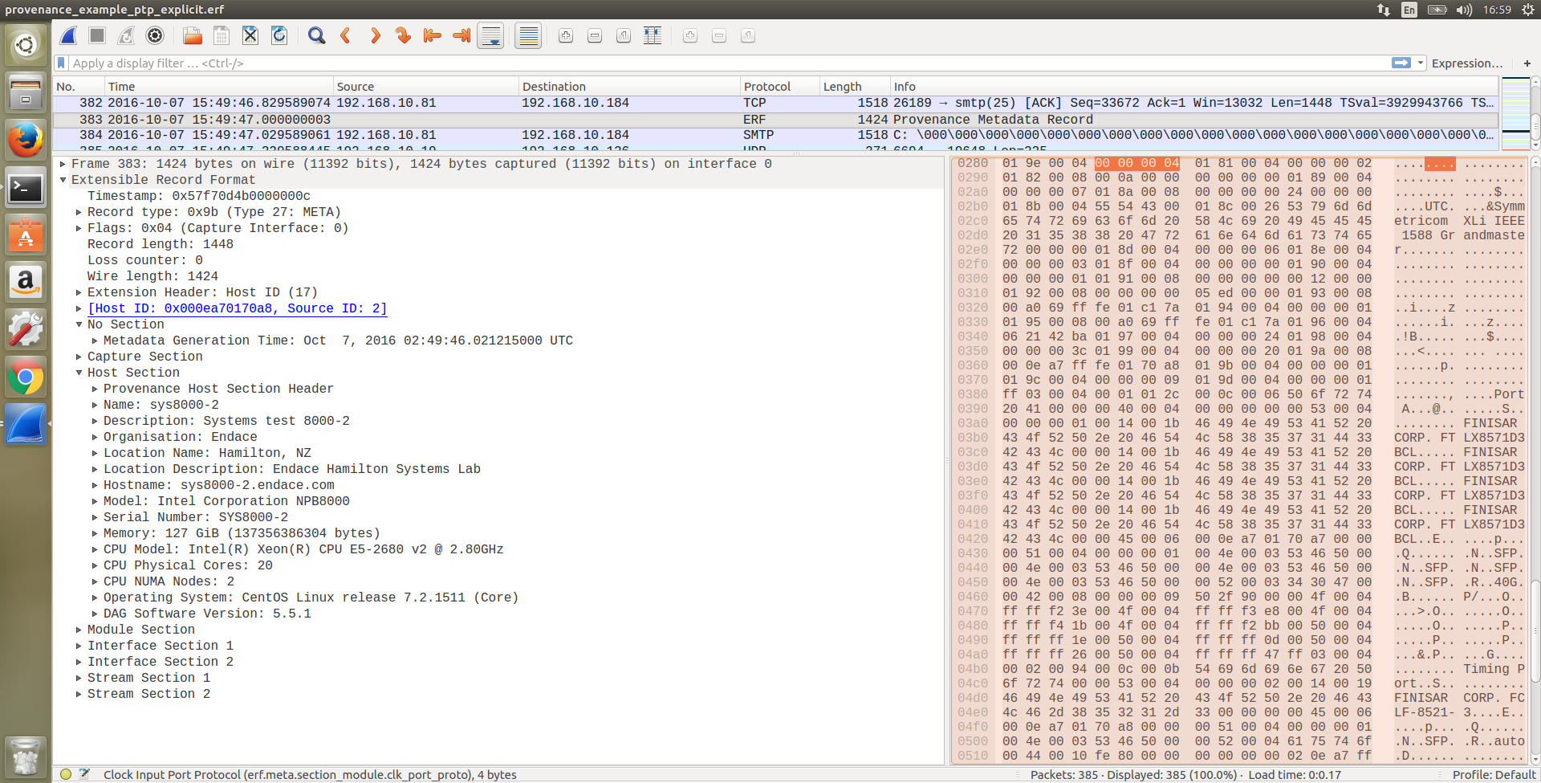
HOW – ERF in Wireshark
Notes:
Host Section, mostly automatic
More detail: hostname, vendor, model, serial, hardware

Slide 34
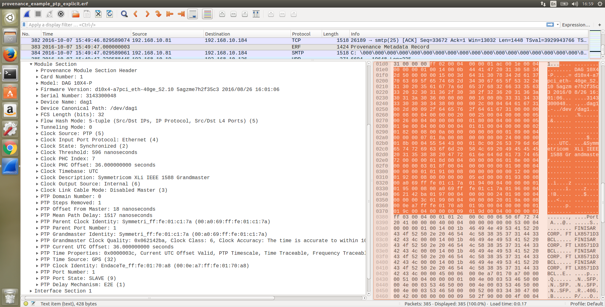
HOW – ERF in Wireshark
Notes:
Module Section
Note clock sync
PTP Offset from Master 18ns (Estimate)

Slide 35
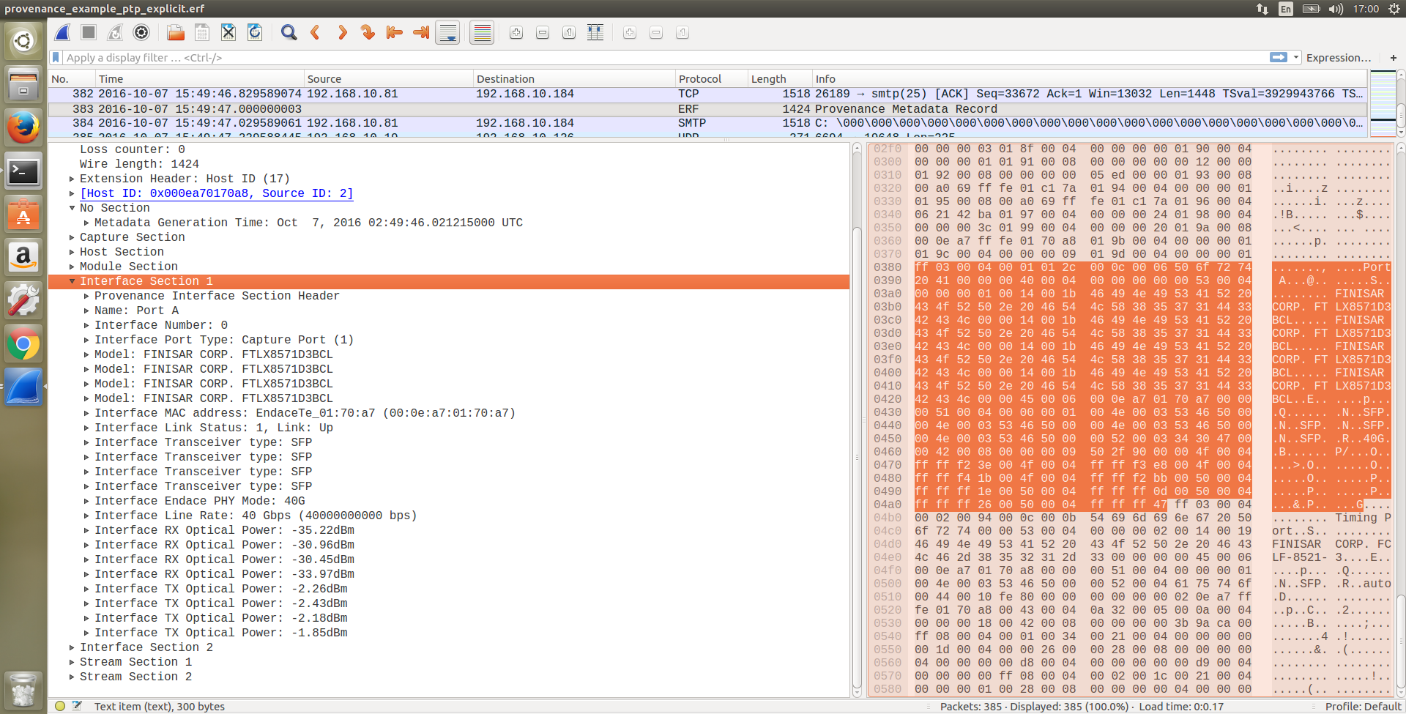
HOW – ERF in Wireshark
Notes:
Interface section.
One 40G interface (one MAC), 4 transceivers
Optical Power is dynamic metadata
Interface 2 is timing port

Slide 36
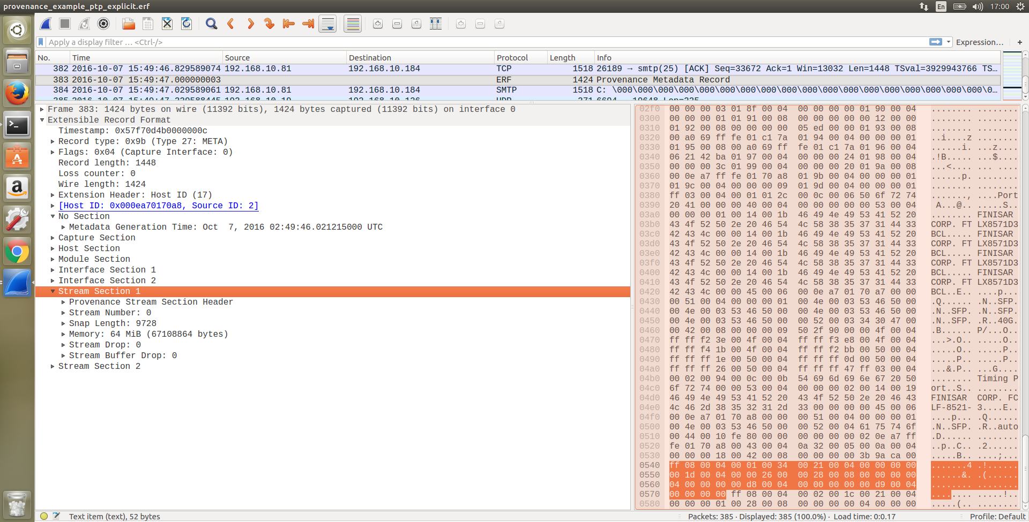
HOW – ERF in Wireshark
Notes:
Stream Section
Note Stream Drop counters

Slide 37
HOW - what does ERF enable?
Metadata in ERF files
What | When | Where | Why | Who | How
Packet contents | Clock source | Interface ID | Ticket # | Authorization | Hardware model
Flags | Sync state | Card ID | IDS alert ID | User ID | OS
Hash | Clock error | Probe ID | Application ID |  | Application
Capture filter | Time stamp | Site | Comments |  | Link State
Search terms | Time stamp resolution | Link name |  |  | Link Speed
 |  | NPB |  |  | Optical Power
 |  | Latitude /Longtitude |  |  | Capture Hardware
Who
Notes:
Metadata supported by ERF Provenance format
All fields defined are dissected by Wireshark
Not all types are currently added at capture time, depends on tools used
Wireshark supports some conversion to/from PCAP-NG

Slide 38
HOW - Comments
PCAP-NG has Comment string options
  For any block: SHB, IDB, EPB, NRB, ISB
  Wireshark implements SHB (capture file comment), EPB (packet comment)
ERF adds Provenance Records
  Contains any Tag Types or Sections including a comment string
    Record comment generation time stamp
    HostID of generating system
    User name of commenter
  Full record dissection available in Packet List
  Linked to a Packet Record with AnchorID Extension Header
  Linked to a Flow by FlowID (Flow Hash)
  Capture File comments stored in Provenance Capture section
Notes:
How do comments work in Wireshark?
Refresh on PCAP-NG
*ERF comment in PR, not in 2.4 yet
Generation time is on save
HostID of generating system, e.g. laptop with Wireshark (set via environment variable)
Flow linking not explicitly supported in Wireshark

Slide 39
HOW - Adding a Comment
Frame 1
Frame 2
Frame 3
ERF
Timestamp=1
Type=ETH
ERF
Timestamp=2
Type=ETH
ERF
Timestamp=3
Type=ETH
Packet
AAAA
Packet
BBBB
Packet
CCCC
Notes:
Trace file with three records
Want to add a comment to Packet 3

Slide 40
HOW – Adding a Comment
Frame 1
Frame 2
Frame 3
Frame 4
ERF
Timestamp=1
Type=ETH
ERF
Timestamp=2
Type=ETH
ERF
Timestamp=3
Type=META
ERF
Timestamp=3
Type=ETH
Packet
AAAA
Packet
BBBB
AnchorID=0xEA56…
AnchorID=0xEA56…
Provenance
Gen Time=76
User=SFD
Comment=Wow!
Packet
CCCC
Notes:
New Provenance record is inserted before record 3
Record 3 becomes record 4, get a new AnchorID extension header
AnchorID in Provenance record links the metadata to the packet
Provenance record contains comment option, PLUS User ID and Generation time
Can potentially contain any Provenance tags

Slide 41
HOW – Summary
PCAP-NG is a file-based approach
  One set of metadata per capture file
    Works well for situations where metadata is static during capture
  Lightweight
  Multiple interfaces
  Good for short, ad-hoc packet captures where environment is static
ERF Provenance is a streaming approach
  A complete set of metadata for every second of capture
    Easy to extract time-ranges with metadata attached
  Reasonably lightweight – adds 1pps/card
  Scalable - Multiple Hosts, Modules, and Interfaces
  Good for long/continuous capture where environment is dynamic
Notes:
Broad comparison of PCAP-NG and ERF
Because ERF is dissected, all metadata is available in export formats including PDML, JSON etc

Slide 42
Conclusions
Trace Metadata provides crucial context
  Interpretation depends on context
  Provenance and Quality of data matters
  Maintain auditable history
Metadata can be Static, Dynamic, or Post-Capture
Automatic Metadata is best, users forget!
Already available in Wireshark
  Start capturing Metadata today
  Encourage others
  Share rich formats with Metadata
Notes:
We want Data Lakes, not Data Swamps. Utility of Big Data depends on capturing context and quality of input data.
Share packet captures in rich formats, not pcap!

Slide 43
Thank you
Any questions?
You can contact me by email at
stephen.donnelly@endace.com
Notes:
Poll: Which do you prefer, PCAP-NG where Blocks are hidden, or ERF where Provenance is dissected explicitly?

Slide 44
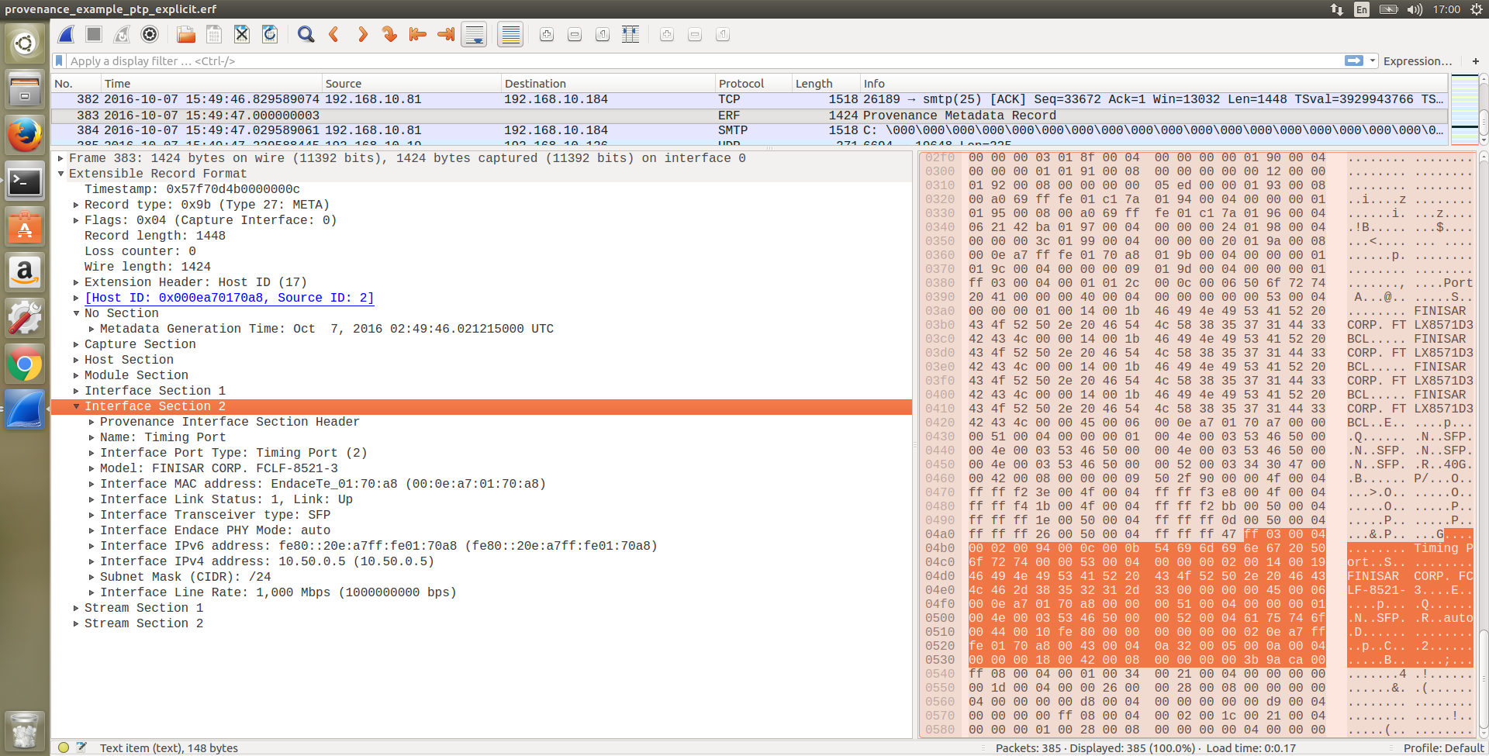
HOW – ERF in Wireshark
Notes:
Extra Detail: Timing Port interface supporting PTP

Slide 45
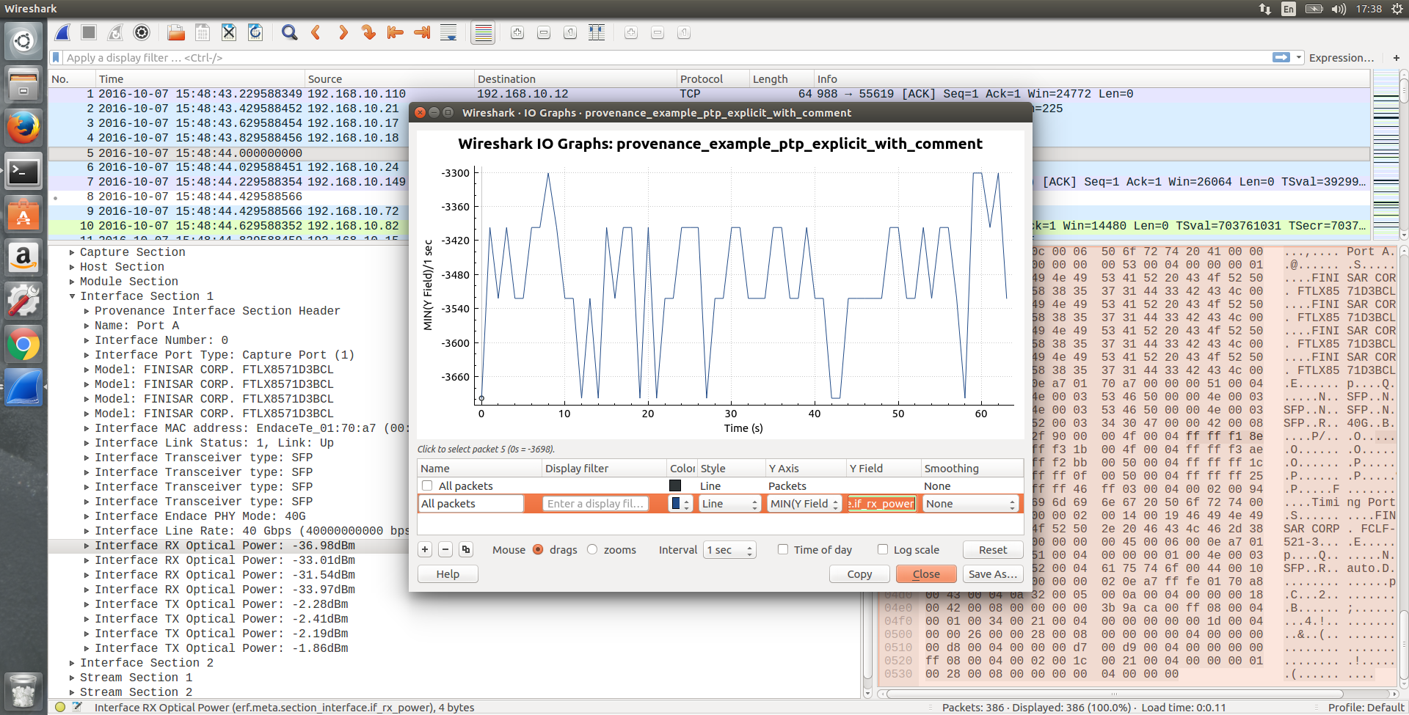
HOW – ERF in Wireshark
Notes:
Because all Provenance fields are dissected, we can ‘abuse’ IO Graph for any metadata, e.g. Optical Power over Time
(Y axis units not quite right)

