Slide 1
WiFiBeat
Visualize 802.11 with Kibana
And Elasticsearch

Slide 2
whoami
Software developer
Security researcher
Author of Aircrack-ng
Work for myself now
Software development
Infosec trainings
Linux consulting

Slide 3
Agenda
Elastic tools
What is a beat?
WiFiBeat development
Other created projects
Demo

Slide 4
Elastic
ElasticSearch
“NoSQL” database
Kibana
Web interface to visualize
Logstash
Parse log and store in ElasticSearch
Beats
Data shippers

Slide 5
Bricks
Logstash can log to ElasticSearch
Can add Kafka/RabbitMQ for redundancy
Then another Logstash on top of it
Beats can communicate with ElasticSearch
Or Logstash
Or Kafka
Pretty much can assemble them the way you need, like Lego

Slide 6
Ever stepped on one of those damn bricks?

Slide 7
So, what are the beats?
GoLang
Library available
Some documentation
Communicate with
Elasticsearch
Logstash
Kafka
…

Slide 8
Beats
Filebeat
Reads log files
Metricbeat
Metrics
Packetbeat
Packet capture
Winlogbeat
Windows Event logs
Heatbeat
Uptime monitoring

Slide 9
So, Packetbeat is what you’re looking for?

Slide 10
Nope, it does not understand RadioTap
“CRIT Exiting: Initializing sniffer failed:
Error creating decoder:
Unsupported link type: RadioTap”
Notes:
And on top of it, packet decoding is very limited
<number>

Slide 11
Introducing WiFiBeat
And a few other related projects

Slide 12
WiFiBeat
Capture frame from WiFi interface
Or read them from pcaps
Store in Elasticsearch
Visualize with Kibana
Full packet decoding
802.11 Wireshark in ElasticSearch
Packet decryption
WEP
WPA/WPA2 PSK
Notes:
Will support Airpcap
Beat protocol ongoing
<number>

Slide 13
WiFiBeat
C++
Wireshark filters in ElasticSearch
99%
Open Source
WiFiBeat: GPLv3
Libraries: BSD
Notes:
<number>

Slide 14
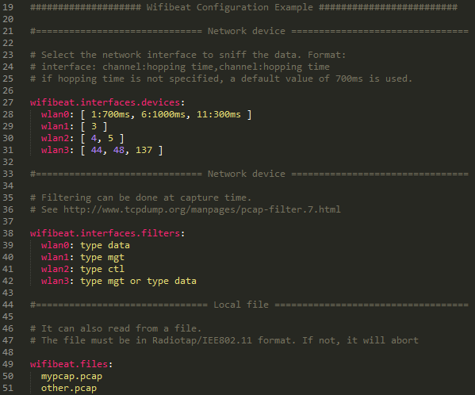
WiFiBeat
Config file
Same format as other beats: YAML

Slide 15
Why not just extend Packetbeat?
802.11 parsing/decrypting is fairly complex
Wireshark code for wireless frames is ~27K lines long
Radiotap/PPI headers are in other files
Existing C++ library: libtins
Lacking some necessary built-in features in my opinion

Slide 16
And not reuse the Elastic Go library?
No persistent queues
Takes months to get code in Elastic repos
Request to have Beat protocol in other languages (than Go)
Because why not?

Slide 17
Challenges
No formal documentation of the beat protocol
Very few useable libraries (JSON, ElasticSearch)
Usage testing
Performance testing

Slide 18
First, the Elasticsearch API
Elasticsearch uses JSON documents
JavaScript Object Notatation
Easier to read than XML
Extensive and well documented API
Beats use Bulk API
{
“name”: “Thomas d’Otreppe”,
“projects”: [ “Aircrack-ng”, “OpenWIPS-ng”,
“WiFiBeat” ],
“email”: “tdotreppe@aircrack-ng.org”
}

Slide 19
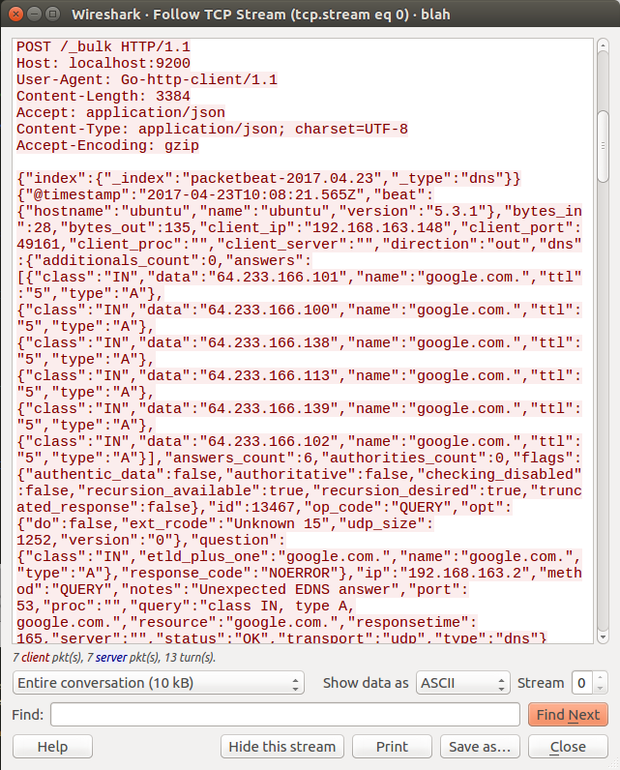
Bulk API
Performs many index (or delete) operations in a single API call
Looks like that →
Even if it wasn’t documented, it’s easy to figure out

Slide 20
Elastic Library – what do we need?
ElasticSearch C++ with JSON
Exists but not great, lacking documentation and/or lacking JSON
REST client with JSON
Exists but either lacking JSON or slow in JSON (performance is important)
If available as package, better
Notes:
Representational State Transfer
<number>

Slide 21
REST client with JSON
CppRestSDK (Casablanca) from Microsoft
Very nice
Cross platform
Slow for lots of data
POCO
Slow in JSON
Ffead-cpp (https://github.com/sumeetchhetri/ffead-cpp)
Didn’t get it to work on time

Slide 22
Other ideas
So how about a custom REST + JSON library?
JSON is easy
Socket is somewhat easy
HTTP protocol
Connection: close vs keep-alive
Compression
Adding HTTPS, even more
A mix of HTTP Client library and JSON library seems a better choice

Slide 23
HTTP Library
Libcurl
Callbacks only
In repository
Restclient-cpp (mrtazz)
Based on curl
HTTPS support
Packages available
POCO
Handles keep-alive
Handles Proxy/HTTPS
CPP Netlib
Doesn’t handle Keep-alive
Notes:
I looked at other libraries mentioned in libcurl webpage but most seemed to lack features or were too complex
<number>

Slide 24
HTTP Client libraries benchmark
Small benchmark tool released
Basic PHP script to accept JSON
CPPNetlib
Hangs after request
POCO
Pretty fast, ~5 seconds to do 10K requests (simple JSON)

Slide 25
JSON Libraries benchmark
Already done
https://github.com/miloyip/nativejson-benchmark
RapidJSON is a clear winner
Conforms
Parsing time
Memory usage
Export to string time
Header-only library
Notes:
POCO also has stuff, but parsing time is a lot longer than RapidJSON
<number>

Slide 26
Header-only library
Very unusual at first but excellent idea in my opinion.
No need to link anything to your code
Just include the header in your code
Can be a nightmare to figure out if not documented
Great for embedded or when stripping executable
Only what’s needed is kept vs a library where everything is kept
However, all the code is in the header files

Slide 27
RapidJSON
Great for parsing JSON documents
Nightmare when generating JSON documents
4+ lines of code to add a string as a value
So, writing code for it is ugly and will be hard to maintain
Weird memory allocations and still memory leaks everywhere after debugging it for a few days
I’m done with this, I’m writing my own
Notes:
<number>

Slide 28
SimpleJSON-cpp
Header-only library
Simple and short ways to create JSON document
No JSON parsing (for now)

Slide 29
SimpleJSON-cpp
Allows duplicate keys
According to RFC7159 “The names within an object SHOULD be unique.”
“SHOULD This word, or the adjective "RECOMMENDED", mean that there may exist valid reasons in particular circumstances to ignore a particular item, but the full implications must be understood and carefully weighed before choosing a different course.”

Slide 30
SimpleJSON-cpp
// Creating document
JSONObject * object = new JSONObject();
// Adding regular objects
// (or variables)
string val = “my value”;
object->Add(“mykey”, val);
object->Add(“number”, 1232);
// Adding another object to it
JSONObject * sub = new JSONObject();
sub->Add(“item”, 1);
object->Add(“subobject”, sub);
// ‘sub’ pointer now belongs to
// ‘object’, don’t delete it
// Adding array to the object
vector<string> vec;
vec.push_back(“w”);
vec.push_back(“a”);
object->Add(“wa”, vec);
// Export to string
string json = object->toString();

Slide 31
What else do we have?
Kibana visualizations and dashboard
ElasticBeat-cpp
Notes:
<number>

Slide 32
ElasticBeat-cpp
Header-only library
Uses POCO for HTTP requests
Need to include it in your project (for now)
Uses RapidJSON to parse JSON documents
Elasticsearch
Simple way to add documents and do basic queries
Elastic BULK API

Slide 33
ElasticBeat-cpp
// Connect to ES and get version
elastic * e = new elastic
(“http://localhost:9200”);
cout << “ES Version: “ << e->Version() << endl;
// Get all indices in ElasticSearch
vector <string> indicesList =
e->getIndices();
// Check if twitter index exists
if (!e->indexExists(“twitter”))
e->createIndex(“twitter”);
// Let’s assume we have a vector with JSON
// documents as strings called ‘docs’
// It will automatically create the index
// based on the date in each document
BulkReponse * r =
e->bulkRequest(docs, “myIndex”, Daily);
// Assuming nothing wrong with the request
if (r->errors) {
cout << “Errors happened: ” <<
r->error << endl;
} else {
// Newly stored document IDs are in
// r->IDs and it matches order in ‘docs’
}
Notes:
<number>

Slide 38
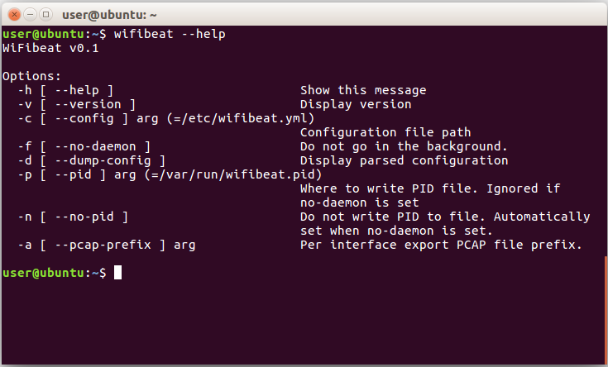

Slide 39
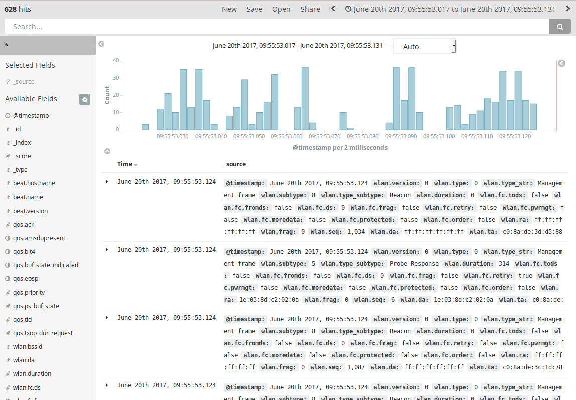

Slide 40
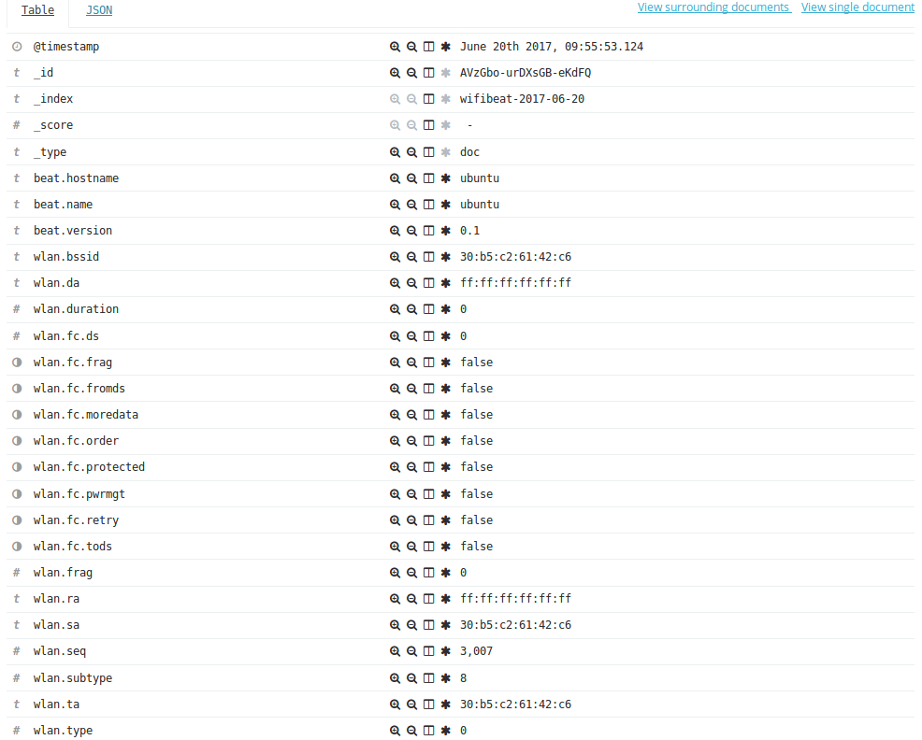

Slide 41
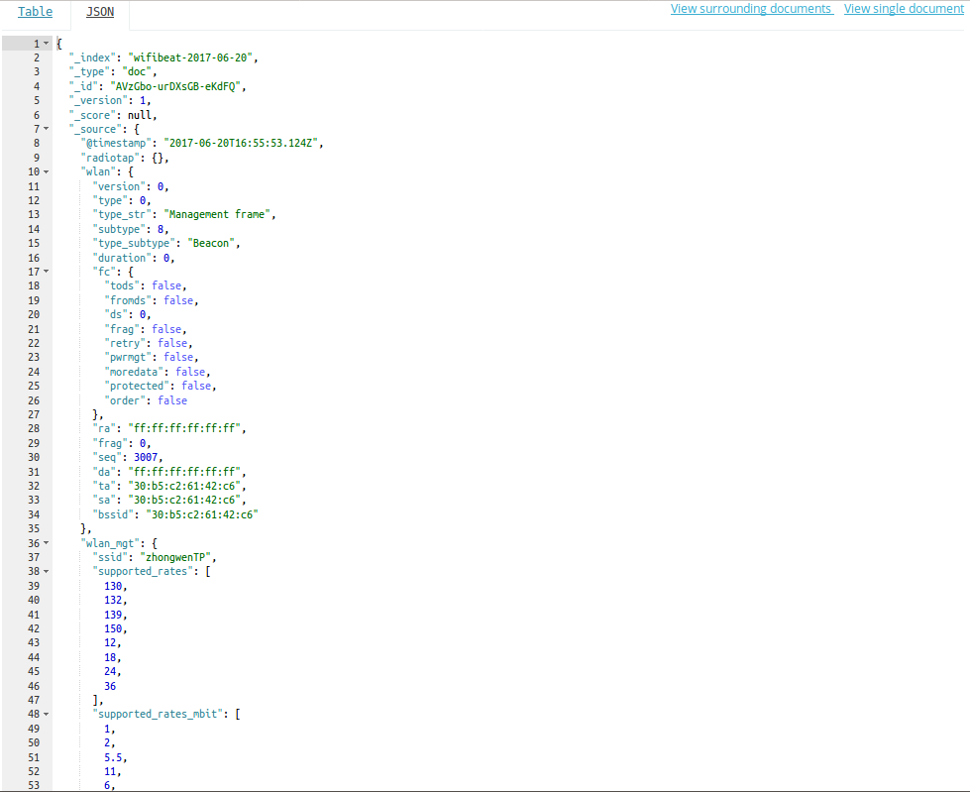

Slide 42
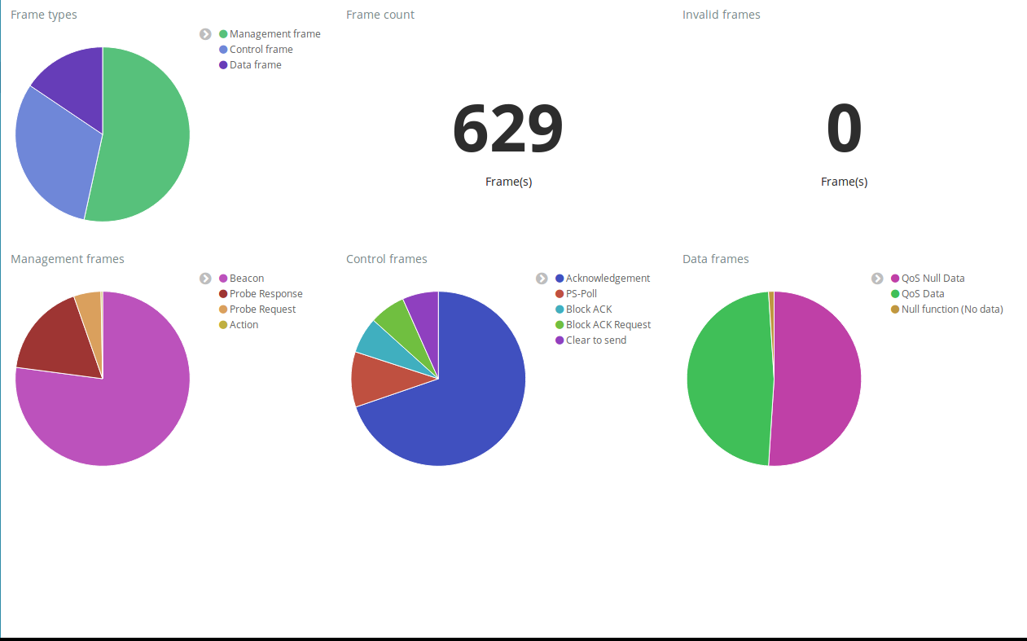

Slide 43
A few last words, next steps
ElasticBeat-cpp
Beat Protocol
Built-in RapidJSON
Built-in HTTP client
SimpleJSON-cpp
JSON Parsing
Performance improvements
WiFiBeat
Persistent queues
NPCAP support
Airpcap support
Unusual channel width (3/5/10MHz) and HT/VHT channels
PCAPng
More link types (AVS, PPI, Prism2)
Data frame payload parsing
Manufacturer resolution
GPS
Notes:
Explain what all those thing means
<number>

Slide 44
OK, OK, OK, I’m done

Slide 45
Can I download it?

Slide 46
All 3 projects are on GitHub

Slide 47
https://github.com/WiFiBeat/
WiFiBeat
ElasticBeat-cpp
SimpleJSON-cpp
http://wifibeat.org

Slide 50
Contact information
Twitter: @aircrackng
Email: tdotreppe@aircrack-ng.org

