Slide 1
Analyzing Exploit Kit Traffic with Wireshark
Analyzing Exploit Kit Traffic with Wireshark
Analyzing Malicious Traffic with Wireshark
Bradley Duncan
Threat Intelligence Analyst | Palo Alto Networks Unit 42

Slide 2
WHY THE CHANGE?
Traditional campaigns using exploit kits were relatively easy to find.
Compro- mised
website
Exploitkit
server

Slide 3
WHY THE CHANGE?

Slide 4
WHY THE CHANGE?
Now, generally malvertising leads to exploit kits
AD
Exploitkit
server
Normal
website
GATES

Slide 5
INTRODUCTION
@malware_traffic

Slide 6
OVERVIEW
Wireshark setup
Find traffic based on an IDS alert
Find root cause after post-infection alerts
Example of exploit kit traffic

Slide 7
PCAPS ONLINE AT:
http://www.malware-traffic-analysis.net/2017/06/01/ 2017-06-01-SharkFest-pcap-for-lab-by-Duncan-01.pcap.zip
http://www.malware-traffic-analysis.net/2017/06/01/ 2017-06-01-SharkFest-pcap-for-lab-by-Duncan-02.pcap.zip
http://www.malware-traffic-analysis.net/2017/06/01/ 2017-06-01-SharkFest-pcap-for-lab-by-Duncan-03.pcap.zip

Slide 8
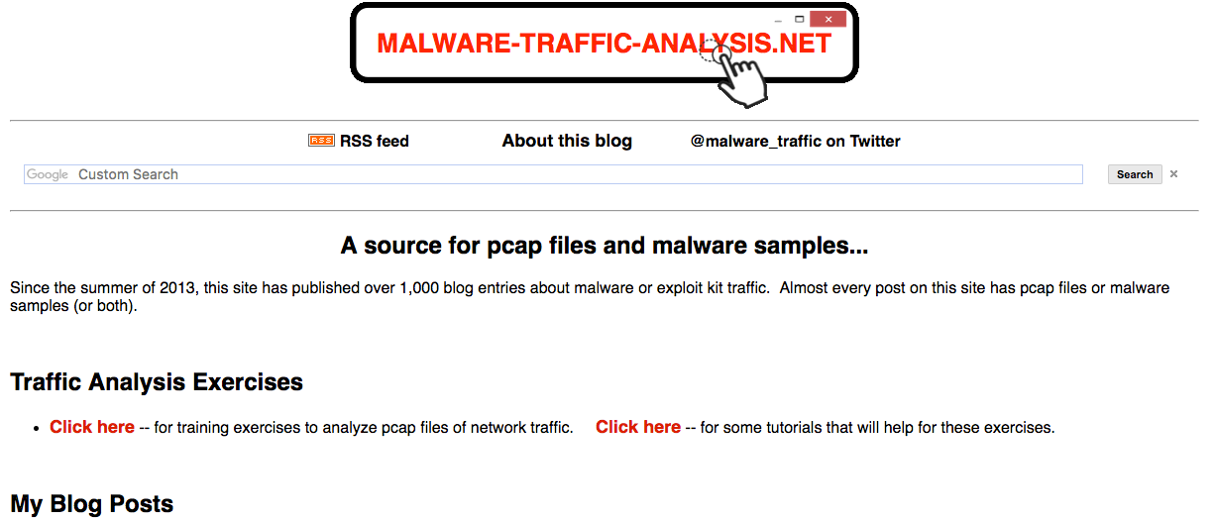
WIRESHARK SETUP

Slide 9
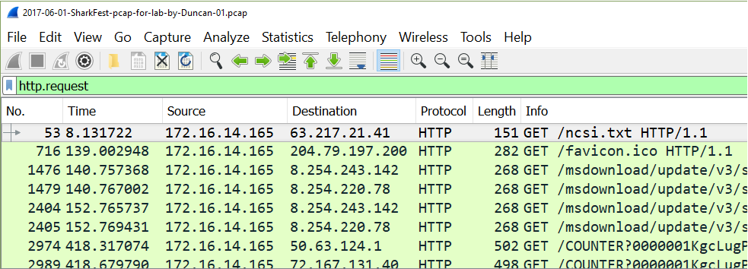
WIRESHARK SETUP
Default column display not ideal for HTTP traffic

Slide 10
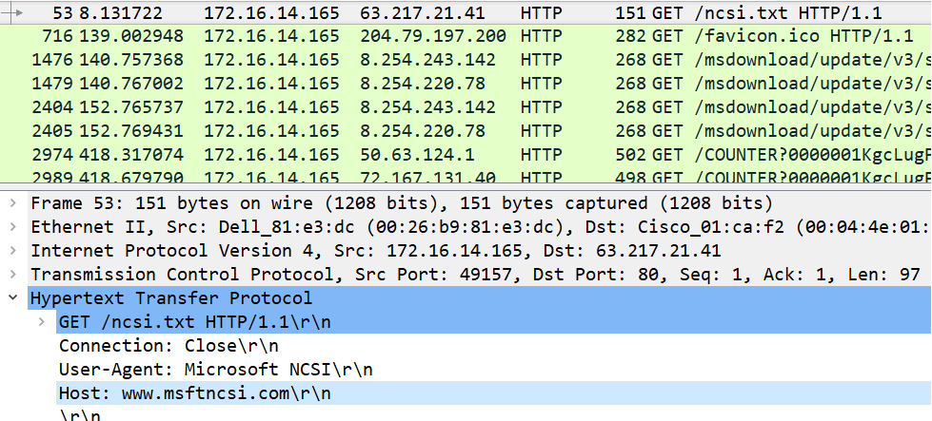
WIRESHARK SETUP

Slide 11
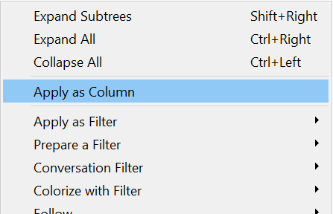
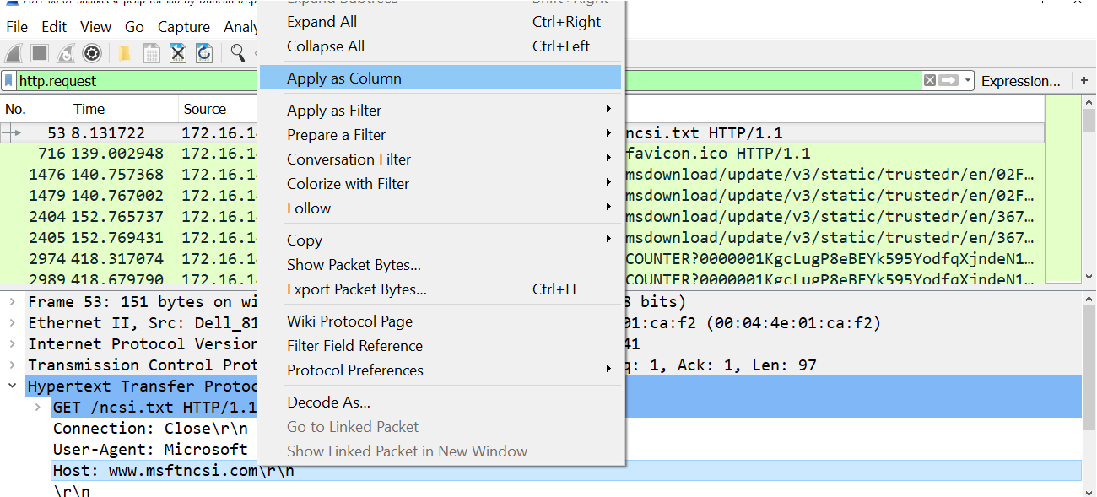
WIRESHARK SETUP

Slide 12
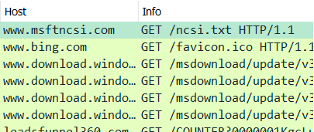
WIRESHARK SETUP

Slide 13
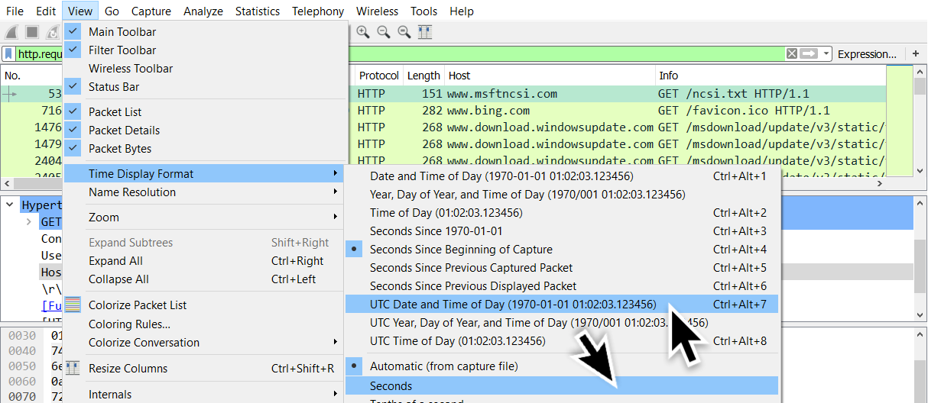
WIRESHARK SETUP
Time display to UTC

Slide 14
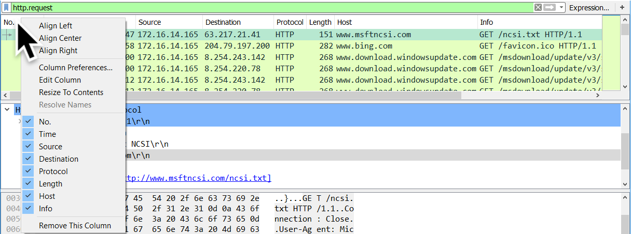
WIRESHARK SETUP
Hide or remove the colums you don't need.

Slide 15
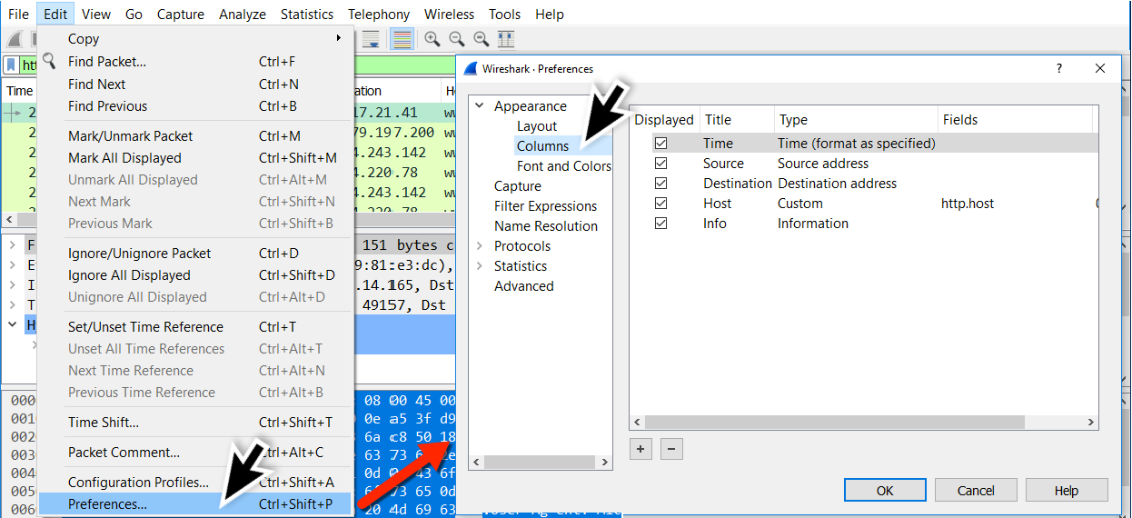
WIRESHARK SETUP
Go to Column Preferences

Slide 16
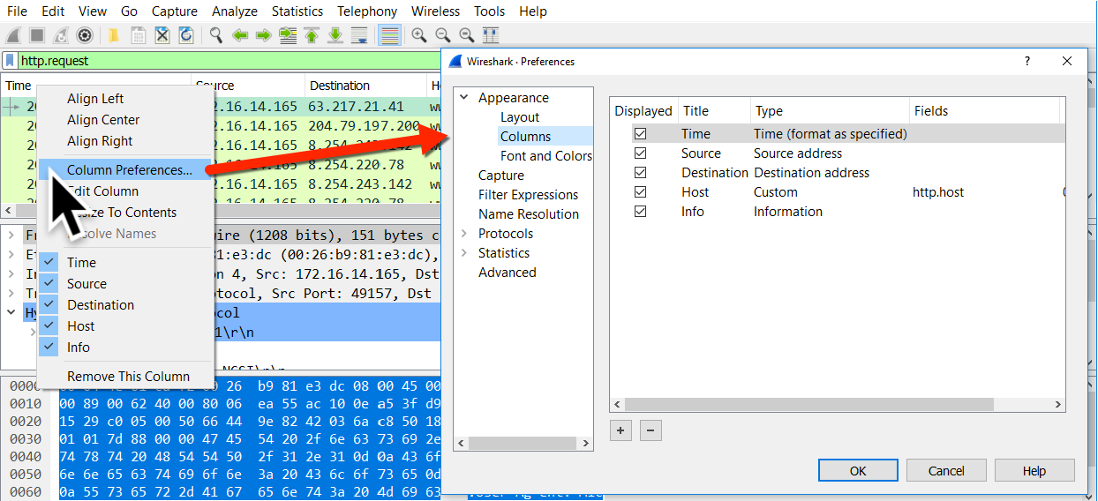
WIRESHARK SETUP
Go to Column Preferences

Slide 17
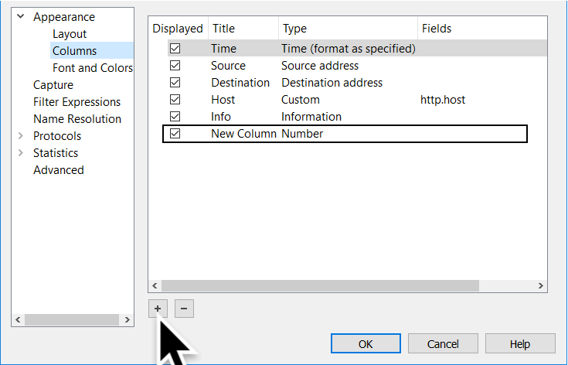
WIRESHARK SETUP
Adding a column

Slide 18
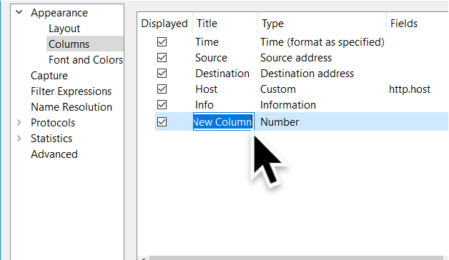
WIRESHARK SETUP
Adding a column

Slide 19
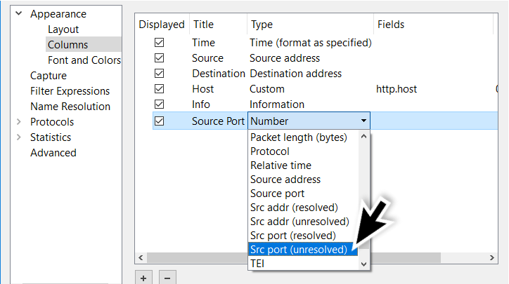
WIRESHARK SETUP
Adding a column

Slide 20
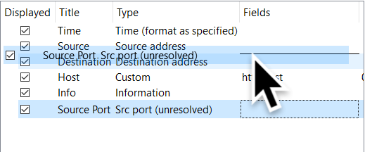
WIRESHARK SETUP
Adding a column

Slide 21
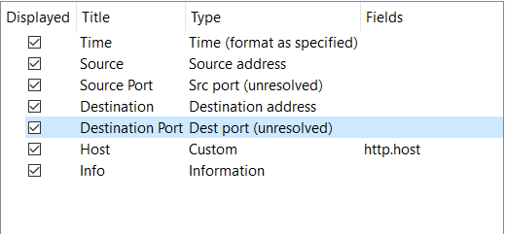
WIRESHARK SETUP
Adding a column

Slide 22
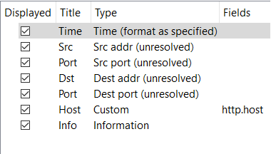
WIRESHARK SETUP
Adding a column

Slide 23
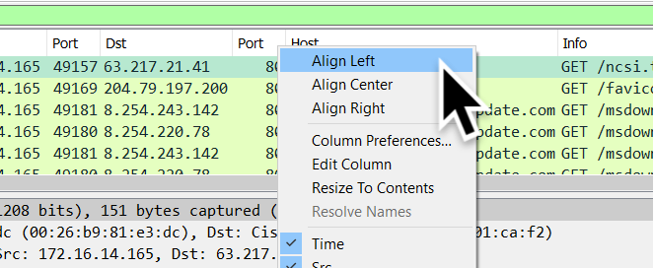
WIRESHARK SETUP
Aligning the columns

Slide 24
WIRESHARK SETUP
Time Source IP Source port Destination IP
Destination port HTTP host Info

Slide 25
UP NEXT...
Wireshark setup
Find traffic based on an IDS alert
Find root cause after post-infection alerts
Example of exploit kit traffic

Slide 26
FROM IDS ALERT
Initial alerts on the first pcap show a JS or WSF downloader

Slide 27
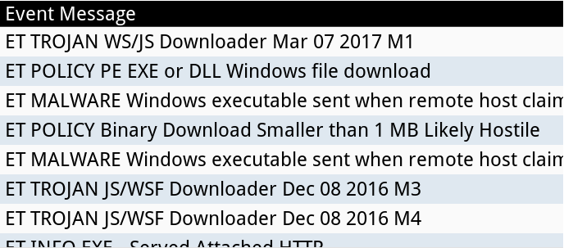
FROM IDS ALERT

Slide 28
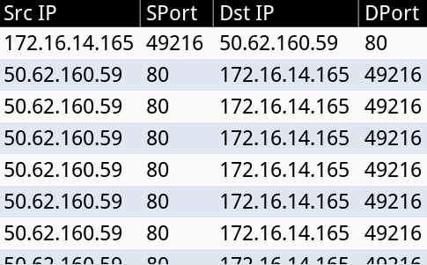
FROM IDS ALERT

Slide 29
FROM IDS ALERT
http.request and tcp.port eq 49216

Slide 30
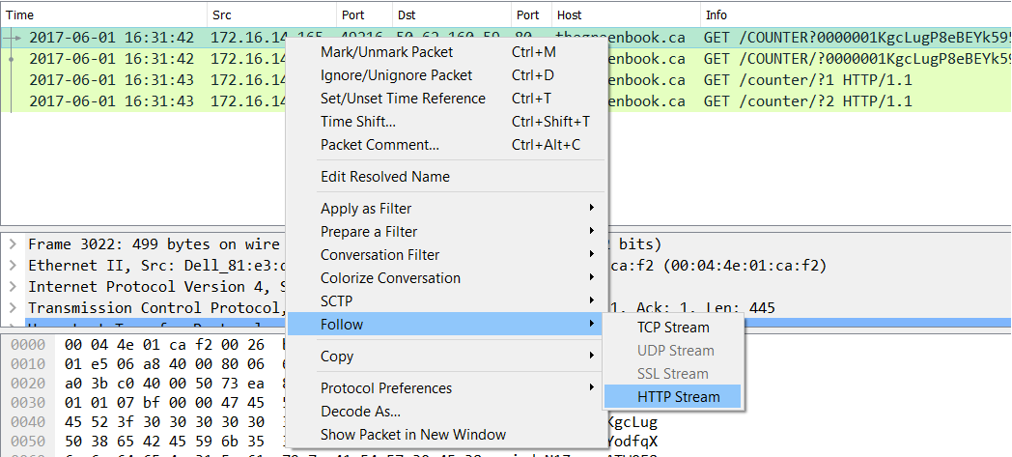
FROM IDS ALERT

Slide 31
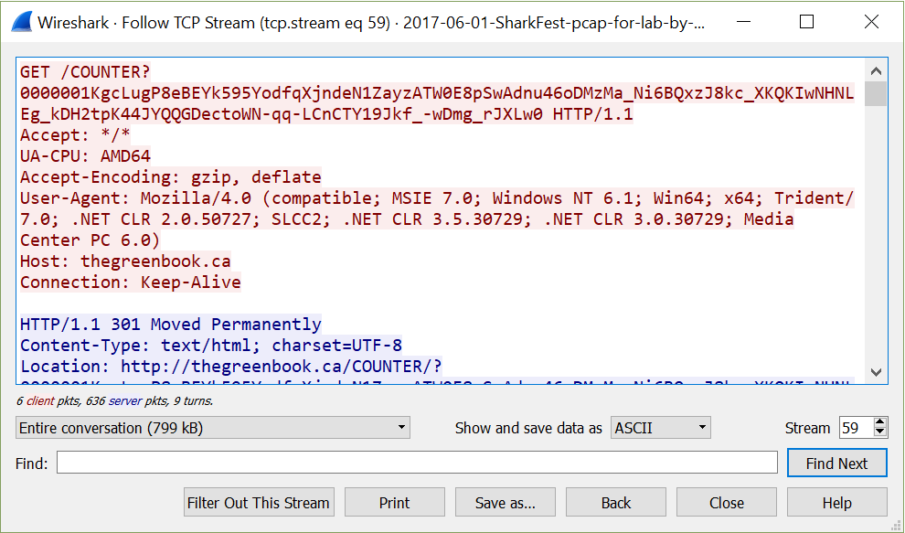
FROM IDS ALERT

Slide 32
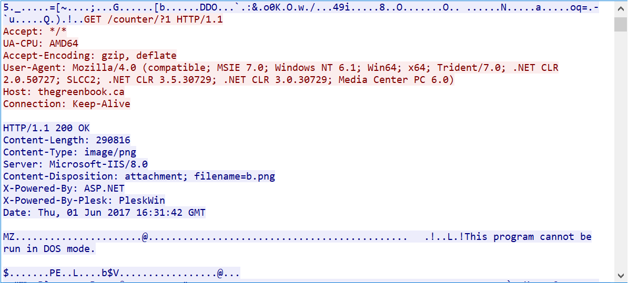
FROM IDS ALERT

Slide 33
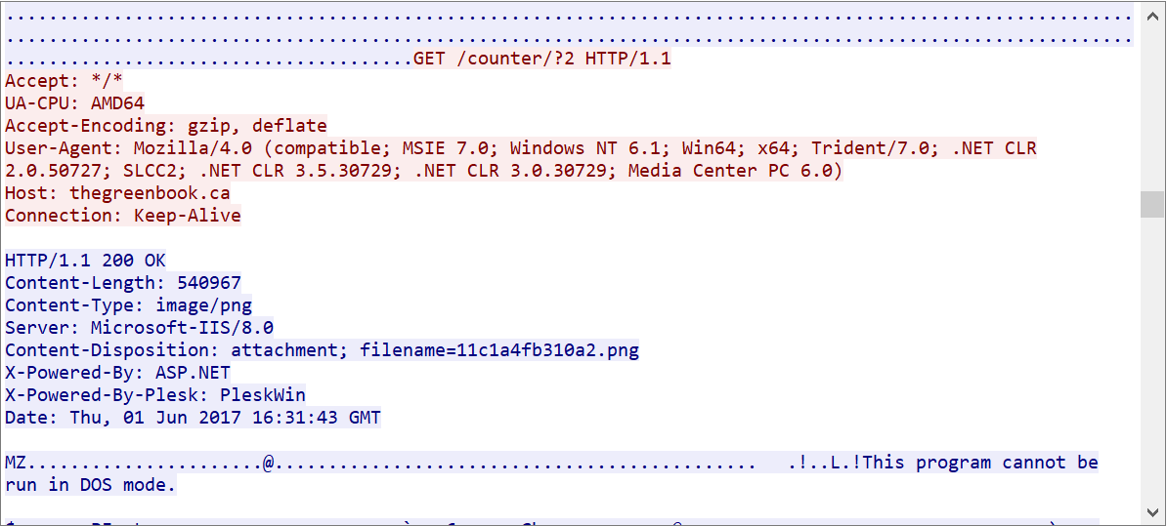
FROM IDS ALERT

Slide 34
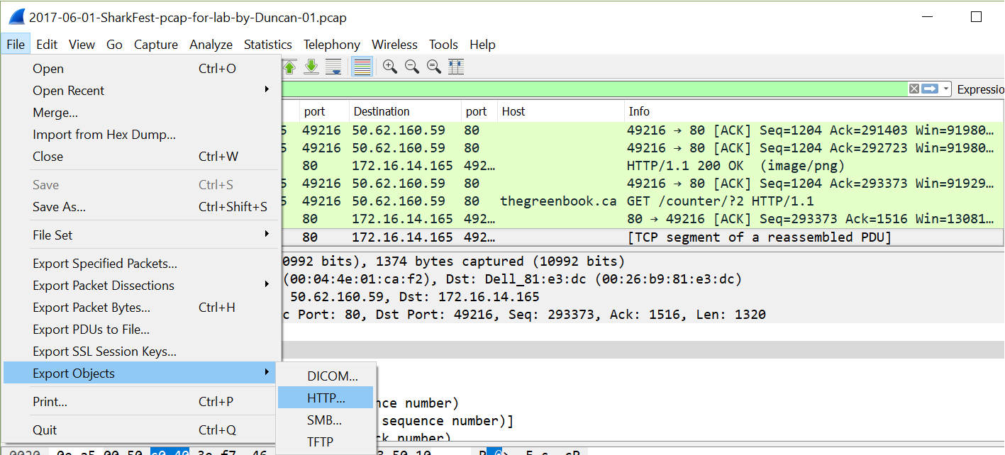
FROM IDS ALERT

Slide 35
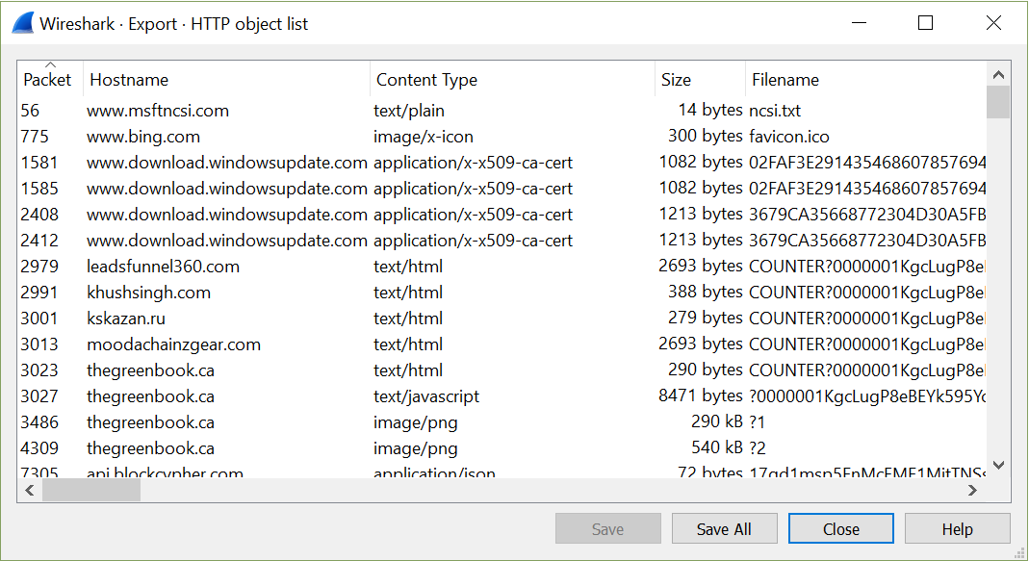
FROM IDS ALERT

Slide 36
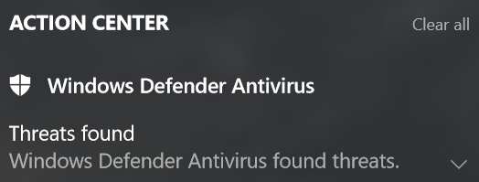
FROM IDS ALERT

Slide 37
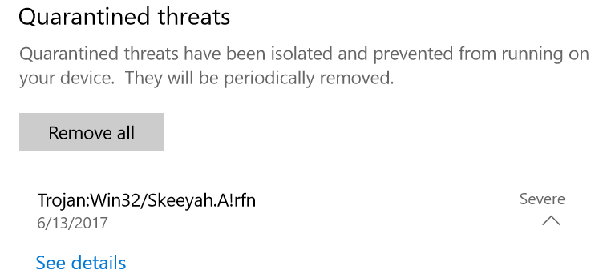
FROM IDS ALERT

Slide 38
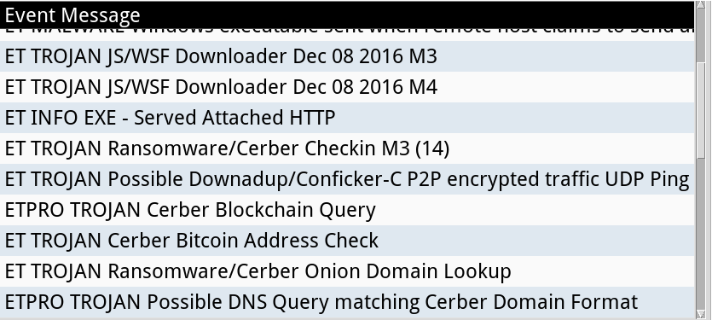
FROM IDS ALERT

Slide 39
FROM IDS ALERT

Slide 40
UP NEXT...
Wireshark setup
Find traffic based on an IDS alert
Find root cause after post-infection alert
Example of exploit kit traffic

Slide 41
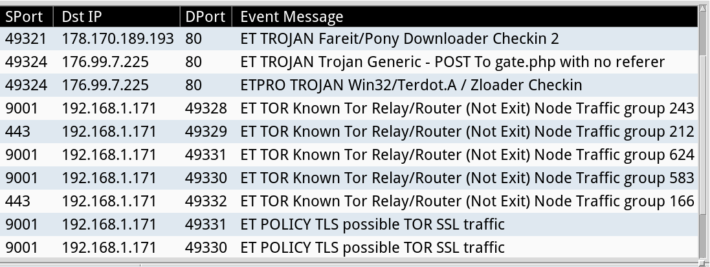
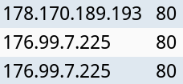
ROOT CAUSE AFTER POST-INFECTION
Alerts for Fareit/Pony, Terdot.A/Zloader, and Tor

Slide 42
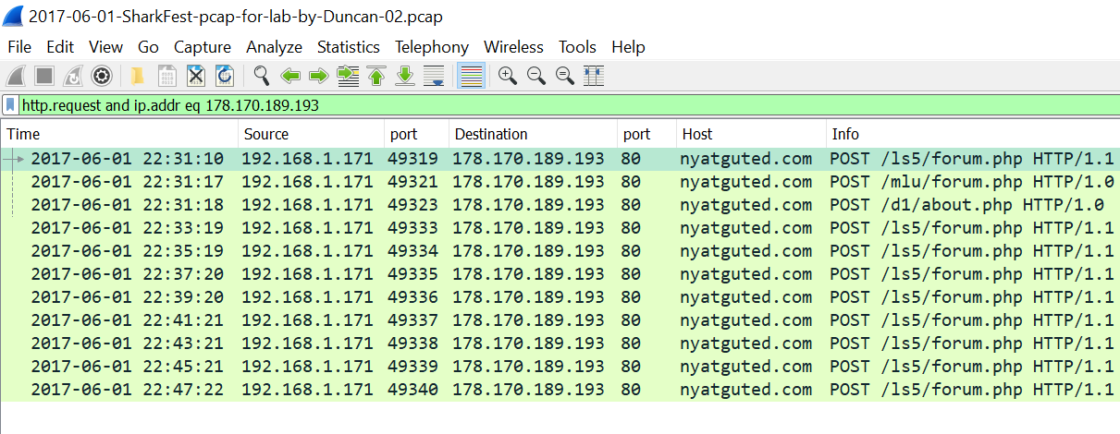
ROOT CAUSE AFTER POST-INFECTION
Filter: http.request and ip.addr eq 178.170.180.193

Slide 43
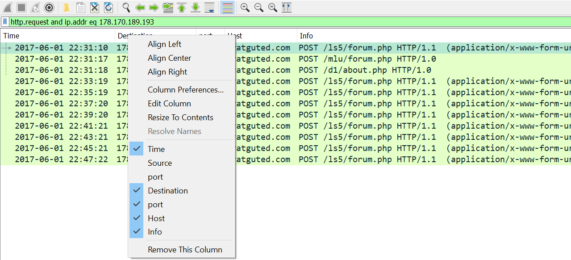
ROOT CAUSE AFTER POST-INFECTION

Slide 44
ROOT CAUSE AFTER POST-INFECTION
Filter: http.request and ip.addr eq 176.99.7.225

Slide 45
ROOT CAUSE AFTER POST-INFECTION
Domains from the alerts
nyatguted.com
soevenghappar.ru

Slide 46
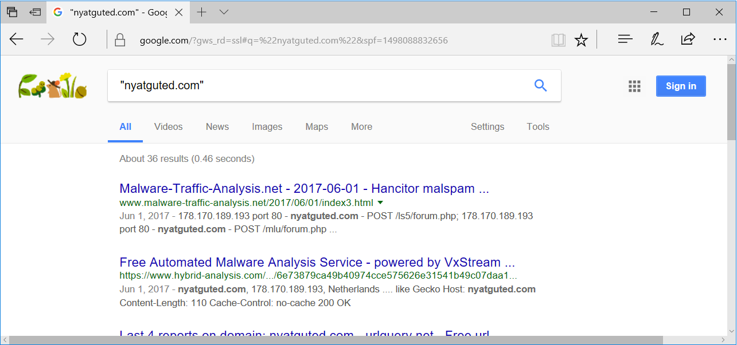
ROOT CAUSE AFTER POST-INFECTION

Slide 47
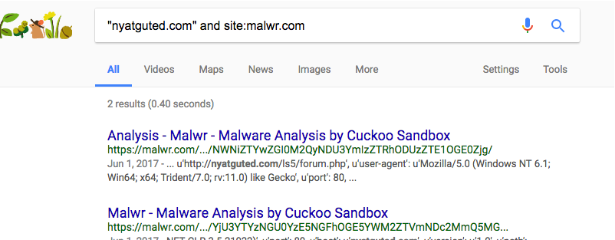
ROOT CAUSE AFTER POST-INFECTION
"nyatguted.com" and site:malwr.com

Slide 48
ROOT CAUSE AFTER POST-INFECTION
"nyatguted.com" and site:hybrid-analysis.com

Slide 49
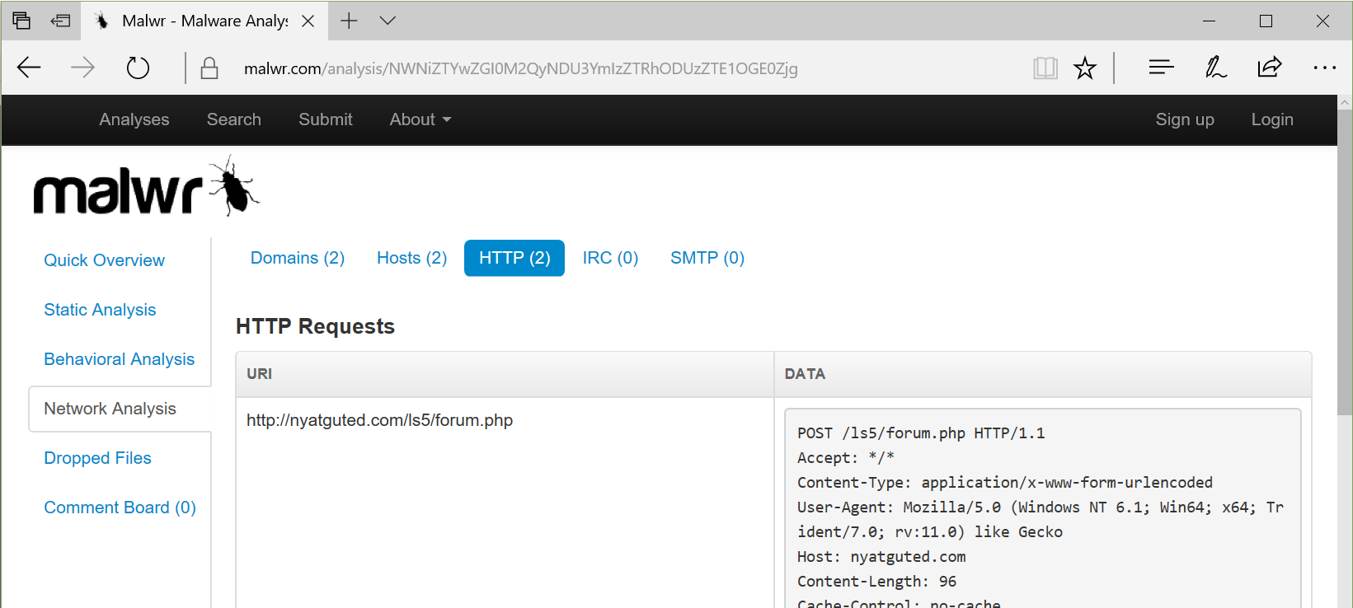
ROOT CAUSE AFTER POST-INFECTION

Slide 50
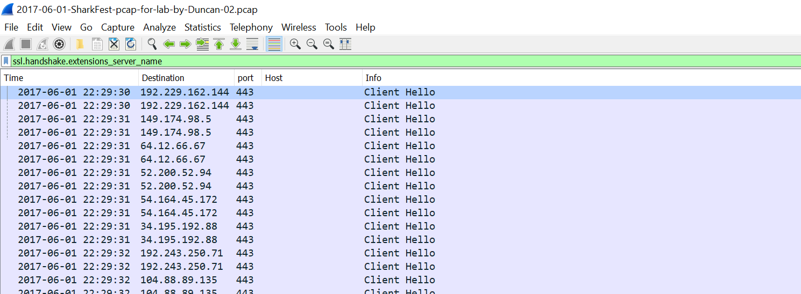
ROOT CAUSE AFTER POST-INFECTION
Filter: ssl.handshake.extensions_server_name

Slide 51
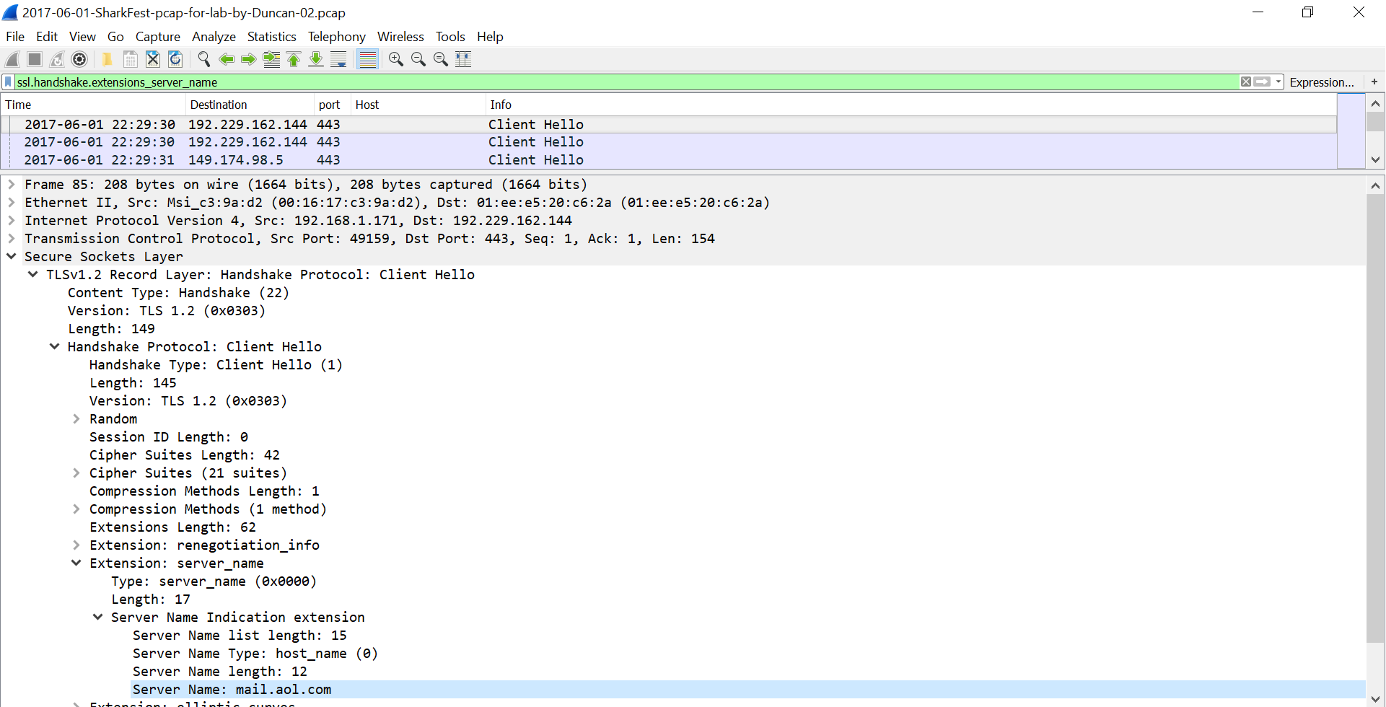
ROOT CAUSE AFTER POST-INFECTION

Slide 52
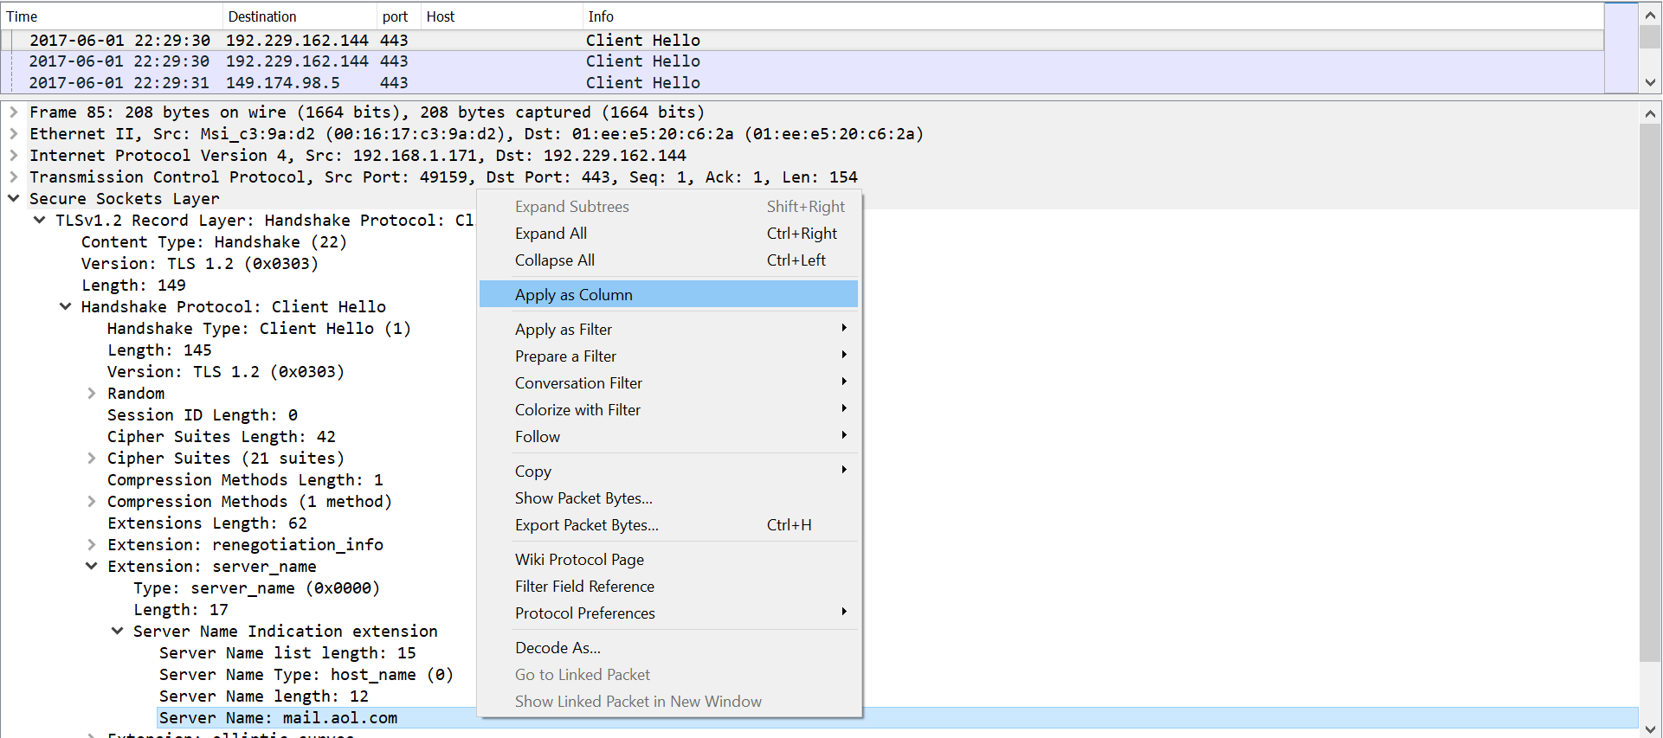
ROOT CAUSE AFTER POST-INFECTION

Slide 53
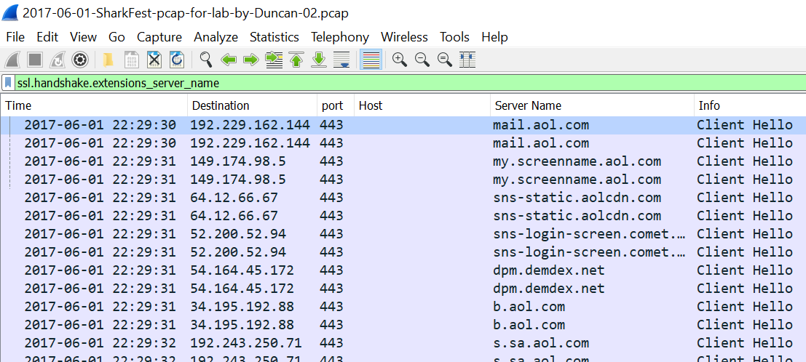
ROOT CAUSE AFTER POST-INFECTION

Slide 54
ROOT CAUSE AFTER POST-INFECTION
http.request or ssl.handshake.extensions_server_name

Slide 55
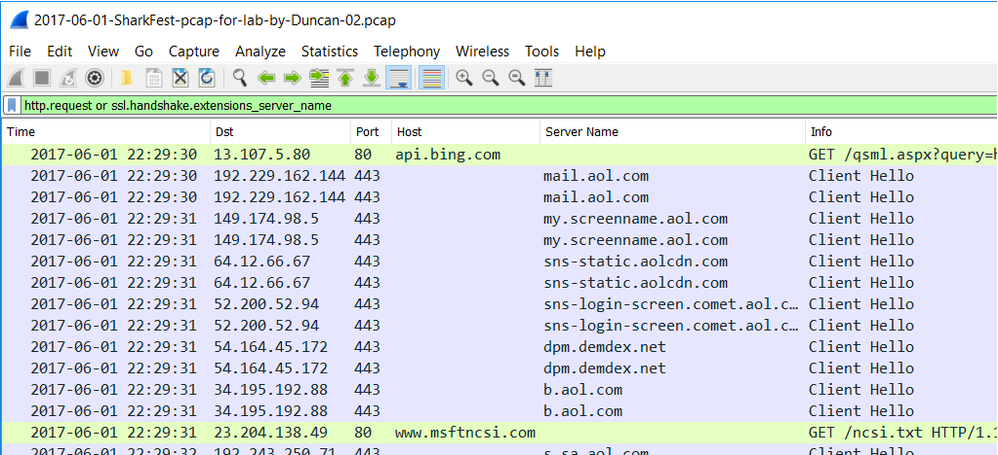
ROOT CAUSE AFTER POST-INFECTION

Slide 56
UP NEXT...
Wireshark setup
Find traffic based on an IDS alert
Find root cause after post-infection alert
Example of exploit kit traffic

Slide 57
EXPLOIT KIT TRAFFIC
Rig EK is often easiest to replicate.
EKs are evolving.
Rig EK URL patterns changed last week on June12th or June 13th.
Rig EK payload is encrypted.

Slide 58
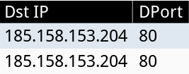
EXPLOIT KIT TRAFFIC

Slide 59
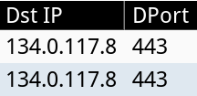
EXPLOIT KIT TRAFFIC
Post-infection alerts

Slide 60
EXPLOIT KIT TRAFFIC
http.request and ip.addr eq 185.158.153.204

Slide 61
EXPLOIT KIT TRAFFIC
Flow of events from the EK domain:
Landing page
exploit
payload

Slide 62
EXPLOIT KIT TRAFFIC
Flow of events from the EK domain:
Landing
page & IE exploit
payload

Slide 63
EXPLOIT KIT TRAFFIC
(http.request or http.response) and ip.addr eq 185.158.153.204

Slide 64
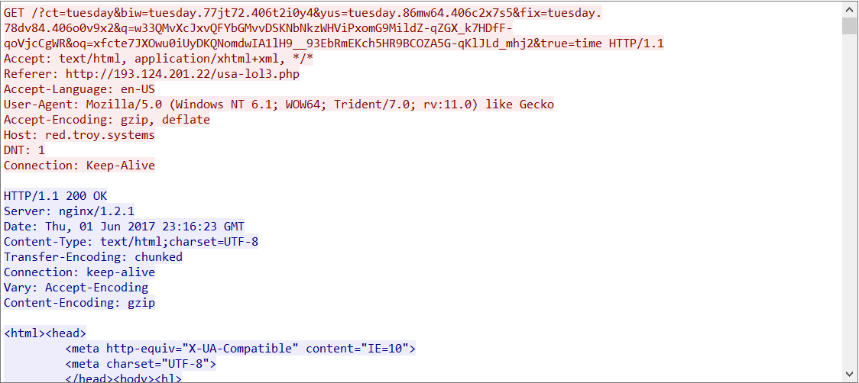
EXPLOIT KIT TRAFFIC

Slide 65
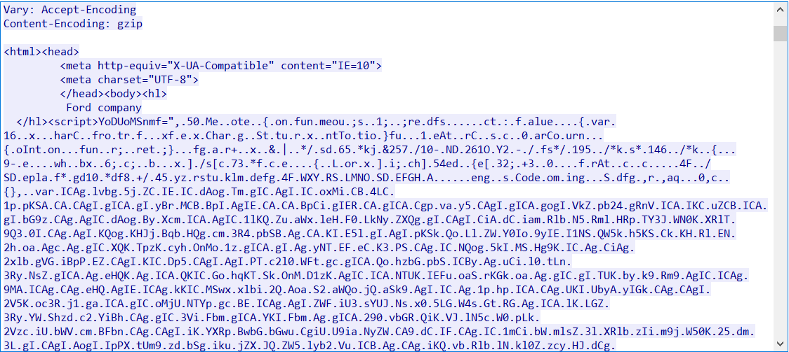
EXPLOIT KIT TRAFFIC

Slide 66
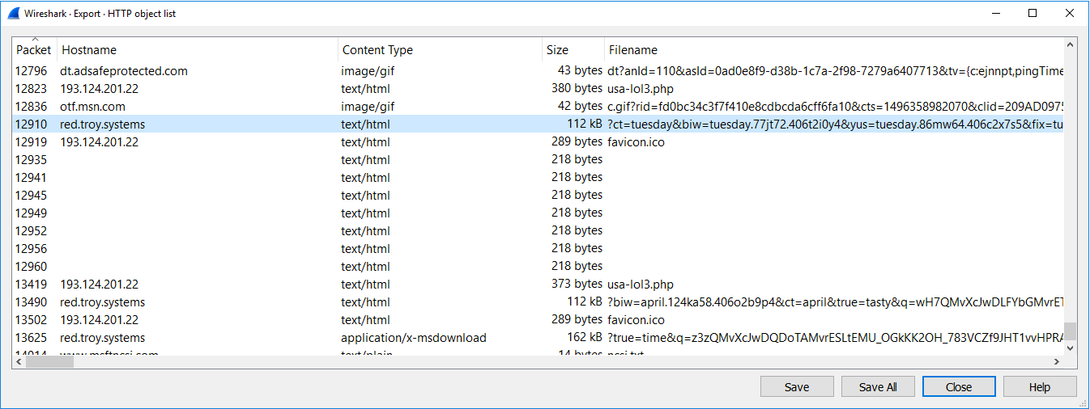
EXPLOIT KIT TRAFFIC
File → Export Objects → HTTP

Slide 67
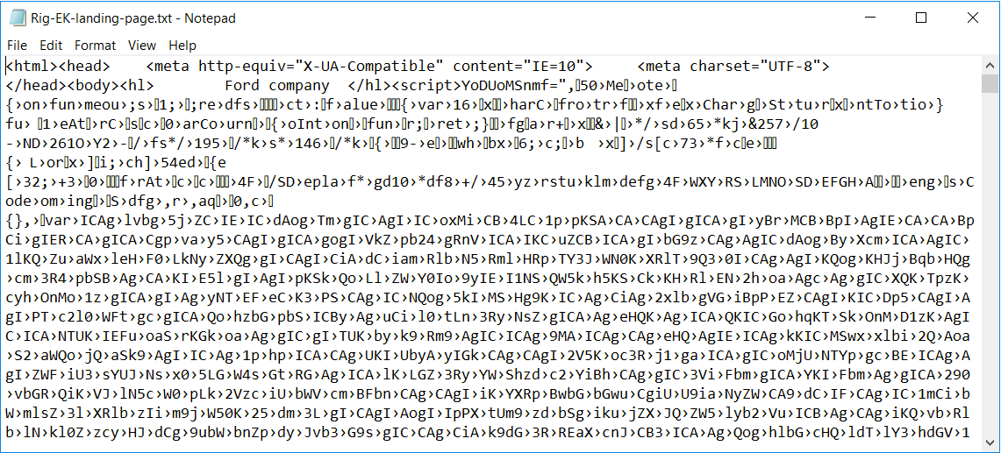
EXPLOIT KIT TRAFFIC

Slide 68
EXPLOIT KIT TRAFFIC
(http.request or http.response) and ip.addr eq 185.158.153.204

Slide 69
EXPLOIT KIT TRAFFIC
File → Export Objects → HTTP

Slide 70
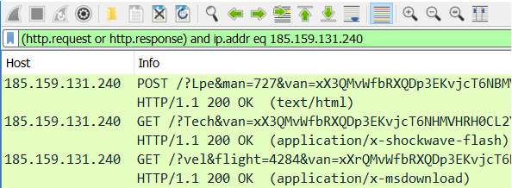
EXPLOIT KIT TRAFFIC
Example from Tuesday 2017-06-20:

Slide 71
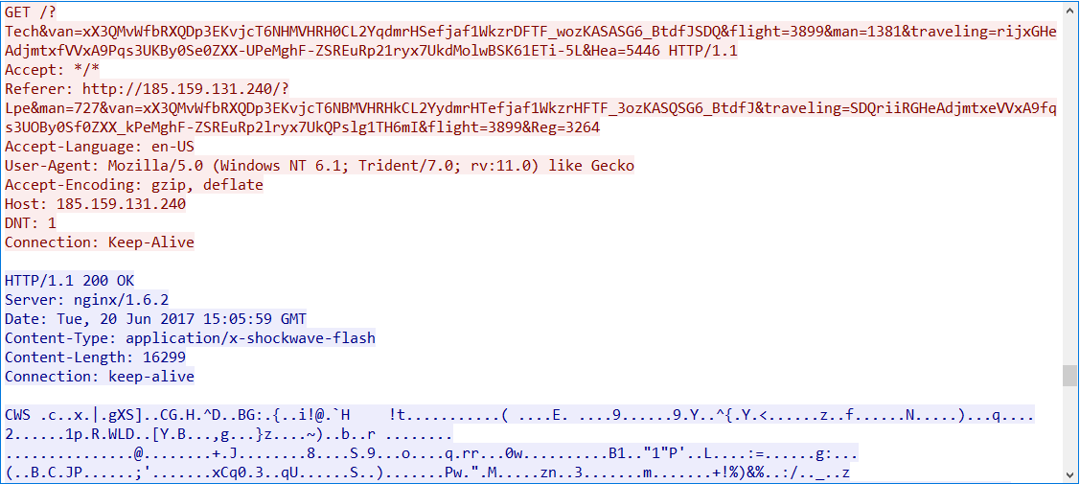
EXPLOIT KIT TRAFFIC

Slide 72
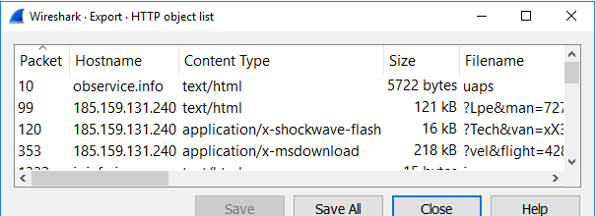
EXPLOIT KIT TRAFFIC
Example from yesterday on 2017-06-20

Slide 73
EXPLOIT KIT TRAFFIC
(http.request or http.response) and ip.addr eq 185.158.153.204

Slide 74
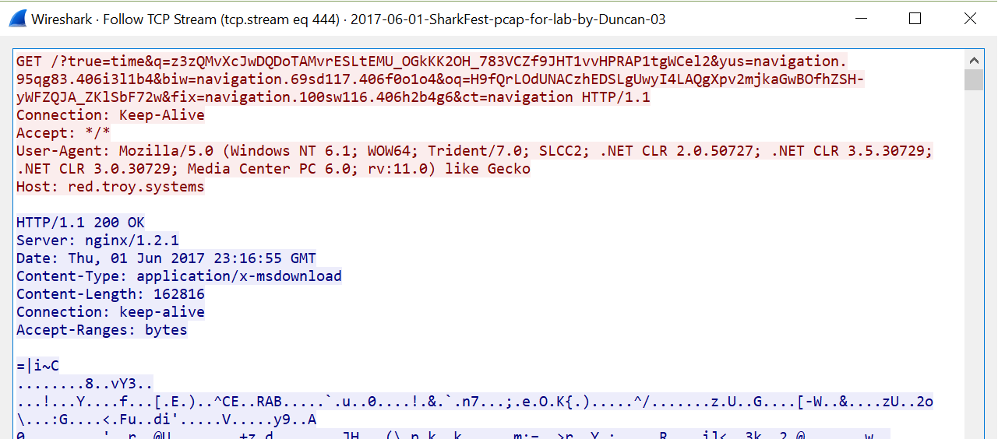
EXPLOIT KIT TRAFFIC

Slide 75
EXPLOIT KIT TRAFFIC

Slide 76
EXPLOIT KIT TRAFFIC
ip contains red.troy.systems

Slide 77
EXPLOIT KIT TRAFFIC

Slide 78
EXPLOIT KIT TRAFFIC

Slide 79
SUMMARY
Wireshark setup
Find traffic based on an IDS alert
Find root cause after post-infection alerts
Example of exploit kit traffic

Slide 80
Analyzing Exploit Kit Traffic with Wireshark
Analyzing Malicious Traffic with Wireshark
Bradley Duncan
Threat Intelligence Analyst | Palo Alto Networks Unit 42

