Slide 1


TLS Encryption and Decryption
What every IT engineer should know about TLS
Ross Bagurdes
Data network Engineer
@bagurdes

Slide 2

https://www.pluralsight.com

Slide 3
Goals
A Brief History
Encrypting Data
Key Exchange
Data Encryption Protocols
TLS 1.2 and 1.3 Handshakes
Decrypting TLS in Wireshark

Slide 4
The public key encrypts the data.
The private key decrypts the data.

Slide 5
Web Browser Encryption

Slide 6
Web Browser Encryption
Negotiate Encryption Session
Secure Socket Layer (SSL)
Transport Layer Security (TLS)
Encryption Protocols
RSA
Diffie Hellman
ECDHE
3DES
AES
ChaCha20

Slide 7
Web Browser Encryption
Negotiate Encryption Session
Secure Socket Layer (SSL)
Transport Layer Security (TLS)
Encryption Protocols
RSA
Diffie Hellman
ECDHE
3DES
AES
ChaCha20

Slide 8
Web Browser Encryption
Negotiate Encryption Session
Secure Socket Layer (SSL)
Transport Layer Security (TLS)
Encryption Protocols
RSA
Diffie Hellman
ECDHE
3DES
AES
ChaCha20

Slide 9
SSL/TLS Version History
1994
SSLv2
Netscape Navigator
1999
TLSv1.0
RFC 2246
2008
TLSv1.2
RFC 5246
2018
TLSv1.3
Prop. Standard
TLS v1.3
1995
SSLv3
resolved serious v2 issues
2006
TLSv1.1
RFC 4346
2013
Microsoft/Apple
Enable support for
TLSv1.2
TLS v1.2

Slide 10
SSL/TLS Versions
TLS v1.2
TLS v1.3

Slide 11
Data Encryption Basics

Slide 12




Encrypting Communication
HTTPs Client
HTTPs Server

Slide 13


Encrypting Communication
HTTPs Client
HTTPs Server
+

Slide 14
Encrypting Communication
HTTPs Client
HTTPs Server
+

Slide 15
Encrypting Communication
HTTPs Client
HTTPs Server
+

Slide 16
Encrypting Communication
HTTPs Client
HTTPs Server

Slide 17
Encrypting Communication
HTTPs Client
HTTPs Server
secretkey
secretkey

Slide 18
Encrypting Communication
HTTPs Client
HTTPs Server
+

Slide 19
Encrypting Communication
HTTPs Client
HTTPs Server
+

Slide 20
Encrypting Communication
HTTPs Client
HTTPs Server
+

Slide 21
Encrypting Communication
HTTPs Client
HTTPs Server

Slide 22
Encrypting Communication
HTTPs Client
HTTPs Server

Slide 23
TLS Encryption
Data Encryption
Key Exchange
Handshake Integrity

Slide 24
TLS Encryption
Key Exchange
Data Encryption
Handshake Integrity

Slide 25
Diffie-Hellman Key Exchange
HTTPs Client
HTTPs Server

Slide 26
Diffie-Hellman Key Exchange
HTTPs Client
HTTPs Server

Slide 27

Diffie-Hellman Key Exchange
HTTPs Client
HTTPs Server
p = 149
g = 17

Slide 28
Diffie-Hellman Key Exchange
HTTPs Client
HTTPs Server
p = 149
g = 17

Slide 29
Diffie-Hellman Key Exchange
p = 149
g = 17
HTTPs Client
HTTPs Server
Public
Key
a = 8
Private
Key

Slide 30
Diffie-Hellman Key Exchange
p = 149
g = 17
HTTPs Client
HTTPs Server
a = 8
Private
Key

Slide 31
Diffie-Hellman Key Exchange
p = 149
g = 17
HTTPs Client
HTTPs Server
a = 8
gª MOD p = encrypted key
Private
Key

Slide 32
Quick Math Lesson

Slide 33

95/8

Slide 34
95/8
“95 divided by 8”

Slide 35
95/8
“95 divided by 8”
8
95

Slide 36
95/8
“95 divided by 8”
8
95

Slide 37
95/8
“95 divided by 8”
1
8
95

Slide 38
95/8
“95 divided by 8”
1
8
95
8

Slide 39
95/8
“95 divided by 8”
1
8
95
8
15

Slide 40
95/8
“95 divided by 8”
1
1
8
95
8
15

Slide 41
95/8
“95 divided by 8”
1
1
8
95
8
15
8

Slide 42
95/8
“95 divided by 8”
1
1
8
95
8
15
8
7

Slide 43
95/8
“95 divided by 8”
1
1
.####
8
95
8
15
8
7
7

Slide 44
95/8
“95 divided by 8”
R 7
1
7
1
8
95
8
15
8
7

Slide 45
95/8
“95 divided by 8”
Modulus
R 7

Slide 46
95/8
“95 divided by 8”
Modulus
7

Slide 47
Diffie-Hellman Key Exchange
p = 149
g = 17
HTTPs Client
HTTPs Server
a = 8
gª MOD p = encrypted key
Private
Key

Slide 48
Diffie-Hellman Key Exchange
p = 149
g = 17
HTTPs Client
HTTPs Server
a = 8
gª MOD p = encrypted key
Private
Key
17⁸ MOD 149 =
5

Slide 49
Diffie-Hellman Key Exchange
p = 149
g = 17
HTTPs Client
HTTPs Server
a = 8
5
Private
Key

Slide 50
Diffie-Hellman Key Exchange
p = 149
g = 17
HTTPs Client
HTTPs Server
a = 8
5
Private
Key

Slide 51
Diffie-Hellman Key Exchange
a = 8
Private
Key
p = 149
g = 17
HTTPs Client
HTTPs Server
5

Slide 52
Diffie-Hellman Key Exchange
a = 8
5
Private
Key
p = 149
g = 17
Encrypted
Key
HTTPs Client
HTTPs Server
b = 6
Private
Key

Slide 53
Diffie-Hellman Key Exchange
a = 8
5
Private
Key
p = 149
g = 17
Encrypted
Key
HTTPs Client
HTTPs Server
b = 6
g^{b} MOD p = encrypted key
Private
Key

Slide 54
Diffie-Hellman Key Exchange
a = 8
5
Private
Key
p = 149
g = 17
Encrypted
Key
HTTPs Client
HTTPs Server
b = 6
g^{b} MOD p = encrypted key
Private
Key
17⁶ MOD 149 =
16

Slide 55
Diffie-Hellman Key Exchange
a = 8
5
Private
Key
p = 149
g = 17
Encrypted
Key
HTTPs Client
HTTPs Server
16
b = 6
Private
Key

Slide 56
Diffie-Hellman Key Exchange
a = 8
5
Private
Key
p = 149
g = 17
Encrypted
Key
HTTPs Client
HTTPs Server
16
b = 6
Encrypted
Key
Private
Key

Slide 57
Diffie-Hellman Key Exchange
p = 149
g = 17
HTTPs Client
HTTPs Server
a = 8
16
5
b = 6
Private
Key
Encrypted
Key
Encrypted
Key
Private
Key

Slide 58
p = 149
g = 17
HTTPs Client
HTTPs Server
a = 8
16
5
b = 6
Private
Key
Encrypted
Key
Encrypted
Key
Private
Key
(enc key)ª MOD p = key
(enc key)^{b} MOD p = key

Slide 59
p = 149
g = 17
HTTPs Client
HTTPs Server
a = 8
16
5
b = 6
Private
Key
Encrypted
Key
Encrypted
Key
Private
Key
(enc key)ª MOD p = key
(enc key)^{b} MOD p = key
129
16⁸ MOD 149 =

Slide 60
p = 149
g = 17
HTTPs Client
HTTPs Server
a = 8
16
5
b = 6
Private
Key
Encrypted
Key
Encrypted
Key
Private
Key
(enc key)ª MOD p = key
(enc key)^{b} MOD p = key
129
129
16⁸ MOD 149 =
5⁶ MOD 149 =

Slide 61
p = 149
g = 17
HTTPs Client
HTTPs Server
a = 8
16
5
b = 6
Private
Key
Encrypted
Key
Encrypted
Key
Private
Key
129
129
Key
Key

Slide 62
Diffie-Hellman Key Exchange
HTTPs Client
HTTPs Server
129
129

Slide 63
TLS Encryption
Key Exchange
Data Encryption
Handshake Integrity

Slide 64
TLS Encryption
TLS v1.2
TLS v1.3
Key Exchange
Data Encryption
Handshake Integrity
RSA
Diffie Hellman
Elliptical Curve
Diffie Hellman
RSA
Diffie Hellman
Elliptical Curve
Diffie Hellman

Slide 65
TLS Encryption
TLS v1.2
TLS v1.3
Key Exchange
Data Encryption
Handshake Integrity
RSA
Diffie Hellman
Elliptical Curve
Diffie Hellman
Elliptical Curve
Diffie Hellman

Slide 66
TLS Encryption
TLS v1.2
TLS v1.3
Key Exchange
Data Encryption
Handshake Integrity
RSA
Diffie Hellman
Elliptical Curve
Diffie Hellman
Elliptical Curve
Diffie Hellman

Slide 67
TLS Encryption
TLS v1.2
TLS v1.3
Key Exchange
Data Encryption
Handshake Integrity
RSA
Diffie Hellman
Elliptical Curve
Diffie Hellman
Elliptical Curve
Diffie Hellman

Slide 68
TLS Encryption
TLS v1.2
TLS v1.3
Key Exchange
Data Encryption
Handshake Integrity
RSA
Diffie Hellman
Elliptical Curve
Diffie Hellman
Elliptical Curve
Diffie Hellman

Slide 69
Elliptical Curve
Diffie-Hellman Ephemeral

Slide 70
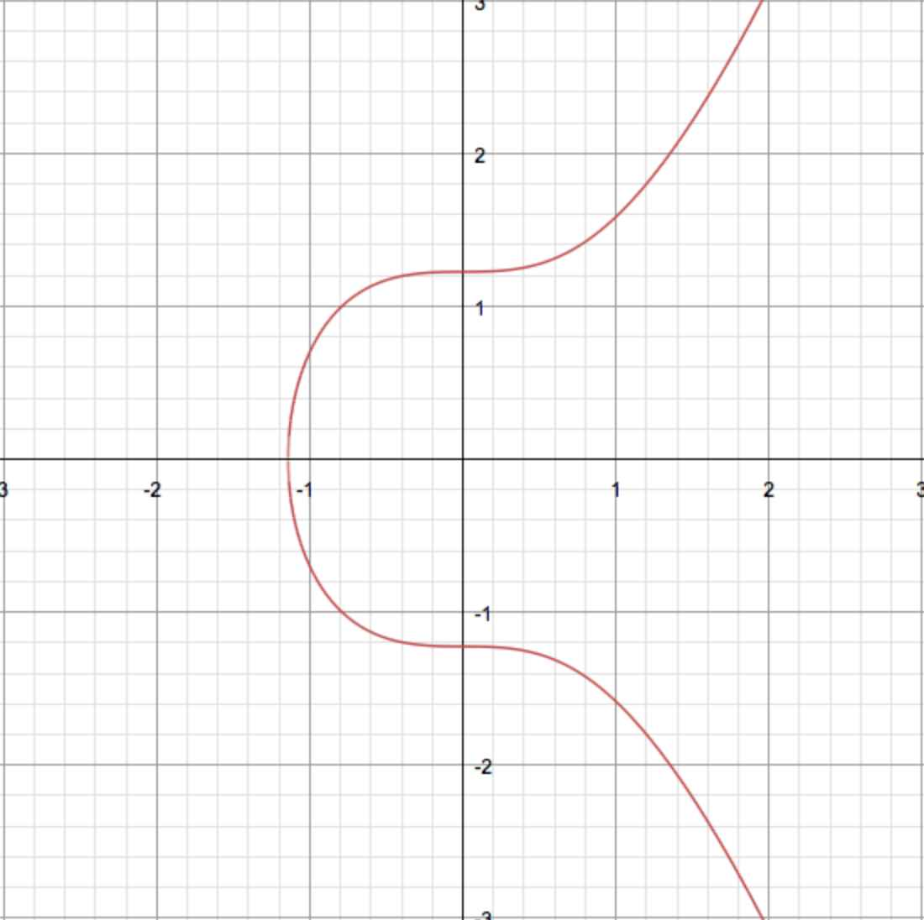
Elliptical Curve
Curve Types
x25519
secp256r1
secp284r1
fecp521r1
ffdhe2048
ffdhe3073

Slide 71
Elliptical Curve
Curve Types
x25519
secp256r1
secp284r1
fecp521r1
ffdhe2048
ffdhe3073

Slide 72
Elliptical Curve

Slide 73
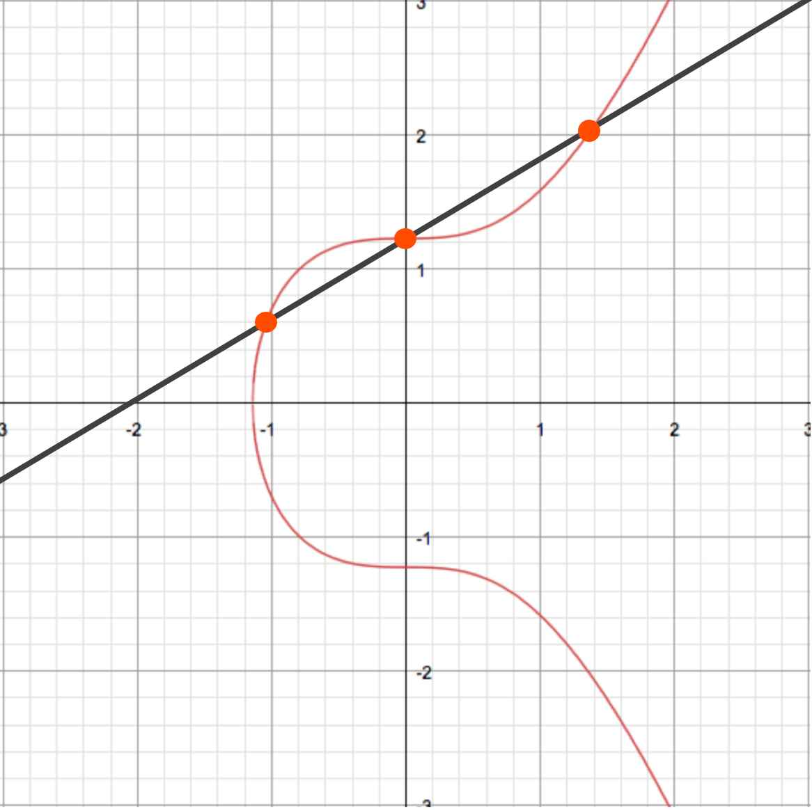
TLS 1.3 DHECE Key Exchange
Private
Key
HTTPs Client
HTTPs Server
Enc.
Key

Slide 74
TLS 1.3 DHECE Key Exchange
Private
Key
Enc.
Key
Enc.
Key
HTTPs Client
HTTPs Server
Enc.
Key

Slide 75
TLS 1.3 DHECE Key Exchange
Private
Key
+
Enc.
Key
Enc.
Key
HTTPs Client
HTTPs Server
Enc.
Key

Slide 76
TLS 1.3 DHECE Key Exchange
Private
Key
+
Enc.
Key
HTTPs Client
HTTPs Server
Enc.
Key

Slide 77
TLS 1.3 DHECE Key Exchange
Private
Key
Enc.
Key
HTTPs Client
HTTPs Server
Enc.
Key

Slide 78
TLS 1.3 DHECE Key Exchange
Private
Key
Private
Key
Enc.
Key
HTTPs Client
HTTPs Server
Enc.
Key

Slide 79
TLS 1.3 DHECE Key Exchange
Enc.
Key
Private
Key
Private
Key
Enc.
Key
HTTPs Client
HTTPs Server

Slide 80
TLS 1.3 DHECE Key Exchange
Enc.
Key
Private
Key
+
Private
Key
Enc.
Key
HTTPs Client
HTTPs Server

Slide 81
TLS 1.3 DHECE Key Exchange
Enc.
Key
Private
Key
+
Private
Key
HTTPs Client
HTTPs Server
Enc.
Key

Slide 82
TLS 1.3 DHECE Key Exchange
Enc.
Key
Private
Key
Private
Key
HTTPs Client
HTTPs Server
Enc.
Key

Slide 83
TLS 1.3 DHECE Key Exchange
Enc.
Key
Private
Key
Private
Key
HTTPs Client
HTTPs Server
Enc.
Key

Slide 84
TLS 1.3 DHECE Key Exchange
Private
Key
Private
Key
+
+
Enc.
Key
Enc.
Key
HTTPs Client
HTTPs Server

Slide 85
TLS 1.3 DHECE Key Exchange
Private
Key
Private
Key
+
+
Enc.
Key
Enc.
Key
HTTPs Client
HTTPs Server

Slide 86
TLS 1.3 DHECE Key Exchange
Private
Key
Private
Key
+
+
Enc.
Key
Enc.
Key
HTTPs Client
HTTPs Server

Slide 87
TLS Encryption
Key Exchange
Data Encryption
Handshake Integrity

Slide 88

Data Encryption Protocols
Ciphers
3DES (168 bits)
AES (128 or 256 bits)
  GCM
  CBC
Chacha20
  Poly1305

Slide 89
TLS Encryption
Key Exchange
Data Encryption
Handshake Integrity

Slide 90
TLS Encryption
Key Exchange
Data Encryption
Handshake Integrity

Slide 91

Handshake Integrity
SHA
SHA-256
SHA-384

Slide 92
TLS Encryption
Key Exchange
Data Encryption
Handshake Integrity
Server Authenticity

Slide 93
TLS Encryption
Key Exchange
Data Encryption
Handshake Integrity
Server Authenticity

Slide 94
Certificates

Slide 95

Server Certificates
RSA Encryption
Public Key (DH)
  p and g
Verification information
  Certificate Chain
  ”Signed” certificates

Slide 96
TLS Handshake

Slide 97


Slide 98
Goals
A Brief History
Encrypting Data
Key Exchange
Data Encryption Protocols
TLS 1.2 and 1.3 Handshakes
Decrypting TLS in Wireshark

