Slide 1
How long is a packet?
(And does it matter?)

Slide 2
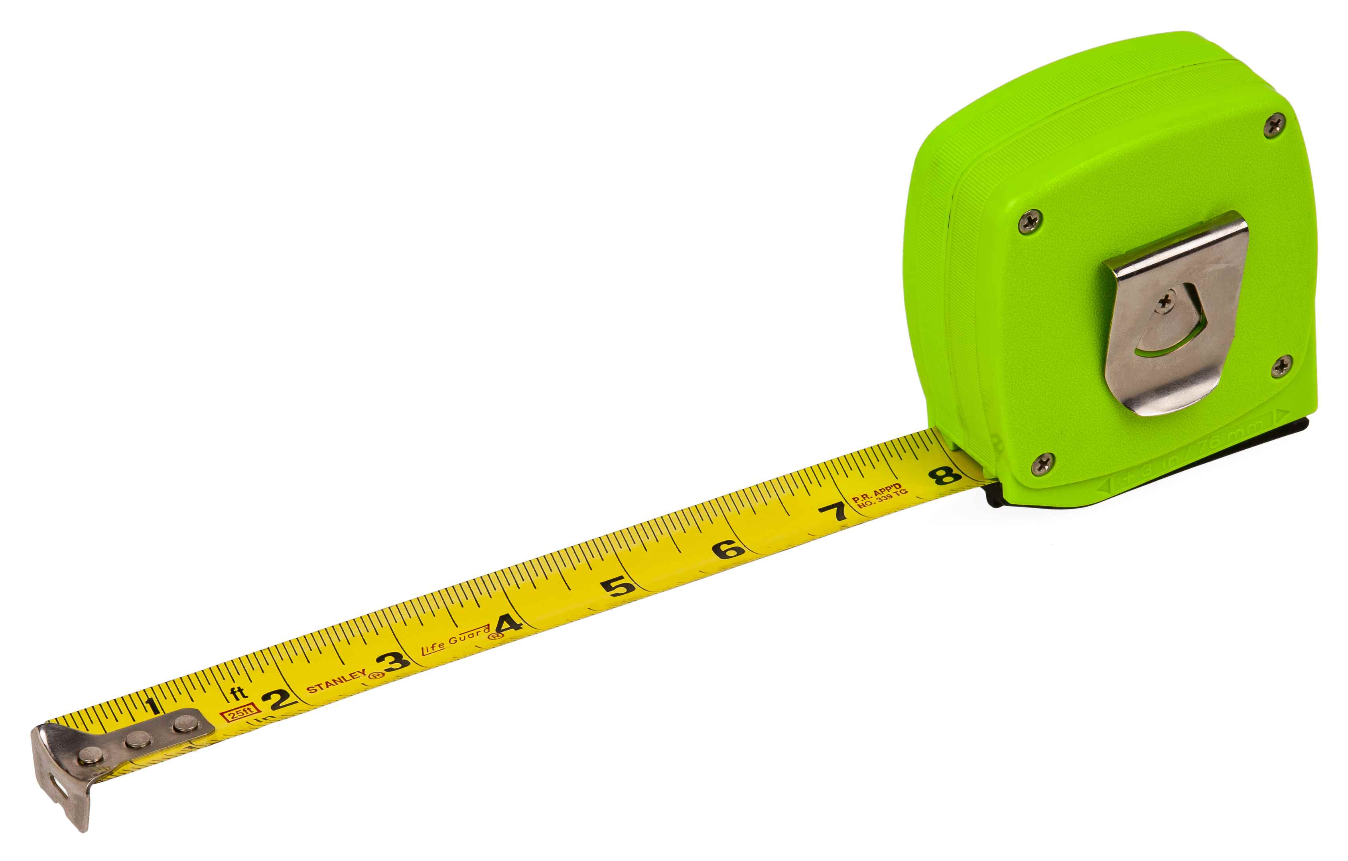
How long is a packet?
Notes:
By Evan-Amos - Own work, Public Domain, https://commons.wikimedia.org/w/index.php?curid=11294046

Slide 3
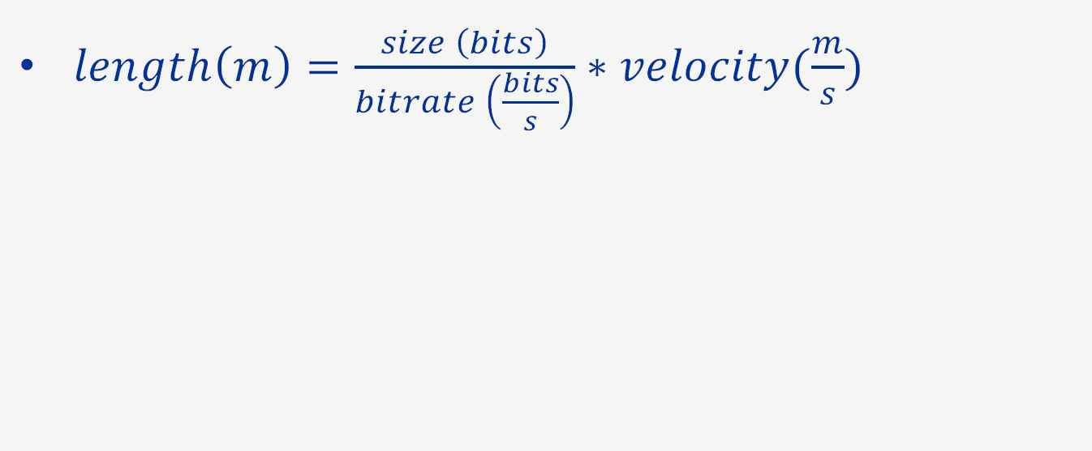
100 Byte packet at 1Gbps
Notes:
Length is time to send multiplied by the speed of the signal in the media in the media
Units cancel to leave metres

Slide 4
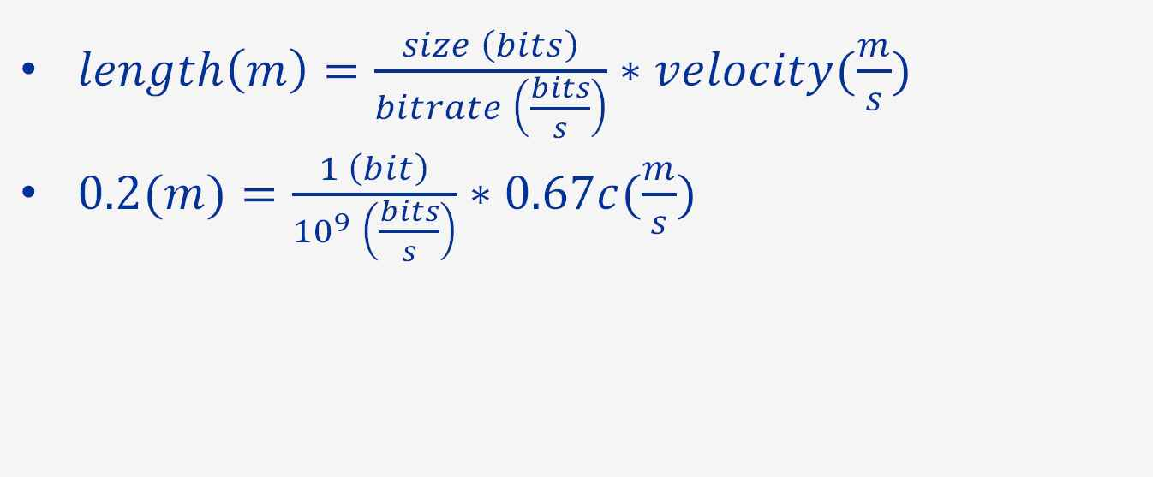
100 Byte packet at 1Gbps
Notes:
Velocity factor: Speed of light in fibre is ~2/3c. c = 3*10^8m/s
Each bit at 1Gbps is 20cm in fibre, 7.9”
Refer to slide 2 image for 8” visyalisation!

Slide 5
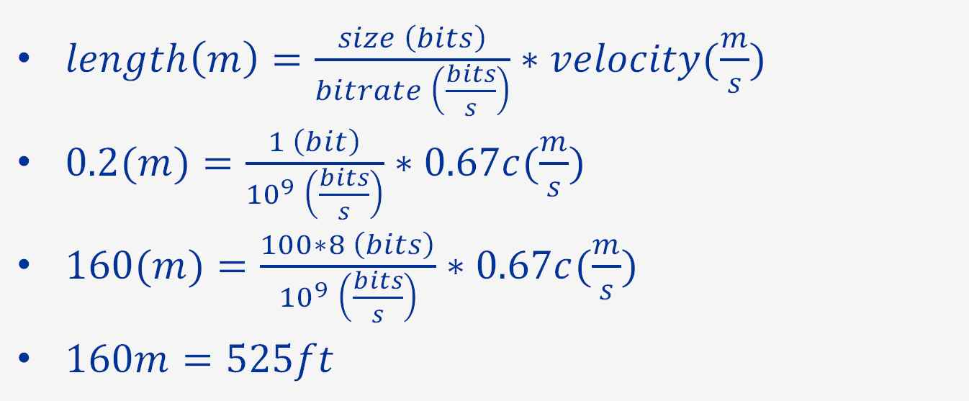
100 Byte packet at 1Gbps
Notes:
Fibre > 160m, packet is stored as light pulses. Copy in sending PC.

Slide 6
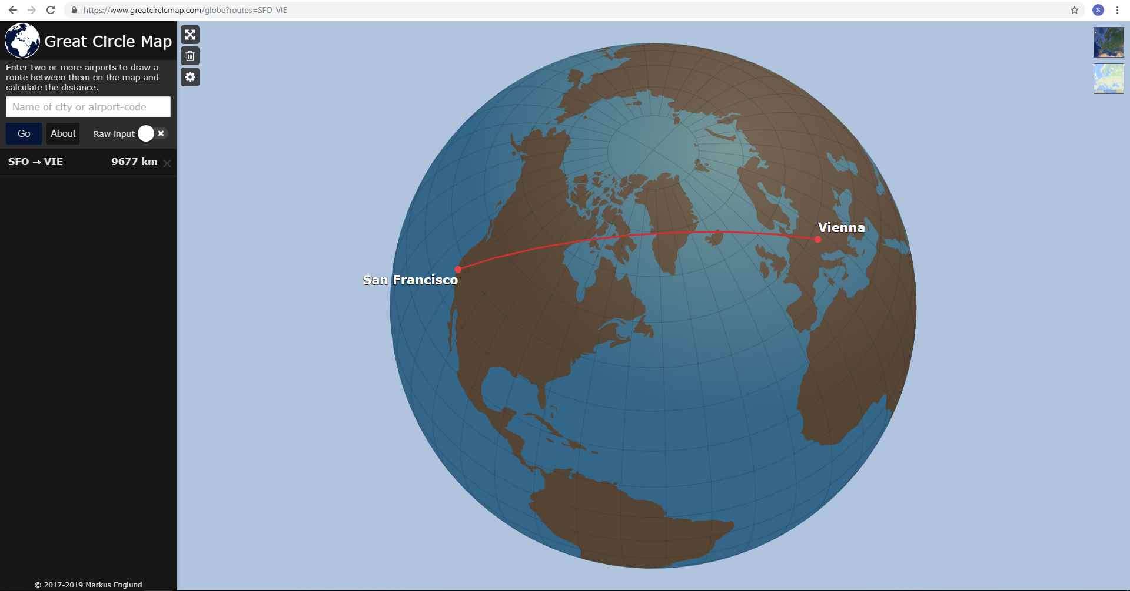
Great Circle Paths
Notes:
Path to previous Sharkfest EU’18 in Vienna, Austria
9,677km = 6,013mi

Slide 7
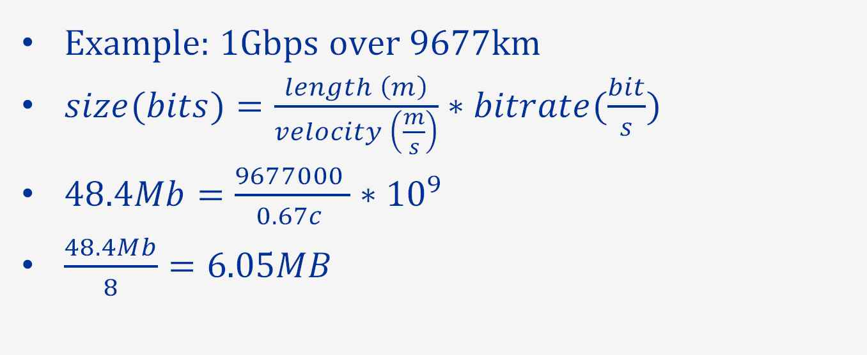
Bandwidth Delay Product
Notes:
One-way-delay is 48ms, about 1/20s
Why is Bandwidth Delay Product important?

Slide 8
UDP
Not a reliable transport
No feedback
Sender chooses the rate: “Fire and forget”
Excess packets are dropped
Can build feedback on top, E.g. QUIC
Notes:
QUIC proposed by Google, used for google.com, Gmail etc

Slide 9
TCP
Send data, wait for acknowledgement
TCP receiver advertises a Receive Window
  The maximum amount of unacknowledged data
Sender must retain all data in the Window
If the Window is too small, transfer is inefficient
Sender cannot influence the Receive Window
Notes:
SF-Vienna: 100B in 2 * 48ms is only 17kb/s
Larger packet: 1000B packet only 170kb/s
What Window size should be choose?

Slide 10
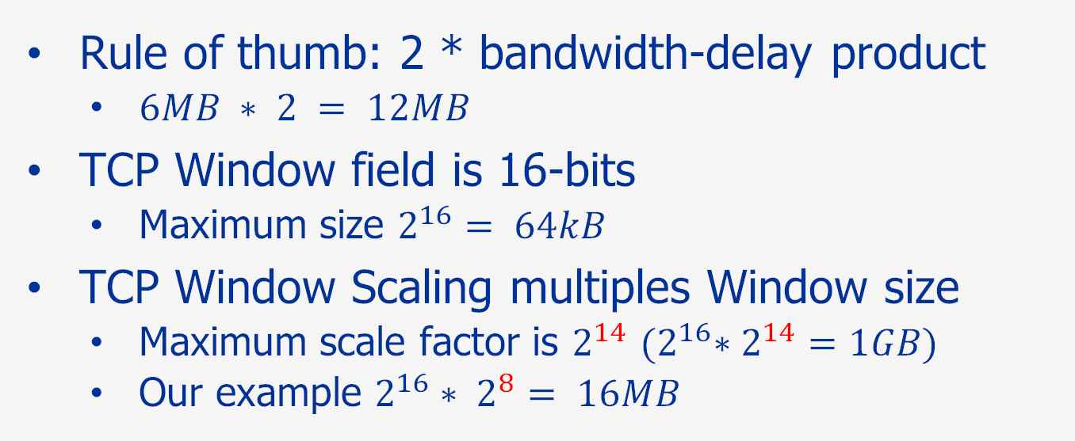
TCP Window
Notes:
Window size is regardless of packet size
Window Scaling RFC 1323, TCP Option
But I don’t edit my OS, am I Internet-ing wrong?
Not expecting 1Gbps per TCP session

Slide 11
TCP Autotuning
Modern OS support Autotuning
  Don’t pre-allocate large buffers to save memory
  Dynamically increase Window if needed (to a limit)
Not all devices on Internet run modern OS
Is Autotuning enough?
  TCP over very high BDP?
  Really long path and/or really high bandwidth
Notes:
MS Windows auto-scales to 16MB, Linux auto-scales to 4MB but wmem limit is 200kB?

Slide 12

Really long paths
Notes:
Dr James O'Donoghue @physicsJ
https://twitter.com/physicsJ/status/1085001643270303744
https://youtu.be/_61SxDrdyhI

Slide 13
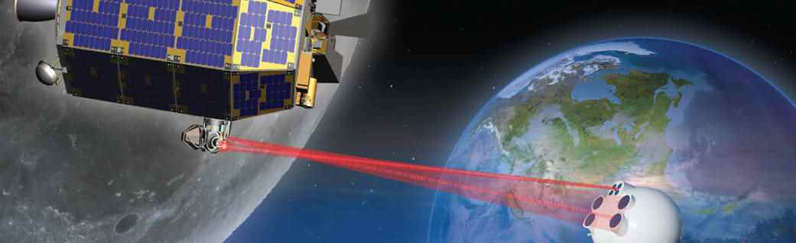
🌙 to 🌎
LADEE satellite orbited the moon in 2013
  Lunar Laser Communications Demonstration (LLCD)
  622Mb/s over 384400km (1.28 light seconds)
  Bandwidth-delay product = 99.6MB
Notes:
Lunar Atmosphere and Dust Environment Explorer
200MB Window < 1GB max, would require manual tuning!
Max window 1GB limits b/w to the moon to 3Gbps per TCP stream
Mars is 56-401 Million km away, 3-23 minutes delay. Delay Tolerant Networking

Slide 14
Back to Earth
How long is an Ethernet frame?
Type/Length
DST MAC
SRC MAC
Ethernet Payload
FCS
6
6
2
46-1500
4
64-1518
Notes:
Ethernet Payload is also called the MAC Client Data Field in IEEE 802.3
802.3 doesn’t specify minimum of 46, will pad with zeros

Slide 15
Wire Length
How long is an Ethernet frame on the wire?
Start of Frame Delimiter
Type/Length
Preamble
DST MAC
SRC MAC
Ethernet Payload
FCS
Inter-Frame Gap
7
1
6
6
2
46-1500
4
12
64-1518
84-1538
Notes:
Preamble nominally 7 bytes, can get reduced
IFG nominally 12 byte times, can get reduced
Important number is 20 extra bytes

Slide 16
VLAN Tag
How long is an Ethernet frame with VLAN?
Start of Frame Delimiter
Type/Length
Preamble
DST MAC
SRC MAC
VLAN
Ethernet Payload
FCS
Inter-Frame Gap
7
1
6
6
2
4
42-1500
4
12
64-1522
84-1542
Notes:
IEEE 802.1q VLAN
Frame was extended by 4 bytes
Payload was not, still 1500 max
Minimum payload can be smaller though

Slide 17
Envelopes
How long is an Ethernet Envelope frame?
Start of Frame Delimiter
Type/Length
Preamble
DST MAC
SRC MAC
Envelope
Ethernet Payload
FCS
Inter-Frame Gap
7
1
6
6
2
0-482
0-1500
4
12
64-2000
84-2020
Notes:
Envelopes such as 802.1ad QinQ, Provider Bridges, Stacked VLANs, also MAC Security
We finally know how large Ethernet frames can be!
But what about…

Slide 18
Jumbo Packets
Frames >2000B are not standards compliant
  Non-standard extensions
  Interoperability problems
  FCS weakness
Session 12: Jumbo frames & how to catch them
  Patrick Kinnison
  3:15pm Krutch Room 104
Notes:
Why not longer? Isn’t there like 9000B packets?
Interoperability – no way to signal too long back to sender, no fragmentation
FCS protection weakens as packets get longer

Slide 19
Wireshark
How does Wireshark report packet length?
Inevitable Wireshark live demo
Notes:
Hint: not in inches!
File 1: 1-interface.pcap, sort by length, note packets <64B! No FCS, No Pad
File 2: fcs-capture.pcap, sort by length, note smallest is 64B, FCS and padding captured. Enable Ethernet Assume FCS option and reload initial file, show problems.
File 3: superpackets.pcap, sort by length descending. 23kB packets! Show Frame and IP dissectors. Length due to NIC accelerations. Unleash Networks blog
File 4: fusion_hpt_example.pcap, sort by length, show pseudo-trailer

Slide 20
Captured Length
Wireshark reports len and caplen from libpcap
Libpcap gets length from the OS
The OS gets length from the NIC driver
The NIC driver gets length from the hardware
The hardware/driver/OS often truncate FCS and padding, and drop errored/short/long frames
Notes:
Packet traces from PC NICs generally don’t capture link errors, so check interface and switch statistics. SNMP is good for something!

Slide 21
NIC Accelerations
NIC acceleration features such as RSO/TSO/GSO/GRO happen below libpcap
Reduce effective packet rate for the OS
Reported RX/TX packet lengths can be much larger than MTU
TX Checksums not filled in
Not seeing what is really on the wire
Notes:
Work around is Port Mirror/SPAN/TAP
Disabling accelerations may affect performance, or even the issue you are trying to fix!

Slide 22
Pseudo-headers
Metadata not on the wire can be counted in len
RSPAN and ERSPAN add/remove headers
Some link types get pseudo-headers (USB, PPP)
Packet Brokers tap multiple links and direct traffic to capture systems
  Pseudo-header or pseudo-trailer (with/without FCS)
  VLAN tagging
Notes:
Do these extra bytes matter? Calculating utilisation/bandwidth

Slide 23
Speed?
Instantaneously a point in a network link is either carrying packet or not
Throughput: amount of data transferred over a time period
  Often normalised to bits per second
Bandwidth: the maximum link throughput
Goodput: achieved transfer rate
Notes:
1GB/hour is a throughput, 2.2Mbps

Slide 24
Minimum size packets
L1: 84B @ 1Gbps, 100% load = 1,488,095.2 pps
L2: Ethernet 64B = 761,904,761.9 bps
L3: IPv4 46B = 547,619,047.6 bps
L4: TCP 26B = 309,523,809.5 bps
L5-7: App 6B = 71,428,571.4 bps
Notes:
L2 loses 28%
L3 loses 45%
L4 loses 69%
L5 loses 93%

Slide 25
1500B packets
L1: 1538B @ 1Gbps, 100% load = 81,274.4 pps
L2: Ethernet 1518B = 986,996,098.8 bps
L3: IPv4 1500B = 975,292,587.8 bps
L4: TCP 1480B = 962,288,686.6 bps
L5-7: App 1460B = 949,284,785.4 bps
Jumbo frames only slightly more efficient, but lower the effective packet rate
Notes:
L2 loses only 1.4%
L3 loses 2.5%
L4 loses 3.8%
L5 loses 5.1%
Jumbo frames only increase efficiency a few percent, but greatly lower the effective packet rate

Slide 26
Capture effects
Always use len (not caplen) to avoid underestimating throughput and utilisation
Not capturing FCS and padding underestimates throughput and utilisation
Including pseudo-headers and trailers overestimates throughput and utilisation
NIC offloads can underestimate packet rate/count and throughput/utilisation
Notes:
A difference in packet count between interface stats and packet trace could be packet loss, or could be offloads

Slide 27
Provisioning
Consider link utilisation as well as throughput
Real networks have a mix of packet sizes
Bulk file transfer uses the MTU for efficiency
Streaming media/VOIP/Financial/Gaming may not

Slide 28
Unstoppable Force meets Immovable Barrier
Different links may have different MTUs
  Not everything is Ethernet!
  Jumbo packets
  Encapsulation: Tunnels, Security, Virtualisation
Ethernet switch drops oversize frames
Routers can be smarter

Slide 29
IPv4 Fragmentation
IPv4 packets can be fragmented mid-path
  Receiver reassembles fragments
  Transparent to sender
  Inefficient: CPU load, Fragment loss/re-ordering
IPv4 has a Don’t Fragment (DF) bit
  ICMP “Destination Unreachable: Fragmentation needed & DF set” message sent back to Sender
  Used in PMTU discovery
Notes:
Also IP Fragments don’t contain L4 information, so may not be handled correctly by firewalls and load balancers

Slide 30
IPv6 Fragmentation?
IPv6 does not support mid-path fragmentation
If a packet is too large for the outgoing link, router must return ICMPv6 Packet too Big
Endpoints are expected to perform PMTUd
If higher level protocol can’t reduce message size, the IPv6 Fragment extension header can be used for end-to-end fragmentation
Notes:
There is no DF bit in IPv6, it’s always implied

Slide 31





Connectivity Problem
Home
ISP
ISP
Bank
Ethernet
ADSL
Ethernet
Ethernet
Ethernet
Ethernet
Notes:
Early Internet
Browsing Bank website worked fine
Secure banking Log In failed

Slide 32
Connectivity Problem
Home
ISP
ISP
Bank
Ethernet
ADSL
Ethernet
Ethernet
Ethernet
Ethernet
1500
1492
1500
1500
1500
1500
Notes:
Show MTUs
ADSL operates on PPPoE(oA), so MTU is smaller

Slide 33
Connectivity Problem
Home
ISP
ISP
Bank
Ethernet
ADSL
Ethernet
Ethernet
Ethernet
Ethernet
1500
1492
1500
1500
1500
1500
Block
ICMP
Notes:
Bank was blocking all ICMP bi-directionally
SSL/TLS traffic has DF set, Home ISP returning ICMP DU was dropped at Bank Firewall, connection stalled at first large packet

Slide 34
Connectivity Problem
Home
ISP
ISP
Bank
Ethernet
ADSL
Ethernet
Ethernet
Ethernet
Ethernet
1500
1492
1500
1500
1500
1500
Block
ICMP
Don’t block ICMP Destination Unreachable!
Notes:
Solution: Don’t block outgoing ICMP, and don’t block ICMP DU incoming, it’s not a security issue!

Slide 35
Recap
Physical packet lengths
Bandwidth Delay Product – Long Fat Networks
Ethernet frame length
Wireshark and libpcap – Packet capture
Throughput calculation
Fragmentation/PMTU

Slide 36
Thank You!
Please fill in your Survey on the App!
Any questions?
You can contact me by email at
stephen.donnelly@endace.com

