Slide 1
Wireshark And Open Source
@WiresharkNews

Slide 2
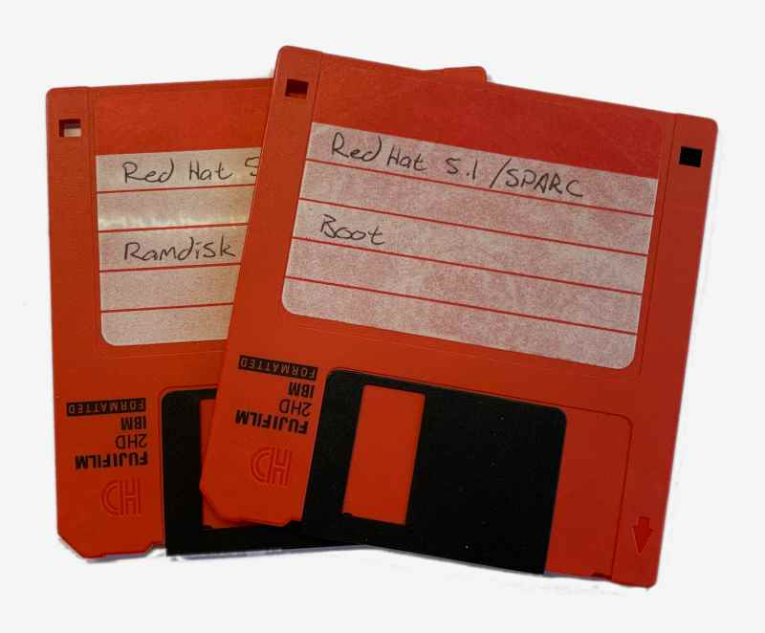
The Opposite Of Open Source
First job as a programmer
No one else should see the code
If they do, they shouldn’t understand it
Notes:
Every time I talk about Wireshark’s history I mention that I wanted to give back to open source.
Let’s expand on that a bit.
My first real programming job was while I was still in college.
It was for a one-man shop that made insurance rating software.
The owner was really nice, but his livelihood literally depended on some Pascal code.
It was closed source.
Things you need to know:
* He was paranoid about getting his code stolen. Everything was on floppies that he took home.
* When we write software, we give names to things, e.g. "alpaca_count" to store the number of alpacas.
* He did not do this. Instead there were arrays of numbers and bits of text, e.g. i[10].
I lasted maybe a day.
----
I first read about GPL in a college class.
It was pretty abstract and I didn't think much about it.

Slide 3
Naming Things
Most software
alpaca_count := 5;
alpacaCount := 5;
My first programming job i[85] := 5;
Notes:
Suppose the number of alpacas you own affects your auto insurance rate.
You don’t know. It’s closed source.
When you’re writing code you have to keep a bunch of stuff in your head – a mental model – so standard practice is to use descriptive names for variables.
What you typically don’t want to do is be intentionally obtuse and make it harder to maintain that mental model. Otherwise it’s easy to introduce bugs. Why am I telling you this? Because my first programming job – my very first exposure to professional software development – there weren’t any variable names.
I was only there for a day, but this really stuck with me.
---- https://en.wikipedia.org/wiki/Naming_convention_(programming)

Slide 4
Passive-Aggressive Source
Later: VMS operator
The VAX had tape drives, CD-ROM drives, etc…
…but the VMS source code was on microfiche
Notes:
Something else that stuck with me happened later on.
I got a job at the university I was attending. At one point I was a VMS operator. In one of the desk drawers in the operator room there was a bunch of microfiche. It was the source code to VMS, the operating systems that ran on the great big VAX computers. People needed the source code, but this was kind of a middle finger.

Slide 5
The Unsung Hero Of Open Source
✨ configure && make && make install ✨
No purchase orders, mag tapes, dongles, license keys, or other junk
If you want to spread your ideals, lower your barriers to entry
Notes:
After that I was a UNIX administrator. Part of my job was installing software, mostly open source.
I remember being asked to install some software and the three commands above were the bulk of the process.
“configure && make && make install” were and still are the commands you typed to install lots of open source software.
It was easy and worked on different platforms.
I think people underestimate how powerful that was and is.
This was about the time that open source software was beginning to get mindshare in the general technology community.
I’m not sure if it was a conscious decision on the part of the FSF, but I think this helped open source adoption quite a bit.
As much as I agree with their ideals, that’s not enough.
You also need adoption.

Slide 6
Campus Network, ‘90s Style
Many protocol stacks
Several PHYs
One Sniffer
IPv4, DECnet, IPX, AppleTalk, SNA, other random ancient eldritch horrors
Ethernet, FDDI, Token Ring, Frame Relay, SLIP, etc.
Which was heavy
Notes:
Part of my job as a UNIX administrator was to help take care of the network.
How many people think it’s terrible that you have to support IPv4 and IPv6?
We had IPv4, DECnet, AppleTalk, IPX, SNA, and others.
We also had Ethernet, FDDI, Token Ring, Frame Relay, etc.
For troubleshooting we had exactly one Sniffer.
If there was a network problem I had to track it down because someone was always using it.
This was also my first hands-on exposure to troubleshooting networks.

Slide 7
Barrier Removal
“Can I have a Sniffer?” “No.”
“Can I have a Sniffer?” “No.”
“Can I have a Sniffer?” “No.”
“Can I at least have EtherPeek?” “No.”
“Fine. I'll just write one. This open source stuff seems nice enough.”
Notes:
Later on I worked at an ISP.
My job duties were mostly the same, but something was missing.
Instead of one Sniffer we had zero.
I got to specify the software that we used.
I usually went with open source.
Except there wasn’t an open source packet analyzer.

Slide 8
My Experience At This Point
Open source had good connotations and associations.
Closed source didn’t.
Notes:
When I say that I wanted to give back to the community it sounds noble, HOWEVER:
By that time I had firsthand experience that told me that closed source software was junk.
I really needed to look at packets on our network.

Slide 9
Developer Time
Notes:
Introductions How did you get into open source?

Slide 10
FOSS Licenses
FOSS = Free and Open Source Software
Cover use, modification, attribution, distribution, patents, etc.
Landscape still evolving, sometimes angrily
Typically apply to copyright, not trademark
GPL focuses on use at the expense of distribution
Notes:
When you looked through the SharkFest agenda, I’m sure a lecture on software licensing was at the top of your list.
When you release code to the public it’s a good idea to assign it a license in order to ensure that it’s used properly.
One of the great pastimes in the open source community is arguing about licenses.
The current debate stems from companies like Amazon building services on top of various code bases.
Software licenses tend to focus on things that are copyrightable, such as source code and documentation. They typically don’t focus on trademarks, such as your name or logo.
For example, many years ago the Debian and Mozilla projects had a disagreement about whether or not what Debian was shipping was actually Firefox.
Debian had every right to distribute the software, but they couldn’t use the name.
That’s why you ended up with a web browser named Iceweasel on Debian for a while.
An example that’s much closer to home is the name “Ethereal”.
I am not a lawyer.
People like Karen Sandler, Bradley Kuhn, and Eben Moglen are.

Slide 11
Our License
Wireshark is released under the GPLv2+
+
No copyright assignment
=
Strong social contract
Notes:
Wireshark is available under the GNU General Public License, specifically the GPL version 2 or later.
We’re one revision behind the FSF, which is on version 3.
We haven’t had a compelling need to bump the version so far.
We also don’t do copyright assignment.
If you want to contribute code to some projects, particularly ones run by large companies, they require that you sign your code over to them before they will accept it.
I never saw the need.
These two things result in a strong social contract. When you contribute code to Wireshark, it will always be open and you will always own it.
I’m not sure how important that is to people who contribute, but it’s important to me.
We have about 1600 authors so far.
I think the GPL contributed to our success.
----
When I started writing Ethereal I looked at various licenses that were available.
At the time I had used a bunch of GPLed software. Linux was popular.
The GPL has “four freedoms”: Use, study+modify, distribute, and modify+distribute.
If you contribute code to the project, that code is forever available to everyone.

Slide 12
Our Goal
Help as many people as possible understand their networks as much as possible
Notes:
We have a goal, as you can see on the screen.
As I’ve mentioned before, I didn’t start the project with this in mind, but it sort of manifested itself early on.

Slide 13
Tool Or Ideology?
Us: Everyone should have access to their packets
The FSF: Everyone should have software freedom
Our users: We have work to do. On Windows.
Notes:
We as a project have one goal.
The Free Software Foundation, who wrote the GPL, has another.
What do we do when those goals don’t align?
Is the GPL a tool or an ideology in our case?
I really wrestle with this from time to time.
I’m not sure I have a clear answer yet.
When it comes to end users, they typically come first.
For instance, we use Microsoft’s compiler for our Windows packages. If you want to run Wireshark on macOS or Windows, which are primarily closed platforms, we ship you software.
Wireshark’s goal is to let people know what’s happening on their network.
I’m not going to insist that you run an open source platform in order to do that.
When it comes to our infrastructure we lean heavily toward open source.

Slide 14
Sustainability
Notes:
I’m hesitant to use the word “sustainability” because it’s overused.
But it is something that we’ve been focusing on for a while.

Slide 15
The Wireshark Foundation
Enough of a legal entity to purchase things
This is useful but not sustainable
Currently has a small bus factor
https://en.wikipedia.org/wiki/Bus_factor
Notes:
We have something called the Wireshark Foundation.
The full name is the Wireshark Foundation Incorporated.
This is enough of a legal entity for me to do things on behalf of the project, but not much more than that.
It’s definitely not sustainable in the long term due to our bus factor.
Wikipedia defines bus factor as the number of people that can be hit by a bus before an organization is adversely impacted.
Bigger is better.
For many parts of the project this isn’t a concern.
For some parts our bus factor is one.
I’m working on increasing that or eliminating it entirely.

Slide 16
An Embarrassment Of Options
Umbrella organization
Independent not-for-profit: 501(c)(3), 501(c)(6)
Independent for-profit
Corporate overlord
Notes:
One of the main reasons I haven’t chosen a direction is that there are so many options.
There are even options-within-options, particularly for umbrella organizations.
501 is part of the U.S. tax code.
Assets would be one-way.
We could even combine options.
The Mozilla Foundation (a 501c3) owns the Mozilla Corporation (a private company).

Slide 17
Timeline Considerations
I’m lazy
Some changes are one-way
Riverbed makes things really convenient

Slide 18
Current Status
We’re in a good place
We need a place that’s as good or better
Questions or comments? Visit the Developer Den
Notes:
We aren’t like most open source projects. We’re well funded, Looked at 501(c)(3). Not a good fit? We ship primarily on Windows, macOS, and Linux

Slide 19
Trivia Time

Slide 20
Thank You

Slide 21
Questions

Slide 22
Bonus Slides

Slide 23
Open Source ≠ Magic
You still need a developer community
You still need a user community
You still need infrastructure
You still need educators
You still need to care

Slide 24
First Contribution
TACACS software was 32-bit
DEC Alphas were not 32-bit
Modifying code was normal
Notes:
My boss and I also ported some TACACS code to 64-bit. We ran Alphas when everyone else ran 486es.
He contributed our changes back, so this was my normal.
It became apparent that at least in my little world, open source worked.
I spent a lot of the late '90s and early aughts with a smug "glad you finally caught up" attitude.

