Slide 1
Kismet & Wireless Security
Mike Kershaw
@kismetwireless

Slide 2
About me
Author of the Kismet Wi-Fi tool and other wireless related tools
Involved in Wi-Fi security since the early 2000s
Kismet is over 18 years old now
Get off my lawn

Slide 3
Why do we care?
Wi-Fi sniffing has been around since the late 90s...
But Wi-Fi is only becoming more prevalent
Majority of corporate is Wi-Fi now
Sensors, control networks, etc...

Slide 4
Why is wireless special?
Why do we need something special? Can't we just do promisc mode like anything else?
Aren't there plenty of tools that monitor packets already?
If only we had a conference about some of them...

Slide 5
Gotta be special
Truly shared media. Every transmission impacts someone!
Not restricted to a physical network like Ethernet
Every adjacent network or device impacts your networks!
It isn't Ethernet. Your OS might present it like Ethernet. It isn’t.
Knowing a network is present from advertisements isn't the same as knowing what's going on!
Remember your OSI model? You're going to really care about Layers 1 and 2 all of a sudden

Slide 6
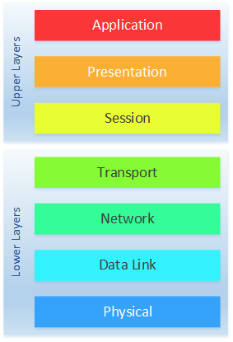
OSI
Most Wi-Fi capture issues live down here!

Slide 7
Discovering Wi-Fi networks
Several ways to detect Wi-Fi networks
Scanning mode detects networks based on advertisements. This is not packet capture and will not show things like clients, etc!
Enterprise AP-assisted discovery is found on some higher-end APs which can scan for interfering APs and adjacent networks
None of these methods get you actual packets though. We want to see those packets. This is Sharkfest afterall!

Slide 8
Getting packets
OK, so how do we get packets?
We can open the interface in Wireshark normally...
You’ll probably get some sort of packets … but...

Slide 9
Lies, and screenshots of lies

Slide 10
Lies and screenshots of lies

Slide 11
Lies and screenshots of lies

Slide 12
Lies and screenshots of lies

Slide 13
Ethernet!?
The OS presents the Wi-Fi card as an Ethernet device, because things know how to treat an Ethernet card
Data packets on Wi-Fi can hold the same content as Ethernet, so it makes sense
This only gets us data packets, and usually only from your connection. And broadcast. Depending on your driver.
There's a lot more to Wi-Fi than just data.
There’s even more to Wi-Fi data packets than just data!

Slide 14
What we really want

Slide 15
Getting to Wi-Fi
So how do we get that?
For traditional NICs there's "promisc" mode which turns off the packet filter, but still returns Ethernet packets
We need a whole other mode of operation
Wi-Fi calls it "Monitor mode" or "rfmon"
The OS won't understand raw 802.11, but Kismet and Wireshark do!
Monitor mode isn't part of the spec, but many drivers support it… with exceptions and some strange behavior, because of course

Slide 16
Getting monitor mode
Now the "fun" part
We need an OS that supports monitor mode
We need a Wi-Fi card with firmware that supports monitor mode
We need drivers that support monitor mode
…
That's a lot of moving pieces
This means the specific chipset of the card matters, not the brand or even the model: manufacturers will change the internal chipset used w/ no change to product name!

Slide 17
Problems with monitor mode
It's not a standard, so it's not required, and may not be consistently implemented
Some Wi-Fi NICs don't implement it at all
Common failure modes including reporting no packets, only data packets, corrupt packets, bogus packets...
Getting monitor mode is easier now than 10 years ago, but still has challenges
Kismet solves it automatically whenever possible

Slide 18
Missing firmware modes
Most prevalent on mobile chipsets
Also found on chipsets like those in the Raspberry Pi
Projects to replace the missing monitor mode – nextmon solves it for Broadcom (rpi, etc)

Slide 19
Bogus packets
Wi-Fi packets have a checksum
You'd think this would be enough to solve this...
Some drivers don't report checksums. Just.. At all..
Some only report validity but no checksum - so we have to trust they're doing the right thing
Some report a checksum they calculate from the data in the buffer themselves... defeating the entire purpose

Slide 20
OS support
Start with Linux
If for some reason this isn't an option, OSX can do it with the internal Airport but not typically with any USB adapters
Windows has no good non-commercial solutions
WSL/WSL2 is not a solution

Slide 21
Wi-Fi keeps evolving
Wi-Fi keeps evolving
802.11b, g, a, n, ac, ax
Significant differences and challenges in each iteration
Generally speaking, the newer and faster it is, the harder it is to capture

Slide 22
Total coverage?
As a passive observer, it is impossible to get guaranteed total coverage
Clients and APs will see packets you never do
There are many channels
There is localized interference
Ultimately just have to accept this

Slide 23
Sniffing 11b (and g, and a)
The oldest of the common Wi-Fi standards
Fairly easy to sniff – simple encodings, slow rates
One antenna transmitting – even if your AP has 2, only one is active
If you're in range, you're going to see packets
Quite uncommon to find legacy 11b now...

Slide 24
Modern Wi-Fi
N, AC, AX
MIMO – Multiple In, Multiple Out
Really means: Many antennas working at the same time
More bandwidth!
But much harder to sniff because of spatial components, multipath, etc
Physical location becomes part of the signal due to multiple transmissions forming a packet
Can be much more challenging to sniff data packets

Slide 25
Beamforming, phased array
Next-level sci-fi stuff
Multiple omnidirectional antennas operate out of phase to create an additive directional signal
TL;DR the AP can attempt to beam the signal directly to the user, increasing signal and bandwidth
Terrible news for sniffing data!

Slide 26
Newer hardware
Sniffing newer protocols requires newer hardware
You might see the advertisements of a network due to backwards compatibility
But you'll never see 11n data with an 11g card
Newer Wi-Fi is more complex, which costs more to develop
Fewer companies making it
There's a small handful of 11ac cards which can sniff
As far as I know, one single 11ax card which can sniff (Intel AX200)

Slide 27
Picking for capture
So what are the options for capture?
Depends on operating system

Slide 28
OSX
Capture with the built-in Airport NIC
Nothing else can, at least not in the open source world
No generic USB monitor capability due to drivers on OSX
Apple continually making it harder to add out-of-kernel drivers

Slide 29
Windows
AirPCAP from CACE – but EOL
Some commercial products
WSL can not talk to USB devices
WSL2 is based on HyperV, which does not have USB support
Sometimes another VM can work

Slide 30
Linux
Best chance
Many chipsets work
Intel
Atheros
Mediatek
Raspberry Pi (with patches)
Others
Small / embedded systems can be used for remote capture
LiveCD / USB can work

Slide 31
Cards to avoid
The RTL8812 series of cards is very prevalent
Very cheap
… but very bad.
The drivers are not, and likely never will be, in the kernel
The drivers tend to work – or not work – on any given git commit
If compiling your own kernel drivers isn’t for you, avoid!

Slide 32
LiveCD/USB
Many distributions have a "Live" version which boots without modifying the hard drive
Kali, Pentoo
Typically a quick way to get going
May not have the most current versions of the tools
May require disabling secure boot

Slide 33
Virtual machines
Sometimes work, but generally discouraged
USB devices may work via passthrough
PCI/PCIe/etc will not work
Success with VMWare on Windows
Often the community will refuse to help with VMs due to prevalence of issues

Slide 34
Remote capture
Kismet supports remote capture over TCP
Can capture from any supported device on any OS and send it to a Kismet server running elsewhere
Good option for feeding packets to Kismet on OSX or Windows in WSL from an embedded system, like a Raspberry Pi

Slide 35
When is it worth the hassle?

Slide 36
Do you need monitor?
You don't need monitor when:
Analyzing data traffic from your own laptop (such as looking at HTTP, application traffic, etc)
Looking at broadcast/multicast to/from your own system
Looking at data network-wide at the switch or enterprise AP level

Slide 37
You DO need monitor...
You absolutely DO need monitor mode to:
Capture Wi-Fi layer packets
See access points, including “hidden” ones
See clients
See peer-to-peer Wi-Fi (like Wi-Fi Direct)
Monitor for attacks or denial of service conditions
Audit WEP, WPA, WPS

Slide 38
Kismet

Slide 39
Lets talk about Kismet
Designed to do several things in the Wi-Fi tool space
Manage Wi-Fi cards
Detect different card types
Deal with quirks of getting them into monitor mode automatically
Keep the OS from breaking our setup
Deal with channels
Enumerate networks and clients, and their relationships
More "Network" and "Device" centric than packet centric
Able to talk to any other tools – like Wireshark – that handle packets

Slide 40
Old Kismet
Kismet has been around since 2001
You may be used to it looking like this (especially since a lot of distributions don't update...)

Slide 41
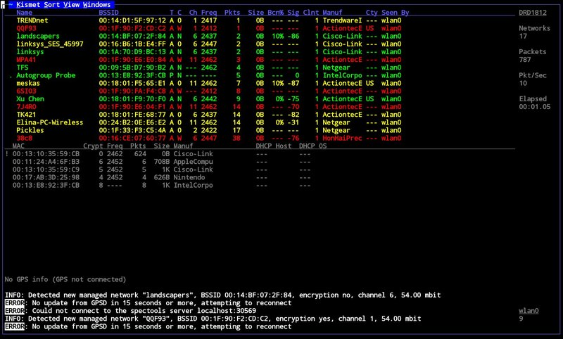

Slide 42
Significantly rewritten
Kismet has had a significant rewrite
Web-based UI
REST and JSON based integration API
New logging system and common logfile
Live packet feeds over HTTP
Seamless remote capture

Slide 43
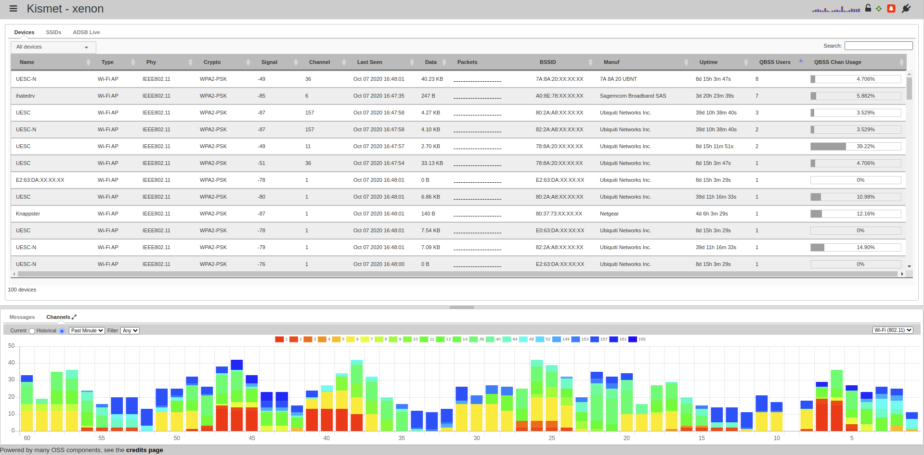

Slide 44
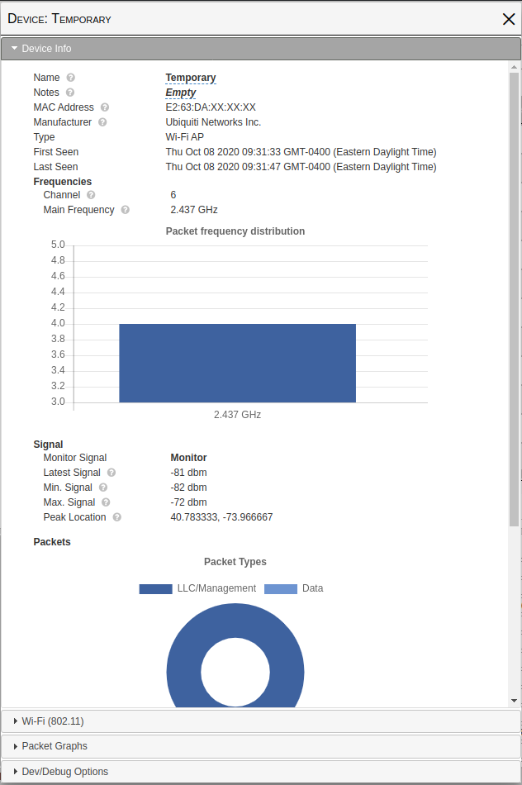
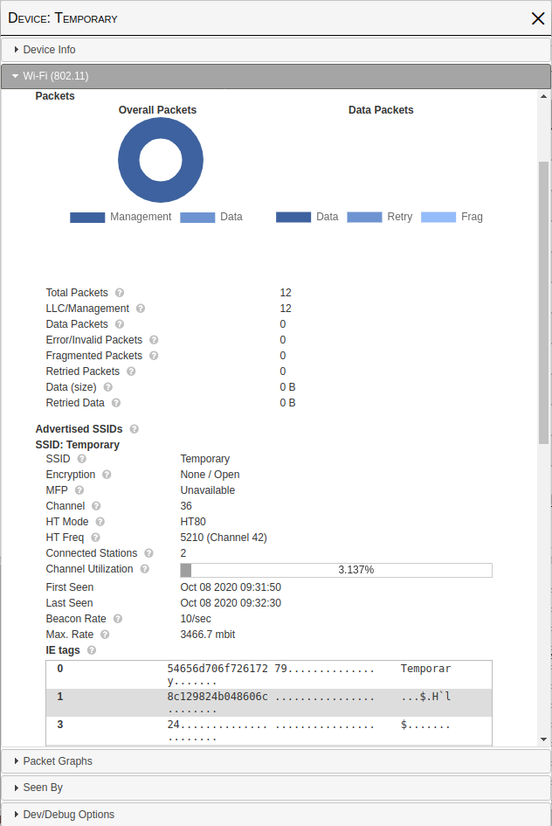

Slide 45
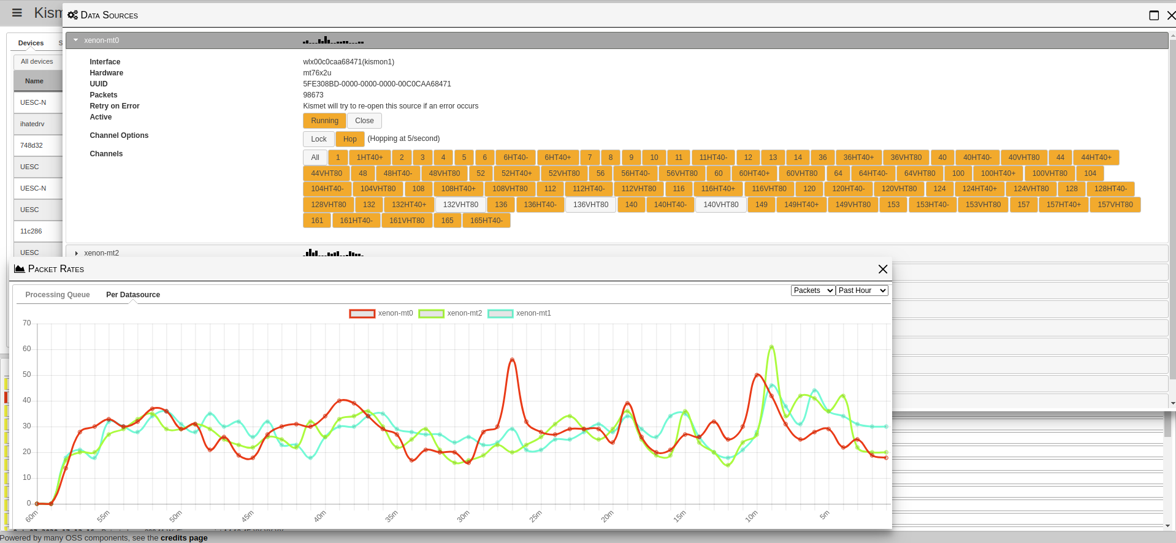

Slide 46
Kismet v Wireshark
Kismet and Wireshark are complementary
You'll certainly want to use both, depending what you're doing!
Wireshark is packet oriented
Kismet is network and device oriented

Slide 47
Traditional pcap
Plug into span port on network
Look at the packets
Maybe worry about vlans

Slide 48
Wireless pcap
What channel?
Is it user-to-user / Wi-Fi Direct?
Is there another AP causing interference?
Did someone bring their own AP from home?
BYOD hotspots?

Slide 49
Kismet packet handling
Wi-Fi has over 45 types of packets
Kismet looks at the contents (like Wireshark) to determine the packet types
But then Kismet sorts them into device, network, related connections, and so on
Tracks interactions between devices – a single client might go to many different access points on different networks within a single monitoring session
Can include geolocation data from GPS or inside the protocols
Can convert multiple packet types from multiple radios into one record

Slide 50
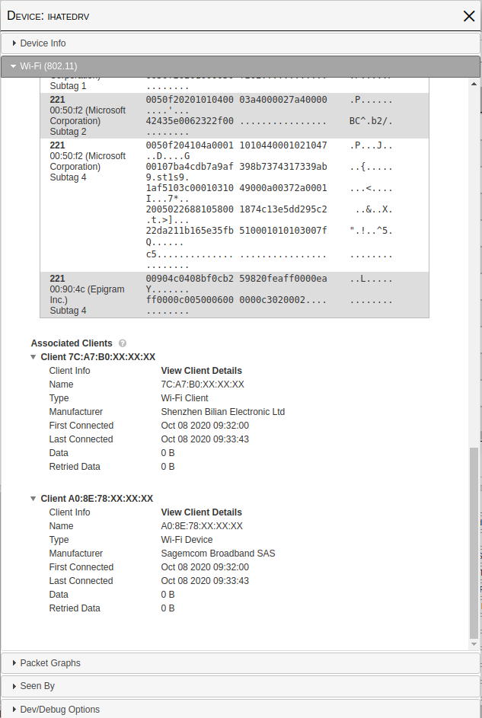
How Kismet sees a network

Slide 51
Data over time
Network representation is from packets over time
Advertisements (beacons) define the network name, encryption, and carry other info
Clients are mapped based on traffic over time
Trend-based security alerts when attributes change

Slide 52
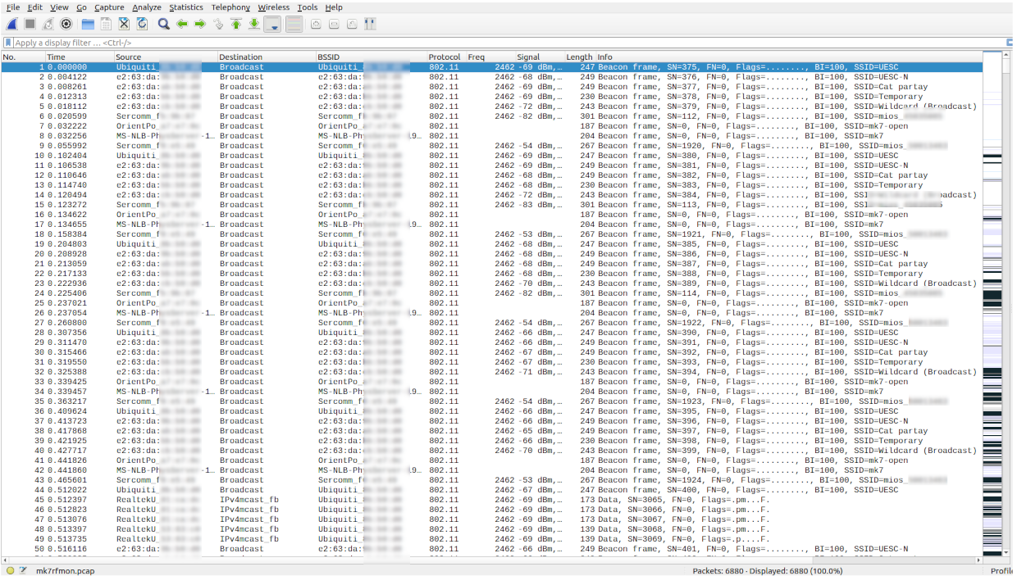
How wireshark sees it

Slide 53
Packet oriented
All the same info (and more!) is in Wireshark
But presented very differently
For example, not immediately obvious what networks a client is associated with
Great for detailed packet analysis, which Kismet is not really meant to do

Slide 54
Packet types
Ethernet has one fundamental packet type – Ethernet
Wi-Fi has 3 primary packet types
… And something like 45 sub-packet types

Slide 55
Management packets
Define a network (Beacons)
Control access to a network (Probes and Responses)
Contain nested lists of data (IE tags) which contain all the information about the network (encryption, SSID, radio reports, and more)

Slide 56
Control packets
Extremely short packets, often with only one MAC address
Used for collision avoidance
Used to reserve the channel for transmit
Used to confirm data received correctly

Slide 57
Data packets
Holds data – like a traditional Ethernet frame
May be L2 encrypted with WPA, etc
May hold L3+ encrypted data (VPN, SSL, etc)

Slide 58
You need all 3
You need to be able to capture all 3 to know what's going on
Without management, you don't know what networks are present
Without control, you can't see hidden nodes, some denial of service attacks, etc
Without data you have no content

Slide 59
Channels and Coverage

Slide 60
“You can see all of the channels, some of the time, or some of the channels, all of the time, but you can’t see all the channels all the time.”
-- PT Barnum

Slide 61
“Don’t trust every quote you read on the Internet”
-- Abraham Lincoln

Slide 62
Why channels matter
Wi-Fi breaks the available radio space up into channels
Some overlap. Some don't.
On 2.4GHz, channels are 22MHz (or 20) wide, but only 5Mhz apart
Sniffing on one channel can get you packets from adjacent channels
Typically 1, 6, 11 are the only channels considered to be non-overlapping for 802.11b/g. It gets far worse with 40MHz channels for 11n!
On 5GHz there are many, many more channels
There's also 40MHz channels for 802.11n
And 80MHz channels for 802.11ac. And 160MHz channels for 802.11ac/ax

Slide 63
Channel challenges
A Wi-Fi radio is designed to tune to a single channel, and strongly exclude other channels to improve signal quality
Typically it can only tune to one "mode" - 20MHz, 40MHz, 80MHz, etc
So if we want to see what's happening across all of the available Wi-Fi, we need to have many radios, or change channels
It's a trade-off: See a little of every channel, a lot of a few channels, or most of a single channel
Like trying to listen to all the songs on the radio by leaving your stereo in 'seek' mode
More channels means less time per channel, or more hardware

Slide 64
Channels, channels, channels
802.11b: 1, 2, 3, 4, 5, 6, 7, 8, 9, 10, 11
802.11g: 1, 2, 3, 4, 5, 6, 7, 8, 9, 10, 11
Some parts of the world add 12, 14
Significant overlap, relatively easy to cover all channels

Slide 65
802.11a
36, 40, 44, 48, 52, 56, 60, 64, 68, 72, 76, 80, 84, 88, 92, 96, 100, 104, 108, 112, 116, 120, 124, 128, 132, 136, 140, 144, 149, 153, 157, 161, 165, 169, 173, 177, 181
38 more channels
Notice the gaps in the numbers? They don't interfere with each other
Better for signal – worse for sniffing. Now we have 4x the channels we need to look at with our radio

Slide 66
802.11n
1, 1HT40+, 2, 3, 4, 5, 6, 6HT40-, 6HT40+, 7, 8, 9, 10, 11, 11HT40-, 36, 36HT40+, 40, 40HT40-, 44, 44HT40+, 48, 48HT40-, 52, 52HT40+, 56, 56HT40-, 60, 60HT40+, 64, 64HT40-, 100, 100HT40+, 104, 104HT40-, 108, 108HT40+, 112, 112HT40-, 116, 116HT40+, 120, 120HT40-, 124, 124HT40+, 128, 128HT40-, 132, 132HT40+, 136, 136HT40-, 140, 140HT40-, 149, 149HT40+, 153, 153HT40-, 157, 157HT40+, 161, 161HT40-, 165, 165HT40-

Slide 67
Wait, what?
How did we get to 64 channels?
802.11n adds 40MHz channels
Above and below (40+ and 40-)
Now we need to look at channel 1 – but also 1HT40+, and 6, but also 6HT40- and 6HT40+

Slide 68
802.11ac
...

Slide 69
91 channels... so far...
1, 1HT40+, 2, 3, 4, 5, 6, 6HT40-, 6HT40+, 7, 8, 9, 10, 11, 11HT40-, 12, 13, 36, 36HT40+, 36VHT80, 40, 40HT40-, 40VHT80, 44, 44HT40+, 44VHT80, 48, 48HT40-, 48VHT80, 52, 52HT40+, 52VHT80, 56, 56HT40-, 56VHT80, 60, 60HT40+, 60VHT80, 64, 64HT40-, 64VHT80, 100, 100HT40+, 100VHT80, 104, 104HT40-, 104VHT80, 108, 108HT40+, 108VHT80, 112, 112HT40-, 112VHT80, 116, 116HT40+, 116VHT80, 120, 120HT40-, 120VHT80, 124, 124HT40+, 124VHT80, 128, 128HT40-, 128VHT80, 132, 132HT40+, 132VHT80, 136, 136HT40-, 136VHT80, 140, 140HT40-, 140VHT80, 144, 144HT40-, 144VHT80, 149, 149HT40+, 149VHT80, 153, 153HT40-, 153VHT80, 157, 157HT40+, 157VHT80, 161, 161HT40-, 161VHT80, 165, 165HT40-

Slide 70
80MHz channels
Now we have 20MHz, 40MHz, 80MHz, and 160MHz channels. And 80+80MHz non-contiguous channels.
80 and 160MHz channels can have many control channels within, expanding the effective number even further

Slide 71
6GHz Wi-Fi
Just added more spectrum in 2020
Not much public HW yet, but adds another 1.2GHz of spectrum
This is more than current 2.4 and 5.8 combined
Likely to be available as many smaller channels and a few much larger channels for very high bandwidth

Slide 72
And yet more
802.11x adds sub-channels dedicated to per-user streams
Some devices support non-standard half (10MHz) and quarter (5MHz) widths, too

Slide 73
More & faster
So we need to change channel, quickly, to see what is going on
We have two choices:
Hop faster. At some point, there is a limit – either the hop is shorter than most packet times, or more likely, the OS/firmware can't keep up
Add more radios. This adds more power, cost, antennas, and possible conflicts

Slide 74
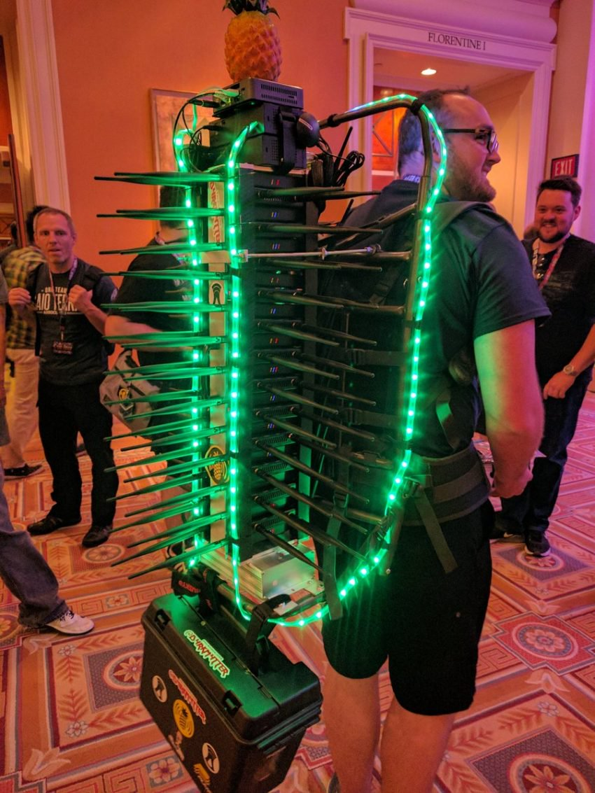

Slide 75
Kismet and multiple NICs
Kismet can run as many NICs as your OS can handle
And many, many more over the network as remote sensors
Practical limits – after 4+ cards, the kernel tends to have a Bad Time with interrupts, timeouts, and locking
Remote sensors have a much higher limit
Still constrained by the CPU and RAM of the system processing the packets

Slide 76
Smarter hopping
Kismet tries to optimize channel hopping:
Scrambling the channels so that we don't hop from one adjacent channel to another, maximizing overlap helping us
Splitting the channel list start between cards, so that multiple cards aren't on the same channel at the same time

Slide 77
Crazy capture setups
Wi-Fi Cactus is 25 Hak5 Tetras, each with 2 802.11abgn radios for 50 capture radios
Remote capture to an Intel i7 NUC
Reported ~515,000 devices in a single session at Defcon
Filled a 2TB SSD every 2 hours
Powered by a lead-acid car battery

Slide 78
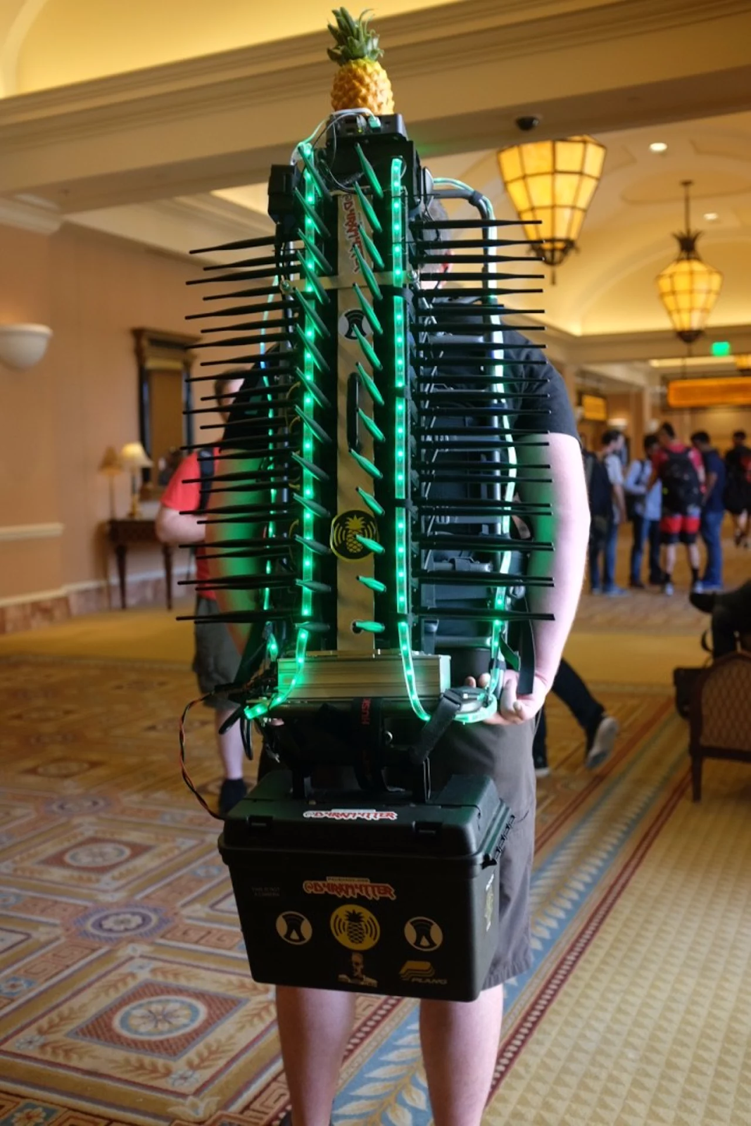
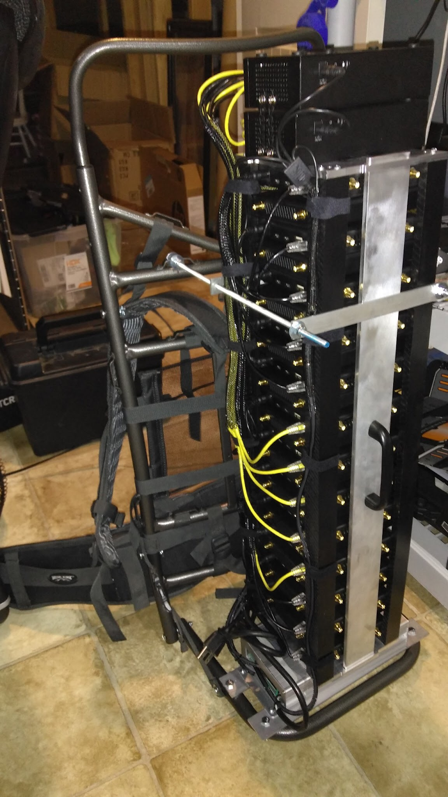

Slide 79
Alftel
Alftel makes many "Interesting" radios
Thunderbolt + PCI expanders + Antenna combiners

Slide 80
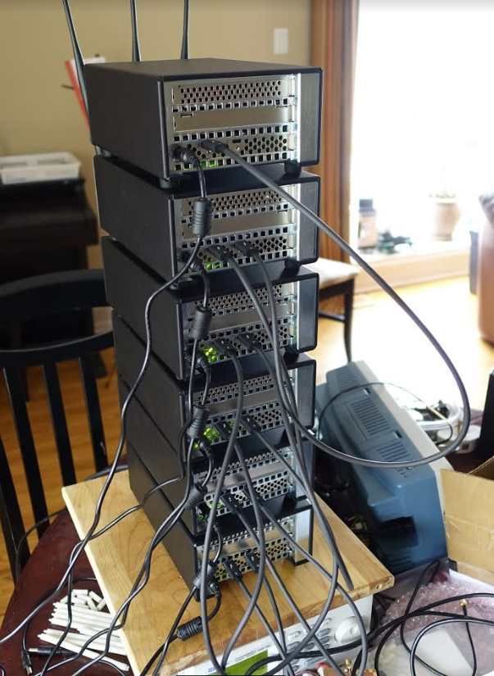
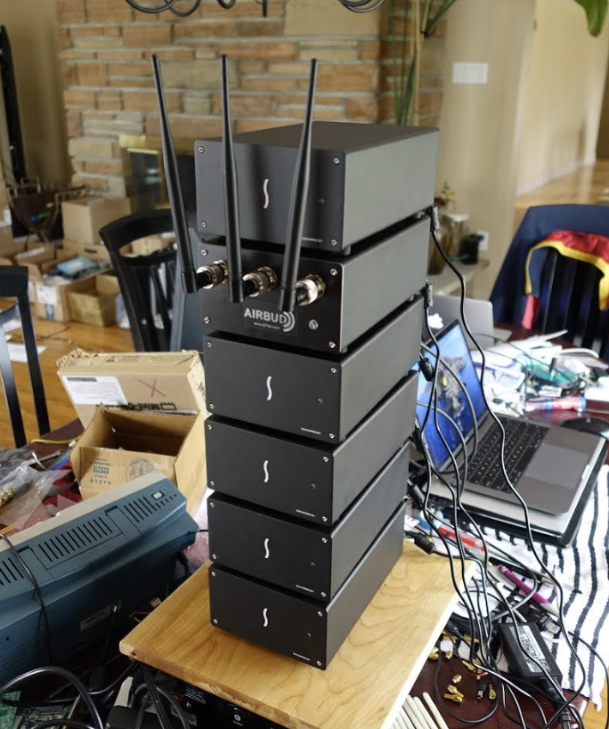

Slide 81
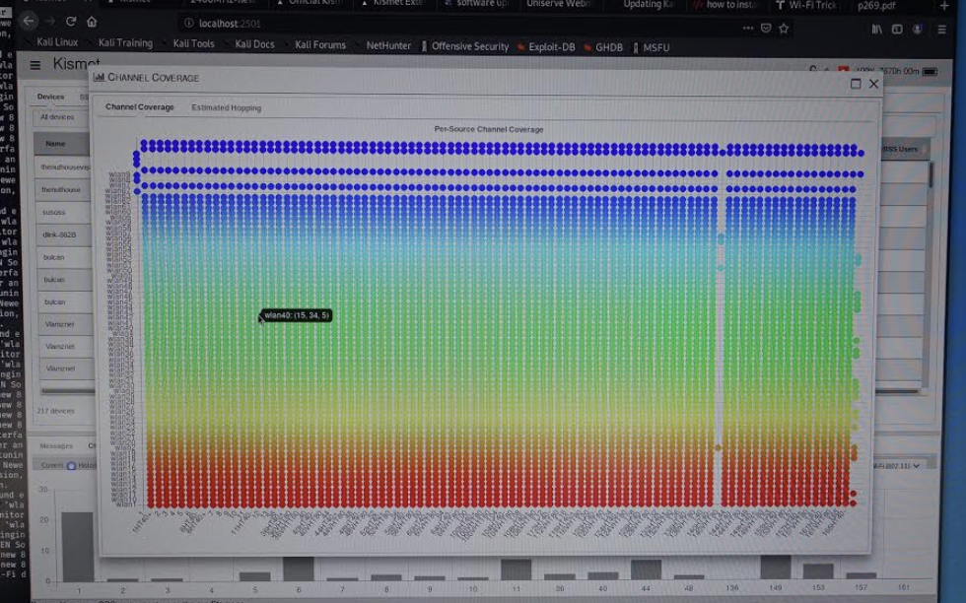
64 802.11ax radios

Slide 82
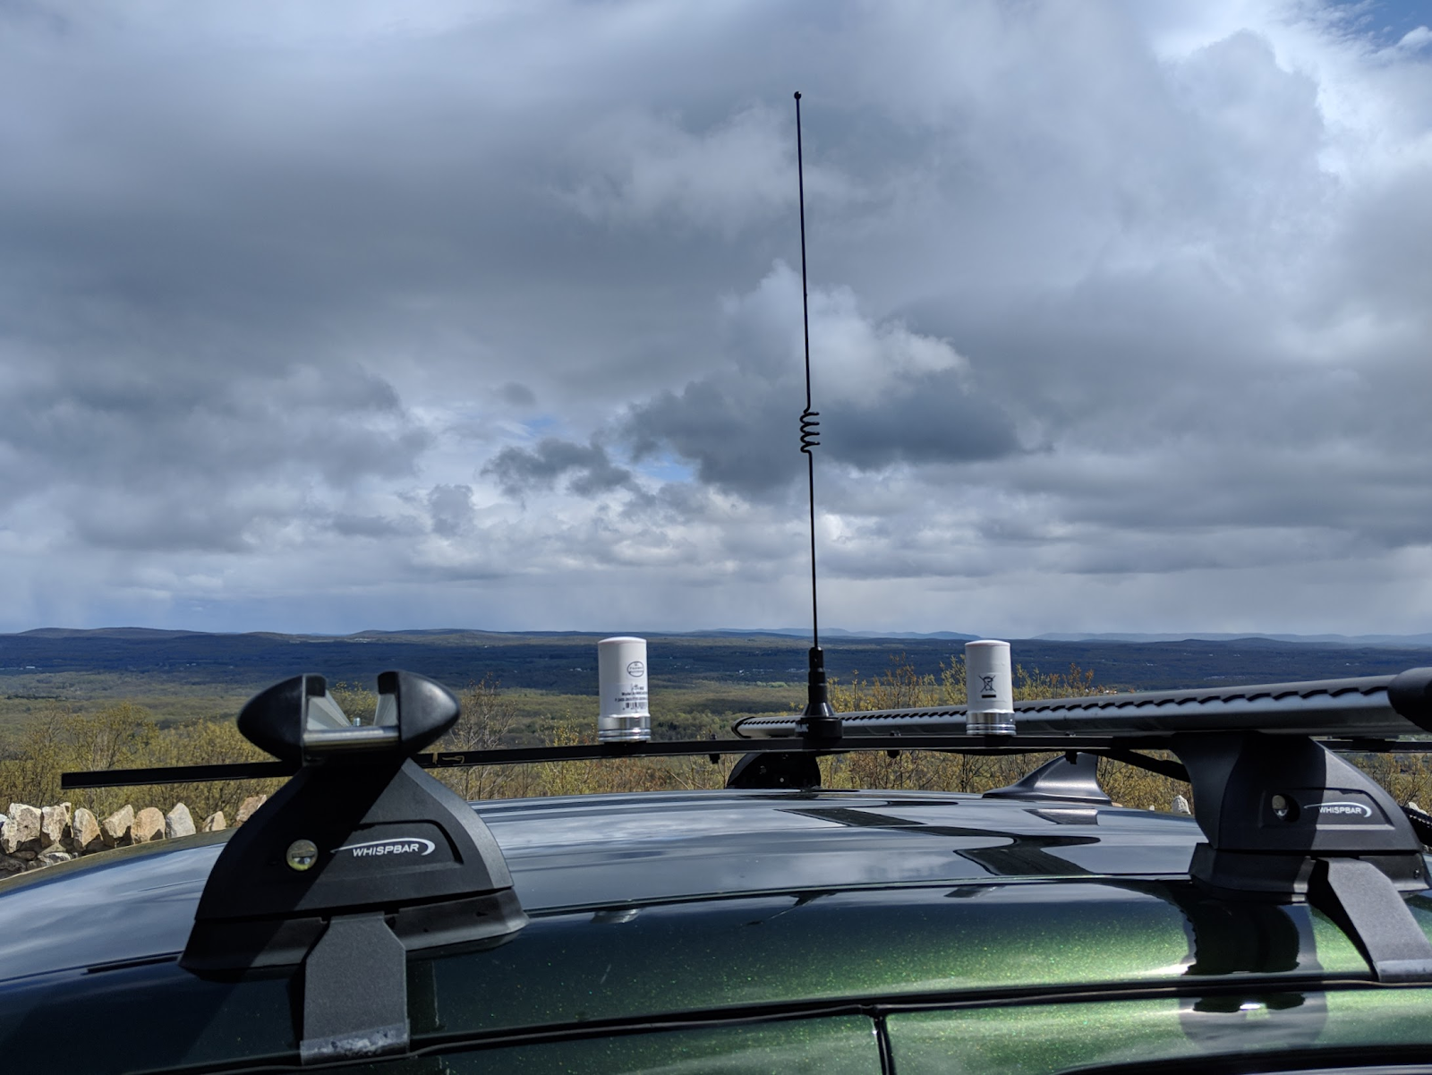
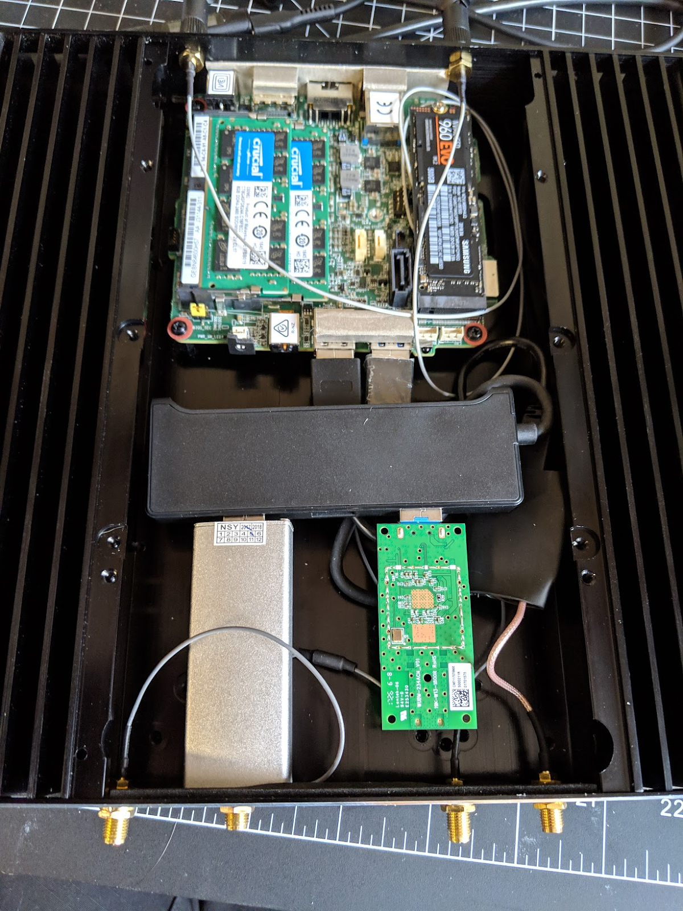
Mobile monitoring

Slide 83
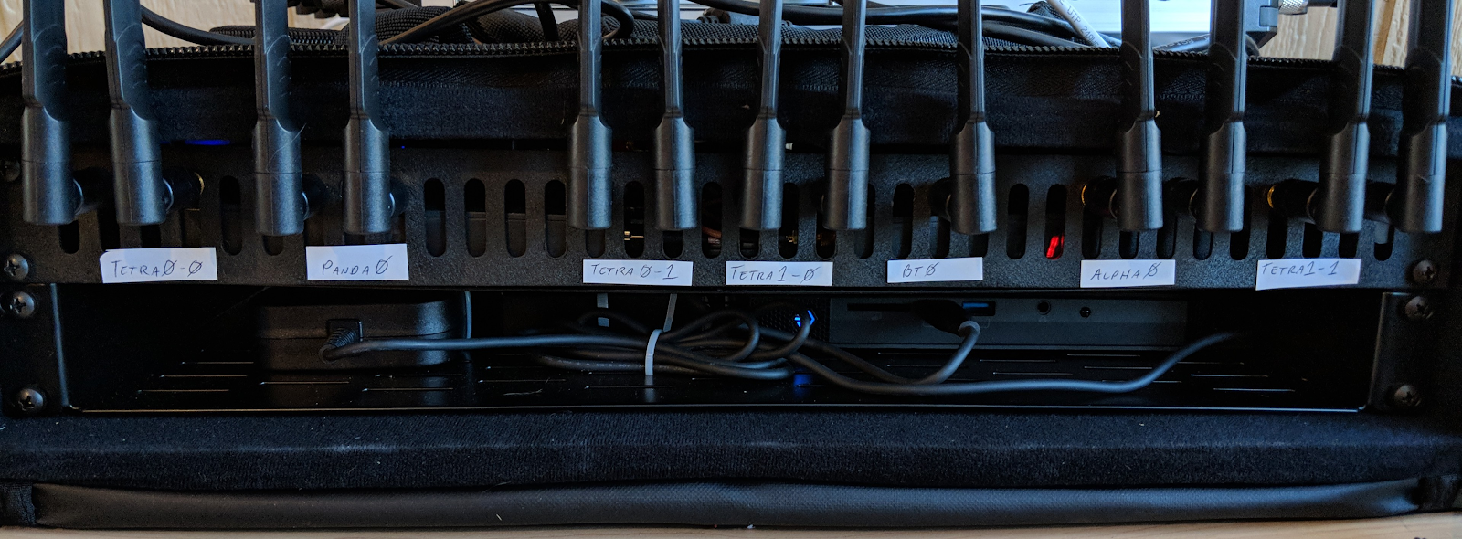
Demo portable rack

Slide 84
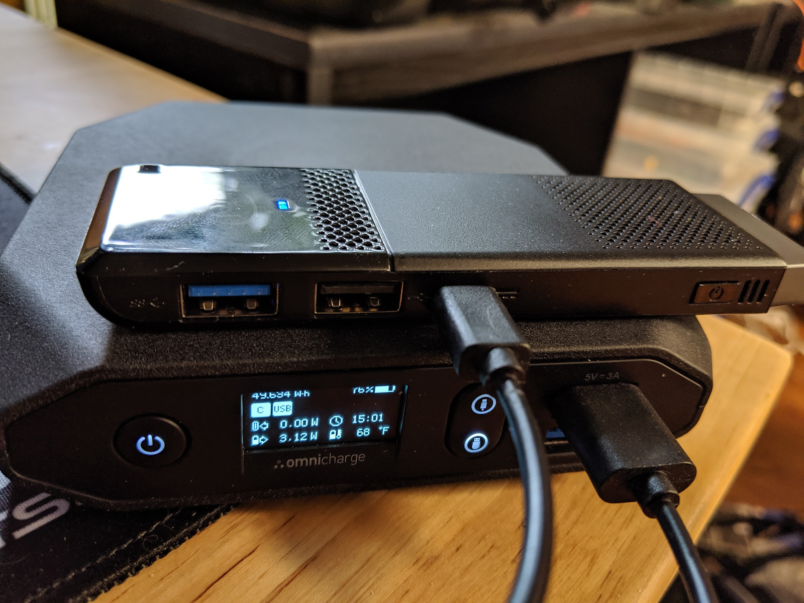
High portability

Slide 85
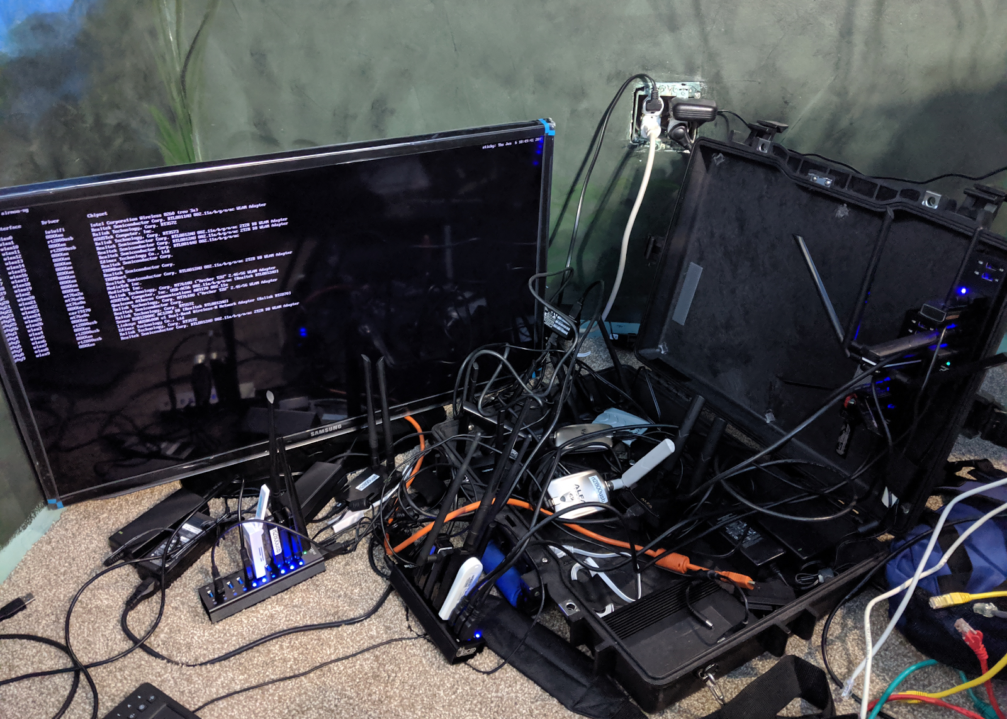
… less portability

Slide 86
Scaling Kismet
Kismet can run on anything from a single-core OpenWRT system with 256MB of RAM...
… Up to however much resources you have
Rules of thumb: About 25,000-40,000 devices per gig of RAM
More CPU always helps

Slide 87
Per session
These limits are per running session.
No reason smaller devices can't be used with something like an hourly rotation
Kismet also has device and log timeout options for long-running sensors

Slide 88
Antennas

Slide 89
Antennas matter!
What antenna you pick matters!
Pick based on what you want to do
Lots of bad marketing out there for antennas
There's always a tradeoff
Antennas don’t add power, they only shape it

Slide 90
Antenna types
Antennas come in 2 basic types
Omnidirectional – effective in all directions (hence "omni")
Directional – most effective in a specific direction, usually from 180 degrees down to a few degrees

Slide 91
Antenna charts
Learn to read antenna charts!
All (reputable/decent) antennas should have a chart showing their power
Typically shown as horizontal and vertical gain
Horiz/Vert or Elevation/Azimuth or XY/Z

Slide 92
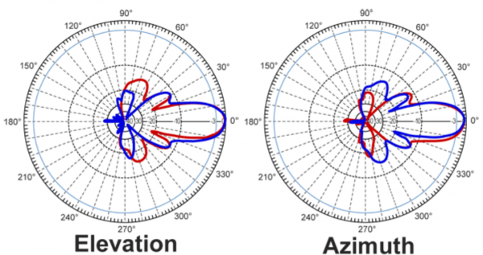
Highly directional

Slide 93
3d plot

Slide 94
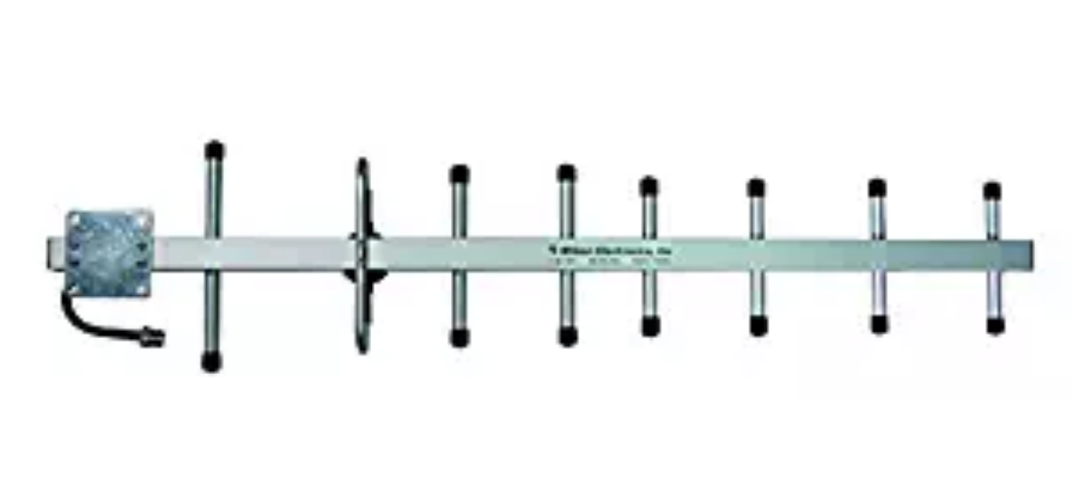
Yagi, etc

Slide 95
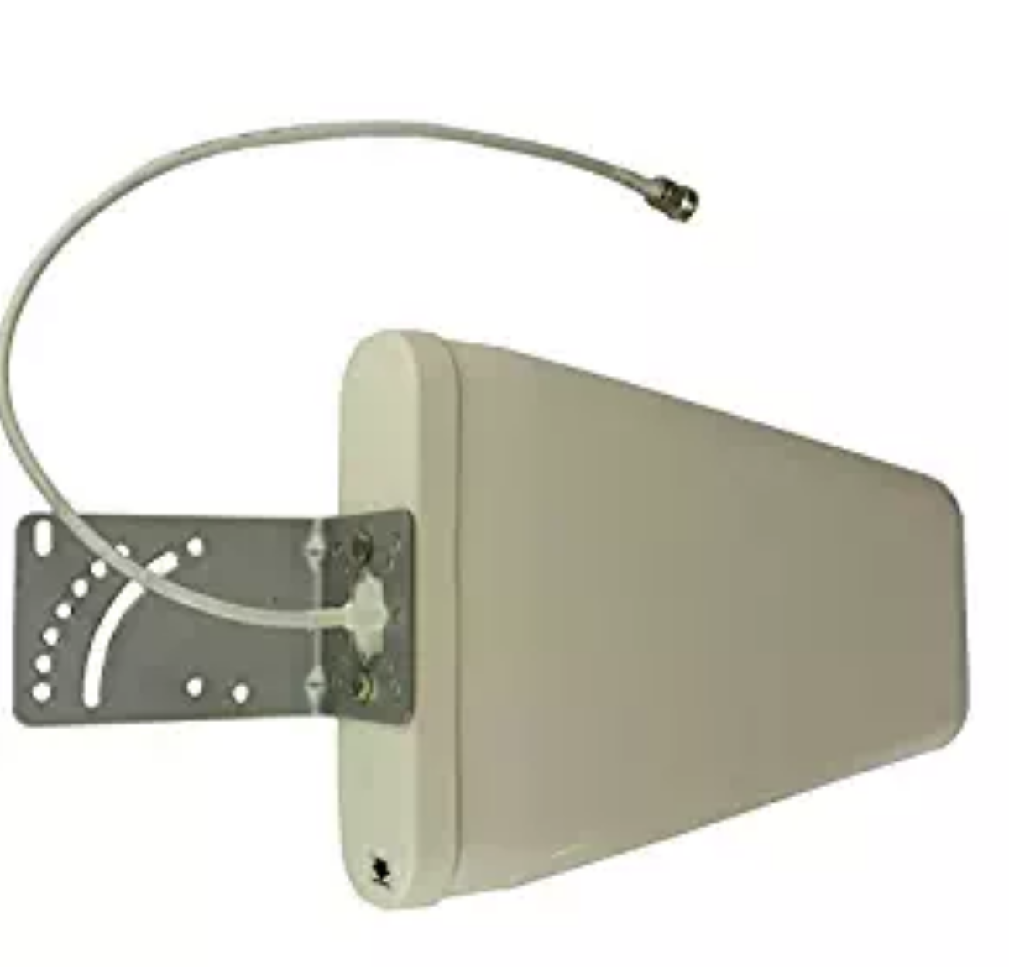
Other styles

Slide 96
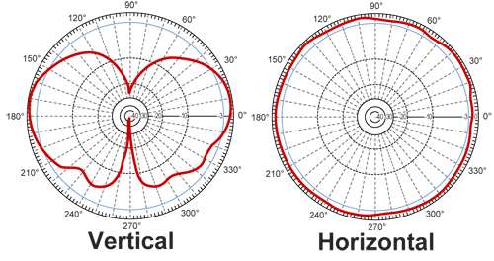
Omnidirectional

Slide 97
3d

Slide 98
Omnis

Slide 99
More gain != more better
"More gain! That's what I need!"
Not always
Increasing gain decreases coverage! Even on omnis!
All those cards on Amazon saying they have "18 db gain" antennas...

Slide 100
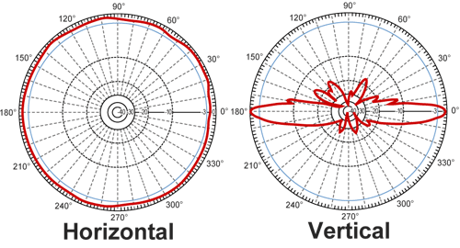
Silly level of gain

Slide 101
Reduced vertical
Reduced vertical gain
Could be reduced to a few feet vertical range
Miss networks on the second floor, or even just on a different shelf!

Slide 102
Other antenna concerns
You need an antenna designed for Wi-Fi
2.4/5.8GHz
50 Ohm
Proper connectors
CB, TV, other antennas are not what you want!

Slide 103
More than just Wi-Fi?

Slide 104
Other things
Lots of other stuff in the airwaves!
Generally requires either:
1. A radio specifically for that protocol
Or
2. A software-defined radio and appropriate software

Slide 105
Non-traditional data
Kismet can handle non-Wi-Fi data
Other radio packet protocols
Stuff that isn't strictly packets
Or has no official standard
Hard to make a pcap definition when it's essentially a manufacturer one-off...

Slide 106
SDR?
Commercial radios (ie, Wi-Fi) are designed for one thing
Low power, fast processing, dedicated chips
Can only see the specific radio band its designed for
Can only handle that exact protocol

Slide 107
SDR?
SDR is a generic digitizer + RF front end
Can handle "any" protocol if there is software for it
The catch? Power hungry, incredibly CPU hungry, expensive, radio isn't as good
Software is quite hard

Slide 108
SDR characteristics
Different HW has different features
Bandwidth – amount of data captured at once
Range – amount of spectrum it can cover
Sample size – 8bit or 16bit
Single or multiple capture options?
More features = $$$, easily $10,000USD+

Slide 109
Cheap-as-dirt
There is one cheap as dirt SDR option
RTL-SDR
Uses a tuner meant for DVB terrestrial TV
It's not a very good SDR
But it is a very very cheap SDR
Can’t see Wi-Fi but can see lots of other stuff

Slide 110
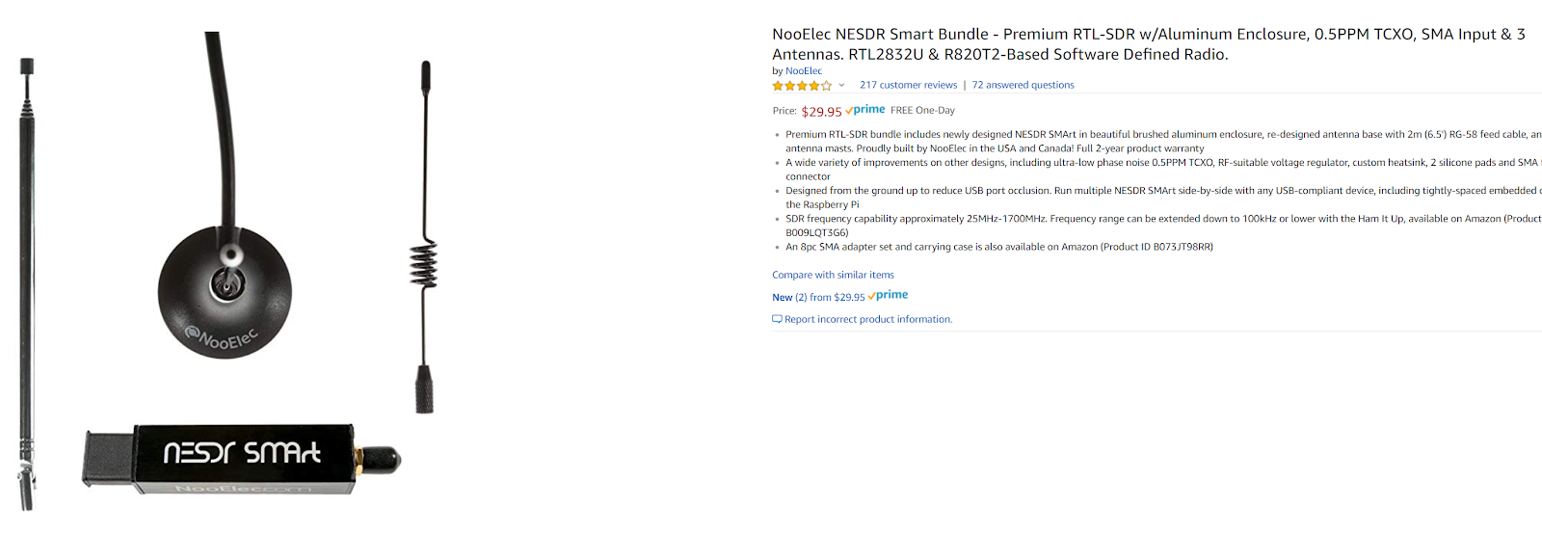
One of the expensive models

Slide 111
So cheap its good
It really is a crap device
But for $20 to see quite a few protocols...
Great way to get into SDR
Kismet can use it for a number of things
Or you can use a number of RTLSDRs at once for multiple protocols

Slide 112
Power meters
Some implement automatic power monitoring protocols
Allows the power company to read them from the street...
Kismet can also decode them!

Slide 113
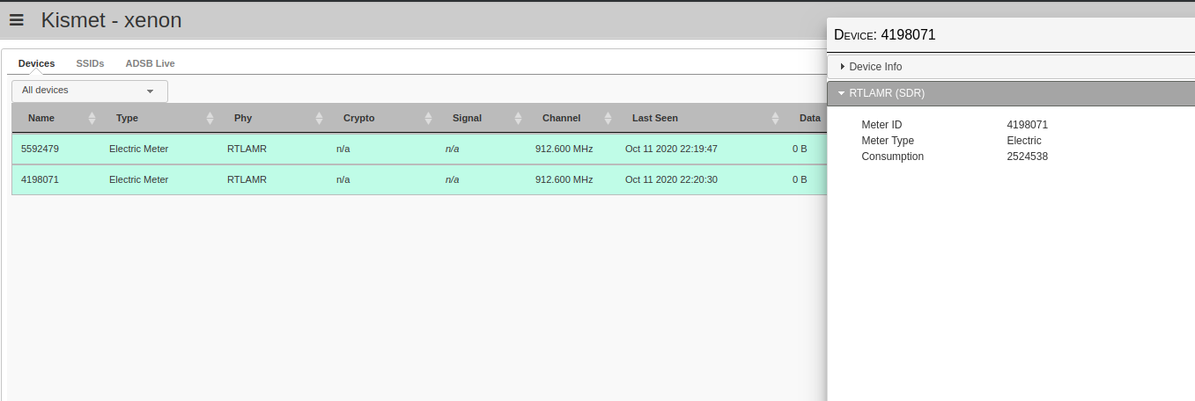
AMR

Slide 114
Weather and temperature
Lots of weather stations have 433mhz radio links to the in-house display
Same for thermometers with a central display

Slide 115
Weather stations

Slide 116
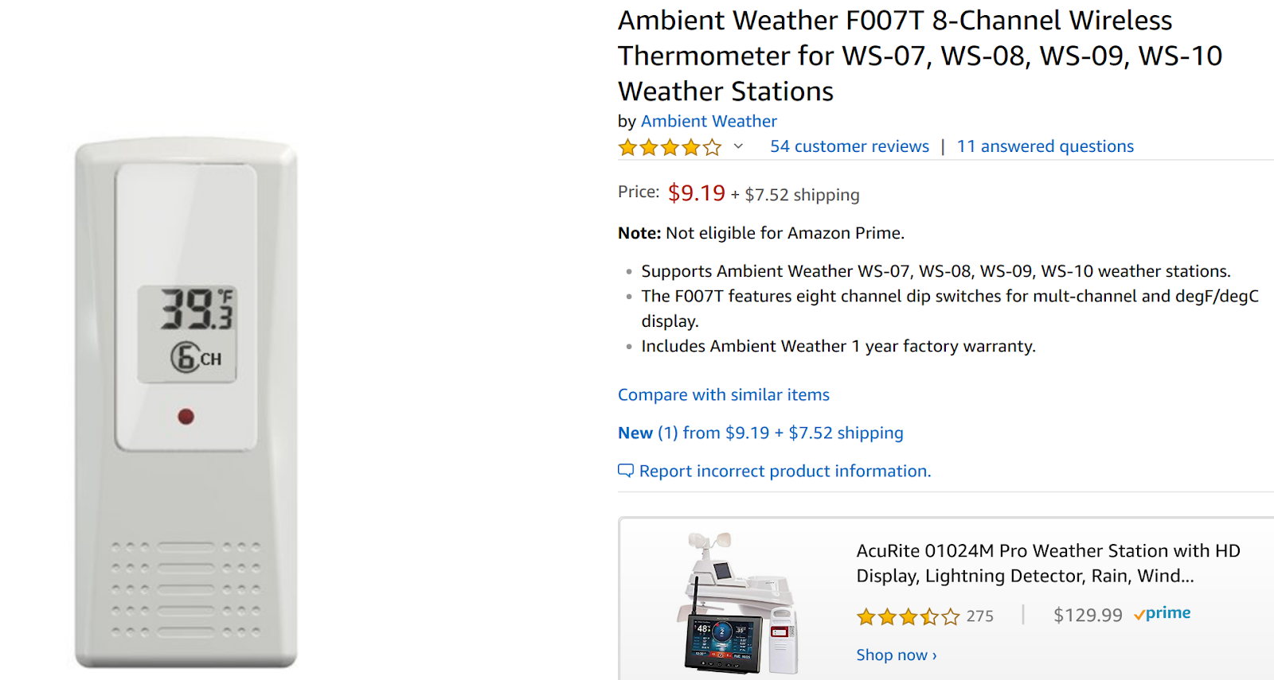
Thermometers

Slide 117
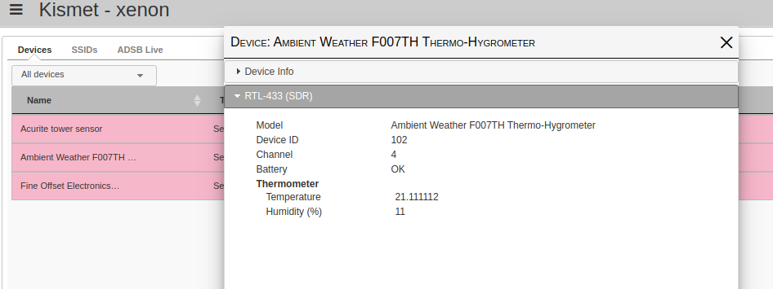
Thermometers

Slide 118
ADSB
FAA mandates planes have an active transponder
ADSB packets include the registration info, callsigns, altitude and direction
How sites like Flightaware work

Slide 119
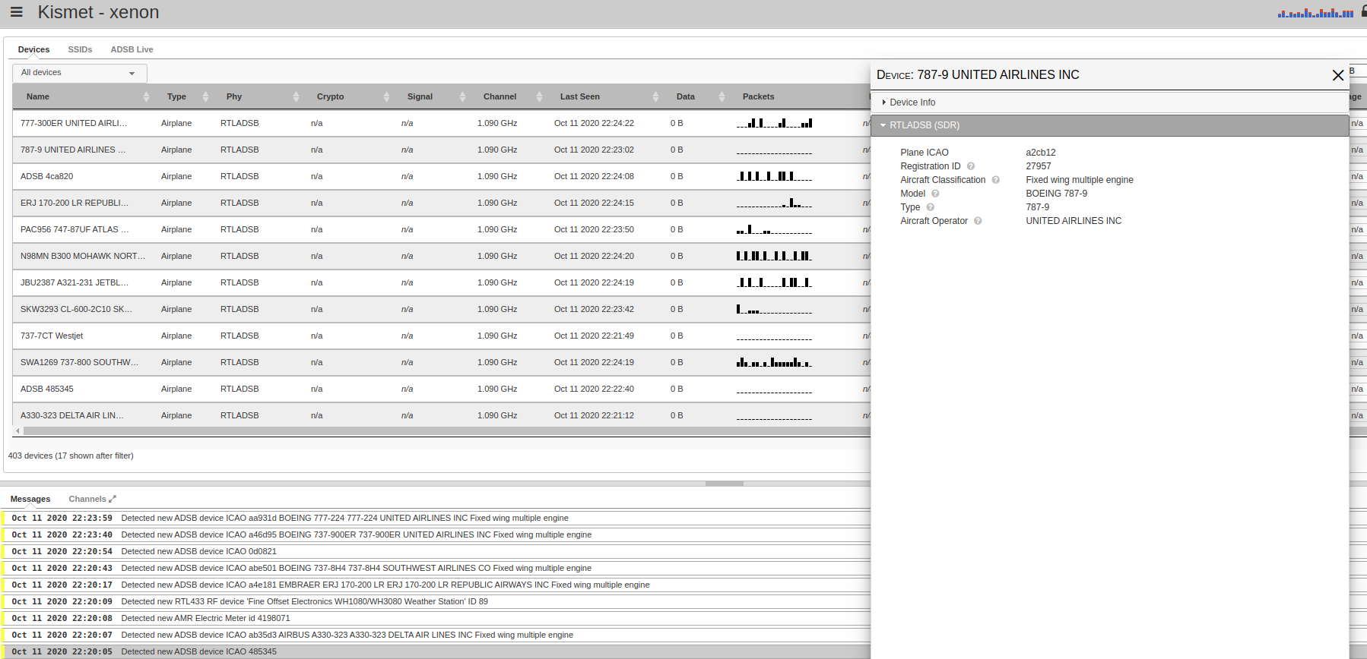
Airplanes!?

Slide 120
More planes!

Slide 121
Decoding SDR
SDR reports data as a constant stream of "IQ"
Gives power and phase of the signal
Can be used to decode radio signal
Fairly complex to identify packets among the noise and conflicting data
Usually takes a lot of CPU

Slide 122
Bluetooth
Much harder to sniff than Wi-Fi
Kismet can detect advertising devices with hci
Can sniff BTLE with Ubertooth, TICC2540, NXP, Others

Slide 123
BT

Slide 124
Zigbee
Can capture with Freaklabs, TICC2531, others
Can't currently display
CAN log pcaps of zigbee

Slide 125
Keyboards
Can detect some wireless keyboards
Logitech, Microsoft, etc use nRF chipset
Can be sniffed
Uses Mousejack firmware, crazyPA radio, and others

Slide 126
Detecting Shenanigans

Slide 127
Kismet as a WIDS
WIDS = Wireless Intrusion Detection System
Can detect attacks, denial of service, other weirdness
Does not attempt to prevent – often not even possible

Slide 128
Wi-Fi attacks
Very large attack surface
Denial of Service
Spoofing/impersonation
Attacks against drivers

Slide 129
Kismet alerts
Three main types of alerts
1. Trend based alerts. Strange/broken behavior over time, like denial of service attacks
2. Signature based alerts. Specific bad packets like attempts to overflow buffers in drivers
3. User-configured fingerprints

Slide 130
Example detections
Encryption options changing on a known AP
Regex-based AP spoof detection; find SSIDs similar to the official one
Fingerprinting of attacks against drivers, like Broadpwn
Detection of brute force attempts against WEP, WPS, etc

Slide 131
The more we have...
The more data we have...
The more we can look for discrepencies
Advertised encryption
Other vendor-specific flags

Slide 132
BTLE attacks
Super new – announced yesterday!
Just added detections in kismet-git for BleedingTooth
New kernel code execution vuln in Linux/Android
First Kismet WIDS alert for Bluetooth

Slide 133
Talking to other tools

Slide 134
No tool is an island
Several APIs to talk to other tools
Tools for converting log files for other tools
Old Kismet had a custom TCP protocol
New Kismet talks http, json, etc!

Slide 135
REST-like API
Everything in the UI comes from the REST-like API
Any language that can talk http/https and JSON
Heavily documented on the Kismet website

Slide 136
Pcap over HTTP
Kismet can generate a live pcapng stream over HTTP
Also filter by device, or AP, or capture card
Also able to return packets from the current logfile

Slide 137
HTTP proxy
Since Kismet is just HTTP...
You can proxy it through nginx
Tunnel over ssh
Add SSL via LetsEncrypt...

Slide 138
Kismetdb logs
Old logs were split into multiple files and had to be correlated manually
New logs are sqlite3 databases
Packets, device JSON, messages, configuration info, trends, alerts, etc all logged

Slide 139
Simple to process
Tools already for converting to pcap, pcapng, wigle csv, json, and more
Any language that can talk sqlite and json can do complex filtering

Slide 140
Historic live data!
Now that logs are random-accessible...
We can return things live that occurred in the past!
Now Kismet can do things like provide a pcap stream of the packets surrounding an alert

Slide 141
Plugins
Kismet can have several types of plugins
C++ native code compiled as a .so can do anything Kismet can do already
External helper tools communicating over IPC can do packet capture, web serving, and receive events
Web-only plugins can add new interfaces

Slide 142
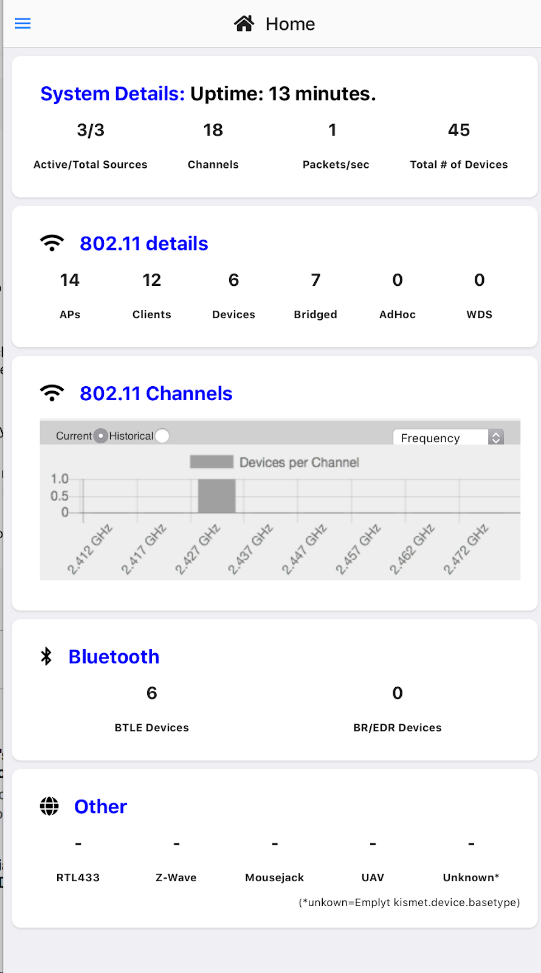
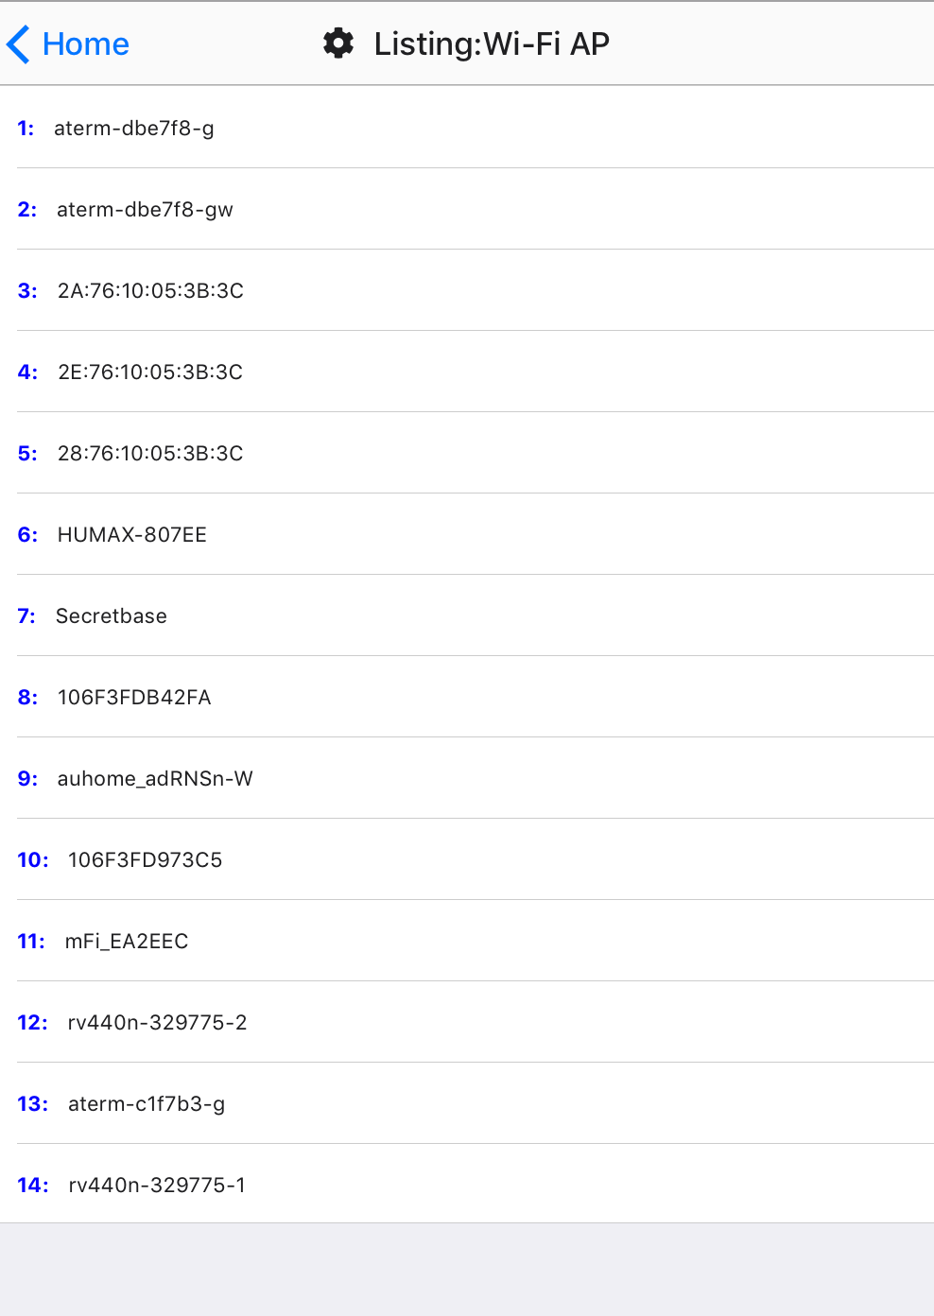

Slide 143
What's next
More WIDS features
Websockets for faster UI and simpler remote capture
More capture sources

Slide 144
Where to find it
https://www.kismetwireless.net
Links to packages, the Kismet discord, documentation, and more are there
@kismetwireless on twitter for release infonw

