Slide 1
Visualizing TLS Encryption
Ross Bagurdes
Bagurdes Technology LLC

Slide 2
Session Topics
SSL vs TLS
Encrypting Data
DH Key Exchange
Data Encryption Protocols
Decrypting TLS in Wireshark

Slide 3
https://tinyurl.com/y388zy8r

Slide 4
Web Browser Encryption

Slide 5
Web Browser Encryption
Negotiate Encryption Session
Secure Socket Layer (SSL)
Transport Layer Security (TLS)
Encryption Protocols
RSA
Diffie Hellman
ECDHE
3DES
AES
ChaCha20

Slide 6
Web Browser Encryption
Negotiate Encryption Session
Secure Socket Layer (SSL)
Transport Layer Security (TLS)
Encryption Protocols
RSA
Diffie Hellman
ECDHE
3DES
AES
ChaCha20

Slide 7
Web Browser Encryption
Negotiate Encryption Session
Secure Socket Layer (SSL)
Transport Layer Security (TLS)
Encryption Protocols
RSA
Diffie Hellman
ECDHE
3DES
AES
ChaCha20

Slide 8
1994
Netscape Navigator

Slide 9
1994
SSLv2
Netscape Navigator

Slide 10
1995
SSLv3
Netscape Navigator

Slide 11
1995
Netscape Navigator
SSLv3

Slide 12
1995
Netscape Navigator
SSLv3

Slide 13
1995
Netscape Navigator
SSLv3

Slide 14
Shall We Play a Game?

Slide 15
1999
Netscape Navigator
SSLv3
TLS
TLS v1.2
TLS v1.3

Slide 16
1999
TLS
Netscape Navigator
TLS v1.2
TLS v1.3
SSLv3

Slide 17
Current TLS Versions
TLS
TLS v1.2
TLS v1.3

Slide 18
Data Encryption Basics

Slide 19
Encrypting Communication
HTTPs Client
HTTPs Server

Slide 20
Encrypting Communication
HTTPs Client
HTTPs Server
+

Slide 21
Encrypting Communication
HTTPs Client
HTTPs Server
+

Slide 22
Encrypting Communication
HTTPs Client
HTTPs Server
+

Slide 23
Encrypting Communication
HTTPs Client
HTTPs Server

Slide 24
Encrypting Communication
HTTPs Client
HTTPs Server
secretkey
secretkey

Slide 25
Encrypting Communication
HTTPs Client
HTTPs Server
+

Slide 26
Encrypting Communication
HTTPs Client
HTTPs Server
+

Slide 27
Encrypting Communication
HTTPs Client
HTTPs Server
+

Slide 28
Encrypting Communication
HTTPs Client
HTTPs Server

Slide 29
Encrypting Communication
HTTPs Client
HTTPs Server

Slide 30
TLS Encryption
Data Encryption
Key Exchange
Handshake Integrity

Slide 31
TLS Encryption
Key Exchange
Data Encryption
Handshake Integrity

Slide 32
Diffie-Hellman Key Exchange
HTTPs Client
HTTPs Server

Slide 33
Diffie-Hellman Key Exchange
HTTPs Client
HTTPs Server

Slide 34
Diffie-Hellman Key Exchange
HTTPs Client
HTTPs Server
p = 149
g = 17

Slide 35
Diffie-Hellman Key Exchange
HTTPs Client
HTTPs Server
p = 149
g = 17

Slide 36
Diffie-Hellman Key Exchange
p = 149
g = 17
HTTPs Client
HTTPs Server
Public
Key
a = 8
Private
Key

Slide 37
Diffie-Hellman Key Exchange
p = 149
g = 17
HTTPs Client
HTTPs Server
a = 8
Private
Key

Slide 38
Diffie-Hellman Key Exchange
p = 149
g = 17
HTTPs Client
HTTPs Server
a = 8
gª MOD p = encrypted key
Private
Key

Slide 39
Quick Math Lesson

Slide 40
95/8

Slide 41
95/8
“95 divided by 8”

Slide 42
95/8
“95 divided by 8”
8
95

Slide 43
95/8
“95 divided by 8”
8
95

Slide 44
95/8
“95 divided by 8”
1
8
95

Slide 45
95/8
“95 divided by 8”
1
8
95
8

Slide 46
95/8
“95 divided by 8”
1
8
95
8
15

Slide 47
95/8
“95 divided by 8”
1
1
8
95
8
15

Slide 48
95/8
“95 divided by 8”
1
1
8
95
8
15
8

Slide 49
95/8
“95 divided by 8”
1
1
8
95
8
15
8
7

Slide 50
95/8
“95 divided by 8”
1
1
.####
8
95
8
15
8
7
7

Slide 51
95/8
“95 divided by 8”
R 7
1
7
1
8
95
8
15
8
7

Slide 52
95/8
“95 divided by 8”
Modulus
R 7

Slide 53
95/8
“95 divided by 8”
Modulus
7

Slide 54
Diffie-Hellman Key Exchange
p = 149
g = 17
HTTPs Client
HTTPs Server
a = 8
gª MOD p = encrypted key
Private
Key

Slide 55
Diffie-Hellman Key Exchange
p = 149
g = 17
HTTPs Client
HTTPs Server
a = 8
gª MOD p = encrypted key
Private
Key
17⁸ MOD 149 =
5

Slide 56
Diffie-Hellman Key Exchange
p = 149
g = 17
HTTPs Client
HTTPs Server
a = 8
5
Private
Key

Slide 57
Diffie-Hellman Key Exchange
p = 149
g = 17
HTTPs Client
HTTPs Server
a = 8
5
Private
Key

Slide 58
Diffie-Hellman Key Exchange
a = 8
Private
Key
p = 149
g = 17
HTTPs Client
HTTPs Server
5

Slide 59
Diffie-Hellman Key Exchange
a = 8
5
Private
Key
p = 149
g = 17
Encrypted
Key
HTTPs Client
HTTPs Server
b = 6
Private
Key

Slide 60
Diffie-Hellman Key Exchange
a = 8
5
Private
Key
p = 149
g = 17
Encrypted
Key
HTTPs Client
HTTPs Server
b = 6
g^{b} MOD p = encrypted key
Private
Key

Slide 61
Diffie-Hellman Key Exchange
a = 8
5
Private
Key
p = 149
g = 17
Encrypted
Key
HTTPs Client
HTTPs Server
b = 6
g^{b} MOD p = encrypted key
Private
Key
17⁶ MOD 149 =
16

Slide 62
Diffie-Hellman Key Exchange
a = 8
5
Private
Key
p = 149
g = 17
Encrypted
Key
HTTPs Client
HTTPs Server
16
b = 6
Private
Key

Slide 63
Diffie-Hellman Key Exchange
a = 8
5
Private
Key
p = 149
g = 17
Encrypted
Key
HTTPs Client
HTTPs Server
16
b = 6
Encrypted
Key
Private
Key

Slide 64
Diffie-Hellman Key Exchange
p = 149
g = 17
HTTPs Client
HTTPs Server
a = 8
16
5
b = 6
Private
Key
Encrypted
Key
Encrypted
Key
Private
Key

Slide 65
p = 149
g = 17
HTTPs Client
HTTPs Server
a = 8
16
5
b = 6
Private
Key
Encrypted
Key
Encrypted
Key
Private
Key
(enc key)ª MOD p = key
(enc key)^{b} MOD p = key

Slide 66
p = 149
g = 17
HTTPs Client
HTTPs Server
a = 8
16
5
b = 6
Private
Key
Encrypted
Key
Encrypted
Key
Private
Key
(enc key)ª MOD p = key
(enc key)^{b} MOD p = key
129
16⁸ MOD 149 =

Slide 67
p = 149
g = 17
HTTPs Client
HTTPs Server
a = 8
16
5
b = 6
Private
Key
Encrypted
Key
Encrypted
Key
Private
Key
(enc key)ª MOD p = key
(enc key)^{b} MOD p = key
129
129
16⁸ MOD 149 =
5⁶ MOD 149 =

Slide 68
p = 149
g = 17
HTTPs Client
HTTPs Server
a = 8
16
5
b = 6
Private
Key
Encrypted
Key
Encrypted
Key
Private
Key
129
129
Key
Key

Slide 69
Diffie-Hellman Key Exchange
HTTPs Client
HTTPs Server
129
129

Slide 70
TLS Encryption
Key Exchange
Data Encryption
Handshake Integrity

Slide 71
TLS Encryption
TLS v1.2
TLS v1.3
Key Exchange
Data Encryption
Handshake Integrity
RSA
Diffie Hellman
Elliptical Curve
Diffie Hellman
RSA
Diffie Hellman
Elliptical Curve
Diffie Hellman

Slide 72
TLS Encryption
TLS v1.2
TLS v1.3
Key Exchange
Data Encryption
Handshake Integrity
RSA
Diffie Hellman
Elliptical Curve
Diffie Hellman
Elliptical Curve
Diffie Hellman

Slide 73
TLS Encryption
TLS v1.2
TLS v1.3
Key Exchange
Data Encryption
Handshake Integrity
RSA
Diffie Hellman
Elliptical Curve
Diffie Hellman
Elliptical Curve
Diffie Hellman

Slide 74
TLS Encryption
TLS v1.2
TLS v1.3
Key Exchange
Data Encryption
Handshake Integrity
RSA
Diffie Hellman
Elliptical Curve
Diffie Hellman
Elliptical Curve
Diffie Hellman

Slide 75
TLS Encryption
TLS v1.2
TLS v1.3
Key Exchange
Data Encryption
Handshake Integrity
RSA
Diffie Hellman
Elliptical Curve
Diffie Hellman
Elliptical Curve
Diffie Hellman

Slide 76
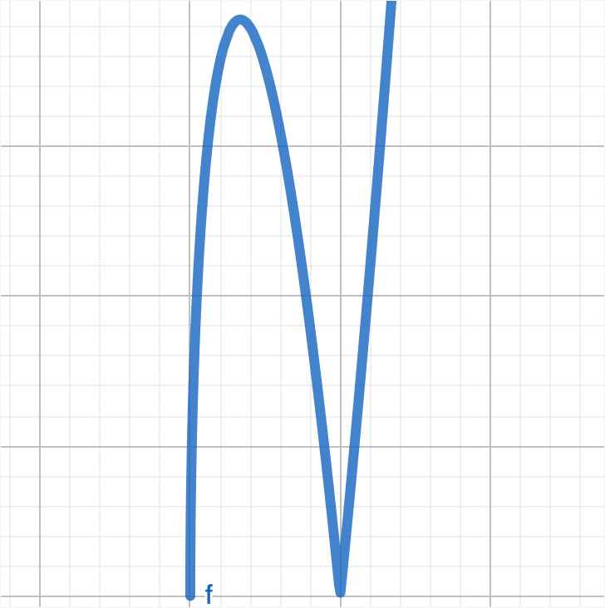
Elliptical Curve Diffie-Hellman Ephemeral

Slide 77
Elliptical Curve
Curve Types
x25519
secp256r1
secp284r1
fecp521r1
ffdhe2048
ffdhe3073

Slide 78
Elliptical Curve
Curve Types
x25519
secp256r1
secp284r1
fecp521r1
ffdhe2048
ffdhe3073

Slide 79
TLS 1.3 DHECE Key Exchange
HTTPs Client
HTTPs Server

Slide 80
TLS 1.3 DHECE Key Exchange
HTTPs Client
HTTPs Server
Private Key
af49806d618a8e0055727d1ea3fcf37776ea990627975a44d43165c09fb82e61

Slide 81
TLS 1.3 DHECE Key Exchange
HTTPs Client
Private Key
HTTPs Server
af49806d618a8e0055727d1ea3fcf37776ea990627975a44d43165c09fb82e61

Slide 82
TLS 1.3 DHECE Key Exchange
HTTPs Client
Private Key
HTTPs Server
af49806d618a8e0055727d1ea3fcf37776ea990627975a44d43165c09fb82e61
500fb57e7b13fbaa8fa2630f79481db38c7189ef2ee10ab32797bcf9d8243753

Slide 83
TLS 1.3 DHECE Key Exchange
HTTPs Client
Private Key
HTTPs Server
af49806d618a8e0055727d1ea3fcf37776ea990627975a44d43165c09fb82e61
Public Key
500fb57e7b13fbaa8fa2630f79481db38c7189ef2ee10ab32797bcf9d8243753

Slide 84
TLS 1.3 DHECE Key Exchange
HTTPs Client
Private Key
HTTPs Server
af49806d618a8e0055727d1ea3fcf37776ea990627975a44d43165c09fb82e61
Public Key
500fb57e7b13fbaa8fa2630f79481db38c7189ef2ee10ab32797bcf9d8243753

Slide 85
TLS 1.3 DHECE Key Exchange
Private Key
HTTPs Client
HTTPs Server
Public Key

Slide 86
TLS 1.3 DHECE Key Exchange
Private Key
HTTPs Client
HTTPs Server
Public Key

Slide 87
TLS 1.3 DHECE Key Exchange
Private Key
HTTPs Client
HTTPs Server
Public Key

Slide 88
TLS 1.3 DHECE Key Exchange
Public Key
Private Key
HTTPs Client
HTTPs Server

Slide 89
TLS 1.3 DHECE Key Exchange
Public Key
Private Key
Private Key
HTTPs Client
HTTPs Server
Public Key

Slide 90
TLS 1.3 DHECE Key Exchange
Public Key
Private Key
Private Key
HTTPs Client
HTTPs Server
Public Key

Slide 91
TLS 1.3 DHECE Key Exchange
Public Key
Public Key
Private Key
Private Key
HTTPs Client
HTTPs Server

Slide 92
TLS 1.3 DHECE Key Exchange
HTTPs Client
HTTPs Server
Public Key
Public Key
Private Key
Private Key

Slide 93
TLS 1.3 DHECE Key Exchange
HTTPs Client
HTTPs Server
Private Key
Public Key
Public Key
Private Key

Slide 94
TLS 1.3 DHECE Key Exchange
HTTPs Client
HTTPs Server

Slide 95
TLS 1.3 DHECE Key Exchange
HTTPs Client
HTTPs Server
Application Keys

Slide 96
TLS Encryption
Key Exchange
Data Encryption
Handshake Integrity

Slide 97
Data Encryption Protocols Ciphers
3DES (168 bits)
AES (128 or 256 bits)
Chacha20

Slide 98
TLS Encryption
Key Exchange
Data Encryption
Handshake Integrity

Slide 99
TLS Encryption
Key Exchange
Data Encryption
Handshake Integrity

Slide 100
Handshake Integrity
Secure Hash Algorithm
SHA
SHA-256
SHA-384

Slide 101
TLS Encryption
Key Exchange
Data Encryption
Handshake Integrity
Server Authenticity

Slide 102
TLS Encryption
Key Exchange
Data Encryption
Handshake Integrity
Server Authenticity

Slide 103
Certificates

Slide 104
Server Certificates
RSA Encryption
Public Key (DH)
p and g
Verification information
Certificate Chain
”Signed” certificates

Slide 105
TLS Encryption
Key Exchange
Data Encryption
Handshake Integrity
Server Authenticity

Slide 106
TLS Encryption
Key Exchange
Data Encryption
Handshake Integrity
Server Authenticity

