Slide 1

Intro to QUIC
The TCP Killer?
Chris Greer
Packet Pioneer LLC

Slide 2
Hello!
I am Chris Greer
Wireshark Instructor/YouTube
You can find me at @packetpioneer
YouTube: Chris Greer

Slide 3


What is QUIC?
QUIC (not an acronym) is a general-purpose, reliable transport protocol for web and other applications – over UDP.
In short – designed to accelerate
web app delivery and make it more secure

Slide 4

Welcome to the World, QUIC!
May 27th, 2021
  RFC 8999 – Version Independent Properties
  RFC 9000 – QUIC Transport
  RFC 9001 – Using TLS to Secure QUIC
  RFC 9002 – Loss Detection and Congestion Control

Slide 5






Who Uses QUIC?
Notes:
Now, who actually uses QUIC to deliver their services? Odds are, you do!
Well you know, just the small guys – Google, YouTube, Facebook, Cloudflare, and many other content delivery networks. In fact, even Apple, Microsoft, Amazon, and other players in the game are poised and ready to flip the switch from TCP-only delivery of their websites and services to utilizing QUIC.
In order to use QUIC for transport however, it takes both the server side and the client side to support it. On the client end – the chrome browser has been using QUIC for several years to retrieve services from Google and other sites. Now, firefox, edge, and safari all have support for quic.
In fact, you just may be watching this course using QUIC over UDP.
So QUIC is here – and it is supporting more and more web applications everyday.

Slide 6
Internet Martini Glass
APPLICATIONS (email, video, voice, www)
HTTP 1.0, 1.1, 2.0, SMTP, RTP
SSL 3.0, TLS 1.0, 1.1, 1.2, 1.3
TCP, UDP
IP, IPv6
Data Link (Ethernet, WAN, etc)
Web is mostly HTTP1.1 or 2/TLS/TCP

Slide 7

Why is TCP Hard to Replace?
Baked in – Firewalls, Load balancers, IDS, WAN accelerators, NAT expect TCP behavior
Network tries to help – MSS adjustments, connection termination
A new transport protocol on top of IP would be hard to roll out – kernel stacks, network infrastructure
Firewall
CTP/IP?

Slide 8
What’s Wrong with TCP?
RFC 793 – September 1981
  Improvements in options since
  Congestion Control Algorithms
Reliable, connection-oriented
Used to carry most application traffic in the world.
SYN
SYN/ACK
ACK
Notes:
Now TCP was first standardized in September of 1981 as request for comments 793. Think about that – TCP is now 40 years old. Which speaks to its durability and resilience. Although since then there have been some big adjustments in the use of TCP options and congestion control to help TCP continue to do its thing over modern networks. After all, in 1981 nobody ever imagined a 40Gbps link across the ocean with 80ms of latency, did they?
TCP became the protocol of the world because it is reliabile, connection oriented, and is still used to carry most application traffic in the world.

Slide 9
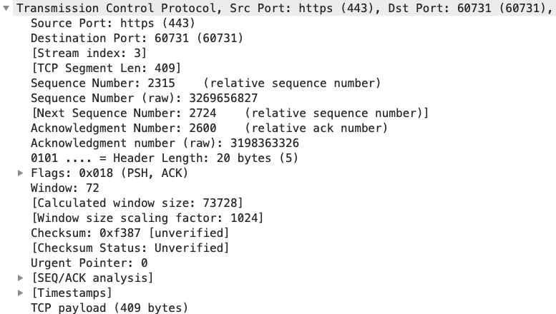
What’s Wrong with TCP?
Headers not encrypted
Out of TCP Option space for new options (40 bytes of option space)
Connections don’t migrate to new networks well

Slide 10


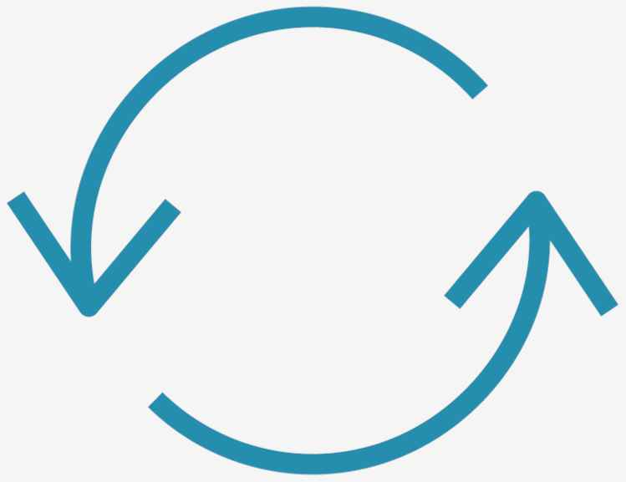
Why Else?
Limited Room to Change
Head of line blocking
Network Round-Trips
Network adjusts all it can
Ossification
Each connection is single stream, loss causes bottleneck
The TCP and TLS Handshakes take several roundtrips
Notes:
But back up a minute.
Web over UDP?? Isn’t that an unreliable protocol? Besides, what is wrong with TCP?
First, let’s talk about TCP – it has limited room to change. Due to the structure of the headers and overall operation, there isn’t much more room to squeeze additional performance out of TCP. After all it was originally designed when the internet and networking world was a MUCH different place.
Also, WAN Accelerators, firewalls, and intrusion detection systems have been baked in to observe and even adjust specific behaviors of TCP. So changing it at this point can end up breaking other things.
Second – another big problem with TCP for web delivery is a problem called head of line blocking. We will discuss this in detail in a little bit, but for now, just know that when loss happens, TCP becomes a bottleneck because it halts data transport as it deals with loss recovery. This can impact application performance because the brakes get pulled on all requests as TCP deals with retransmissions.
Another reason for the shift from TCP is that in order for an application to start new connections it first has to wait through several network roundtrips as TCP and TLS establish themselves. Reducing the number of roundtrips will reduce the overall connection time, which will increase performance. Let’s take a closer look at why this is the case.

Slide 11
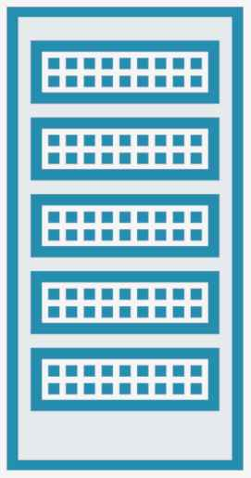

Head of Line Blocking
192.168.1.100 : 1000
10.1.1.100 : 443
GET 1
GET 1 , GET 2
GET 2
GET 2
GET 3
200 OK - 1
GET 2 - Retrans
200 OK - 2
200 OK - 3
Notes:
So let’s say you are checking out at a grocery store, you choose your checkout line, which seems the shortest, and sure enough something happens with a customer ahead of you and it holds up the line for everybody. Well, that is an example of head of line blocking. Let’s look at how this happens with web over TCP Today.
So HTTP/2 is designed to support multiplexed streams over a single TCP connection. (click). What that means is that it can send multiple GET (or POST, HEAD WHATEVER) requests to the server in parallel. If there is space, it can even do so within the same physical packet. It is possible to have three requests over three different streams on a single TCP connection. Great, right!
Well – yeah, until a packet gets lost.
So le’s imagine that along its way to the server, this packet with information for the second GET request gets dropped along the route. The packet after though – with the Third GET, makes it to the server just fine. Now TCP does not know anything about these requests themselves, it only understands bytes of data. So it has no idea that a complete GET arrived and there is no need to hold up GET 3 until the rest of GET 2 is resent. It just wants to make sure all bytes made it from A to B.
So in order to respond to the third get, the server has to wait to receive all of GET 2 which it will then start to respond to.
There is a whole lot more going on here under the hood but that is the simple concept called head of line blocking.

Slide 12
QUIC!
Let’s see how this guy came into the world

Slide 13
The History of QUIC - 2012
Quick UDP Internet Connections (QUIC)
Notes:
So how long has QUIC been around? Well, back in 2012 – Google first began to develop its own proprietary protocol for speeding up connectivity to its services. This protocol was called gQUIC or Google QUIC, but this time it actually was an Acronym.
Google was in an excellent position to do this, since they had direct development of both the server side, and the client side with the Chrome browser. Since both had wide adoption, it was not as difficult to experiment with QUIC as a transport method, which Google started to do for end users, mostly under the hood, back in 2013. Today, if you use chrome or a chrome-based browser, to any of Google’s services, you are definitely using quic!

Slide 14

The History of QUIC - 2016
Notes:
As Google started to see success with this new transport method, they approached the IETF in 2016 so the protocol could be further developed and standardized for broader implementation. The IETF went ahead and formed a working group and created the pathway forward to standardize QUIC.

Slide 15
The Story of QUIC – 2021 Version 1
Notes:
By early 2021, the quic protocol had changed significantly from the original spec designed by google back in 2012. But as a formal standard, it is poised to be implemented by even more services across the internet and other applications.

Slide 16
The QUIC Protocol Stack
HTTP/2
HTTP/3
QUIC
TLS 1.3
TLS 1.3
TCP
UDP
IP/IPv6
IP/IPv6
Notes:
But how is QUIC secured?
Easy – using TLS 1.3. But rather than treat it as a separate function that application traffic sits on top of – QUIC embeds TLS 1.3 into its function. At the start of a QUIC connection, the TLS handshake happens and therafter, is out of the way from a layer point of view.

Slide 17


QUIC – The TCP Killer?
Will eventually replace many (if not most) services over the web.
Microsoft considering SMB over QUIC – Others will follow
Uber over QUIC – Others will follow

Slide 18
QUIC – The TCP Killer?
Not for large data transfers – performance improvement is minimal
Less than a few MB data transfer per transaction? QUIC might be better –Lars Eggert–NetApp/QUIC Founding Father

Slide 19

Obstacles for QUIC
Firewalls don’t fully support it yet
Kernels are not optimized to support it, still heavy on some
IDS and DPI boxes can’t monitor it
Load balancers not fully QUIC-able yet
Improvement in performance may not be worth reworking apps – yet

Slide 20
Browser Tools
Chrome Developer Tools
http3check.net

Slide 21
Want more?
Protocol Deep Dive: QUIC

Slide 22
QUIC!
Enough talking – demo!
First YouTube then CTF

