Slide 1

Intrusion Analysis and Threat Hunting with Suricata
Peter Manev
Josh Stroschein
Open Information Security Foundation (OISF)

Slide 2

Hello!
Direct of Training/Outreach
@jstrosch / @suricata_ids
jstroschein@oisf.net
Threat researcher with Bromium/HP, Pluralsight author, Air National Guard (retired :) ) and univ prof

Slide 3
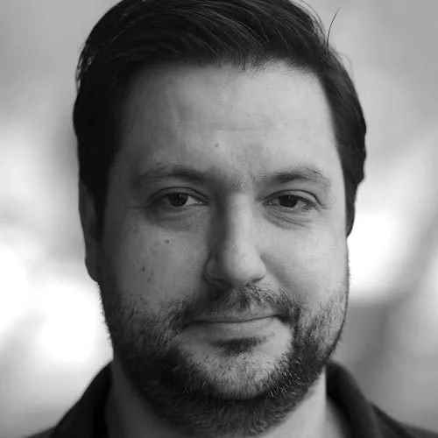
Hello!
Direct of Training/Outreach
@pevma / @suricata_ids
pmanev@oisf.net
QA/Training lead OISF, Co-founder Stamus Networks, OISF Executive board member, SELKS mantianer, SEPTun co-author

Slide 4
Training material
https://drive.google.com/drive/folders/1k9ZCyHA3k2hTh8HDnXDZ-ya3fO4WQHOy
  OR https://bit.ly/2XyEaLR
PCAPS contain live malware
Training distro based on OSS/GPLv3 SELKS
  https://github.com/StamusNetworks/SELKS
Examples from (big shout out!)
https://www.malware-traffic-analysis.net/

Slide 5
Agenda
OISF
Suricata
Threat hunting hands on

Slide 6
Goals
Explain some of the main features of Suricata
Explain what Suricata is capable of producing
Explain and showcase a concept for hunting
Walk a way with an actual example that can be used in practice

Slide 7
OISF
Mission
Funding
Support
Code / Community
SuriCon (Yearly User Conference)
Trainings
  NSM | Practical SigDev | Advanced Deployment | Dev Deep Dive | Online

Slide 8

Suricata
A network threat detection engine
Owned and supported by Open Information Security Foundation, a 501(c)3 non-profit
Powered by Open Source GPLv2 (source on GitHub)
Worked on/Developed from many continents, open community

Slide 9
Suricata
Different modes for flexible deployment:
IDS - sniffing
IPS – inline
IDPS - hybrid
Network Security Logging
  Totally passive
  Full protocol logging for evidence
Full Packet Capture capable
Threat intelligence agnostic
PCAP digest - read pcap or folders of pcaps

Slide 10
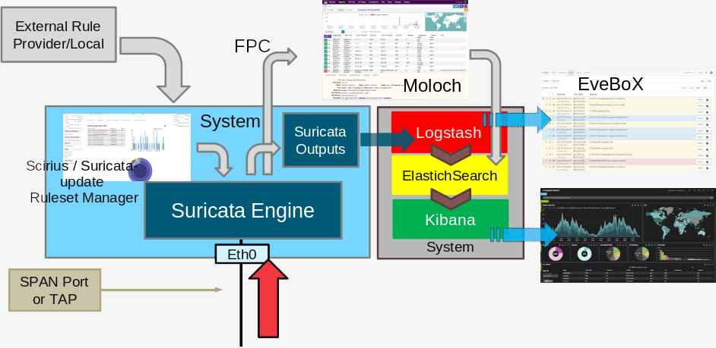
Suricata - a deployment scenario

Slide 11
Suricata major features
Standard based formats (YAML, JSON) ease integrations with SIEM or other analysis tools
Multithreaded, Scales and it is fast
Auto protocol detection
Advanced HTTP, DNS, SMTP and TLS support plus many more
File extraction - FTP/SMTP/HTTP(2)/NFS/SMBv1/2/3
File hashing MD5, SHA1 and SHA256 checksums

Slide 12
Suricata major features
Written in C plus Rust
Can use :
  Lua scripting
  Signatures
  Any threat intel and match lists
IP lists, IP/Domain reputation and GeoIP
TLS certs extraction
HTTP/File Transactions/SMB/KRB5/NFS/SSH/SMTP
  And many more
JA3/JA3S
TrafficID, SCADA protocols

Slide 13
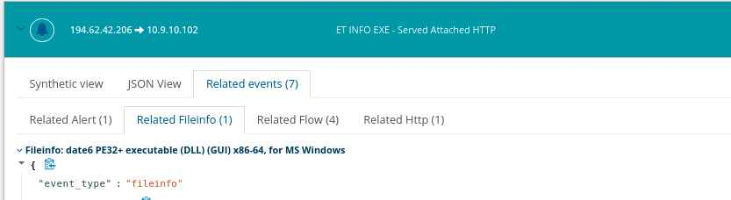
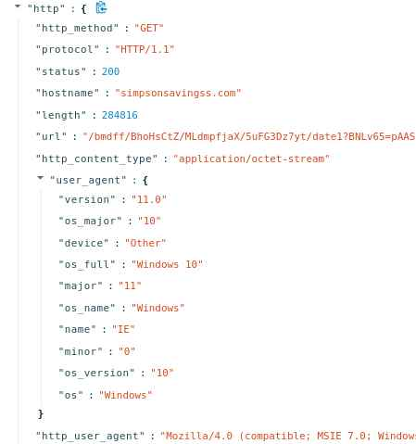
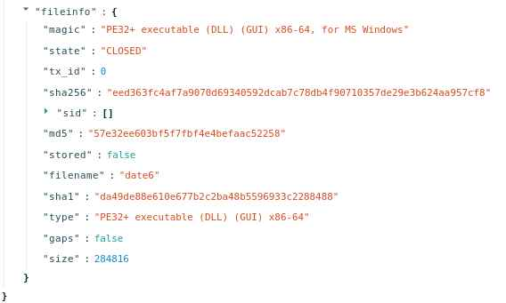
Suricata Network Protocol Evidence

Slide 14
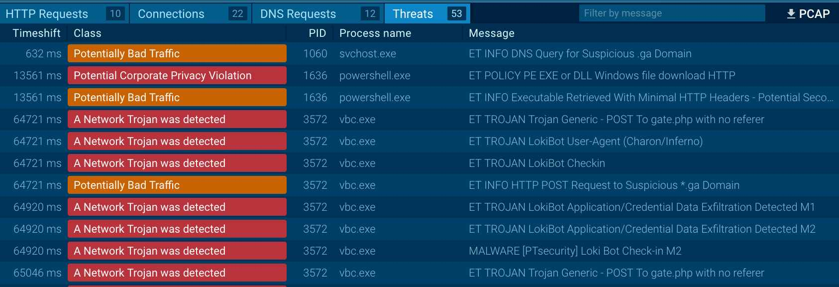
Suricata Assisting Malware Analysis

Slide 15
Suricata pcap ingestion
There are multiple ways of reading PCAPs:
Passing a command argument
  suricata -k none -r /myrepo/mypcap.pcap
Read the whole folder
  suricata -k none -r /myrepo/
Unix socket
  suricatasc -c "pcap-file /myrepo/file1.pcap /tmp/file1"
Suricata is often used in batch pcpa processing mode (sandboxing etc)

Slide 16
Suricata FPC
Suricata can also do Full Packet Capture (FPC)
  where it will write into one pcap
  or write one pcap per thread
FPC gives you the ability to timeline
  Look into the history of your traffic
  Mine traffic for anomalies / edge cases
  Get forensic evidence

Slide 17
Suricata Outputs
Suricata has JSON output by default
  eve.json - Extensible Event Format
  default location in /var/log/suricata/eve.json
configuration section in eve section of suricata.yaml
  controlling different protocol and metadata logging
Suricata can also output to
  Redis
  Syslog
  Unix socket

Slide 18
Suricata FlowID
Suricata’s native ability
Correlate all protocol logs to an alert
  Providing network security log evidence
Correlate alerts to protocol transaction log
  Enhancing hunting perspective and capabilities

Slide 19
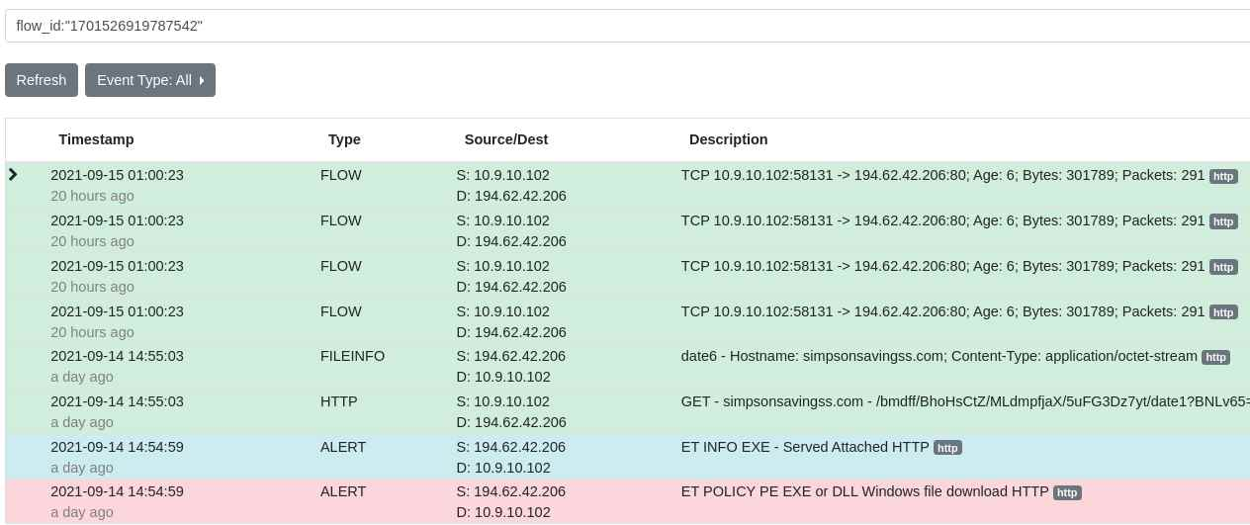
Suricata FlowID

Slide 20
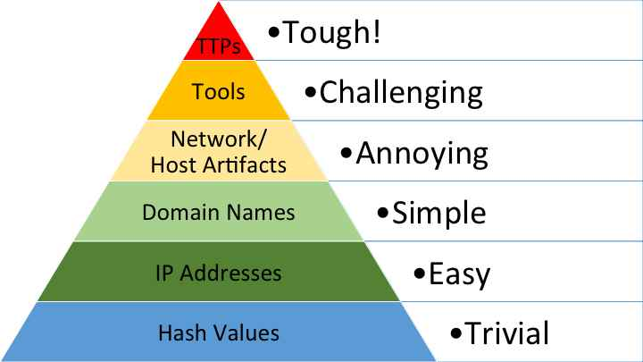
Threat Hunting & Pyramid of Pain
David Bianco
https://detect-respond.blogspot.com/2013/03/the-pyramid-of-pain.html

Slide 21
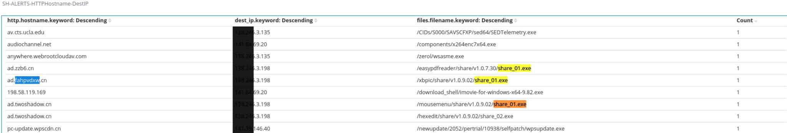
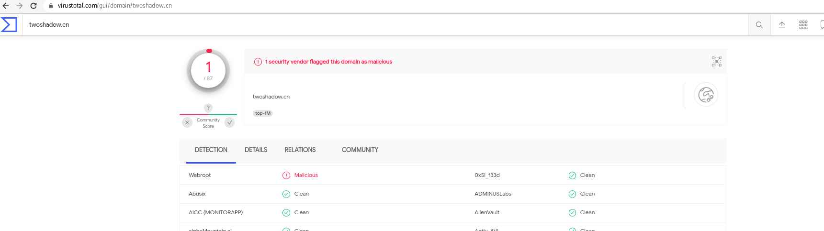
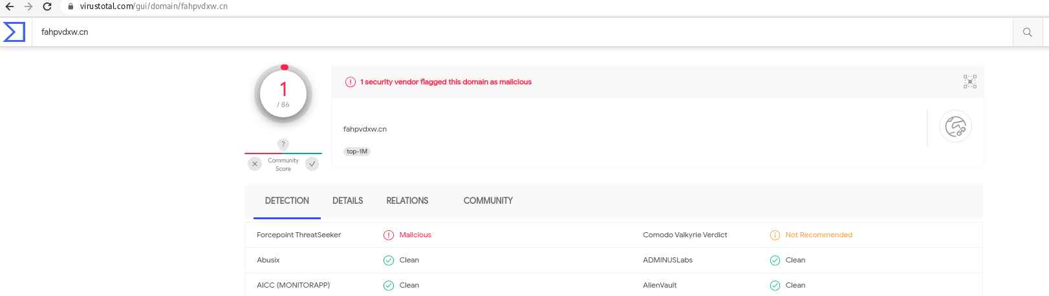
Live hunting results form prod system

Slide 22
Live hunting results form prod system
Watch out for newly registered or dga domains

Slide 23
Suricata Threat Hunting
Hands on hunting concept example
  executables
Quick intro of the environment
Let’s dive in...

Slide 24
Thank you
Come out and play
Pcap:
  https://www.malware-traffic-analysis.net/2021/07/21/index.html
Suricata forums/help/discussions:
  https://forum.suricata.io/
Suricata trainings/webinars:
  https://suricata-ids.org/training/
OISF: https://oisf.net/
SELKS(ISO or Docker based) - https://www.stamus-networks.com/selks

Slide 25

Example 1
Point 1
  Point 1a
Point 2
  Point 2a
    Point 2ac
Exclamation

