Slide 1

Wireshark at Enterprise Scale
Stephen Donnelly
endace

Slide 2
Agenda
Why We Capture
How We Capture
How We Scale

Slide 3
Why: Who is it for
NetOps
SecOps
DevOps

Slide 4
Why: Application team
Owns the applications
Responsible for application availability and performance
  Business Critical Infrastructure and Services
Troubleshooting Application Issues
  Has access to server and application logs
  Rely on Network
Request Packets for advanced troubleshooting

Slide 5
Why: Network team
Owns the network
  Has access to network infrastructure
  Controls switching, routing, and firewalls
Responsible for Network availability and performance
Monitoring for network layer issues
  High-level SNMP statistics
  NetFlow/IPFIX
Packets for advanced troubleshooting

Slide 6
Why: Security team
Responsible for securing the enterprise
Network monitoring for security
  Detect intrusions, IOCs, threats, vulnerabilities
  May rely on NetOps for access or response
Need full packet capture in real-time (DPI)
  Signature detection (IDS)
  Behavioural Analysis (NBAD)
Packet capture and retention for incident analysis

Slide 7
Why: what you can’t do without Packets
Collect and examine evidence
  Requests and responses
  Actual data transferred
Develop and test rules/signatures/ACLs
Debug network/transport layer issues
  Protocol and application errors
  Timing issues, packet loss, latency, microbursts
Regulatory compliance

Slide 8
Why: Enterprise Challenges
Scale
  Multiple distributed capture points
  High speed links
  Huge data volumes
  History vs Cost
Comprehension
  Visualisation
  Indexing
  Search

Slide 9
Agenda
Why We Capture
How We Capture
How We Scale

Slide 10
How: Types of capture
On Demand
Live Inspection
Triggered Recording
Continuous Recording

Slide 11

How: On-demand capture
Low to no equipment costs
  Open source - Wireshark!
  Existing equipment
High time cost
  Expert staff/consultants
Reactive – no history recorded
  Temporary
  Iterative

Slide 12

How: Live inspection
Continuous capture without recording
  Permanent dedicated equipment
  Placement affects coverage
Open source – Suricata, Snort, Zeek
Commercial IDS/NBAD/NDR/AI
    Appliance or software model
Logged alerts provide historical summary
  May log individual triggering packet(s)

Slide 13

How: Triggered recording
Live Inspection plus “Smart” recording
Records only limited subset of traffic based on triggers/alerts
  Less storage space and performance required compared to Continuous Capture
  Trigger criteria determined in advance
    May miss traffic of interest (e.g. Zero Days)
  Limited pre-trigger visibility (buffer depth)

Slide 14

How: Continuous recording
Capture 100% of packets to disk
  Maintain rotating capture buffer
  Optional filtering/compression
No risk of missing traffic of interest
Storage capacity limits retention time
  Time-to-investigation window
Complementary to live inspection tools
  Potentially co-hosted

Slide 15
How: Technology
Acquiring packets
Tap/tool placement
Storage requirements
Encryption/decryption
Compression

Slide 16
How: On-Demand Capture
Capture on end-point
  NIC Offloads
  Time stamp quality
  Heisenberg – observation affects system
Port Mirror/SPAN + laptop
  Many laptops no longer have Ethernet!
  Thunderbolt NIC + NVMe SSD
  Limited capture time
Portable “Sniffers”

Slide 17
How: Live/Continuous Capture
Dedicated capture/inspection system(s)
Port Mirror/SPAN
  Consumes valuable switch ports
  Limits concurrent tools on same traffic
Passive (or active) TAP
  Single (bidirectional) link at a time
  Maintains timing and packet order
  Check optical link budget

Slide 18
How: Network Packet Broker
Programmable multi-port device
  Taps multiple links
  Timestamps Packets
  Optional filter, truncate, decrypt
Steers traffic to multiple tools
  Aggregate multiple slower links
  Support multiple tools via duplication
  Load balance traffic to slower tools, or to increase storage capacity

Slide 19






How: Deployment options
DMZ
Trusted Zone
LAN
Telecommuters
Business Partners
Core
Switch
Internet
Private
Data
Center
Internal
Firewall
Partner Zones
Trusted WiFi
Branch Offices
HQ or Private Datacenter

Slide 20

How: Continuous Capture Storage
Bandwidth over time
  1Gbps = 125MB/s
  125MB/s * 3600s = 450GB/hr
  450GB/hr * 24h = 10.8TB/day
  10.8TB/day * 7d = 75.6TB/week
  Plus indexes and metadata
Network links are bi-directional
  75.6TB/week * 2 = 151.2TB/week!
  At 10Gbps * 2 = 1.512PB/week

Slide 21
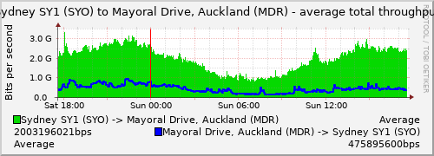
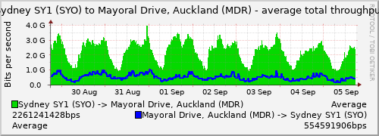

How: Example - REANNZ WAN traffic
Example 10Gbps+ WAN link
  Link asymmetry >4:1
  7-day bi-directional average 2.8Gbps
7-day raw packet total = 212TB
https://weathermap.reannz.co.nz/node.php?src=and09&int=ae0&cf=AVERAGE

Slide 22
How: Compression
Some network data compresses well
  Packet headers, text, html, JSON…
  Binary compression ratios can be 2:1 or better
Some data is incompressible
  Compressed data (media)
    Detect by file type or payload entropy
  Encrypted data (without keys)
    Detect by TLS or payload entropy
  Can be truncated, keeping packet headers

Slide 23
How: Compression
- payload entropy
Shannon entropy is measured in bits
  0 is highly regular, 8 is totally random
Possible to categorise content types:
  Text ~4-5
  JPEG ~6-7
  Binary compressed >7
  Encrypted >7.5

Slide 24
How: Compression + Truncation
Incompressible payloads can be truncated
  If they provide little useful information
  Dynamic truncation length based on payload offset rather than fixed snap length
Remaining data compresses well
Combined reduction of 4-10:1 possible
  REANNZ 212TB/week could become
  20-50TB/week

Slide 25
How: Encryption/decryption
Known server keys - Deprecated
  Perfect Forward Secrecy
Logging secrets client-side (SSLKEYLOGFILE)
  Limited coverage
TLS proxy/offload
  Proxy requires trusted CA/re-signing (MitM)
  Crypto offload common for server farms

Slide 26
Agenda
Why We Capture
How We Capture
How We Scale

Slide 27
Scale: Comprehension
Fabrics
Capture Metadata
Time Synchronization
Visualization
Search

Slide 28
Scale: Fabrics
Enterprise scale networks
  Globally distributed
    Datacenters, branch offices, staff
  10-100k+ Devices
  10s-100s of NPBs, Capture Devices
Fabric: distributed capture, storage, search
  Avoid data backhaul
  Centralized search front-end
  Scalability

Slide 29




Enterprise Fabric
Group A
(SecOps)
Group B
(NetOps)
Group …
InvestigationManager instances
IT / Operations
EndaceCMS
Single EndaceProbe
Single EndaceProbe
Single EndaceProbe
Stack of EndaceProbes
Stack of EndaceProbes
Stack of EndaceProbes

Slide 30
Scale: Multi-point capture
Coverage
History
Reachability
  Packet Loss determination
Latency
  One-way-delay vs Round-trip
Mutation

Slide 31
Scale: Capture Metadata
Packets tell us What happened
  Need Who, When, Where, How, Why?
    Who: Multi-tenant, Authorization, Users
    When: Time stamps, Synchronization
    Where: Probe and link details
    How: Capture tools, versions, statistics
    Why: Ticket IDs, alerts, comments
  Critical when capturing at multiple points
May require anonymization when sharing

Slide 32
Scale: Time Synchronization
High Resolution sufficient for single points
  Round-trip time
  Service response time
Synchronization necessary for multi-point
  One-way delay, latency
  Ordering of packets, events
  Correlation with logs, alerts
Financial industry

Slide 33
Scale: Visualisation
Visualize network information
  Over time
  Connectivity
  Flows/applications
  Statistics
Based on flow data or indexes
  Accelerate searches

Slide 34
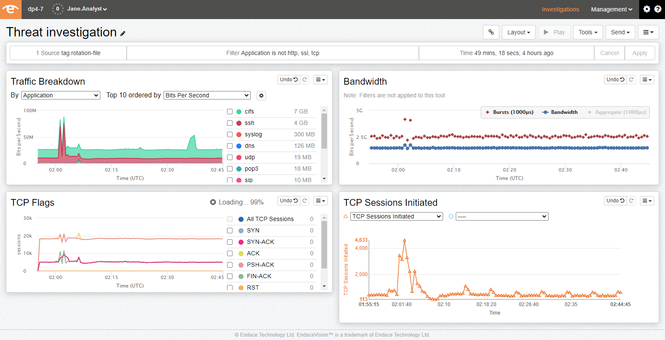

Slide 35
Scale: Search
How do you find one flow in TBs of packets?
  Time indexes
  Address indexes
  Flow indexes (5-tuple: Addresses, Ports, Protocol)
  Extraction capability -> dissect/download
  Comprehensive indexes can be large
APIs and Integrations for Automation
  REST
  SIEM

Slide 36
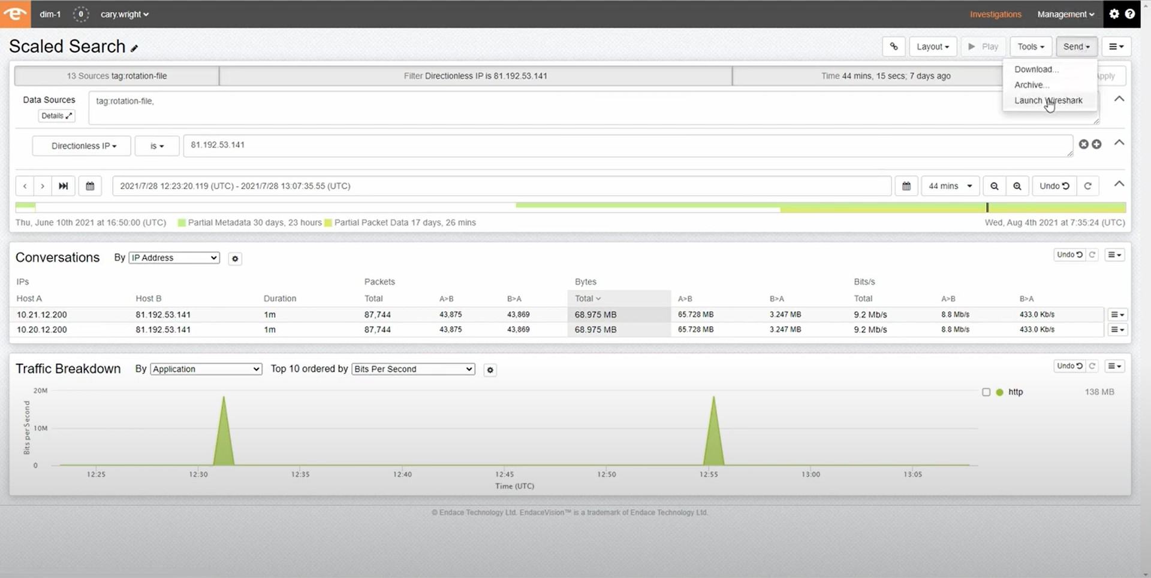

Slide 37
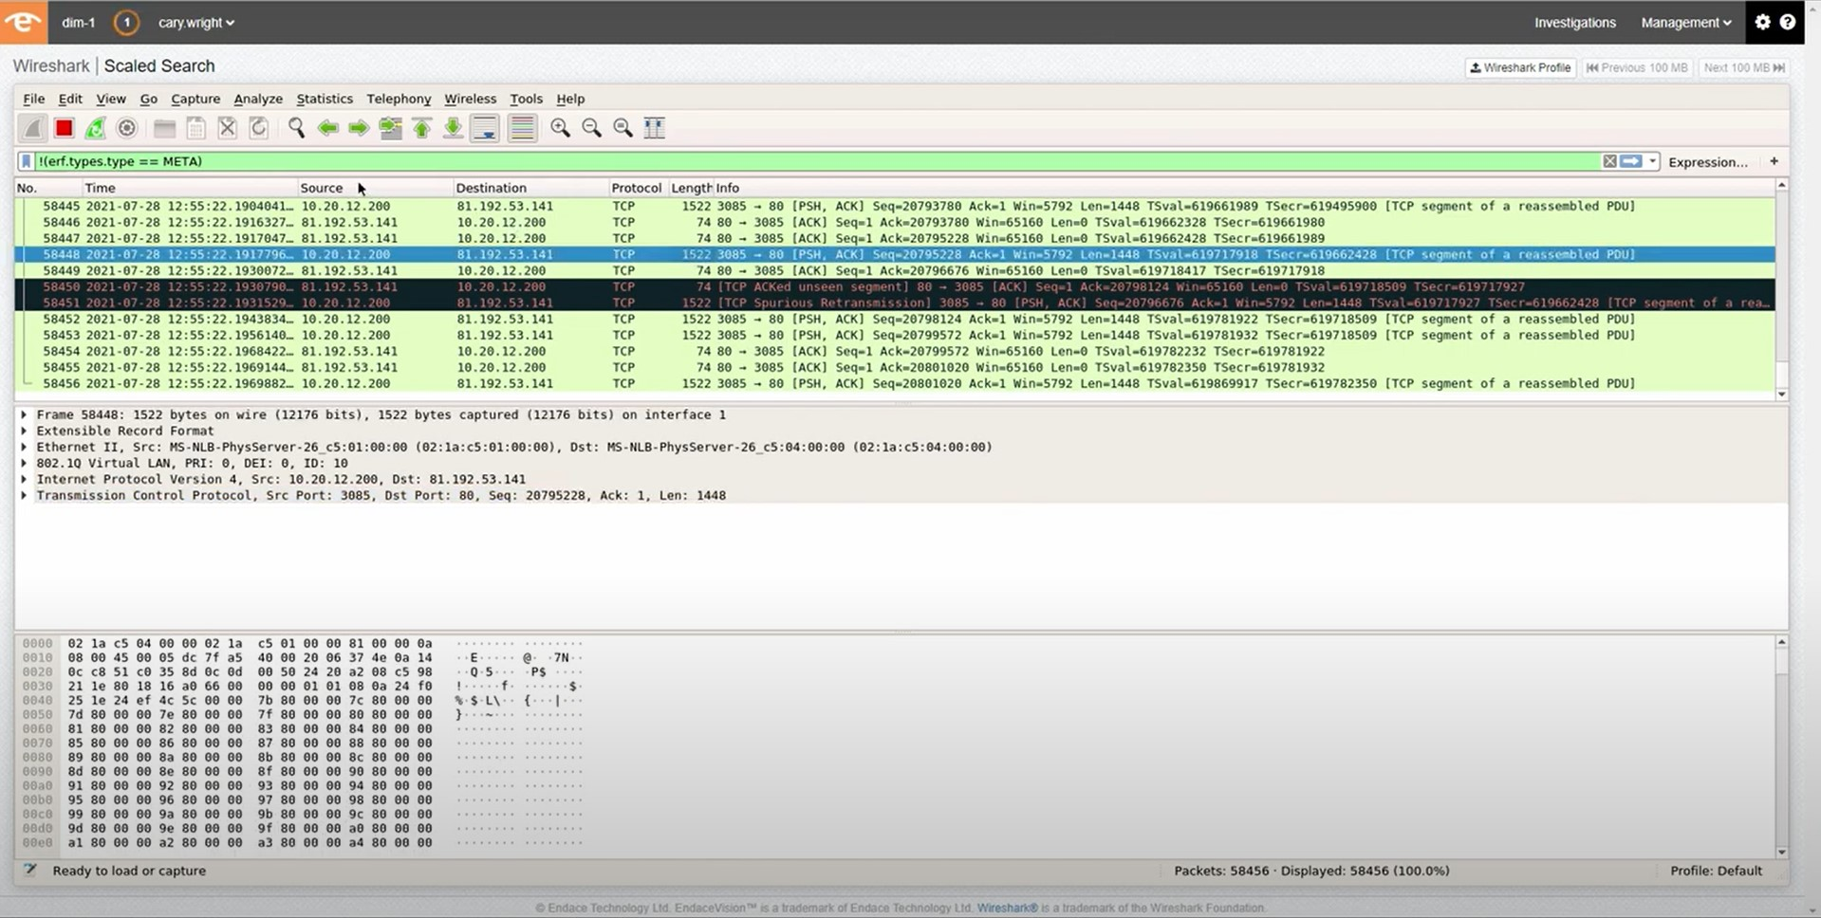

Slide 38
Conclusion: Wireshark in Enterprise
Wireshark is a tremendous analysis tool!
  Unparalleled detail
  2800+ protocols, 228k+ fields
Augmented to Enterprise Scale
  High performance multi-point capture
  Metadata generation and collection
  Indexing and Storage
  Distributed Fabric Search
Perfect combination

Slide 39
Thank You!
Please fill in your session feedback Survey!
Any questions?
You can contact me on Discord or
stephen.donnelly@endace.com

