Slide 1

Packet Capture in Public Cloud
Stephen Donnelly
Notes:
SF19EU Automating cloud infrastructure for packet capture and analysis by Brad Palm & Ryan Richter

Slide 2
Why capture Packets?
NetOps
SecOps
DevOps
Compliance

Slide 3
Why capture Packets in Cloud?
If “There is no Cloud, it’s just someone else’s computer”
Then Cloud Networks are just someone else’s network!
  Same Application Performance issues
  Same Networking issues
  Same Security issues
  Same Compliance issues

Slide 4
Shared Responsibility Model
Cloud Providers
Secure:
Physical facilities and plant
Hosting infrastructure and services
Servers, Hypervisors, Network, Storage
Provide basic security tools
Identity and Access Management
Logging
Network Routing, ACLs, VPNs
Tenants
Secure:
VMs, Operating Systems, Containers
Applications, Services, APIs, and Endpoints
Data at rest and in motion
Configure Cloud services
Manage user access and authorization
Monitor logs
Secure the network
Patch vulnerabilities and mitigate Zero-day attacks
Flow logs, Traffic Mirrors

Slide 5
Shared Responsibility Confusion
Tenants may expect the Cloud Provider to secure their workloads
Cloud Providers only offer basic tools and advice
Tenants must take responsibility for their own security!
But you can’t manage what you can’t see
Network Visibility is as important in Public Cloud as in Private Datacenter

Slide 6
Why capture Packets in Cloud?
Visibility of Data in Motion
Log Files are only a summary
  Application POV
  Limited/no network visibility
  Authenticity suspect post-compromise
Flow Logs are also only a summary
  Similar to NetFlow, IPFIX etc
  High-level view of flows only
  No/limited Application metadata, service latency, TCP dynamics, TLS details, payloads…
Packet capture fills in the visibility gap

Slide 7
How to capture Packets in Cloud
Ad hoc capture on Endpoints
Software Agents on Endpoints
Inline/Bump in the Wire
Traffic Mirrors
Network/Cloud Packet Brokers

Slide 8
Just capture on the Endpoints!?
Ad hoc capture
  Single point of view
  Barn Door problem for Security
  Difficult to capture intermittent issues
Same issues as on physical machines
  Accessibility/Permission to instrument
  Segmentation Offloads
  Unset checksums
  Capturing can affect behaviour or performance

Slide 9
Software Agents
Capture software installed into VM/Instance
  Capture traffic and send to remote collector
  Same limitations as Endpoint capture
  Adds network traffic
Network Packet Brokers support Virtual Tap Agents
  Introduces additional costs
Azure Network Watcher
  Installed via Agent Extensions (Windows and Linux)
  Captures to local file and/or Azure Blob storage
  Defaults to 1GB or 5hrs, then writes file

Slide 10
Inline Traffic Mirror
Route traffic through an instance to mirror
  Virtual Router - Vyatta VyOS
  Firewall - F5 Big-IP
Send duplicated traffic to collector
  L2 encapsulation
    L2TP
    VXLAN
Potential traffic bottleneck

Slide 11







Inline Traffic Mirror
AWS Cloud
Virtual private cloud (VPC)
Internet gateway
Public subnet
Private subnet
VXLAN
Webserver
ENI
ENI
Firewall
ENI
ENI
Capture

Slide 12
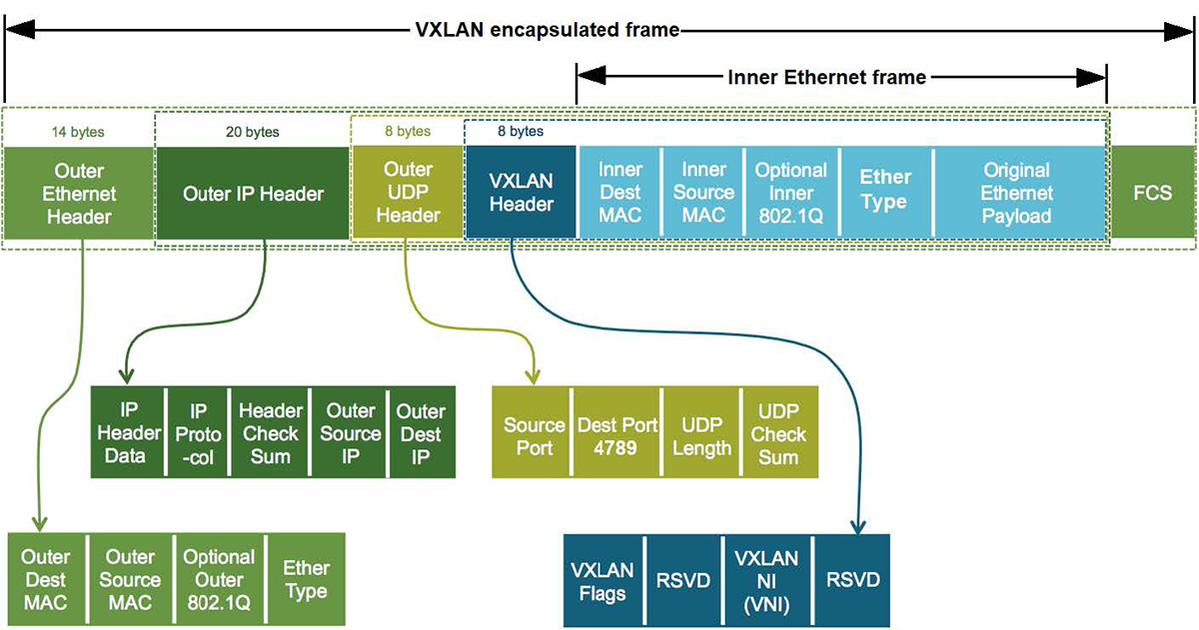
VXLAN Encapsulation

Slide 13
VXLAN
L2 (Ethernet) over UDP/IP
Adds 50 bytes per packet
  Overhead can cause IP Fragmentation
  Azure recommends 1400B MTU!
Drops original FCS
24-bit VXLAN Network ID
Outer UDP Source Port is Inner Ethernet Frame Header hash

Slide 14
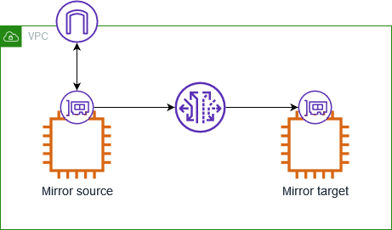
Native Cloud Port Mirror
Not available in Azure
AWS VPC Mirror service
  Mirrors traffic from an Instance interface to a Target
  Three components
    Mirror session
    Mirror filters
    Mirror target

Slide 15
AWS VPC Mirror Session
One Source: ‘Instance’ ENIs only
  Not all Instance types are supported
Single Destination
  Instance ENI, NLB, GWLBe
Single Filter, up to 10 rules
Configurable Truncation Length
VXLAN Encapsulation
Mirror Session cost $0.015/ENI/hr
  5 sessions x 30 days x 24 hr/day x $0.015 = $54/mo

Slide 16
AWS VPC Mirror Limitations
Can only mirror from ‘Instance’ ENIs
  Cannot mirror from Services: Gateways, NATs, WAFs, Load Balancers etc
Cannot mirror ARP, DHCP, Instance Metadata Service, NTP, Windows activation
Maximum 3 Mirror Sessions per source ENI
Each packet can only be mirrored once
  Evaluated in Session Number order per source
Mirror bandwidth comes from the Instance allocation
  Mirrored traffic has lower priority than production traffic
Packets over MTU are truncated, not fragmented
Maximum 10 Sessions per Mirror Target

Slide 17
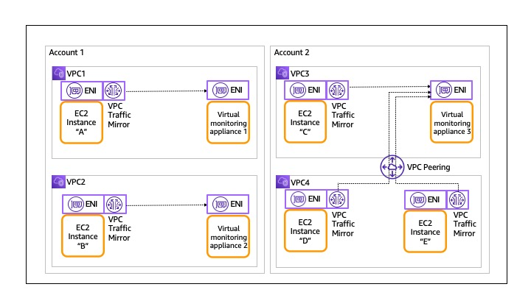
VPC Mirror Targets: ENI
Notes:
What if you want to have more than 10 mirror sessions? What if you need more than one capture appliance? -> NLB

Slide 18
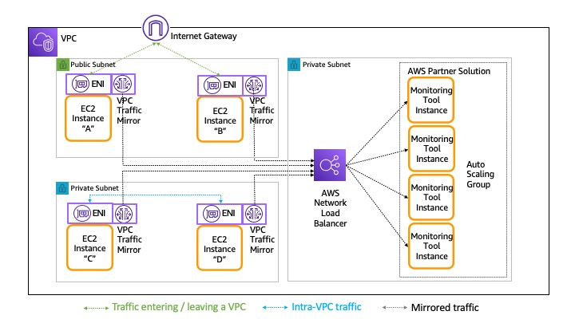
AWS Network Load Balancer

Slide 19
VPC Mirror Targets: NLB
Load balances UDP VXLAN flows to parallel tool instances
  Unlimited number of Mirror Sessions
  Supports Auto-scaling Groups
  No packet duplication
NLB Charges
  $0.0225/hr/NLB + $0.006/NLCU
    For UDP traffic, an NLCU contains:
      400 new UDP flows per second
      50,000 active UDP flows (sampled per minute)
      1 GB per hour
  $0.0225/hr + 450GB/hr/Gbps * $0.006 = $2.72/hr/Gbps
    2.72/hr * 730hr/mo = $1,985/mo/Gbps

Slide 20
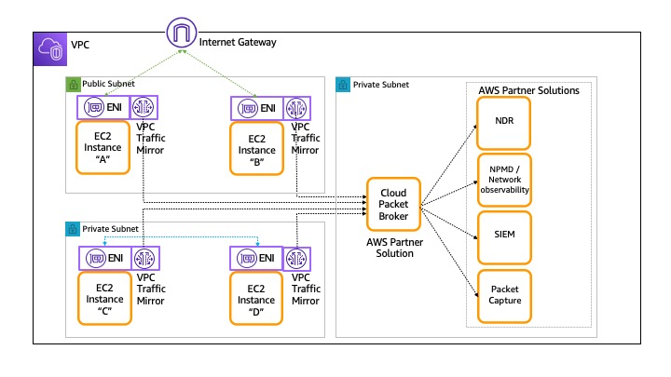
Network/Cloud Packet Broker

Slide 21
VPC Mirror Targets: NPB/CPB
Network/Cloud Packet Brokers can provide
  Load balancing
  Duplication
  Filtering
  Truncation
Count as Instances for Mirror Session Targets
  Can only sink 10 Mirror Sessions
  But can be placed behind NLB for scaling Sessions
Can capture from Agents w/o VPC Mirror
Additional instance and licence costs
Notes:
Third VPC Mirror destination type is GWLB

Slide 22
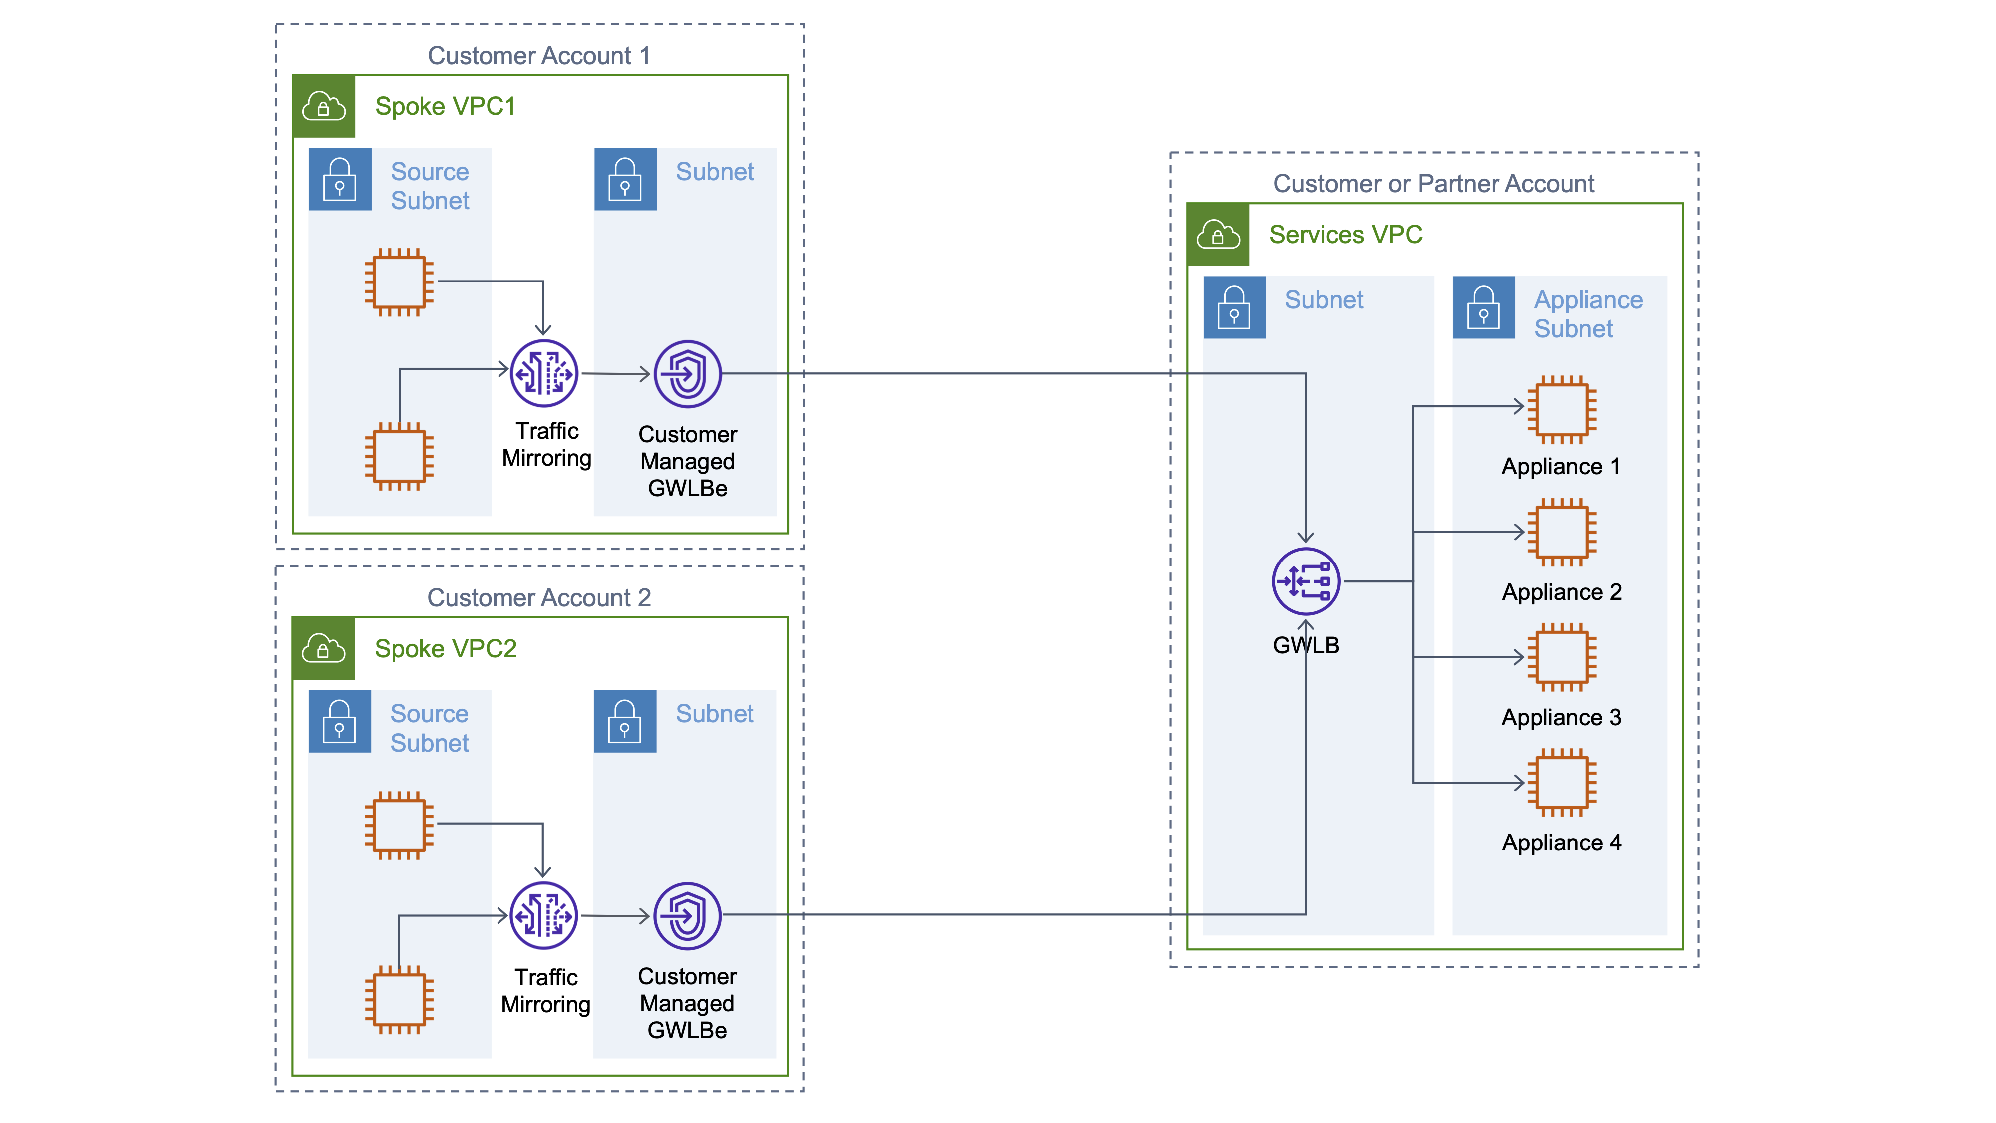
GWLB: Gateway Load Balancer

Slide 23
VPC Mirror Targets: GWLB
Centralize analysis tools across multiple VPCs/Accounts
VXLAN over GENEVE (!)
GWLB Charges
  $0.0125/hr/GLB + $0.004/GLCU
    GLCU contains:
      600 new UDP flows per second.
      60,000 active UDP flows (sampled per minute).
      1 GB per hour
GWLBe Endpoint Charges
  $0.01/hr/Availability Zone + $0.0035/GB
$0.0225+.01 + 450GB * (0.004+.0035) =$3.41/hr/Gbps
  3.41/hr * 730hr/mo = $2,487/mo/Gbps

Slide 24
Or GWLB Inline, no Mirrors!
GWLBs can also inspect traffic inline
  No VPC Mirrors needed!
  AWS and Azure
  Requires pass-through appliances
  Load balanced NVA pool for redundancy and scale
  Centralized model
    Multiple business units/project VPCs/VNets
    Single Tool/Service VPC/VNet
  TLS proxy/termination options for decryption

Slide 25
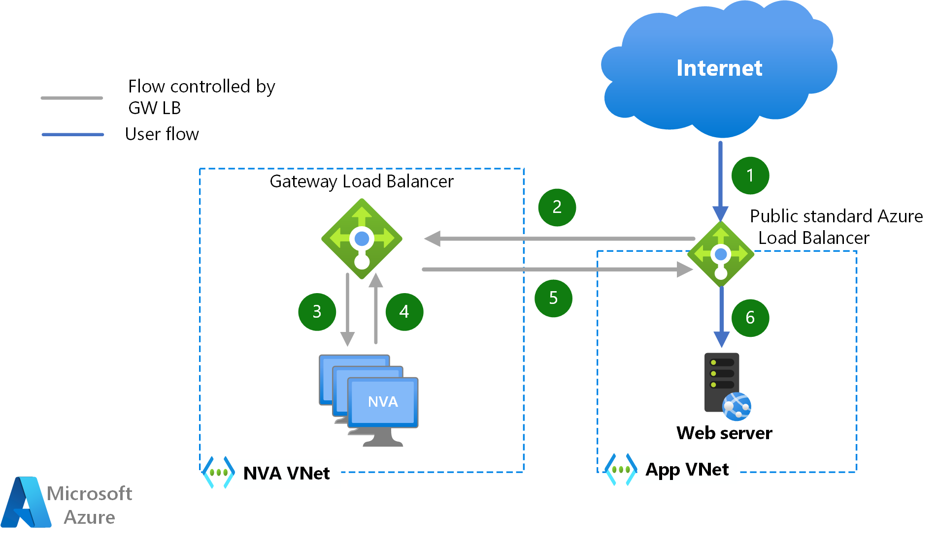
Azure Gateway Load Balancer

Slide 26
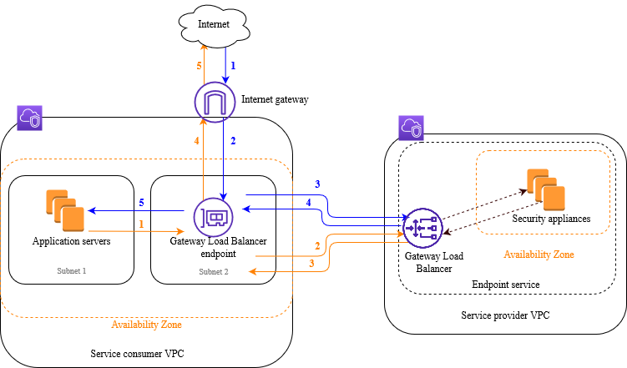
AWS Gateway Load Balancer

Slide 27
Conclusions
Packet Capture is both necessary and practical in Public Cloud
Solutions for AWS and Azure include
  Endpoint capture
  Agents
  Inline inspection
  VPC Mirror
Happy Wiresharking!

Slide 28

AWS VPC Mirror Demo
AWS Cloud
Virtual private cloud (VPC)
Private subnet
Traffic mirroring
Browser
ENI
ENI
Webserver
ENI
Wireshark

