Slide 1

#sf2
4us
Using wireshark in
LTE, and 5G
networks…
Mark Stout
T-Mobile

Slide 2

About me?
#sf2
4us
• In wireless technology CDMA/LTE/5G since 1998
• Work on various OEM’s
• Cisco
• Ericsson
• Nokia
• Nortel

Slide 3
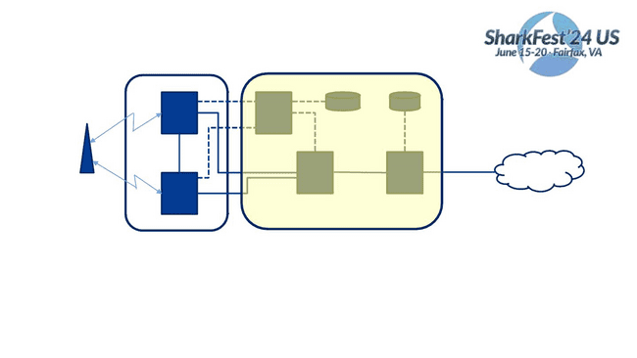
eNodeB
#sf2
4us
S1-MME
Uu
Uu
X2
SGi
Internet
UE
eNodeB
E-UTRAN
Enhanced Packet Core (EPC)
We will concentrate on packets entering, exiting, and within the highlighted portion.
UE
User Equipment, Users phone, or device
eNodeB
MME
S-GW
P-GW
HSS
Radio Access side of the network
Local Mobility Management Entity. Only handles signaling for call setup, and certain hand offs
Serving Gateway. Mobility anchor point. Handles signaling, and data plane
PDN-GW. Packet Data Network Gateway. Provides IP, and session connectivity(UE Anchor).
Home Subscriber Server. Houses subscriber related information, and provides Authentication, and Authorization.
PCRF
Policy and Charging Function.
**Certain nodes are not represented for simplicity

Slide 4
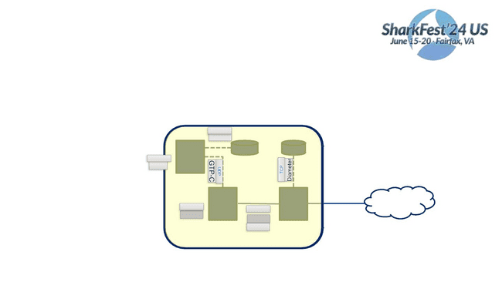
Protocols we’re covering
#sf2
4us
• SCTP – Session Control Transmission Protocol
• Diameter
• GTP – GPRS Tunneling Protocol
• S1ap – S1 Application Protocol
• Then 5G
SCTP
Diameter
S1-MME
SCTP
S1ap
SGi
Internet
UDP
GTP-U
UDP
GTP-U
GTP-C

Slide 5
SCTP
Stream Control Transmission Protocol RFC4960
•
#sf2
4us
Not datagrams, nor Segments, SCTP uses Chunks.
•
•
•
Chunk: Unit of information within an SCTP packet. Chunks contain either user data, or SCTP
control data.
Multiple chunks can be bundled into one SCTP packet up to the MTU size, except for the INIT,
INIT ACK, and SHUTDOWN COMPLETE chunks.
Endpoint: The logical sender/receiver of SCTP packets. On a multi-homed host, an SCTP
endpoint is represented to its peers as a combination of a set of eligible destination transport
addresses to which SCTP packets can be sent and a set of eligible source transport addresses
from which SCTP packets can be received.
•
SCTP uses stream as the logical channel for transporting in-order application messages. A
stream is defined as unidirectional

Slide 6
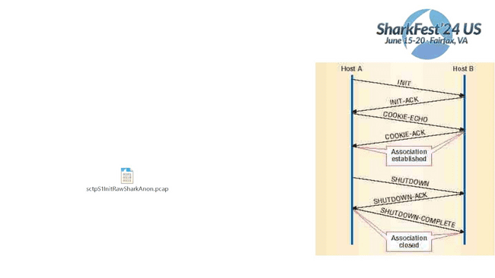
SCTP
Stream Control Transmission Protocol RFC4960
•
•
#sf2
Association establishment and shutdown. SCTP uses a cookie
mechanism in a four-way handshake to establish an association.
The shutdown process is a three-way handshake.

Slide 7
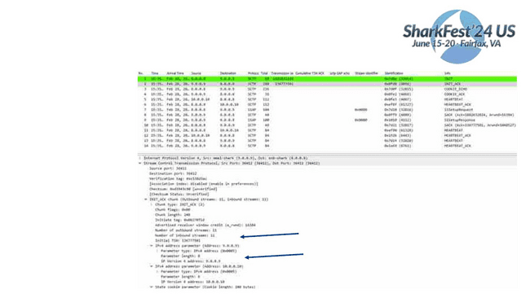
Redundancy built in
#sf2
Multihoming can be
established at time of init
ack.
This is how we
dynamically build
redundant route from
Cell Site, to MME.
Redundant route start
heart beat.

Slide 8
SCTP
Stream Control Transmission Protocol RFC4960
• Selective Ack’s
#sf2
4us
•
•
•
The acknowledgements carry all Transmission Sequence Number (TSN) numbers that have been
received by one side with them.
That is, there is a Cumulative TSN Ack value, that indicates all the data that has successfully been
reassembled at the receivers side.
there are Gap Blocks that indicate which segments of data chunks have arrived, with some data chunks
missing in between.
• Path Monitoring
•
•
HEARTBEAT chunks are sent over all paths. Each HEARTBEAT chunk has to be acknowledged by a
HEARTBEAT-ACK chunk.
•
Each path is assigned a state: active or inactive.
The number of events in which heartbeats were not acknowledged within a certain time or the number
of retransmission events exceeds a certain configurable limit, the peer endpoint is considered
unreachable and the association will be terminated via an ABORT chunk.

Slide 9
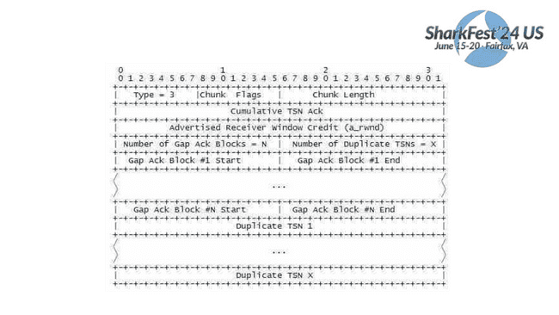
Selective Acknowledgement (SACK)
#sf2
4us
13

Slide 10
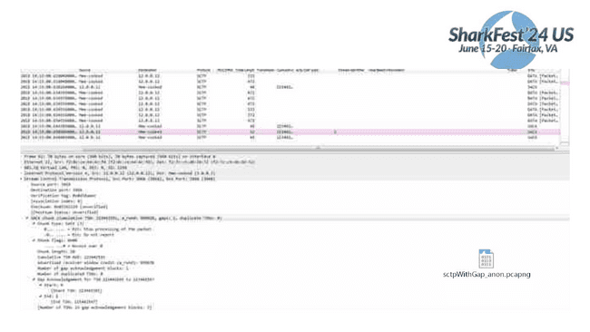
Selective Acknowledgement (SACK)
14

Slide 11
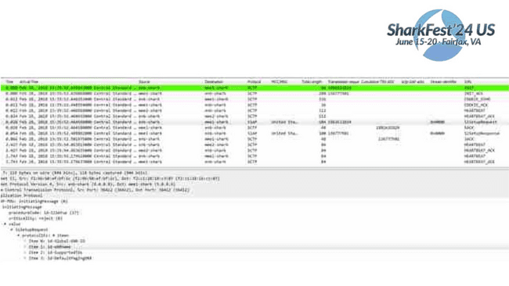
SCTP
Stream Control Transmission Protocol RFC4960
• S1 peering setup
#sf2
4us

Slide 12
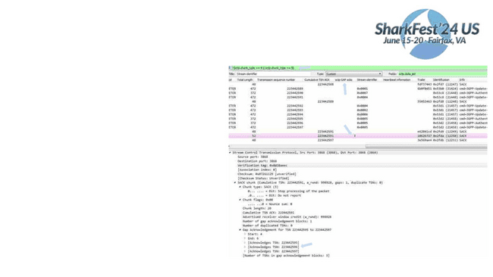
SCTP profile
#sf2
• Create a button to remove heartbeats/acks
• Create columns to show the stream, gap
count, and TSN
• Create a color rule that shows you when gaps
are present
• Create a color rule that shows sctp layer
fragments
• I always create a color rule that shows the
start of a peer, or session.

Slide 13
Diameter
•
•
#sf2
4us
Diameter is the protocol used within the EPC architecture for AAA (Authentication,
Authorization, and Accounting), PCRF (Policy and Charging Rules Function), and HSS (Home
Subscriber Server).
Diameter is specified in RFC 3588 and then by the RFC 6733.
•
The name is a pun on the name of the predecessor protocol, RADIUS(Remote Authentication
Dial In User Service) - a diameter is twice the radius.

Slide 14
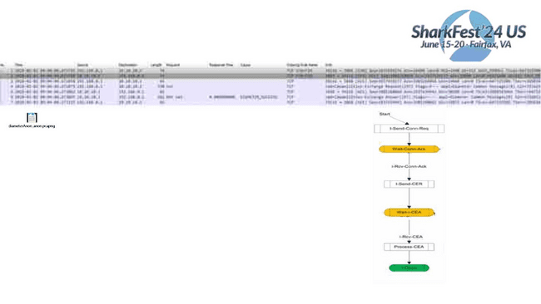
Diameter
Peering State Machine
• I-Send-Conn-Req = SYN
• Wait-Conn-Ack
= SYN, ACK
• I-Rcv-Conn-Ack = ACK
• I-Send-CER
• I-Wait-I-CEA
• I-Rcv-CEA
= send Capabilities Exchange Request
= ACK
= receive Capabilities Exchange Answer

Slide 15
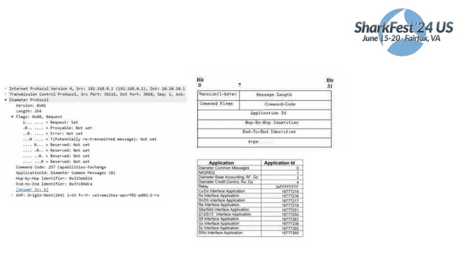
Diameter
Diameter Header information
#sf2
4us
All Diameter headers start with the same 20 bytes. After that AVP’s are added
•
•
Capabilities-Exchange-Request CER 275
•
•
•
•
•
•
•
•
•
Re-Auth-Answer RAA 258
•
Session-Termination-Request STR 275
Session-Termination-Answer STA 275
Accounting-Request ACR 271
•
•
Accounting-Answer ACA 271

Slide 16
Diameter
#sf2
•
4us
All data delivered by diameter is in the form of AVPs (Attribute Value Pairs). Some of these AVP values are used
by the Diameter protocol itself, while others deliver data associated with particular applications that employ
Diameter.
•
•
•
•
•
Ability to exchange messages and deliver AVPs ( Attribute Value Pairs)
Capabilities negotiation
Error notification
Extensibility, required in [RFC2989], through addition of new applications, commands, and AVPs
Basic services necessary for applications, such as the handling of user sessions or accounting

Slide 17
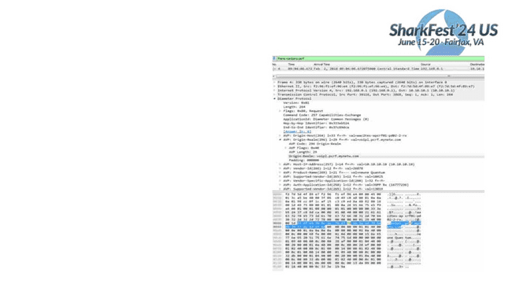
Diameter
• Diameter AVP’s carry a lot of data is asci format. Use
it to your advantage using the “frame contains xxx” as
a filter
• You can also just click on the ascii portion of the
“Packet Bytes” pane, and the AVP will open directly in
the “Packet Details” view.

Slide 18
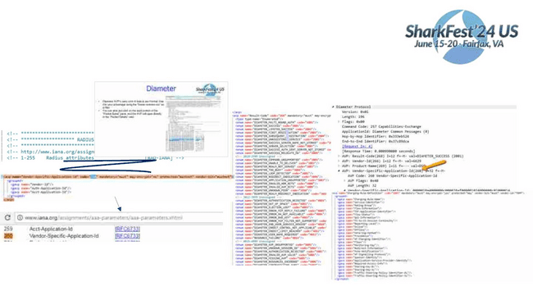
Diameter
#sf2
4us
• The AVP’s are grouped in a parent, child relationship. This relationship is setup in readable xml
files in the <w
• This info is he
documentatio
ectory.
AVP’s could be grouped under one parent, or to find

Slide 19
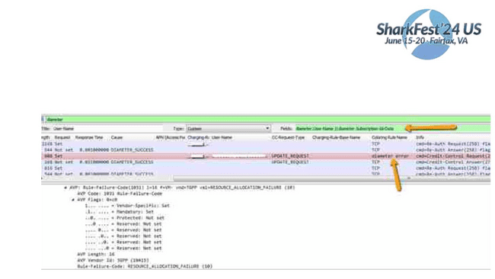
Diameter profile
#sf2
4us
• Diameter has multiple request, and answer types. These can be in different AVP’s. Don’t build multiple
columns for that. Use the custom column, and use || to define different AVP’s.
• Create custom color rule for known bad issues, then show color rule in column.

Slide 20
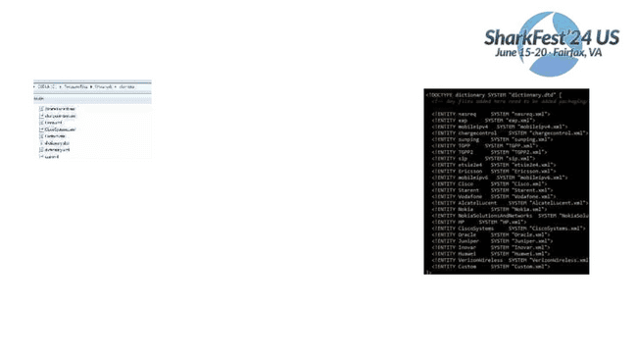
Diameter profile
Dictionary.xml is the main file, and is responsible for calling all the other specific files
#sf2
4us
<avp name="Vendor-Id" code="266" mandatory="must" may-encrypt="no" protected="may" vendor-bit="mustnot">
<type type-name="VendorId"/>
</avp>
<avp name="Firmware-Revision" code="267" mandatory="mustnot" protected="mustnot" may-encrypt="no" vendor-bit="mustnot">
<type type-name="Unsigned32"/>
</avp>
<avp name="Result-Code" code="268" mandatory="must" may-encrypt="no" protected="mustnot" vendor-bit="mustnot">
<type type-name="Enumerated"/>
<enum name="DIAMETER_MULTI_ROUND_AUTH" code="1001"/>
<enum name="DIAMETER_SUCCESS" code="2001"/>

Slide 21
Diameter profile
#sf2
4us
<avp name="Charging-Rule-Name" code="1005" mandatory="must" may-encrypt="yes" protected="may" vendor-bit="must" vendor-
id="TGPP">
<type type-name="OctetString"/>
</avp>
<avp name="Event-Trigger" code="1006" mandatory="must" may-encrypt="yes" protected="may" vendor-bit="must" vendor-id="TGPP">
<type type-name="Enumerated"/>
<enum name="SGSN_CHANGE"
<enum name="QOS_CHANGE"
<enum name="RAT_CHANGE"
<enum name="TFT_CHANGE"
<enum name="PLMN_CHANGE"
code="0"/>
code="1"/>
code="2"/>
code="3"/>
code="4"/>
<enum name="LOSS_OF_BEARER" code="5"/>
</avp>
In this example <avp starts the a new description
name= defines the name that will show in wireshark for the code= defined
type-name=“Enumerated = a number value that will later get a name assigned to the value
OctetString = A string of octets ie. 0a ff cd bb
UTF8String = text
if “Enumerated” is defined then <enum name=“what ever” code=“0”/> associates a string with whatever number value is seen.
Mandatory, May-encrypt, Protected, Vendor-bit = Not used in wireshark, but refers to the flags in the diameter message

Slide 22
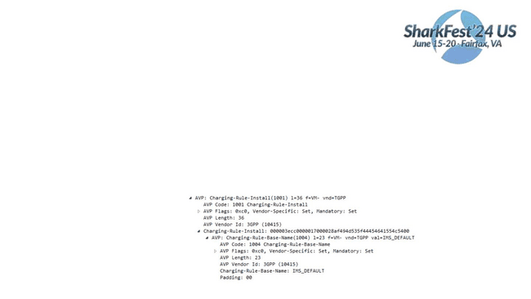
Diameter profile
#sf2
4us
<avp name="Charging-Rule-Install" code="1001" mandatory="must" may-encrypt="yes" protected="may" vendor-bit="must" vendor-id="TGPP">
<grouped>
<gavp name="Charging-Rule-Definition"/>
<gavp name="Charging-Rule-Name"/>
<gavp name="Charging-Rule-Base-Name"/>
<gavp name="Bearer-Identifier"/>
<gavp name="Rule-Activation-Time"/>
<gavp name="Rule-Deactivation-Time"/>
<gavp name="Resource-Allocation-Notification"/>
</grouped>
</avp>
<avp name="Charging-Rule-Base-Name" code="1004" mandatory="must" may-encrypt="yes" protected="may" vendor-bit="must" vendor-id="TGPP">
<type type-name="UTF8String"/>
</avp>

Slide 23
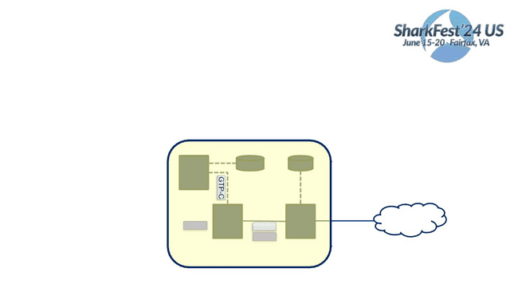
GTP
#sf2
• GPRS Tunneling protocol is a IP/UDP based protocol used in GSM, UMTS and LTE core ne⁴t^{u}w^{s}orks. It is
used to encapsulate user data when passing through core network and also signaling traffic
between various core network entities.
• In LTE, version 2 is used for GTP-C and version 1 is used for GTP-U
• In our shown LTE network implementation, GTP-v2 is used on S5 and S11 interfaces and GTPv1 is used
on S1-U, S5.
S1-MME
SGi
Internet
GTP-U
GTP-C
GTP-U

Slide 24
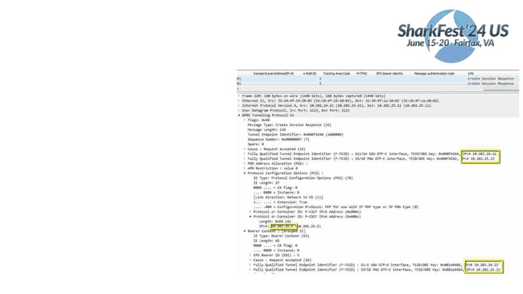
GTPv2
§ Different GTP-C messages are used to
manage a Tunnel or to set up the tunnel for
#sf2
GTPv1.
§ GTP-C does not necessarily tunnel messages,
as no payload is carried above GTP-C.
§ The GTP-C messages are Create Session,
Create Bearer, Modify Bearer, Update Bearer,
Delete Session, Delete Bearer.

Slide 25
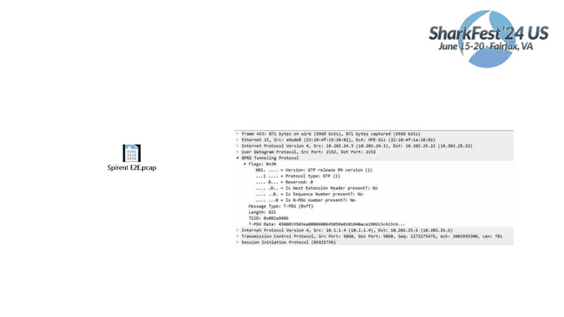
GTPv1
#sf2
4us
• The transport bearer is identified by the GTP-U TEID and the IP address (source TEID,
destination TEID, source IP address, destination IP address)
• As Bearer is received over a TEID on S1-U at the SGW, the SGW then forwards on a
different TEID towards the PGW.

Slide 26
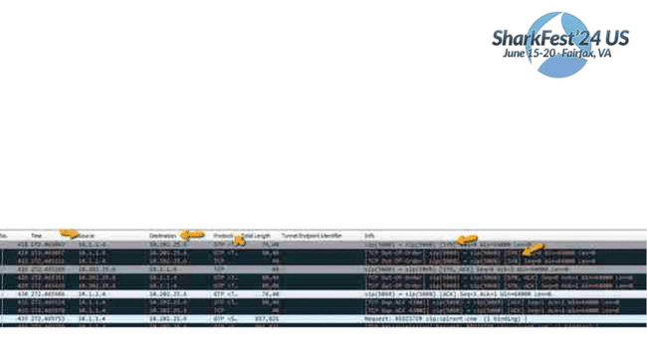
GTP
#sf2
4us
• While GTP is stateless the upper level protocols may not be.
• GTPv2 should be diagnosed from request to response (or lack there of).
• Looking at TCP over GTPv1 holds the best advantages for me. But there are things to look out for!
• When you take a capture at the SGW, and PGW. You will see that wireshark shows 3 packets per 1. Then
Wireshark will do TCP analysis on 3 packets, and mark all packets (except the first) with some error (retran, ooo)
• You’ll also notice that WS will only show the upper most layer IP in the source/Destination field

Slide 27
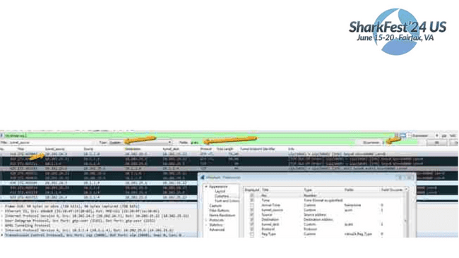
GTP
#sf2
4us
Using the previous example, the 1st thing I want to do is look at my GTP endpoints and not just the upper layer IP
1. Create a new column name “tunnel_source”
2. Choose type “custom”, and fields as ip.src
3. Make occurrences “1” (this is for single tunnel, you can do 2 when you have a tunnel in a tunnel
4. You now see the tunnel_source address, and the upper layer address. (only “Source” will resolve name)

Slide 28
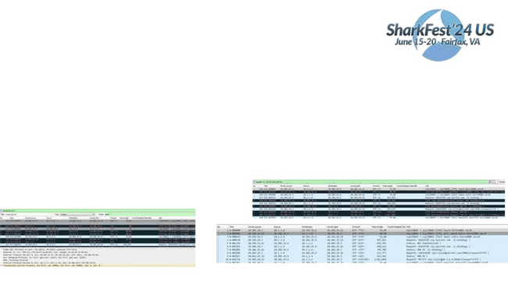
GTP
#sf2
2nd, we need to de’dup the packets so that we can use the TCP analysis feature in wireshark (assuming we’re
4us
looking for things like packet loss).
Putting a display filter does not help in the cases where you capture S1-u, S5, and Sgi in the same capture.
Wireshark analysis feature is based on all packets in the capture regardless of whether you are view them or
not.
1. Find something unique in each of the interfaces. I usually use the MAC address or tunnel IP, since S1, S5,
and Sgi will typically use different interfaces. Then create a display filter for that.
2. This will now show you just show just a single flow of the TCP packets (still showing error). So now “export
specified packets”, and save “displayed”
BEFORE
3. Open the capture you just created.
Original File
AFTER

Slide 29
GTP
#sf2
4us
Tools, Tools, Tools, they are there for you.
Editcap to remove true duplicate packets. Most useful on S5 interface that leaves SGW, and arrives at PGW.
.\editcap.exe -w .0001 -I 12 C:\temp\roamingIssue.pcap C:\temp\roamDedup.pcap
153 packets seen, 12 packets skipped with duplicate time window equal to or less than 0.000100000 seconds.
Tshark can be used to remove dup’s across multiple GTP peers. S11 -> S5, or S1u->S5->SGi
.\tshark.exe -r 'C:\share\Test_cases\PCAP\ExportedData_1.pcap' -R "!(sctp.chunk_type == 5 || sctp.chunk_type == 4)" -2 -w C:\temp\noSctpHeart.pcap
For large files use capinfos to determine size, and calculate the size of the chunks that the pcap can be broken up into.
Mergecap…..

Slide 30
Slicing packets in large traces file to reduce the
file size
#sf2
4us
editcap -s 128 superbowl.pcap superbowl_128.pcapng
Take a larger trace and slice the packets after byte 128 and save to a new file. This means I won’t
get the complete payload, but that is ok in the cases where your troubleshooting packet loss
using TCP analysis. You can always go back to the original trace file if you need the payload. This
will dramatically reduce the size of a trace.
Split a large file into many smaller ones.
editcapꢀ-cꢀ<numberꢀofꢀpacketsꢀperꢀfile>ꢀsuperbowl.pcapꢀsmallSuperbowl.pcap
BecomesꢀsmallSuperbowl_0000.pacpꢀ_0001.pcap,ꢀ
ꢀ
ꢀꢀsmallSuperbowl_0000.pacpꢀ_0002.pcap,
ꢀꢀꢀetc.

Slide 31
Verify each packet has hit every tap
#sf2
4us
Recommend doing this before deduping packets.
tshark.exe -r 4perToBeDeduped.pcap -T fields -e tcp.seq_raw | sort
| uniq -c
4 1000461189
4 1218696134
4 1218697032
4 1218698412
4 1218699792
4 1218701172
1 2689484057
1 2689485425
1 2689486793
1 2689488161
4 2710474120
4 2710476617
4 2746774803
-T <def> = defines output type (fields, text, ps). When using –e this MUST be <fields>
-e <field> = which field to print. Must be repeated print multiple fields

Slide 32
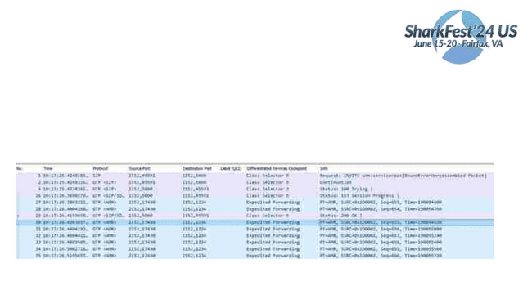
IMS / Volte
#sf2
4us
Volte is really nothing more that SIP/RTP (VoIP) over LTE with a guaranteed bearer and more favorable
DSCP markers on the packet.
Most tools for SIP will work with trouble shooting Volte

Slide 33
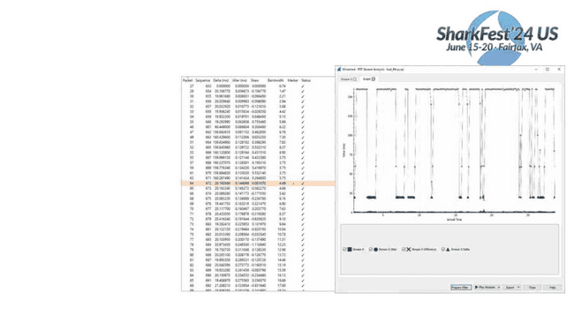
RTP Stream Analysis
A quick view into the nature,
and timing of RTP packets.
Knowing your RTP timers help
when using these tools.
Example; I know in this case
active conversation packets are
20ms, and silent packets are
160ms

Slide 34
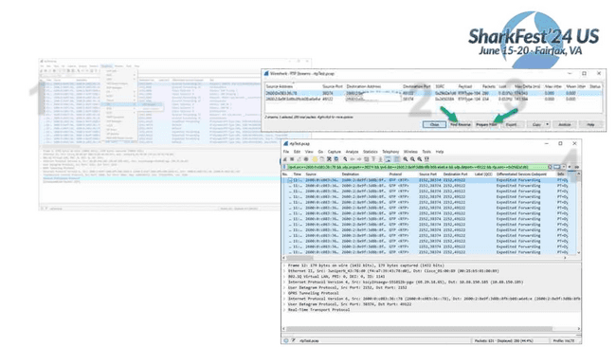
IO Graph for jitter/packet
arrival
1
1. Find all RTP streams in the capture.
2
3
4
2. Pick one side of the str
then click “Find Reverse
3. Click “Prepare Filter”.
4. Go back to Wireshark m
the arrow in the display
execute the filtering of

Slide 35
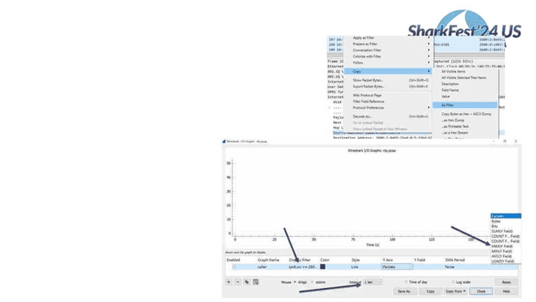
§ Open IO Graph
§ We know RTP active packet time
To get display filter expression
is 20ms, so we’ll set interval to
1ms.
§ Our Y field will be udp.time_delta
which will give us time of arrival
delta between each packet that ^{CTRL-V or}
matches our display filter
Left side of conversation filter

Slide 36
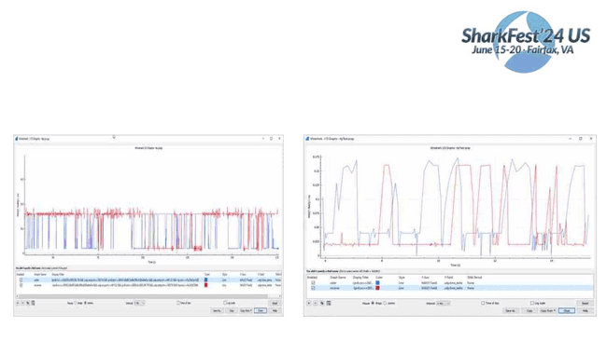
Left graph depicts what we expect to see. That is 20ms time on active packets, and 160ms on
silent packets. Using this graph you can tell who was speaking during this conversation.
Right graph is showing the Caller with an active call time at 40ms instead of 20ms, with spikes
down to 0ms. Hmm.
#sf2
4us

Slide 37
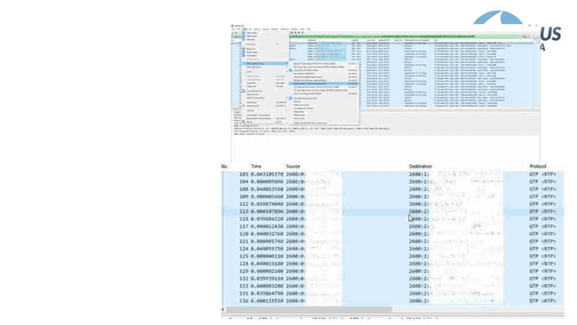
Set time format to “seconds since previous
displayed packet”
Adjust display filter to just show caller.
We can now see that the caller sends 2
packets every 40ms. That is one at the 40ms
mark, then another one within the same sub-
millisecond.
??
This was found to be uplink packet time
scheduling on the eNodeB. Packets could
only be requested on the 40ms timeslot. So
UE would send 2 at a time.

Slide 38
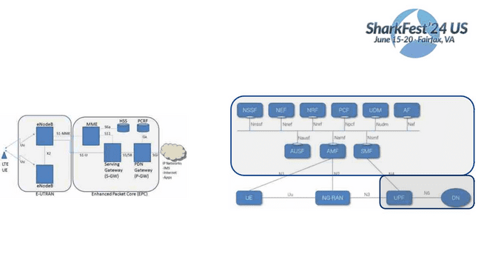
4G to 5G
#sf2
4us
What was combined functions on 4G have now been separated, and segregated into their own
network functions
Functions are now treated like services, and can be called upon with API like queries.

Slide 39
NETWORK FUNCTIONS
•AccessꢀandꢀMobilityꢀManagementꢀfunctionꢀ(AMF) supports:ꢀ
TerminationꢀofꢀNASꢀsignaling,ꢀNASꢀcipheringꢀ&ꢀintegrityꢀ
protection,ꢀregistrationꢀmanagement,ꢀconnectionꢀmanagement,ꢀ
mobilityꢀmanagement,ꢀaccessꢀauthenticationꢀandꢀauthorization,ꢀ
securityꢀcontextꢀmanagement. (AMFꢀhasꢀpartꢀofꢀtheꢀMMEꢀ
functionalityꢀfromꢀEPCꢀworld)
•SessionꢀManagementꢀfunctionꢀ(SMF) supports:ꢀsessionꢀ
managementꢀ(sessionꢀestablishment,ꢀmodification,ꢀrelease),ꢀUEꢀ
IPꢀaddressꢀallocationꢀ&ꢀmanagement,ꢀDHCPꢀfunctions,ꢀ
terminationꢀofꢀNASꢀsignalingꢀrelatedꢀtoꢀsessionꢀmanagement,ꢀDLꢀ
dataꢀnotification,ꢀtrafficꢀsteeringꢀconfigurationꢀforꢀUPFꢀforꢀproperꢀ
trafficꢀrouting.(SMFꢀhasꢀpartꢀofꢀtheꢀMMEꢀandꢀPGWꢀfunctionalityꢀ
fromꢀEPCꢀworld)
•Userꢀplaneꢀfunctionꢀ(UPF) supports:ꢀpacketꢀroutingꢀ&ꢀ
forwarding,ꢀpacketꢀinspection,ꢀQoSꢀhandling,ꢀactsꢀasꢀexternalꢀ
PDUꢀsessionꢀpointꢀofꢀinterconnectꢀtoꢀDataꢀNetworkꢀ(DN),ꢀandꢀisꢀ
anꢀanchorꢀpointꢀforꢀintra-ꢀ&ꢀinter-RATꢀmobility. (UPFꢀhasꢀpartꢀofꢀ
theꢀSGWꢀ&ꢀPGWꢀfunctionalityꢀfromꢀEPCꢀworld)
•PolicyꢀControlꢀFunctionꢀ(PCF) supports:ꢀunifiedꢀpolicyꢀ
framework,ꢀprovidingꢀpolicyꢀrulesꢀtoꢀCPꢀfunctions,ꢀaccessꢀ
subscriptionꢀinformationꢀforꢀpolicyꢀdecisionsꢀinꢀUDR. (PCFꢀhasꢀ
partꢀofꢀtheꢀPCRFꢀfunctionalityꢀfromꢀEPCꢀworld)
•AuthenticationꢀServerꢀFunctionꢀ(AUSF) actsꢀasꢀanꢀ
authenticationꢀserver. (partꢀofꢀHSSꢀfromꢀEPCꢀworld)
•UnifiedꢀDataꢀManagementꢀ(UDM) supports:ꢀge#nsefr2ationꢀ
ofꢀAuthenticationꢀandꢀKeyꢀAgreementꢀ(AKA)ꢀcre4duesntials,ꢀ
userꢀidentificationꢀhandling,ꢀaccessꢀauthorization,ꢀ
subscriptionꢀmanagement. (partꢀofꢀHSSꢀfunctionalityꢀfromꢀ
EPCꢀworld)
•ApplicationꢀFunctionꢀ(AF) supports:ꢀapplicationꢀ
influenceꢀonꢀtrafficꢀrouting,ꢀaccessingꢀNEF,ꢀinteractionꢀ
withꢀpolicyꢀframeworkꢀforꢀpolicyꢀcontrol. (sameꢀasꢀAFꢀinꢀ
EPCꢀworld)
•NetworkꢀExposureꢀfunctionꢀ(NEF) supports:ꢀexposureꢀofꢀ
capabilitiesꢀandꢀevents,ꢀsecureꢀprovisionꢀofꢀinformationꢀ
fromꢀexternalꢀapplicationꢀtoꢀ3GPPꢀnetwork,ꢀtranslationꢀofꢀ
internal/externalꢀinformation. (notꢀpresentꢀinꢀEPCꢀworld)
•NFꢀRepositoryꢀfunctionꢀ(NRF) supports:ꢀserviceꢀ
discoveryꢀfunction,ꢀmaintainsꢀNFꢀprofileꢀandꢀavailableꢀNFꢀ
instances. (notꢀpresentꢀinꢀEPCꢀworld)
•NetworkꢀSliceꢀSelectionꢀFunctionꢀ(NSSF) supports:ꢀ
selectingꢀofꢀtheꢀNetworkꢀSliceꢀinstancesꢀtoꢀserveꢀtheꢀUE,ꢀ
determiningꢀtheꢀallowedꢀNSSAI,ꢀdeterminingꢀtheꢀAMFꢀsetꢀ
toꢀbeꢀusedꢀtoꢀserveꢀtheꢀUE. (notꢀpresentꢀinꢀEPCꢀworld)

Slide 40
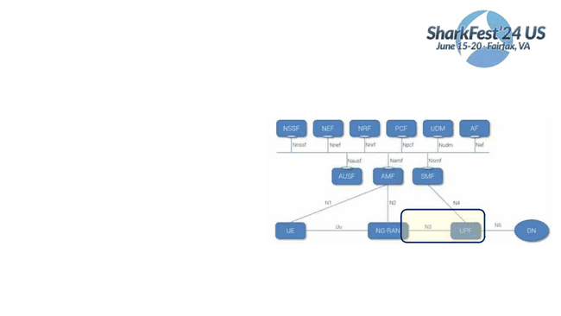
User plane protocols unchanged
#sf2
4us
The highlighted part still uses GTP, like the
previous 4G slides

Slide 41
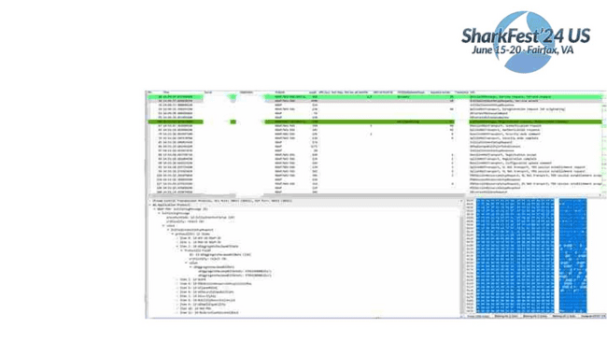
RAN Signaling
S1AP has changed to NGAP, but is the same type of informational elements, just more
Also is still on top of SCTP
#sf2
4us

Slide 42
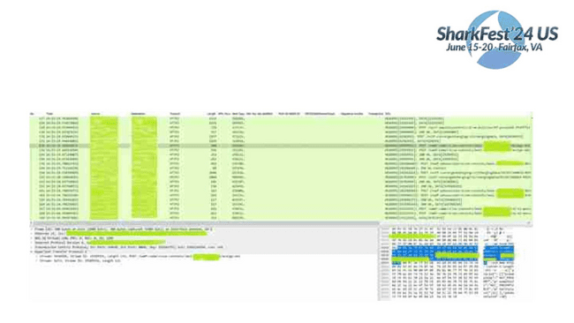
Core signaling over http2
• 4G diameter interfaces have now become JSON over HTTP2 (API like queries) #sf2
4us

Slide 43
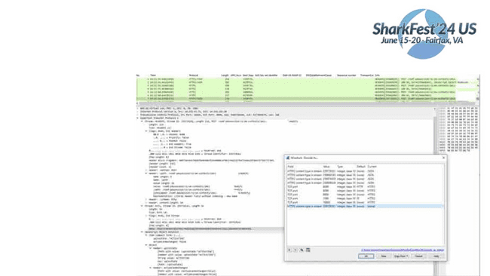
HTTP2 information
• Must have wireshark 3.4 or greater
• Decode As: HTTP2 content type in stream, enter value, and set as JSON
• Currently must be done
#sf2
4us
for each stream ID

Slide 44
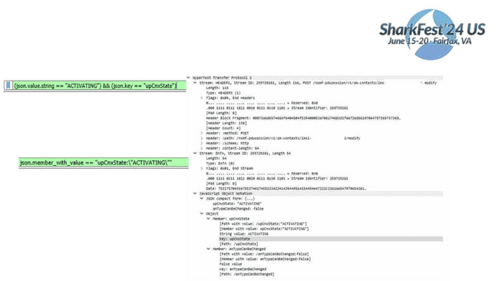
JSON over HTTP2
#sf2
4us
Current WS versions require you to filter like this
This is not great, because it doesn’t match a key value pair.
So any key with a value of “ACTIVATING” could be
matched, as long as the key upCnxState exist.
Development version allows for absolute filters
While this allows for more exact filtering,
there is still work to be done.

Slide 45
LUA dissector pt1
#sf2
4us
Provided to you:
tvb: Protocol data access
pinfo: Packet meta-info
tree: detail tree
You provide:
Header info

Slide 46
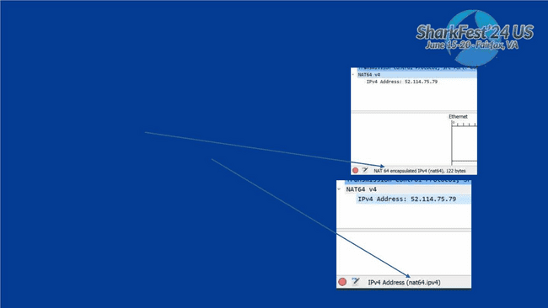
LUA dissector pt2
2
s
-- Append "NAT64" address to the Info column with a post-dissector, and create it's own tree.
-- create a new protocol so we can register a post-dissector
local myproto = Proto("nat64","NAT 64 encapsulated IPv4")
-- create a new field so we can assign that to the Proto
myproto_source = ProtoField.string("nat64.ipv4", "IPv4 Address")
-- Assign field to the proto object.
myproto.fields = { myproto_source }
-- register our new dummy protocol for post-dissection
register_postdissector(myproto)
--local nat64_field = Field
-- the dissector function callback
function myproto.dissector(tvb,pinfo,tree)
--
end

Slide 47
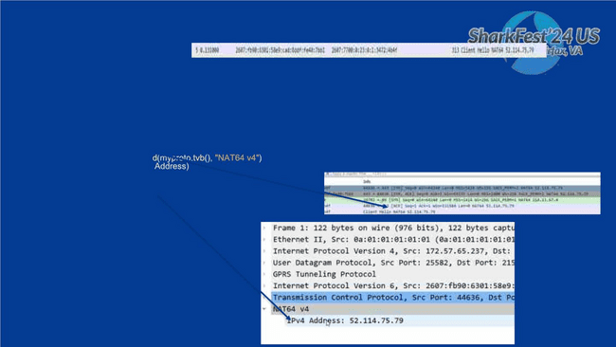
LUA dissector pt3
function myproto.dissector(tvb,pinfo,tree)
local dest = tostring(pinfo.dst)
local source = tostring(pinfo.src)
if string.find(dest, "7700") then
#sf2
4us
first, second = string.match(dest, "%d+:%d+:%d+:%d+:%d+:%d+:(.*):(.*)$")
firstOct, secondOct = string.match(first, "(..)(.+)")
thirdOct, fourthOct = string.match(second, "(..)(.+)")
ipv4Address = tonumber(firstOct, 16) .. "." .. tonumber(secondOct,16) .. "." .. tonumber(thirdOct,16) .. "." .. tonumber(fourthOct,16)
pinfo.cols.info:append( " NAT64 " .. tonumber(firstOct, 16) .. "." .. tonumber(secondOct,16) .. "." .. tonumber(thirdOct,16) .. "." .. tonumber(fourthOct,
16))
local subtree = tree:ad
subtree:add(myproto_source, ipv4
--repeat for source
else
end

Slide 48

-- Append "NAT64" address to the Info column with a post-dissector, and create it's own tree.
-- create a new protocol so we can register a post-dissector
local myproto = Proto("nat64Test","NAT1 64 encapsulated IPv4")
myproto_source = ProtoField.string("nat64.ipv4", "IPv4 Address")
myproto.fields = { myproto_source }
-- the dissector function callback
#sf2
4us
function myproto.dissector(tvb,pinfo,tree)
local dest = tostring(pinfo.dst)
local source = tostring(pinfo.src)
if string.find(dest, "7700") then
first, second = string.match(dest, "%d+:%d+:%d+:%d+:%d+:%d+:(.*):(.*)$")
firstOct, secondOct = string.match(first, "(..)(.+)")
thirdOct, fourthOct = string.match(second, "(..)(.+)")
ipv4Address = tonumber(firstOct, 16) .. "." .. tonumber(secondOct,16) .. "." .. tonumber(thirdOct,16) .. "." .. tonumber(fourthOct,16)
pinfo.cols.info:append( " NAT64 " .. tonumber(firstOct, 16) .. "." .. tonumber(secondOct,16) .. "." .. tonumber(thirdOct,16) .. "." .. tonumber(fourthOct,1
local subtree = tree:add(myproto,tvb(), "NAT64 v4")
subtree:add(myproto_source, ipv4Address)
elseif string.find(source, "7700") then
first, second = string.match(source, "%d+:%d+:%d+:%d+:%d+:%d+:(.*):(.*)$")
firstOct, secondOct = string.match(first, "(..)(.+)")
thirdOct, fourthOct = string.match(second, "(..)(.+)")
ipv4Address = tonumber(firstOct, 16) .. "." .. tonumber(secondOct,16) .. "." .. tonumber(thirdOct,16) .. "." .. tonumber(fourthOct,16)
pinfo.cols.info:append( " NAT64 " .. tonumber(firstOct, 16) .. "." .. tonumber(secondOct,16) .. "." .. tonumber(thirdOct,16) .. "." .. tonumber(fourthOct,1
local subtree = tree:add(myproto,tvb(), "NAT64 v4")
subtree:add(myproto_source, ipv4Address)
else
end
end
-- register our new dummy protocol for post-dissection
register_postdissector(myproto)

Slide 49
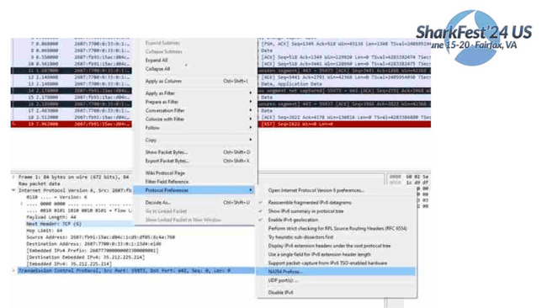
#sf2
4us

Slide 50

#sf2
4us
Time for Q & A

