Slide 1

Enhancing WiFi Networks with AI
A Deep Dive into the Machine Learning for WiFi Health Checks
#sf24us
Murat Bilgic

Slide 2
Way to contact
You can find me at @murat_pnw
Join the discord channel #ai-integration to discuss any items
Will put this presentation there

Slide 3
Your feedback sought
https://www.surveymonkey.com/r/B-Yond-at-Sharkfest24

Slide 4


Where credit is due
Zohaib Aftab
Nathanael Weill

Slide 5
This session is not
A primer/tutorial about AI or ML
Similarly not about Wifi
Or how to dissect pcap

Slide 6
Objectives
Develop insights
Gain awareness
Identify new skills to pursue
Specifically:
Get Familiar with Supervised Learning
Introduction to Time Series Modeling for Machine Learning
Apply Time Series Modeling to Detect Decreases in Data Rate

Slide 7
Important Inequalities
AI ≠ ML
AI ⊃ ML ⊃ DL
ML ≠ DL
AI – Artificial Intelligence
ML – Machine Learning
DL – Deep Learning

Slide 8
Machine Learning
Art of "statistically learn" from data without explicit programming in a continuous manner.

Slide 9
Using ML in Networking
Identification of issues, trends, anomalies, and root causes

Slide 10

Getting organized

Slide 11
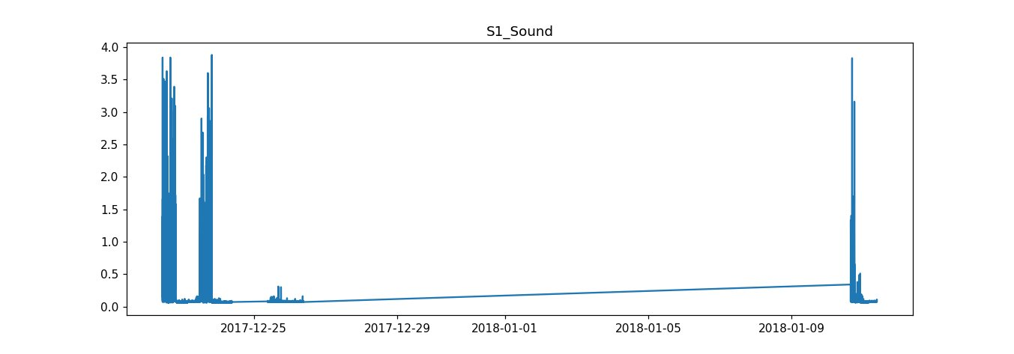
Time Series
A time series is a sequence of data points ordered chronologically.
Essential elements include the datetime or timestamp of each data point and its corresponding value.
Examples:
- Stock prices over time
- Weather station temperature readings
- Daily birth rates across city hospitals
timestamp​ | value​
01/02/2020 15:21​ | -10​
01/03/2020 11:13​ | 0.1​
01/05/2020 01:50​ | 3.5​
…​ | …​

Slide 12
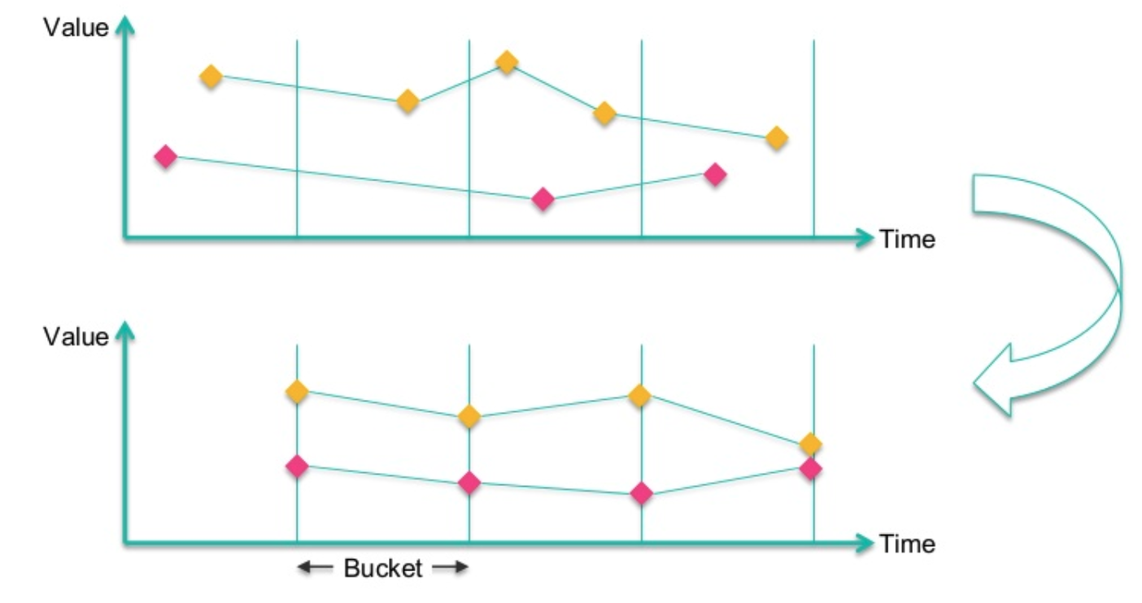
Time series preprocessing: resampling
Purposes:
Eliminates duplicate data points.
Identifies gaps within the dataset.
Resampling Size Consideration:
Must be lower than or equal to the data's inherent granularity.
Aligns with the specific requirements of your analytical problem.

Slide 14
df.set_index('dates').resample('M').mean()

Slide 15
Essential definitions in time series analysis
Now: The current point in time for making predictions. This point is flexible and each selection of "now" leads to a new data observation (= a row).
Step Size: The time gap between successive "now" instances. This interval must be tailored to meet specific business objectives, ranging from minute-by-minute predictions to monthly forecasts.
History: The length of time prior to "now" that is analyzed for creating predictive features. Determines how far back the data is considered to inform the prediction.

Slide 16
Now
history
Step size

Slide 17
Methodology summary
Collect Wifi pcaps from live network, test-bed, emulator
Use tshark to generate csv for essential attributes
Perform exploratory data analysis
Cleanse the data
Resample time-series data
Create features for a selected variable
Optimize model

Slide 18
Future work suggestions
Countless number of causalities to be found in WiFi pcaps
More data with more variety lead to better models
Time-series can also be applied for forecasting

Slide 19
Generated with Microsoft Designer AI
Prompt: Great white shark, standing at a podium with a laptop. The laptop has stickers on it. Darker blue ocean background.

