Slide 1

Passive Fingerprinting Methods for IoT Profiling
#sf24us
Asaf Fried
Data Research TL

Slide 2

whoami
M.Sc. in Software and Information System Engineering
Ben-Gurion University
7 Years of data research roles, IT security industry
Cato Networks, Check Point
Data scientist, Network researcher, Data research TL
Research interests
Asset discovery, risk assessment, and network-based attacks in enterprise environments
Asaf Fried
Data Research TL at Cato Networks
Notes:
SASE – Secure Access Service Edge

Slide 3

Agenda
IoT asset management and why it’s so hard
Passive fingerprinting methods
Wireshark packet captures*
IoT Sentinel
*IoT Sentinel: Automated Device-Type Identification for Security Enforcement in IoT

Slide 4


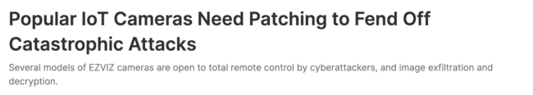
IoT Security
Security Weaknesses: Weak security protocols, inadequate encryption, and lack of regular updates​.
Common Exploits: Cybercriminals exploit these vulnerabilities to launch DDoS attacks, data breaches, and create botnets for further malicious activities​.
Market for Exploits: The dark web hosts a thriving market for IoT-related hacking tools and services, facilitating widespread exploitation of these devices​.

Slide 5
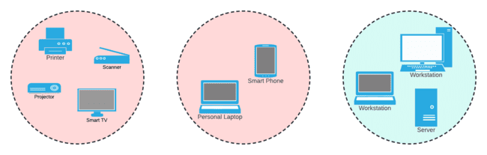
Un/managed Devices
Managed Assets
IoT
BYOD

Slide 6
Passive Fingerprinting
Methods
#sf24us

Slide 7

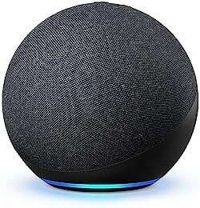
Device Fingerprint
id: "amazon_echo”
conditions:
- type: ”HTTP"
fields:
- "user_agent”
patterns:
- " \(Linux; U; Android ([0-9\.]+); (AEOC[W|H|N|K])$” - type: ”TCP”
fields:
- ”options”
value:
- [2, 4, 8, 1, 3]
- type: ”IP”
fields:
- ”ttl”
value:
- 64
Amazon Echo

Slide 8
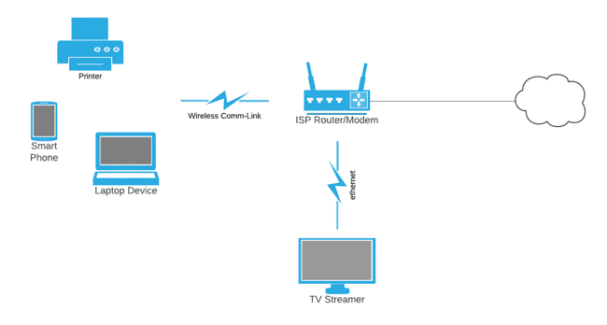
Setup
Simple Home Network
Notes:
Simple networks
Often a single device (ISP modem) that has access to all LAN/inbound/outbound traffic
Running the fingerprinting software on it is sufficient

Slide 9
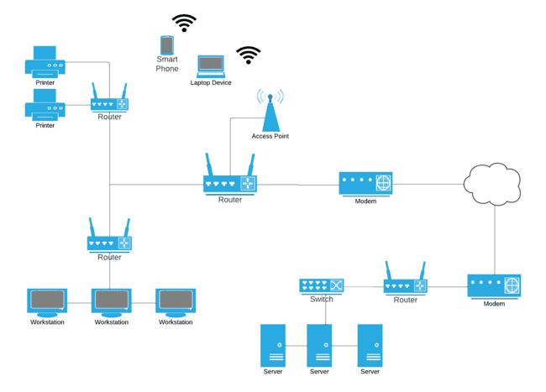
Setup
Complex Business Network
Notes:
Complex networks
Multiple site communicating over WAN
LAN contains multiple subnets
ISP Modem won’t be sufficient for gaining visibility to all LAN devices (only WAN/outbound/Inbound traffic)

Slide 10
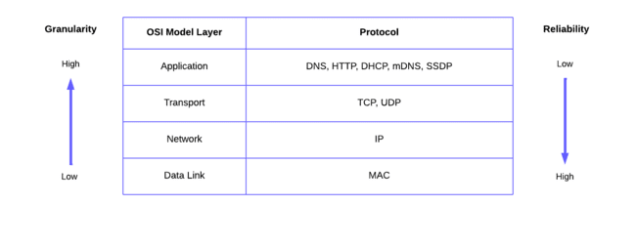
Protocols
Notes:
This is not an exhaustive list, these are the basic and most common

Slide 11
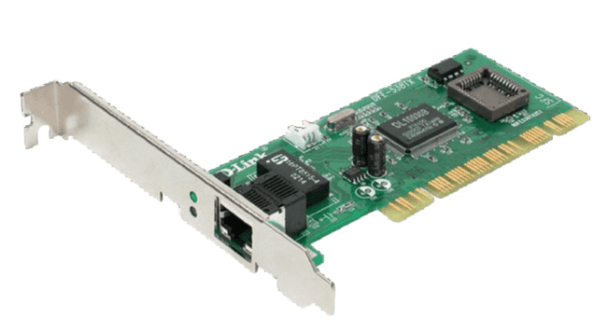
Mac Address
00:11:22 : AA:BB:CC
3 bytes (24 bits)
3 bytes (24 bits)
Organizational Unique Identifier
Device Identifier
Network Interface Card (NIC)

Slide 12
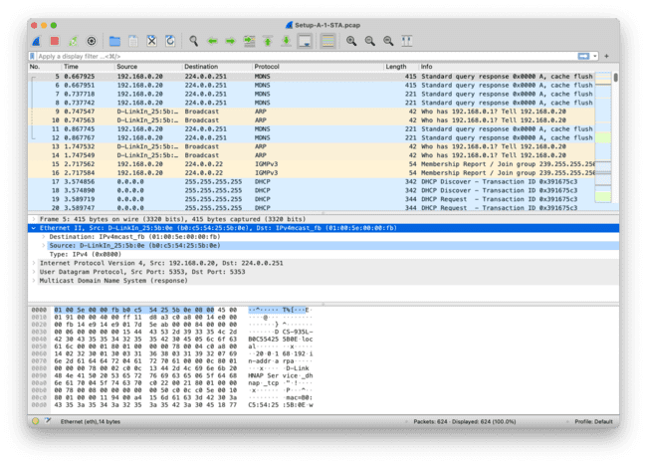
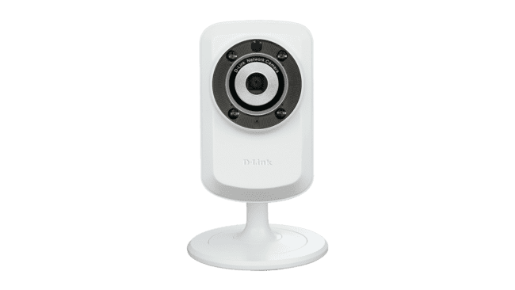
Mac Address
D-Link Cam
OUI == “B0:C5:54” // D-Link International

Slide 13
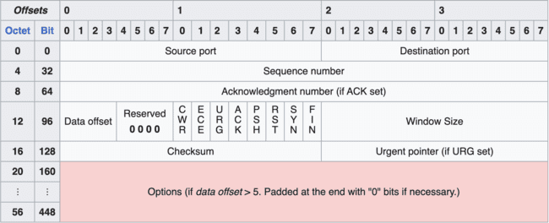
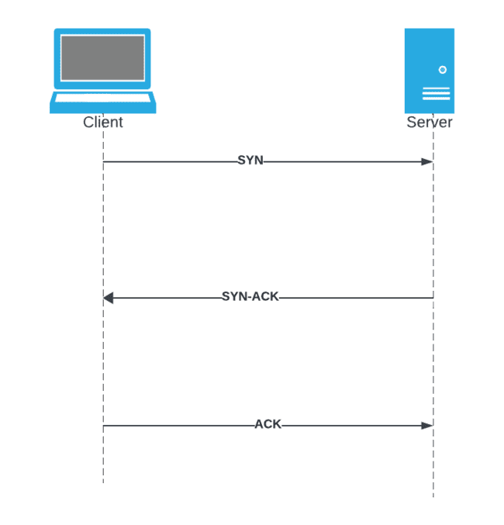
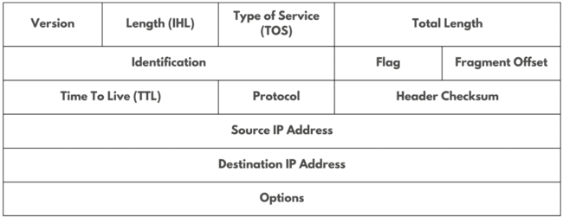
TCP/IP Header
Notes:
- Very commonly used for OS fingerprinting

Slide 14
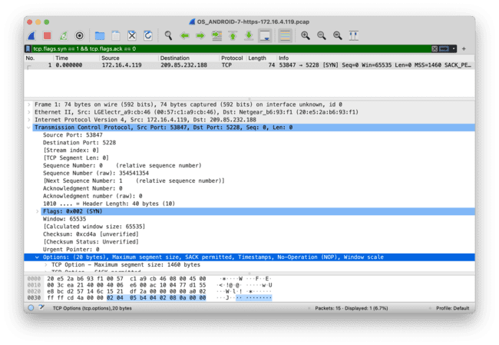


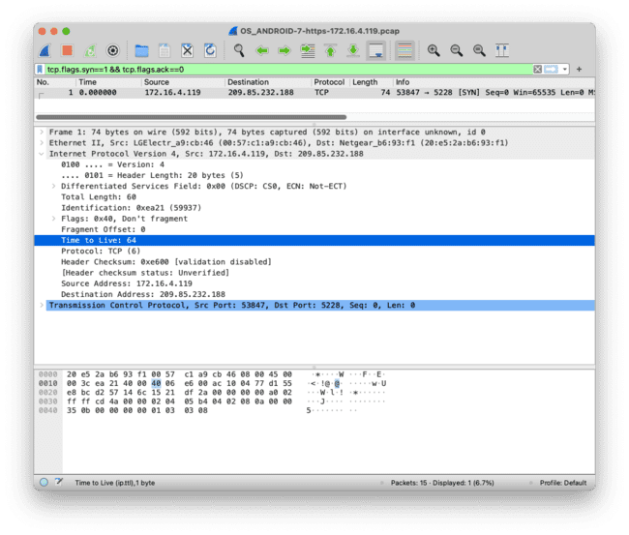

TCP/IP Header
Android based OS
IP TTL== 64 and
TCP Options == 02,04,08,01,03,25

Slide 15
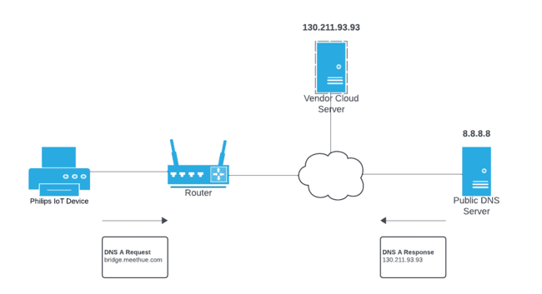
DNS Traffic
Notes:
- IoT need to communicate with external vendor servers for: firmware update, data storage, analytics, authentication, time setting, configuration, and more.
- Most IoTs have a bounded set of external address they communicate with, so DNS can be used for fingerprinting

Slide 16
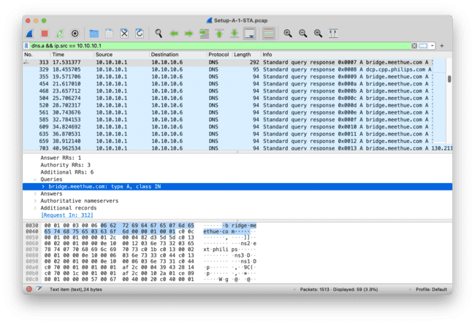
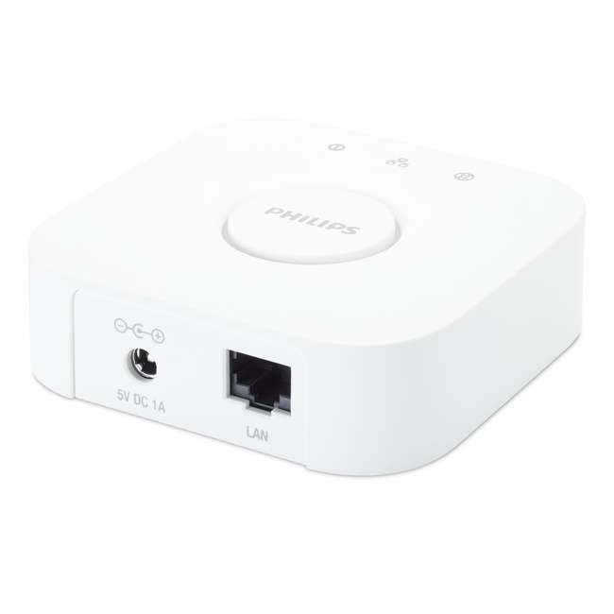
DNS Traffic
Philips Hue Bridge
“bridge.meethue.com” in DNS A and
“dcp.cpp.philips.com” in DNS A

Slide 17
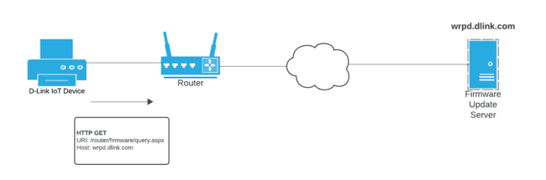
HTTP Traffic
Notes:
It is still very common to see IoT using HTTP over the web
Many IoT devices have limited processing power and memory, making the overhead of HTTPS (which requires encryption, decryption, certificates handling) more demanding

Slide 18
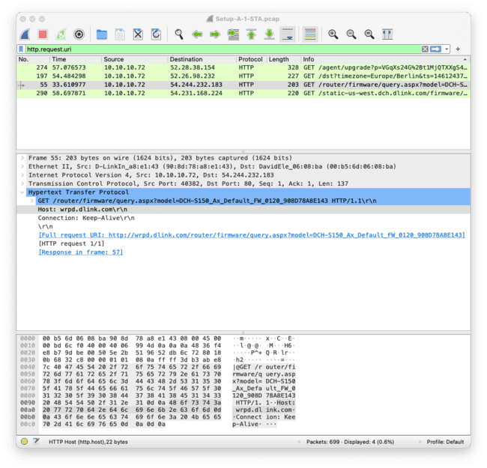
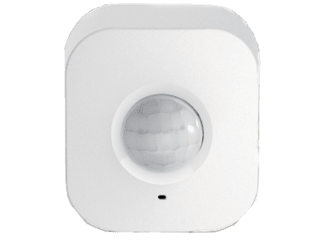
HTTP Traffic
D-Link Motion Sensor
DCH-S150
Firmware update
Host == “wrpd.dlink.com” and
URI contains “DCH-S150”
Notes:
The IP in the PCAP isn’t local (HTTP over the web)

Slide 19
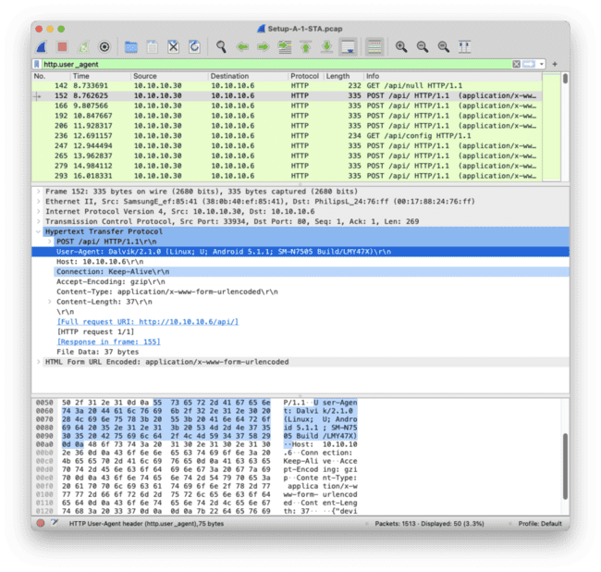
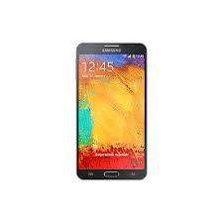
HTTP Traffic
Samsung Galaxy
Note 3 Neo
User-Agent contains “SM-N7505”

Slide 20
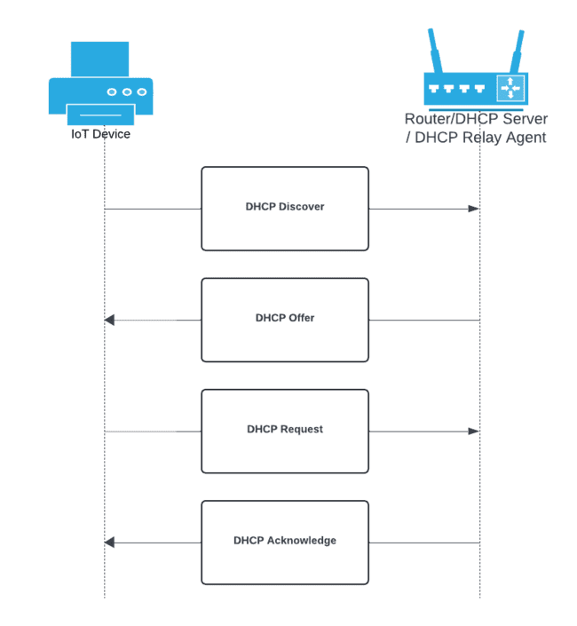
DHCP Traffic
Notes:
Simple network – modem/router given by the ISP also acts as the dhcp server
Complex networks – router or llayer 3 switches are often configured as dhcp relay agents

Slide 21
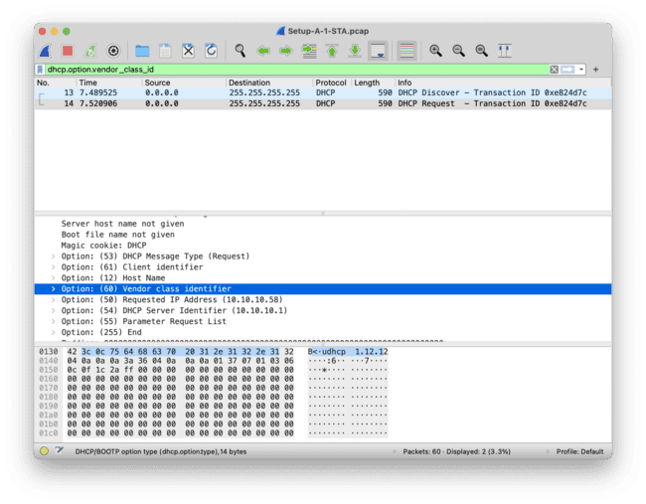
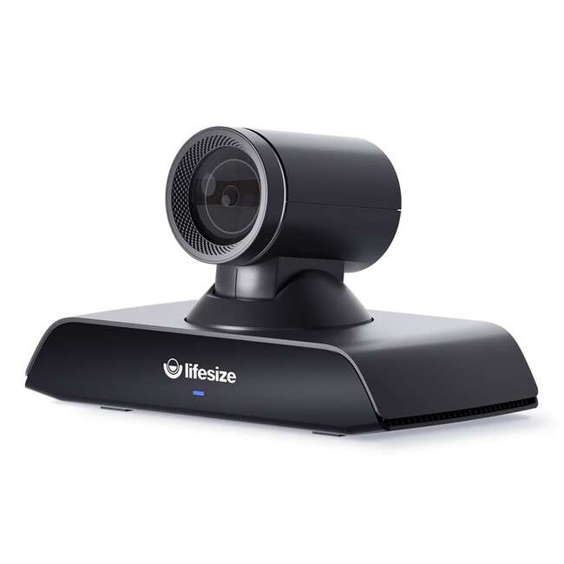
DHCP Traffic
Lifesize Icon IP camera
vendor_class_id pattern “^LifeSize Icon [\d]{2,4}$” // DHCP option 60
Notes:
- Dhcp vendor class is used by DHCP servers to identify the type or class of device making a DHCP request. It allows for customized configuration settings based on the vendor or device type.
- This info isn’t given by all device, but is common for IoT

Slide 22
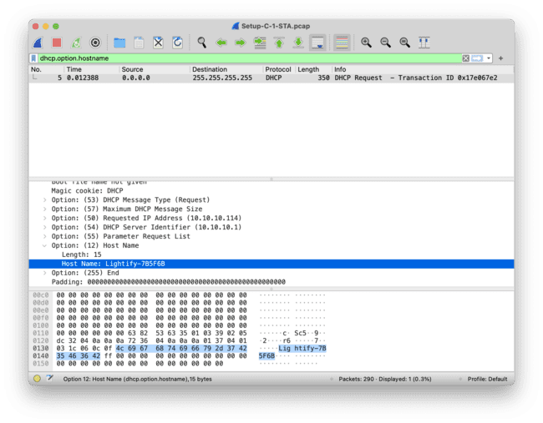
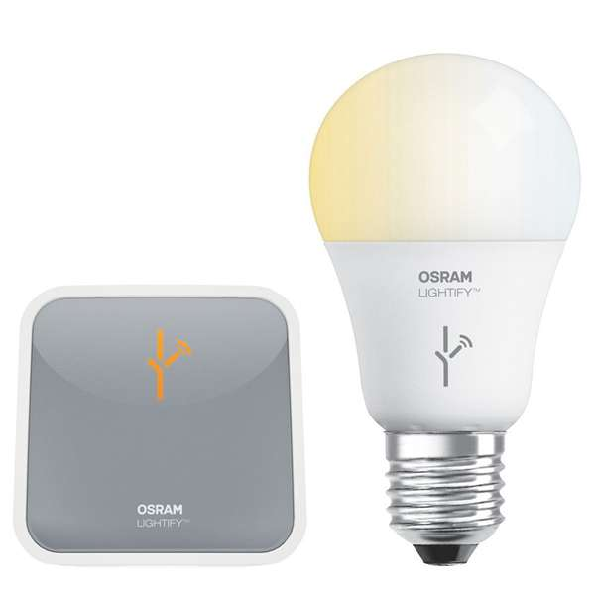
DHCP Traffic
Lightify Smart Bulbs
Hostname contains “Lightify-” // DHCP option 12

Slide 23
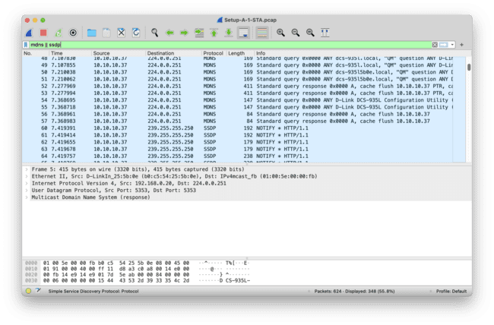
LAN Service Discovery
mDNS (Multicast DNS):
  Enables devices on a local network to discover and communicate with each other without a central DNS server by broadcasting service information.
SSDP (Simple Service Discovery Protocol):
  Facilitates the advertisement and discovery of network services and devices, allowing for automatic discovery in a network, based on the Universal Plug and Play (UPnP) architecture.

Slide 24
Exercise – mDNS / SSDP
Download IoT PCAP files from IoT Sentinel GitHub
Look for mDNS/SSDP indicators
Create a fingerprint that uniquely identifies the IoT
IoT Sentinel

Slide 25
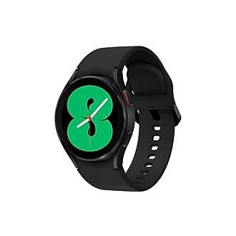
Single Flow (Stateless)
HTTP/s
id: "galaxy_watch_4”
conditions:
- type: ”HTTP"
fields:
- "user_agent”
patterns:
- "SM-R860”
- type: ”TCP”
fields:
- ”options”
value:
- [2, 4, 8, 1, 3]
- type: ”IP”
fields:
- ”ttl”
value:
- 64
- type: ”MAC”
fields:
- ”oui_vendor”
value:
- “Samsung Electronics Co.,Ltd”
HTTP/s
Galaxy Watch 4
TCP
Android based
OS (Wear OS)
IP
MAC
Samsung Device
Notes:
- Be aware of randomized mac address

Slide 26
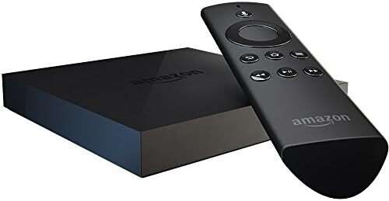
Multiple Flows (Stateful)
TCP + DNS
id: ”amazon_fire_tv”
conditions:
- type: ”DNS"
fields:
- ”a_record”
value:
- ”firetvcaptiveportal.com“
- type: ”TCP”
fields:
- ”options”
value:
- [2, 4, 8, 1, 3]
- type: ”IP”
fields:
- ”ttl”
value:
- 64
- type: ”MAC”
fields:
- ”oui_vendor”
value:
- “Amazon Technologies Inc.”
TCP
Android based
OS (Fire OS)
IP
MAC
Amazon Device

Slide 27
Multiple Flows (Stateful)
TCP + DNS
id: ”amazon_fire_tv”
conditions:
- type: ”DNS"
fields:
- ”a_record”
value:
- ”firetvcaptiveportal.com“
- type: ”TCP”
fields:
- ”options”
value:
- [2, 4, 8, 1, 3]
- type: ”IP”
fields:
- ”ttl”
value:
- 64
- type: ”MAC”
fields:
- ”oui_vendor”
value:
- “Amazon Technologies Inc.”
DNS
Fire TV
UDP
IP
MAC
Amazon Device

Slide 28
Takeaways
Asset management for IoT is hard
Passive fingerprinting – simple and less intrusive
Use multiple protocols for robust and granular fingerprints

