Slide 1
Monitor Your PCAP data Sharkmon The bridge between one and many

Slide 2
inter View
inter View – between the layers
Since 1996
Andreas Died rich
CEO/CTO/CFO/CXO
SE / Consultant
… and office cleaning
ad@inets.de
Service management
Correlation

Slide 3
Do we need DPA Montoring ?
My Experience…
Many of many packet analysis projects
User complain: "S-o-m-e-t-i-m-e-s 🫥 … it's slow … service no response, session hanging ...“ ;(
Existing packet monitoring – some hundred metrics– not detected issues
So what to do ? – we all know .-.
2 days data -> 200 PCAP files
Wireshark -> 5 days of digging
and because many packets were filtered out, a lot of important data was lost ;( and real cause not detected – but just the effect
… and … I am lazy 🙃
I WANTED clear : ….wireshark-deep packet Monitoring !!!!
Auto-Analysis of many pcap files – using all known metrics and display filters

Slide 4
Why we are here
Wireshark / Tshark
Wireshark / Tshark is not just a „tool“
it is the diamond of packet data
The global reference for packet analysis
- 3.000 protocols
- 317.000 display filter = 317.000 metrics !
- Each of these fields including data and/or information
Use cases
- Network – everywhere , infrastructure , application, performance, incidents, security, industry, finance, health, Telco...
- Constantly new protocols
- And daily new attack types (ca. 30.000 per year )
Not using tshark for packet analysis monitoring
is causing gaps
Notes:
tshark as the core for analysis
and also potetnially for monitoring
we are not here to say we can replace somethig
but to show the usecase - how tshark can be used for monitoring

Slide 5
Sharkmon – something ? Or ALL ?
Should be highly flexible solution – like wireshark
300.000 display filter / 267.000 protocol fields
= 300.000 monitoring metrics – or even more ?
3.000 protocols = 3.000 usecases ?
Each of it could be a potentially a monitoring topic
User decides the WHAT and HOW !
Protocol | # Fields
Arp | 55
BGP | 910
BootP | 530
DHCP | 591
DLSW | 71
DNS | 378
ETH | 37
FTP | 38
H323 | 45
Hsrp | 44
http | 107
http2 | 162
Icmp | 108
Imap | 18
IP | 140
Ipv6 | 384
Mpls | 24
mySQL | 292
Nbns | 52
Netbios | 53
Nfs | 691
NTP | 346
OSFP | 337
QUIC | 322
… | …
> Deepest flexibility is essential for any solution here

Slide 6
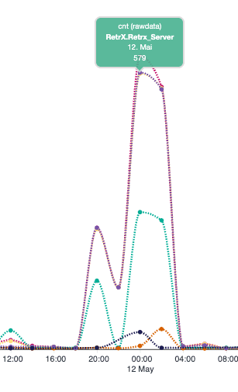
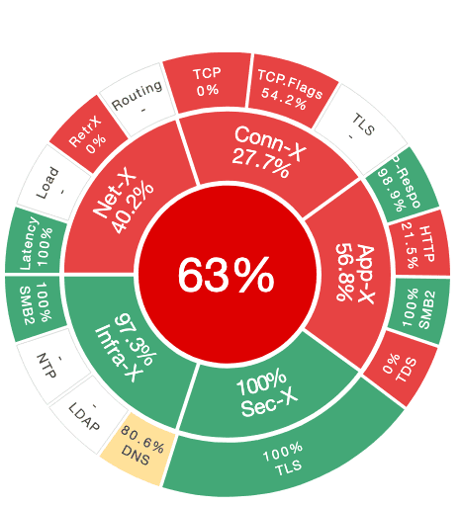
Metric variations – example „Retransmission“
Category : Network
Class : Retrx
Metrics
Retransmission
Fast retransmissions
Dup_Acks, SACKs
Internal / external network
Client / Server
RTO Count
RTO – Time (AVG, MAX, SUM)
TCP SYNC - Retrx
TTL changes ?
Timing effect

Slide 7
Packet Monitoring – What did it mean for us
PCAP data Import / files umlimited !
Flexible data sources
wireshark expertise – should be re-usable for monitoring
MultiCore Support
(near) Real-time / Alerting
insight instead of post-mortem– every lost second increases the problem
Performance
High Performance/Multithreading, 10 Gbps and more as guideline
Correlation methods
Cause & Effect detection across protocol layers – not just raw data
Anomaly detection
deviation from what is normal – needs historical data in same view
Usable
by more than just network protocol experts
Embedded
into operational and service management workflows
Strato Shark as extension ?

Slide 8
Quick demo
Dashboard
1 sec data
Metrics .. All what user wants
Many pcap files
Thresholds an incidents
! Not more !!! Now
No anomaly , index explain etc.

Slide 9
Tshark commands
anyone can do tshark monitoring

Slide 10
Tshark - the DPA diamond
Any protocol field
Any display filter = potential metric
Combined filters (tcp.analysis.retransmission && ip.dst==X && tcp.dstport==123)
Enables deeper logic, such as for internal versus external network
Example: Log4J detection using pattern-based filter

Slide 11
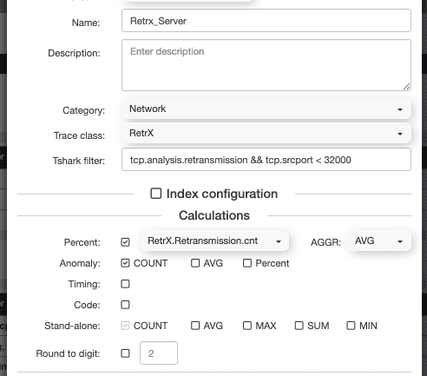
tshark data types for metrics
Counts number of matches, issues, errors
Codes e.g. ICMP code, TLs alert, HTTP response , DNS amm.
Values numeric fields like port, TLS version, TTL, stream ID
Timing like RTT, RTO, handshake time
Text matching - payload containing strings "xyz")
Aggregation types
COUNT - how often something occurs
AVG/MAX/MIN/SUM - for values and timings

Slide 12
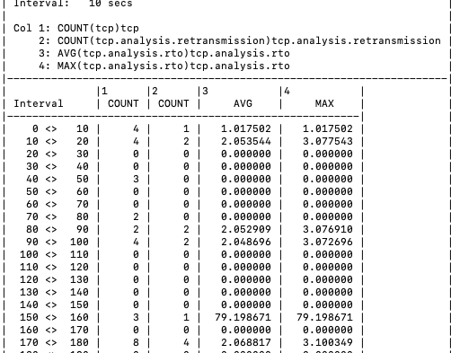
Tshark Data commands
Statistics Table
Parameters
Display filter (e.g. tcp.analysis.retransmission)
Time span (e.g. 10s, 1s)
Aggregation per interval:
COUNT, AVG, MIN, MAX, SUM
Tshark Command
-z io,stat,…
Output
one line per time span
Very small output size – ideal for time graphs
Fast extraction (~1 GB in ~8 sec)
Limitation
- no IP addresses / Ports assigment in results
- We know the what and when – but not the who
tshark -qr trace.pcap -z io, stat, 10, "COUNT(tcp)tcp","COUNT(tcp.analysis.retransmission)tcp.analysis.retransmission","COUNT(tcp.analysis.retransmission)tcp.analysis.fast_retransmission,"AVG(tcp.analysis.rto)tcp.analysis.rto“ …

Slide 13
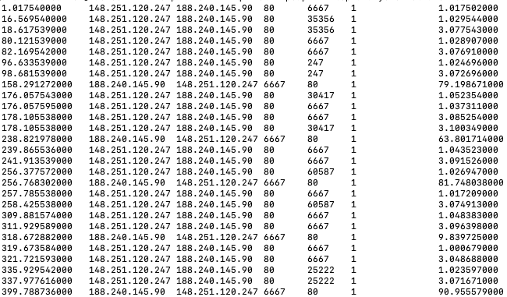
Extended Data Extraction
The When, what … and who
Command
-T fields –e displayfilter
Key Fetures
one line per packet in export file
At 10 Gbps = 1 million lines per file
„display filter“ only data with data for these fields – but …
Each packet has address field ;) so no real reduction
Performance Notes
more processing time
1field= 1GB = 20 Sec
68 fields =50 sec (our default)
Large output data volume
challenge for DB processing ´
tshark -qr trace2.pcap -Y "tcp.analysis.retransmission"
-T fields -e frame.time_relative
-e ip.src -e ip.dst -e tcp.srcport -e tcp.dstport -e tcp.analysis.retransmission -e tcp.analysis.fast_retransmission -e tcp.analysis.rto …> retrx.txt
Notes:
life demo

Slide 14
Summary Tshark
Tshark delivers complete data for deep packet monitoring
Supporting long-term capture
Enables fine-granular aggregation
Any tshark display filter (317,000+) can be used as a metric
Reuse your existing Wireshark skills
Aggregate at any depth – 1 sec, 0.1 sec, or longer
… and get true spikes and max values in that window
Covers virtually every use case in deep packet monitoring
And became data source for Sharkmon

Slide 15
Lets check sharkmon now

Slide 16
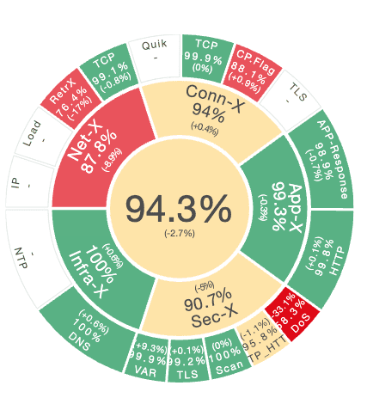
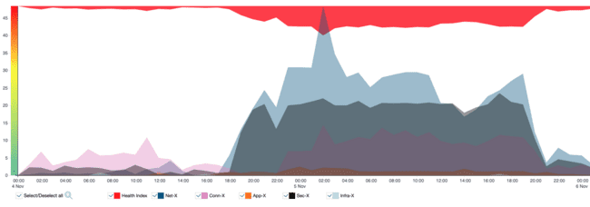
Sharkmon from packet data - to results
Network packets cloud
Where
What
When
Tshark Packet Processing
Calculation
Identification
Filter
Data export
Sharkmon Processing
Data Import
Aggregation
Thresholds
Indexing
Alerting
Database
How

Slide 17
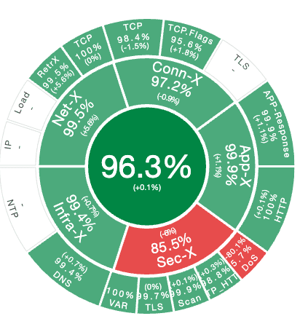
Data organisation
Use cases
Telco, Health, Finance, Webcloud, Satellite, VPN …
Data sources
Scenarios
Views
Profiles
Profiles
Metrics (tshark filter, aggregation, reference)
Thresholds
Categories / Classes
indexing
Notes:
flexibilty - is highest Priority
and requires open architecture

Slide 18
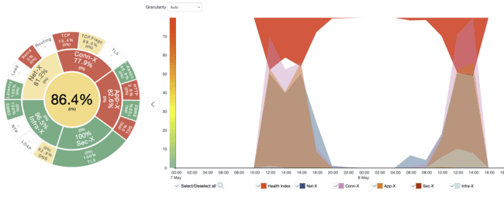
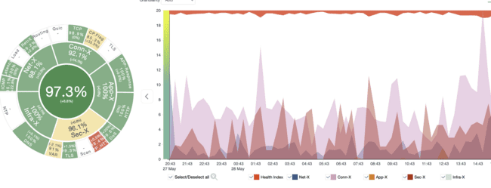
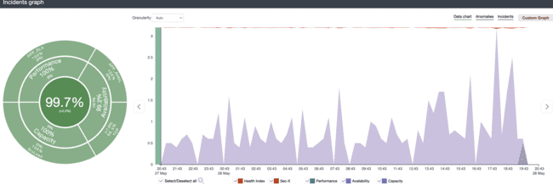
Sharkmon scenario approach
Many Usecases /
Data sources
Scenarios
Various analysis Profiles
Different Scenario views
Scenario A
DS A
Telco A
Profile A
Scenario B
DataSource B
Data center
Profile B
Data Import
Scenario C
Profile A
DS C
Telco B

Slide 19
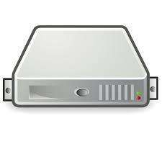
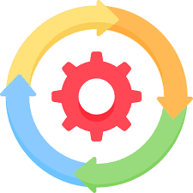
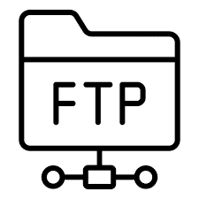
Datasources
Monitoring
Auto-Import
Capture Appliance
API
Parallel data import
Multiple datasources
Multiple locations
Server OS
Tcpdump/ringbuffer
sFTP auto Import
Manual upload
sFTP Put
pcap
Drag & drop

Slide 20
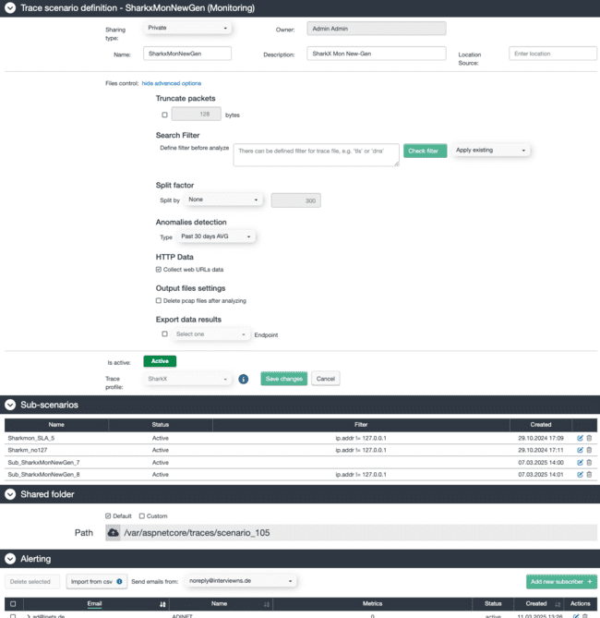
Scenario parameter
Datasource (types)
Data processing ( monitoring / upload)
Split by (packets,Time)
Scenario Filter (BPF/Display filter)
Anomaly detection
30 day AVG
Baseline workdays
Profile
Option
Sub scenarios
Alerting rule
Notes:
show ata sources
wasabi
sharkx - withit 42 TB data
and manuall

Slide 21
Profile Structure – Metrics / Categories / Classes
Organisation Data scheme for many potential usecasess
Metrics
Metrics
Metrics
Metrics
Metrics
Metrics
Metrics
Metrics
Metrics
Metrics
Metrics
Metrics
Metrics
Metrics
Metrics
Metrics
Metrics
Metrics
Metrics
Metrics
Metrics
Metrics
Metrics
Metrics
Metrics
Metrics
Metrics
Classes
Retrx
Classes
Routing
Classes
…
Classes
Http
Classes
SMB2
Classes
…
Classes
User defined
Classes
…
Classes
…
Categories (network)
Categories (Application)
Categories
user defined
Service

Slide 22
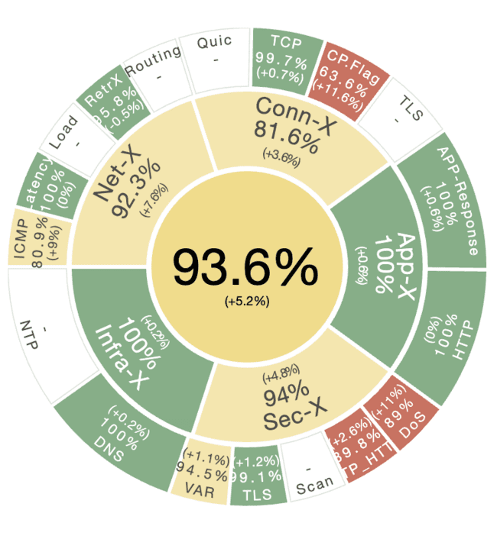
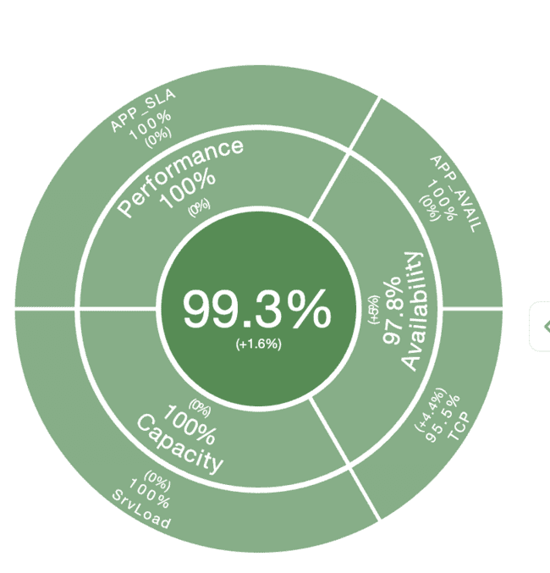
Many scenarios possible
Same Data – different views
Operations
SLA

Slide 23
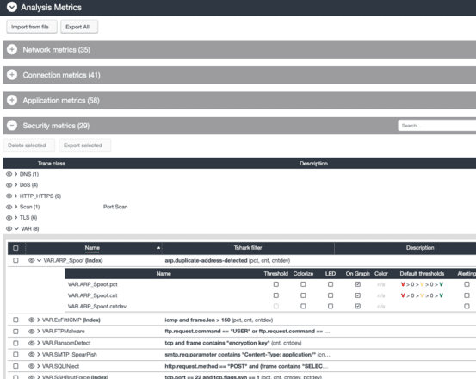
Metric Analysis Profiles
Created based on use cases
Different environments require different metrics → VoIP, WAN, Industry, Finance, Web, Office, Telco, SLA, etc.
Metrics must be predefined using Wireshark display filters
Metrics aggregated in profiles
Grouped by category/class
Profiles include thresholds –
so same metrics can have different thresholds in different profiles – epending on usecase
Include Indexing config
Profiles are portable
Profiles can be exported/imported
Easy to share, reuse, and adapt across teams
Notes:
deoo profile and show
categroreis / classes
create them
metrics
and profile containers
incl. thresholds
create new metric
export merics
export profiles
explain that external ressources / packet doctor, providing shark fitler - can be used to create metrics

Slide 24
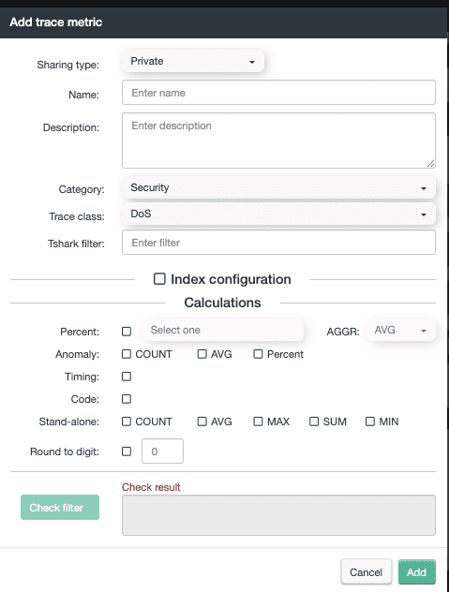
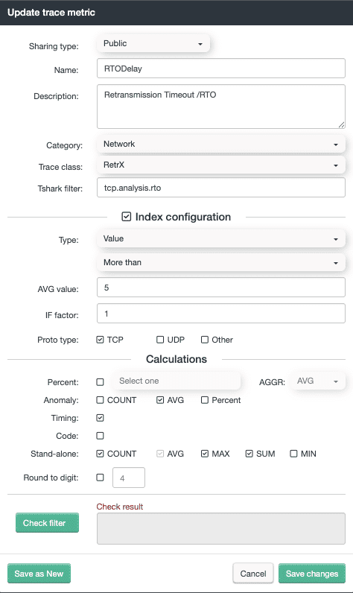
Create Your Own Metrics
Use a custom name
Assign to an existing or custom category (users can create categories)
Copy/paste a Wireshark display filter
Use % as a reference metric (optional)
Select if it's a timing-based or code-based metric
Choose the type: Count, AVG, MAX, MIN, SUM
Mark if it's relevant for anomaly detection
Notes:
from wireshark
warning message

Slide 25
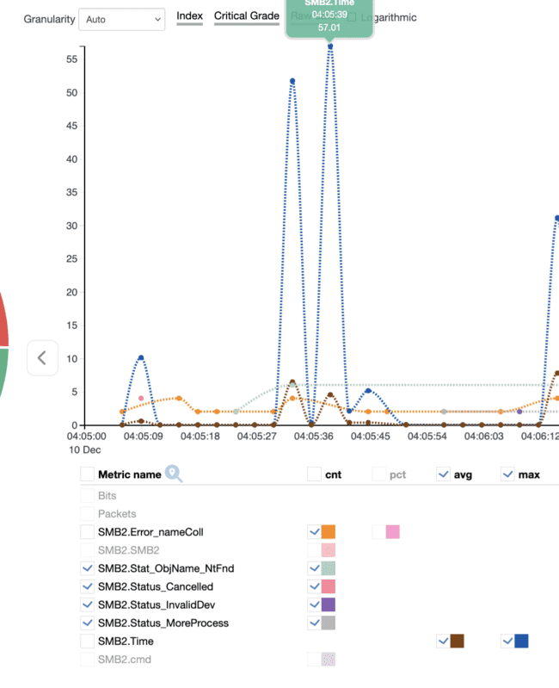
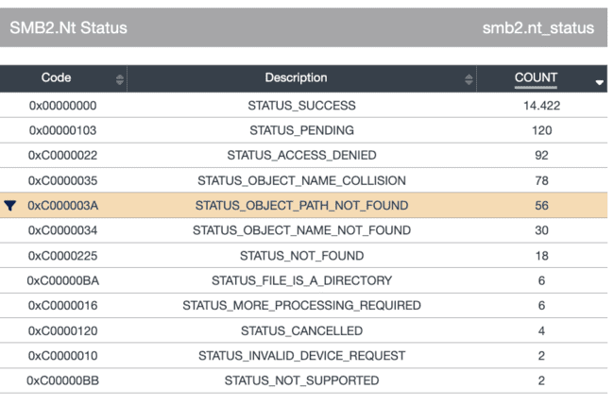
CODE METRICS
Codes are very important for analysis
TLS codes
http codes
SMB Codes
…
Error codes
Status codes
Conflicts
Example SMB2
Every special code can become a single monitoring metric

Slide 26
Indexing – or why raw data is not enough
How such incredible complex data can be readable - for anyone ?
User can‘t and should not know all metrics
Should be usable by Non-Shark-engineers
Indexing !!!
Calculation of „status“ –
of selected metrics, classes, categories, sessions…
and comprehensive service
This lets User can immediately identify
Wether a service is impacted
Critical section / category, responsibilty
deepest view for metrics
And .. rown to Session level –
Who or what is causing or affected

Slide 27
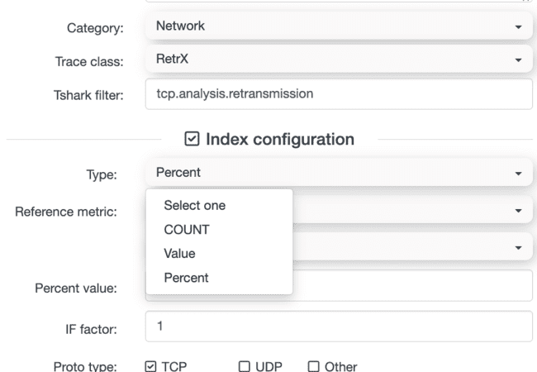
Indexing
Just a default ?
1 retransmission – or 1 Brutforce Attack
- Same ?
Config and Selectable for each metric
Default Index is 100
Loss of quality is reducing by index factor
Can be chnged – from 0.00001 to 1000

Slide 28
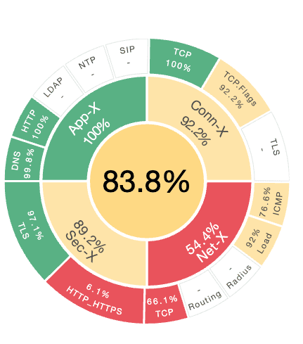
Indexing helps for various user levels
Service quality is too low - 83 % !!
Yes – we have network problem now !
Service
Management
Load & routing is ok – we check deeeper !
high Packetloss – session timeout
Route changes
WAN provider !!!
Network
management
Network Operations

Slide 29
Identify critical Status, Metrics – and Sessions
Top Level
Health 88%
Most crititcal: security
Security Drill down
Most critical – Class VAR
SecVar Drill Down
High Peak SSH BrutForce Attack
- And the attackers and affected systems

Slide 30
Demo Sharkmon
Different ways to deal with data
Area charts
Raw data dashboards
Incidents and anomaly
Categories and classes
Tables
Session tables with index metrics
The benefit :!
Quick view
Precise
Understanding ..
Demo links
https://sharkx-01.sharkmon.net/#reports/autotrace/dashboard?from=15.03.2025+00%3A00&to=29.03.2025+00%3A00&id=151&category=5&class=34

Slide 31
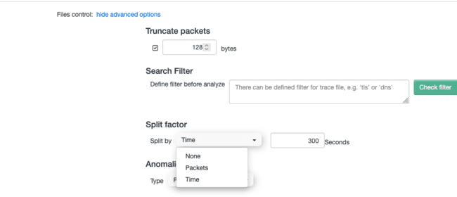
Processing Challenge at Scale
Performance – let‘s check 10 Gbps Data Stream
Single thread processing
1 Sec data at 10 Gbps = 1 million packets = 50 sec tshark processing
1 minute data = 60 Gbyte = 60Mio Packets = 50 minutes processing (3.000 secs) ?
Not feasible without acceleration
Need smarter scaling for real monitoring
Multithreading Parallel Processing !!!
60 X 1 GByte File = 60 Sec Tshark processing
60 cores CPU
60 GByte = 60 secunds
= 10 Gbps tshark processing

Slide 32
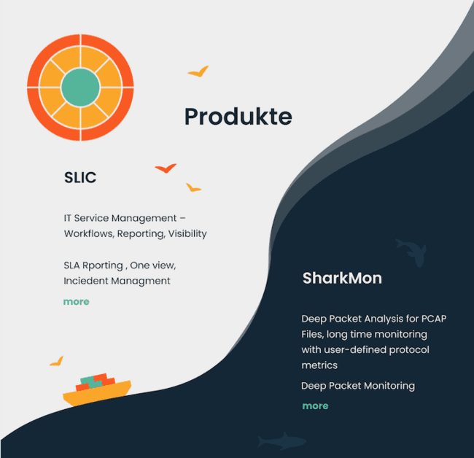
Is DPA isolated ? Just for nerds ?
DPA is by its data – may be the only one non-Isolated
Traditional tools (logs, SNMP, agents) only monitor isolated system symptoms.
DPA identifies root causes by analyzing system behavior and interactions.
Example: It connects a slow router to discard errors, retransmissions, and user delays.
DPA must be part of service monitoring – not a siloed expert-only tool.
DPA enables deep insight by correlating multiple factors across systems.

Slide 33
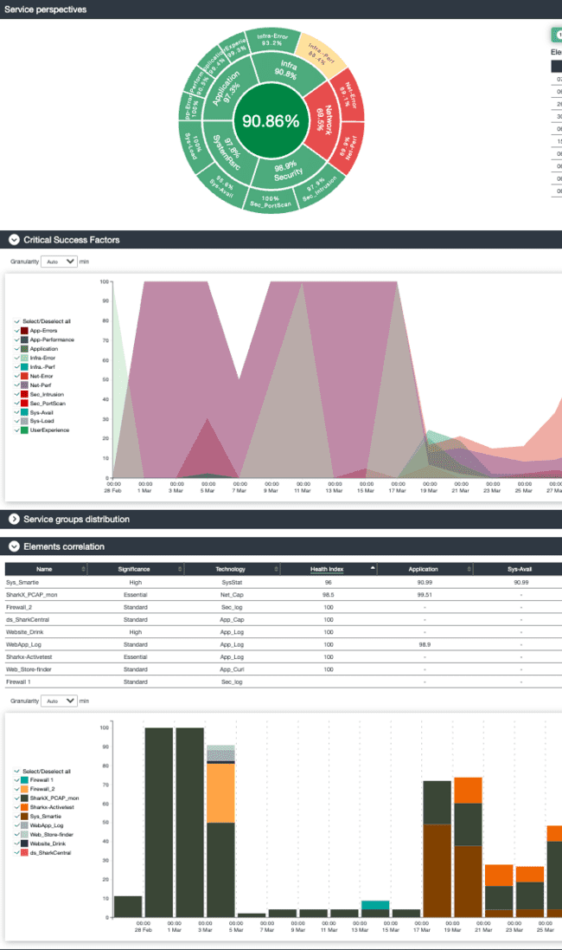
Sharmon and Service Monitoring
Datasources
Sharkmon
Firewall logs
Sysagent
WebApp Log
Active testing (curl)
May be stratoshark ?
I guess in future

Slide 34
Summary
PCAP import
Highest flexible for DPA
Performance limitation
AI still open
Not „the only one!“ solution
Not design to exclude others
But enrich / extend packet monitoring

Slide 35
Sharkport
Easy check features
Manual upload files
Create / change profiles
Invite customers to upload pcaps
Limits
no anomaly detection
Just manual upload
Contact me at ad@inets.de

Slide 36
Feedback

