Slide 1
Wireshark Packet Capture is like Real Estate: Location Matters
George Cragg
gacragg@gmail.com

Slide 2
Wireshark Packet Capture is like Real Estate: Location Matters
Wireshark and packet analysis shows us what happened but to understand the why behind what we see, we apply our expectation of what should happen to what we actually observe. To set the proper expectation, how we actually capture and the location of our diagnostic tool is important. This is a discussion of how we can determine where and how a capture is taken based on what we observe in our pcap files.

Slide 3

Let me introduce myself
George Cragg
Day job: network engineer in a product R&D group
Started using Ethereal in the late 90s after seeing Stevens’ TCP/IP Illustrated, Volume 1: The protocols
One trick pony: Wireshark is preferred tool I use to isolate problems

Slide 4
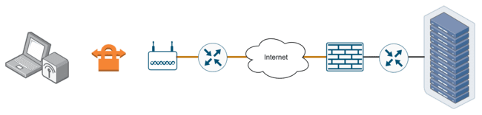
Motivation
Originally planned: Life of a Packet
Capturing through the lifecycle of a packet across the network requires capture and viewing
  Various locations
  Various methods
How/where/when you capture determines what you see
Disclaimer: there are many exceptions – this is typical behavior
Example:
*Data
+HTTP
+TLS
+TCP
+SSH tun
+TCP
+IPsec
+EthII
+WPA3
+802.11
-WPA3
-802.11
+EthII
+NAT
-Ipsec
-TCP
-SSH tun
-TCP
-TLS
...

Slide 5
Motivation
Problem Solving
Goals
Develop proper expectation
Familiarity with analysis tools
How/where/when you capture will determine what you see

Slide 6
Typical Capture Techniques
Three main processes
  On host – e.g. install Wireshark and start collecting on an iface
  Tap on link (i.e. bump in the wire) – purchase device
  Infrastructure mirror/span/monitor session port
There are others with subtle and not so subtle differences
  Monitor mode – dot11 wireless specific
  On an infrastructure device and stored
  On an infrastructure device and tunneled out (TZSP, peekremote, SSH, etc.)
  Et al. There are Sharkfest sponsoring companies that provide great options

Slide 7
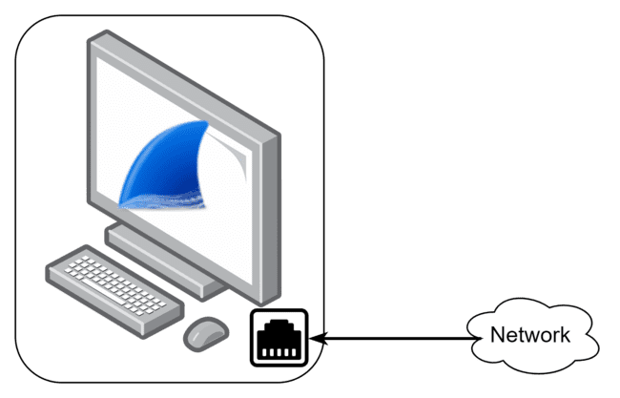
On Host Capture
Install Wireshark locally on host
  Could be just dumpcap, tshark, tcpdump, or other capture tools
Capture traffic to/from host interface(s)
  Could be one or more interfaces
  Physical NIC / loopback / virtual interfaces
Pros / Cons
  +Easy
  -Result affected by host behavior
  -Likely requires privilege to install / run
  -Cannot overcome filtering by upstream network infrastructure

Slide 8
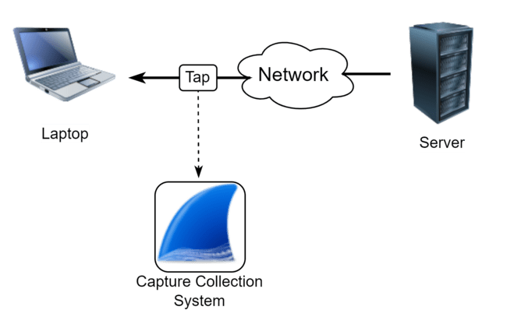
Network Tap
Bump in the wire
Insert tap in network link and copy network traffic
Pros/Cons
  +What is on the network link: truer view of what infrastructure upstream might observe
  -Need to get a tap and get it installed ($ to $$$$)
  -Need link down/up events
  -Cannot overcome filtering by upstream network infrastructure
Note: Discuss mirror/span later

Slide 9
Location: how to tell where capturing
List of examples for discussion
  TCP Handshake timing
  Small Ethernet frames
  Large TCP segments
  IGMP
  ARP
  Access VLAN (RSTP, CDP, LLDP, MNDP)
  Example: use of low end switch w/ mirror port as tap
Examples will demonstrate some of the variations that are possible
Notes:
SKIP: Wireless / fake mode or monitor mode…

Slide 10
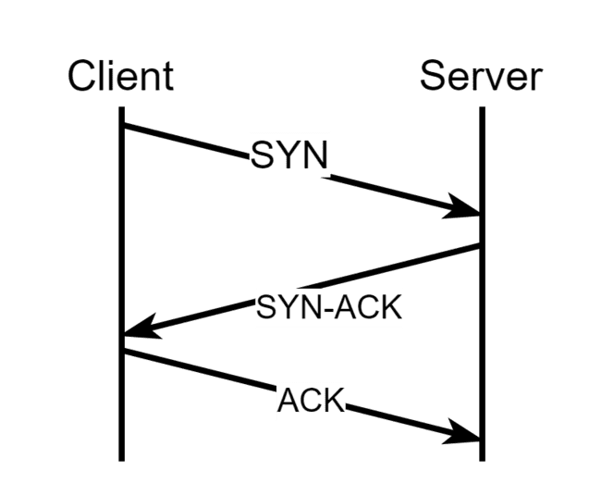
TCP Handshake
Are we capturing at the client or server? In the middle?
Common analysis point when reviewing TCP
Three way handshake - classic picture
  Connection oriented, reliable byte stream --> setup connection to manage data flow
  Client initiates connection
  Server responds to client
  Data can flow bidirectional after connection establishment

Slide 11
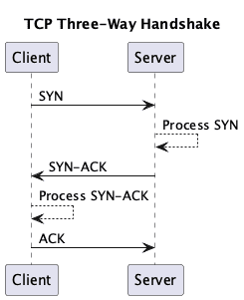
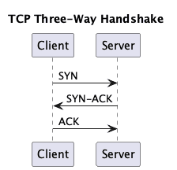
Compare Handshakes
Look at deltaT column... which is which?
Typical View
Add Detail

Slide 12
First End
Client sends SYN --> Start stopwatch
  network time to get to server
  processing time for SYN-ACK
  network time to get back to client
From client POV
  SYN to SYN-ACK is
    RTT + processing time
  SYN-ACK to ACK is
    Processing time

Slide 13
Second End
Server receives SYN --> Start stopwatch
  Don’t know how long it took to get here
  SYN to SYN-ACK time is just processing time
Server responds with SYN-ACK --> Start stopwatch
  network time to get to client
  processing time for ACK
  network time to get back to server
From server POV
  SYN to SYN-ACK is
    Processing time
  SYN-ACK to ACK is
    RTT + processing time

Slide 14
TCP Handshake Timing Summary
From client POV
  SYN to SYN-ACK is
    RTT + processing time
  SYN-ACK to ACK is
    Processing time
From server POV
  SYN to SYN-ACK is
    Processing time
  SYN-ACK to ACK is
    RTT + processing time
Longer delay highlighted

Slide 15
Small Ethernet Frames
IEEE 802.3 defines a runt as smaller than 64bytes → minimum we should see arriving at a wired Ethernet network interface
  60 bytes of data + 4byte FCS
Why is this important
  Frames from the wire (Rx) should always be equal or larger than this minimum
  Nearly all NICs strip 4byte FCS before it shows in capture (with exceptions) → takes work to see FCS bytes for wired packets
What if frame is smaller than minimum? Pad up with bytes.
  Let's hope the padding is not random bytes from memory that might include private keys or other sensitive data!
What about host sending frames (Tx)?

Slide 16
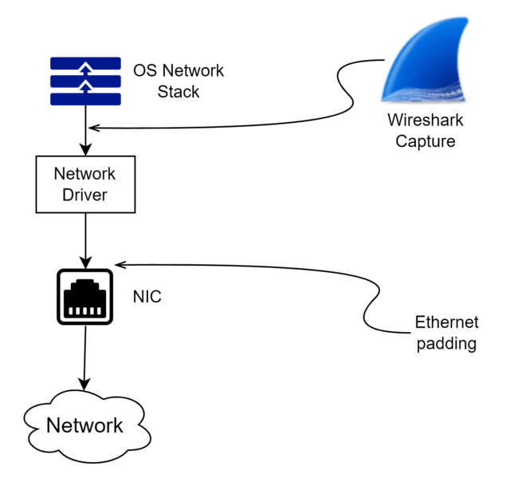
Small Ethernet Frames
What about host sending frames (Tx)?
Padding occurs further down the stack AFTER packet is sent to capture mechanism
Typical Result
  If we observe frames in a wired capture that are smaller than 60 bytes, source MAC is likely host running capture operation
  Watch capture on wireless interface – this does not always apply

Slide 17

Small Ethernet Frames
Sender
Frame length < 60

Slide 18
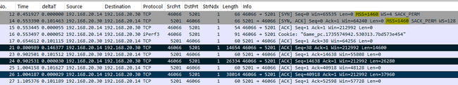
Large TCP segments
Backstory: typical Internet maximum frame size is MTU plus some stuff
  1500 bytes + 14byte EthHdr + 4byte FCS + VLAN tag…or two. Jumbo frames, too. Messy.
  But look at the picture – these are MUCH larger than might be expected
TCP offload is in play – NIC HW does the actual segmentation and prepares the final frames for delivery to the wire
Could be in either Tx or Rx direction

Slide 19
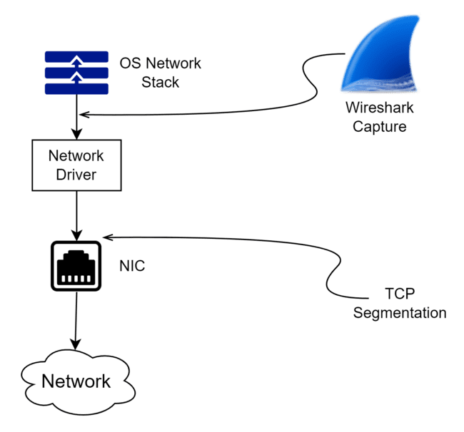
Large TCP segments
Summary
  Packets change as they move across the network. What you observe at one point may or may not be what you observe at a different point. Location matters.
Is Wireshark wrong?
  No – it's correct in the context of where it is
  It is wrong to assume it will always look like this everywhere as packets traverse the network
Best practice for capturing
  Dedicate an adapter for capturing and disable offload if you want to see more representative traffic

Slide 20
IGMP Processing
IGMP snooping is used to manage multicast at layer 2
  Prune destinations that do not wish to Rx the multicast stream
  Assumes managed network – IGMP/PIM may have to be configured. Most simple networks won’t have this.
With snooping configured will see General Queries
  Should only see responses from end host – join or report
  Notice these are less than ethernet min which is a tell for us
Protocol operation sets our expectation of what we should see in a capture

Slide 21
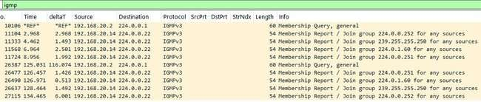
IGMP Processing
Summary
  With functioning IGMP implementation, will only see IGMP Membership Reports (or joins) from end host
  If Membership Reports are less than Ethernet minimum size, we can differentiate between tap and on host capture
  Most modern OSs are chatty and some of that is multicast so common to see Reports even if applications are not using multicast

Slide 22
ARP
Used to resolve MAC address from host IP address
  Critical operation when sending unicast data as L2 Ethernet infrastructure delivers frames using MAC address
What would we observe from our on host or tap capture?
  Three types of traffic
    Broadcast ARPs --> Yes, by convention
    Multicast ARPs --> No, never heard of such a thing
    Unicast ARPs --> Yes, only from end host
Unicast traffic is a common theme beyond ARP
  Usually only see end host unicast traffic of any type due to network filtering going on
Notes:
Exceptions abound: switch FIB flushes for whatever reason (e.g. STP) so unicast traffic would be flooded

Slide 23
ARP Examples
Files
  arp_1b.pcapng
  arp_2b.pcapng
Can we determine capture on host or tap?
Look for small frames
  Anything less than 60 bytes?
Look for IGMP
Look for unicast traffic – how many unicast hosts are present?
Other items
  vlans / cdp / lldp / etc ⬅ may provide some context to the world around this host

Slide 24
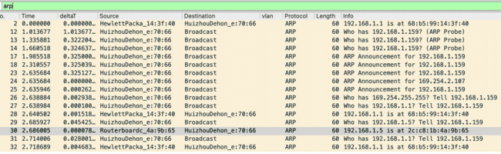
ARP Examples
File: arp_1b.pcapng
Look for small frames
  Anything less than 60 bytes?
Look for unicast traffic – how many unicast hosts are present?
Notice PVSTP – we are on a trunk port
  Can we determine native vlan?
Conclude: likely tap capture of 70:66 host, on a trunk port, native vlan10

Slide 25
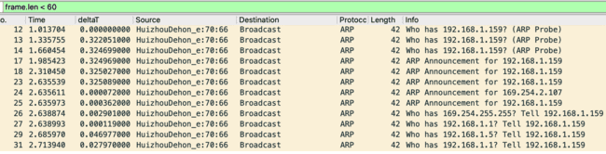
ARP Examples
ARP Examples
File: arp_2b.pcapng
Small frames: source is 70:66
Look for unicast traffic: any present for different host than this one?
Conclude: likely on host capture from 70:66

Slide 26
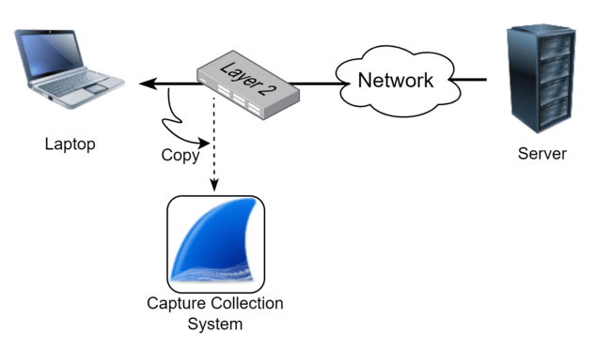
Mirror/SPAN Port
Part of infrastructure – usually feature that is part of enterprise managed network
Pros/cons
  +Can manage infrastructure filtering
  +Usually software configured so no impact to running systems
  -Requires the feature to be configured
  -Requires the feature to be present and can cost $$
  -Location may not be convenient (e.g. switch is in closet but problem is on the next floor)

Slide 27
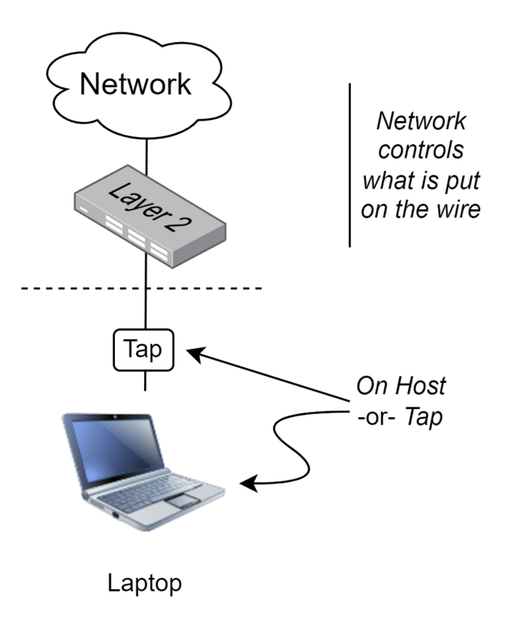
Infrastructure Filtering
Filtering occurs on network side
  Network controls what is sent to access port
Examples of filtering
  VLAN
  Switch unicast filtering based on FIB
  IGMP
  Firewall / ACL
  Etc.
Typically not much end host can do to overcome this (except: IGMP, ARP spoof)
Notes:
Would have to inject traffic… not preferred when passively sniffing since injection would alter the environment. This new environment may or may not have an impact on what you are measuring.

Slide 28
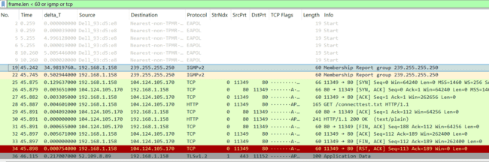
How does this change what we already have?
Infrastructure can override filtering and deliver other types of traffic
  Unicast not-for-end-host can be forwarded
  IGMP from other hosts can be observed
Sample capture: mirror_1c.pcapng
  Usual process
    Small frames – any less than 60bytes?
    IGMP – which hosts are sending reports?
    ARP – any unicast? Unicast that is not related to small frame host?
    Other unicast traffic?
Does it look any different than what we have observed?

Slide 29
Mirror Port
Not a lot different than we have observed
This example
Filter | Result
frame.len < 60 | Capture taken on Dell_93:d5:e8
igmp | Reports are sent by Dell_20:3d:8e This is the mirrored or tapped device
!(eth.dst.ig == True) | Src: Dell_20:3d:8e (34:48:ed:20:3d:8e) Dst: HewlettPacka_14:3f:40 (68:b5:99:14:3f:40) Unicast for 3d:e8 to an (likely) router
http or dns | DNS for www.msftconnecttest.com Time to Live: 128 Dell_20:3d:8e is a Windows host
stp | Native VLAN is 10 with a Cisco L2 infrastructure
eth.dst == 68:b5:99:14:3f:40 and arp | DefaultGW is at 192.168.1.1 Router is HP
eth.addr == 34:48:ed:93:d5:e8 | Mirror or tap in use with ingress disabled

Slide 30
How to use
Scenario | Typical Inference
TCP Handshake shows SYN to SYN-ACK timing is relatively long | Capturing near client
TCP Handshake shows SYN-ACK to ACK timing is relatively long | Capturing near Server
Frames smaller than 60 bytes | Capture is taken on a host with NIC that has eth.src for these small frames
No frames smaller than 60 bytes and some are padded | Capture is taken from a network tap
Large TCP segments visible in capture | Capture taken on host with NIC that has Large Send/Rcv Offload enabled
IGMP Reports are visible from a single host | Capture is taken on a host with NIC that has eth.src and ip.src
IGMP reports or Unicast destination frames present for other than end host are present | Capture taken with mirror/span or on a trunk port (look for VLAN tags then)

Slide 31
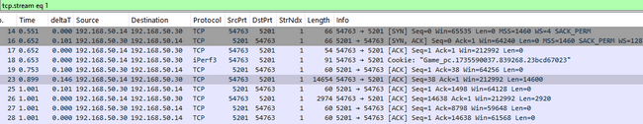
Example 1
From the Internet
  I am having trouble accessing this data across the Internet. I just watched some Youtube videos on using Wireshark so I captured my comm profile with Wireshark and see that my frames are really large (14K) and the don't fragment bit is set. So I think I have a path MTU issue and my large packets are dropped. [file: iperfC3.pcapng]

Slide 32
Example 1
Inferences
  Small frame is visible - see a 54byte ACK in frame 17
    This source MAC/IP is capturing on host
  SYN to SYN-ACK timing is long, so client side capture
    TCP ACK is sent by client and is small so client side capture
  Large TCP segments are present – client has TSO enabled
  Do not see TCP retransmissions so no packet loss here is indicated – review of sequence numbers will show that data is not lost
Conclude that hypothesis is incorrect and problem lies elsewhere

Slide 33
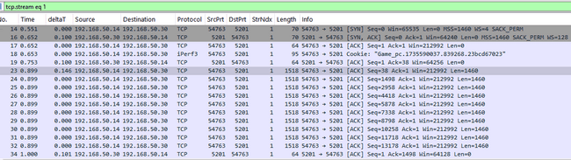
Example 2
See [file: iperfT3.pcapng]
Where/how was this taken?

Slide 34
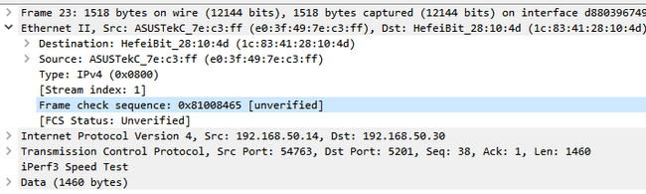
Example 2
Inferences
  Small frames (TCP ACK) are padded so likely tap or mirror capture
  Many TCP data frames are 1518 bytes
    MTU likely 1500 + 14byte hdr --> 1514 bytes
    Account for additional 4 bytes: usually either FCS included or VLAN tag – Wireshark will show the difference
      Here FCS is included so likely special tap capture that can pass up FCS
    Same as previous but AFTER offload. We inferred no MTU issue before base on seq no analysis, prove it now with no frames larger than 1518

Slide 35
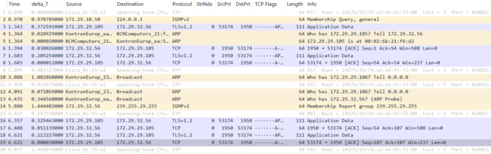
Example 3
See file Tap_3.pcapng
Where/how was this taken? Can we tell?

Slide 36
Example 3
Filter | Result
frame.len < 60 | No frames! No host-based Tx traffic is present. Could be either host-based capture with tuned adapter config to disable all protocols OR tap OR mirror port.
[Sort length in GUI] | Minimum frame size is 64bytes. Likely: VLAN tagged traffic OR FCS is present.
vlan | No vlan headers present
eth.fcs or [inspection] | FCS is present so this is probably a tap capture with this capability
igmp | Reports are sent by KontronEurop_ea:53:c8 (00:00:60:ea:53:c8) This is the tapped device
!(eth.dst.ig == True) [Statistics → Conversations] | Two unicast Ethernet connections present, both with 53:c8
tcp [add ip.ttl column] | Source Address: 172.29.32.56 w/ ip.ttl 128 → Windows host Source Address: 172.29.29.105 w/ ip.ttl 64 → Linux host Guest host OS based on TTL
stp | Native VLAN is 29 with a Cisco L2 infrastructure
Notes:
Some Linux Intel adapter drivers can be configured to pass up FCS
ethtool -k enp0s31f6
rx-fcs: off
rx-all: off
TTL 64 for Linux/macOS, 128 for Windows, and 255 for Cisco routers

Slide 37
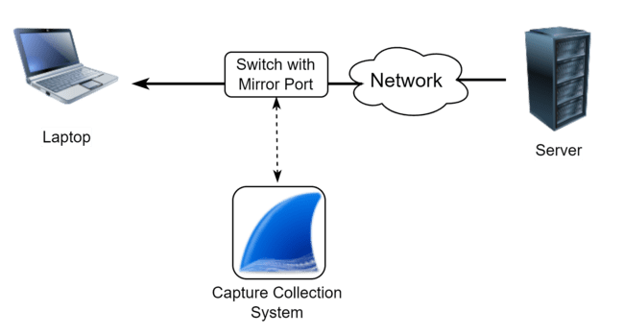
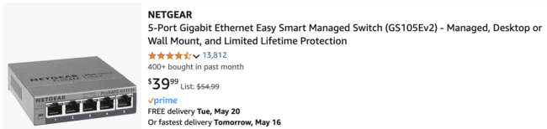
What about this case?
Least expensive mirror port option is a small 5 port switch for about $US30-40
Common use case for me since these are so inexpensive
Users plug their typical wired NIC interface into the mirror destination but this is just another switch port, too – no ingress filtering
This mirror or span port acts as a tap, i.e. can’t overcome network filtering

Slide 38
Low end mirror port
See file LCTap_3.pcapng
Filter | Result
frame.len < 60 | Capture on a host with MAC TPLink_1d:aa:24 (7c:c2:c6:1d:aa:24). Could be host capture, or mirror/tap destination.
!(eth.src == 7c:c2:c6:1d:aa:24) | Typical minimum for non-host frames is 60bytes so no FCS, nor VLAN tag in frames
igmp | Reports are sent by KontronEurop_ea:53:c8 (00:00:60:ea:53:c8) and TPLink_1d:aa:24; aa:24 is the host so 53:c8 is the tapped or mirrored device.
eth.addr == 7c:c2:c6:1d:aa:24 | aa:24 is both source and destination of unicast traffic (i.e. network is responding), so if mirror, no ingress filtering in place and adapter is active on the capture host.
!(eth.dst.ig == True)and not eth.addr[4:2] == aa:24 [Statistics → Conversations] | Two Ethernet conversations, both for KontronEurop_ea:53:c8 (00:00:60:ea:53:c8)
tcp [add ip.ttl column] | Source Address: 172.29.32.56 w/ ip.ttl 128 → Windows host Source Address: 172.29.29.105 w/ ip.ttl 64 → Linux host Guest host OS based on TTL
stp | Native VLAN is 29 with a Cisco L2 infrastructure

Slide 39
Low end mirror port
So what is different to this low end solution vs high end tap?
  Sort of acts like a tap with the mirror port functionality
  Switch is managed via webpage so participates on the network
  No ingress filtering for mirror destination (can disable host network stack on the capture nic)
  No FCS, switch would manage bad packets, as would capture NIC; High end tap will likely manage this via options
  Observe: host NIC and switch interactions with the network with ARP, IGMP, maybe DHCP and other
  Performance is unknown, but doubt it will do full line rate gigE
  Not a great technical option but the price is right for some capture scenarios

Slide 40
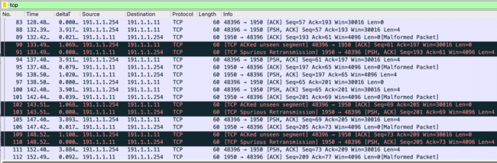
Don’t believe everything you read (see)
Out-of-order.pcapng

Slide 41
Your knowledge is more important than the tool
Where was capture taken? Inference:
  Small frames indicates host is part of network, so on host or mirror port that does not disable ingress
  ARP unicast for other hosts indicates some sort of tap or mirror port
    Three unicast ARP conversations – more than two would infer a mirror port
  TCP shows two connections – one is telnet. What is it to? tcp.port == 23, Follow → TCP Stream.
What about the indicated failure?
  Follow the sequence numbers
  It’s not real – artifact of capture location and technique
Experience: Cisco mirror port and TSO can do this

Slide 42
Monitor Mode / Linux
Linux supports multiple virtual interfaces (vif) in many WiFi drivers
Example: iw dev wlan0 interface add mon0 type monitor
Ndx Iface Phy Driver Mode Up Channel Width Packets Adapter
0 mon0 phy0 mt7921u monitor Y 423452 MediaTek Inc. Wireless_Device
1 wlan0 phy0 mt7921u managed Y 165 (5825MHz) 20MHz 878469 MediaTek Inc. Wireless_Device
Can connect to a WiFi network on wlan0 and capture monitor mode on mon0, with same interface
Great! Saves money on a second adapter for monitor mode… or does it?
See monitormode_2.pcapng
Notes:
Review data field of protected QoS data frames

Slide 43
Monitor Mode / Linux
Filter | Result
eapol | Four way handshake present for one device
[WiFi Profile] [802.11 radio information inspection] | No channel, RSSI, or PHY type for some frames The transmitter has the interface in monitor mode – MAC e8:4e:06:aa:89:32
wlan.addr == e8:4e:06:aa:89:32 | Find QoS data frames – see p bit on wlan flags – protected. Look at data; clearly, this is NOT encrypted.
Notes:
Review data field of protected QoS data frames

Slide 44

MacOS and WiFi
Eth2 frames from WiFi interface are not padded on Rx – so can observe less than Eth minimum for both Tx and Rx
Watch out for tricks – typical does not mean always!

Slide 45
Summary
Where and how we capture affects what we see in a capture file
We reviewed several different protocols and showed how they present under different capture locations and techniques
Thank you!

Slide 46

Feedback
https://conference.wireshark.org/sharkfest-25-us-2024/talk/DE8CQW/feedback

