Slide 1
Cloud doesn’t have Packets! Right?
Stephen Donnelly
Endace CTO

Slide 2
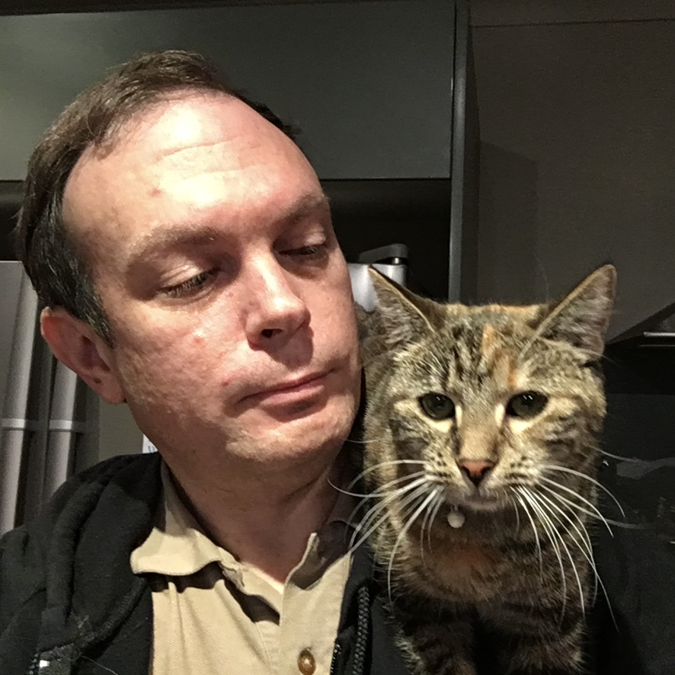

Let me introduce myself
  Stephen Donnelly
  Endace CTO
  Sharkfest Angel Sponsors
  Wireshark Foundation Platinum Sponsors
  endace.com

Slide 3
Apocrypha
“Cloud doesn’t have packets”

Slide 4
Surely…
All communications to and from Cloud uses Packets
Public Internet, Private Connections
Applications, OSes, Containers in Cloud all use Packets
Cloud does have Packets!
Notes:
No surprise, obviously Cloud does have Packets. So why would someone say that?

Slide 5
Theory 1: Abstraction
Cloud has been represented as highly abstract
Adoption driven from the Board/Executives
Lower Costs, TCO, CapEx vs Opex
Focus on Applications
Networking and Security overlooked
Notes:
Were they serious?

Slide 6
Theory 2: Not My Problem
Cloud architecture designed around Applications
Assumption that the Cloud Provider handles Network
Including Configuration?
Including Security?
We’re behind a CDN/WAF right?
Network and Security teams not considered stakeholders
Notes:
“We don’t have to worry about Packets in Cloud”
Even those who know that Cloud has packets may overestimate how much CSPs do for you

Slide 7
Why?
Notes:
Maybe there are packets in Cloud, so what? Should I care?
Why do we capture packets? On Prem? Do we need to capture in Cloud?

Slide 8
Why capture packets?
Networking | Security
Reachability: “Network is Down”, Hardware Faults, DHCP, Routing, DNS, Firewall tuning | Intrusion detection/prevention (IDS/IPS)
Performance: “Network is Slow”, TCP/Application tuning, WiFi issues | Network Behavioral Anomaly Detection (NBAD)
Troubleshooting: Single/Multi-Tier Application or Service | Data Loss Prevention (DLP)
Development: Application, Service, or Protocol | Incident Response (IR)
… | Detection Engineering and Threat Hunting (DEATH)
 | Passive Vulnerability Scanning (PVS)
 | Compliance (US M-21-31, EU MiFID II)
 | …
Notes:
Why do we capture packet on-prem? Not a comprehensive list! Audience survey. Which of these things are still our responsibility in Cloud?

Slide 9
Who does what?
Layer | Cloud Provider | Cloud Customer
Layer 0 Premise, Power, Cooling | Everything | -
Layer 1 Cabling, Patching, Transceivers, Servers, NICs, Storage | Everything | -
Layer 2 Switches | Hardware, Faults, Patching, Secure Management | Virtual Network configuration, Virtual NIC attachments
Layer 3 Routers | Hardware, Faults, Patching, Secure Management, Basic routes, Peering/Transit | Network and subnet configuration, IP allocation, ACLs, Security Groups, User Defined Routes
Layer 4+ OS, Firewall, Application | Marketplace: VM Images, Services (CDNs, WAFs, NAT, Gateways…) | VM, OS, Application installs, Configuration, patching, Security, Management, Firewall Rules, Users, Endpoint Protection, Intrusion Detection, DLP…
Notes:
In on-prem data centers, the owner is responsible for everything. What are Cloud Providers offloading? Shared Responsibility Model

Slide 10
Cloud Packet Capture
Networking | Security
Reachability: “Network is Down”, Hardware Faults, DHCP, Routing, DNS, Firewall tuning | Intrusion detection/prevention (IDS/IPS)
Performance: “Network is Slow”, TCP/Application tuning, WiFi issues | Network Behavioral Anomaly Detection (NBAD)
Single/Multi-Tier Application or Service Troubleshooting | Data Loss Prevention (DLP)
Application, Service, or Protocol Development | Incident Response (IR)
… | Detection Engineering and Threat Hunting (DEATH)
 | Passive Vulnerability Scanning (PVS)
 | Compliance (US M-21-31, EU MiFID II)
 | …
Notes:
Do we need to capture packets in Cloud? Yes.
Can we capture in Cloud?

Slide 11
How?
Notes:
How do we capture Packets? Compare on prem with Cloud

Slide 12
How to capture packets: On premise
Capture software on Client/Server
Passive/Active Tap*
Port Mirror on Switch/Firewall/Router*
Network Packet Broker*
*Plus capture system
Notes:
Talk yesterday: Wireshark Packet Capture is like Real Estate: Location Matters by George Cragg

Slide 13
How to capture packets: In Cloud
Capture software/Agent on Client/Server
Cloud Provider Traffic Mirror service*
Cloud Packet Broker*
Bump-in-the-wire*
*Plus capture system

Slide 14
Capture Software
Same issues as on physical machines:
Access/Permission to install software
NIC Segmentation/Receive Offloads
Unset checksums
Poor timestamps
Can affect Server/Client behavior or performance
Ad hoc deployment - after the fact
Notes:
Just install Wireshark/tshark!
Security: installing packet capture software on compromised system tips off intruders

Slide 15
Capture Agents
Capture software installed into VM/Instance
Capture traffic locally and send to remote collector
On-demand, triggered, or continuous
Same limitations as Software capture
Adds network traffic
Cloud Packet Brokers support Virtual Tap Agents
- Introduces additional costs
+ Decryption*

Slide 16
Agents: Azure Network Watcher – Packet Capture
1st party: Cloud Service Provider
Installed via Agent Extensions (Windows and Linux)
Captures to local file and optionally Azure Blob storage
Captures on all VM interfaces
Supports filters
Defaults to 1GB or 5hrs (max)
Then optionally copies to Blob
Not suitable for continuous capture
Notes:
Special mention, Cloud Provider capture agent

Slide 17
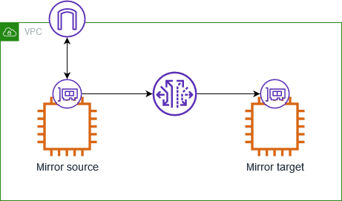
Cloud Traffic Mirror
Three components:
Source
Session
Target
Mirrored traffic consumes instance bandwidth
Notes:
Each packet can only be mirrored once and then sent to a single destination.

Slide 18
Cloud Traffic Mirror Comparison
 | AWS | Azure | Oracle | Google | Google NSI
Name | VPC Mirror | Virtual Network TAP (Public Preview) | VTAP | VPC Packet Mirroring | Network Security Integration Packet Mirroring - OOB
Sources | Instance-type Elastic Network Interfaces (ENI)* | VM Network Interfaces* | Instance VNIC, Load Balancer, Database, Exadata VM Cluster, … | Compute Engine VM instances (subnets, network tags, or instance names) | Firewall Policy/Security Profile
Destinations | Instance ENI, Network Load Balancer, Gateway Load Balancer | VM or Load balancer | Network Load Balancer | Internal Load Balancer | Internal Load Balancer
Mirror Priority | Lower | Free Double Bandwidth! | Lower (default) or Production | Production? | Production?
Encapsulation | VXLAN | VXLAN (VNI 27?) | VXLAN | None | GENEVE
Notes:
AWS VPC Mirror not supported on all instance types
Azure
All instance types, limited regions (2) : Asia East, US West Central. Coming soon: US South, US East
Not IPv6
Not in VNets with encryption enabled
Network downtime up to 60s when added or removed as a source
https://learn.microsoft.com/en-us/azure/virtual-network/virtual-network-tap-overview
https://techcommunity.microsoft.com/blog/azurenetworkingblog/azure-virtual-network-terminal-access-point-tap-public-preview-announcement/4405540
NSI: 15 resources required

Slide 19
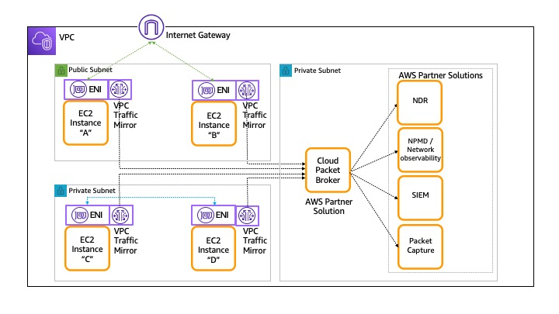
Cloud Packet Brokers
Typically a VM
Aggregates traffic from Agents or Traffic Mirrors
May provide:
Load Balancing
De-duplication
Replication
Filtering
Truncation
Decryption*

Slide 20







Bump-in-the-wire
Inline capture or mirroring by an existing or new network element: Router or Firewall
Route traffic with User Defined Routes
Local capture or Mirror
Decryption*
AWS Cloud
Virtual private cloud (VPC)
Internet gateway
Application subnet
Firewall
subnet
Capture subnet
VXLAN
Webserver
ENI
ENI
Firewall
ENI
ENI
Capture

Slide 21
Scorecard
Capture Method | Pros | Cons
Software | “Simple” “Easy” “Free” Doesn’t steal Bandwidth | Permission to log in, install software NIC Offload issues Steals CPU, IO/storage Ad hoc rather than continuous capture
Agents | Remote control Doesn’t steal IO/storage | Permission to install software NIC Offload issues Steals CPU, Bandwidth
Cloud Traffic Mirror | No software install Doesn’t steal CPU, IO/storage | Not available everywhere May drop packets Additional costs Steals Bandwidth
Bump-in-the-wire | No software install Doesn’t steal CPU, IO/storage, Bandwidth Available everywhere | Network architecture change Potential bottleneck or point of failure Not supported by all devices/services/appliances Additional costs

Slide 22
Where?
Notes:
Where in Cloud should we capture? Is Cloud architecture different?

Slide 23
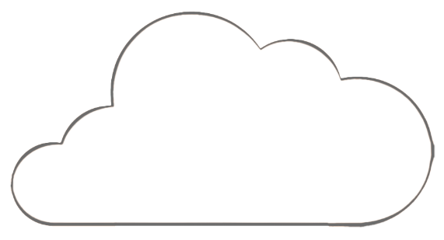






BC – Before Cloud
HQ or Private Datacenter
Cloud SaaS
DMZ
No Longer Trusted Zone
LAN
Core
Switch
Internal
Firewall
Private
Data
Center
Internet
Partner Zones
Untrusted WiFi
Branch Offices

Slide 24
WC – With Cloud
DirectConnect /​
ExpressRoute
HQ
Public Cloud
No Longer Trusted Zone
Dedicated
Connection
LAN
Core
Switch
Internet
Untrusted WiFi
Branch Offices

Slide 25


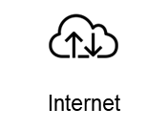
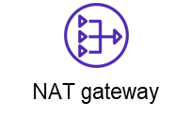
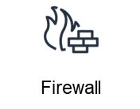

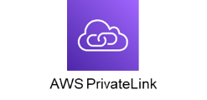

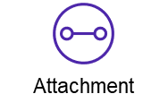
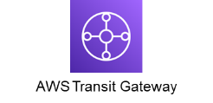

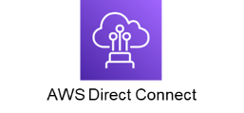
In Cloud - Centralized
AWS Cloud
Network VPC
Firewall subnet
Security subnet
Packet Capture
Shared Services subnet
Corporate
data center
Business Unit 1 VPC
Business Unit 2 VPC

Slide 26




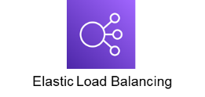
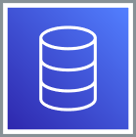
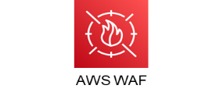
Cloud Native – Multi-Tier
AWS Cloud
Region
Virtual private cloud (VPC)
Availability Zone
Webserver
subnet
Application
subnet
Internet
Database
Availability Zone
Webserver
subnet
Application
subnet
Database

Slide 27

Cloud Native – Multi-Tier
AWS Cloud
Region
Virtual private cloud (VPC)
Availability Zone
Webserver
subnet
Application
subnet
Packet
Capture subnet
Internet
Database
Availability Zone
Webserver
subnet
Application
subnet
Packet
Capture subnet
Database

Slide 28
Conclusions

Slide 29
Conclusions
Cloud does have Packets!
We do (still) need to capture them
We can capture the “Cloud Packets”
Beware of Sharks!

Slide 30

Feedback
Notes:
Please leave feedback!

